Slide 1

2019 Annual WVFMA Conference
Statewide Multi-Hazard Risk Assessments
GIS Reference Data Development
  - Aerial Imagery
  - Parcels
  - Addresses
Flood Risk (and WV Flood Tool updates)
Landslide Risk (not discussed in this talk)
Kurt Donaldson, GISP, CFM
Manager
WV GIS Technical Center
West Virginia University

Slide 2
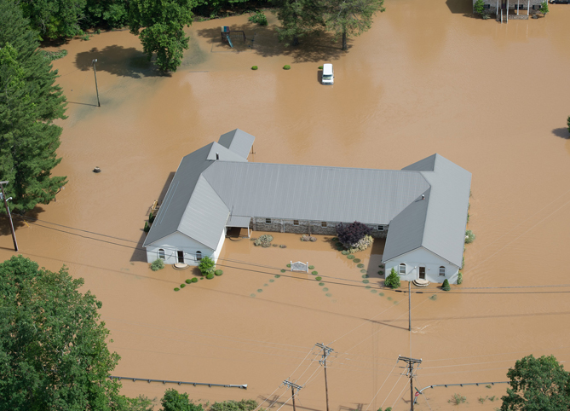
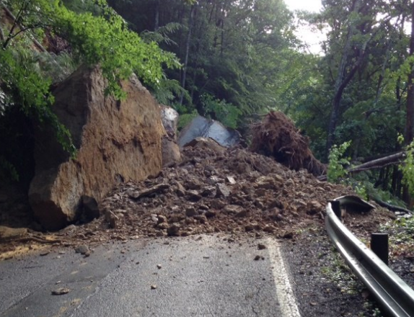
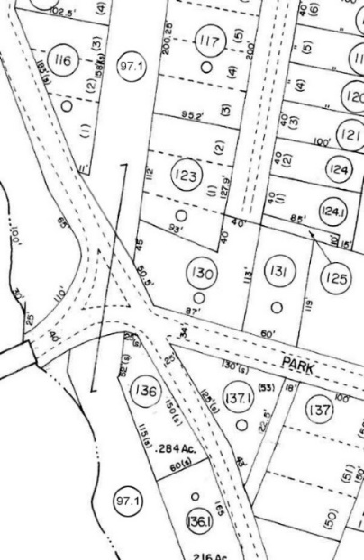
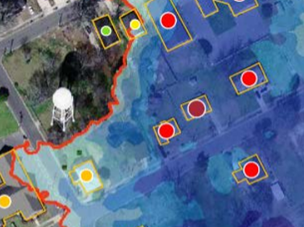

A Statewide Approach to Risk Studies
Multi-Hazard Risk Assessments
Hazard Mitigation Grant Project
Floods Risk (TEIF)
Landslide Risk (TEAL)
Reference Data Development
Inventory Building-Level
Flood-Risk Structures
Statewide
Budget Breakdown
Notes:
WV Map indicating population density

Slide 3
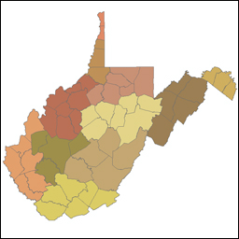









Hazard Mitigation Grant
Multi-Agency Coordination
Federal Agencies
State Agencies
Universities
Regional Councils
Local Counties
Private Companies
11 Regional Planning & Development Councils
55 Counties
232 municipalities

Slide 4

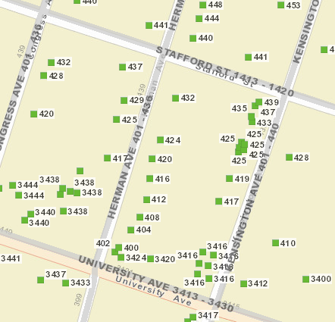
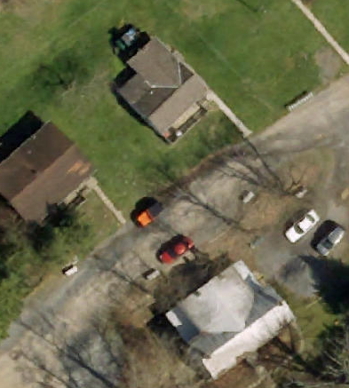
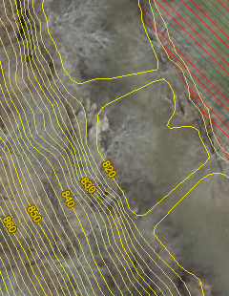
GIS Reference Data Development
Parcels Site Addresses Aerial Imagery Elevation
State’s Spatial Data Infrastructure

Slide 5
GIS Reference Data Development
Statewide Contracts
Tax Map Conversion / Parcel Re-Mapping
E-911 Address Mapping
Aerial Imagery

Slide 6
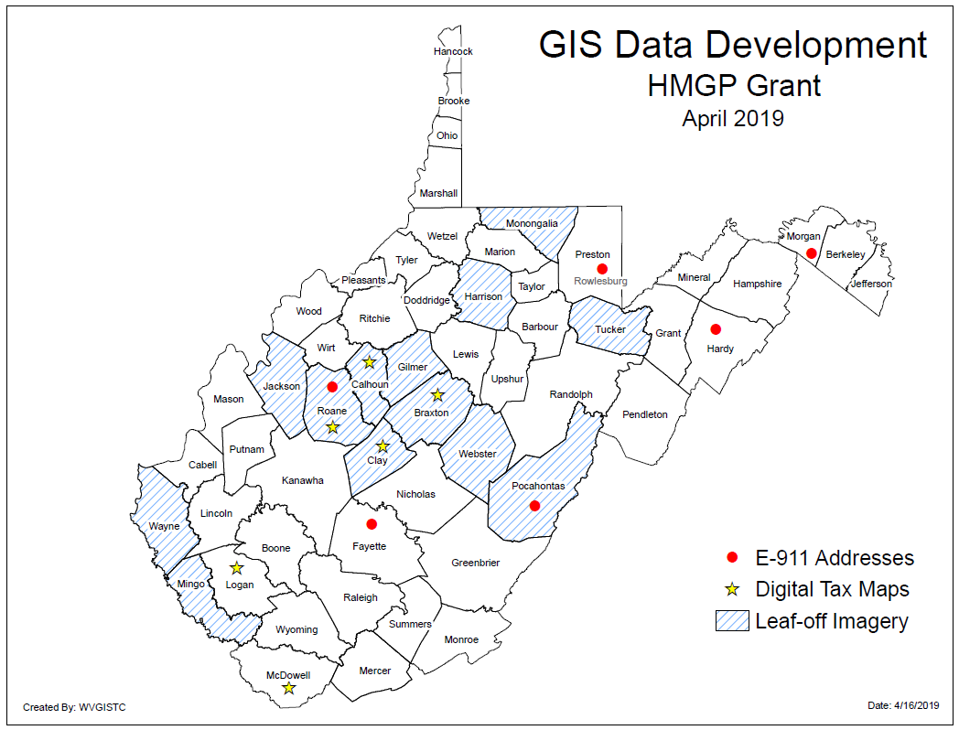
Counties benefiting from HMGP

Slide 7
WV Statewide Aerial Imagery Contract
Statewide Contract: A statewide contract was awarded to Blue Mountain / Thrasher Group in February 2019 for the acquisition of updated digital orthoimagery in West Virginia for the four-year time period 2019-2022. Spring flying season is from late February to Mid-April during leaf-out and no snow conditions.
Non-Exclusive Contract: County offices still have the option to contract with other companies for the same services.
Unit Costs: Aerial imagery can be purchased at four different pixel resolutions. Imagery is unit priced so that participants can budget for projects years in advance. It is recommended that counties acquire leaf-off imagery a minimum of once every five years. Counties will limited funding and resources may qualify for funding assistance.
Pixel Resolution (Detail Level) | 3-inch | 4-inch | 6-inch | 12-inch
Cost per square mile | $62 | $45 | $36 | $25
Map Scale | 1” = 50’ | 1” = 67’ | 1” = 100’ | 1” = 200’
Horizontal Accuracy (ASPRS 1) | 0.5 feet | 0.66 feet | 1.0 feet | 2.0 feet
Note: 4-band stacked imagery that includes color infrared can be added at 25% of the acquisition cost

Slide 8
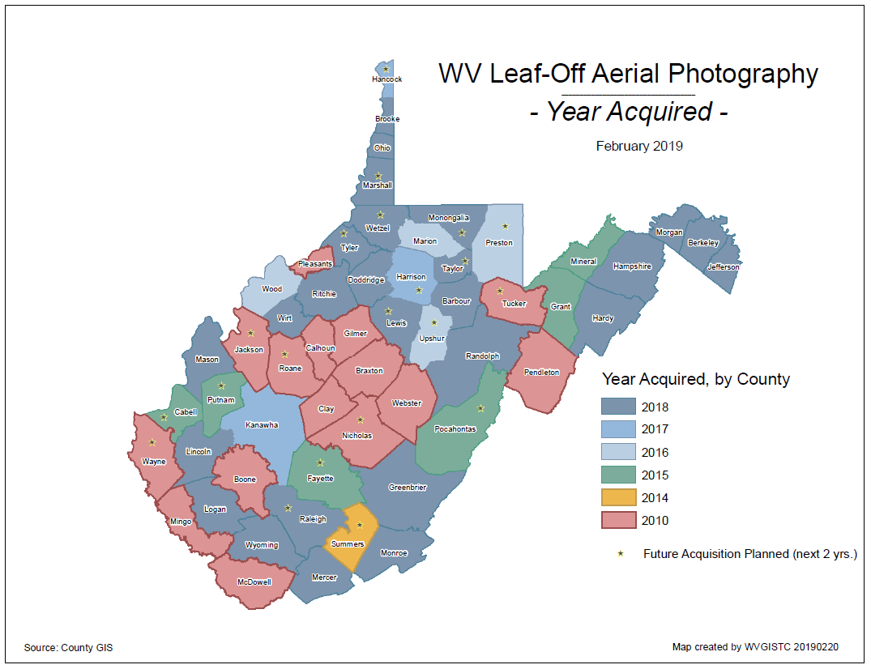
County Aerial Imagery (2018)

Slide 9
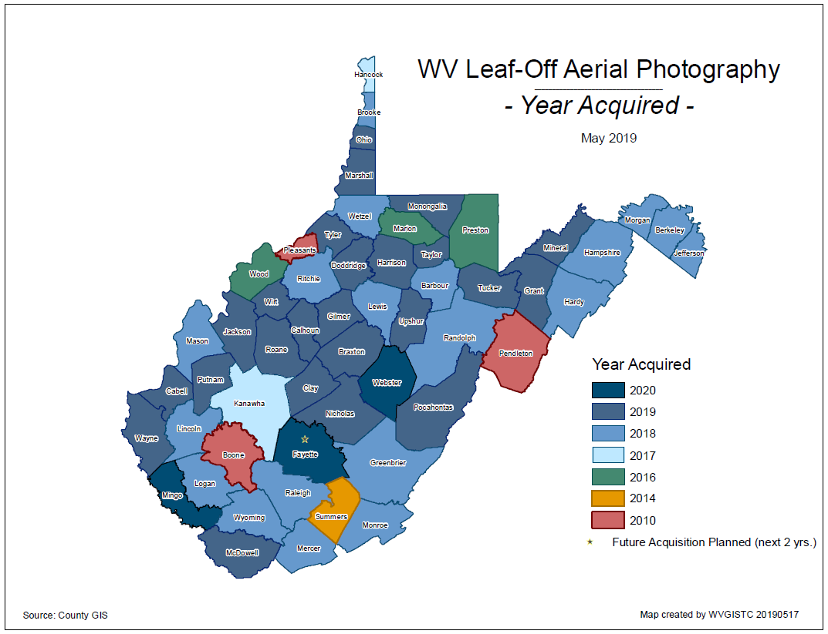
County Aerial Imagery (2019)
Year | Number
2010 | 3
2014 | 1
2016 | 3
2017 | 2
2018 | 19
2019 | 24
2020 | 3
Ideally, leaf-off imagery should not be older than 5 years. Imagery is important for identifying at-risk structures and accurate disaster mapping.

Slide 10
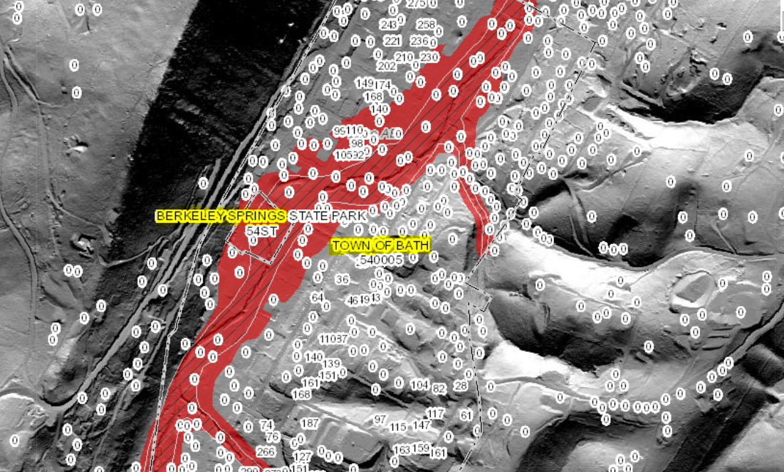
Statewide E-911 Addresses
Missing Address Site Numbers
Berkeley Springs, WV

Slide 11
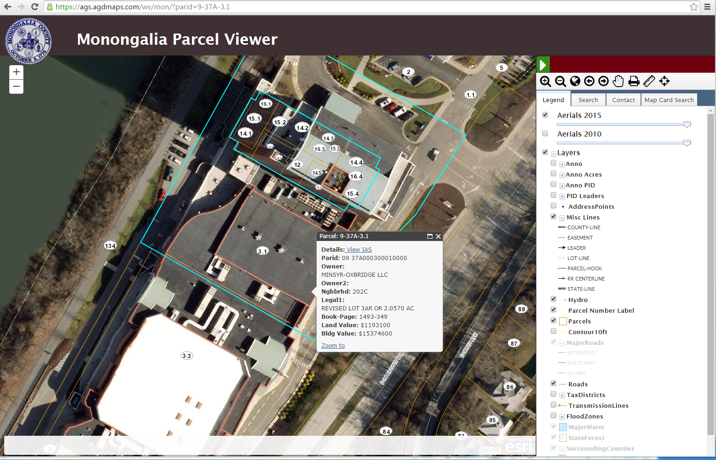
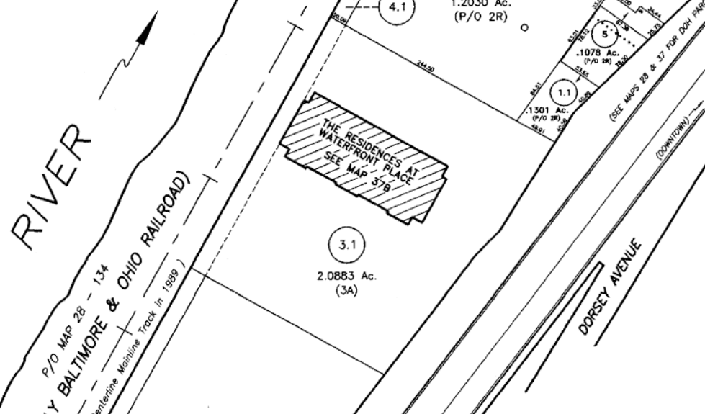
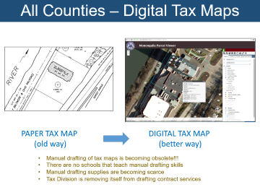
All Counties – Digital Tax Maps
PAPER TAX MAP
(old way)
DIGITAL TAX MAP
(better way)
Manual drafting of tax maps is becoming obsolete!!!
There are no schools that teach manual drafting skills
Manual drafting supplies are becoming scarce
Tax Division is removing itself from drafting contract services

Slide 12
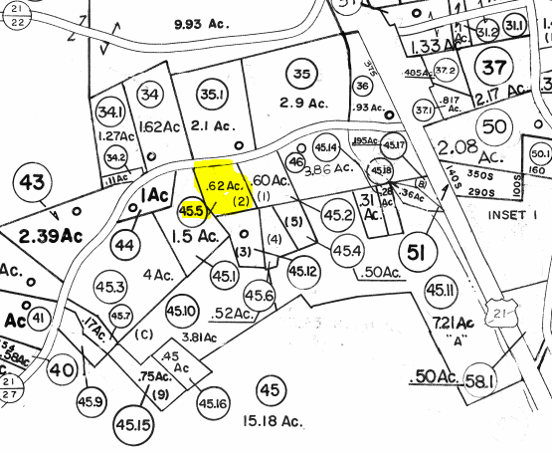
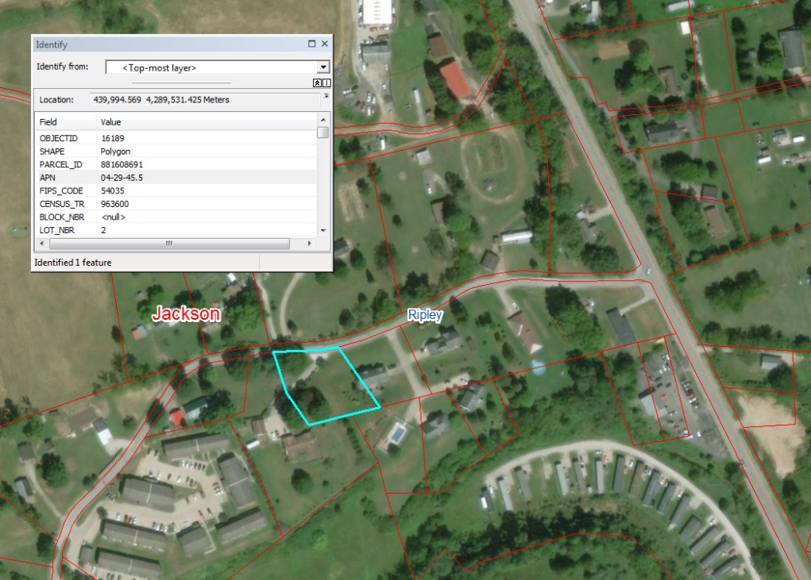
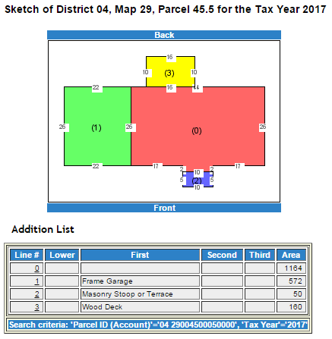
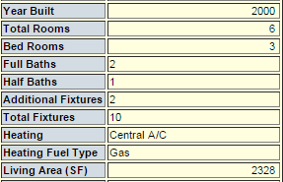
Paper to Digital tax Map Conversion
PAPER TAX MAP
(static map)
DIGITAL TAX MAP
(interactive, seamless, aerial photo reference, map link to attributes (property info) and graphics (building sketch)
Parcel
04-29-45.5
Parcel 04-29-45.5

Slide 13
Data Privacy at State Level
The Privacy Act: Working with local data
Data with Names and/or Addresses
Permits
Substantial Damage
Local Government
Public
Data with Names and/or Addresses
Varying State Laws
States
Public
Data with Names and/or Addresses
The Privacy Act of 1974
Public
FEMA

Slide 14
Communities benefiting from HMGP
GIS Data Development Contracts | # Local Govt. Projects | # Signed MOUs | Vendor | Local Govt. Cost Share | Cost Share Type | FEMA Grant Dollars Obligated | TOTAL COST
E-911 Addresses | 6 | 5 | Atlas Geographic Data | $73,504 | In-Kind (field validation) | $84,895 | $158,399
Digital Tax Maps/Parcels | 7 | 6 | Atlas Geographic Data | $27,474 | In-Kind (imagery) | $235,533 | $263,007
Leaf-Off Imagery | 13 | 13 | Blue Mountaion / Thrasher | $205,536 | Dollars ($) | $56,958 | $262,494
TOTAL | 26 | 23 |  | $306,514 |  | $377,386 | $683,900
GIS Data Development Costs associated with Statewide Multi-Hazards Project

Slide 15
State Hazard Mitigation Grant
FEMA Hazard Mitigation Grant Program (HMGP)
  Recipient: WV DHSEM, State Hazard Mitigation Office
  Sub-Recipient: West Virginia University
FEMA
$$$
WVDHSEM
WVU
Procurement Services
Vendor Contracts
Counties
Assessor and E-911 Offices

Slide 16
Building-Level Flood Risk Assessments
Building-Level Flood Risk Assessments support:
Hazard Mitigation Plans
Floodplain Management
Community Assisted Visits
Community Rating System
DATA INPUTS
Flood Studies
Building Stock
BUILDING ACCURACY IMPROVEMENTS
Building Location
Building Attributes
OUTPUTS
Community-Level
Building-Level
Visualizations
FIELD ACCURACY CHECKS
Floodplain Managers
Local Govt. Officials
Benefits
More detailed and accurate assessments
Automated scripts generate outputs quickly
Cost savings through efficiencies
Helps multiple stakeholders
Comprehensive Building Risk Database
Building-Level Assessment Cycle
Methodology
Consistent methodology statewide
Semi-automated workflows
Continuous cycle to improve and update assessments

Slide 17
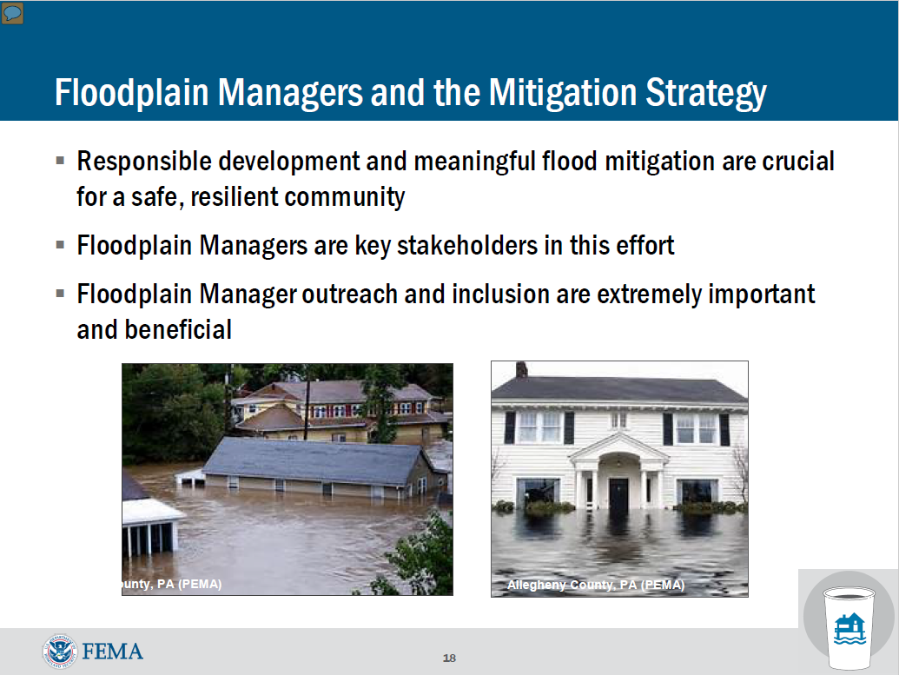

Slide 18
Statewide Flood Risk Assessment
Community-Level
Summary Reports

Slide 19
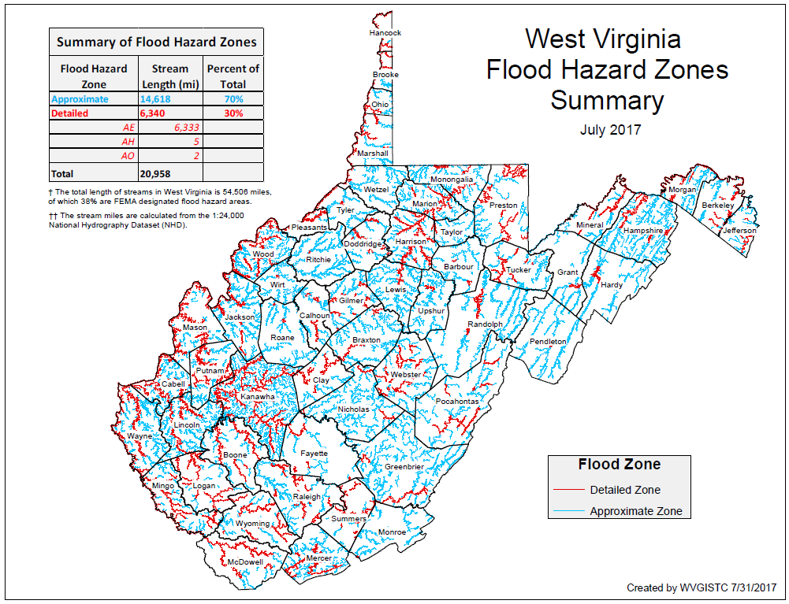
Building Stock in Flood Zones
Although only 30% of the State has mapped Detailed Flood Zones (AE / AO / AH), the Detailed Flood Zones contain 63% of the Building Stock Located in SFHA. A majority of the buildings are located in mapped Detailed Flood Zones.
FLOOD HAZARD ZONES
Stream Miles Length
70% Approximate A
30% Detailed Zones
BUILDINGS IN SFHA
Estimate 100,000
37% buildings in Approximate A
63% buildings in Detailed Zones
BUILDINGS IN NON-REGULATORY ZONES
7,000 Structures mapped in High Risk Zones
BUILDINGS IN SHADED X
Moderate Risk
44,415 structures in 500-YR floodplains
9,718 structures in Levee Protected Zones

Slide 20
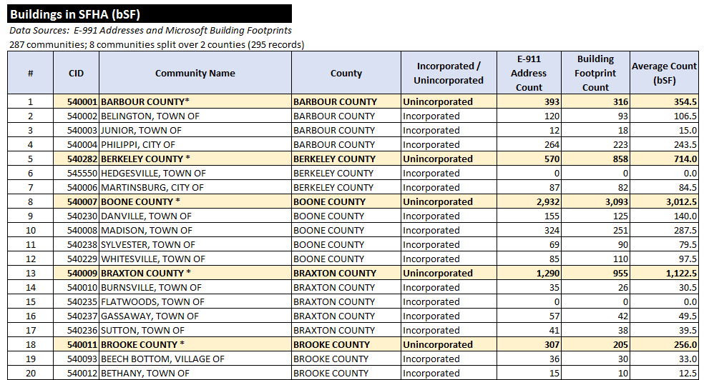
Reports: Buildings in Flood Zones
Preliminary Estimates reveal 100,000 structures in Special Flood Hazard Area

Slide 21
Preliminary Building Statistics
Building Estimates
100,00 structures in SFHA
7,000 structures in “High=Risk” Non-Regulatory Zones (Orange Zones)
119 Essential Facilities in SFHA (Schools, 911 Centers,
Police Depts., Hospitals, Nursing Homes)
6 Essential Facilities in Floodway
Buildings
Pre-FIRM/Post-FIRM
49% are Pre-FIRM (majority)
13% are Post-FIRM
38% are unknown
Based on Building Year of assessment data
Community | Buildings in SFHA
KANAWHA COUNTY * | 9,199
LOGAN COUNTY * | 5,166
MINGO COUNTY * | 3,041
BOONE COUNTY * | 3,013
WAYNE COUNTY* | 2,834
LINCOLN COUNTY* | 2,581
WHEELING, CITY OF | 2,513
RALEIGH COUNTY * | 2,293
WYOMING COUNTY * | 2,233
MCDOWELL COUNTY * | 2,163
MERCER COUNTY* | 2,137
WOOD COUNTY * | 2,089
PUTNAM COUNTY* | 1,969
CABELL COUNTY* | 1,923
CHARLESTON, CITY OF | 1,704
RANDOLPH COUNTY * | 1,467
HAMPSHIRE COUNTY* | 1,440
LEWIS COUNTY* | 1,356
MASON COUNTY * | 1,310
MARION COUNTY* | 1,258
PRELIMINARY FLOOD RISK DATA RESULTS WILL BECOME MORE ACCURATE AFTER BUILDING ACCURACY AND FIELD CHECKS
Top 20 Communities

Slide 22
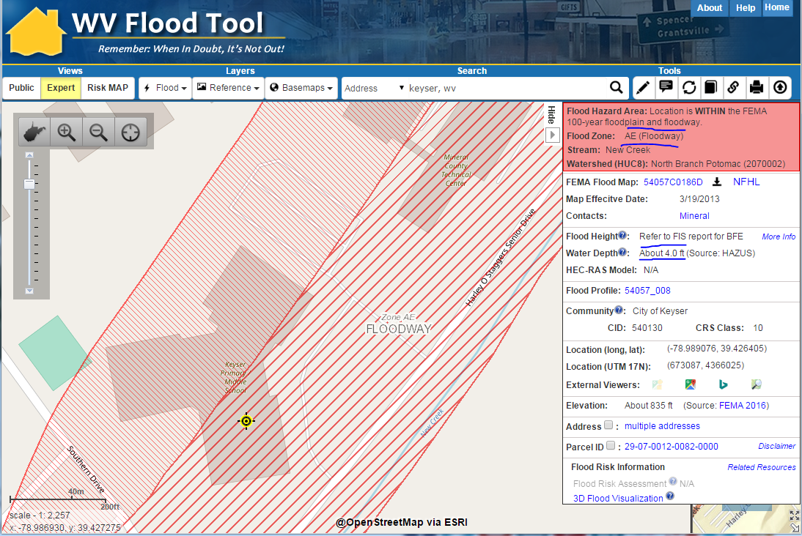
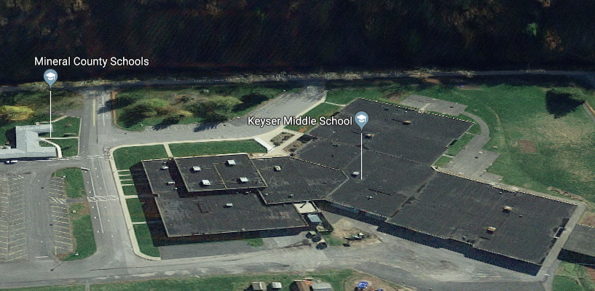
Essential Facilities - School
Keyser Middle School in Floodway

Slide 23
Buildings in SFHA (Top 20)
Communities
Unincorporated Areas
Incorporated Places
Community | Buildings in SFHA
KANAWHA COUNTY * | 9,199
LOGAN COUNTY * | 5,166
MINGO COUNTY * | 3,041
BOONE COUNTY * | 3,013
WAYNE COUNTY* | 2,834
LINCOLN COUNTY* | 2,581
WHEELING, CITY OF | 2,513
RALEIGH COUNTY * | 2,293
WYOMING COUNTY * | 2,233
MCDOWELL COUNTY * | 2,163
MERCER COUNTY* | 2,137
WOOD COUNTY * | 2,089
PUTNAM COUNTY* | 1,969
CABELL COUNTY* | 1,923
CHARLESTON, CITY OF | 1,704
RANDOLPH COUNTY * | 1,467
HAMPSHIRE COUNTY* | 1,440
LEWIS COUNTY* | 1,356
MASON COUNTY * | 1,310
MARION COUNTY* | 1,258
County Unincorporated | bSFHA
KANAWHA COUNTY | 9,199
LOGAN COUNTY | 5,166
MINGO COUNTY | 3,041
BOONE COUNTY | 3,013
WAYNE COUNTY | 2,834
LINCOLN COUNTY | 2,581
RALEIGH COUNTY | 2,293
WYOMING COUNTY | 2,233
MCDOWELL COUNTY | 2,163
MERCER COUNTY | 2,137
WOOD COUNTY | 2,089
PUTNAM COUNTY | 1,969
CABELL COUNTY | 1,923
RANDOLPH COUNTY | 1,467
HAMPSHIRE COUNTY | 1,440
LEWIS COUNTY | 1,356
MASON COUNTY | 1,310
MARION COUNTY | 1,258
CLAY COUNTY | 1,219
DODDRIDGE COUNTY | 1,175
GREENBRIER COUNTY | 1,147
Incorporated Place | bSFHA
WHEELING, CITY OF | 2,513
CHARLESTON, CITY OF | 1,704
WELLSBURG, CITY OF | 1,097
DUNBAR, CITY OF | 1,077
NEW MARTINSVILLE | 898
HUNTINGTON, CITY OF | 729
BUCKHANNON, CITY OF | 593
MILTON, CITY OF | 557
NITRO, CITY OF | 508
WHITE SULPHUR SPRINGS | 446
MARLINTON, TOWN OF | 419
SOUTH CHARLESTON | 404
RICHWOOD, CITY OF | 371
BUFFALO, TOWN OF | 370
GARY, CITY OF | 368
WESTON, CITY OF | 362
WELCH, CITY OF | 356
MOUNDSVILLE, CITY OF | 347
CLENDENIN, TOWN OF | 345
VIENNA, CITY OF | 336
Data Sources: (1) E-911 Site Addressing Database and
(2) Microsoft Building Footprints
Of the 232 incorporated areas in West Virginia, only 12 municipalities (5%) have no regulatory floodplains
Preliminary Data Sources – not verified

Slide 24
Acreage of the SFHA (Top 20)
Top 20 Unincorporated / Incorporated Areas with Highest Acreage of SFHA (aSFHA)
County Unincorporated | Modified aSFHA
HAMPSHIRE COUNTY | 26,388
MASON COUNTY | 21,771
KANAWHA COUNTY | 21,196
GREENBRIER COUNTY | 20,060
RANDOLPH COUNTY | 19,842
WOOD COUNTY | 17,523
HARDY COUNTY | 16,850
JACKSON COUNTY | 15,300
WAYNE COUNTY | 13,521
PENDLETON COUNTY | 13,218
LINCOLN COUNTY | 11,137
BERKELEY COUNTY | 10,300
CABELL COUNTY | 10,278
POCAHONTAS COUNTY | 10,092
PRESTON COUNTY | 9,965
PUTNAM COUNTY | 9,934
NICHOLAS COUNTY | 8,999
WEBSTER COUNTY | 8,907
MINERAL COUNTY | 8,885
RALEIGH COUNTY | 8,719
Incorporated Place | County | Modified aSFHA
CHARLESTON, CITY OF (SPLIT) | KANAWHA COUNTY | 1,486
WHEELING, CITY OF (SPLIT) | OHIO COUNTY | 1,318
PARKERSBURG, CITY OF | WOOD COUNTY | 1,217
HUNTINGTON, CITY OF (SPLIT) | CABELL COUNTY | 823
NEW MARTINSVILLE, CITY OF | WETZEL COUNTY | 652
BUCKHANNON, CITY OF | UPSHUR COUNTY | 616
POINT PLEASANT, CITY OF | MASON COUNTY | 614
MOUNDSVILLE, CITY OF | MARSHALL COUNTY | 563
MARLINTON, TOWN OF | POCAHONTAS COUNTY | 494
MOOREFIELD, TOWN OF | HARDY COUNTY | 475
WEIRTON, CITY OF (SPLIT) | HANCOCK COUNTY | 456
CLARKSBURG, CITY OF | HARRISON COUNTY | 453
FAIRMONT,CITY OF | MARION COUNTY | 408
MORGANTOWN, CITY OF | MONONGALIA COUNTY | 387
MILTON, CITY OF | CABELL COUNTY | 377
BUFFALO, TOWN OF | PUTNAM COUNTY | 342
ELEANOR, TOWN OF | PUTNAM COUNTY | 340
PRINCETON, CITY OF | MERCER COUNTY | 332
BARBOURSVILLE, VILLAGE OF | CABELL COUNTY | 314
DUNBAR, CITY OF | KANAWHA COUNTY | 313
Modified aSFHA = Total aSFHA minus (1) large water bodies and (2) federal lands > 10 acres

Slide 25
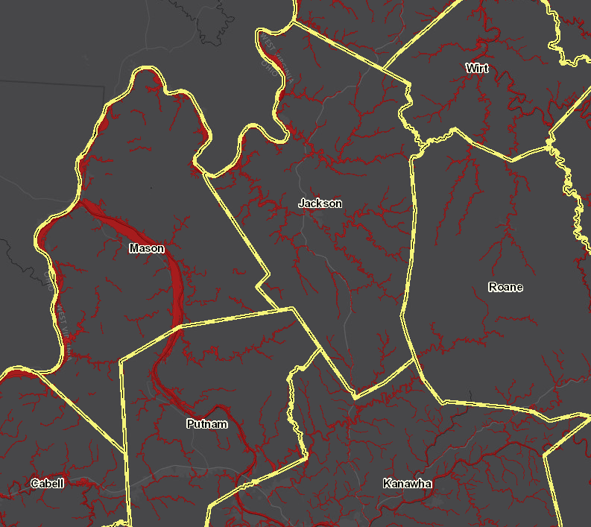
Ratio of aSFHA to Community Area
Unincorporated Areas
Ratio = Acreage of SFHA (aSFHA) divided by Community Area
County Unincorporated | aSFHA
MASON COUNTY | 7.8%
WOOD COUNTY | 7.6%
JEFFERSON COUNTY | 6.8%
HAMPSHIRE COUNTY | 6.4%
CABELL COUNTY | 6.1%
MORGAN COUNTY | 5.7%
WIRT COUNTY | 5.4%
JACKSON COUNTY | 5.1%
BERKELEY COUNTY | 5.1%
TYLER COUNTY | 4.9%
PUTNAM COUNTY | 4.6%
HARDY COUNTY | 4.5%
PLEASANTS COUNTY | 4.5%
MINERAL COUNTY | 4.3%
WAYNE COUNTY | 4.2%
LINCOLN COUNTY | 4.0%
KANAWHA COUNTY | 3.9%
CALHOUN COUNTY | 3.6%
HARRISON COUNTY | 3.3%
BROOKE COUNTY | 3.3%
7.6%
5.4%
5.1%
7.8%
2.2%
4.6%
6.1%
3.9%

Slide 26
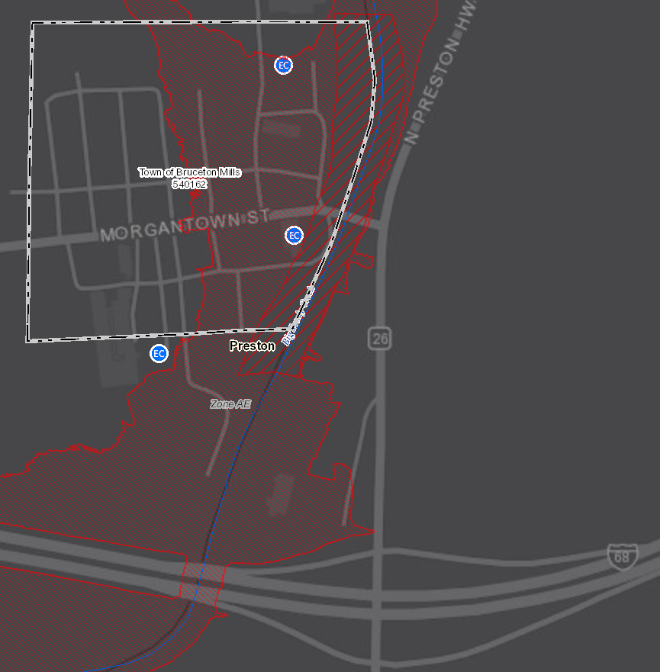
Ratio of aSFHA to Community Area
Top 20 Incorporated Areas with Highest Ratio of SFHA Acreage to Community Area
Incorporated Places | County | aSFHA
FRIENDLY, TOWN OF | TYLER COUNTY | 58.5%
HAMBLETON, TOWN OF | TUCKER COUNTY | 50.0%
REEDY, TOWN OF | ROANE COUNTY | 48.0%
BRUCETON MILLS | PRESTON COUNTY | 47.2%
PARSONS, CITY OF | TUCKER COUNTY | 43.5%
ELIZABETH, TOWN OF | WIRT COUNTY | 42.9%
HENDERSON, TOWN OF | MASON COUNTY | 42.6%
PINE GROVE, TOWN OF | WETZEL COUNTY | 42.4%
MATEWAN, TOWN OF | MINGO COUNTY | 41.7%
CAPON BRIDGE TOWN | HAMPSHIRE COUNTY | 40.0%
SMITHERS, TOWN OF | KANAWHA COUNTY | 40.0%
CHESAPEAKE, TOWN OF | KANAWHA COUNTY | 39.4%
ALBRIGHT,TOWN OF | PRESTON COUNTY | 38.9%
ROWLESBURG, TOWN OF | PRESTON COUNTY | 38.5%
GARY, CITY OF | MCDOWELL COUNTY | 37.9%
NEW MARTINSVILLE | WETZEL COUNTY | 37.6%
MILTON, CITY OF | CABELL COUNTY | 37.5%
ALDERSON, TOWN OF | MONROE COUNTY | 37.3%
HARTFORD, TOWN OF | MASON COUNTY | 36.4%
BANCROFT, TOWN OF | PUTNAM COUNTY | 35.5%
Bruceton Mills, WV
47%
Ratio = Acreage of SFHA (aSFHA) divided by Community Area

Slide 27
Building Cost / Property Class
Community Name | SFHA Building Count | Residential | Commercial | Apartment Class | Farm Class | Industrial Class | Building Cost Community-wide
BERKELEY COUNTY * | 624 | 424 | 81 | 0 | 68 | 1 | $ 5,362,549,400
MORGANTOWN, CITY OF | 304 | 140 | 135 | 22 | 0 | 1 | $ 4,264,243,155
MONONGALIA COUNTY * | 940 | 624 | 174 | 62 | 25 | 6 | $ 4,176,539,753
CHARLESTON, CITY OF | 1630 | 1134 | 241 | 59 | 0 | 2 | $ 3,806,378,642
KANAWHA COUNTY * | 8464 | 6929 | 729 | 278 | 12 | 56 | $ 3,214,064,214
JEFFERSON COUNTY * | 470 | 351 | 58 | 0 | 31 | 17 | $ 2,964,853,200
PUTNAM COUNTY* | 1818 | 1112 | 368 | 0 | 292 | 5 | $ 2,647,809,016
RALEIGH COUNTY * | 2407 | 1970 | 145 | 0 | 121 | 20 | $ 2,136,911,200
HUNTINGTON (Ohio Co.) | 459 | 428 | 16 | 1 | 0 | 1 | $ 2,122,688,800
WOOD COUNTY * | 1685 | 958 | 385 | 121 | 157 | 8 | $ 1,824,892,600
WHEELING (Cabell Co.) | 2659 | 2170 | 340 | 30 | 0 | 7 | $ 1,762,753,250
CABELL COUNTY* | 1532 | 1022 | 247 | 28 | 157 | 9 | $ 1,710,523,700
PRESTON COUNTY* | 475 | 321 | 29 | 0 | 47 | 1 | $ 1,687,091,500
HARRISON COUNTY* | 1249 | 727 | 156 | 0 | 301 | 2 | $ 1,396,697,400
PARKERSBURG, CITY OF | 226 | 144 | 59 | 10 | 0 | 3 | $ 1,370,712,900
MERCER COUNTY* | 1976 | 1161 | 712 | 0 | 18 | 8 | $ 1,348,812,600
GREENBRIER COUNTY* | 1007 | 785 | 118 | 0 | 75 | 0 | $ 1,322,271,000
BRIDGEPORT, CITY OF | 97 | 66 | 23 | 3 | 0 | 0 | $ 1,200,009,322

Slide 28
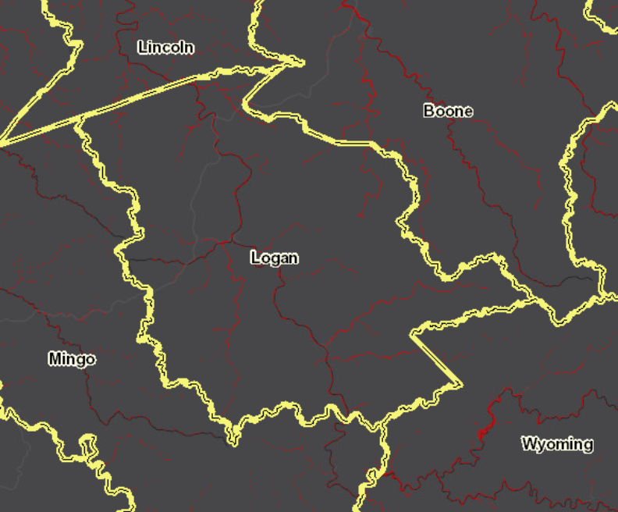
Building Counts – Logan County
Community Name | Regulatory Floodway | Effective SFHA | Non-Regulatory High Risk
KANAWHA COUNTY * | 1,216 | 8,230 | 234
LOGAN COUNTY * | 1,124 | 5,696 | 706
HAMPSHIRE COUNTY* | 613 | 1,501 | 0
BOONE COUNTY * | 454 | 2,932 | 535
MINGO COUNTY * | 398 | 3,295 | 258
WAYNE COUNTY* | 332 | 3,102 | 232
MCDOWELL COUNTY * | 331 | 2,369 | 928
SUMMERS COUNTY * | 289 | 1,362 | 104
WYOMING COUNTY * | 279 | 2,421 | 831
MINERAL COUNTY * | 196 | 707 | 2
RICHWOOD, CITY OF | 136 | 366 | 0
KEYSER, CITY OF | 116 | 290 | 0
MORGAN COUNTY* | 115 | 767 | 54
HANCOCK COUNTY * | 110 | 307 | 21
WHEELING, CITY OF | 110 | 2,658 | 1
NEW MARTINSVILLE | 103 | 905 | 0
MASON COUNTY * | 102 | 1,182 | 0
WHITE SULPHUR SPRINGS | 99 | 470 | 0
PLEASANTS COUNTY * | 93 | 481 | 66
PARSONS, CITY OF | 91 | 356 | 0
WELCH, CITY OF | 90 | 380 | 18
MERCER COUNTY* | 84 | 1,907 | 69
Logan County has a significant number of structures in the SFHA, Floodway, and Non-Regulatory Advisory A Zones that are High Risk

Slide 29
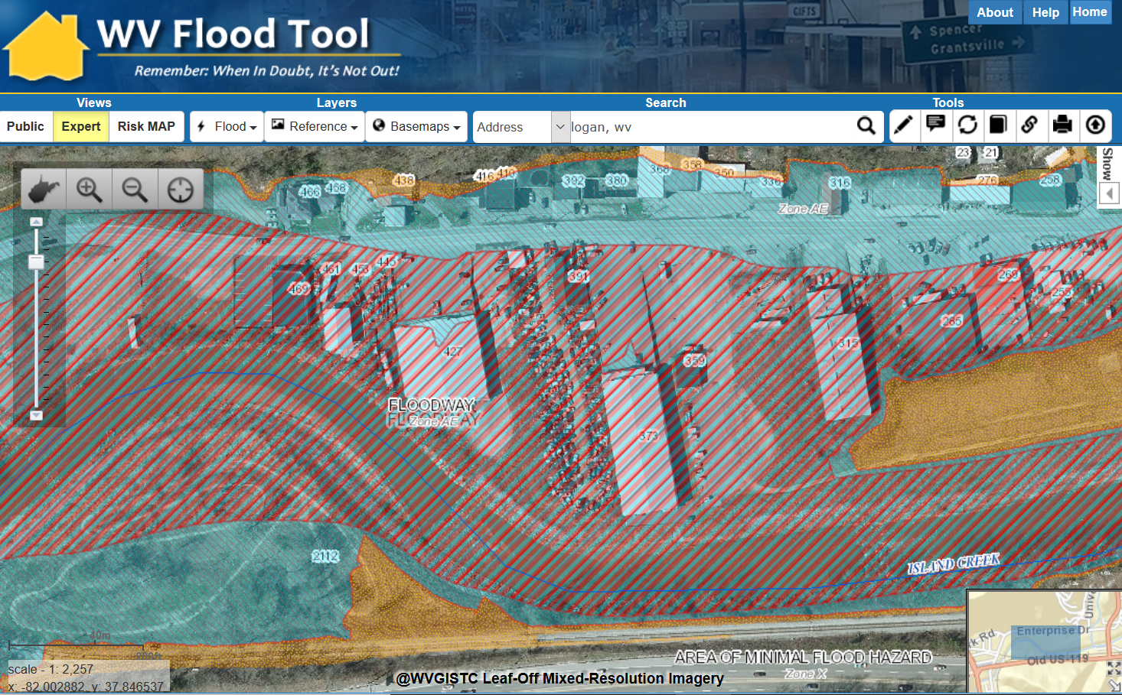
Building Counts in Floodway
Buildings in Floodway

Slide 30
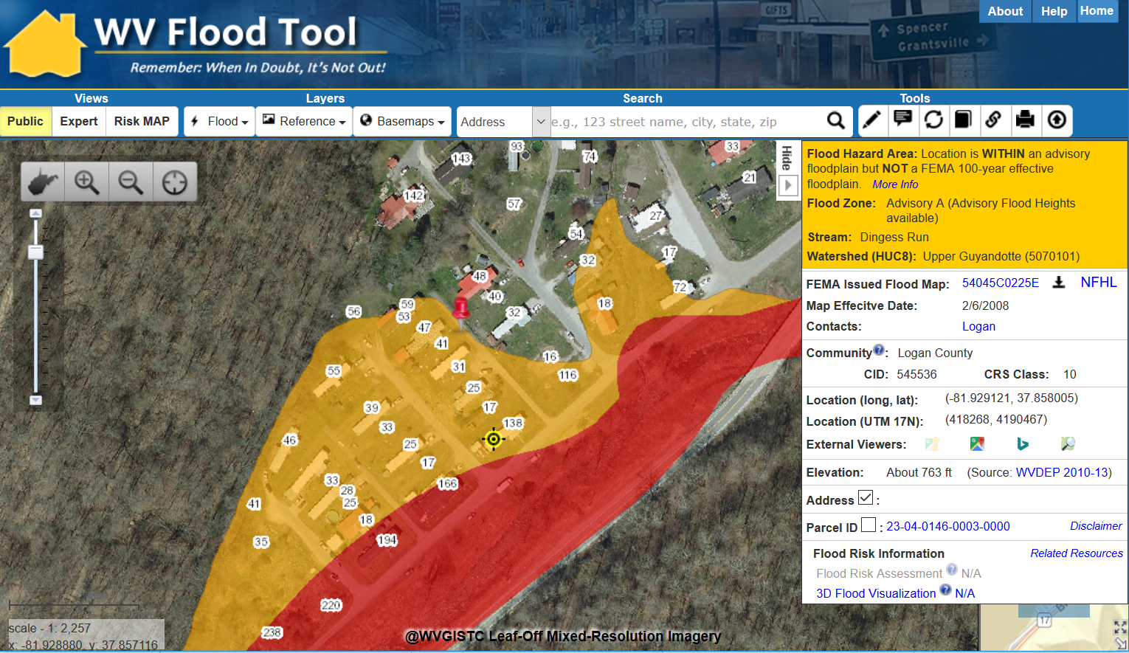
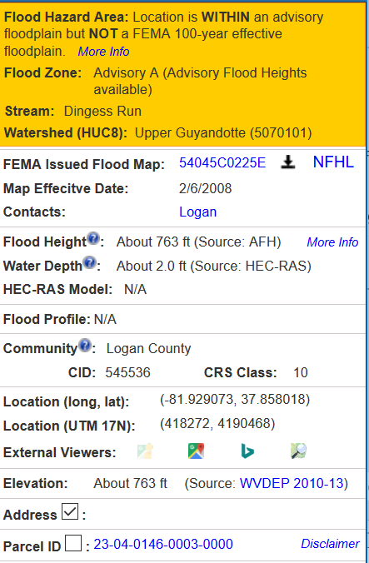
Building Counts in Advisory A
Buildings in Non-Regulatory Advisory A Zones

Slide 31
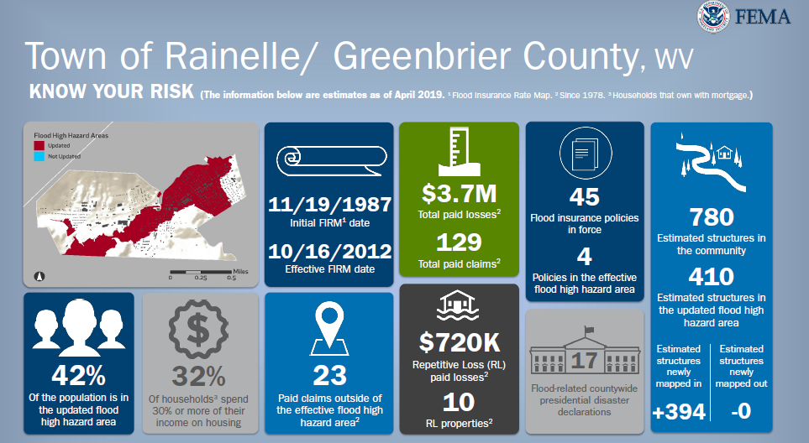
New Flood Studies Affect Building Counts
Estimated structures of RAINELLE newly mapped IN: +394
Source: FEMA Flood Risk Review meeting May 2019

Slide 32
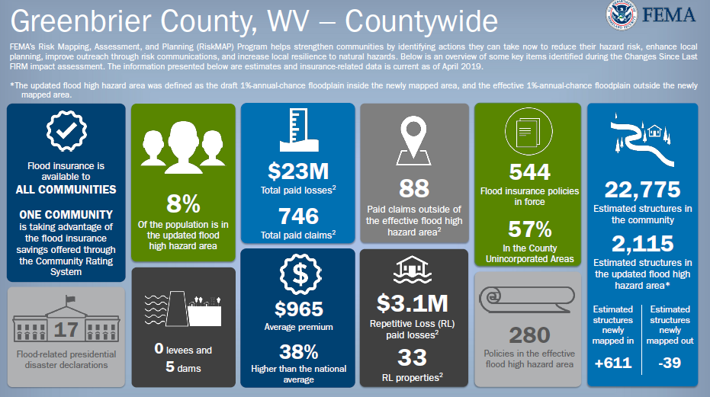
New Flood Studies Affect Building Counts
Estimated structures of Greenbrier County newly mapped IN: +611
Source: FEMA Flood Risk Review meeting May 20109

Slide 33
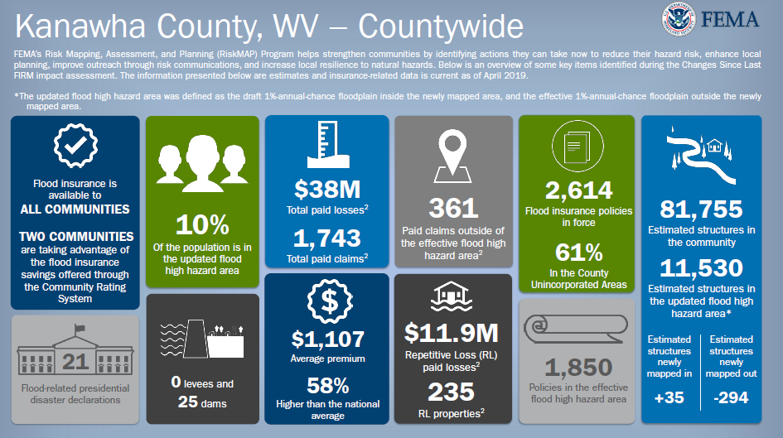
New Flood Studies Affect Building Counts
Estimated structures of KANAWHA COUNTY newly mapped OUT: -294
Source: FEMA Flood Risk Review meeting May 2019

Slide 34
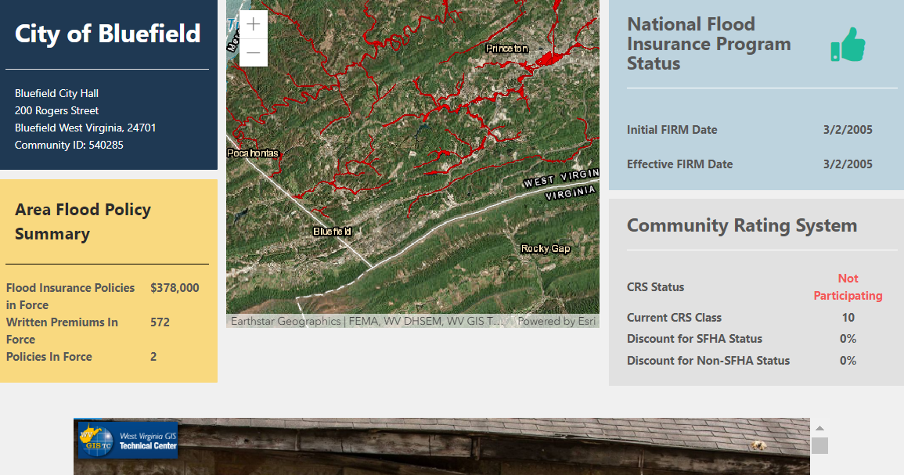
Community Profile Dashboards
Flood Risk
CRS Credits
Landslide Risk
WV Flood Tool
WV Flood Tool Quick View of Bluefield
Story Maps of Flood Risk and Mitigation
http://mapwv.gov/flood/communities/?id=540285

Slide 35
Statewide Flood Risk Assessment
Building-Level Reports

Slide 36
Building 7170:19-07-022B-0021-0000
Building ID | 7170:19-07-022B-0021-0000
Full E-911 Address | 7170 QUEEN ST, KEARNEYSVILLE, WV 25430
Full Owner Address | 7170 QUEEN ST, KEARNEYSVILLE, WV 25430
GIS Parcel ID | 19-07-022B-0021-0000
WV Flood Tool Link | https://mapwv.gov/assessment/detail/?pid=1907022B002100000000
WV Parcel Assessment Link | https://mapwv.gov/flood/map/?pid=19-07-022B-0021-0000
CID | 540065
Community Name | JEFFERSON COUNTY *
County | JEFFERSON COUNTY
Incorporated/Unincorporated | Unincorporated
Flood Zone Designation | Effective 100 yr Zone AE - Floodway
Floodway | Yes
Regulatory Status | Regulatory
FIRM Status | Pre-FIRM
Flood Depth Value | 0.5
Flood Depth Source | HEC-RAS
Ground Elevation | 151.9
Ground Elevation Source | 2012 FEMA Jefferson, Berkeley & Morgan Lidar
Year Built | 1900
Grade | B+
Property Class Code | R
Property Class Description | Residential
Land Use Code | 101 - Residential 1 Family
Land Use Description | 101
Hazard Occupancy Code | RES1
Stories | 2
Exterial Wall Type | Frame
Architectural Style | None
Structure Area | 4006
Basement Type | Part
Dwelling Value | 269300
OBY Value | 5160
Building Appraisal | $274,500

Slide 37
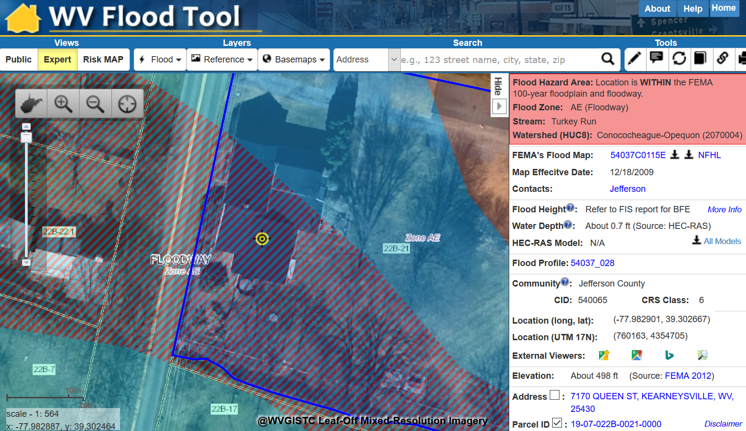
Building 7170:19-07-022B-0021-0000
Residential Home in Floodway with
High Building Exposure Value of $274,500

Slide 38
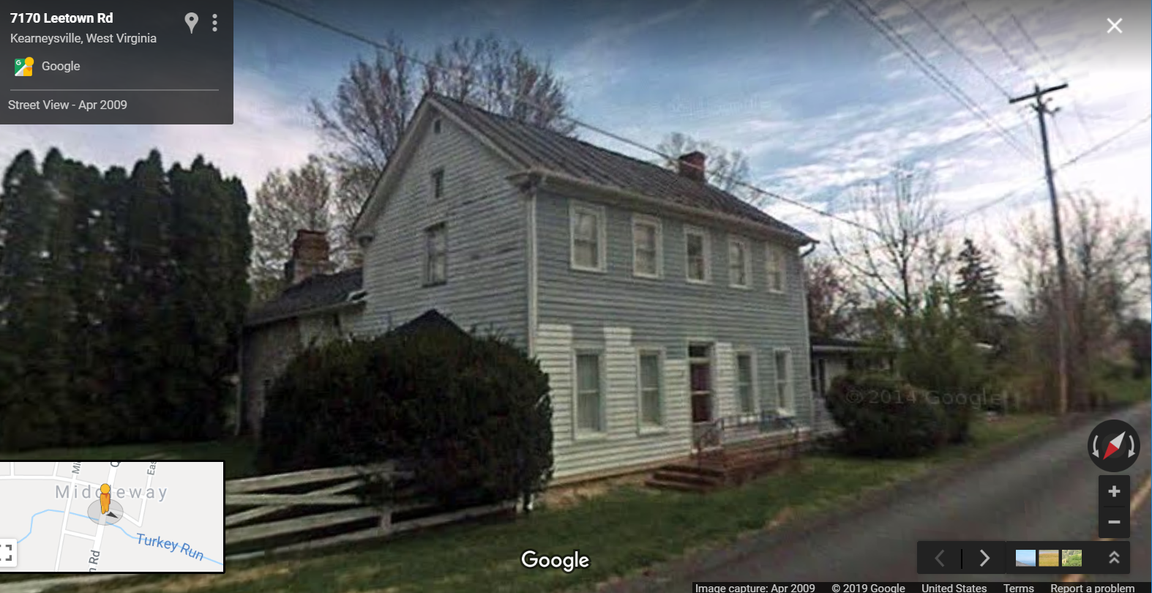
Building 7170:19-07-022B-0021-0000
External Link to Google Street View

Slide 39
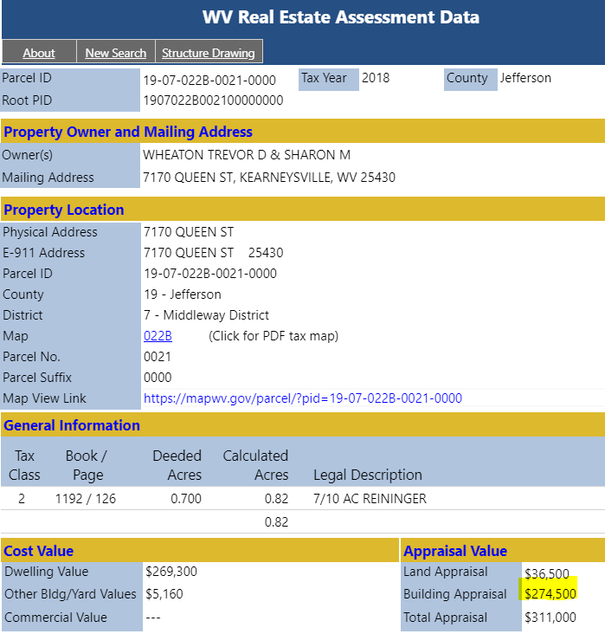
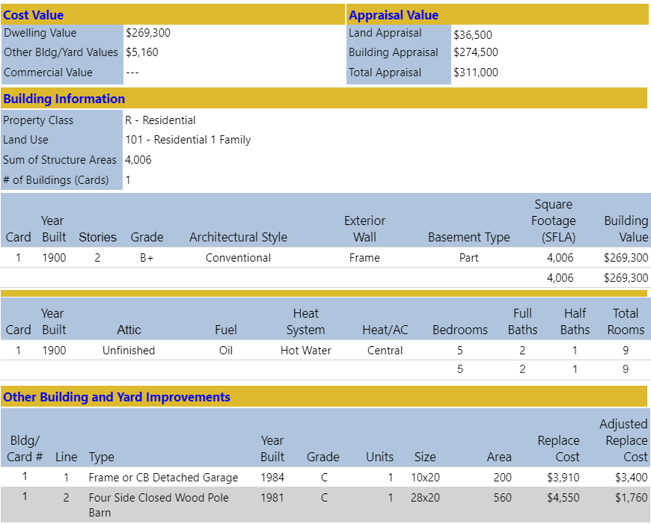
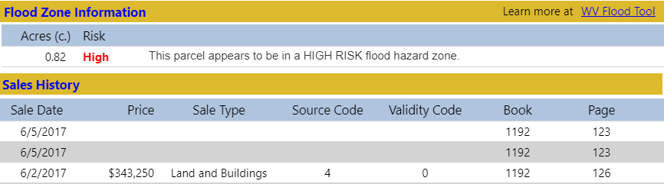
Building 7170:19-07-022B-0021-0000
Parcel Assessment Report

Slide 40
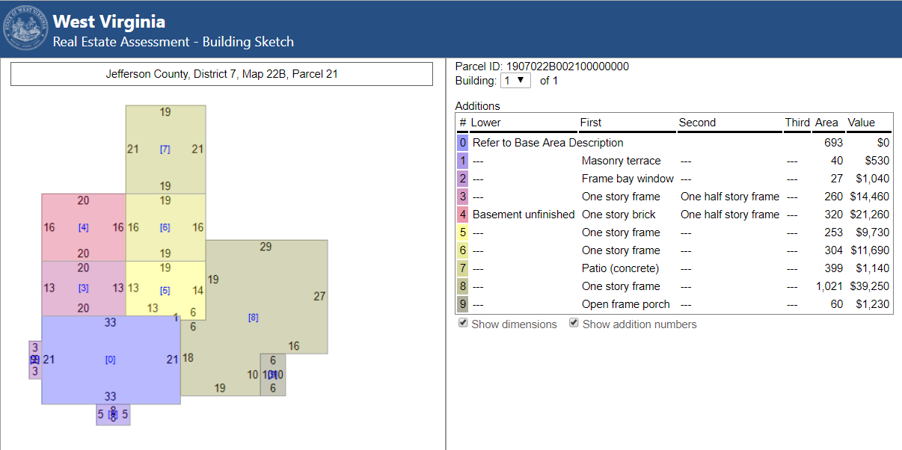
Building 7170:19-07-022B-0021-0000
Building Sketch

Slide 41
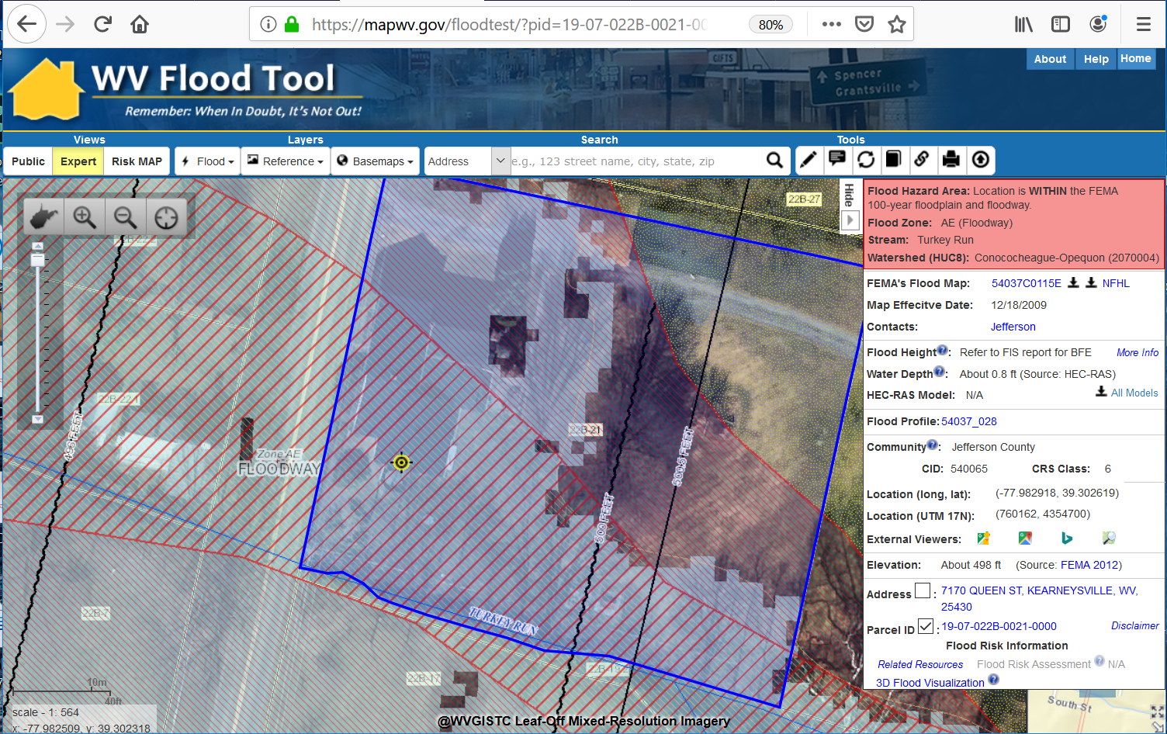
Building 7170:19-07-022B-0021-0000
1% Annual Chance Flood Depth Exists for this Building

Slide 42
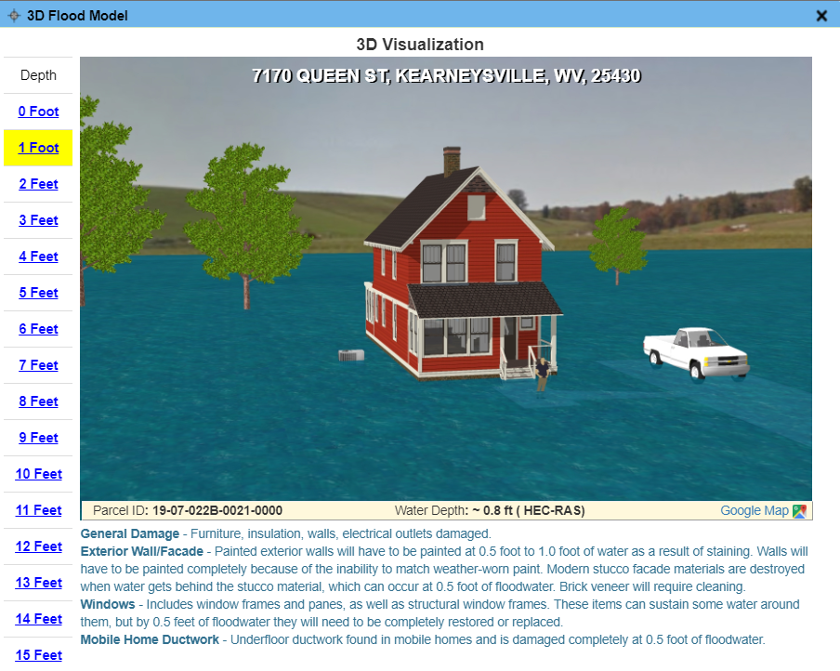
Building 7170:19-07-022B-0021-0000
3D Flood Visualization

Slide 43
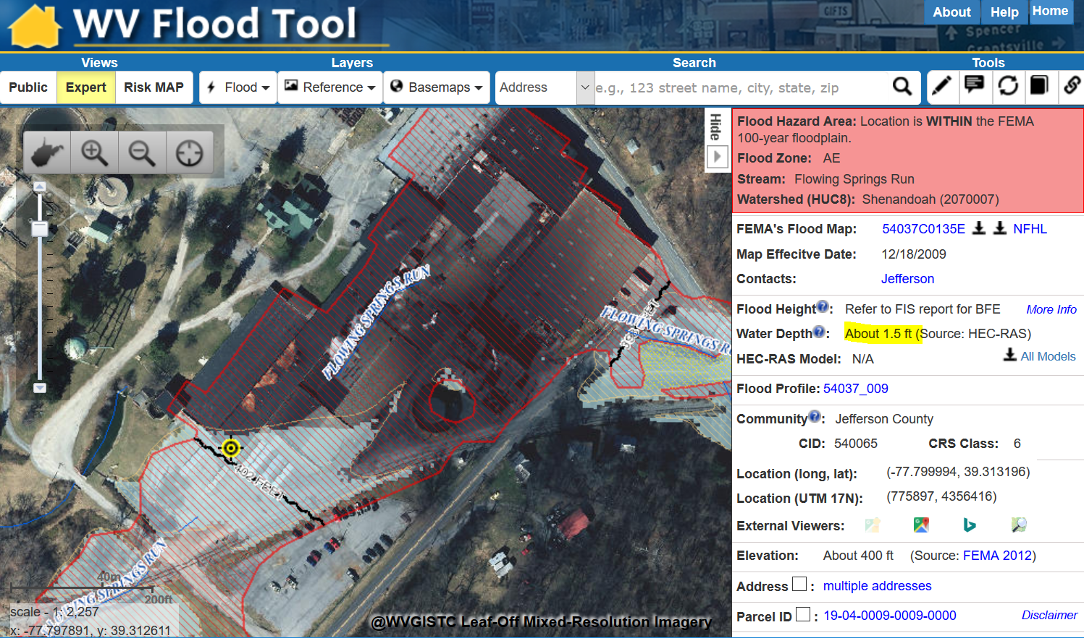
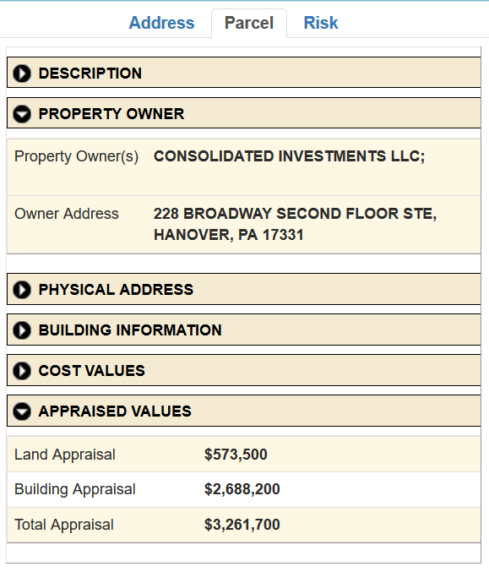
Building 755:19-04-0009-0009-0000
755 HALLTOWN RD, HARPERS FERRY, WV 25425
Industrial Building Valued at $2.6M located in AE Zone

Slide 44
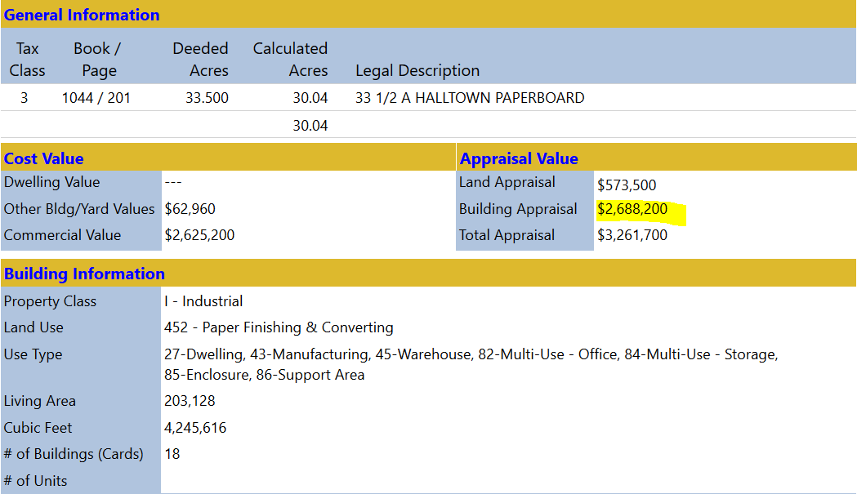
Building 755:19-04-0009-0009-0000
Assessment Report for Industrial Building Valued at $2.6M located in AE Zone

Slide 45
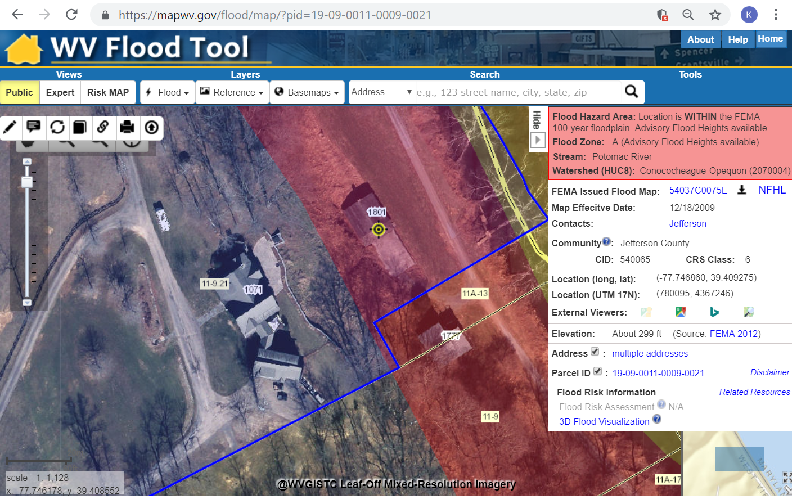
Building 1801:119-09-0011-0009-0021
1801 KNOTT RD, SHEPHERDSTOWN, WV 25443
Is 1801 Knott Road a Primary or Accessory Structure?

Slide 46
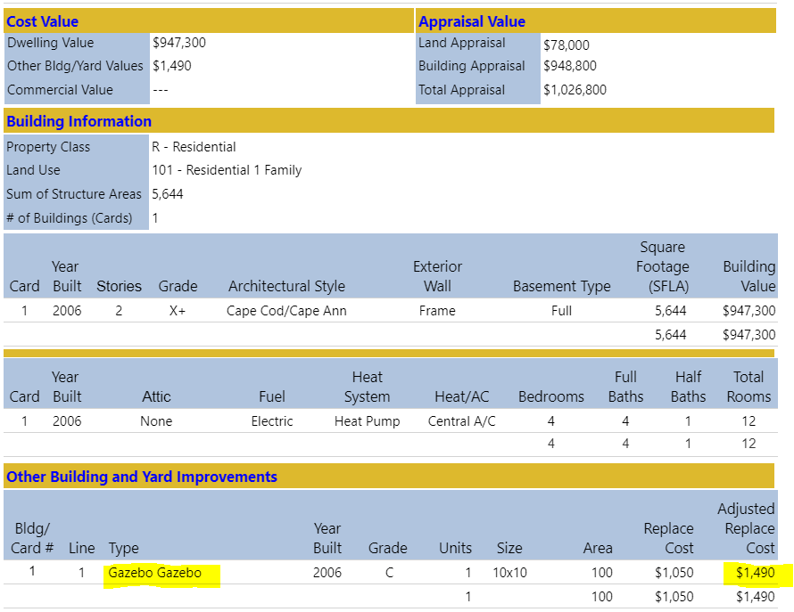
Building 1801:119-09-0011-0009-0021
1801 Knott Road is a Gazebo valued at $1,490 – not the primary structure 1071 Knott Road valued at $948,800

Slide 47
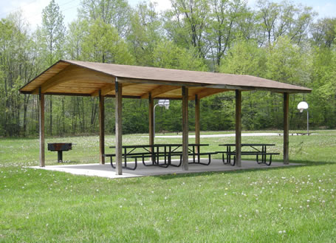
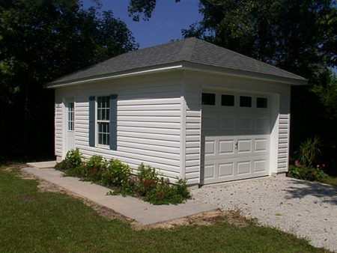
Not a Building
CRS Manual Page 300-5
“Not a Building”
Open pavilions, carports, underground pump stations, trailers, etc. are not buildings
Accessory structures are not counted

Slide 48

Building Accuracy Improvement

Slide 49
Statewide Flood Risk Assessment
Risk Map Building Layers

Slide 50
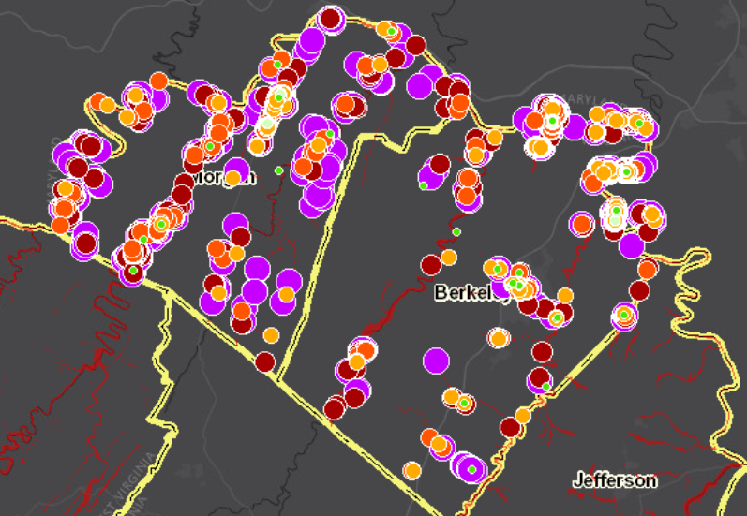
Statewide Flood Risk Assessment
Flood Risk Building Layers
Published to RiskMAP View of WV Flood tool

Slide 51

RiskMAP View
Flood Risk Awareness & Mitigation Planning
https://www.mapwv.gov/flood/map/?wkid=102100&x=-8678412&y=4788996&l=11&v=2

Slide 52


Flood Risk Structures of Martinsburg
Building Flood Loss Damage
57% of Residential Home Damaged at a Loss of $88,834
Flood Risk Building Info
Flood Risk Assessment Building Link
https://www.mapwv.gov/flood/map/?wkid=102100&x=-8678481&y=4788856&l=11&v=2
The Risk MAP View allows for viewing flood loss estimates at the building or structure level for a 1%-annual-chance flood event.

Slide 53




RiskMAP View – 3D Visualization
Building
Exposure
Flood Depth
HAZUS Loss Estimate
Street View Image

Slide 54
Building-Level Risk Symbology
Flood Zones
  Floodway
  Regulatory
  Non-Regulatory
Building Exposure
  Building Exposure ($) Community-wide
  Building Exposure ($) 100-YR Floodplains
Building Physical Damage
  Damage by Percent (%)
  Damage by Dollars ($)
Critical infrastructure
Dual Symbols: Property Class letters (R, F, C, I, A, U, X) combined with symbols. Also may contrast between building points that have been verified for accuracy and those that have not.

Slide 55
Building-Level Symbols - Flood Zones:
Regulatory / Non-Regulatory / Floodway
Effective SFHA versus Preliminary SFHA
Effective AE Zone versus Updated AE Zone
REGULATORY ONLY
SFHA Effective
(AE or A Zones)
REGULATORY & NON-REGULATORY
Effective SFHA & Preliminary SFHA
NON-REGULATORY ONLY
Preliminary SFHA
REGULATORY ONLY
Effective AE Zone
REGULATORY & NON-REGULATORY
Effective AE & Updated AE
NON-REGULATORY ONLY
Updated AE Zone
Effective A Zone versus Advisory A Zone
Effective AE versus Floodway AE
AE Zone
REGULATORY ONLY
Effective A Zone
REGULATORY & NON-REGULATORY
Effective A & Advisory A
NON-REGULATORY ONLY
Advisory A Zone
AE Zone
Floodway
AE Zone

Slide 56

Building Changes Since Last FIRM
Mapped IN SFHA
No Change
Mapped Out of SFHA
Non-Regulatory
Preliminary Studies
Advisory A Zones
Updated AE Zones
Analogous to Changes Since Last FIRM (CLSF), but Building Changes Since Last FIRM (bCLSF)

Slide 57



Building Exposure and Building Physical Damage
Building Exposure
Building Physical Damage
Parcel Centroid - Statewide
Building Accuracy Improvement – 100-YR Floodplain Regulatory & Non-Regulatory
No Model
No Model
Hazus UDF Output – Building % Damage
Hazus UDF Output – Building Cost Damage

Slide 58

Building Exposure and Building Physical Damage

Slide 59

Building Flood Risk by % Damage
Berkeley Springs

Slide 60

Building Stock: Dam / Levee Failures
WV Silver Jackets
Team Initiative

Slide 61
WV Flood Tool Updates
June 2019 Updates
Flood Zones
  Revise 10 Flood Zone Categories in Flood Query Results Panel
  Add Preliminary SFHA for viewing and display in Query Results Panel
  Add Upper Monongahela Watershed RiskMAP Study
Expert View
  Consume additional NFHL layers
  Provide metadata links
  Utilize FEMA’s Effective Panel layer for querying FIRM maps and downloads
  Reorganize and Group layers
  Permit user to display all Flood Zone View Types:
    Expert View (default)
    Public View
    NFHL View)
  Update legend of Printed Map
Reference Data
  Add new Logan County aerial imagery and lidar-derived DEM
  Add statewide Microsoft Building Footprints
New flood data and updated query programming logic

Slide 62

Flood Zone Layers

Slide 63

Preliminary Flood Data

Slide 64

Flood Zone: < zone designation >
Status # | Flood Risk Zone Designation | Message | Floodplain Type Label | Flood Degree Risk | Color Warning Status
1 | AE, AH (5), AO (2) | Location is WITHIN the FEMA 100-year floodplain. | Effective 100 yr Zone AE, AH, AO | High | Red
2 | AE (Floodway) | Location is WITHIN the FEMA 100-year floodplain and floodway. | Effective 100 yr Zone AE, AH, AO – Floodway | High | Red
3 | A | Location is WITHIN the FEMA 100-year floodplain. | Effective 100 yr Zone A | High | Red
3A | A (Advisory Flood Heights available) | Location is WITHIN the FEMA 100-year floodplain. Advisory Flood Heights available. | Effective 100 yr Zone A and Advisory Zone A | High | Red
4 | Preliminary Flood Zone | Location is WITHIN an updated FEMA 100-year flood hazard zone. The flood zone is preliminary and under review to become effective. | Preliminary 100 yr Zone A or Preliminary 100 yr AE | High | Orange
5 | Updated AE Floodplain Boundary | Location is WITHIN an updated detailed floodplain boundary but NOT a FEMA 100-year effective floodplain. | Updated Zone AE | High | Orange
6 | Advisory A (Advisory Flood Heights available) | Location is WITHIN an advisory floodplain but NOT a FEMA 100-year effective floodplain. | Advisory Zone A | High | Orange
7 | Shaded X (500-YR Flood) | Location is WITHIN a moderate flood risk hazard such as a FEMA 500-year floodplain. | Zone X - 0.2 PCT ANNUAL CHANCE FLOOD HAZARD | Moderate | Yellow
8 | X (Levee Protected) | Location is PROTECTED by a levee from a 100-year flood | Zone X - AREA WITH REDUCED FLOOD RISK DUE TO LEVEE | Moderate | Yellow
9 | Near Flood Zone | Location is NOT WITHIN identified flood hazard area, but within 75 feet of an identified flood hazard area. | Separate Buffer Layer | Moderate | Yellow
10 | Out of Flood Zone | Location is NOT WITHIN any identified flood hazard area. Unmapped flood hazard areas may be present. | No Record Found | Low | Green
Three Degrees of Risk: High, Moderate, Low. Four Warning Status Colors: In 100-YR Effective Floodplains (red), Preliminary Flood Zones and non-regulatory Advisory A/Updated AE Floodplains (orange), moderate risk or close to high risk zones (yellow), low risk (green). The query consists of six stacked floodplain boundary layers (see next slide)

Slide 65
Flood Zone Determination Sequence
HIGH:
100-YR Effective Floodplain
HIGH:
Preliminary Flood Hazard Zones
(AE or A)
MODERATE:
500-YR Effective
Floodplain & Levee Reduced Risk
MODERATE:
Within 75-ft of Flood Zone
LOW:
No identified Flood Risk
HIGH:
Non-Regulatory
Updated AE
HIGH:
Non-Regulatory
Advisory A
Flood zone determination sequence important for programming logic
WV Flood Tool first checks query location for High Risk flood zones, then Moderate Risk flood zones.

Slide 66



Multiple Flood Zone Symbology Types
NFHL View
EXPERT View
PUBLIC View
NFHL Viewer
Depth Grid Underlies Flood Zones
Regulatory (red) and
Non-Regulatory (orange)

Slide 67

(FEMA NFHL Viewer)

Slide 68

WV Flood Tool – Expert View
Regulatory Floodway
1-Percent-Annual-Chance Flood Hazard Area
Without Base Flood Elevation (BFE)
ZONE AE
ZONE A
1-Percent-Annual-Chance Flood Hazard Area
With BFE
HIGH RISK
Preliminary
Non-Regulatory Preliminary SFHA
Updated AE
Non-Regulatory Updated AE Boundary
Advisory A
Non-Regulatory Advisory A Zone
Shaded X
0.2-Percent-Annual-Chance Flood Hazard Area or Levee Protected Zones
Near Flood Zones are presented on Flood Results Query Panel
MODERATE
RISK
Shaded X

Slide 69
WV Flood Tool – Public View
Regulatory Floodway
1-Percent-Annual-Chance Flood Hazard Area
Without Base Flood Elevation (BFE)
ZONE AE
ZONE A
1-Percent-Annual-Chance Flood Hazard Area
With BFE
NON-REG.
Non-Regulatory Flood Zones
Preliminary or Advisory A or Updated AE
Moderate Risks:
Shaded X or Near Flood Zones are presented in Flood Results Query Panel

Slide 70


New Logan County Elevation Data

Slide 71







Flood Tool Development Team
Xiannian Chen
Lead Programmer
Jim Schindling
Database Programmer
Kurt Donaldson
Manager
  WV GIS Technical Center
  West Virginia University
  Morgantown, WV
  http://wvgis.wvu.edu
Kevin Kuhn
GIS Analyst / Address-Parcel Specialist
Frank LaFone
Systems Administrator
Eric Hopkins
GIS Analyst / Flood Risk Specialist
Yibing Han
GIS Programmer
Maneesh Sharma
GIS Analyst / Flood Risk Specialist

Slide 72
Contact Information
  WVU GIS Technical Center
  Kurt Donaldson, GIS Manager
  kurt.donaldson@mail.wvu.edu, phone: (304) 293-9467
  Eric Hopkins, GIS Analyst
  Eric.Hopkins@mail.wvu.edu, phone: (304) 293-9463
  Maneesh Sharma, GIS Analyst
  Maneesh.Sharma@mail.wvu.edu, phone (304) 293-9466

