Slide 1
WV Flood Tool 2018
Talking Points
Overview of WV Flood Tool (www.mapwv.gov/flood)
Flood Tool for Disaster Assessment
State-Level Data Integration of Reference Layers
  Parcels, Addresses, Imagery, Elevation
Floodplain Management and Mapping Activities
WV Hazard Mitigation Grant Application (HMGP)
  Flood Risk Assessments for 283 communities
  Landslide Risk Assessments for 55 counties
  Data Development for missing/incorrect reference layers
FEMA Region III Meeting 5/30/2018 Philadelphia, PA

Slide 2
WV Flood Tool 2018
Flood Tool Overview
(www.mapwv.gov/flood)
Public View for general public
Expert View for floodplain managers
RiskMAP View for community planners

Slide 3
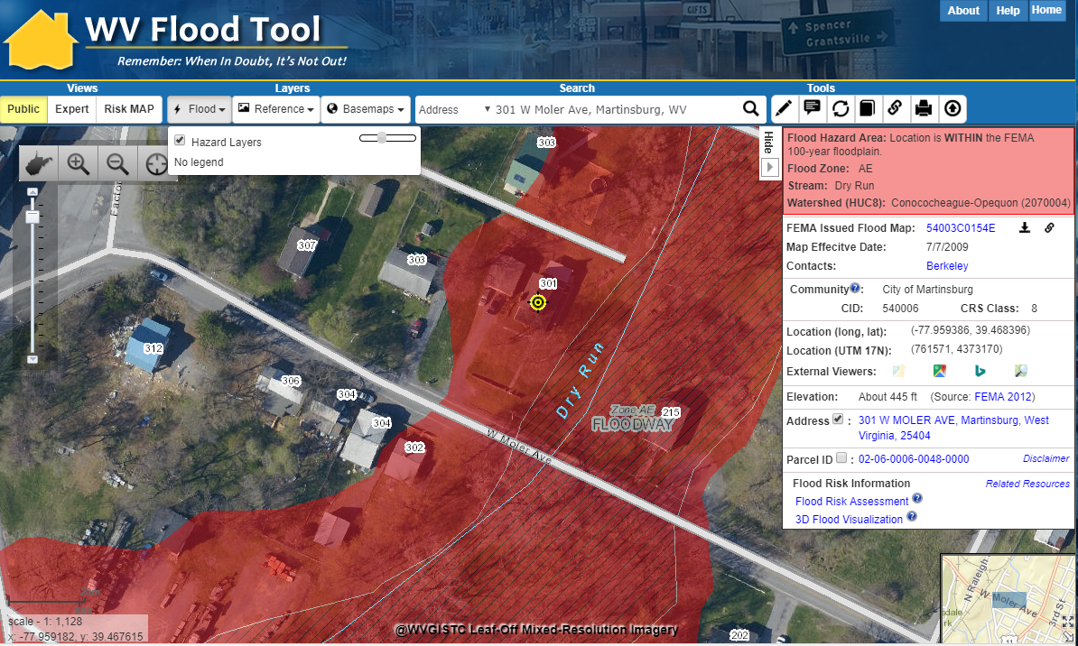
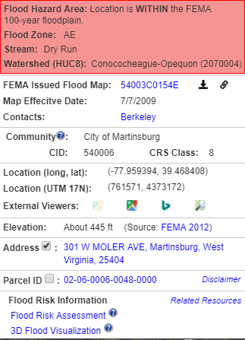
Public View
Flood Results Query Panel
General Public
Flood Zone Determination
https://www.mapwv.gov/flood/map/?v=0&address=301%20W%20MOLER%20AVE,%20Martinsburg,%20West%20Virginia,%2025404

Slide 4

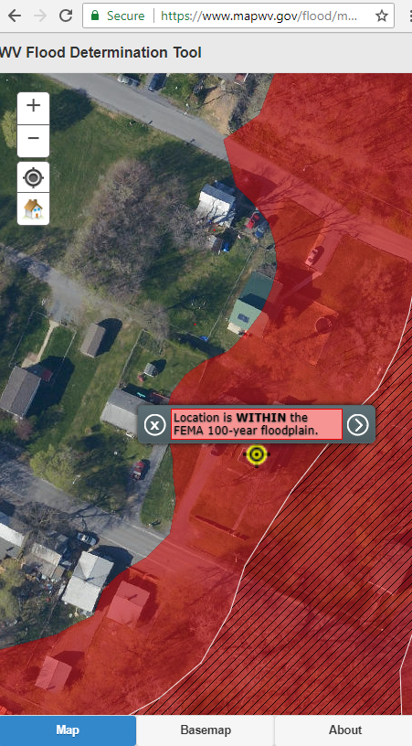
WV Flood Tool (smartphone)
Smartphone Version has limited functionality
Public View only
Future upgrade planned
Mobile Flood Tool

Slide 5
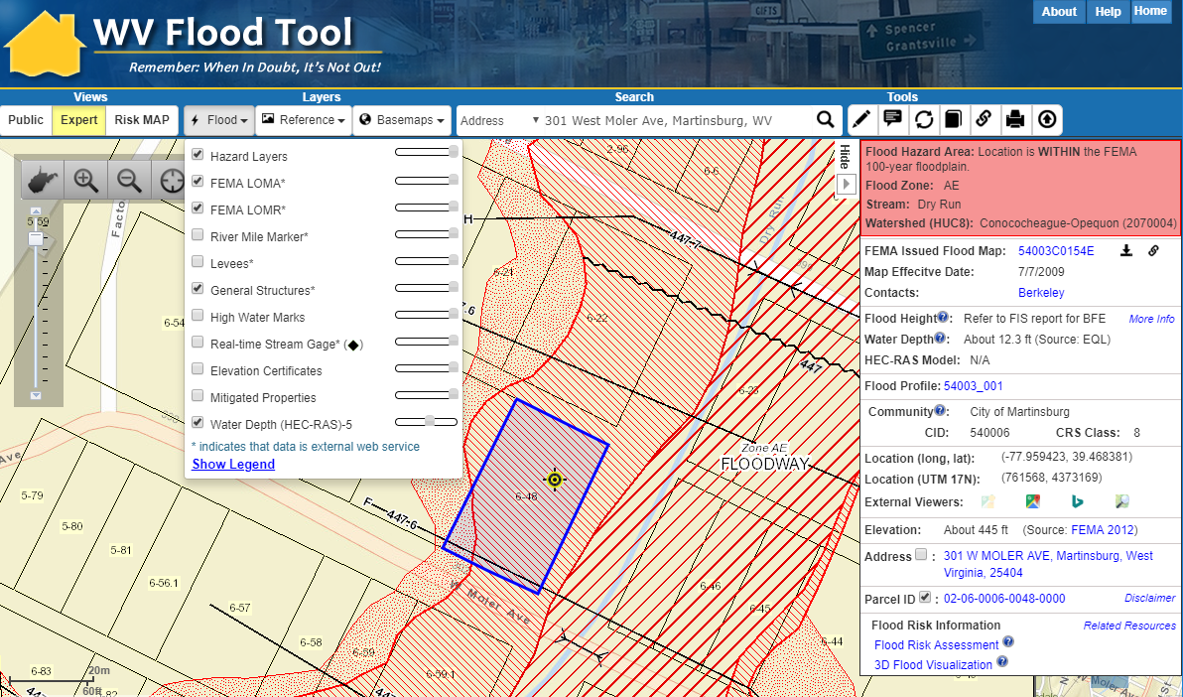
Expert View – External Links
FEMA Flood Maps
Flood Profile
Elevation Metadata
https://www.mapwv.gov/flood/map/?v=1&pid=02-06-0006-0048-0000

Slide 6
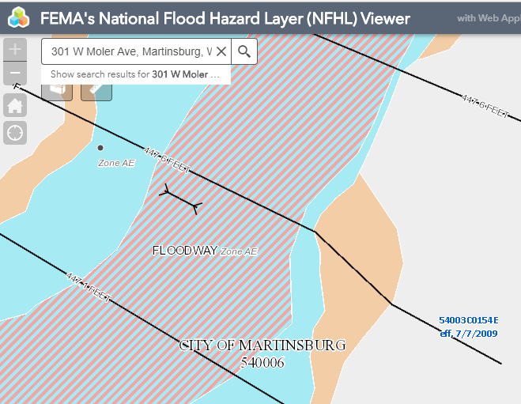
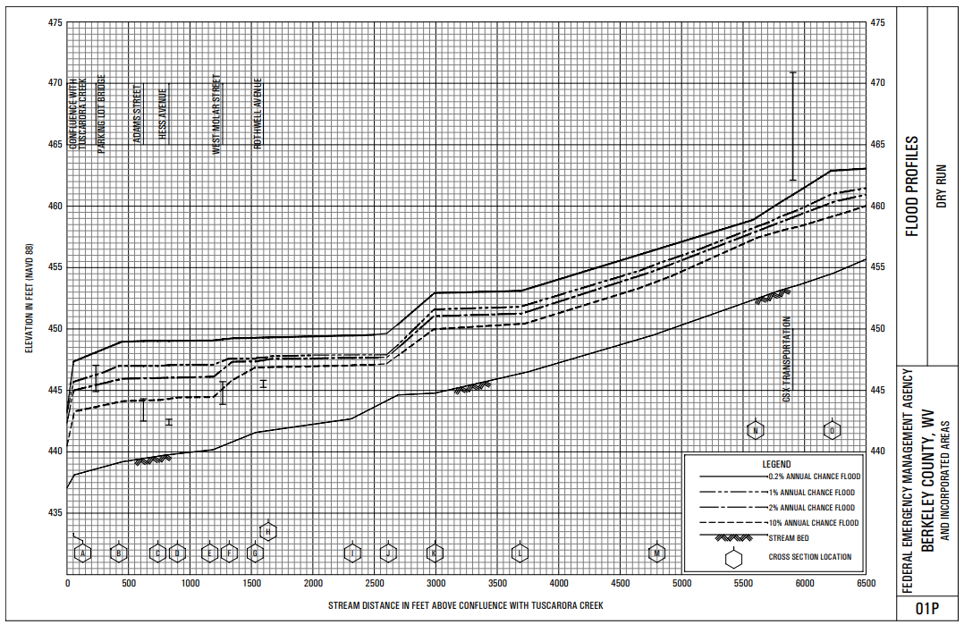
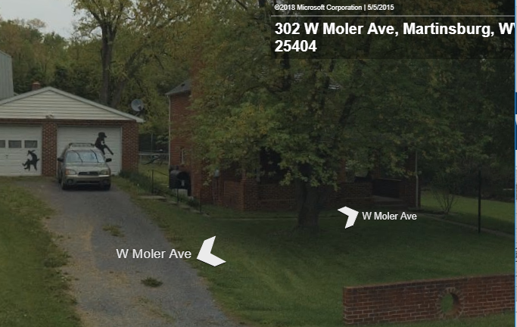
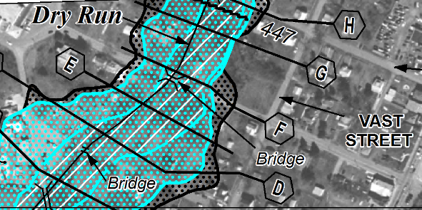
Expert View – External Links
FEMA’s NFHL Viewer
Flood Profile
FEMA Issued Flood Map
Street View Image
https://www.mapwv.gov/flood/map/?v=1&pid=02-06-0006-0048-0000

Slide 7
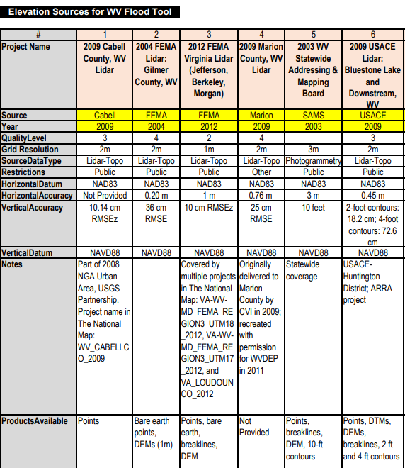
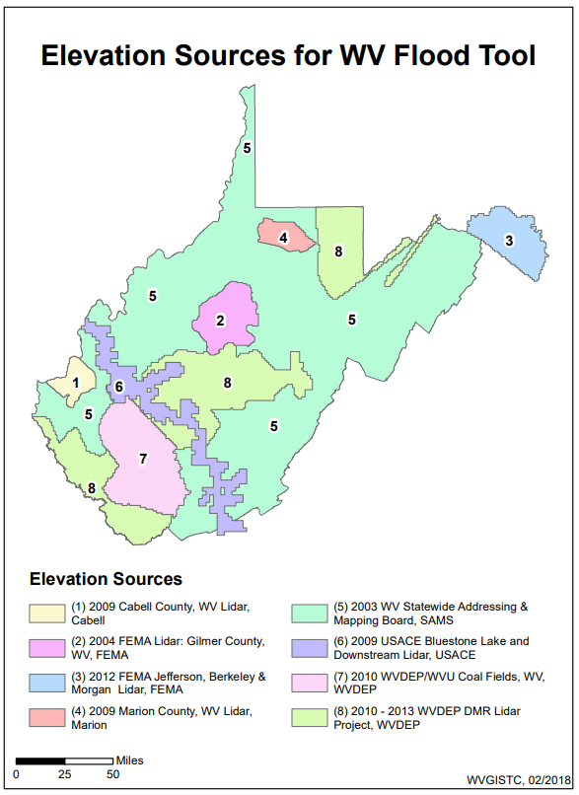
Expert View – External Links
Elevation Metadata
https://www.mapwv.gov/floodtest/docs/WV_Flood_Tool_Elevation_Source_Metadata_20180222.pdf

Slide 8
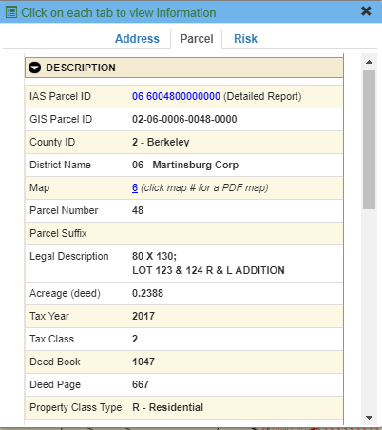
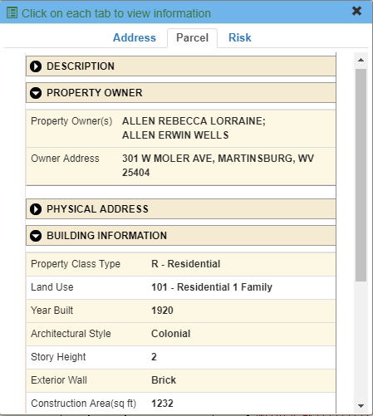
Expert View – External Links
(2) Click on Parcel ID
to link to Web Report
(1) Click on Parcel ID
to open Parcel Tab
https://www.mapwv.gov/flood/map/?v=1&pid=02-06-0006-0048-0000

Slide 9
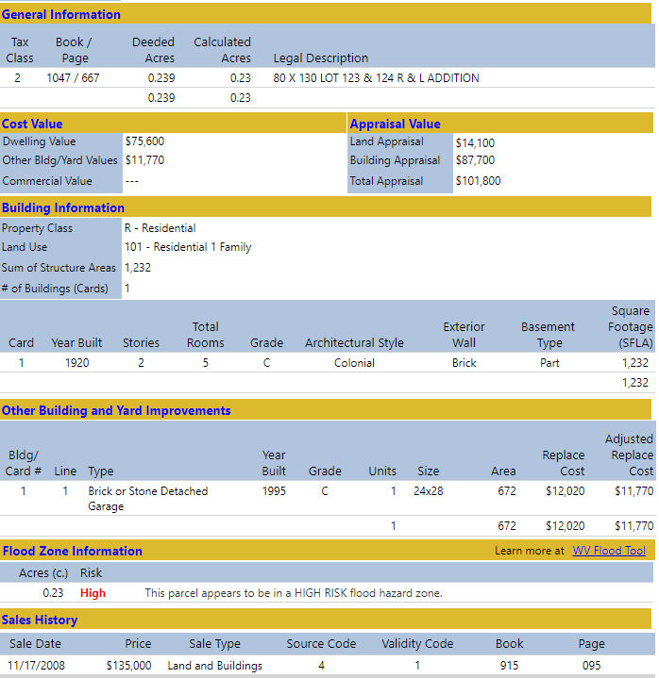
Expert View – External Links
Detailed Property
Report
http://www.mapwv.gov/Assessment/?PID=02060006004800000000

Slide 10
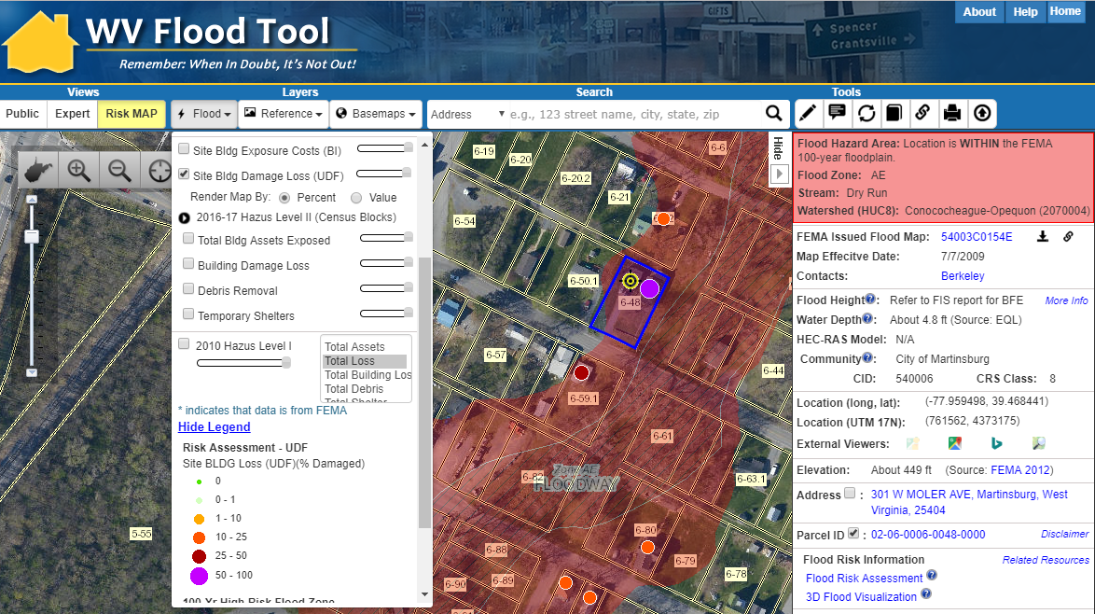
RiskMAP View
Flood Risk Awareness & Mitigation Planning
https://www.mapwv.gov/flood/map/?wkid=102100&x=-8678412&y=4788996&l=11&v=2

Slide 11
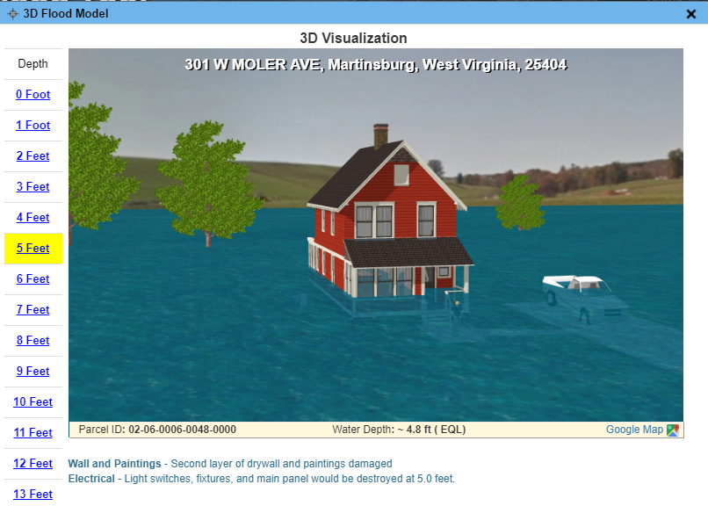
RiskMAP View – 3D Visualization
https://www.mapwv.gov/flood/map/?wkid=102100&x=-8678412&y=4788996&l=11&v=2

Slide 12
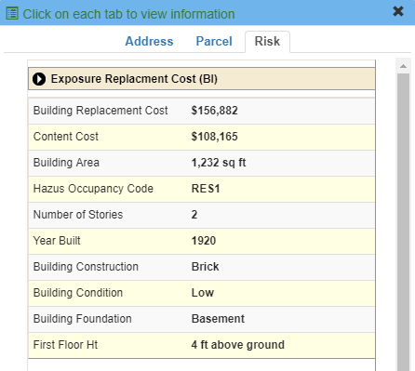
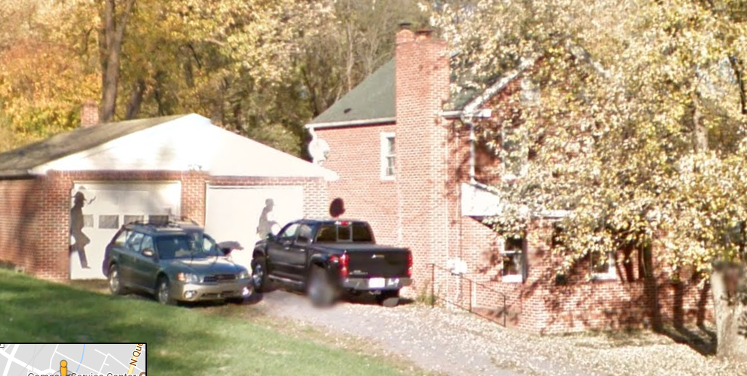
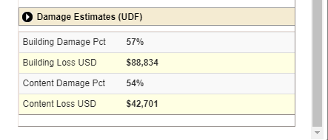
RiskMAP View – 3D Visualization
Building
Exposure
Flood Depth
HAZUS Loss Estimate
Street View Image

Slide 13
Flood Layers
FLOOD LAYERS | Public View for general public | Expert View floodplain managers | RiskMAP View flood risk reduction
Flood Hazard Layers Flood Hazard Areas Flood Height Values (BFE and AFH) Panel Index (link to FEMA issued map) X-Sections / BFE’s LOMAs / LOMRs* Structures, Levees, Mile Markers* Political Areas/CRS Communities Flood Elevation Certificates (Barbour Co. Pilot) | Yes** No No No No No Yes No | Yes Yes Yes Yes Yes Yes Yes Yes | Yes Yes No No No No Yes Yes
Flood Risk Flood Water Depths (HEC-RAS models) Other Water Depths (USGS HWM, Hazus, EQL) Historical High-Water Marks (points) Building-Specific Flood Risk Assessments Historical Flood/Dam/Levee Inundation Maps | No No No No No | Yes No Yes No No | Yes Yes Yes Yes Yes
Property Mitigation Mitigated Structures/Buyout Properties | No | Yes | Yes
Flood Prediction USGS Real-Time Stream Gages* | No | Yes | Yes
Italics Text = To Be Added in Future * External Agency Web Map Services ** 100-YR Floodplain only

Slide 14
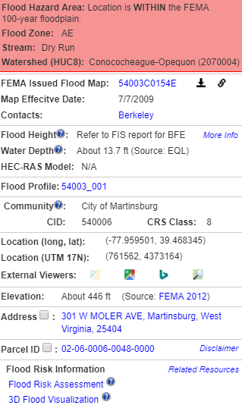
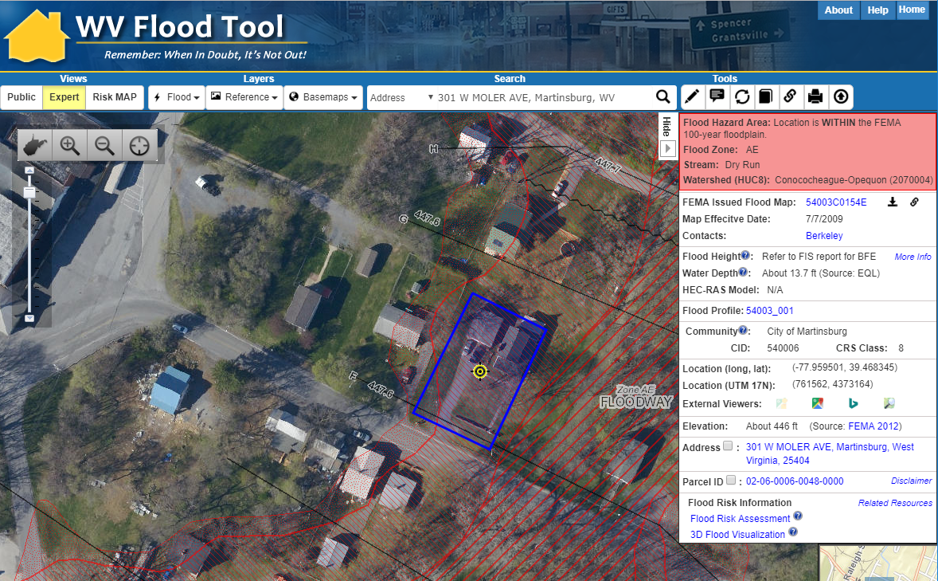
Flood Query Results Panel
# | Each Location Query Answers:
1 | In Flood Hazard Area? Flood Zone? Floodway?
2 | Stream & Watershed names?
3 | FEMA Issued Flood Map / NFHL links?
4 | Floodplain Manager Contact?
5 | Flood Height value or information?
6 | Water Depth value and source?
7 | HEC-RAS Model available?
8 | Flood Profile available?
9 | CRS community information?
10 | Coordinate x,y location?
11 | External Map Viewer Links?
12 | Ground elevation value and source?
13 | E-911 Address (link to address info)
14 | Parcel ID (link to property info)
15 | Flood risk assessment info?
16 | 3D flood visualization?
1
2
3
4
5
301
W Moler Ave
7
6
8
9
10
11
12
13
14
Click Here
15
16
Parcel ID Web Link: https://www.mapwv.gov/flood/map/?v=1&pid=02-06-0006-0048-0000

Slide 15


WV Flood Tool 2018
Disaster Assessments
▪ Property Identification
▪ State-Level Data Integration
▪ Building Information
Hazard Risk Reduction
▪ Hazard Risk Assessments
▪ Hazard Mitigation Plans
▪ 3d Flood Visualizations
▪ At-risk structures
Floodplain Management
▪ Flood Zone Determinations
▪ Flood mapping activities
▪ NFIP / CRS Program
▪ Flood Depth Grids
Data
Kevin Sneed
State NFIP Coordinator
Brian Penix
State Hazard Mitigation Officer

Slide 16
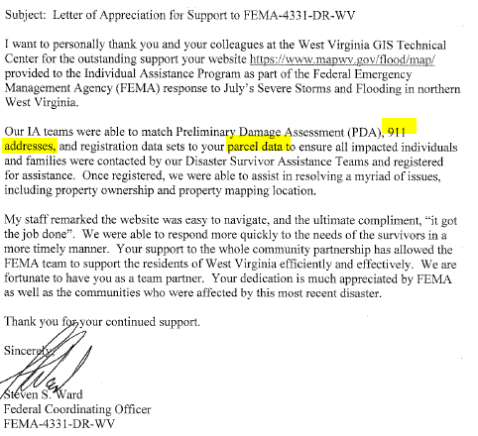

WV Flood Tool 2018
Disaster Assessment
FEMA Letter dated September 29, 2017, about
WV Flood Tool support for Disaster Assessments

Slide 17
Property Identification
Collect multiple spatial identifiers to verify location
Parcel | 01-08-0011-0069-0000
Address | 604 S Main St, Philippi, West Virginia, 26416
X,Y Coordinate | -80.033529, 39.144752
Share URL Link | https://www.mapwv.gov/flood/map/?wkid=102100&x=-8909292&y=4742427&l=12&v=1

Slide 18
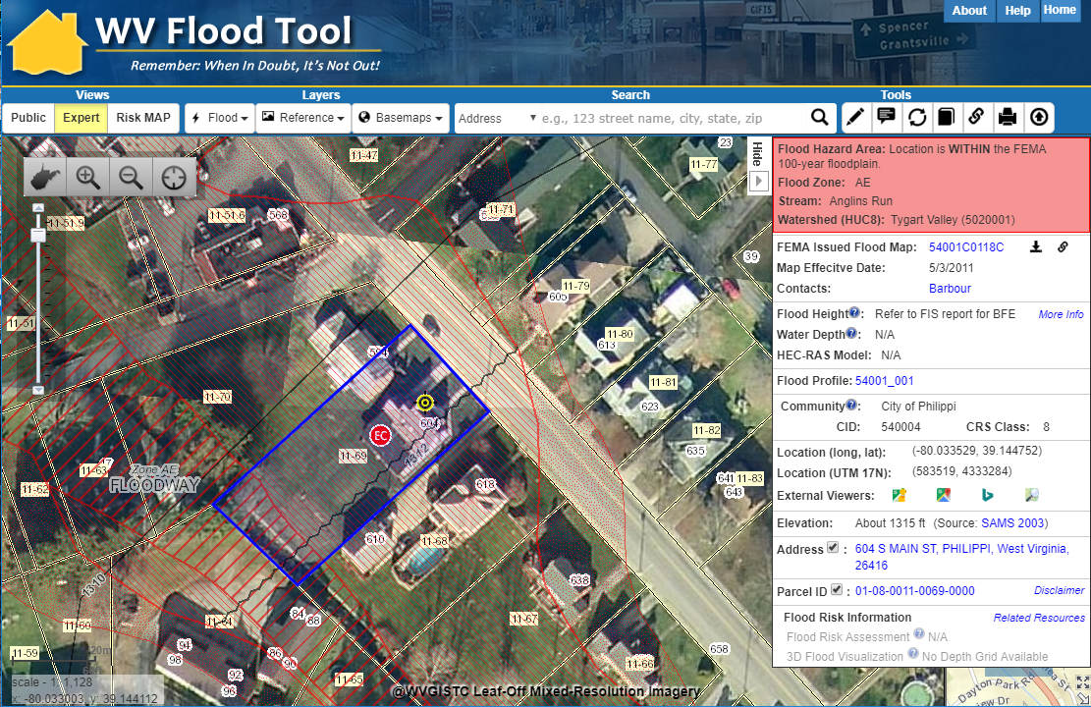
Property Identification
SHARE LINK
604 Main St, Philippi, WV 26416
X,Y COORD.
ADDRESS
PARCEL
Share Link: https://www.mapwv.gov/flood/map/?wkid=102100&x=-8909292&y=4742427&l=12&v=1

Slide 19
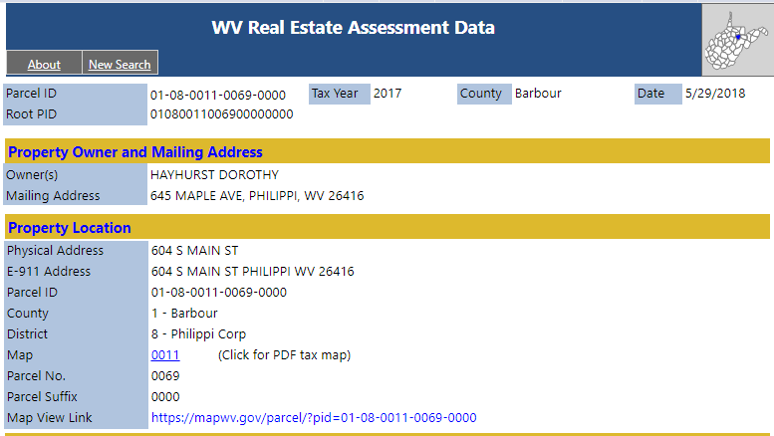
Property Identification
E-911 and County Assessor report location as 604 S Main Street
Property Parcel Address
E-911 Address
Share Link: http://www.mapwv.gov/Assessment/?PID=01080011006900000000

Slide 20
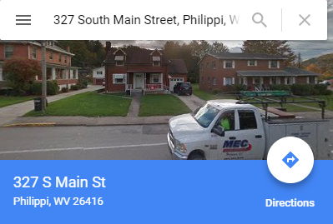
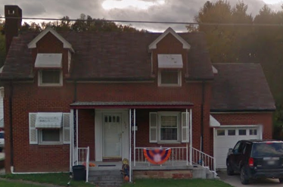
Property Identification
Google Street View and House Number list location as 327 S Main Street

Slide 21
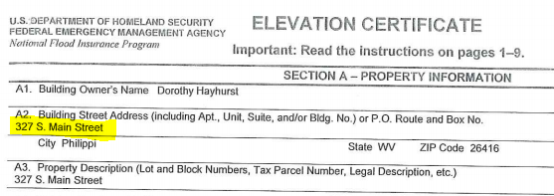
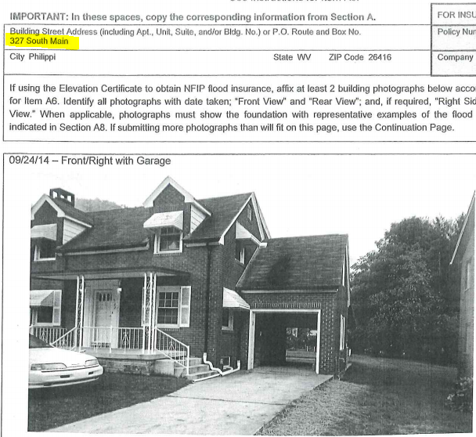
Property Identification
FEMA’s Elevation Certificate lists location as 327 S Main Street

Slide 22
Property Identification
But the correct location is 604 S Main Street
Always collect multiple spatial identifiers to verify location!
Parcel | 01-08-0011-0069-0000
Address | 604 S Main St, Philippi, West Virginia, 26416
X,Y Coordinate | -80.033529, 39.144752
Share URL Link | https://www.mapwv.gov/flood/map/?wkid=102100&x=-8909292&y=4742427&l=12&v=1
TEMPLATE FOR SPATIAL LOCATIONS FOR FLOOD ELEVATION CERTIFICATES
EC # | E-911 Address | Parcel ID | Longitude, Latitude | Share Tool Link
EX | 195 N WALNUT ST, PHILIPPI, West Virginia, 26416 | 01-08-0004-0109-0000 | -80.041465, 39.154333 | https://www.mapwv.gov/flood/map/?wkid=102100&x=-8910178&y=4743809&l=12&v=1
1 | 604 S MAIN ST, Philippi, West Virginia, 26416 | 01-08-0011-0069-0000 | -80.033472, 39.144704 | http://www.mapwv.gov/flood/map/?wkid=102100&x=-8909285&y=4742420&l=11&v=1
Example Excel Spatial Template for Elevation Certificates in West Virginia

Slide 23
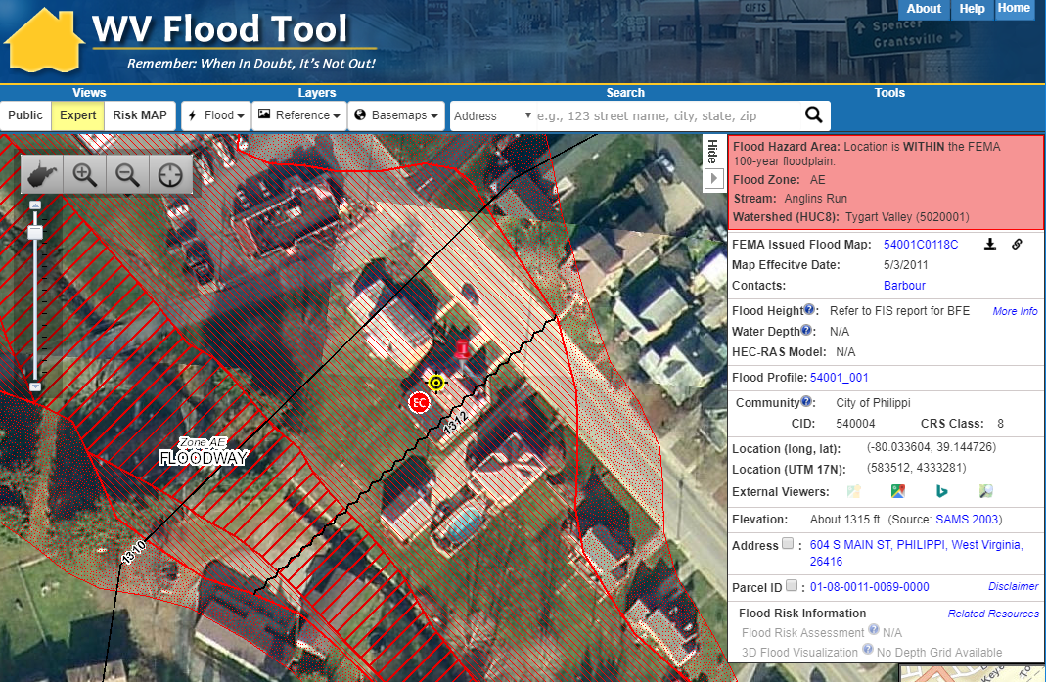
Property Identification – Case Study
Correct Address is 604 Main Street – Confirmed with Floodplain Manager
604 Main St, Philippi, WV 26416
Share Link: https://www.mapwv.gov/flood/map/?wkid=102100&x=-8909292&y=4742427&l=12&v=1

Slide 24
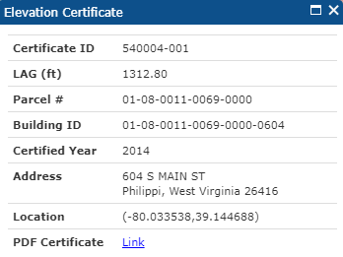
Property Identification – Case Study
604 Main St, Philippi, WV 26416
Correct information used to add Elevation Certificate point to WV Flood Tool
Share Link: https://www.mapwv.gov/flood/map/?wkid=102100&x=-8909292&y=4742427&l=12&v=1

Slide 25
WV Flood 2018
State-Level Data Integration
          Parcels
          Addresses
          Imagery
          Elevation

Slide 26
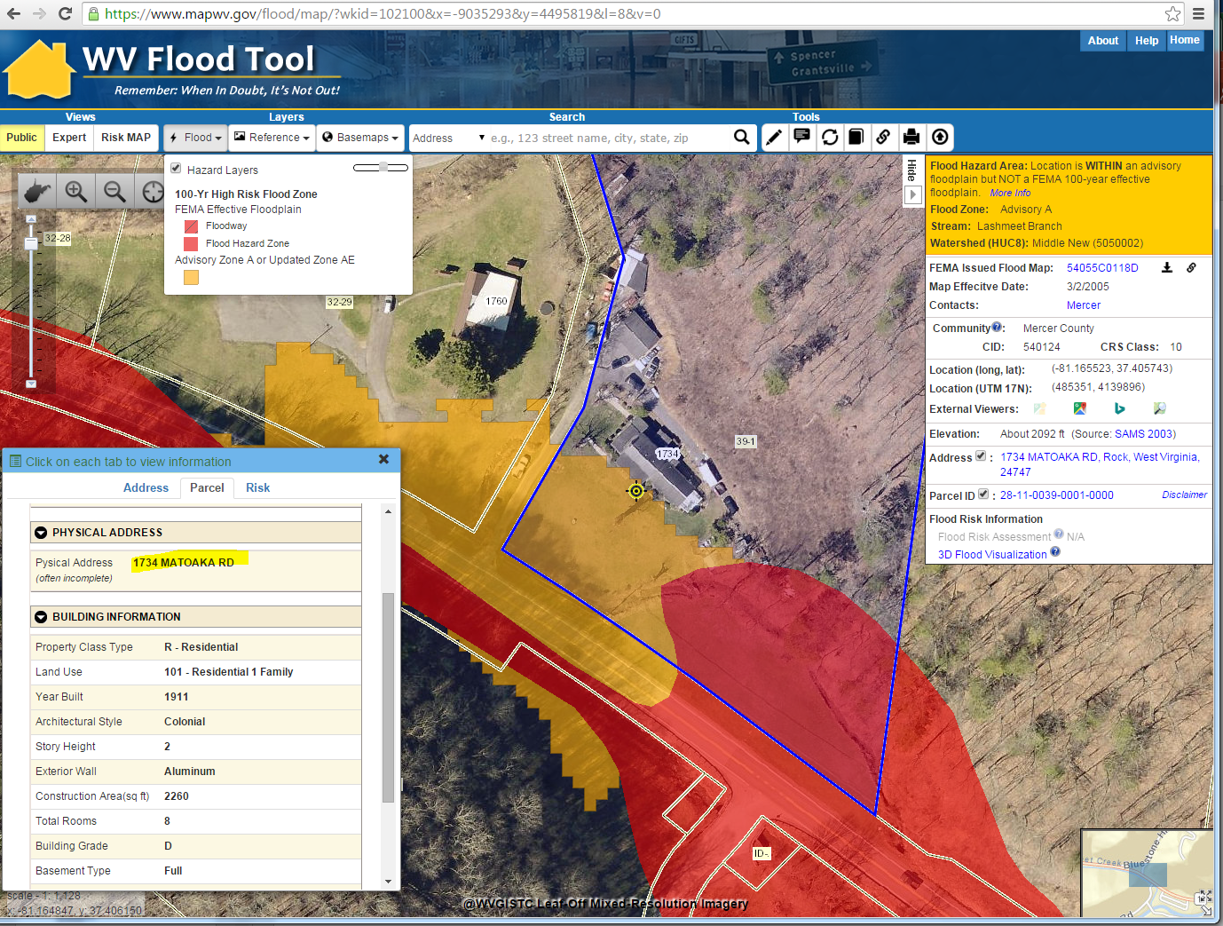
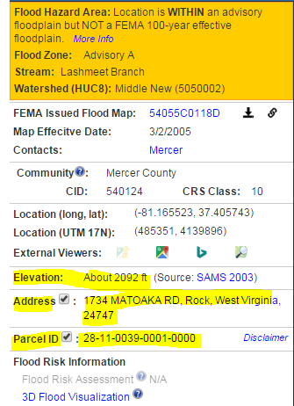
Flood Tool Data Integration
2018 IMAGERY
ELEVATION
ADDRESS
PARCEL
https://www.mapwv.gov/flood/map/?wkid=102100&x=-9035305&y=4495817&l=12&v=0

Slide 27
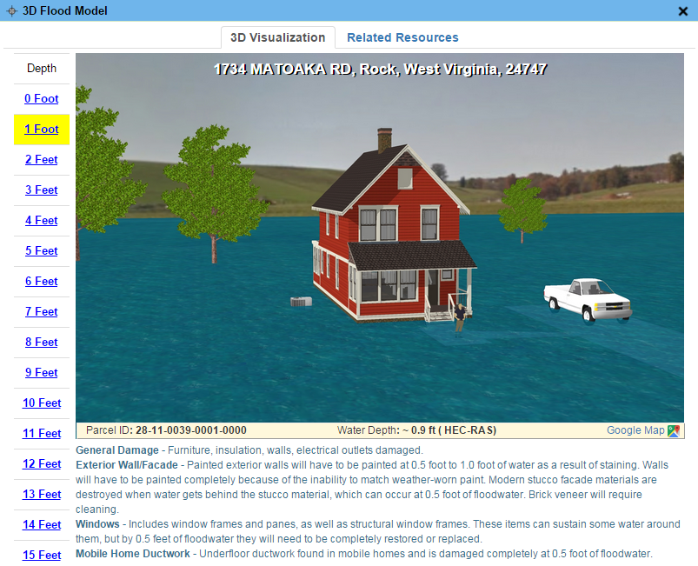
More Info – Flood Visualization
3D Flood Visualization

Slide 28
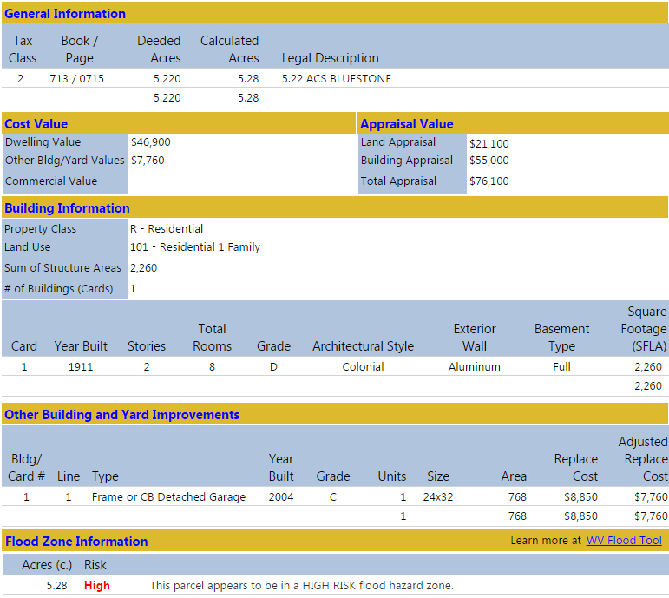
More info – Web Parcel Report
http://mapwv.gov/Assessment/?PID=28110039000100000000

Slide 29
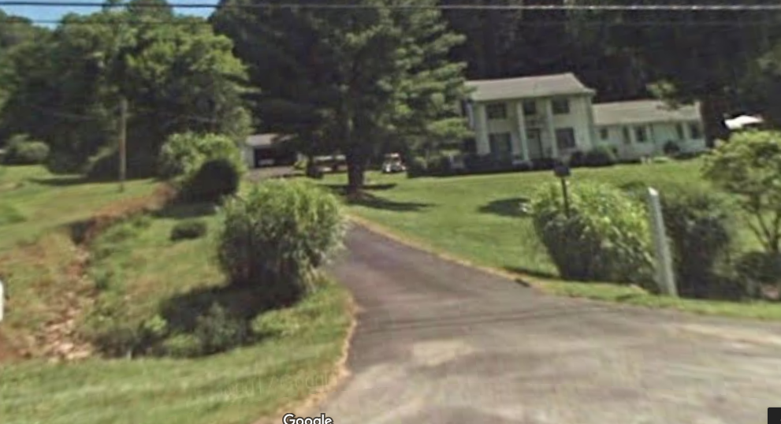
More Info – Google Street View
https://goo.gl/maps/FEsUXpGFyAG2
2-Story Colonial House, Full Basement
Detached Garage
Google Street View

Slide 30
Flood Tool Data Integration
2018 IMAGERY
ELEVATION
ADDRESS
PARCEL
https://www.mapwv.gov/flood/map/?wkid=102100&x=-9035305&y=4495817&l=12&v=0

Slide 31
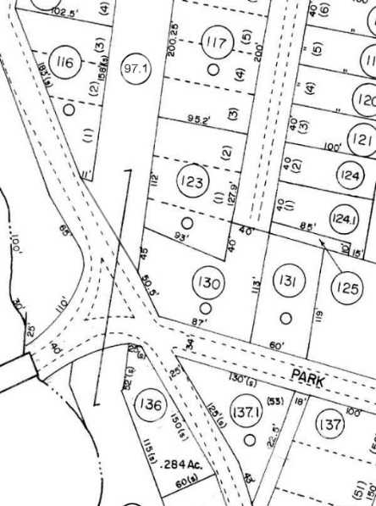
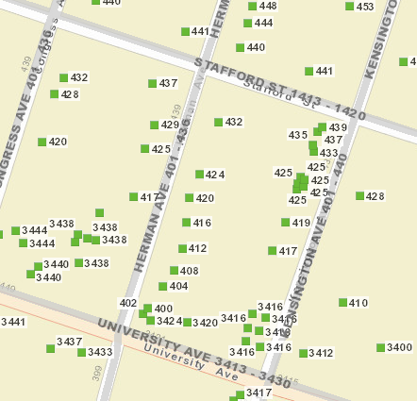
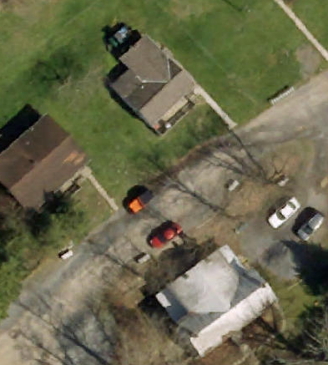
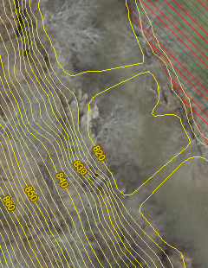
Spatial Data Layers
Parcels Site Addresses Aerial Imagery Elevation
State Spatial Data Infrastructure

Slide 32
State-Level Integration
Parcels
Addresses
Imagery
Elevation
SOURCE:
County Assessors
Property Tax Division
Statewide Master Parcel File / IAS
SOURCE:
Local Addressing Offices
Division of Homeland Security & Emergency Management
Statewide
Addressing & Mapping System
SOURCE:
County Offices
WV GIS Technical Center
Statewide
Leaf-Off Imagery Service
SOURCE:
Local, State, primarily FEMA
WV DEP
WV GISTC
Statewide Elevation
Web Services
State-level integration allows for statewide mapping products and services

Slide 33
WV Flood Tool 2018
Parcels

Slide 34
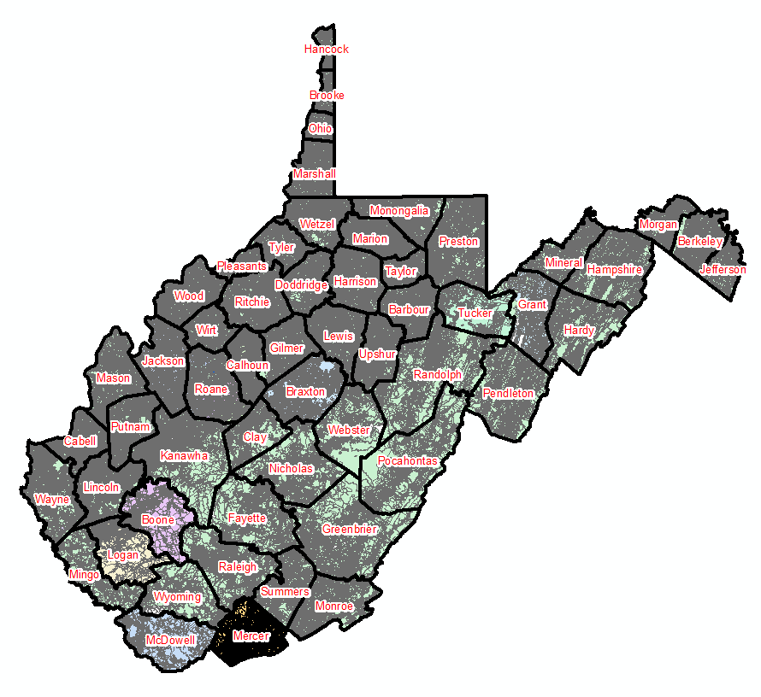
Statewide Digital Parcel File
599 Tax Districts
Estimated $6 Million Value for Statewide Parcel File and Assessment Records
347 Districts
252 Corporations
Digital Parcel Sources
Assessor Offices
E-911 Offices
State Tax Department

Slide 35
Assessment Building Info
West Virginia Parcel Property Class Breakdown for Tax Year 2017
Code | Property Class | # of Parcels | Percent (%)
R | Residential | 1,164,470 | 79.61%
F | Farm | 121,384 | 8.30%
A | Apartment | 3,222 | 0.22%
C | Commercial | 65,784 | 4.50%
I | Industrial | 3,105 | 0.21%
X | Exempt | 97,773 | 6.68%
U | Utility | 192 | 0.01%
Other | Not classified | 6,837 | 0.47%
 |  | 1,462,767 | 100.00%
Assessment records are important for building inventories and are used to estimate the total building exposure ($) and building loss ($) for multi-hazards. Often building inventories and corresponding loss estimates are organized by property class.

Slide 36
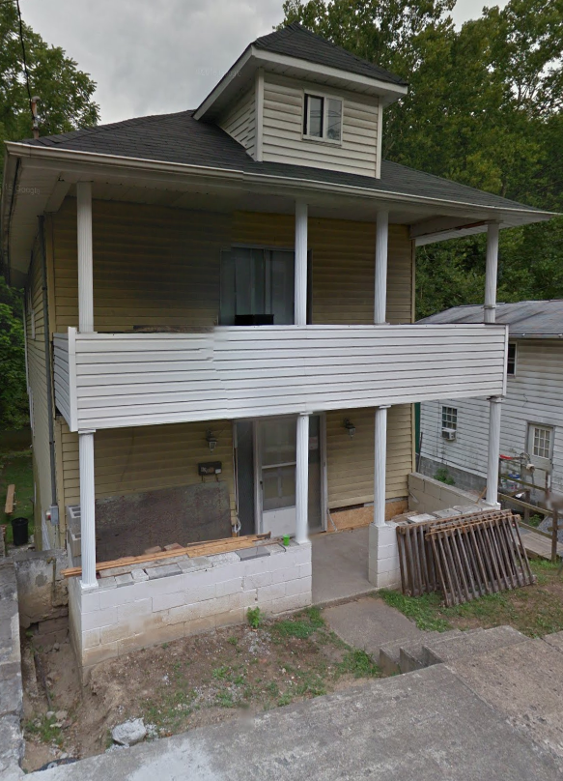
Parcels link to Owner/Building Info
Residential or Farm Property
DESCRIPTION
GIS Parcel ID | 31-10-0029-0130-0000
Legal Description | BL 12-1/2 LOT 10
Acreage (deed) | 0.0373
Tax Year | 2015
Tax Class | 4
Deed Book / Page | 1259 / 45
PROPERTY OWNER(S)
Property Owner(s) | Smith John
629 PENNSYLVANIA AVE, Morgantown, WV, 26501
https://www.mapwv.gov/flood/map/?wkid=102100&x=-8899684&y=4811867&l=13&v=0
BUILDING INFORMATION
Property Class Type | R- Residential
Land Use | 101 - Residential 1 Family
Year Built | 1911
Architectural style | Conventional
Exterior Wall | Aluminum
Stories | 2
Total Rooms | 8
Building Grade | C
Basement Type | Full
Structure Area | 1,320
Building (card) Number | 1
# of main BLDGs (cards) | 1
APPRAISED VALUES
Land Appraisal | $33,200
Building Appraisal | $29,000
Total Appraisal | $62,200

Slide 37
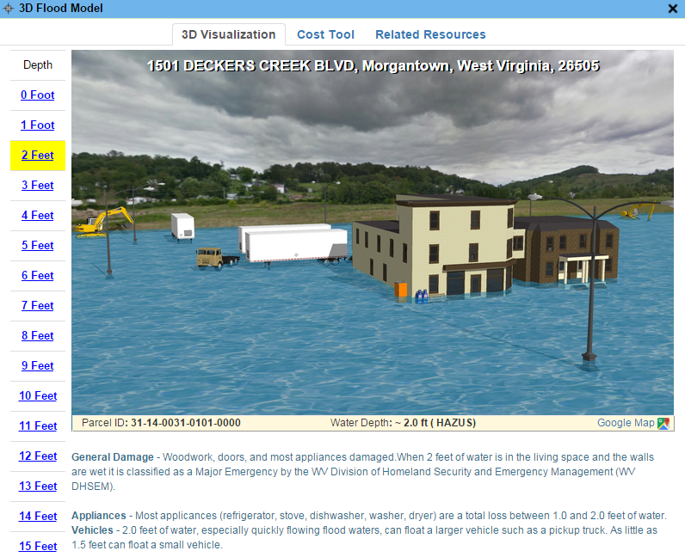
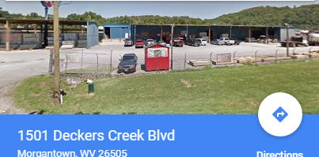
Parcels link to Owner/Building Info
Commercial or Industrial Property
DESCRIPTION | 84 Lumber
GIS Parcel ID | 31-14-0031-0101-0000
Legal Description | 5.0922 AC;SABRATON
Acreage (deed) | 5.09
Deed Book / Page | 1376 / 234
PROPERTY OWNER(S)
Property Owner(s) | SPIRIT SPE PORTFOLIO
1501 DECKERS CREEK BLVD, Morgantown, West Virginia, 26505
https://www.mapwv.gov/flood/map/?v=0&pid=31-14-0031-0101-0000
BUILDING INFORMATION
Property Class Type | C- Commercial
Land Use | 373 - Retail-Single Occupancy
Year Built | 1994
Stories | 2
Exterior Wall | Brick or Stone
Construction Type | Pre-Engineered Steel
Building Grade | D+
Basement Type | None
Business Living Area | 15,255
Cubic Feet | 292,380
Use Type | 34-Retail Store, 82- Multi-Use Office
COST VALUES
Other Bldg/Yard Values | $67,020
Commercial Value | $227,700
APPRAISED VALUES
Land Appraisal | $378,800
Building Appraisal | $294,700
Total Appraisal | $673,500

Slide 38
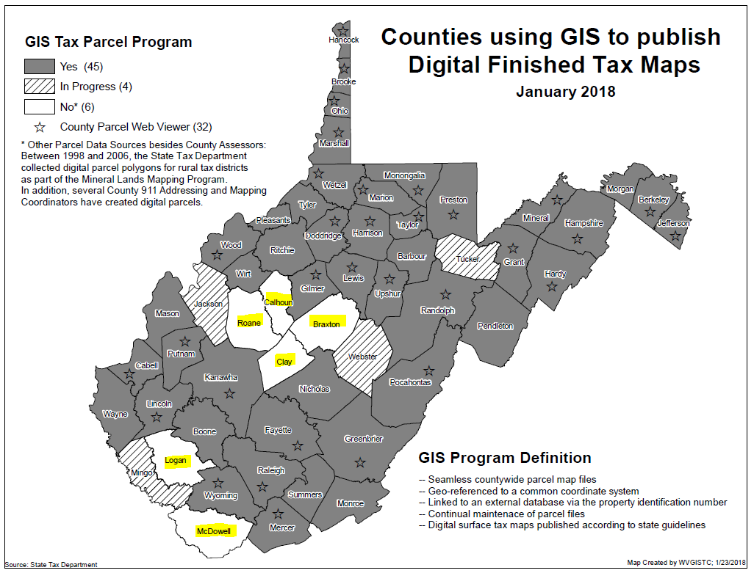
GIS Digital Tax Conversion Status
Six counties need assistance with digital tax map conversion

Slide 39
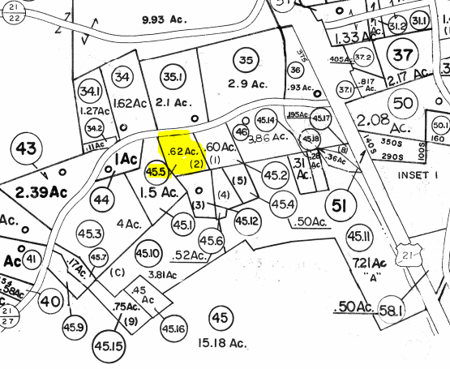
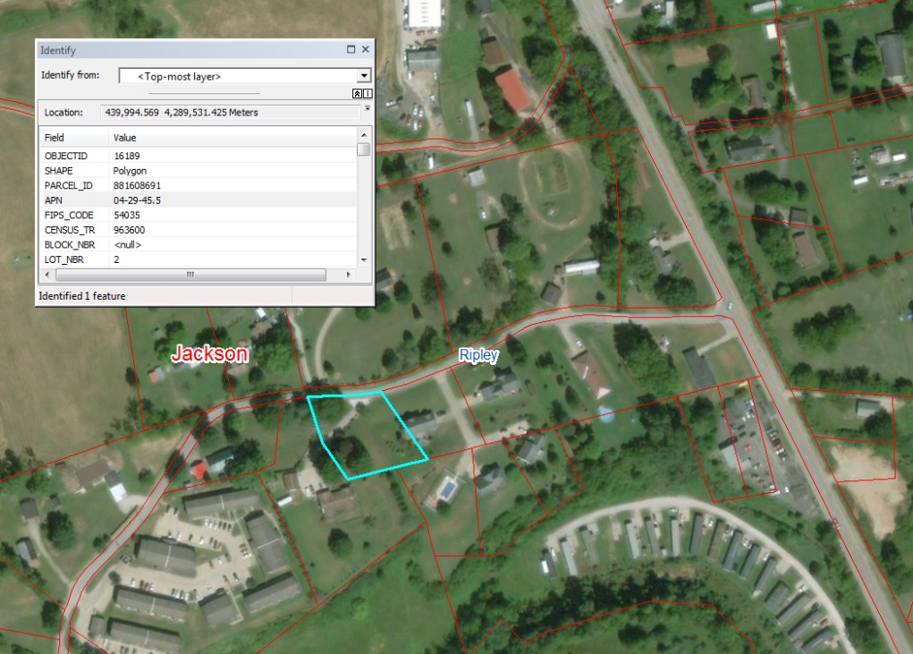
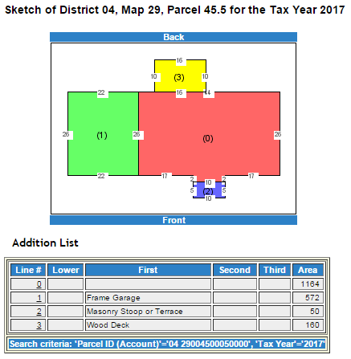
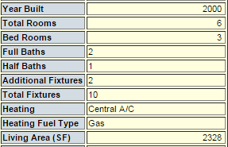
18 Colonial Drive, Ripley, WV
PAPER TAX MAP
(static map)
DIGITAL TAX MAP
(interactive, seamless, aerial photo reference, map link to attributes (property info) and graphics (building sketch)
Parcel
04-29-45.5
Parcel 04-29-45.5

Slide 40
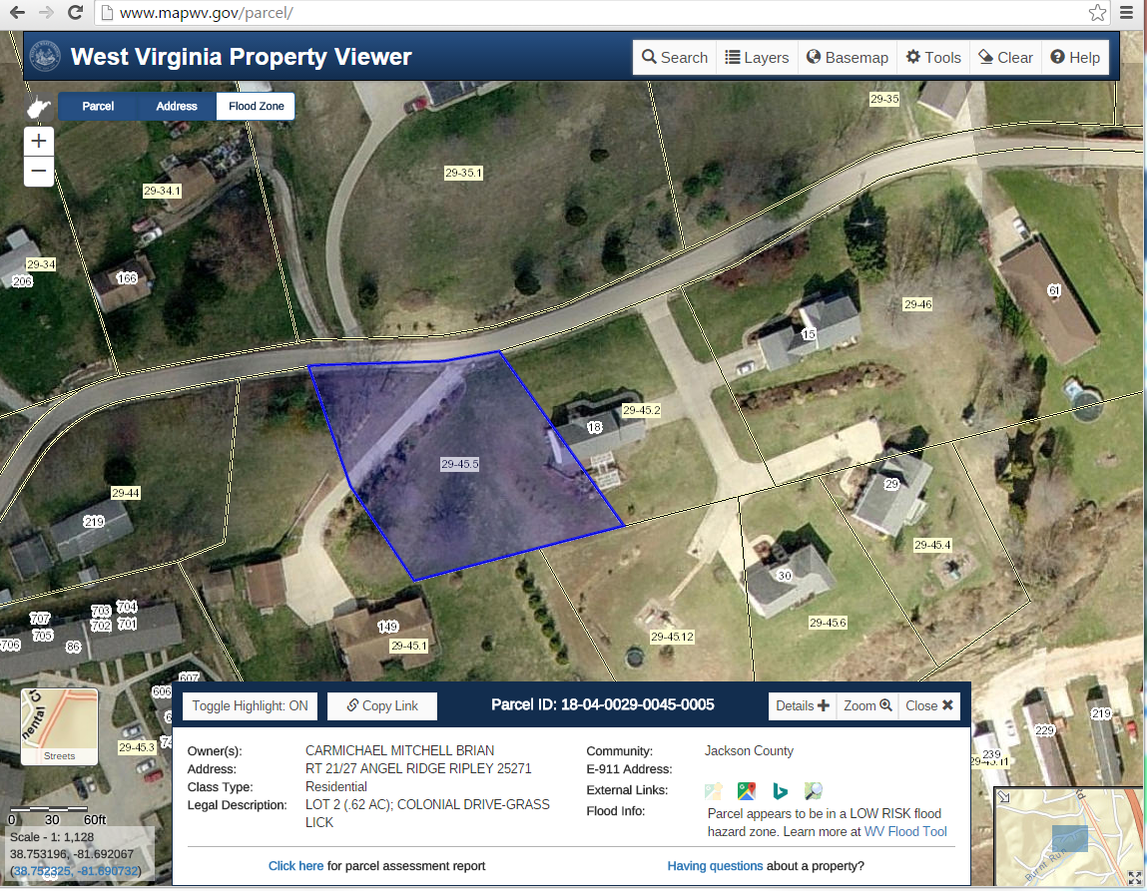
Why Conversion/Re-Mapping Necessary?
Jackson County example
Parcel 29-45.5 not aligned properly with imagery. Should be located with 18 Colonial Dr. structure.
29-45.5
18 Colonial Drive

Slide 41
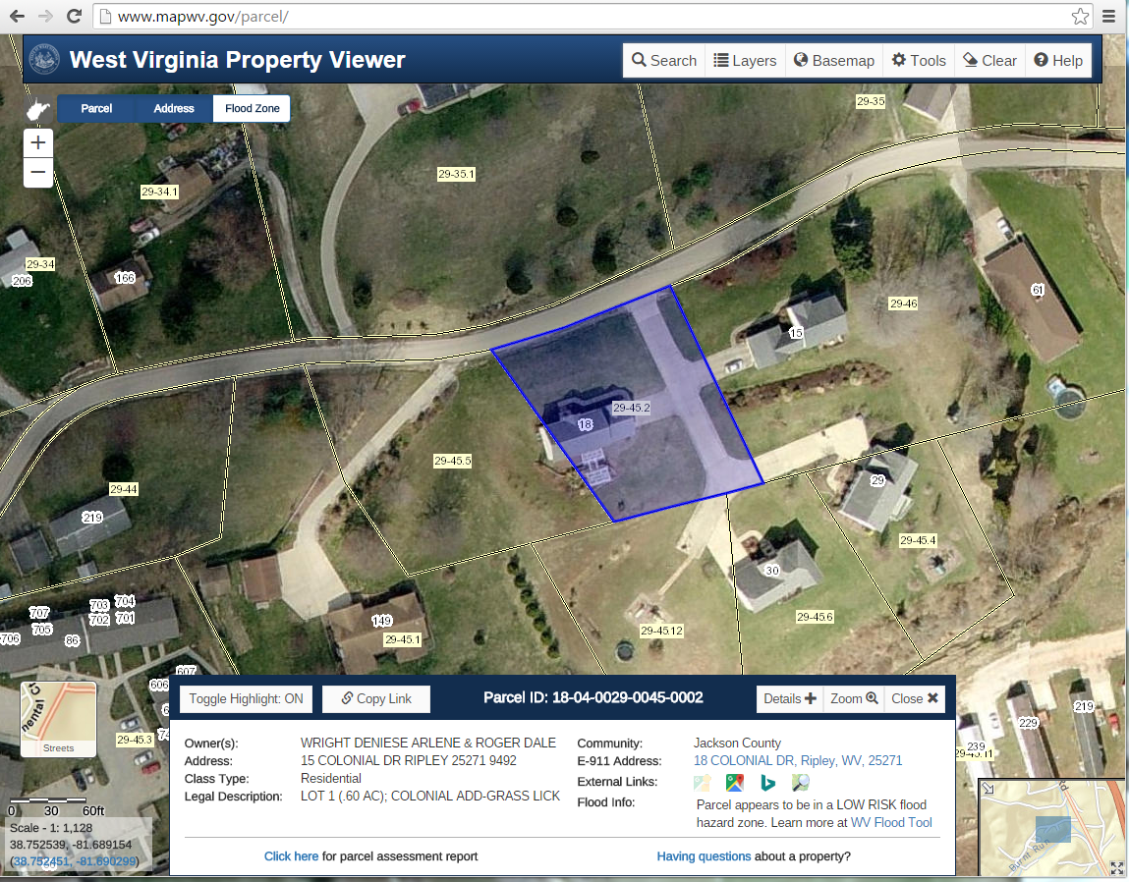
Why Conversion/Re-Mapping Necessary?
Jackson County example
Parcel 29-45.5 should be aligned with structure located at 18 Colonial Drive, Ripley, WV
29-45.5
18 Colonial Drive

Slide 42
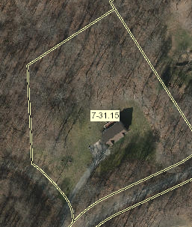
What is in a Parcel Identifier
GIS Parcel ID: 31-05-0007-0031-0015
7-31.15
County | 31 (Monongalia County)
District | 05 (Clinton Tax District)
Map | 7
Parcel Prefix | 31
Parcel Suffix | 15
The GIS Parcel ID is a unique number that is the basis for identifying all parcels in West Virginia. The GIS Parcel ID consists of five elements: County code, District code, Map number, Parcel Prefix, and Parcel Suffix.

Slide 43

WV Property Viewer
Statewide Parcel Application and Web Services
  WV Property Viewer application
  (www.mapwv.gov/property)
  Online Tax PDF Maps
  Web Parcel Reports
  Beneficial for Disaster Assessments

Slide 44


WV Flood Tool Outreach
WV Property Viewer
www.mapwv.gov/property
Charleston WV Billboard Marketing (April 2017)
Which instrument is better for the public discovering the WV Flood Tool – a Billboard Campaign or a Real Estate Property Viewer?

Slide 45


WV Property Viewer (Mobile)
www.mapwv.gov/property
682 Killarney Drive, Morgantown, WV
Mobile Home Page
Zoom to E-911 Address
Toggle Layers of Interest

Slide 46



WV Property Viewer (Mobile)
www.mapwv.gov/property
682 Killarney Drive, Morgantown, WV
Touch Parcel for More Info
View Parcel Attributes
Link to Detailed Report

Slide 47
WV Property Viewer - www.mapwv.gov/property
Developed in collaboration with WV Property Tax Division
Modelled after Tennessee Property Viewer
FEMA/State Hazard Mitigation is a business driver for identifying
flood hazards. Serves as a gateway to WV Flood Tool.
Key Features:
  Statewide parcel attribute searches (e.g., owner name, acreage)
    www.mapwv.gov/assessment (still being built out)
  Integrated with E-911 Statewide Addressing & Mapping System
  General info on all properties (R, F, C, A, I, X, U)
  Counties/State Agencies can link to Statewide Parcel Web Services
    PDF Full-Version Tax Maps
    https://www.mapwv.gov/taxmaps/?m=31-15-0054 (County Code - District No. - Map ID)
    Web Parcel Reports – displays multiple records (e.g., structures)
      http://mapwv.gov/Assessment/?PID=28110039000100000000
Free property viewer for county offices with limited resources
Formal release this summer with 2018 Tax Year data

Slide 48
WV Flood Tool 2018
E-911 Addresses

Slide 49
Statewide E-911 Address & Mapping File
Property Identification for disaster assessments
Address Match Locators – Geocoding
Validate Parcel Addresses
Emergency Service Zone Boundaries
Other uses:
  Fire insurance rates
  Flood insurance discounts
  Broadband, emergency, hazard reduction, and transportation planning

Slide 50


Statewide E-911 Addresses
Address Issues
Missing Address Site Numbers
Wrong Addresses
(98 Graham St. should be 315 Graham St.)
Fairmont, WV
Elkins, WV

Slide 51
WV Address Issues
 | Address Issues |  |  |  | Community Name
 | Missing Address Information |  |  |  | Boone County*(4) – Danville, Madison, Sylvester, Whitesville, Cabel County*, Calhoun County*, Gilmer County (2) – Glenville, Sand Fork, Grant County (1) – Petersburg, Lewis County*, Marion County*(6) – Barrackville, Fairmont, Farmington, Rivesville, White Hall, Worthington, McDowell County (1) – Bradshaw, Mingo County (1) – Williamson, Morgan County*(2) – Bath, Great Cacapon, Pleasants County (1) – Belmont, Pocahontas County*(3) – Durbin, Hilsboro, Marlinton, Putnam County (6) – Bancroft, Buffalo, Eleanor, Hurricane, Poca, Winfield, Summers County (1) – Bluestone, Tyler County (1) – Friendly, Wayne County*, Webster County*(3) – Addison, Camden-On-Gauley, Cowen, Wyoming County (1) - Mullens
 | Counties 9
 | Municipalities 33
 | Incorrect Address Information |  |  |  | Putnam County*
 | Counties 2 |  |  |  | Randolph County (1) – Elkins
 | Municipalities 3 |  |  |  | Roane County* (2) – Reedy, Spencer
 | Misaligned Addresses or Parcels |  |  |  | Hardy County* (1) – Moorefield
 | Counties 1 |  |  |  | Jefferson County (1) – Shepherdstown
 | Municipalities 3 |  |  |  | Randolph County (1) – Womelsdorf
* Address issues with the entire county

Slide 52
WV Flood Tool 2018
Leaf-Off Imagery

Slide 53


Leaf-Off Aerial Imagery Web Service
https://services.wvgis.wvu.edu/arcgis/rest/services/ImageryBaseMaps/wv_aerial_photos_mixed_resolutions_wm/MapServer?f=jsapi
32 Counties have provided leaf-off imagery for State Imagery Web Service
2018 Mercer County
Aerial Imagery

Slide 54

Aerial Imagery
58% of the counties have acquired leaf-off imagery since 2010
What is the cost?
$70 per square mile for aerial imagery
Ideally, leaf-off imagery should not be older than 5 years. Imagery is important for identifying at-risk structures and accurate disaster mapping.

Slide 55
WV Flood Tool 2018
Elevation

Slide 56


Statewide Elevation Layers
Elevation Grids, Hillshade Grids, Contours, used for Flood Depths, Imagery Orthorectification
Layer | Source | Coverage
SAMB | 2003 SAMB, 3-meter, 10-foot contours | Statewide
Lidar | Lidar, 2-foot or 1-foot contours | Select Areas
SAMB ELEVATION
WV DEP SAMB-Lidar Hillshade
LIDAR ELEVATION

Slide 57

High Resolution Elevation
New FEMA LiDAR Elevation Data is 10x better than 2003 Statewide Elevation Data Set
SAMB Elevation
10 FT Contours
FEMA LiDAR
1 FT Contours

Slide 58


FEMA Hi-Resolution Elevation Data
(QL2 LiDAR - 1 Ft Contours)
Elevation data can be accessed through State Data Clearinghouse - www.mapwv.gov/lidar
Possible Fall 2018 LiDAR Acquisitions (Blue Circles)

Slide 59
WV Flood Tool 2018
Floodplain Management

Slide 60
Flood Zone: < zone designation >
Status # | Flood Risk Zone Designation | Message | Flood Degree Risk | Color Warning Status
1 | AE, AH (5), AO (2) | Location is WITHIN the FEMA 100-year floodplain. | High | Red
2 | AE (Floodway) | Location is WITHIN the FEMA 100-year floodplain and floodway. | High | Red
3 | A | Location is WITHIN the FEMA 100-year floodplain. | High | Red
4 | A (Advisory A) | Location is WITHIN the FEMA 100-year floodplain. Advisory Flood Heights available. | High | Red
5 | Updated AE Floodplain Boundary | Location is WITHIN an updated detailed floodplain boundary but NOT a FEMA 100-year effective floodplain. | High | Orange
6 | Advisory A | Location is WITHIN an advisory floodplain but NOT a FEMA 100-year effective floodplain. | High | Orange
7 | Shaded X | Location is WITHIN a moderate flood risk hazard such as a FEMA 500-year floodplain. | Moderate | Yellow
8 | Near Flood Zone | Location is NOT WITHIN identified flood hazard area, but within 75 feet of an identified flood hazard area. | Moderate | Yellow
9 | Out of Flood Zone | Location is NOT WITHIN any identified flood hazard area. Unmapped flood hazard areas may be present. | Low | Green
Three Degrees of Risk: High, Moderate, Low. Four Warning Status Colors: In 100-YR Effective Floodplains (red), Advisory A/Updated AE Floodplains (orange), moderate risk or close to high risk zones (yellow), low risk (green). Three Stacked Floodplain Boundary GIS Files: (1) 100-YR NFHL effective, (2) 100-YR Advisory A-Updated AE, (3) 500-YR NFHL Effective

Slide 61
Flood Zone Determination Sequence
HIGH:
100-YR Effective Floodplain
HIGH:
Advisory A or Updated AE Floodplain
MODERATE:
500-YR Effective
Floodplain
MODERATE:
Within 75-ft of Flood Zone
LOW:
Not in Flood Zone
Flood zone determination sequence important for programming logic
WV Flood Tool first checks query location for High Risk flood zones, then Moderate Risk flood zones.

Slide 62

AFH Proposed Schedule

Slide 63

Flood Zone – Structure in Advisory A
Parcel ID: 33-01-0010-0033-0000
https://www.mapwv.gov/flood/map/?wkid=102100&x=-8698746&y=4815674&l=12&v=2
Structure is WITHIN an Advisory A Floodplain but NOT a FEMA 100-year effective floodplain. Parcel ID 33-01-0010-0033-0000 in Morgan County, WV.

Slide 64




Flood Zone – Structure in Advisory A
Parcel ID: 33-01-0010-0033-0000
Google Street View
Flood Visualization
Web Parcel Report
Flood Zone Map
http://www.mapwv.gov/Assessment/?PID=33010010003300000000

Slide 65


Advisory A Zones – Outreach Information
R
Regulatory IN and Advisory A OUT
Regulatory OUT and Advisory A IN
Both Regulatory
& Advisory
(No Change)
Effective Regulatory Floodplain
Advisory A Floodplain
Union | Meaning | Building Changes | Area Changes
No Change | IN both Regulatory and Advisory A | 1 | 11 m²
Advisory A Only | Regulatory OUT and Advisory A IN | 2 | 13 m²
Regulatory Only | Regulatory IN and Advisory A OUT | 4 | 21 m²
The geographic union of Regulatory and Advisory Floodplains generates a change polygon for flood risk analysis by area. Subsequently the union polygon can be intersected with site-specific structures to analyze the impact of the Advisory Floodplain changes to the Regulatory Floodplain.

Slide 66

Proposed Flood Studies

Slide 67

Flood Zone – Updated AE
Parcel ID: 19-07-0018-0026-0000
http://www.mapwv.gov/flood/map/?v=1&pid=19-07-0018-0026-0000
Structure is WITHIN an Updated AE Floodplain Boundary but NOT a FEMA 100-year effective floodplain. Parcel ID 19-07-0018-0026-0000, Address: 288 OUR LN, Kearneysville, WV, 25430. Opequon Creek in Jefferson County, WV.

Slide 68




Flood Zone – Updated AE
Parcel ID: 19-07-0018-0026-0000
Google 3D View
https://goo.gl/maps/AQACNLC4XD62
Flood Visualization
Web Parcel Report
Flood Zone Map
http://www.mapwv.gov/Assessment/?PID=19070018002600000000

Slide 69
Updated Floodplains - Building Counts
100-YR Flood (High Flood Risk)
 | (A) |  | (B) | (A+B) | (C) | (B+C) | (A+B)-(B+C)
FLOOD ZONE | ONLY Effective |  | BOTH Effective & Advisory A | SUM Effective | ONLY Advisory A | SUM Advisory A | Net
Approximate A Zone | 20 |  | 352 | 372 | 10 | 362 | +10
 | (A) |  | (B) | (A+B) | (C) | (B+C) | (A+B)-(B+C)
FLOOD ZONE | ONLY Effective |  | BOTH Effective & Update AE | SUM Effective | ONLY Updated AE | SUM Updated AE | Net
Detailed AE Zone | 10 |  | 400 | 410 | 21 | 421 | -11
500-YR Flood (Moderate Flood Risk)
500-YR |  |  |  | 45

Slide 70
Flood Height: < Value >
Status # | Flood Height Designation | Flood Zones | Message on Flood Query Results Panel | More Info Link on Flood Query Results Panel
1 | Advisory Flood Heights | A Zones Flood Zone Statuses 4 & 6 (Refer to Flood Zone Slide) | FLOOD HEIGHT: About < value> ft. (AFH) | Advisory Flood Heights (AFH) for Approximate A Zones: CAUTION CAUTION!! The advisory flood height should be used with caution in the proximity of a culvert, bridge, flood control structure or other impoundment since stream crossings were not included in the hydraulic analyses for approximate floodplains. Also, if the site is close to the confluence with a larger stream, compare the advisory flood height at the location of interest to the advisory flood height or Base Flood Elevation on the larger stream to determine whether the site is within the backwater influence of the larger stream. More information: http://www.mapwv.gov/flood/content/documents/AFHhandout.pdf Restudy and Non-Restudy AE Zones: To validate base flood elevations refer to the Flood Profiles and Flood Elevation Tables in the FIS Report. Vertical Datum: The vertical datum of all flood height values in West Virginia is NAVD 88 except for McDowell county is NGVD 29.
2 | Base Flood Elevation (Restudy) Upper Mon Watershed only | AE Zones Flood Zone Statuses 1 & 2 | FLOOD HEIGHT: < value> feet (BFE)
3 | Base Flood Elevation (Non-Restudy) | AE Zones Flood Zone Statuses 1,2,7 | FLOOD HEIGHT: Refer to FIS report for BFE
4 | No Flood Height Information | Flood Zone Statuses 3, 5, 8, 9 | FLOOD HEIGHT: N/A
Invisible Composite Query Rasters for flood height values of Water Surface Elevation Level (WSEL) layers: Effective Base Flood WSEL Grid (WSEL_BFE_01pct_1m-cell.grid) and Advisory Flood Height WSEL Grid (WSEL_AFH_01pct_5ft-cell.grid)

Slide 71
Water Depth: about <<value>>
Water Depth | Message | Sources
Water Depth: | About << value >> ft. | Model-Backed Depth Grids Engineering Studies (HEC-RAS) AE Non-Restudy Re-Delineations Other Depth Grids HAZUS EQL USGS Inundation Layers
A statewide “composite” Flood Risk Assessment Depth Grid is created from model-backed
(1) Effective, (2) Advisory A, and (3) Updated AE floodplain boundary depth grids at a 5-foot cell resolution (1.5 meters)
Water Depth Grids are a flood risk assessment product – not a flood regulatory product. Water depths are important for flood loss damages and by flood visualizations of site-specific structures
Depth grids are a source of credits for CRS communities

Slide 72

Jefferson County Composite Depth Grid

Slide 73

Model-Backed Depth Grids
Preliminary “Model-Backed” Depth Grid for 1% Annual Event Flood for all of Jefferson County
Depth grids derived from FEMA 2010 1-meter lidar elevation data
Water Depth important for 3D flood visualizations and flood risk building loss estimates
Communities receive CRS credit for published water depth grids
Jefferson County
Advisory A Depth Grid (AECOM)
Depth Grid from Updated AE Floodplain Boundary (WVU)
Jefferson County: 162 stream miles of Approximate A Zones, 77 miles of Detailed Flood Zones

Slide 74


Statewide Composite WSEL / Depth Grids
Effective Regulatory
Advisory A / Updated AE (new Topo)
Integration
Required

Slide 75
WV Flood Tool 2018
Hazard Mitigation Grant Application
Flood Risk Assessments (283 communities)
Landslide Assessments (55 counties)
Data Development (parcels, addresses, imagery)
Site-specific building-level inventories for hazard exposure and loss estimates
Technical support for (1) Local/State Hazard Mitigation Plans and for the (2) Community Rating System (CRS)

Slide 76





A Statewide Approach to Risk Studies
Multi-Hazard Risk Assessment Proposal
Hazard Mitigation Grant Proposal
Floods Risk (TEIF)
Landslide Risk (TEAL)
Reference Data Development
Identify Site-Specific
At-Risk Structures
Statewide
Budget Breakdown
Notes:
WV Map indicating population density

Slide 77









Hazard Mitigation Grant Proposal
Multi-Agency Coordination
Federal Agencies
State Agencies
Universities
Regional Councils
Local Counties
Private Companies
11 Regional Planning & Development Councils
55 Counties
283 communities

Slide 78

Support for Community Rating System

Slide 79
Support for Community Rating System
Communities with CRS Participation Ranked by CRS Class
Community ID | Community | CRS Class | Flood Insurance Policies
540065 | Jeffereson County | 6 | 158
540282 | Berkeley County | 7 | 181
540226 | Hampshire County | 8 | 177
540199 | City of Buckhannon | 8 | 164
540194 | City of Parsons | 8 | 107
540004 | City of Phillipi | 8 | 78
540006 | City of Martinsburg | 8 | 21
540073 | City of Charleston | 9 | 389
540164 | Putnam County | 9 | 330
540144 | Morgan County | 9 | 131

Slide 80

Statewide Flood Risk Structure File
Various Flood Risk Reports by community, stream name, flood zones, etc. can be generated from the Flood Risk Data (FRD).
Structure-specific (called “User-Defined Facilities”, or UDFs, in Hazus) flood risk assessments produce loss estimates at the building or structure level, and can often help facilitate flood risk discussions with individual home- or business-owners in a community. These types of risk assessments can provide valuable information to communities to help pre-screen properties and projects before going through a more in-depth Benefit-Cost Analysis (BCA). Personally-identifiable information (PII) such as property address, name of owner, etc. will not be included in FEMA's Flood Risk Assessment dataset (S_UDF_Pt and L_RA_UDF_Results). Source: Flood Risk Assessment Guidance - https://www.fema.gov/media-library-data/1469146645661-31ad3f73def7066084e7ac5bfa145949/Flood_Risk_Assessment_Guidance_May_2016.pdf

Slide 81
Site-Specific Building Inventories
BUILDING INVENTORY
Historical Flood Inundation / Flood Registry
NFIP Repetitive Loss
(Internal Use Only)
HAZUS Flood Loss Estimates
Elevation Certificates
Flood Proof or Mitigated Structures
SFHA Building Counts
Levee/Dam Failure Inundation
Studies
Building Inventories important for flood reduction activities

Slide 82

Building Inventories
CRS Activities Requiring Building Inventories
Building Inventories important for flood reduction activities including the NFIP Community Rating System
Source: CRS Coordinator’s Manual
https://www.fema.gov/media-library-data/1493905477815-d794671adeed5beab6a6304d8ba0b207/633300_2017_CRS_Coordinators_Manual_508.pdf

Slide 83


Flood Risk Structures of Martinsburg
Building Flood Loss Damage
57% of Residential Home Damaged at a Loss of $88,834
Flood Risk Building Info
Flood Risk Assessment Building Link
https://www.mapwv.gov/flood/map/?wkid=102100&x=-8678481&y=4788856&l=11&v=2
The Risk MAP view allows for viewing flood loss estimates at the building or structure level for a 1%-annual-chance flood event.

Slide 84

Building Inventories – Deficient Dams

Slide 85


Building Inventories – Deficient Dams

Slide 86

Building Inventories – Deficient Dams

Slide 87

WV Board of Risk & Insurance Management
Building value source for state tax-exempt buildings

Slide 88




3D Flood Visualizations
Visualizations are easier for non-technical users to understand flood risks to their property in feet of water rather than comprehending the adjacent base flood elevation
1-Story Home
Mobile Home
Commercial
      "The 3D visualization is really cool. Our citizen comes to the counter and says 'there is no way there can be a flood like that.' Then we show them how much water you will get in your house and how much it will cost to repair it. The 3d visual is really good! And then we like the way you can click on a parcel ID and it brings up all the information as far as property owner, tax map and parcel number, deed book, page number - everything is right there. And the building information is really good too because it tells what the structure is made of, whether it has a basement - all the information that we would have to go to another system to pull is right there.“ Source: 3D Flood Visualization Comment from Debbie Robinson, Kanawha County Planning and Development Office
2-Story Home
3D flood visualizations are available statewide for locations where flood depth grids exist. The parcel assessment data fields (land use, stories) are necessary to identify the correct property type: residential one- or two-story homes, mobile home, commercial/industrial, etc.

Slide 89


3D Flood Visualizations
Brooke County
https://www.mapwv.gov/flood/map/?v=1&pid=05-07-W22P-0161-0000
1412 Charles St, Wellsburg, WV, 26070, Parcel ID: 05-07-W22P-0161-0000
      “This is the coolest thing ever….thank you!!!”
      Source: 3D Flood Visualization Comment from Terri Jo Bennett, CFM, Upshur County Building Permit, Floodplain and Addressing and Mapping Coordinator
Upshur County
https://www.mapwv.gov/flood/map/?v=0&pid=49-05-0003-0031-0000
673 Vicksburg RD, Buckhannon, WV, 26201, Parcel ID: 49-05-0003-0031-0000

Slide 90


Landslide Risk Assessment
Landslide
Risks
Buildings Exposed to Landslide Risks
Risk Assessment table showing building counts along with estimated replacement costs in landslide zones of concern
Landslide susceptibility map showing generalized USGS map and detailed WVGISTC map

Slide 91


FUTURE DIRECTIONS
Use FEMA’s CRS Program as a performance measure

Slide 92
FUTURE DIRECTIONS
Programming Enhancements
Mobile Flood Tool: Update mobile phone version with new flood hazard information
Flood Query Layers: Update query layers for stream names, HEC-RAS models, and flood profiles
Flood Resource Links: Coordinate with floodplain managers and flood insurance administrators to publish useful links on WV Flood Tool. Resources links can be organized by flood insurance needs. CRS Series 300 (Public Information)
Community Web Resource Links: Link to CRS Activity 350 (General floodplain page)
Detailed Risk Assessments (RiskMAP View): CRS Activity 510 (Floodplain Management Planning)
  Flood Risks: Total Exposure in Floodplains (TEIF). Add building-level Hazus loss estimates for all flood structures located in flood hazard areas.
  Landslide Risks: Total Exposure in Areas of Landslides (TEAL). Add link to new landslide incident and susceptibility maps.
  Dam/Levee Failures: Building inventories for CRS Series 600 Warning and Response activities; CRS 632.a State Dam Safety program credit for communities downstream of high-hazard-potential dams.

Slide 93
FUTURE DIRECTIONS
Flood Layers
New Advisory A: Add Advisory Flood Heights (AFH) for Barbour and Boone counties. CRS element 512.a. (Floodplain Management Planning)
News Depth Grids: Credit under CRS element 322.d. (Map Information Service)
  Countywide HEC-RAS Depth Grid: Finalize “model-backed” depth grid for Jefferson County.
  Flood 2016 Depth Grid: Add USGS flood inundation depth grids from high water marks/terrain for 2016 flood areas. (Also CRS element 322.f credit)
Historical Flood Data: Credit under CRS element 322.f
  USGS High Water Marks for previous disasters
Elevation Certificates: Publish Flood Elevation Certificates for interested floodplain managers. Coordinate effort with Community Rating System (CRS) program.
  Building elevation data on a website is credited under CRS Activity 350 (Flood Protection Information) and having it on a GIS is credited under Activity 440 (Flood Data Maintenance).
Update Buyout Properties: CRS Activity 520 (Acquisition and Relocation) and CRS 422.b (Open Space Deed Restrictions)

Slide 94
FUTURE DIRECTIONS
Reference Layers
Aerial Imagery: Add new 2018 county aerial imagery for 20 counties
Parcels: Secure HMGP funding for select county assessor offices to convert from manual to digital parcel maintenance systems CRS Activity 440 (Flood Data Maintenance); CRS 420 (Open Space).
Addresses: Provide technical support for E-911 Addressing Offices to correct missing or incorrect addresses in high risk flood zones. CRS Activity 330 (Outreach Project – print out addresses of all properties in floodplain)
Elevation: Add New Hi-Resolution Topography. Capitalize on FEMA’s considerable investment in high-resolution topography by incorporating one-meter resolution digital elevation models and one-foot contours in WV Flood Tool. (CRS Activity 440)
Wetlands and Soils: CRS Activity 440

Slide 95
WV Flood Tool Updates
March 2018 Updates
Flood Zones
  Revised 9 Flood Zone Categories in Flood Query Results Panel
  Added preliminary Updated AE Floodplain Boundaries for Jefferson County and Clear Fork, Wyoming County.
  Uploaded the most current and official National Flood Hazard Layers (NFHL)
    Cleaned and further processed NFHL for cartography and flood queries (e.g., flood zone, panel index number, community information)
    Added 500-YR floodplain boundaries and flood zone labels to EXPERT View map
  Added “orange” color high-risk flood zones to the PUBLIC View for Advisory A and Updated AE floodplain zones that exist but are NOT in a FEMA 100-year effective floodplain
Flood Heights
  Display Base Flood Elevations (BFE) in the Flood Query Results Panel for the preliminary Upper Monongahela Watershed Restudy
  Increased resolution of statewide composite Advisory Flood Height layer from 10-ft to 5-ft grid cells Advisory Flood Height layer from 10-ft to 5-ft grid cells
Depth Grids
  Created a new statewide composite depth grid of 5-ft cell resolution that incorporates all depth grids from Restudies, Advisory Flood Height studies, and Updated AE floodplain boundary redelineations
  For Jefferson County published preliminary countywide “model-backed” depth grid for 100-year floodplains
New flood data and updated query programming logic

Slide 96
WV Flood Tool Updates (cont.)
March 2018 Updates
Community and CRS Class
  In Flood Query Results Panel added Community Name, Community Identifier, and CRS Class
  Added FEMA’s community boundaries as a reference layer
Elevation
  Added a more current, accurate 10-ft resolution elevation grid from the best available topographic sources to include LiDAR data
  Provide a metadata link about the elevation source based on the queried location
Parcel Reference Layer
  Added parcels from the best available sources for all 55 West Virginia counties
  Created web links for all the full-version tax maps (n = 22,875) for all 55 West Virginia counties. The full-version PDF tax maps are the authoritative source for digital parcels.
Aerial Photography Base Layer
  Added new 2017 leaf-off aerial photography for Kanawha County
Map Functions
  For selected location added external viewer links to Google Street View, Google Maps, Bing Maps, and OpenStreetMap
  Includes a new map function that allows users to add GIS files or web services to the WV Flood Tool

Slide 97







Flood Tool Development Team
Xiannian Chen
Lead Programmer
Jim Schindling
Database Programmer
Kurt Donaldson
Manager
  WV GIS Technical Center
  West Virginia University
  Morgantown, WV
  http://wvgis.wvu.edu
Kevin Kuhn
GIS Analyst / Address-Parcel Specialist
Frank LaFone
Systems Administrator
Eric Hopkins
GIS Analyst / Flood Risk Specialist
Yibing Han
GIS Programmer
Maneesh Sharma
GIS Analyst / Flood Risk Specialist

Slide 98
Contact Information
  WVU GIS Technical Center
  Kurt Donaldson, GIS Manager
  kurt.donaldson@mail.wvu.edu, phone: (304) 293-9467
  Eric Hopkins, GIS Analyst
  Eric.Hopkins@mail.wvu.edu, phone: (304) 293-9463
  Maneesh Sharma, GIS Analyst
  Maneesh.Sharma@mail.wvu.edu, phone (304) 293-9466

