Slide 1
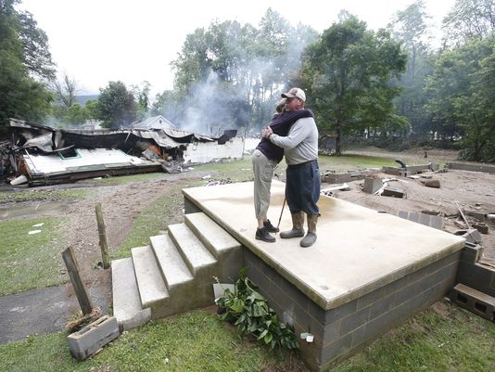
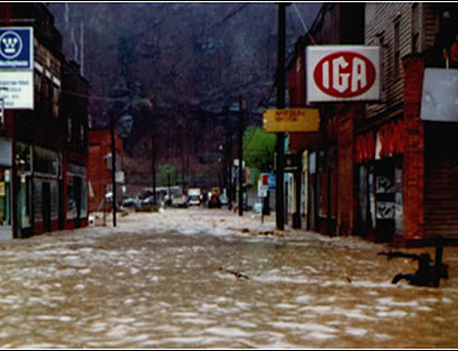
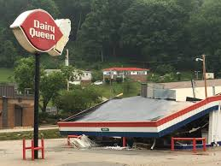
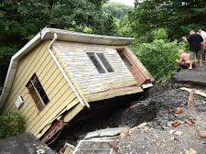
West Virginia Statewide Flood Risk Assessment
Kurt Donaldson, GISP, CFM Manager WV GIS Technical Center West Virginia University kdonalds@wvu.edu September 2019
Devastating 2016 June Flood

Slide 2
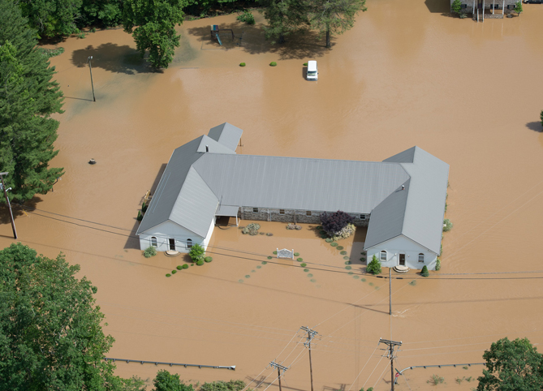
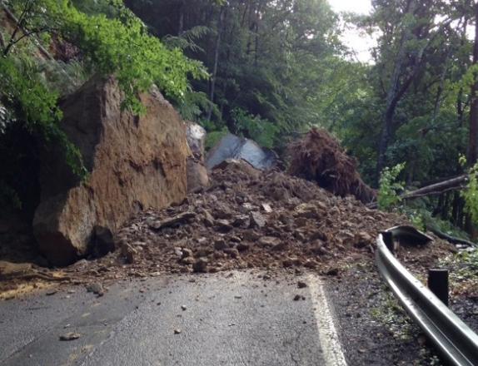
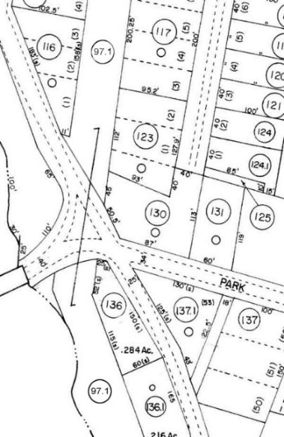
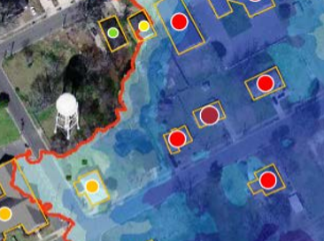
A Statewide Approach to Risk Studies Multi-Hazard Risk Assessments
Hazard Mitigation Grant Project
Floods Risk (TEIF)
Landslide Risk (TEAL)
Reference Data Development
Inventory Building-Level Flood-Risk Structures
Statewide
Budget Breakdown
Notes:
WV Map indicating population density

Slide 3
Flood Risk Development Team
Full and Part-Time Staff
Xiannian Chen GIS Programmer
Jim Schindling Database Programmer
Kevin Kuhn GIS Analyst / Address-Parcel Specialist
Frank LaFone Systems Administrator
Kurt Donaldson Manager
WV GIS Technical Center West Virginia University Morgantown, WV http://wvgis.wvu.edu
Maneesh Sharma GIS Analyst / Flood Risk Specialist
Kevin Shrader GRA Building Inventory, Flood Visualization
Yibing Han
GIS Programmer
Eric Hopkins GIS Analyst / Flood Risk Specialist
Behrang Bidadian GRA
Shelter Models

Slide 4
Flood Risk Projects & Contacts
Year | Activity | Contact | Organization
2003 | DFIRM Map Preparation | Lee Brancheau | FEMA Region III
2006 | WV Flood Tool - Genesis | Robert Perry | State NFIP Coordinator
2011 | WV Flood Tool - Continued Development | Kevin Sneed | State NFIP Coordinator
2013 | WV Flood Tool - Flood Mapping Development | Bob Pierson | Region III
2015 | Hazus-MH Flood Model Building Inventory Tool | Cynthia McCoy Kevin Mickey | FEMA Region III (now Region X) The Polis Center, IUPUI
2016 | Pilot County Risk Assessments published | Kevin Mickey | The Polis Center, IUPUI
2018 | Statewide Multi-Hazard Risk Assessment Project (3-years) - HMPG Project | Brian Penix | WV State Mitigation Office
2018 | Risk Assessment Project Coordination | Will Melville Matt McCullough | FEMA Region III
2018 | ArcGIS Python Script Alternative to the Hazus-MH Flood Model for User-Defined Facilities | John Bauer | Oregon Geological Survey
2019 | OpenHazus Flood Assessment Structure Tool | Jordan Burns Ujvala Sharma | NIYAMIT / FEMA Hazus Team
2019 | Hazus Short-term Shelter Needs Methodology | John Harrald | George Washington University, Professor Emeritus
WV GIS Technical Center involved with FEMA Flood Risk Projects since 2003

Slide 5
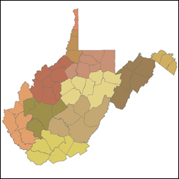
Hazard Mitigation Grant
Multi-Agency Coordination
Federal Agencies
State Agencies
Universities
Regional Councils
Local Counties
Private Companies
11 Regional Planning & Development Councils
55 Counties
232 municipalities

Slide 6
Statewide Flood Risk Assessment
Support for…
Local/State Hazard Mitigation Plans
Floodplain Management Activities
Community Rating System (CRS) Activities
Community Assisted Visits
Flood Event Modeled
Riverine 1% Annual Chance Flood Event for ALL Structures
Regulatory and Non-Regulatory High Risk Flood Zones
Estimate 100,000 structures in West Virginia
Riverine .2% Annual Event for Essential Facilities
Detailed Building Inventories
Key Reference Layers: parcels, assessment attributes, E-911 address points, leaf-off imagery, building footprints, community boundaries
User Defined Facilities Enhanced for spatial and attribute accuracy
Flood Risk Assessment GIS (FRAGIS) Database
State-level integration
Identifies GIS Data Gaps or Deficiencies

Slide 7
WV Flood Risk Assessment
Statewide Depth Grid
Composite Depth Grid of best available sources to include:
Model-Backed HEC-RAS Depth Grids or Statewide 2010 Hazus Level-1 Depth Grid
Flood Model Software and Programs
FEMA’s OpenHazus FAST (Flood Assessment Structure Tool) and other customized programming scripts.
Most model outputs at the Building Level: Damage Loss, Debris Removal, Population Displacement
Outputs: Analytics / Reports / Publish Online
Community and Building-Level Reports/GIS Files
State GeoPlatform (WV Flood Tool - www.mapWV.gov/Flood)
3D Flood Visualizations
Field Verification & Community Engagement
Field verification of model inputs (building stock) and model outputs
Iterative process of improving Flood Risk Assessment GIS

Slide 8
Building-Level Flood Risk Assessments
Building-Level Flood Risk Assessments support:
Hazard Mitigation Plans
Floodplain Management
Community Assisted Visits
Community Rating System
MODEL INPUTS
Flood Studies Depth Grids Building Stock
BUILDING INVENTORY & ACCURACY IMPROVEMENTS
Building Location
Building Attributes
COMMUNITY ENGAGEMENT & FIELD ACCURACY CHECKS
Floodplain Managers
Local Govt. Officials
Benefits
More detailed and accurate assessments
Automated scripts generate outputs quickly
Cost savings through efficiencies
Helps multiple stakeholders
Comprehensive Building Risk Database
Building-Level Assessment Cycle
MODEL OUTPUTS
Building Level Community Level
3D Visualizations
Published to WV Flood Tool
Methodology
Consistent methodology statewide
Semi-automated workflows
Continuous cycle to improve and update assessments

Slide 9
Statewide Flood Risk Assessment
Model Data Inputs
GIS Reference Data
Community Boundaries
Parcels/Assessment Attributes (Building Stock)
E-911 Addresses (Building Stock)
Leaf-Off Aerial Imagery (Building Stock)
New Elevation Data
Driver for Flood Studies (new flood zone boundaries)
Depth Grids and WSEL Grids
Ground Elevation: 1-ft contours, 1-m DEM
MODEL INPUTS
Flood Studies Depth Grids Building Stock

Slide 10
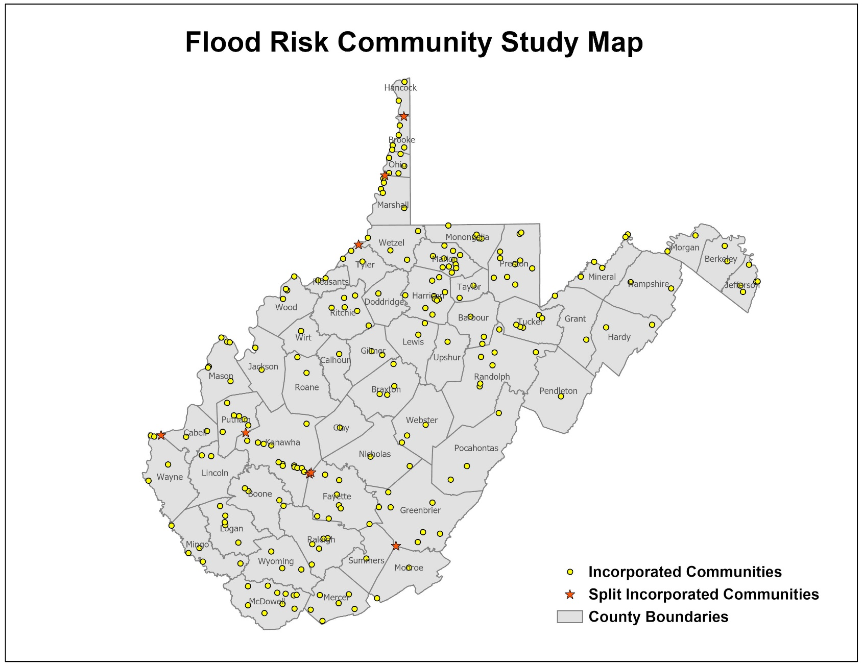
Community Boundaries / Statistical Units
232 incorporated areas
+55 unincorporated areas 287 Communities + 8 split communities 295 Statistical Geographies
295 Statistical Geographies form 287 Communities which form
55 Counties which form
11 PDC Regions which form
1 Statewide Flood Risk Assessment
95% of WV Municipalities have Special Flood Hazard Areas (SFHA)

Slide 11
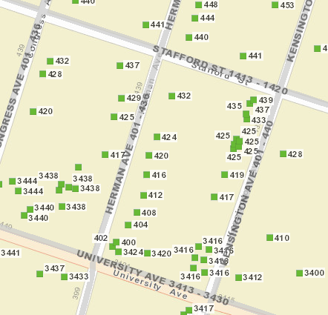
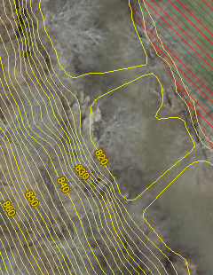
GIS Data Development
Parcels Site Addresses Aerial Imagery Elevation
Migrate six counties from paper to digital parcels
Flood-risk communities with missing or incorrect E-911 addresses
County Leaf-off imagery no older than 5 years
Statewide 1-meter DEM and 1-ft. contours. Flood Studies, Depth & WSEL Grids
Improving State’s Spatial Data Infrastructure

Slide 12
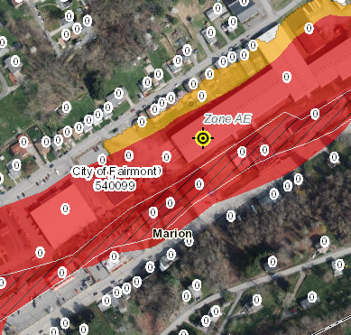
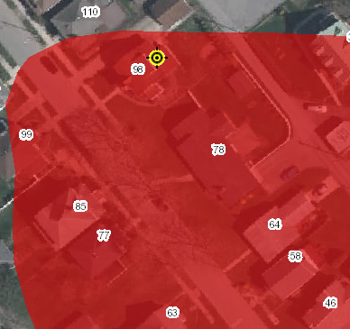
Statewide E-911 Addresses
Address Issues
Missing Address Site Numbers
Wrong Addresses (98 Graham St. should be 315 Graham St.)
Fairmont, WV
Elkins, WV

Slide 13
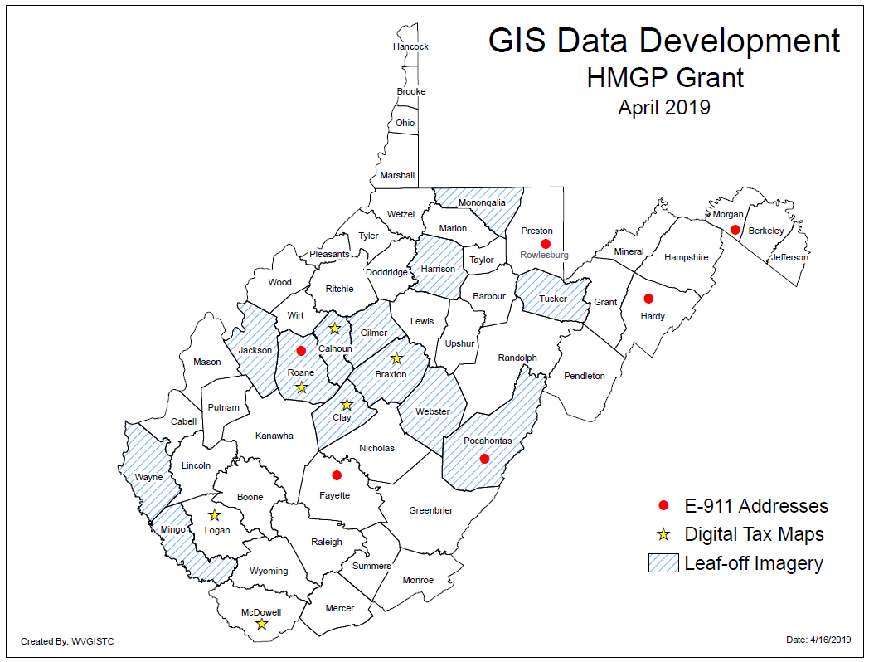
Counties benefiting from HMGP

Slide 14
Communities benefiting from HMGP
GIS Data Development Costs associated with Statewide Multi-Hazards Project
GIS Data Development Contracts | # Local Govt. Projects | # Signed MOUs | Vendor | Local Govt. Cost Share | Cost Share Type | FEMA Grant Dollars Obligated | TOTAL COST
E-911 Addresses | 7 | 7 | Atlas Geographic Data | $81,629 | In-Kind (field validation) | $75,520 | $156,149
Digital Tax Maps/Parcels | 6 | 6 | Atlas Geographic Data | $27,474 | In-Kind (imagery) | $235,533 | $263,007
Leaf-Off Imagery | 13 | 13 | Blue Mountain / Thrasher | $205,536 | Dollars ($) | $56,958 | $262,494
TOTAL | 26 | 26 |  | $314,639 (40%) |  | $437,991 | $752,630
FEMA
$$$
WV DHSEM
WVU
Procurement Services
Vendor Contracts
Counties
Assessor and E-911 Offices
Grantor
Recipient
Sub-Recipient
Statewide Contracts
Communities

Slide 15
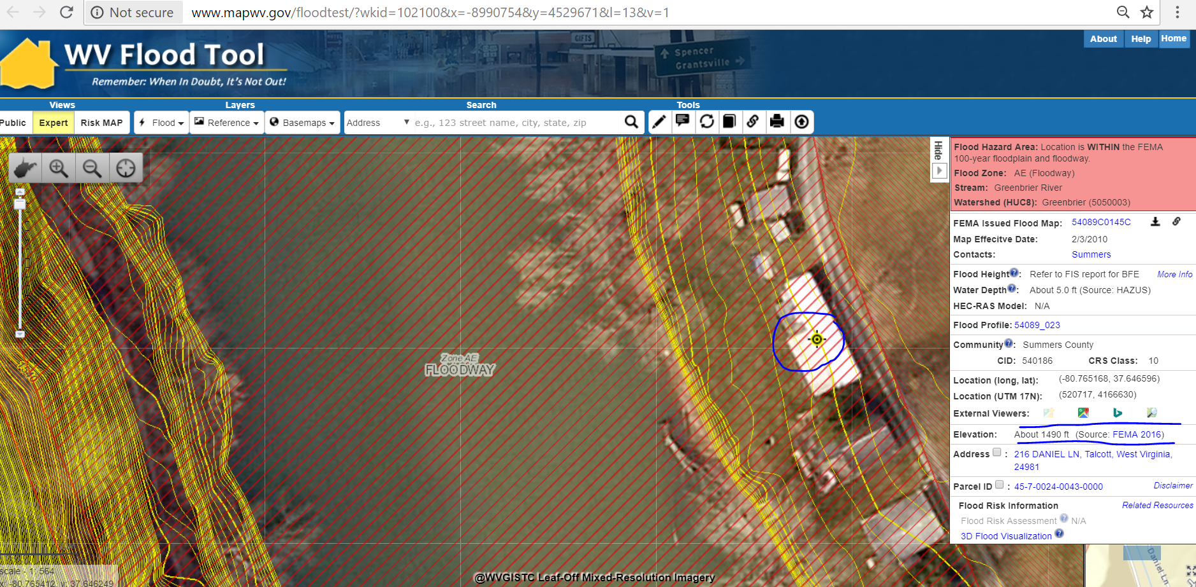
LiDAR-Derived 1-FT Contours
The WV Flood Tool Allows Users to View:
Ground Elevation 1-M DEM Value/1-Ft. Contour, Water Depth, and Flood Height (WSEL) if available
Source: FEMA 2016
FEMA-purchased elevation data can be accessed through State Data Clearinghouse www.mapwv.gov/lidar or the U.S. Geological Survey’s The National Map

Slide 16
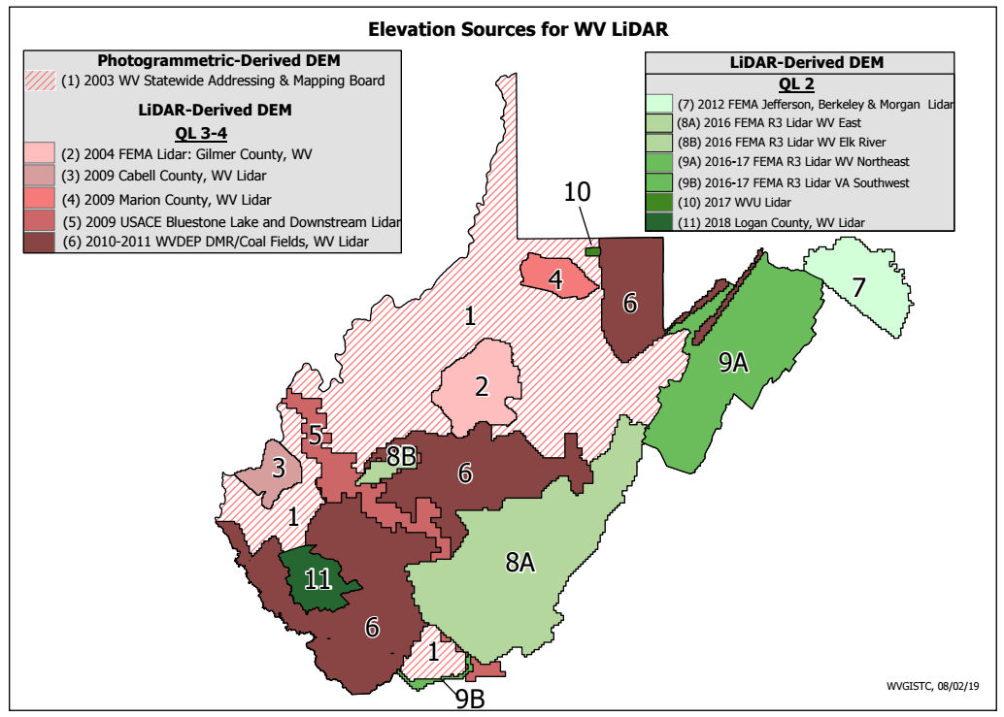
Elevation Source
Source: FEMA 2016
Source Table
Source Graphic
WV Elevation Source Listing and Graphic: https://www.mapwv.gov/floodtest/docs/WV_FloodTool_ElevationSource_Metadata.pdf

Slide 17
Statewide Flood Risk Assessment
Building Inventory & Accuracy Improvements
Building Inventory Objectives
Identify Primary Structures points
Verify Building Identification
E-911 Address
Parcel geometry and assessment record
Aerial and StreetView Images
Building Sketches (parcel assessment record)
Determine Building Characteristics (Occupancy Class, Cost, Basement, Foundation Type, Stories, Area, etc.)
Default Characteristics derived from Assessment Records
Overriding Modified Building Characteristics from user-defined values
Ensure Building Point in most Restrictive Flood Zone
Iterative Process and QC to make more accurate
Record Data Issues and Data Gaps
BUILDING INVENTORY & ACCURACY IMPROVEMENTS
Building Location
Building Attributes

Slide 18
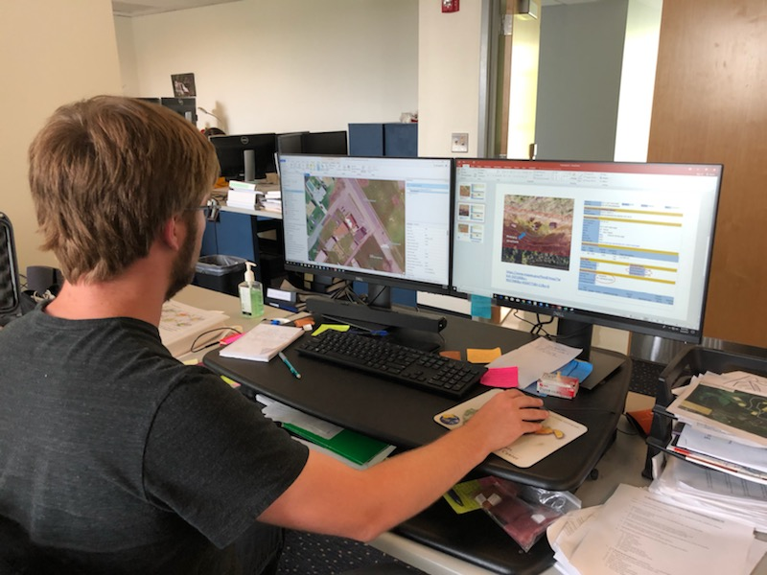
Building Inventory
GIS Specialist conducting Building Inventory

Slide 19
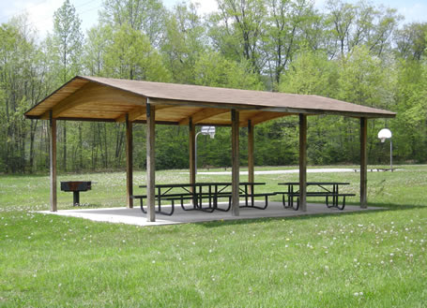
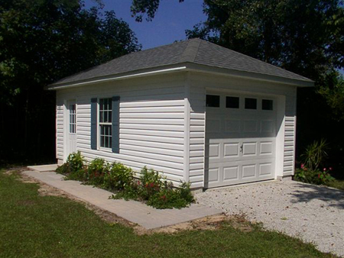
Primary Structure: Not a Building
CRS Manual Page 300-5
“Not a Building”
Open pavilions, carports, underground pump stations, trailers, etc. are not buildings
Accessory structures are not counted
All primary structures in high-risk flood zones are inventoried.
Critical infrastructure in moderate-risk flood zones also inventoried.

Slide 20
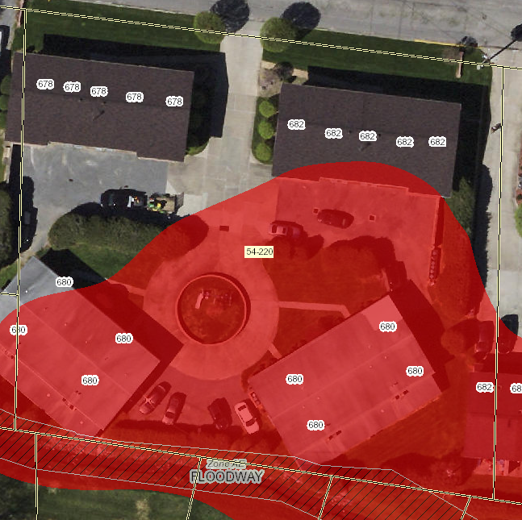
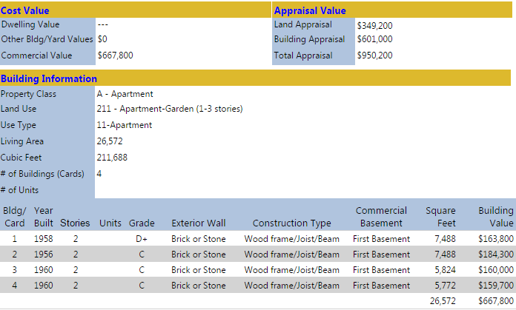
Multiple Structures in a Single Parcel
Single Building Point for Multiple Buildings on a Single Parcel/Assessment
Outbuildings and detached structures associated with a Primary Structure as a single point that correlates with Building Appraisal Value.
Multiple buildings associated with commercial, industrial, or agricultural sites are identified as a single Primary Structure point if all structures are in the flood zone and can be correlated with Total Building Appraisal Value in Assessment Report.
Multiple Building Points in Single Parcel/Assessment (see example below – 4 Apt. Bldgs.)
Points are associated with each Primary Structure in Flood Zone. Associated Model Input Parameters (Cost, Area, Occupancy Class, etc.) are recorded as separate building records. 3 apartments below are primary.
682
PID: 31-15-0054-0215-0000
Flood Tool Assessment Report
680B
680A
682
680A
680B
Flood Tool Map View
The Web Parcel Assessment Reports provide a breakdown of individual building values and characteristics in single parcel

Slide 21
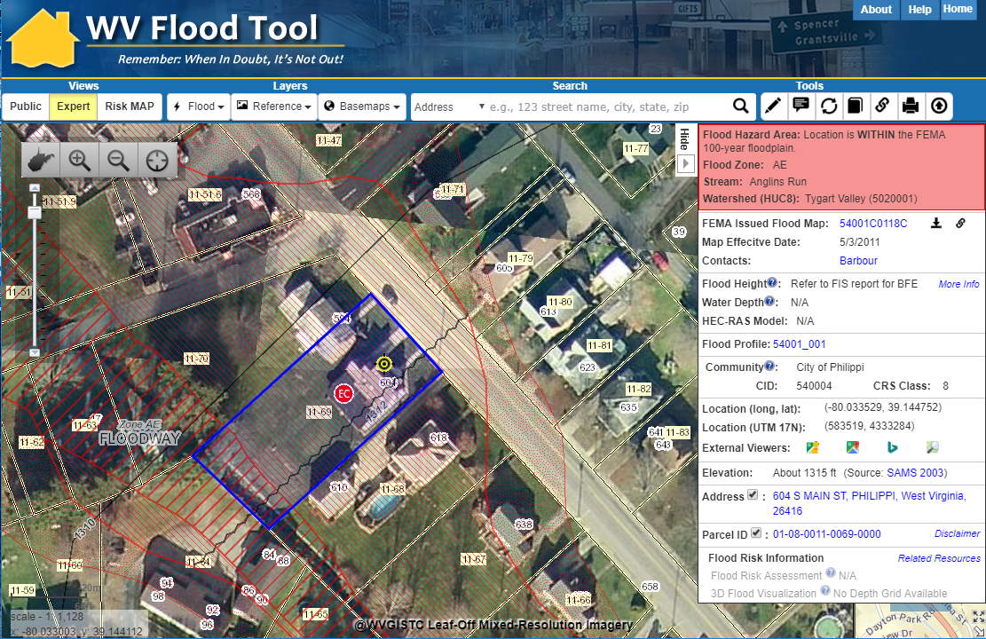
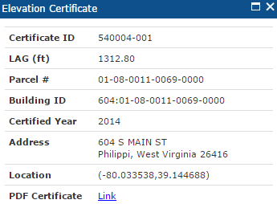
Building Identification
SHARE LINK
604 Main St, Philippi, WV 26416
X,Y COORD.
0
ADDRESS
PARCEL
Share Link: https://www.mapwv.gov/flood/map/?wkid=102100&x=-8909292&y=4742427&l=12&v=1

Slide 22
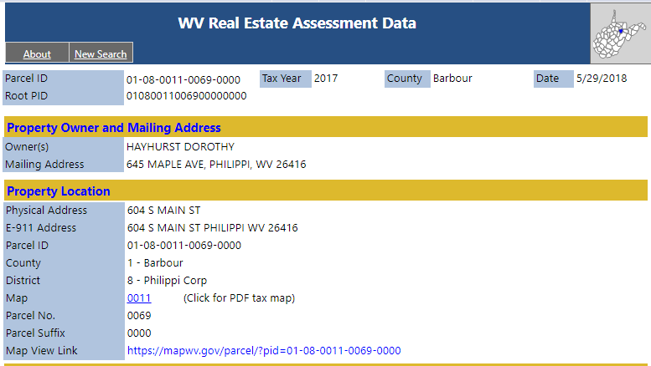
Building Identification
E-911 and County Assessor report location as 604 S Main Street
Property Parcel Address
E-911 Address
Share Link: http://www.mapwv.gov/Assessment/?PID=01080011006900000000

Slide 23
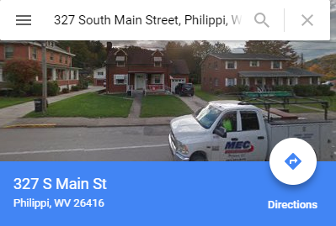
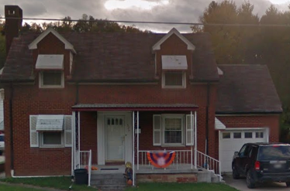
Building Identification
Google Street View and House Number list location as 327 S Main Street

Slide 24
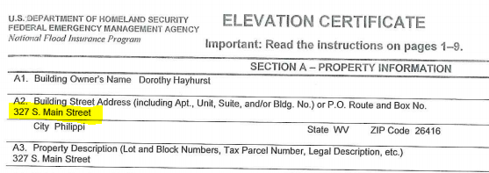
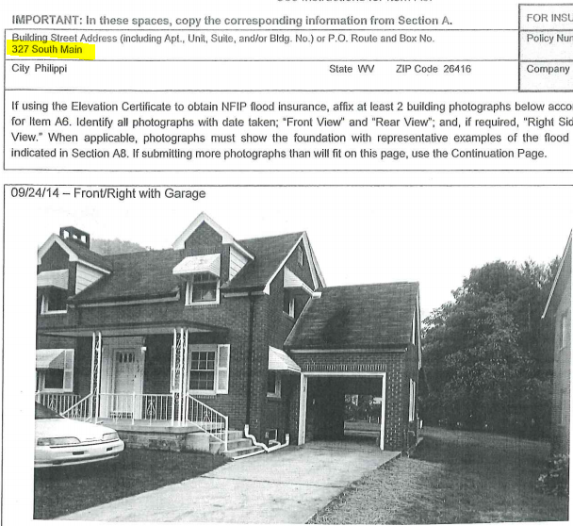
Building Identification
FEMA’s Elevation Certificate lists location as 327 S Main Street

Slide 25
Building Identifiers
Collect multiple spatial identifiers to verify location
Address | 604 S Main St, Philippi, West Virginia, 26416
Parcel | 01-08-0011-0069-0000
01 | - | 08 | - | 0011 | - | 0069 | - | 0000
County |  | District |  | Map |  | Parcel |  | Suffix
Building Identifier | 604: 01-08-0011-0069-0000
X,Y Coordinate | 39.144752, -80.033529
Google Plus Code (11-digit) | 86FX4XV8+VHF
Share MAP URL Link | https://www.mapwv.gov/flood/map/?wkid=102100&x=-8909292&y=4742427&l=12&v=1
Share Parcel Assessment URL Link | http://www.mapwv.gov/Assessment/Detail/?PID=01080011006900000000
Notes: Owner Name from assessment records and Building Pictures (elevation certificates) can be helpful for property identification purposes
Proper Building and Property Identifiers are important for exchanging building-level data efficiently among local, state, and federal partners (including UDFs, LOMAs, Mitigated Buyout Properties, Elevation Certificates, Repetitive Loss Structures, etc.)
= Unique Identifiers

Slide 26
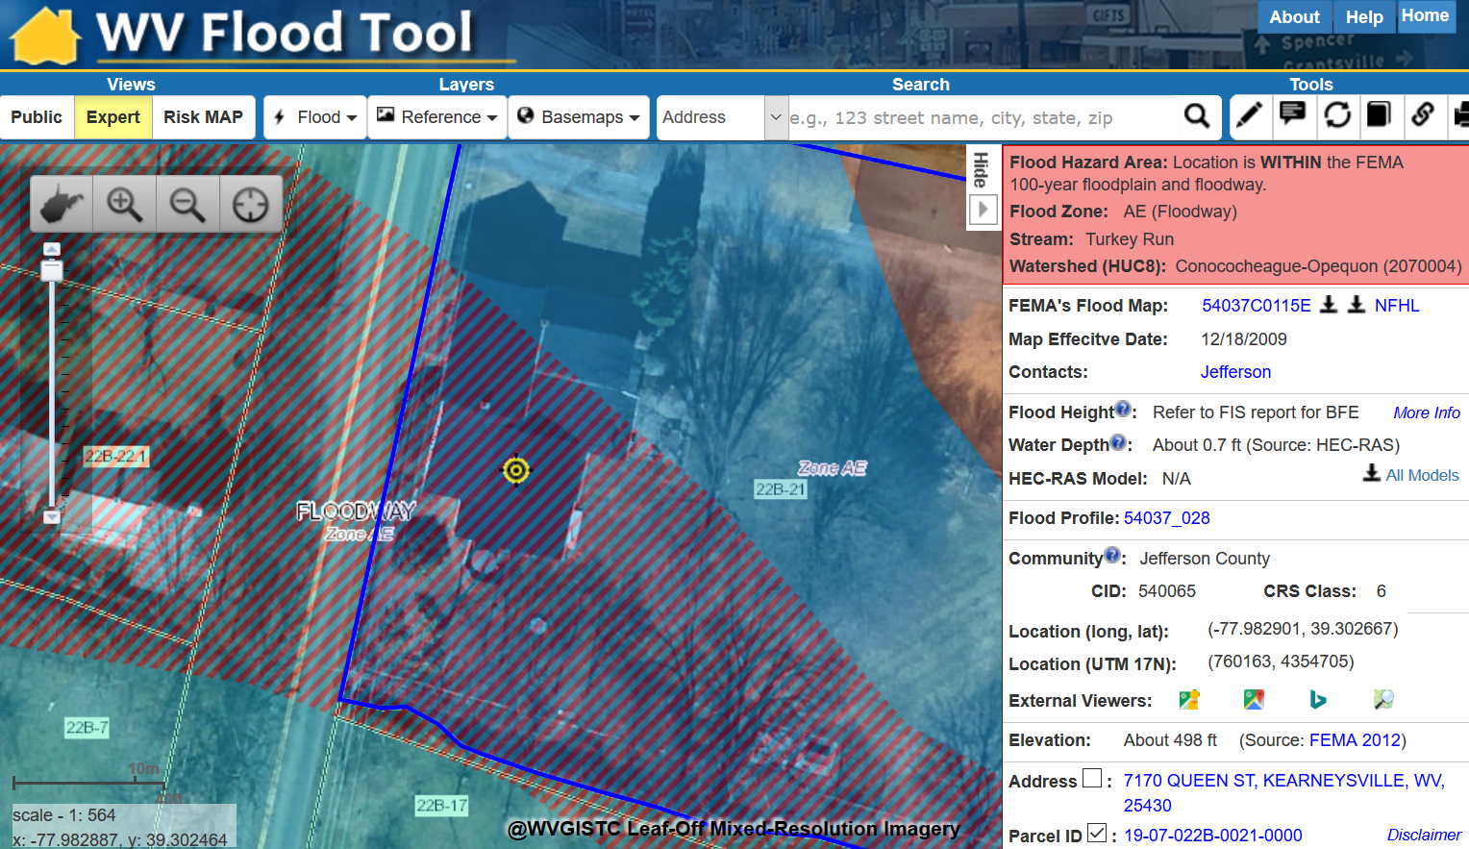
Building 7170:19-07-022B-0021-0000
Detailed Building Inventory Record
Residential Home in Floodway with
High Building Exposure Value of $274,500

Slide 27
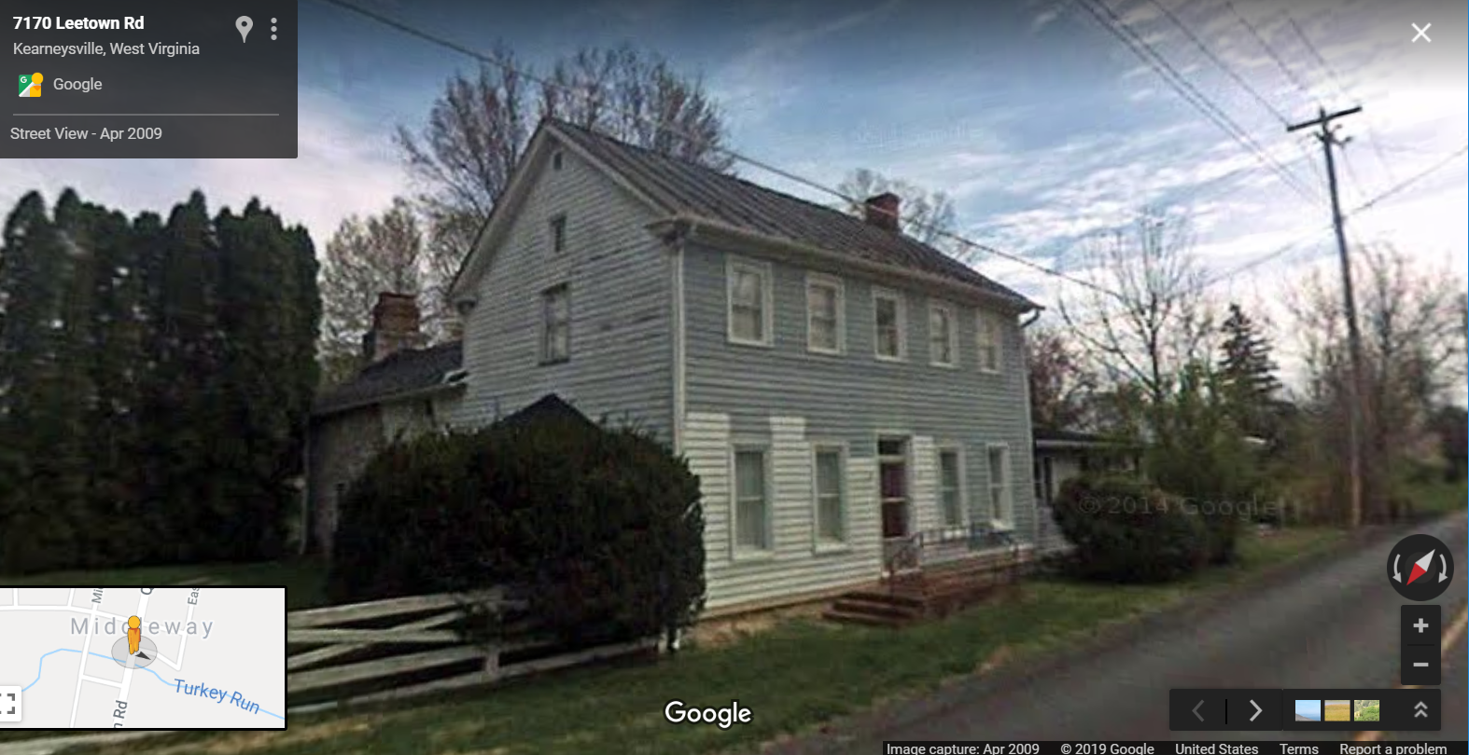
Building 7170:19-07-022B-0021-0000
Flood Tool External Link to Google Street View

Slide 28
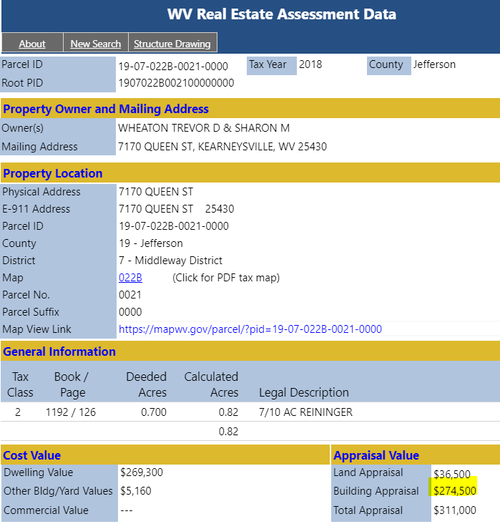
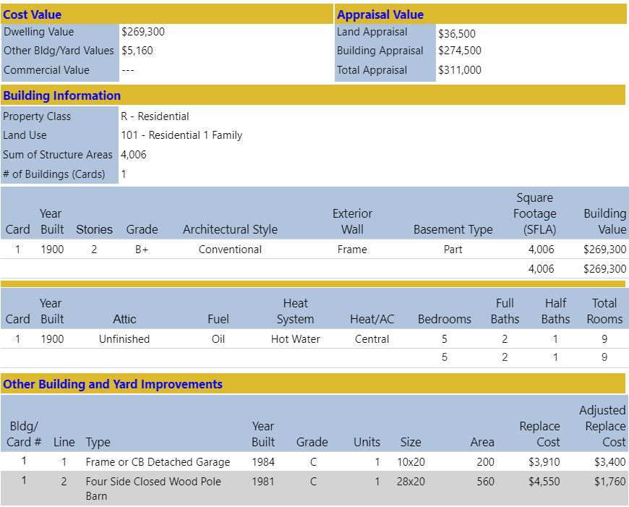
Building 7170:19-07-022B-0021-0000
Main Building Information
Owner and Property Location
Outbuildings
Legal Description
Cost Values
Property Intersect Flood Zone
Web Parcel Assessment Report for Building Identification, Building Characteristics, and Cost Values

Slide 29
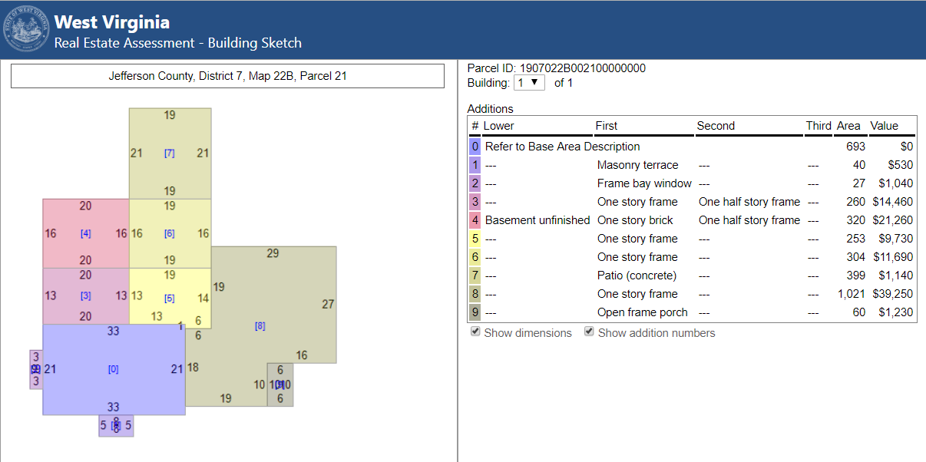
Building 7170:19-07-022B-0021-0000
Building Sketch Diagram (main area and additions)
Building Sketches from parcel assessment records are available for all Residential and Farm properties. Very useful for Building Identification.

Slide 30
Building 7170:19-07-022B-0021-0000
Building ID | 7170:19-07-022B-0021-0000
Full E-911 Address | 7170 QUEEN ST, KEARNEYSVILLE, WV 25430
Full Owner Address | 7170 QUEEN ST, KEARNEYSVILLE, WV 25430
GIS Parcel ID | 19-07-022B-0021-0000
WV Flood Tool Link | https://mapwv.gov/assessment/detail/?pid=1907022B002100000000
WV Parcel Assessment Link | https://mapwv.gov/flood/map/?pid=19-07-022B-0021-0000
CID | 540065
Community Name | JEFFERSON COUNTY *
County | JEFFERSON COUNTY
Incorporated/Unincorporated | Unincorporated
Flood Zone Designation | Effective 100 yr Zone AE - Floodway
Floodway | Yes
Regulatory Status | Regulatory
FIRM Status | Pre-FIRM
Flood Depth Value | 0.5
Flood Depth Source | HEC-RAS
Ground Elevation | 151.9
Ground Elevation Source | 2012 FEMA Jefferson, Berkeley & Morgan Lidar
Year Built | 1900
Grade | B+
Property Class Code | R
Property Class Description | Residential
Land Use Code | 101 - Residential 1 Family
Land Use Description | 101
Hazard Occupancy Code | RES1
Stories | 2
Exterial Wall Type | Frame
Architectural Style | None
Structure Area | 4006
Basement Type | Part
Dwelling Value | 269300
OBY Value | 5160
Building Appraisal | $274,500
Detailed Building Inventory Record

Slide 31
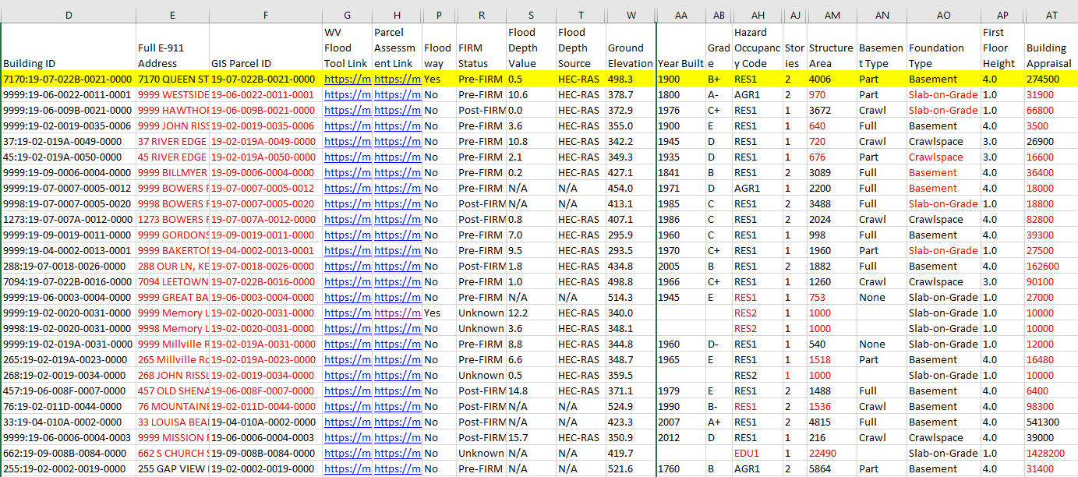
Building 7170:19-07-022B-0021-0000
Sample Records of Modified Building Inventory for Jefferson County
Black Text: Default E-911 Parcel/Assessment Values
Red Text: Modified Building Records (Identifiers, HazusOccCode, Cost, Area, etc.)
Blue Text: Map and Assessment Report Web Links to WV Flood Tool

Slide 32
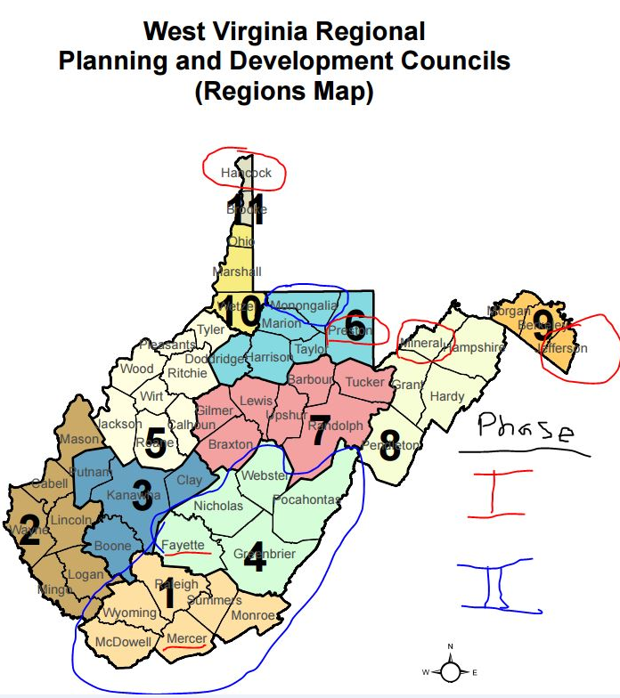
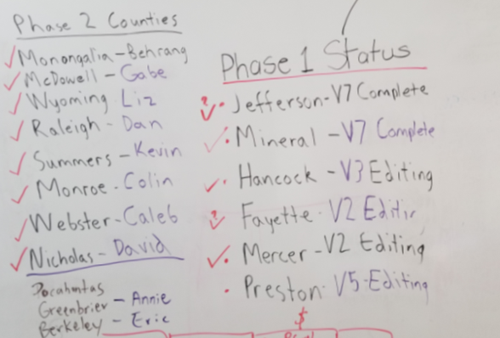
Building Inventory Status
Currently identifying flood-risk structures for 16 counties
Building Inventory Versions of Accuracy Improvement
Version 7
Ongoing Building Inventory Counties
Building Inventory - Iterative Process & Versions

Slide 33
Statewide Flood Risk Assessment
Flood Model Outputs
Flood Models
FEMA Open Hazus Flood Assessment Structure Tool (FAST)
Building Direct Economic Loss Estimates
Incorporate Population Displacement and Short-Term Shelter Needs in FEMA’s Open Hazus script
Model Data Outputs
Community-Level
Building-Level
3D Visualizations
Risk Layers Published to RiskMAP View of WV Flood Tool (www.mapwv.gov/Flood)
Community Flood Risk Assessments
Submit flood risk assessments and data to communities, state, and federal partners
Identify potential mitigation actions and resources for stakeholders that correlate with risk assessment outputs/analytics
MODEL OUTPUTS
Community-Level
Building-Level
3D Visualizations Published to WV Flood Tool

Slide 34
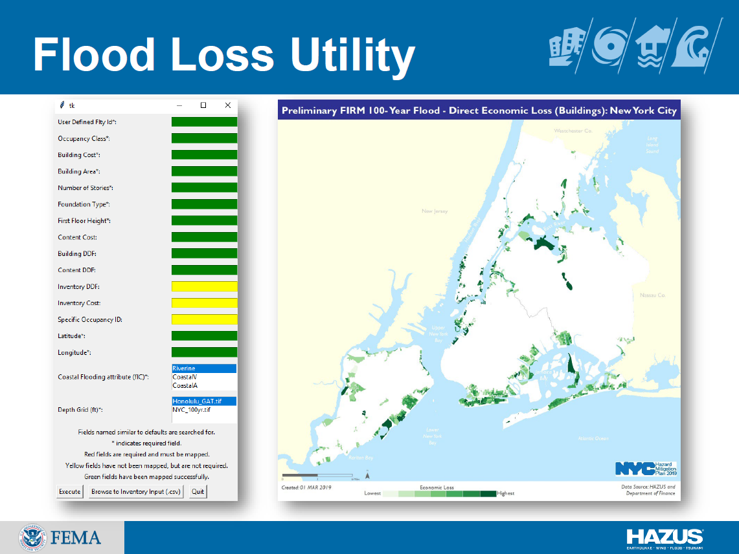
Hazus Flood Loss Estimation Program
It works! Very beneficial for project!
Slide courtesy of FEMA

Slide 35
Goal: Add Shelter Model to Hazus FAST
ORIGINAL MODEL:
The expert-based short-term shelter model developed by Harrald et al. (1989) at George Washington University for the earthquakes in Northern California in a contract with the American Red Cross
Reference:
Harrald, J. R., Al-Hajj, S., Fouladi, B., & Jeong, D. (1994). Estimating the demand for sheltering in future earthquakes. Unpublished paper, Department of Engineering Management, the George Washington University, Washington, DC.
Socio-economic variables for shelter model weighted by experts:
Income (In five classes from $10,000 to $35,000)
Ethnicity (White, African American, Hispanic, Asian/Other)
Age (Under or above 65)
Residence Type (Owned, Rental, Vacation)
Modified and applied to floods in "Flood Model Hazus-MH Technical Manual", Chapter 13 removing ethnicity and residence type
VARIABLES:
Objective: Incorporate Population Displacement and Short-Term Shelter Needs in FEMA’s Open Hazus script

Slide 36
Jefferson County– Proposed Shelter Model
Building-Level
Building-Level
Assessment Records
Population
Displacement
Building Characteristics
Occupancy Class
Flood Depth Value >=1 ft
Based on limitations of physical access
Community-Level
Average Household Size
Short-term Shelter Needs
Community-Level
Shelters used up to 3 weeks
U.S. Census Data
Population & Household Size
Income
Age
Ethnicity
Housing Characteristics
Can be used in the future models

Slide 37
Jefferson County– Displacement
BASE MODEL: Flood Model Hazus-MH Technical Manual
MODIFICATIONS: Scale of calculations changed to buildings
DATA:
Hazard Occupancy Code and Flood Depth Value from assessment data of Jefferson County at the scale of buildings (Building Inventory)
Average Household Size of the communities from census data (2017 American Community Survey (ACS) 5-Year Estimates downloaded from "American Fact Finder“)
METHOD:
Extraction of the buildings located in flood zones with the depth value of 1 ft or more
Estimating the number of the residential units in each building using the occupancy code
Calculation of the estimated residing population in each building using the average household size of the community
Adding the population of the buildings in each community

Slide 38
Jefferson County– Displacement
DEFINED EQUATION:
$${\#DI}_{IN}=\sum_{j=1}^{n}{{(ResUNIT}_{IN}×{AveHHSize}_{COMM})}$$
Where:
#DI_{IN} = the number of displaced individuals as a result of inundation with the depth equal or more than 1 foot
ResUNIT_{IN}= the number of residential units in each building located within the area of inundation with the depth equal or more than 1 foot
AveHHSize_{COMM}= the average household size of the community where the building is located
j= the number of residential buildings within the flooded area with the depth equal or more than 1 foot
A part of the population displacement table at building level

Slide 39
Jefferson County– Shelter Needs
BASE MODEL: Flood Model Hazus-MH Technical Manual
MODIFICATIONS: Income classes updated based on the inflation rate
DATA:
Displaced Population estimated in the previous part
Household Income and Age from census data (2017 American Community Survey (ACS) 5-Year Estimates downloaded from "American Fact Finder“)
METHOD:
Based on "Flood Model Hazus-MH Technical Manual", Chapter 13, at the scale of communities:
Calculation of the percentage of households in the income classes:
- IM1: HH Income per year < $20,000
- IM2: $20,000 <= HH Income per year < $30,000
- IM3: $30,000 <= HH Income per year < $50,000
- IM4: $50,000 <= HH Income per year < $60,000
- IM5: $60,000 <= HH Income per year
Calculation of the percentage of individuals in the age classes:
AM1: Less than 15 years
AM2: 15 to 64 years
AM3: 65 years or more

Slide 40
Jefferson County– Shelter Needs
MODIFICATIONS TO INCOME CLASSES:
The inflation rate of 1990 to 2017 (1.87) was slightly changed while applying to make the intervals match the census data
Income Class | Original and Hazus Models | Modified Model
IM1 | HH Income < $10,000 | HH Income < $20,000
IM2 | $10,000 <= HH Income < $15,000 | $20,000 <= HH Income < $30,000
IM3 | $15,000 <= HH Income < $25,000 | $30,000 <= HH Income < $50,000
IM4 | $25,000 <= HH Income < $35,000 | $50,000 <= HH Income < $60,000
IM5 | $35,000 <= HH Income | $60,000 <= HH Income

Slide 41
Jefferson County– Shelter Needs
USED EQUATIONS:
$$\#STP=\sum_{k=1}^{5}{\sum_{m=1}^{3}{\left[α_{km}×DP×{HI}_{k}×{HA}_{m}\right]}}$$
Where:
#STP = Number of people using established shelters
α_{km} = a constant calculated as below
DP = Displaced population by inundation with equal or more than 1 foot depth (from the previous stage)
HI_{k} = Percentage of population in the k^{th} income class
HA_{m} = Percentage of population in m^{th} age class
$$\left.α_{km}=(IW×{IM}_{k})+(AW×{AM}_{k}\right)$$
Where:
IW = Shelter category weight for income (0.8)
AW = Shelter category weight for age (0.2)
IM_{k} = Relative modification factor for income (calculated using table 13.2 in the manual)
AM_{m} = Relative modification factor for age (calculated using table 13.2 in the manual)

Slide 42
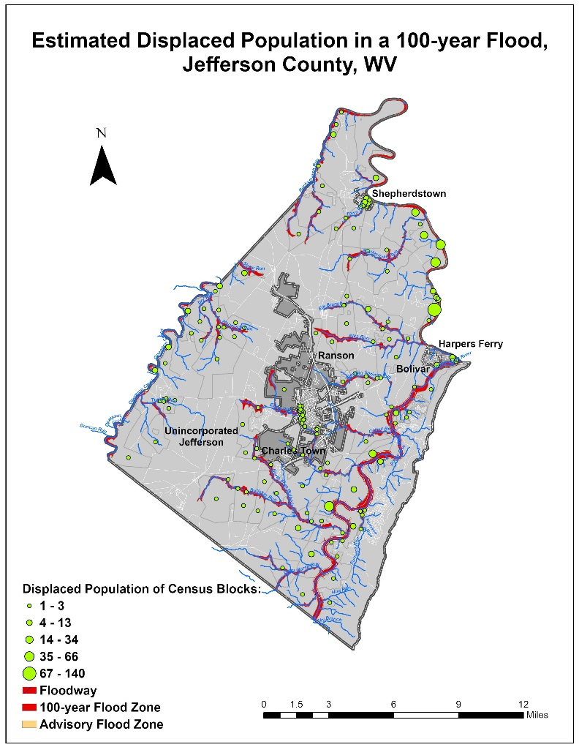
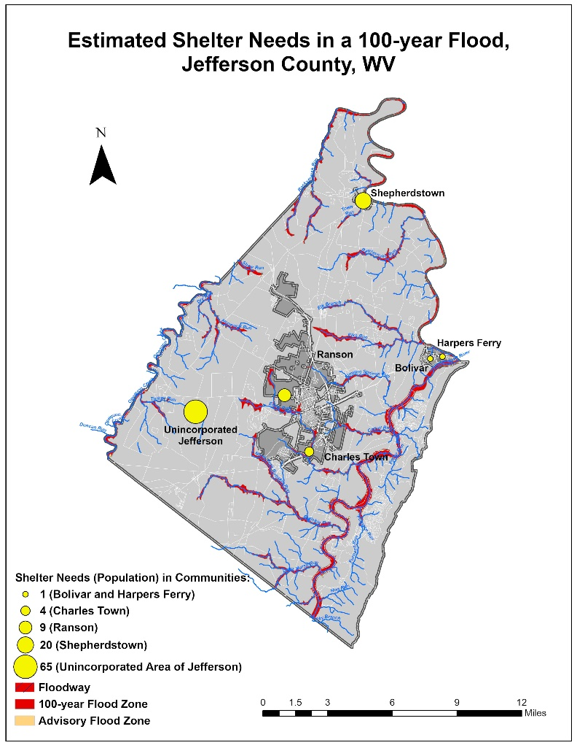
Jefferson County– Results
# | CID | Census ID | Community Name | County | Incorporated / Unincorporated | Total Population | Residential Units in Flood Zones | Average Household Size | Population Residing in Flood Zones | Percentage of Population Residing in Flood Zones | Estimated Displaced Population (Inundation >= 1 ft) | Percentage of Population in Flood Zones Displaced | Estimated Population in Need of Shelter (Inundation >= 1 ft) | Percentage of Population in Flood Zones in Need of Shelter
1 | 540065 | _ | JEFFERSON COUNTY * | JEFFERSON COUNTY | Unincorporated | 41,907 | 501 | 2.6 | 1322 | 3.2% | 549 | 41.5% | 65 | 4.9%
2 | 540030 | 5408932 | BOLIVAR, TOWN OF | JEFFERSON COUNTY | Incorporated | 1,246 | 3 | 2.4 | 7 | 0.6% | 7 | 100.0% | 1 | 15.7%
3 | 540066 | 5414610 | CHARLES TOWN, CITY OF | JEFFERSON COUNTY | Incorporated | 5,766 | 24 | 2.5 | 60 | 1.0% | 22 | 37.5% | 4 | 6.1%
4 | 540067 | 5435284 | HARPERS FERRY, TOWN OF | JEFFERSON COUNTY | Incorporated | 236 | 6 | 2.1 | 13 | 5.3% | 10 | 83.3% | 1 | 10.1%
5 | 540068 | 5466988 | RANSON, CITY OF | JEFFERSON COUNTY | Incorporated | 4,945 | 81 | 2.7 | 215 | 4.4% | 51 | 23.5% | 9 | 4.3%
6 | 540069 | 5473468 | SHEPHERDSTOWN, TOWN OF | JEFFERSON COUNTY | Incorporated | 1,573 | 61 | 1.7 | 104 | 6.6% | 100 | 96.7% | 20 | 19.4%
7 | Total in county |  |  | Jefferson County | _ | 55,673 | 676 | _ | 1721 | 3.1% | 740 | 43.0% | 100 | 5.8%

Slide 43
Future Directions
Include more variables relevant to housing characteristics in the shelter model such as:
Housing Ownership Type (Owned or Rental)
Occupancy Type (Single family, Multi-family, & Mobile Home)
Geography: Urban versus Rural
Research and review the actual shelter data of floods provided by the American Red Cross to test the model
Data preparation for unincorporated areas missing in the census data by subtracting the demographic data of the communities from those of the county
Automate data processing of the required variables for displacement and shelter estimations
Customize Open Hazus “FAST” Flood Assessment Structure Tool including population displacement and shelter needs
“… the task of estimating and preparing for shelter demand is still very challenging.” (Dr. John Harrald, 2019)
“The results of all modeling efforts should be interpreted with a degree of skepticism.” (Harrald et al., 1994, p.13)
“Any model is a selective representation of reality.” (Harrald et al., 1994, p.14)

Slide 44
Statewide Flood Risk Assessment
Outputs Published
Model Data Outputs
Community-Level
Building-Level
3D Visualizations
Risk Layers Published to RiskMAP View of WV Flood Tool (www.mapwv.gov/Flood)

Slide 45
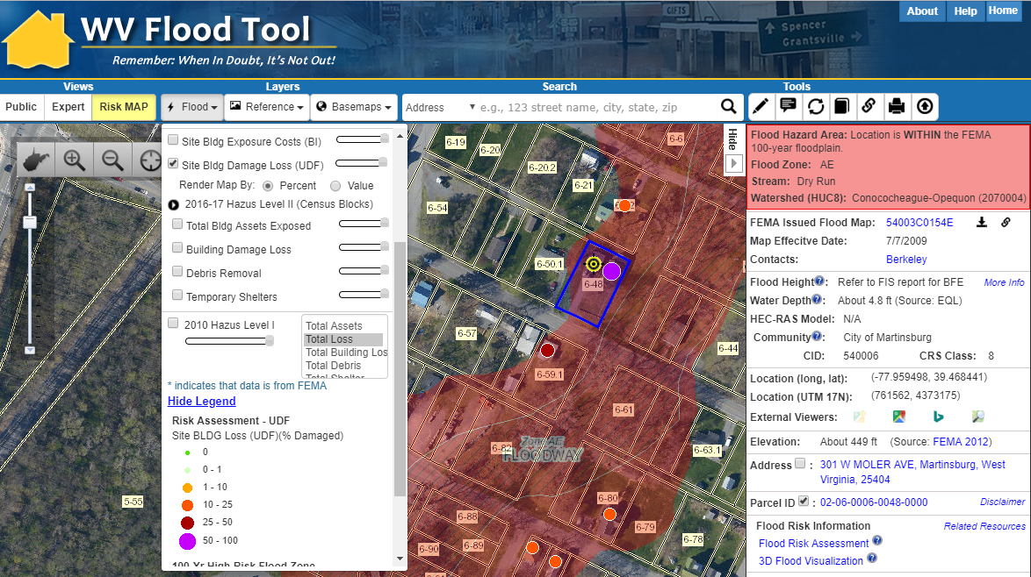
RiskMAP View – Martinsburg, WV
Flood Risk Awareness & Mitigation Planning
https://www.mapwv.gov/flood/map/?wkid=102100&x=-8678412&y=4788996&l=11&v=2

Slide 46
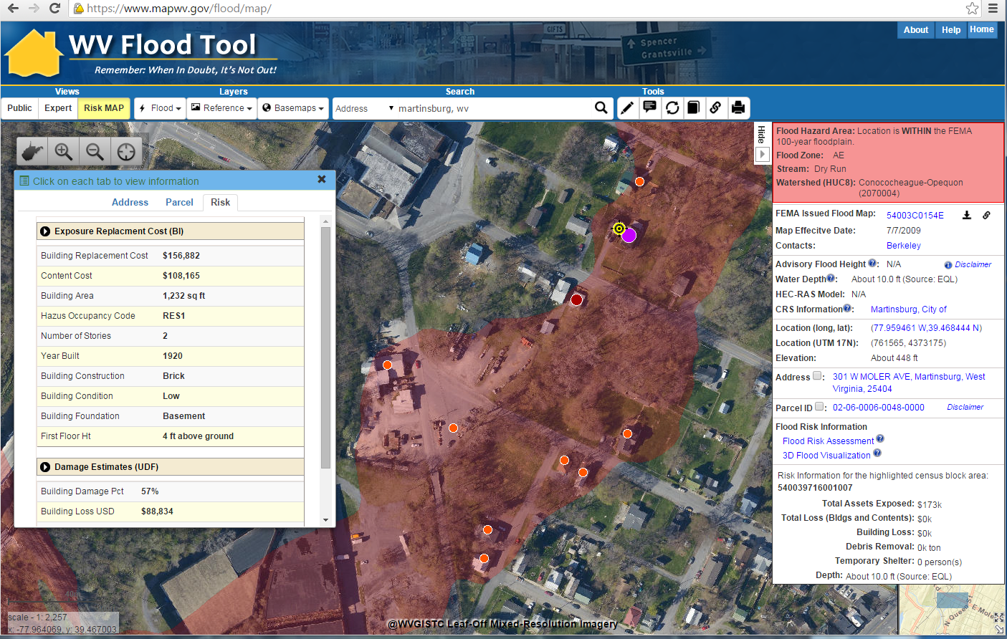
Flood Risk Structures of Martinsburg
Building Flood Loss Damage
57% of Residential Home Damaged at a Loss of $88,834
Flood Risk Building Info
Flood Risk Assessment Building Link
https://www.mapwv.gov/flood/map/?wkid=102100&x=-8678481&y=4788856&l=11&v=2
The Risk MAP View allows for viewing flood loss estimates at the building or structure level for a 1%-annual-chance flood event

Slide 47
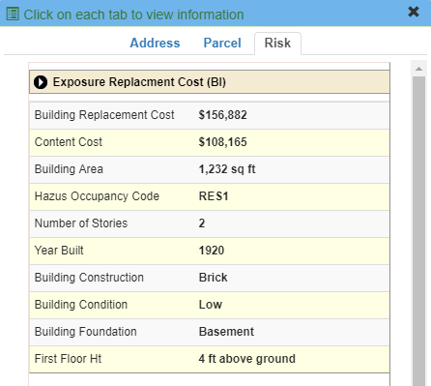
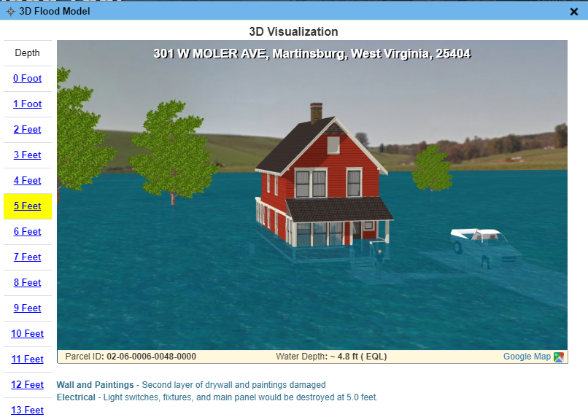
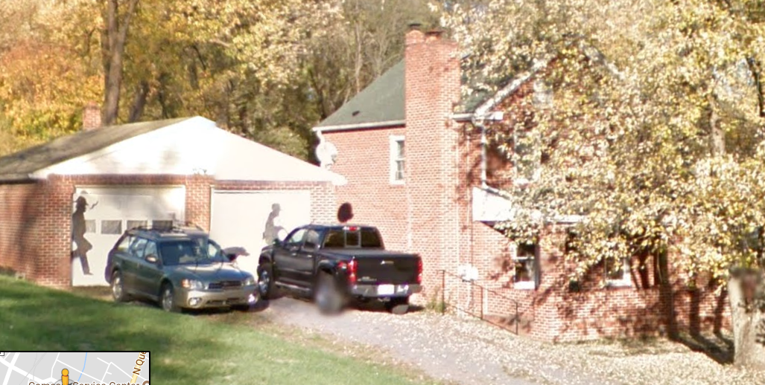
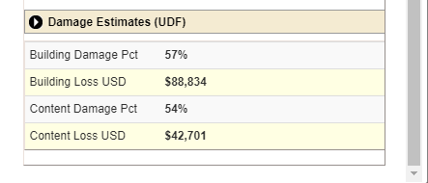
RiskMAP View – 3D Visualization
Building Exposure
Flood Depth – 3D Visualization
HAZUS Loss Estimate
Street View Image

Slide 48
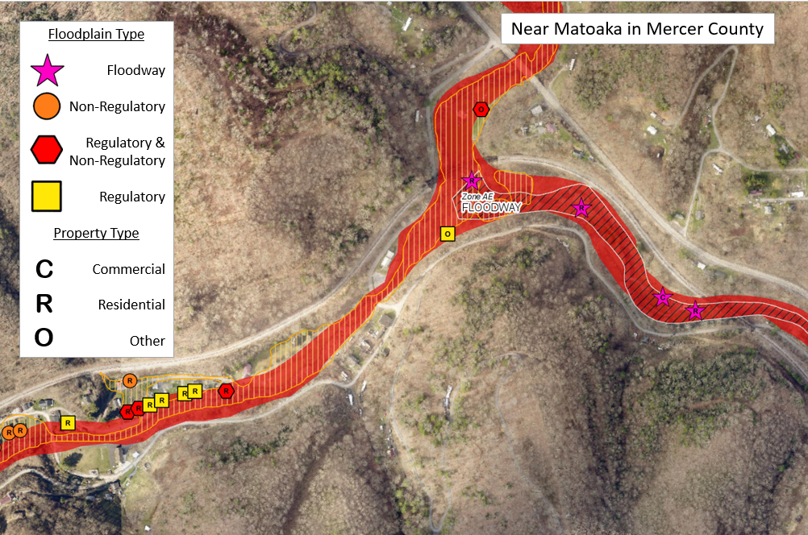
Building Changes Since Last FIRM
Concept Slide of Flood Risk Layer on Flood Tool
Mapped IN SFHA
No Change
Mapped Out of SFHA
Non-Regulatory
Preliminary Studies
Advisory A Zones
Updated AE Zones
Analogous to Changes Since Last FIRM (CLSF), but Building Changes Since Last FIRM (bCLSF)

Slide 49
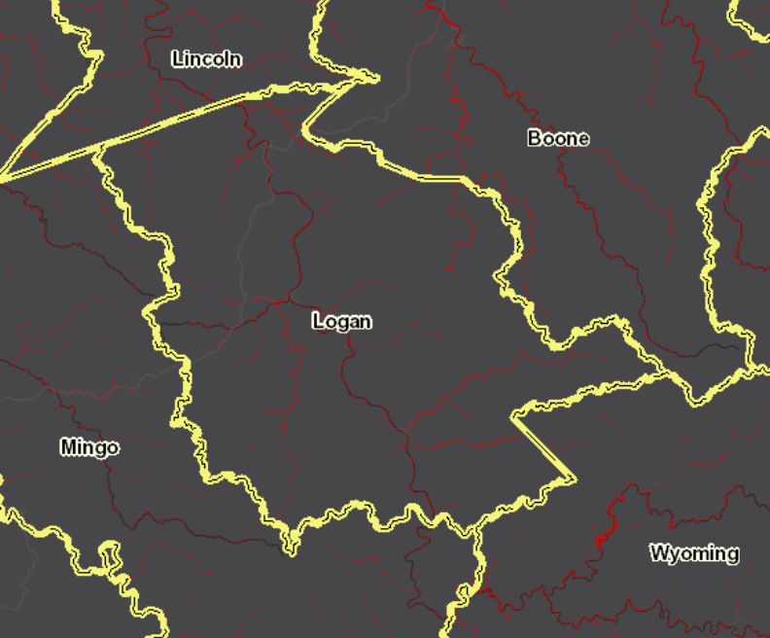
Building Counts – Logan County
Community Name | Regulatory Floodway | Effective SFHA | Non-Regulatory High Risk
KANAWHA COUNTY * | 1,216 | 8,230 | 234
LOGAN COUNTY * | 1,124 | 5,696 | 706
HAMPSHIRE COUNTY* | 613 | 1,501 | 0
BOONE COUNTY * | 454 | 2,932 | 535
MINGO COUNTY * | 398 | 3,295 | 258
WAYNE COUNTY* | 332 | 3,102 | 232
MCDOWELL COUNTY * | 331 | 2,369 | 928
SUMMERS COUNTY * | 289 | 1,362 | 104
WYOMING COUNTY * | 279 | 2,421 | 831
MINERAL COUNTY * | 196 | 707 | 2
RICHWOOD, CITY OF | 136 | 366 | 0
KEYSER, CITY OF | 116 | 290 | 0
MORGAN COUNTY* | 115 | 767 | 54
HANCOCK COUNTY * | 110 | 307 | 21
WHEELING, CITY OF | 110 | 2,658 | 1
NEW MARTINSVILLE | 103 | 905 | 0
MASON COUNTY * | 102 | 1,182 | 0
WHITE SULPHUR SPRINGS | 99 | 470 | 0
PLEASANTS COUNTY * | 93 | 481 | 66
PARSONS, CITY OF | 91 | 356 | 0
WELCH, CITY OF | 90 | 380 | 18
MERCER COUNTY* | 84 | 1,907 | 69
Logan County has a significant number of structures in the SFHA, Floodway, and Non-Regulatory Advisory A Zones that are High Risk
Sample Community-Level Report

Slide 50
Acreage of the SFHA (Top 20)
Sample Community-Level Tabular Report
Top 20 Unincorporated / Incorporated Areas with Highest Acreage of SFHA (aSFHA)
County Unincorporated | Modified aSFHA
HAMPSHIRE COUNTY | 26,388
MASON COUNTY | 21,771
KANAWHA COUNTY | 21,196
GREENBRIER COUNTY | 20,060
RANDOLPH COUNTY | 19,842
WOOD COUNTY | 17,523
HARDY COUNTY | 16,850
JACKSON COUNTY | 15,300
WAYNE COUNTY | 13,521
PENDLETON COUNTY | 13,218
LINCOLN COUNTY | 11,137
BERKELEY COUNTY | 10,300
CABELL COUNTY | 10,278
POCAHONTAS COUNTY | 10,092
PRESTON COUNTY | 9,965
PUTNAM COUNTY | 9,934
NICHOLAS COUNTY | 8,999
WEBSTER COUNTY | 8,907
MINERAL COUNTY | 8,885
RALEIGH COUNTY | 8,719
Incorporated Place | County | Modified aSFHA
CHARLESTON, CITY OF (SPLIT) | KANAWHA COUNTY | 1,486
WHEELING, CITY OF (SPLIT) | OHIO COUNTY | 1,318
PARKERSBURG, CITY OF | WOOD COUNTY | 1,217
HUNTINGTON, CITY OF (SPLIT) | CABELL COUNTY | 823
NEW MARTINSVILLE, CITY OF | WETZEL COUNTY | 652
BUCKHANNON, CITY OF | UPSHUR COUNTY | 616
POINT PLEASANT, CITY OF | MASON COUNTY | 614
MOUNDSVILLE, CITY OF | MARSHALL COUNTY | 563
MARLINTON, TOWN OF | POCAHONTAS COUNTY | 494
MOOREFIELD, TOWN OF | HARDY COUNTY | 475
WEIRTON, CITY OF (SPLIT) | HANCOCK COUNTY | 456
CLARKSBURG, CITY OF | HARRISON COUNTY | 453
FAIRMONT,CITY OF | MARION COUNTY | 408
MORGANTOWN, CITY OF | MONONGALIA COUNTY | 387
MILTON, CITY OF | CABELL COUNTY | 377
BUFFALO, TOWN OF | PUTNAM COUNTY | 342
ELEANOR, TOWN OF | PUTNAM COUNTY | 340
PRINCETON, CITY OF | MERCER COUNTY | 332
BARBOURSVILLE, VILLAGE OF | CABELL COUNTY | 314
DUNBAR, CITY OF | KANAWHA COUNTY | 313
Modified aSFHA = Total aSFHA minus (1) large water bodies and (2) federal lands > 10 acres

Slide 51
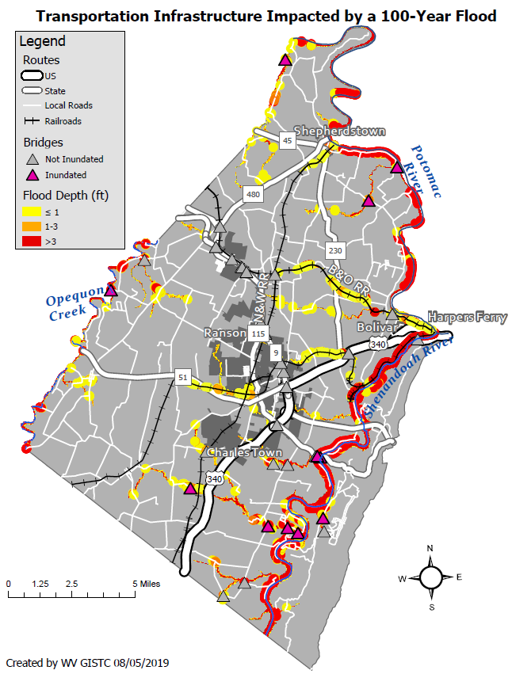
Transportation Infrastructure
Jefferson County, West Virginia
WATER DEPTH | VEHICLES
<= 1 foot | A foot of water will float many vehicles.
1 – 3 feet of water | Two feet of water will carry away most vehicles. Three feet of water will easily float a bus.
> 3 feet | All vehicles incur substantial water damage and can be carried away by flood waters.
WATER DEPTH | RESCUE RESPONSE
<= 1 foot | Response focused on those who need additional assistance.
1 – 3 feet of water | A high-water vehicle rescue limit is about 3 feet.
> 3 feet | Boats and helicopters are required to perform high water rescues when water depths exceed three feet. The risk to people increases with higher water velocities and flood depths.
Sample Flood Hazard Map on Transportation Infrastructure

Slide 52
Statewide Flood Risk Assessment
Slide courtesy of FEMA
Identify Mitigation Actions derived from Risk Assessments

Slide 53
Statewide Flood Risk Assessment
Community Engagement & Field Verification
Community Flood Risk Assessments
Submit flood risk assessments and data to communities, state, and federal partners.
Review potential mitigation actions and resources with stakeholders that correlate with risk assessment outputs/analytics. Link to available FEMA and State Resource Guides:
Reducing Damage from Localized Flooding: A Guide for Communities
Community Rating System Coordinators Manual
WV Floodplain Management Quick Guide
Field Accuracy Checks
Make necessary edits to Flood Risk Assessment GIS
Revisions serve as new Model Inputs for Building Inventory Cycle
Communities do not need mapping software since…
Building-Level Flood-Risk Assessments can be viewed in a Spreadsheet Table with web links to WV Flood Tool
COMMUNITY ENGAGEMENT & FIELD ACCURACY CHECKS
Floodplain Managers
Local Govt. Officials

Slide 54
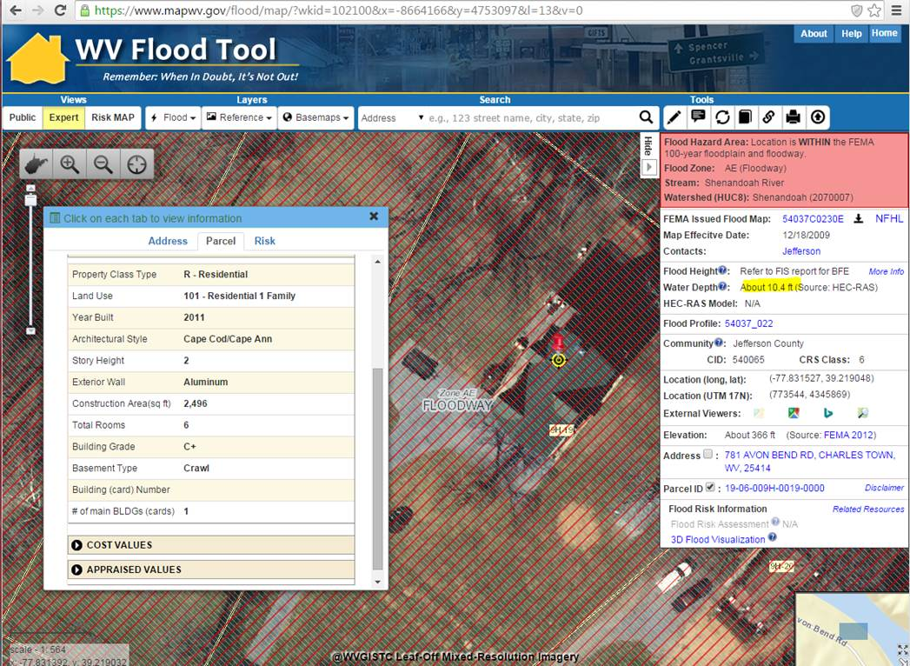
Field Verification – Post-FIRM Structure
We are reviewing the model outputs and preparing the results for others to review. For example, assessment data for the structure located at 781 Avon Bend Road in Charles Town along the Shenandoah River reveals that the Post-FIRM structure was built in 2011 with a crawlspace. Besides this structure being in the Regulatory Floodway, the estimated 1% Annual Chance Water Depth for this structure is 10 feet. Perhaps this would be a structure that someone may want to check the building permit to make sure the structure was built above the BFE+Freeboard.
<< 781 Avon Bend Road, Charles Town, WV 25414 >>
https://www.mapwv.gov/flood/map/?wkid=102100&x=-8664166&y=4753097&l=13&v=0
10 ft. Water Depth
Built 2011
Crawl Basement
<< 781 Avon Bend Road, Charles Town, WV 25414 >>
https://www.mapwv.gov/flood/map/?wkid=102100&x=-8664166&y=4753097&l=13&v=0

Slide 55
Post-FIRM Structure in Floodway?
Building ID | 781:19-06-009H-0019-0000
Full E-911 Address | 781 AVON BEND RD, CHARLES TOWN, WV, 25414
Full Owner Address | 9299 ALL SAINTS RD, LAUREL, MD 20723
GIS Parcel ID | 19-06-009H-0019-0000
Lat | 39.218996
Long | -77.83151391
Plus Code | 87F46599+H9X
WV Flood Tool Link | https://mapwv.gov/flood/map/?wkid=102100&x=-8664164.49652&y=4753089.59353&l=13&v=0
WV Parcel Assessment Link | https://mapwv.gov/Assessment/Detail/?PID=1906009H001900000000
CID | 540065
Community Name | JEFFERSON COUNTY *
Stream Name | Shenandoah River
Watershed (HUC8) | Shenandoah (2070007)
Flood Zone Designation | Effective 100 yr Zone AE - Floodway
Floodway | Yes
Year Built | 2011
FIRM Status | Post-FIRM
Hazard Occupancy Code | RES1
Stories | 2
Basement Type | Crawl
First Floor Height | 4.0
Building Appraisal | $170,200
Structure Area | 2496
Flood Depth Value | 9.8
Flood Depth Source | HEC-RAS
WSEL Value | 376.0
WSEL Source | UAE
Ground Elevation | 366.2
Ground Elevation Source | 2012 FEMA Jefferson, Berkeley & Morgan Lidar
Grade | C+
Tax Class | 2
Land Use Description | Residential 1 Family
Exterial Wall Type | Aluminum
Building ID | 781:19-06-009H-0019-0000
Full E-911 Address | 781 AVON BEND RD, CHARLES TOWN, WV, 25414
GIS Parcel ID | 19-06-009H-0019-0000
Plus Code | 87F46599+H9X
WV Flood Tool Link | https://mapwv.gov/flood/map/?wkid=102100&x=-8664164.49652&y=4753089.59353&l=13&v=0
WV Parcel Assessment Link | https://mapwv.gov/Assessment/Detail/?PID=1906009H001900000000
Full Owner Address | 9299 ALL SAINTS RD, LAUREL, MD 20723
Occ | RES1
Cost | 170200
NumStories | 2
FoundationType | 5
FirstFloorHt | 4
Area | 2496
UserDefinedFltyId | 453
Latitude | 39.218996
Longitude | -77.83151391
Depth_Grid | 9.825653
Depth_in_Struc | 5.825653076
flExp | 1
SOID | R12N
BDDF_ID | 107
BldgDmgPct | 23.7
BldgLossUSD | $40,254
ContentCostUSD | $85,100.00
CDDF_ID | $23.00
ContDmgPct | $37.95
ContentLossUSD | $32,298.78
DebrisID | RES1NBFT4
Debris_Tot | 16.9728
Restor_Days_Min | 270
Restor_Days_Max | 450
GridName | AFH_wm.tif
Building Inventory
FAST Utility Output
Identify Mitigation Actions derived from Risk Assessments

Slide 56
Field Verification
Field Verification of the structure located at 781 Avon Bend Road in Charles Town along the Shenandoah River in the Regulatory Floodway reveals that this Post-FIRM (2011) structure is built on a piles foundation. The Foundation Type/First Floor Height will be changed in the Building Inventory and the FAST Loss Estimate Utility executed again for this structure.
The estimated Base Flood Water Depth for this structure is 10 feet and with 2 feet of freeboard 12 feet.
781 Avon Bend Road, Charles Town, WV 25414 Building ID 781:19-06-009H-0019-0000
WV Flood Tool Link: https://mapwv.gov/flood/map/?wkid=102100&x=-8664165&y=4753090&l=13&v=1
Field Verified from Shenandoah River

Slide 57
Contact Information
WVU GIS Technical Center, West Virginia University Kurt Donaldson, GIS Manager kurt.donaldson@mail.wvu.edu, phone: (304) 293-9467 Eric Hopkins, GIS Analyst Eric.Hopkins@mail.wvu.edu, phone: (304) 293-9463 Maneesh Sharma, GIS Analyst
Maneesh.Sharma@mail.wvu.edu, phone (304) 293-9466
Behrang Bidadian , Graduate Research Assistant behrang.bidadian@mail.wvu.edu

