Slide 1
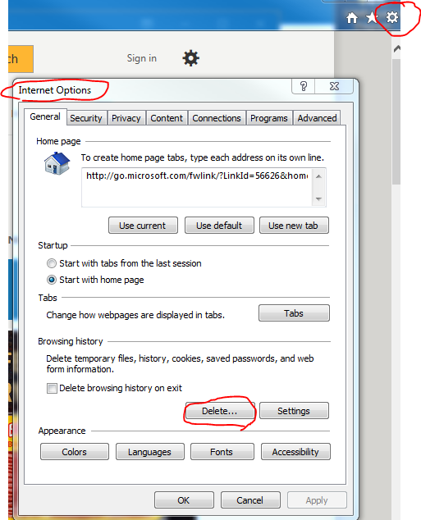
Clear Browser Cache
Remember to clear browser cache to access all the current information and updates
Step 1
Press [Control]+[F5] on the keyboard. This is a FORCED refresh.
Step 2
This process is more complicated. To do it thoroughly follow these steps.
close all browser windows
open a single browser
go to [Tools] on the top menu
select [Internet Options]
You will get a dialog box similar to the one shown below.
Press the [Delete Files] button. This should clear all the files in your browser cache.

