Slide 1
FUTURE DIRECTIONS
Flood Query Panel (requires updating query programming logic)
Advisory AE Flood Zone (e.g, Clear Fork pilot AE Non-Restudy)
Base Flood Height (e.g., Upper Mon Watershed Restudy)
Composite Depth Grid (all studies)
Statewide Integration of Effective & Advisory Floodplains
Continued Development and Analytics (change in buildings & area)
Statewide Flood Risk Assessments
Buildings Exposed to Multi-Hazards (parcel centroid)
Buildings in 1%-annual-chance floodplain
Both effective and advisory floodplains
Building centroid or maximum flood height of structure
Statewide Building Footprints Reference Layer
Created from multiple sources
Useful for identifying structures and 3D community flood visualizations
Planning Acquisition Maps of Flood Studies (AFH, Restudies, Non-AE Study Re-delineations/Depth Grids) for Risk MAP Flood Risk Products And Regulatory Flood Hazard Products.
July 2017

Slide 2
Flood Zone: < zone designation >
Flood Risk Zone Designation | Message | Color Warning Status
AE (Floodway) | Location is WITHIN the FEMA 100-year floodplain. | Red
AE | Location is WITHIN the FEMA 100-year floodplain. | Red
A | Location is WITHIN the FEMA 100-year floodplain. | Red
Advisory AE | Location is WITHIN an advisory floodplain but NOT a regulatory floodplain. More info link. | Orange
Advisory A | Location is WITHIN an advisory floodplain but NOT a regulatory floodplain. More info link. | Orange
Near Flood Zone | Location is NOT WITHIN identified flood hazard area, but within 75 feet of an identified flood hazard area. | Yellow
Out of Flood Zone | Location is NOT WITHIN any identified flood hazard area. Unmapped flood hazard areas may be present. | Green
GIS Query Layers: Regulatory Floodplains (red), Advisory Floodplains (orange), Advisory/Regulatory Buffer (yellow). Two files: R_SFHA.poly and A_SFHA.poly

Slide 3
Flood Height: < Value >
Flood Height Designation | Flood Height Determination | Disclaimer
Base Flood Elevation (Restudy) | < value> feet (Base Flood Elevation) | If you are in doubt of an accurate BFE, then refer to the Flood Profiles or Flood Elevation Tables in the FIS Report.
Advisory Flood Height | About < value> ft. (Advisory Flood Height) | CAUTION CAUTION!! The advisory flood height should be used with caution in the proximity of a culvert, bridge, flood control structure or other impoundment since stream crossings were not included in the hydraulic analyses for approximate floodplains. Also, if the site is close to the confluence with a larger stream, compare the advisory flood height at the location of interest to the advisory flood height or Base Flood Elevation on the larger stream to determine whether the site is within the backwater influence of the larger stream.
Non-Restudy AE | Refer to FIS report | For an accurate BFE determination refer to the Flood Profiles or Flood Elevation Tables in the FIS Report
NEW
NEW
Invisible Composite Query Rasters for flood height values of Water Surface Elevation Level (WSEL) layers: Effective WSEL Grid (E_WSEL_01pct.grid) and Advisory WSEL Grid (A_WSEL_01pct.grid)

Slide 4
Water Depth: about <<value>>
Water Depth | Message | Sources
Water Depth: | About << value >> ft. | Engineering Studies (HEC-RAS) AE Non-Restudy Re-Delineations HAZUS EQL
A statewide “Composite” Flood Risk Assessment Depth Grid will be created from effective (R_Depth_01pct.grid) and advisory (A_Depth_01pct.grid) depth grids.
Water Depth Grids are a flood risk assessment product – not a flood regulatory product. Water depths are important for flood loss damages and by flood visualizations of site-specific structures.
See FEMA’s Flood Risk Assessment Guidance (May 2016) for guidance on composite depth grids:
https://www.fema.gov/media-library-data/1469146645661-31ad3f73def7066084e7ac5bfa145949/Flood_Risk_Assessment_Guidance_May_2016.pdf

Slide 5
Advisory Changes to Regulatory Floodplain
R
Regulatory IN and Advisory OUT
Regulatory OUT and Advisory IN
Both Regulatory
& Advisory
(No Change)
Effective Regulatory Floodplain
Advisory Floodplain
Union | Meaning | Building Changes | Area Changes
No Change | IN both Regulatory and Advisory | 1 | 11 m²
Advisory Only | Regulatory OUT and Advisory IN | 2 | 13 m²
Regulatory Only | Regulatory IN and Advisory OUT | 4 | 21 m²
The geographic union of Regulatory and Advisory Floodplains generates a change polygon for flood risk analysis by area. Subsequently the union polygon can be intersected with site-specific structures to analyze the impact of the Advisory Floodplain changes to the Regulatory Floodplain.

Slide 6
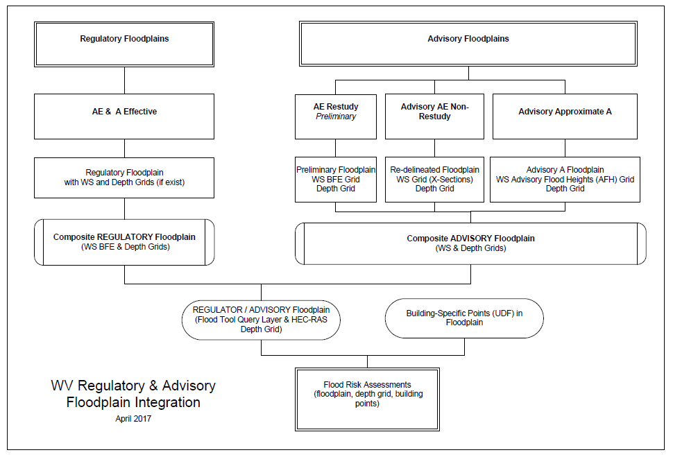
Regulatory vs. Advisory Floodplains
Effective Regulatory
Advisory
Integration
Required

Slide 7
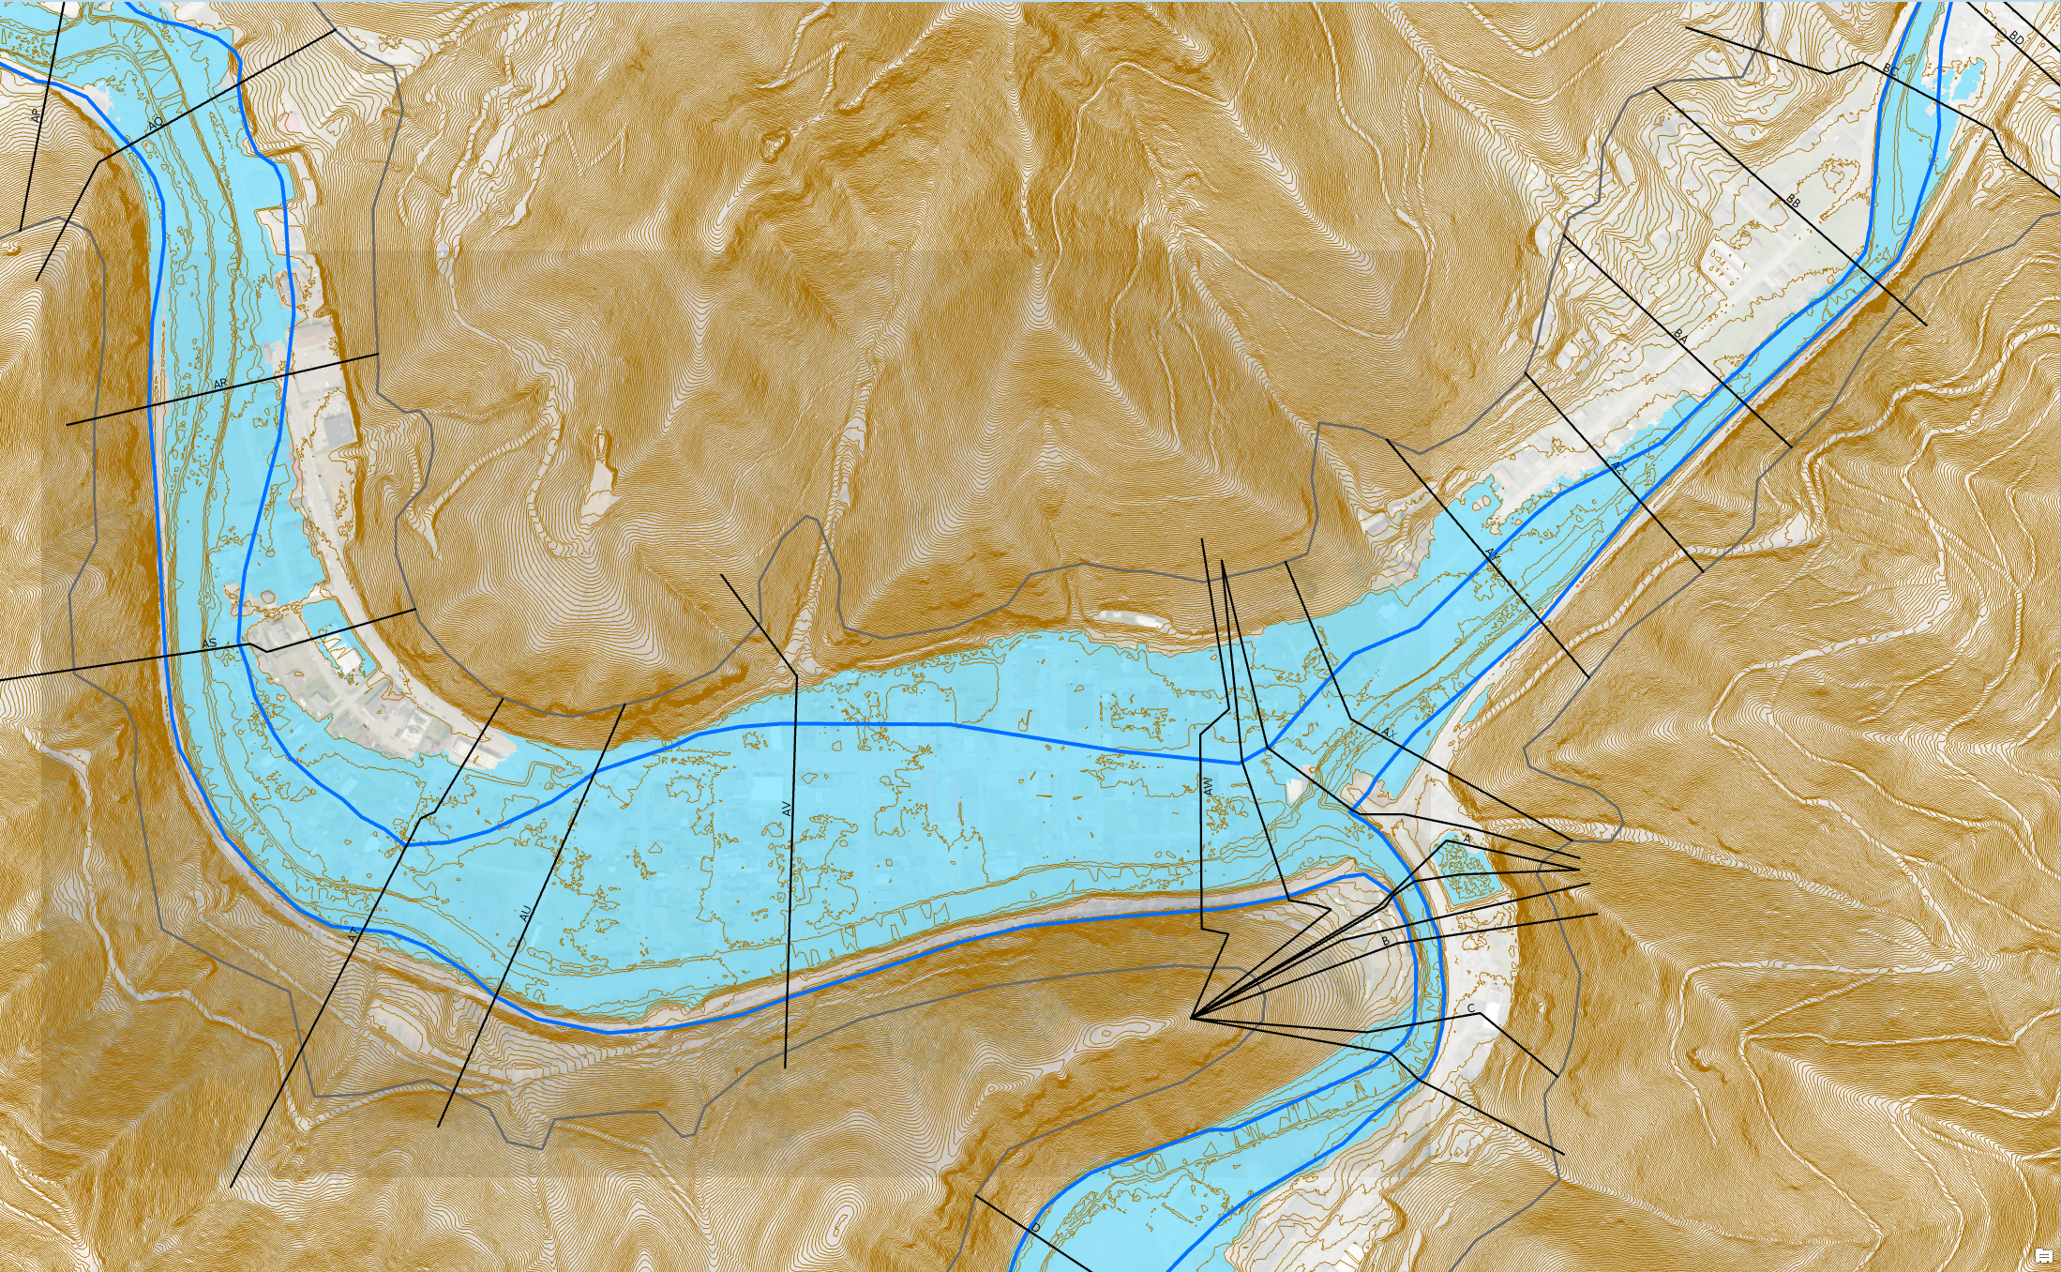
Advisory AE Floodplain
Redelineated Floodplain Using New Topo
Regulatory AE Floodplain
Advisory AE Floodplain
Advisory AE
Zone
Clear Fork
Oceana
Location: Clear Fork, Oceana, Wyoming County, WV
Objective: Zone AE Floodplain Redelineation and Flood Risk Products using existing LiDAR-derived elevation data
https://www.mapwv.gov/flood/map/?wkid=102100&x=-9086441&y=4536103&l=9&v=1

Slide 8
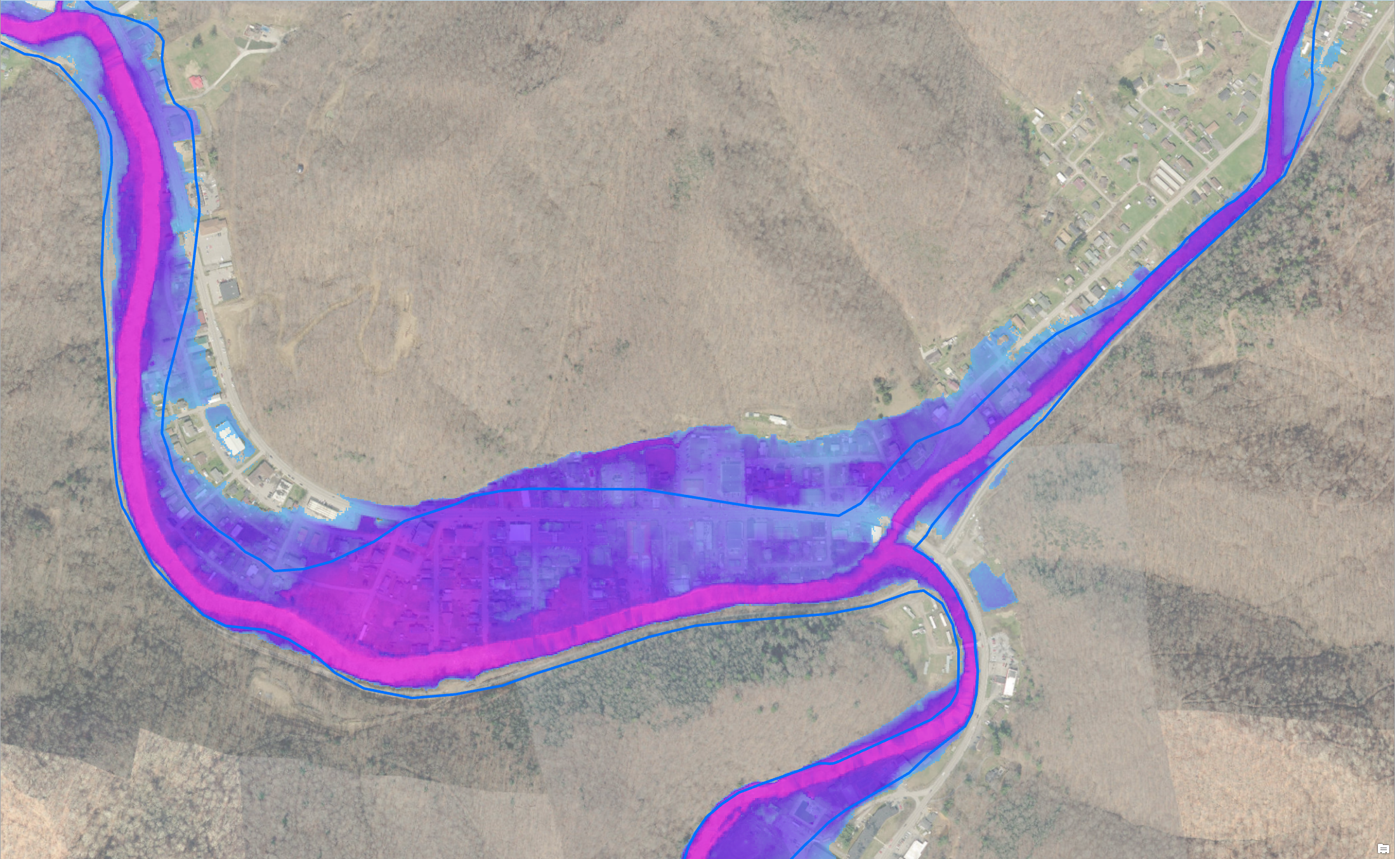
Advisory AE Depth Grid
Regulatory AE Floodplain
Advisory AE
Water Depth
Advisory AE Water Depth
Clear Fork
Oceana
Location: Clear Fork, Oceana, Wyoming County, WV
https://www.mapwv.gov/flood/map/?wkid=102100&x=-9086441&y=4536103&l=9&v=1

Slide 9
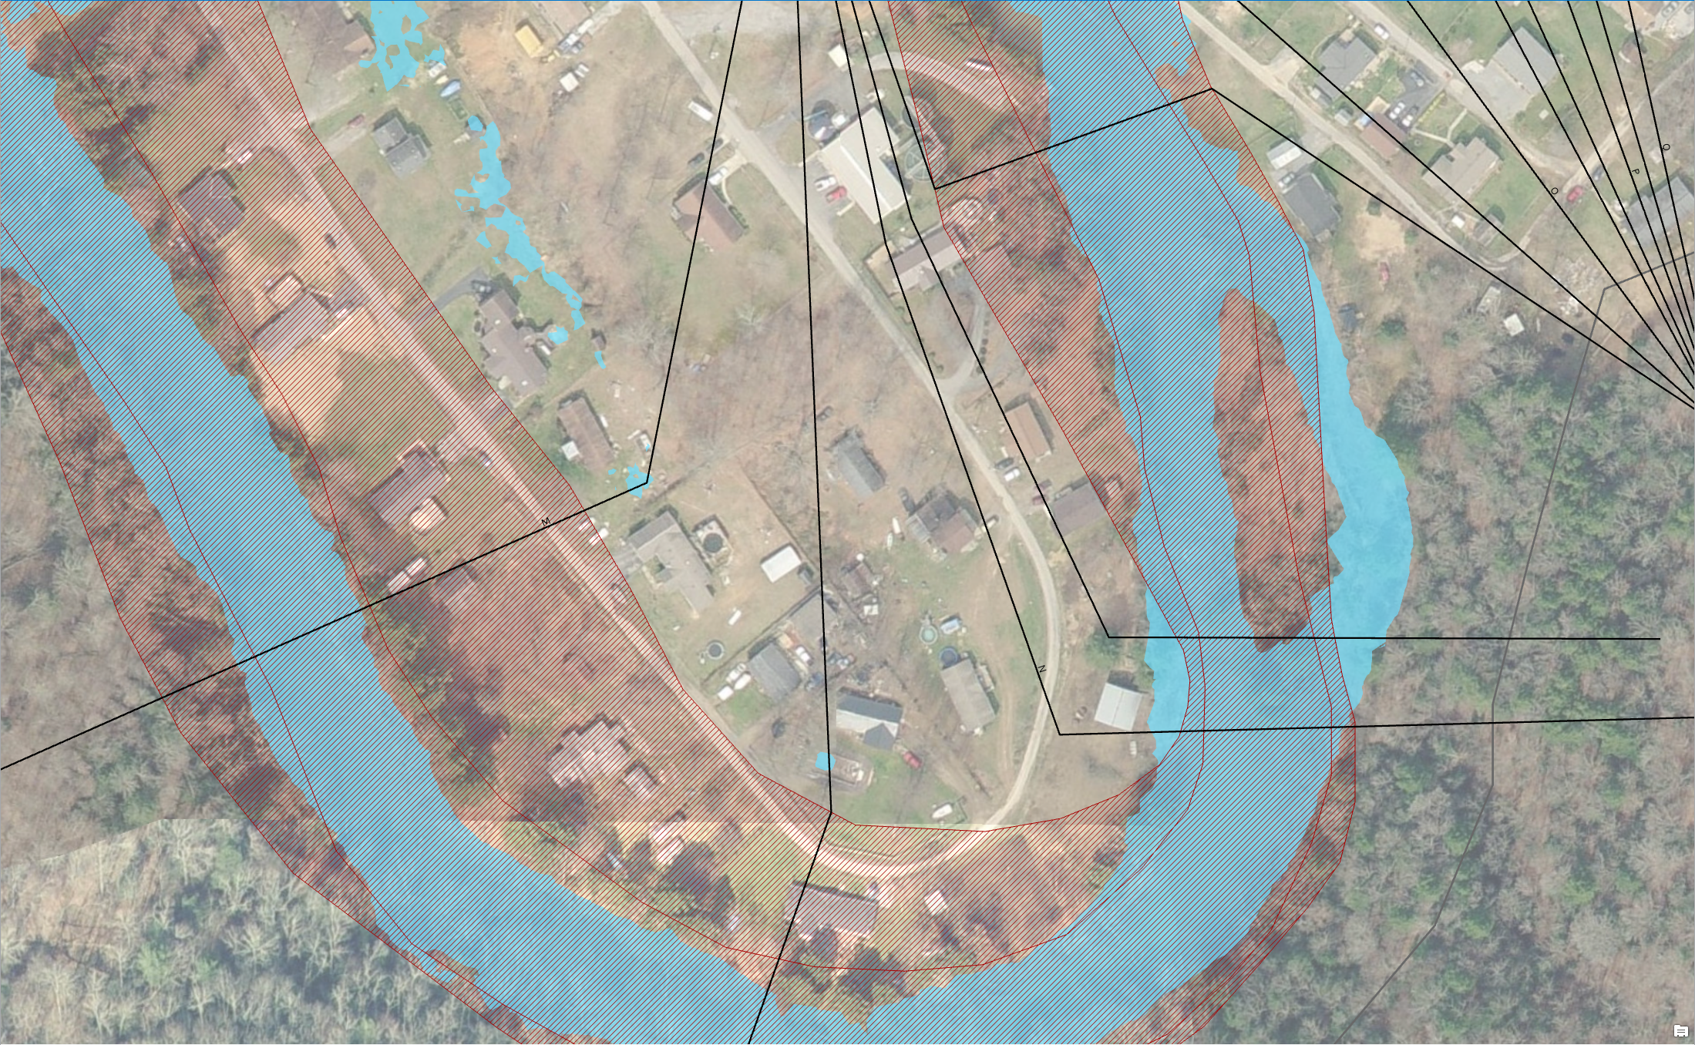
Advisory AE Determinations
Regulatory IN but Advisory OUT
Regulatory AE Zone
Advisory AE Zone
Structures IN Regulatory AE Zone and OUT Advisory AE Zone
What do you tell the public? Acquire an elevation certificate and use the advisory flood elevation to request a LOMA to amend the effective NFIP map.

Slide 10
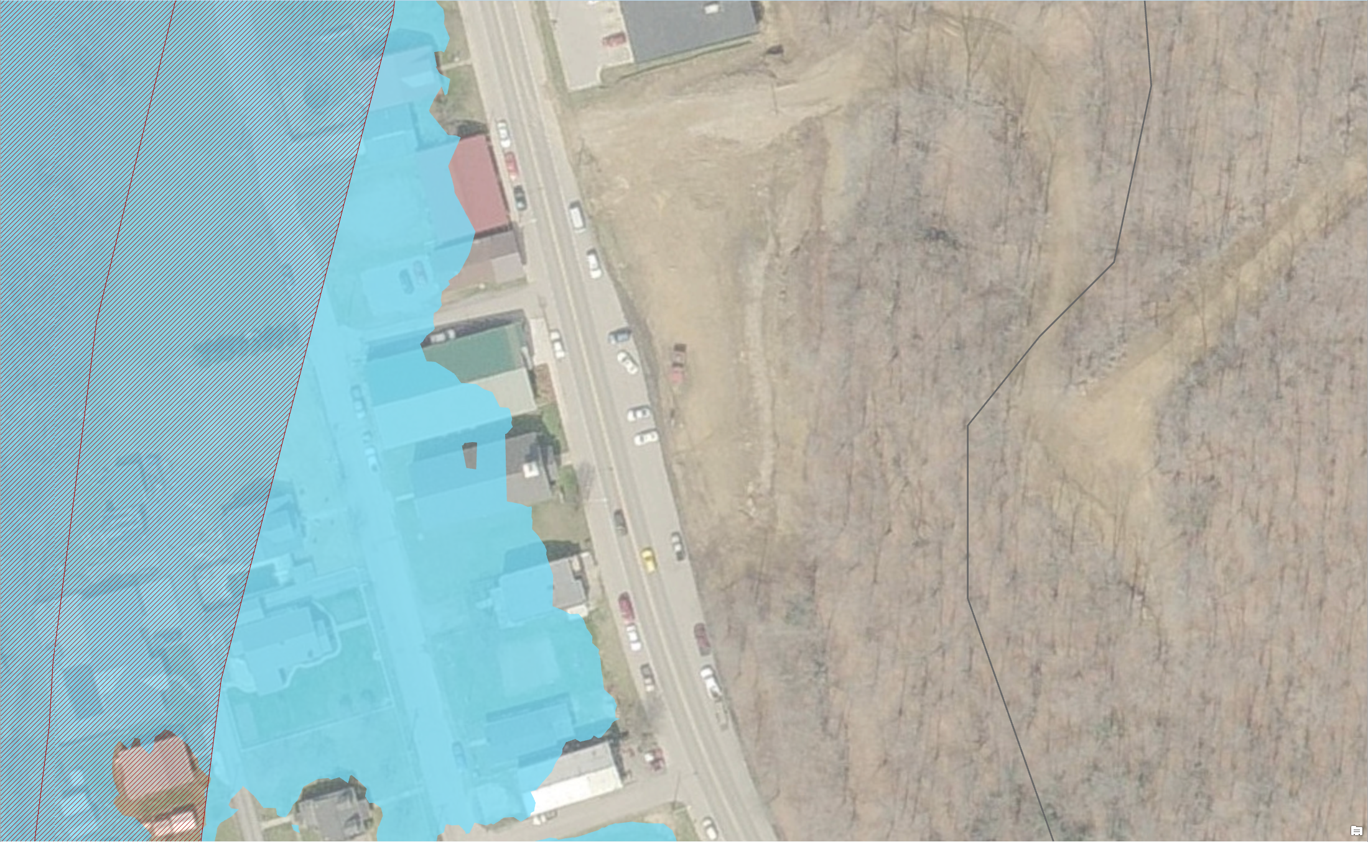
Advisory AE Determinations
Regulatory
AE Zone
Regulatory OUT but Advisory IN
Advisory
AE Zone
Structures OUT Regulatory AE Zone and IN Advisory AE Zone
What do you tell the public? Advisory information indicates a flood hazard area and will likely be incorporated into future effective NFIP maps. New development should not occur in Advisory Floodplains without a detailed study to show development reasonably safe from flooding. Recommend purchasing flood insurance for existing structures.

Slide 11
Flood Risk Assessments
Source Data
Quality digital source data is essential for correctly identifying and producing site-specific structures with accurate replacement values: assessment building records, property parcels, site addresses, leaf-off imagery, and building footprints
Engage local floodplain managers to quality check building inventories and critical facilities
Building Inventory Tool
The Building Inventory Tool streamlines the process for creating an inventory of buildings assets exposed to multi-hazards and for executing Hazus flood loss models at the building or structure level. The Tool requires further refinements like updating the building construction tables for commercial/industrial properties and including building information from non-assessment sources. The tool also has to be robust in that building updates can be performed quickly when newer data sources become available.
Building Values
Structures with significant variance between building replacement values and appraised values should be flagged and reviewed. Certain structures may require substituting the replacement value (cost to replace or rebuild the structure) with the appraised value (resell value).
Building values for tax-exempt properties like governmental, educational, or religious properties must be derived from other sources such as school and insurance databases. The WV Board of Risk and Insurance Management (BRIM) database is one such source.
Depth Grids
Accurate and comprehensive flood depth grids are essential for credible building loss damage estimates. Many of the flood risk structures are located in AE Zones where no depth grids exist. A composite depth grid is created from the best available depth grids.
Lessons Learned from Flood Risk Assessment Pilot Studies of Berkeley and Morgan Counties

Slide 12
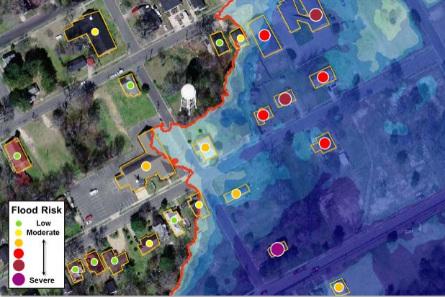
Statewide Flood Risk Structure File
Various Flood Risk Reports by community, stream name, flood zones, etc. can be generated from the Flood Risk Data (FRD).
Structure-specific (called “User-Defined Facilities”, or UDFs, in Hazus) flood risk assessments produce loss estimates at the building or structure level, and can often help facilitate flood risk discussions with individual home- or business-owners in a community. These types of risk assessments can provide valuable information to communities to help pre-screen properties and projects before going through a more in-depth Benefit-Cost Analysis (BCA). Personally-identifiable information (PII) such as property address, name of owner, etc. will not be included in FEMA's Flood Risk Assessment dataset (S_UDF_Pt and L_RA_UDF_Results). Source: Flood Risk Assessment Guidance - https://www.fema.gov/media-library-data/1469146645661-31ad3f73def7066084e7ac5bfa145949/Flood_Risk_Assessment_Guidance_May_2016.pdf

Slide 13
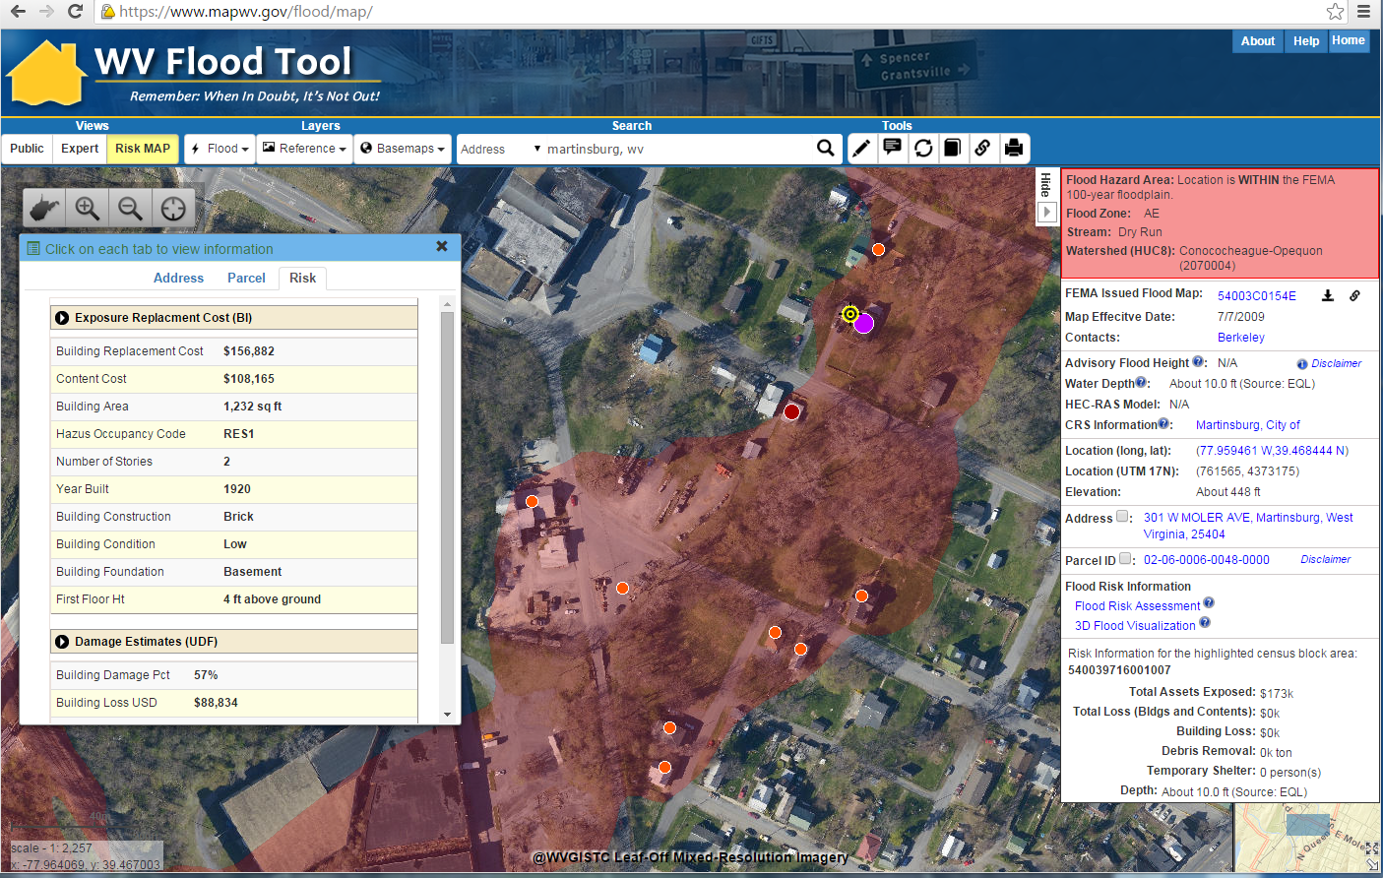
Flood Risk Structures of Martinsburg
Building Flood Loss Damage
57% of Residential Home Damaged at a Loss of $88,834
Flood Risk Building Info
Flood Risk Assessment Building Link
https://www.mapwv.gov/flood/map/?wkid=102100&x=-8678481&y=4788856&l=11&v=2
The Risk MAP view allows for viewing flood loss estimates at the building or structure level for a 1%-annual-chance flood event.

Slide 14
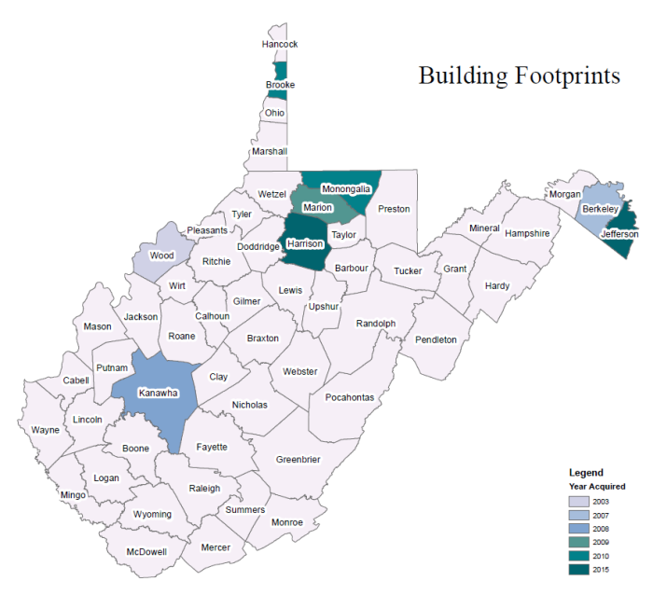
Statewide Building Web Service
Statewide building footprint reference layer created from best available sources
Layer | Source | Coverage
SAMB | 2003 2-ft. resolution leaf-off imagery, Statewide Addressing & Mapping Board (large buildings only) | Statewide
Counties | 6” or better leaf-off imagery | Select Counties
ORNL | 2016 1-meter Leaf-On, FEMA Region III contract to Oak Ridge National Lab | Statewide
County
How are BUILDING FOOTPRINTS beneficial?
Improves the locational pin-pointing of structures for multi-hazard assessments
Enhances visual representation of structures on 2D flood risk maps
Necessary for 3D flood visualization models
Building footprints extruded to known heights
Beneficial to communicating flood risk to communities

Slide 15
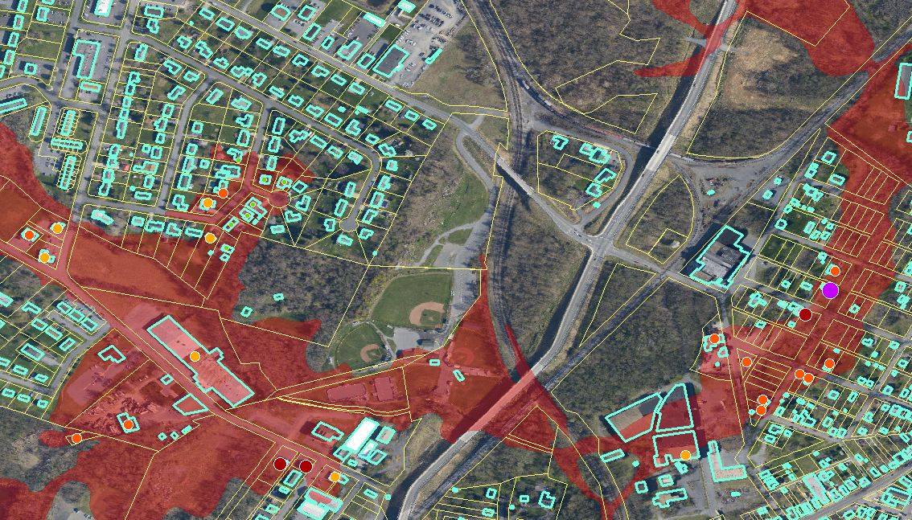
Building Footprints
Building footprints can enhance flood risk assessment maps
Building Flood Loss Damage
57% of Residential Home Damaged at a Loss of $88,834

Slide 16
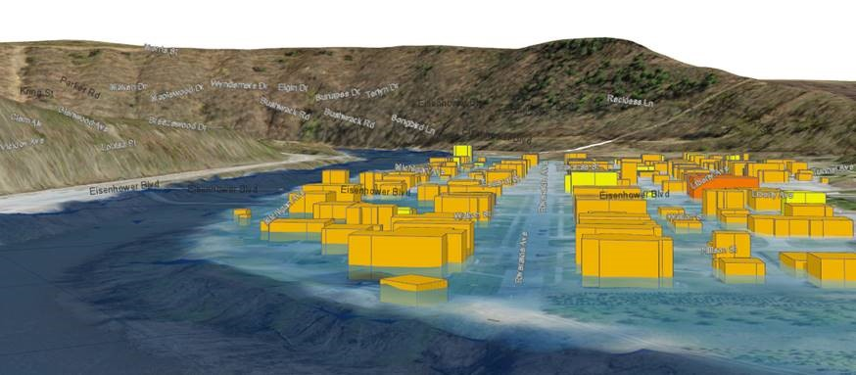
3D Flood Visualization - Community
Basic Steps for Creating 3D Flood Visualizations
Start with High-Resolution Digital Terrain Model
Overlay High-Resolution Aerial Image
Then add Streets
Then add Building Footprints
Extrude Building Footprints to Known Heights (“sugar-cube” 3D buildings)
Generate Detailed 3D Building Models
Photo-Texture the 3D Building Models
Add Trees and other Landscape/Streetscape Features
Add Flood Overlay (Riverine 1% Annual Chance Flood) Source: NEMAC
The objective is to make the 3D visualizations as realistic as possible in a minimal amount of processing time

Slide 17
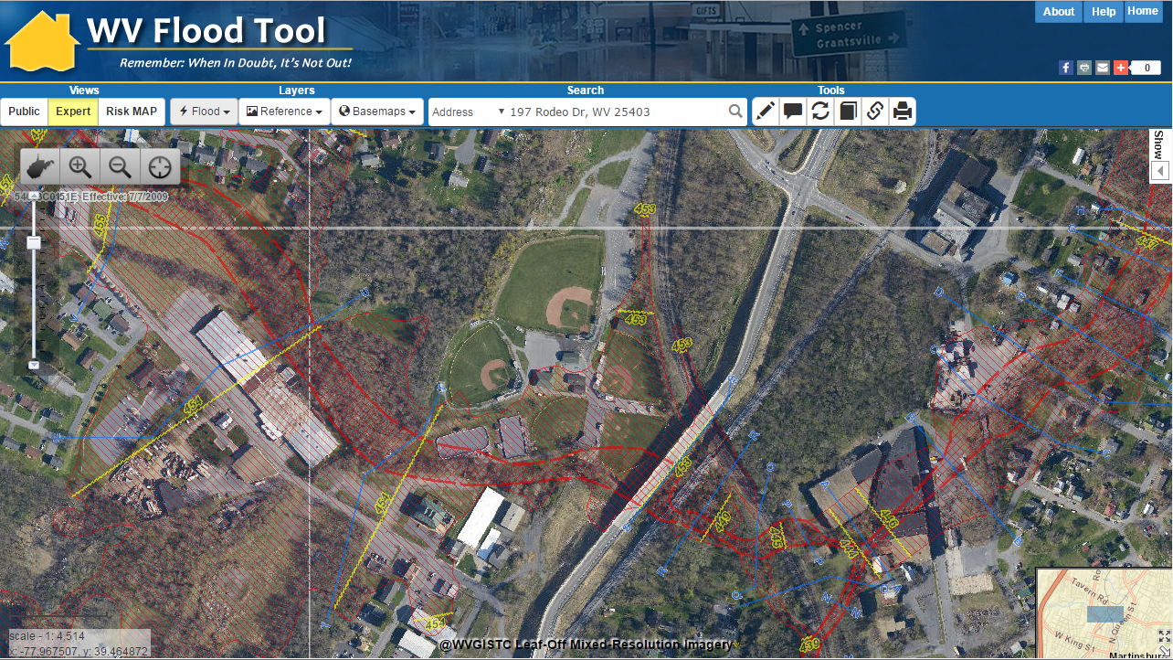
3D Flood Visualization - Community
Baltimore Street, Martinsburg, WV
3D
3D Northwest View
WV Flood Tool Conceptual Slide

Slide 18
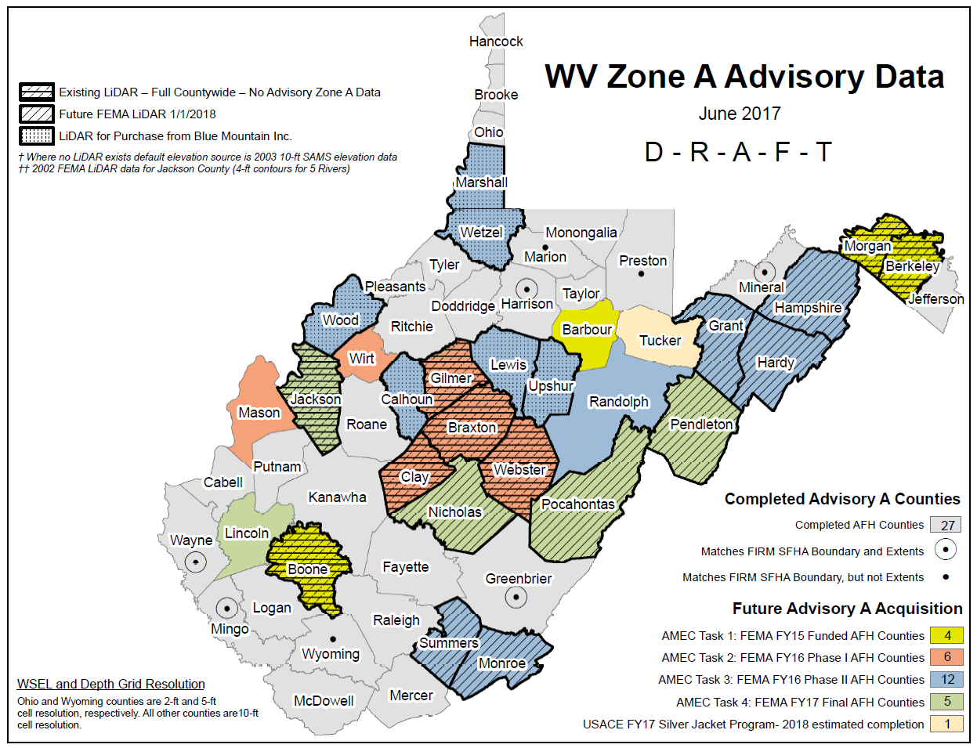
AFH Proposed Schedule

Slide 19
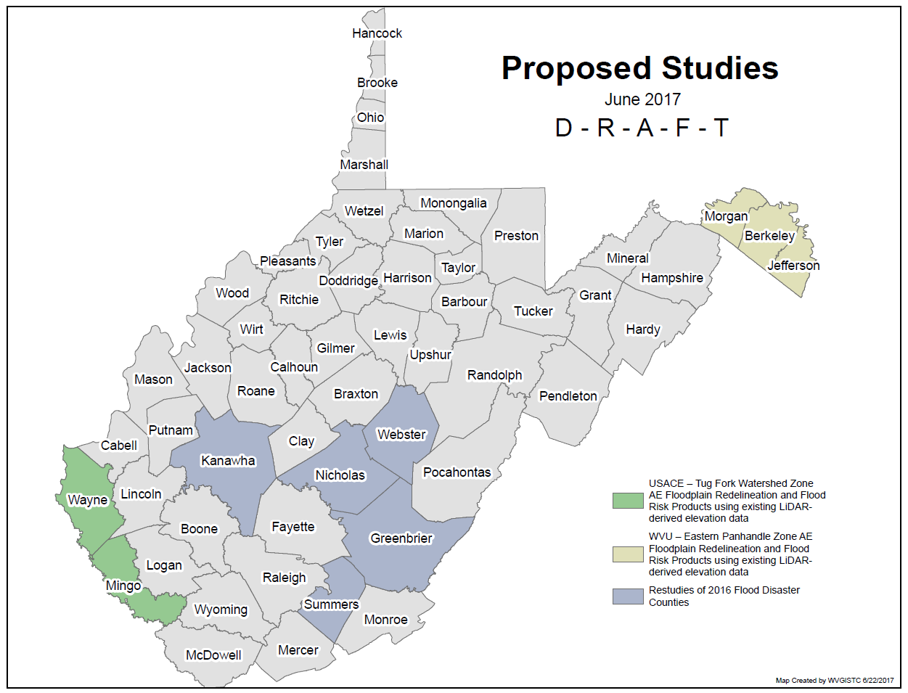
Proposed Flood Studies

