Slide 1
WV Flood Tool Upgrades
www.mapWV.gov/Flood
Flood Query Results Panel
External Links
Shared Links
Parcel Search
Building-Specific Risk Assessments
3D Flood Visualizations
Mobile Enhancements
Improved Data Layers
Flood Layers
Advisory Floodplains
Mitigated/Buyout Properties
Local Data (parcels, addresses, imagery, elevation)
Other Enhancements
Future Statewide Coverage Goals
August 2017

Slide 2
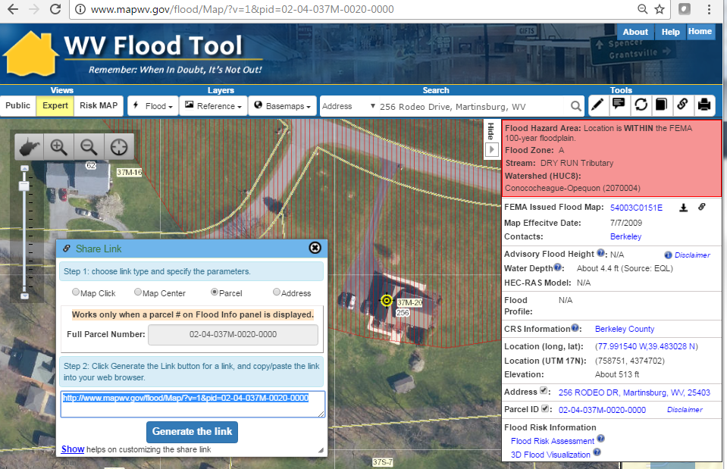
Flood Query Results Panel
# | Each Location Query Answers:
1 | In Flood Hazard Area? In Floodway?
2 | Stream name?
3 | Watershed name?
4 | FEMA Issued Flood Map?
5 | Floodplain Manager Contact?
6 | Flood Height value?
7 | Water Depth value?
8 | HEC-RAS Model available?
9 | Flood Profile available?
10 | In a CRS community?
11 | Coordinate x,y location?
12 | Ground elevation value?
13 | Street address location?
14 | Parcel ID location?
15 | Flood risk assessment info?
16 | 3D flood visualization?
1
2
Click Here
3
4
256
Rodeo Dr.
5
6
7
8
9
10
11
12
13
14
15
16
Parcel ID Web Link: http://www.mapwv.gov/flood/Map/?v=1&pid=02-04-037M-0020-0000

Slide 3
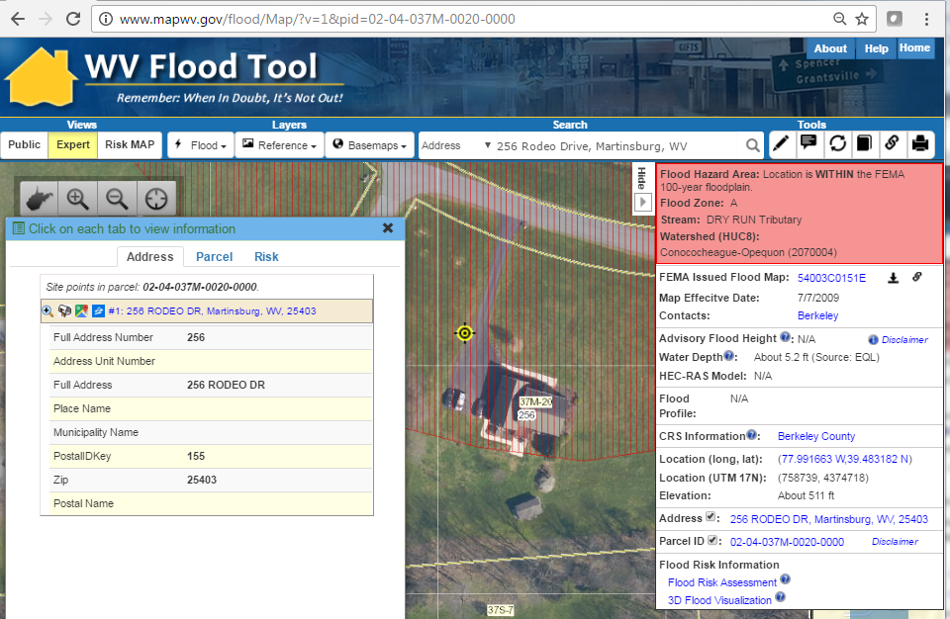
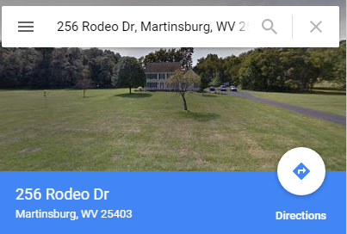
New External Links
EXTERNAL WEB LINKS
Google Street View (address required)
Zillow.com (single address required)
View FEMA Flood Map (panel ID required)
Download FEMA Flood Map (panel ID)
(5) FEMA’s National Flood Hazard Layers (NFHL) web viewer (map extent and zoom level passed as parameters)
3
4
5
1
2
256 Rodeo Drive
External links launched from WV Flood Tool
Parcel ID Web Link: http://www.mapwv.gov/flood/Map/?v=1&pid=02-04-037M-0020-0000

Slide 4
More Shared Links
Parcel ID Web Link: http://www.mapwv.gov/flood/Map/?v=1&pid=02-04-037M-0020-0000
Share Link
256 Rodeo Drive
Exchange flood info with others using various link types: (1) Map Click, (2) Map Center, (3) Parcel ID, (4) Address

Slide 5
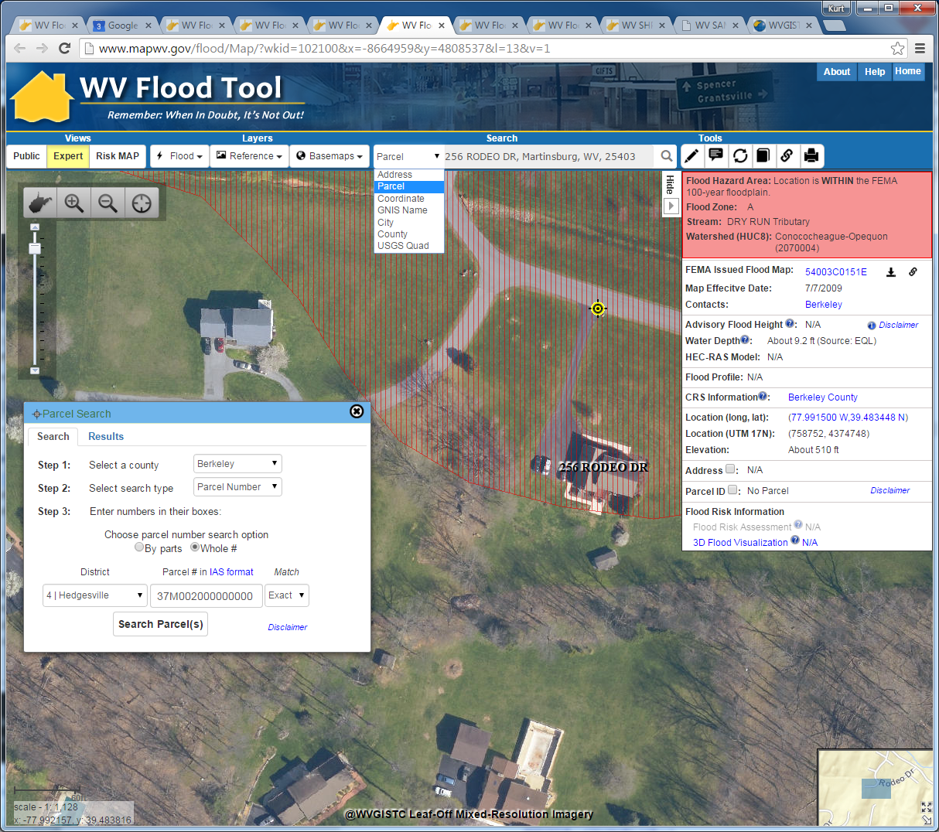
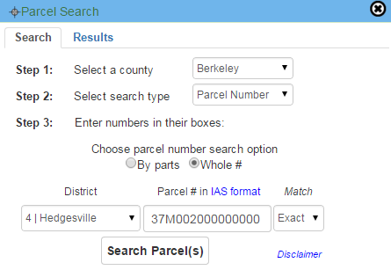
Parcel Search
Parcel Search
Parcel Search for 256 Rodeo Drive
Search by:
Parcel Owner
Parcel Address
Parcel Number
Parcel Search Results
IAS Parcel ID:
04 37M002000000000
GIS Parcel ID:
02-04-037M-0020-0000
256 Rodeo Drive
Locate and zoom to parcels using various search parameters

Slide 6
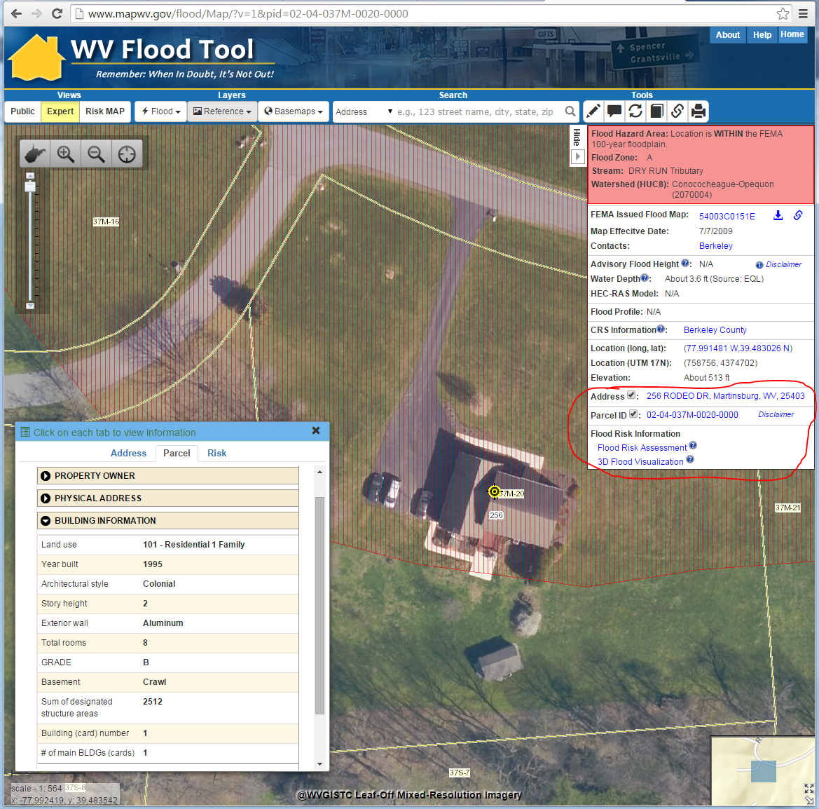
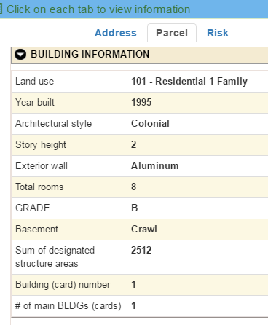
Building-Specific Flood Risk Assessments (Currently only Berkeley & Morgan Counties)
Web Link: http://www.mapwv.gov/flood/Map/?v=1&pid=02-04-037M-0020-0000
The tax parcel centroids and associated building characteristic data (YRBLT, STYLE, STORIES, EXTWALL, GRADE, BSMT, AREASUM) from the Integrated Assessment System --along with RS Means construction cost values, flood inundation areas, and water depth inputs -- are used by Hazus Flood Model software to estimate flood damages to each structure for a riverine 1% annual flood event.
256 Rodeo Drive
Click on Parcel ID (Building Info), Flood Risk Assessment, and 3D Flood Visualization links in bottom right of Flood Query Results Panel

Slide 7
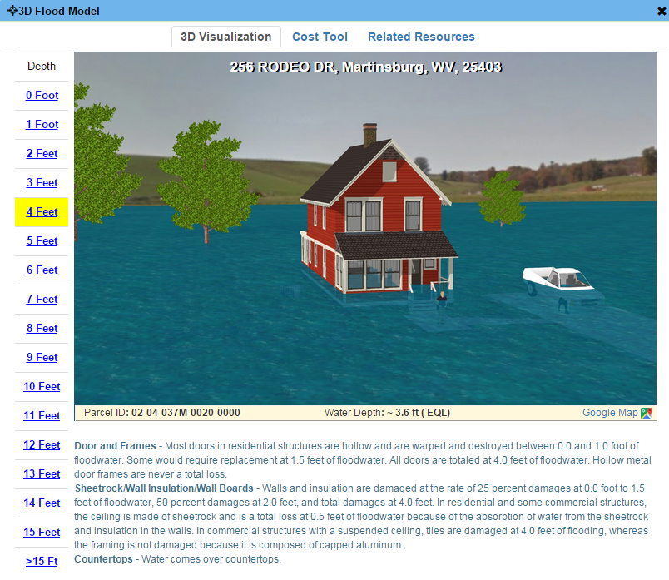
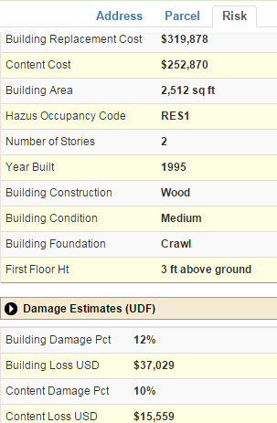
Flood Risk Assessment (Cont.)
Structure-specific (called “User-Defined Facilities”, or UDFs, in Hazus) flood risk assessments produce results and loss estimates at the building or structure level, and can often help facilitate flood risk discussions with individual home- or business-owners in a community. Source: “Guidance for Flood Risk Analysis and Mapping, Flood Risk Assessments”
Web Link: http://www.mapwv.gov/flood/Map/?v=1&pid=02-04-037M-0020-0000
Example flood risk assessment information for 256 Rodeo Drive. Includes 3D flood visualization with water depth-flood damage information for homeowner.

Slide 8
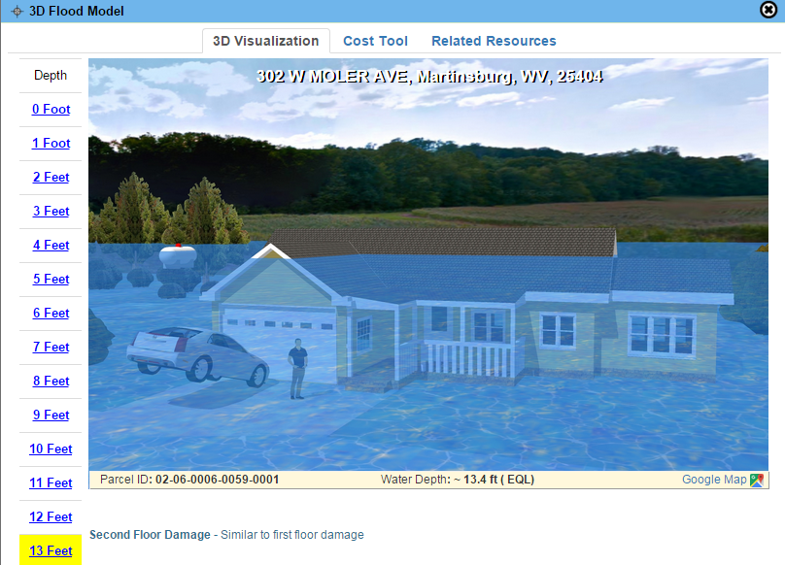
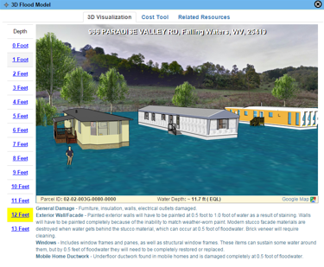
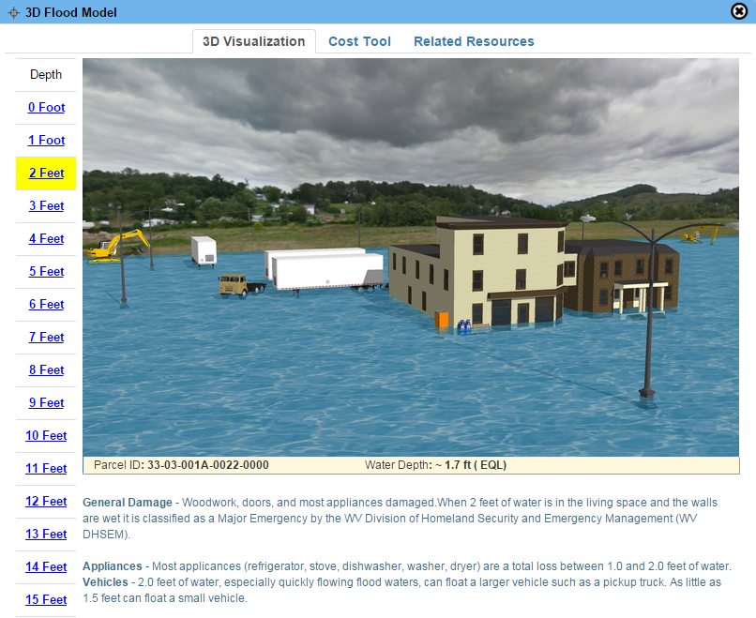
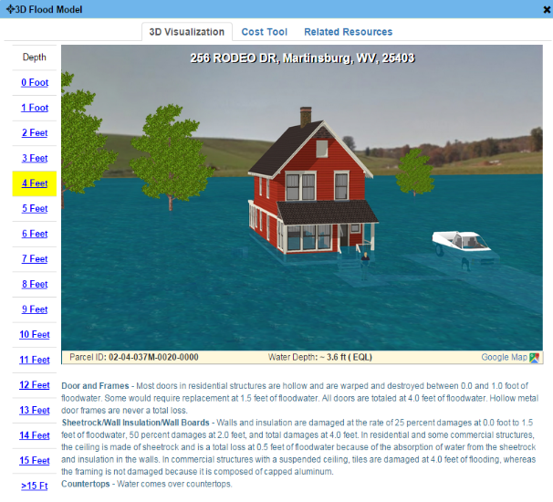
3D Flood Visualizations
Visualizations are easier for non-technical users to understand flood risks to their property in feet of water rather than comprehending the adjacent base flood elevation
1-Story Home
Mobile Home
Commercial
"The 3D visualization is really cool. Our citizen comes to the counter and says 'there is no way there can be a flood like that.' Then we show them how much water you will get in your house and how much it will cost to repair it. The 3d visual is really good! And then we like the way you can click on a parcel ID and it brings up all the information as far as property owner, tax map and parcel number, deed book, page number - everything is right there. And the building information is really good too because it tells what the structure is made of, whether it has a basement - all the information that we would have to go to another system to pull is right there.“ Source: 3D Flood Visualization Comment from Debbie Robinson, Kanawha County Planning and Development Office
2-Story Home
3D flood visualizations are available statewide for locations where flood depth grids exist. The parcel assessment data fields (land use, stories) are necessary to identify the correct property type: residential one- or two-story homes, mobile home, commercial/industrial, etc.

Slide 9
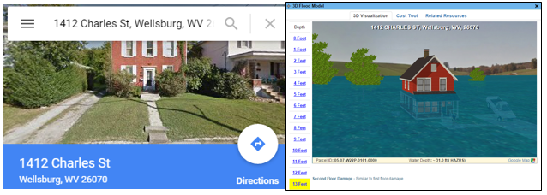
3D Flood Visualizations
Brooke County
https://www.mapwv.gov/flood/map/?v=1&pid=05-07-W22P-0161-0000
1412 Charles St, Wellsburg, WV, 26070, Parcel ID: 05-07-W22P-0161-0000
“This is the coolest thing ever….thank you!!!”
Source: 3D Flood Visualization Comment from Terri Jo Bennett, CFM, Upshur County Building Permit, Floodplain and Addressing and Mapping Coordinator
Upshur County
https://www.mapwv.gov/flood/map/?v=0&pid=49-05-0003-0031-0000
673 Vicksburg RD, Buckhannon, WV, 26201, Parcel ID: 49-05-0003-0031-0000

Slide 10
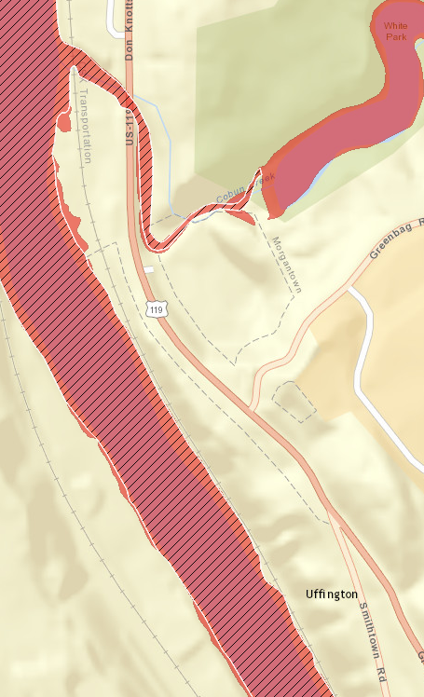
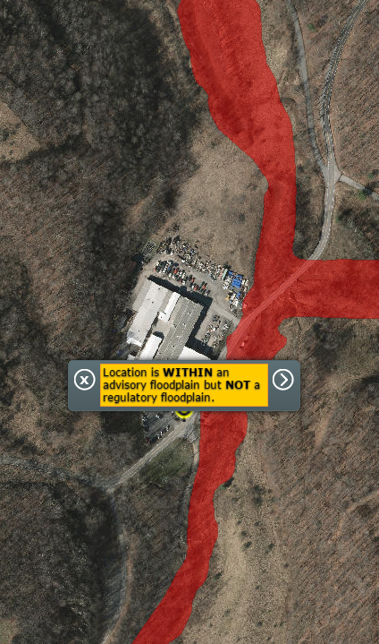
Mobile Application Enhancements
http://www.mapwv.gov/flood/mmap/
Added Floodway
Advisory Floodplain Notification

Slide 11
New Flood Layers Added
FLOOD LAYERS | Public View for general public | Expert View for floodplain managers | RiskMAP View for flood risk planning
Flood Hazard Layers Flood Hazard Zones Panel Index X-Sections BFE’s / Advisory Flood Heights LOMAs / LOMRs* Structures, Levees, Mile Markers* | Yes No No No No No | Yes Yes Yes Yes Yes Yes | Yes No No No No No
Flood Prediction USGS Real-Time Stream Gages* | No | Yes | No
Flood Mitigation Mitigated/Buyout Properties | No | Yes | Yes
Flood Risk Flood Water Depths Historical High Water Marks Site-Specific Flood Risk Assessment Data Flood/Dam Inundation Maps (future) | No No No No | Yes Yes No No | Yes Yes Yes Yes
Italics Text = New Layers Added * External Agency Web Map Services

Slide 12
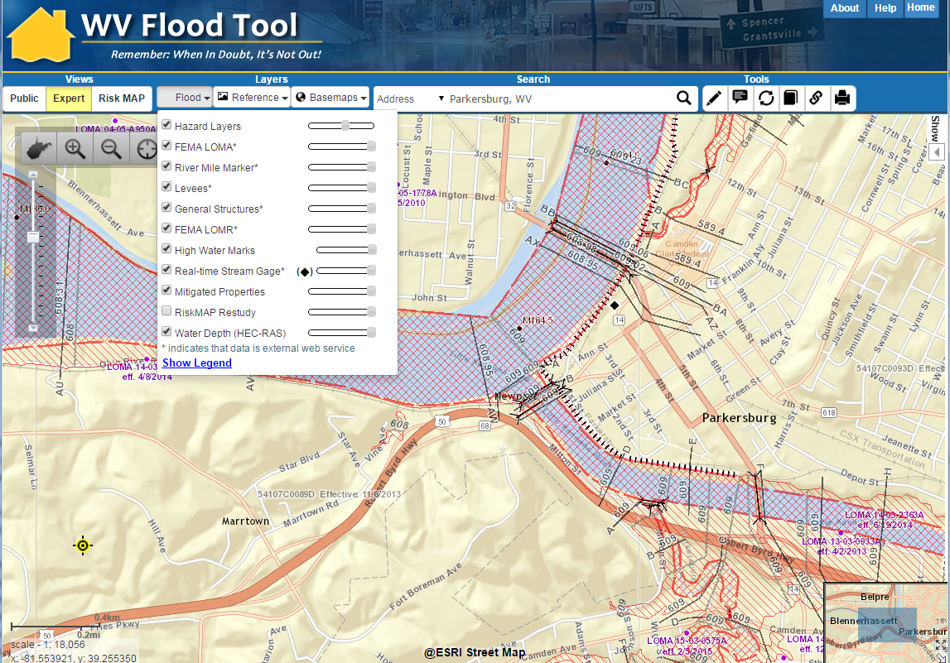
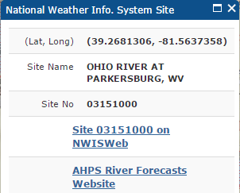
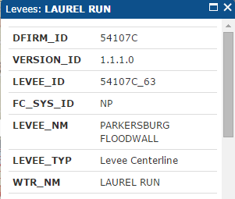
New Flood Layers Added
NWIS
Stream Gage
Laurel Run
Levee
Example: Levee structure and real-time stream gage located at Parkersburg, WV
http://www.mapwv.gov/flood/Map/?wkid=102100&x=-9080275&y=4759882&l=8&v=1

Slide 13
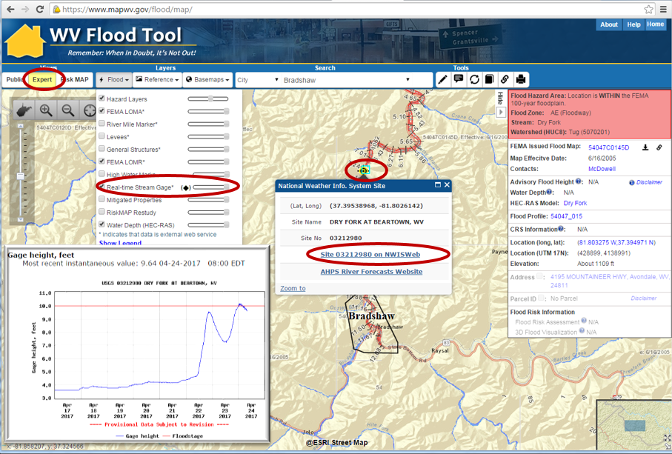
NWIS Stream Gage
Beartown
Stream Gage
Example: Real-Time Stream Gage Data for Dry Fork at Beartown, WV (Expert View) https://www.mapwv.gov/flood/map/?wkid=102100&x=-9104675&y=4491964&l=6&v=1

Slide 14
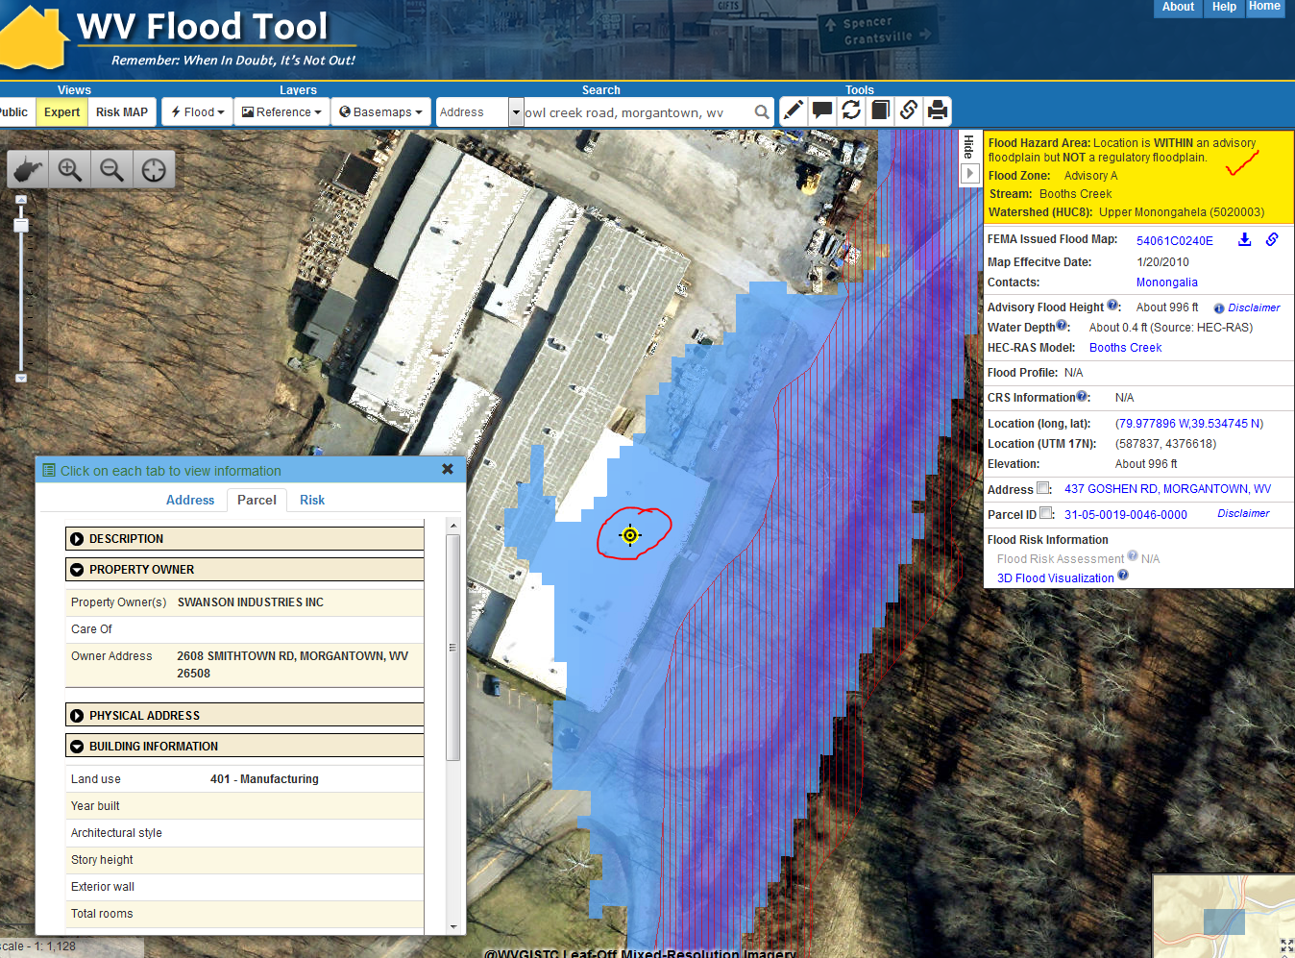
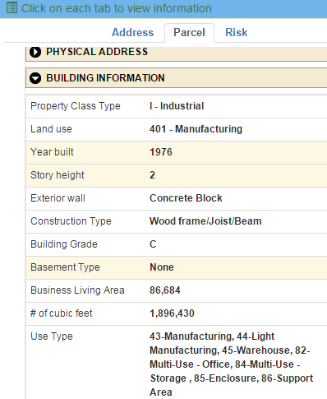
Advisory Floodplains
New advisory flood heights, depth grids, and floodplain boundaries are being added to the WV Flood Tool and will exist for all counties in the near future
A new flood zone status (orange/mango color) has been added to the WV Flood Tool when the location is WITHIN an advisory floodplain but NOT a regulatory floodplain. In the example on the left note how a the Swanson Industries building is located in the new model-backed Advisory A Zone (blue water depth grid) but not the effective Approximate A Zone (red vertically hachured polygon). This example represents an Advisory A Zone but the same could be done for new Advisory AE Zones generated from re-delineated AE Non-Restudy areas using new topography.
Advisory A
437 Goshen Road
Example: 437 Goshen Road, Morgantown, WV (Swanson Industries Plant)
https://www.mapwv.gov/flood/map/?wkid=102100&x=-8903099&y=4798561&l=12&v=1

Slide 15
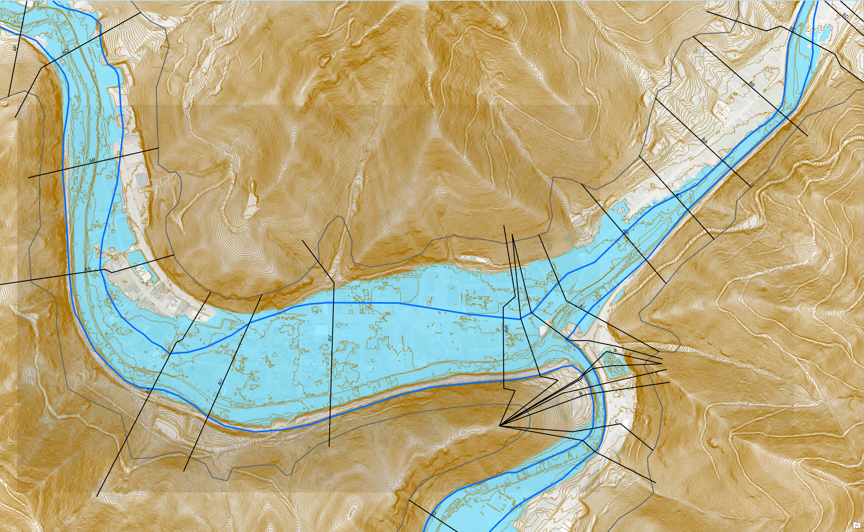
Advisory AE Floodplain
Redelineated Floodplain Using New Topo
Regulatory AE Floodplain
Advisory AE Floodplain
Advisory AE
Zone
Clear Fork
Oceana
Location: Clear Fork, Oceana, Wyoming County, WV
https://www.mapwv.gov/flood/map/?wkid=102100&x=-9086441&y=4536103&l=9&v=1

Slide 16
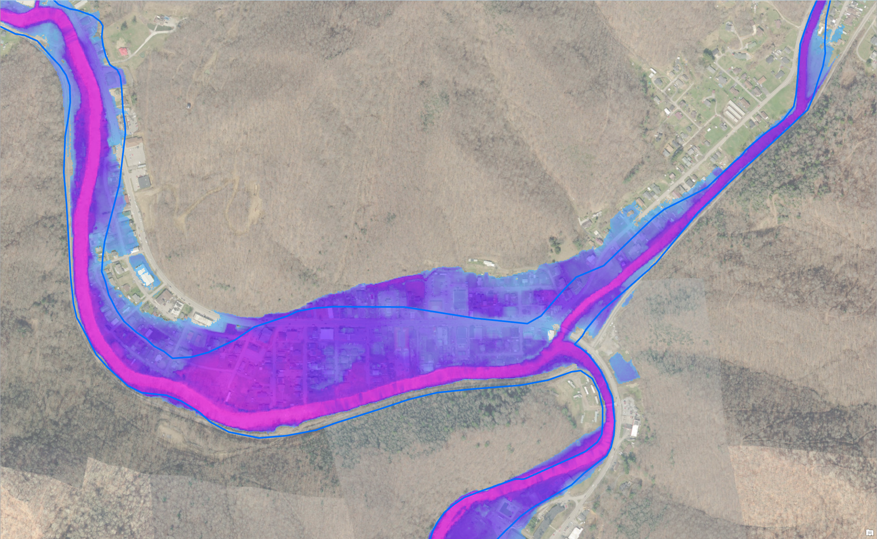
Advisory AE Depth Grid
Regulatory AE Floodplain
Advisory AE
Water Depth
Advisory AE Water Depth
Clear Fork
Oceana
Location: Clear Fork, Oceana, Wyoming County, WV
https://www.mapwv.gov/flood/map/?wkid=102100&x=-9086441&y=4536103&l=9&v=1

Slide 17
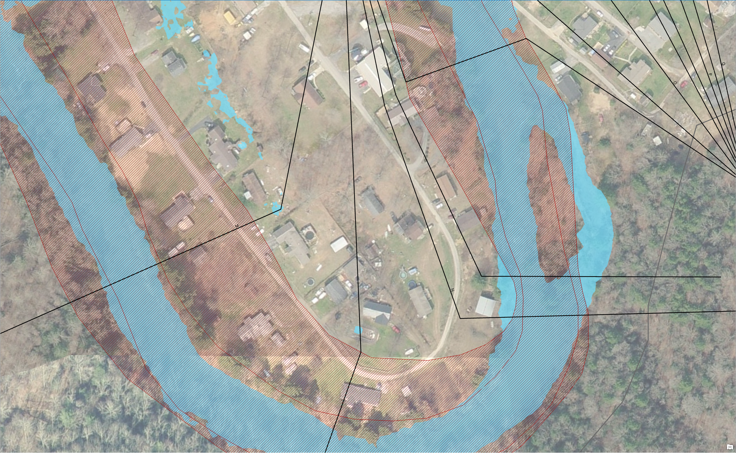
Advisory AE Determinations
Regulatory IN but Advisory OUT
Regulatory AE Zone
Advisory AE Zone
Structures IN Regulatory AE Zone and OUT Advisory AE Zone
What do you tell the public? Acquire an elevation certificate and use the advisory flood elevation to request a LOMA to amend the effective NFIP map.

Slide 18
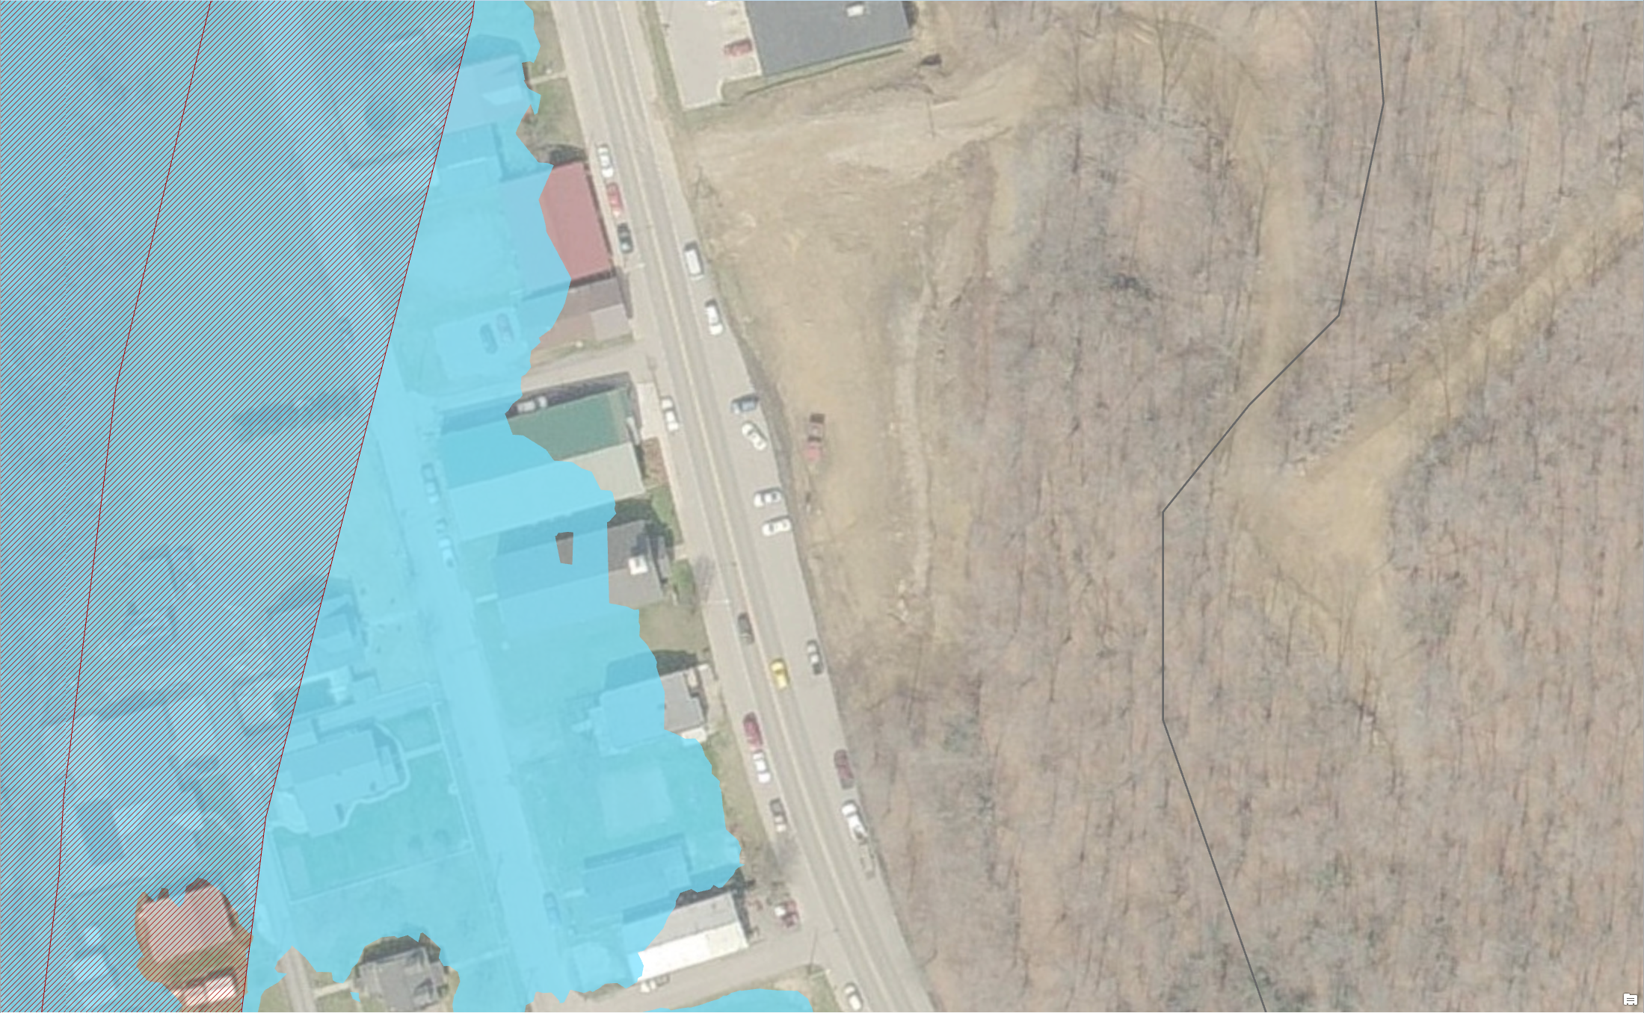
Advisory AE Determinations
Regulatory
AE Zone
Regulatory OUT but Advisory IN
Advisory
AE Zone
Structures OUT Regulatory AE Zone and IN Advisory AE Zone
What do you tell the public? Advisory information indicates a flood hazard area and will likely be incorporated into future effective NFIP maps. New development should not occur in Advisory Floodplains without a detailed study to show development reasonably safe from flooding. Recommend purchasing flood insurance for existing structures.

Slide 19
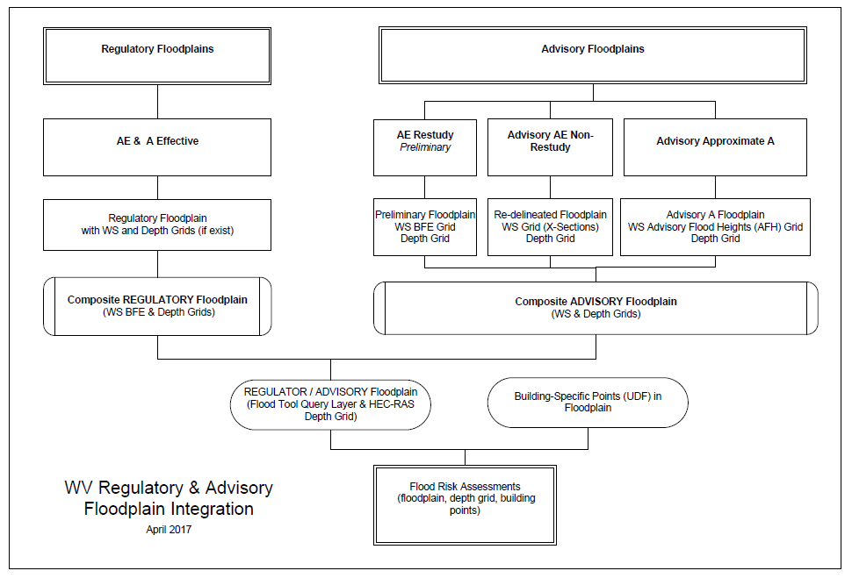
Regulatory vs. Advisory Floodplains
Regulatory
Advisory
Integration
Required

Slide 20
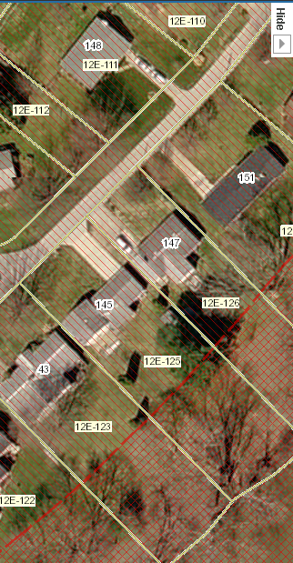
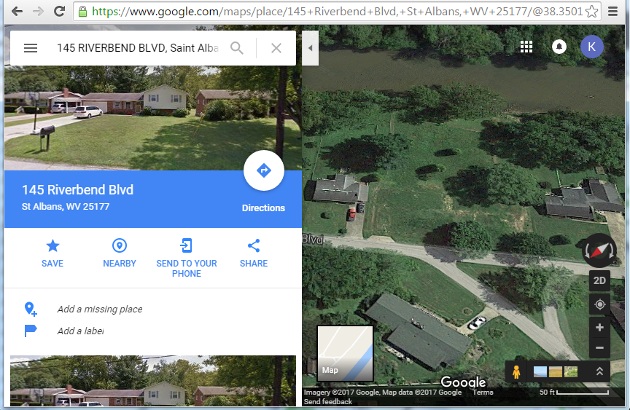
Mitigated/Buyout Properties
Google Maps
Address: 145 Riverbend Blvd
Parcel ID: 20-16-012E-0125-0000
Example: 145 Riverbend Blvd, Saint Albans, WV (adjacent to Coal River)
House still visible in default imagery of WV Flood Tool and Google StreetView; however, in Google Maps oblique view the structure has been removed.
https://www.mapwv.gov/flood/map/?v=0&pid=20-16-012E-0125-0000
WV
Flood Tool

Slide 21
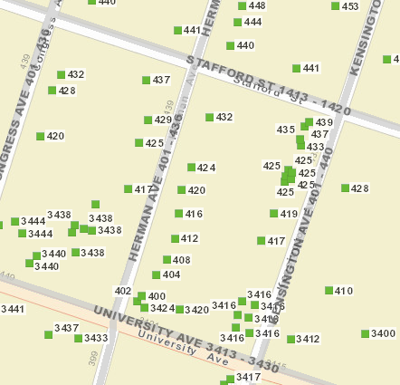
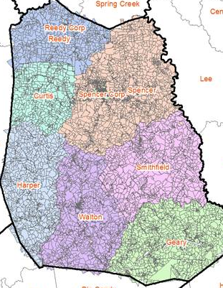
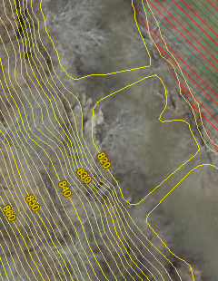
Improved Local Data Integration
Site Addresses Tax Parcels Aerial Imagery Elevation Contours
Roane County
41
E-911 offices updated addresses to the Statewide Addressing & Mapping System which links to WV Flood Tool
38
county assessors have given permission to have parcels added to the WV Flood Tool
29
counties have submitted their more current aerial imagery to be included in the WV Flood Tool
3
counties have requested that their 2-foot elevation contours be displayed in the WV Flood Tool
County data reference layers are very important for flood determinations and flood risk products

Slide 22
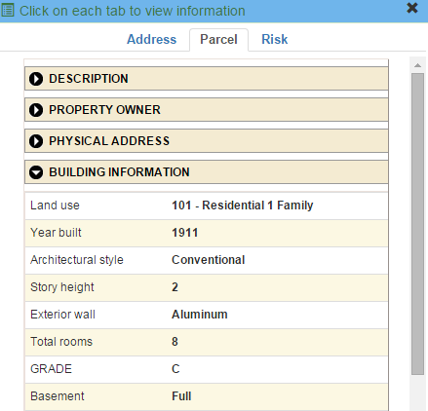
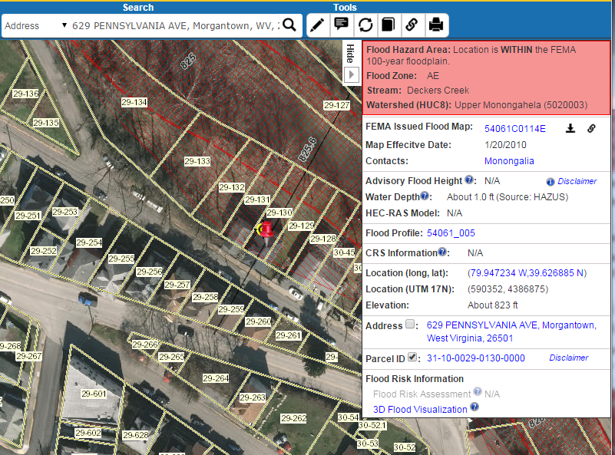
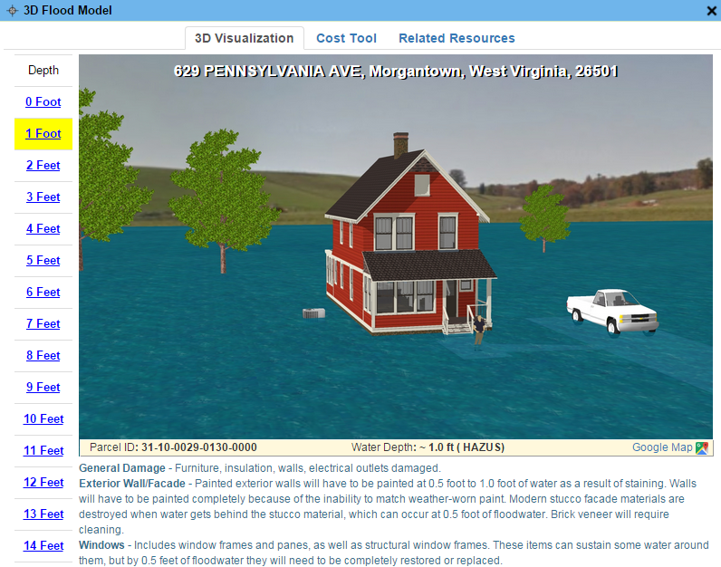
Parcels link to Owner/Building Info
629 PENNSYLVANIA AVE, Morgantown, WV, 26501
https://www.mapwv.gov/flood/map/?wkid=102100&x=-8899684&y=4811867&l=13&v=0
Residential or Farm Property

Slide 23
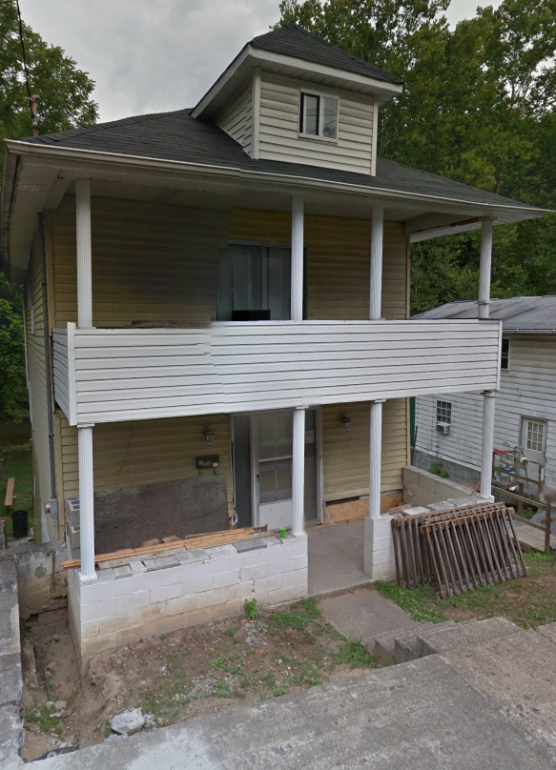
Parcels link to Owner/Building Info
Residential or Farm Property
DESCRIPTION
GIS Parcel ID | 31-10-0029-0130-0000
Legal Description | BL 12-1/2 LOT 10
Acreage (deed) | 0.0373
Tax Year | 2015
Tax Class | 4
Deed Book / Page | 1259 / 45
PROPERTY OWNER(S)
Property Owner(s) | Smith John
629 PENNSYLVANIA AVE, Morgantown, WV, 26501
https://www.mapwv.gov/flood/map/?wkid=102100&x=-8899684&y=4811867&l=13&v=0
BUILDING INFORMATION
Property Class Type | R- Residential
Land Use | 101 - Residential 1 Family
Year Built | 1911
Architectural style | Conventional
Exterior Wall | Aluminum
Stories | 2
Total Rooms | 8
Building Grade | C
Basement Type | Full
Structure Area | 1,320
Building (card) Number | 1
# of main BLDGs (cards) | 1
APPRAISED VALUES
Land Appraisal | $33,200
Building Appraisal | $29,000
Total Appraisal | $62,200

Slide 24
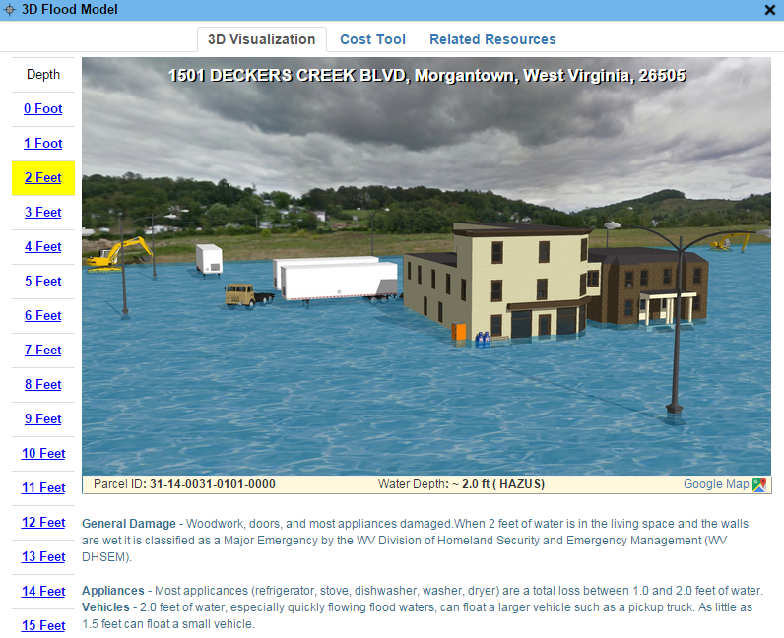
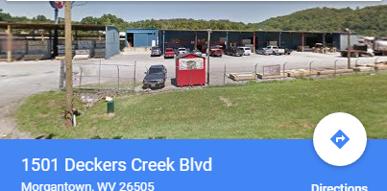
Parcels link to Owner/Building Info
Commercial or Industrial Property
DESCRIPTION | 84 Lumber
GIS Parcel ID | 31-14-0031-0101-0000
Legal Description | 5.0922 AC;SABRATON
Acreage (deed) | 5.09
Deed Book / Page | 1376 / 234
PROPERTY OWNER(S)
Property Owner(s) | SPIRIT SPE PORTFOLIO
1501 DECKERS CREEK BLVD, Morgantown, West Virginia, 26505
https://www.mapwv.gov/flood/map/?v=0&pid=31-14-0031-0101-0000
BUILDING INFORMATION
Property Class Type | C- Commercial
Land Use | 373 - Retail-Single Occupancy
Year Built | 1994
Stories | 2
Exterior Wall | Brick or Stone
Construction Type | Pre-Engineered Steel
Building Grade | D+
Basement Type | None
Business Living Area | 15,255
Cubic Feet | 292,380
Use Type | 34-Retail Store, 82- Multi-Use Office
COST VALUES
Other Bldg/Yard Values | $67,020
Commercial Value | $227,700
APPRAISED VALUES
Land Appraisal | $378,800
Building Appraisal | $294,700
Total Appraisal | $673,500

Slide 25
Assessment Building Info
West Virginia Parcel Property Class Breakdown for Tax Year 2017
Code | Property Class | # of Parcels | Percent (%)
R | Residential | 1,164,470 | 79.61%
F | Farm | 121,384 | 8.30%
A | Apartment | 3,222 | 0.22%
C | Commercial | 65,784 | 4.50%
I | Industrial | 3,105 | 0.21%
X | Exempt | 97,773 | 6.68%
U | Utility | 192 | 0.01%
Other | Not classified | 6,837 | 0.47%
 |  | 1,462,767 | 100.00%
Assessment records are important for building inventories and are used to estimate the total building exposure ($) and building loss ($) for multi-hazards. Often building inventories and corresponding loss estimates are organized by property class.

Slide 26
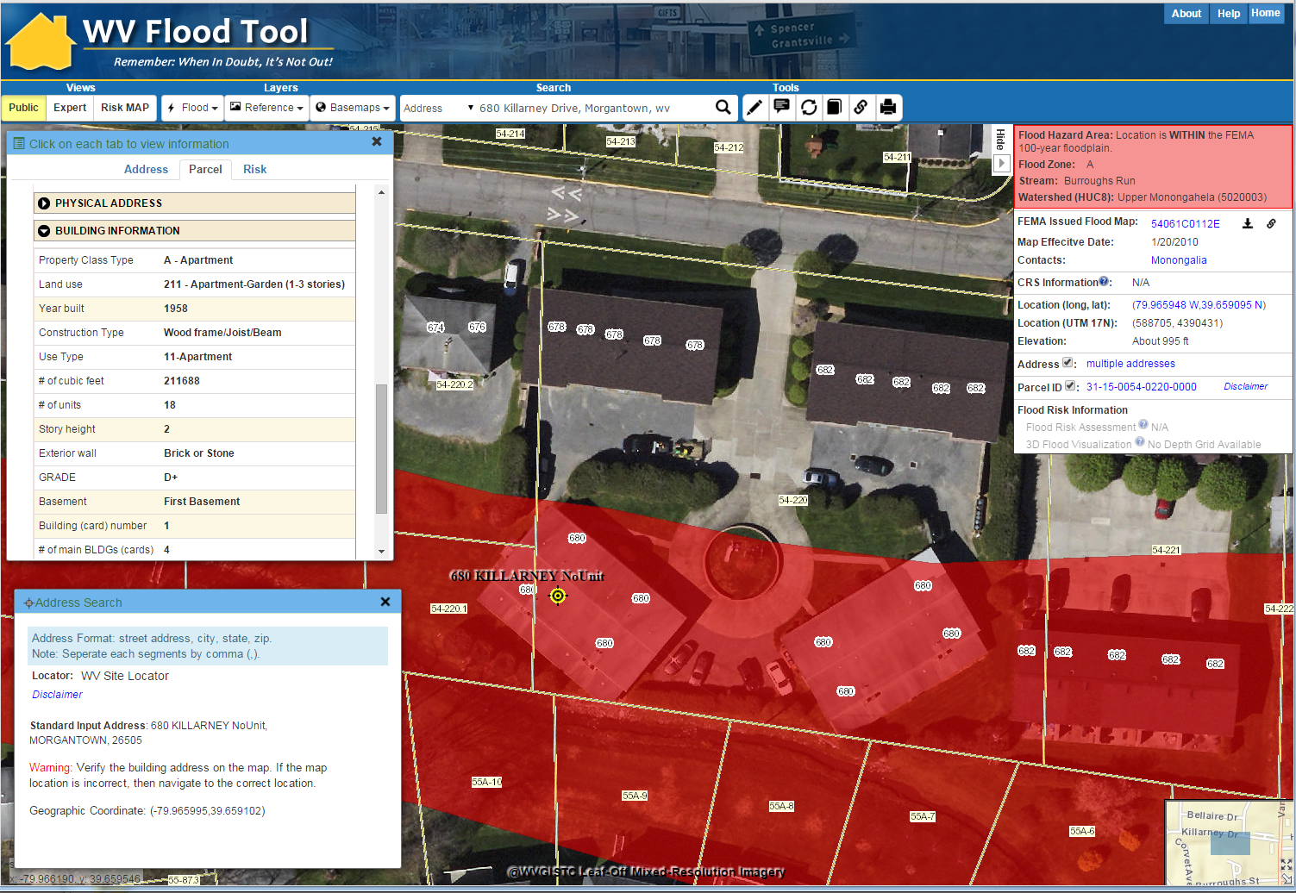
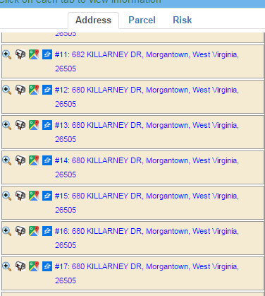
Addresses Link to Parcels
https://www.mapwv.gov/flood/map/?wkid=102100&x=-8901769&y=4816526&l=13&v=0
Parcel Building Info
1
3
2
3
2
Multi-Unit Addresses
1
Site Address Match

Slide 27
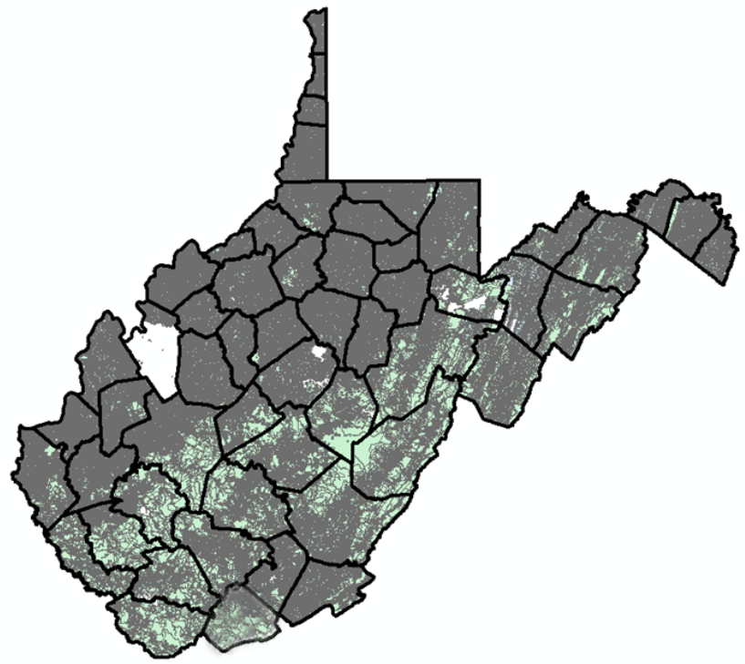
Statewide Digital Parcel File
606 Tax Districts
5% or 33 tax districts have incomplete or no digital parcel boundaries
Digital Parcel Sources
Assessor Offices
E-911 Offices
State Tax Department

Slide 28
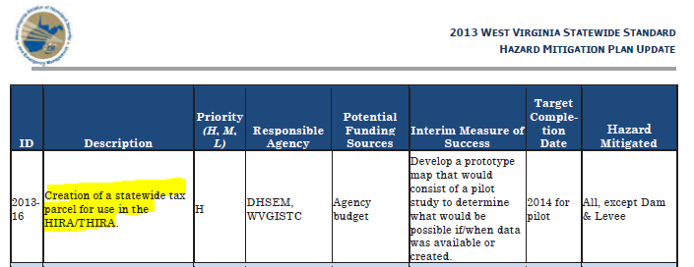
Statewide Digital Parcel File
High Priority
of
2013 State Hazard Mitigation Plan

Slide 29
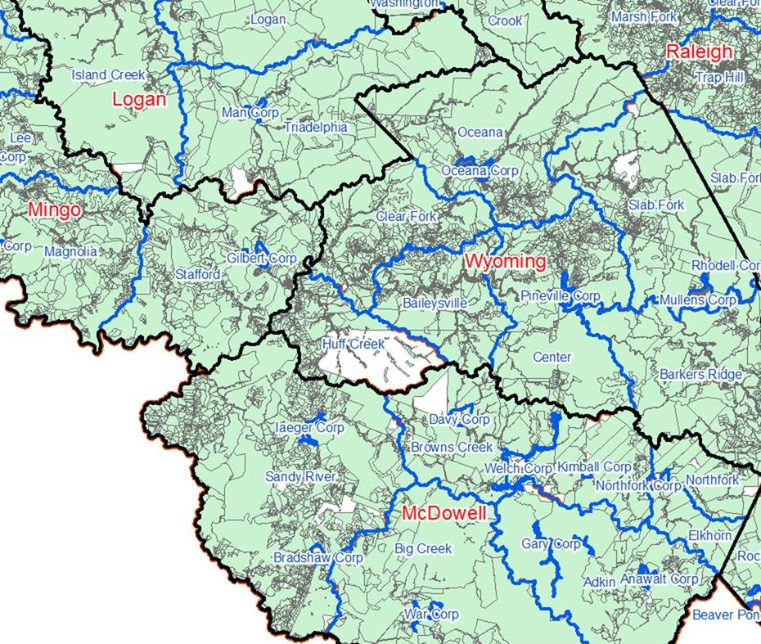
Statewide Digital Parcel File
# | Missing/ Obsolete Data Parcels
1 | Boone
2 | Braxton
3 | Calhoun
4 | Clay
5 | Jackson
6 | Logan
7 | McDowell
8 | Roane
9 | Tucker
10 | Tyler
11 | Wirt
12 | Wyoming
What is the cost for parcel conversion?
$3.00 to $3.50 per parcel
Cost estimate of $420K to achieve a current and accurate Digital Parcel Boundary file

Slide 30
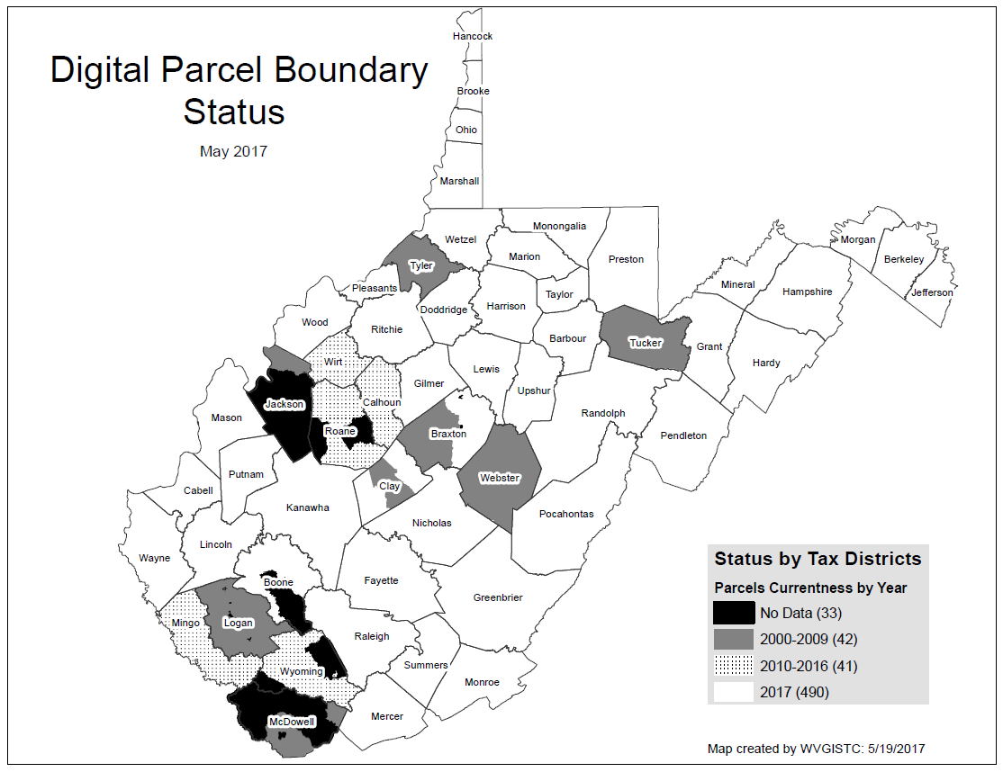
Statewide Digital Parcel File
# | Missing/ Obsolete Data Parcels
1 | Boone
2 | Braxton
3 | Calhoun
4 | Clay
5 | Jackson
6 | Logan
7 | McDowell
8 | Roane
9 | Tucker
10 | Tyler
11 | Wirt
12 | Wyoming
Estimated cost of $420K to achieve a current, accurate, and maintained Digital Parcel Boundary file
SB 588 – As of July 5 will cost about $25 instead of $165,000 to acquire Statewide Parcel File

Slide 31
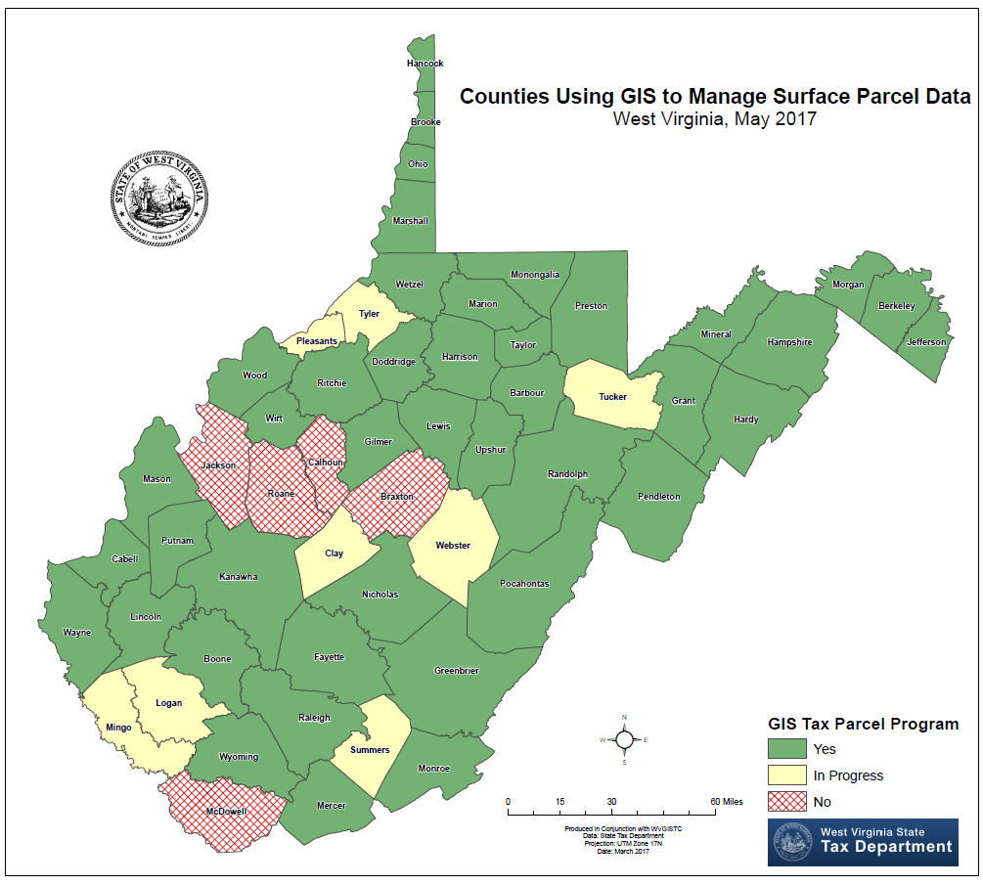
Counties using GIS

Slide 32
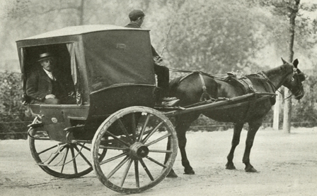
Paper to Digital Tax Maps
Mapper: “I was apprehensive four years ago when our newly elected assessor decided to digitize our parcel mapping system; but with the work done by the mapping contractor then and their continual assistance today, I cannot imagine returning to the manual system.” Source: 2017 Tax Map Survey
MANUAL (Paper) TRANSITION DIGITAL
5 counties 7 counties 43 counties
Manual drafting of tax maps is becoming obsolete!!!
There are no schools that teach manual drafting skills
Manual drafting supplies are becoming scarce
Tax Division may remove itself from drafting contract services

Slide 33
Statewide Digital Parcel File
606 Tax Districts
5% or 33 tax districts have incomplete or no digital parcel boundaries
Digital Parcel Sources
Assessor Offices
E-911 Offices
State Tax Department

Slide 34
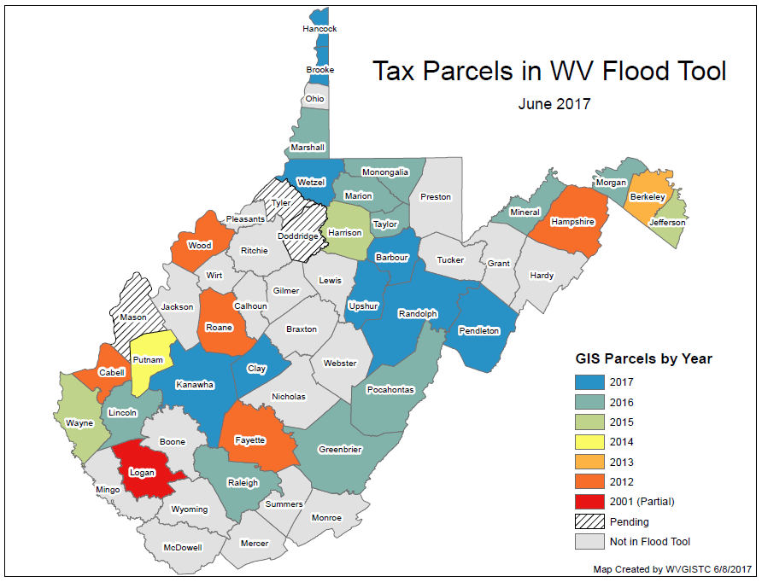
Parcels in WV Flood Tool
Contact your assessor about including parcels in WV Flood Tool

Slide 35
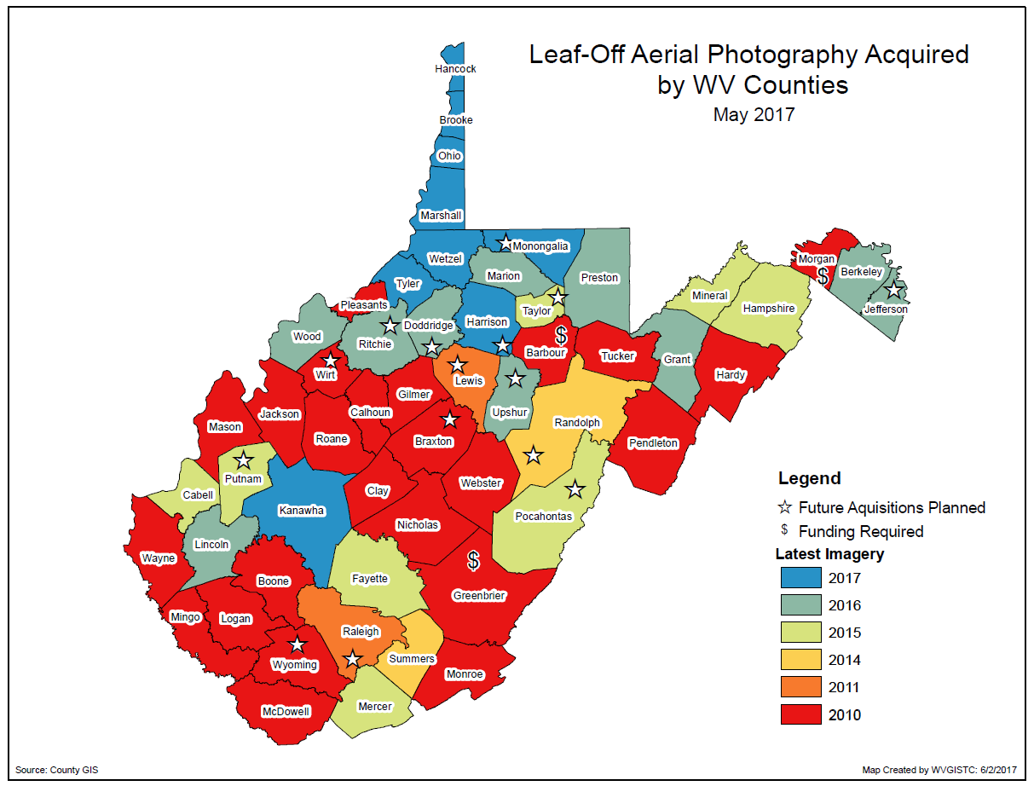
Aerial Imagery
55% of the counties have acquired leaf-off imagery since 2010
What is the cost?
$70 per square mile for aerial imagery
Ideally, leaf-off imagery should not be older than 5 years. Imagery is important for identifying at-risk structures and accurate disaster mapping.

Slide 36
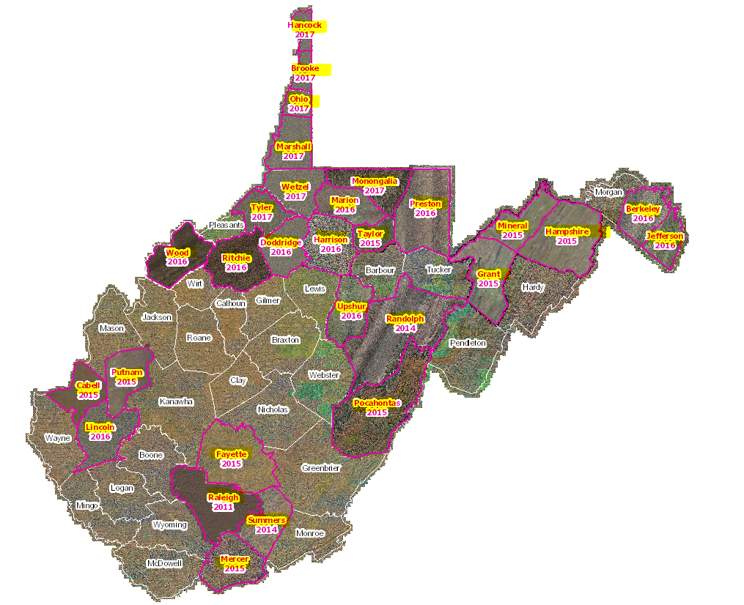
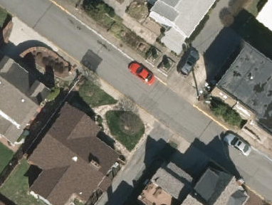
Leaf-Off Aerial Imagery Web Service
https://services.wvgis.wvu.edu/arcgis/rest/services/ImageryBaseMaps/wv_aerial_photos_mixed_resolutions_wm/MapServer?f=jsapi
29 Counties have provided leaf-off imagery for State Imagery Web Service
2017 Monongalia County Aerial Imagery

Slide 37
Aerial Imagery Costs
Currentness
Yellow highlighted counties indicates imagery older than 5 years.
Resolution
6-inch resolution or better
Leaf-Off
WV 3rd most forested state (78% forested)
Funding Sources
Assessor Valuation or County Commission Funds

Slide 38
State-Level Integration
55 County Assessor Offices
WV Tax Department
Master Surface File & Assessment Records
55 County E-911 Offices
WV Division of Homeland Security & Emergency Management
Statewide Addressing & Mapping System
Various Local & Regional Sources
WV GIS Technical Center
Statewide Imagery Web Service
Local Level
State Level
State Product
Parcels
Addresses
Imagery

Slide 39
Other & Future Enhancements
Other Enhancements Accomplished
Added Leaf-on USDA NAIP 2016 Statewide Imagery & WV DEP Hillshade
Best Leaf-Off imagery updated with aerial imagery from 29 counties
Parcels added for 36 counties, with 2 counties pledged by end of summer
Added Tug Fork Detailed Restudy
Improved Parcel ID Search tool
Embedded FloodSmart.gov Cost Calculator (currently out of service due to security breach)
Link to National Weather Service Advanced Hydrologic Prediction Service (AHPS)
Links to Flood Smart and Flood Risk Documents
Updated WV Address Locator Services
Re-programmed toolbar icons for restrictive settings on federal IE web browsers
Improved drawing and text markup tools
Update contact list of Floodplain Managers
Update statewide mitigated buyout properties flood layer
Added floodway to mobile application, updated data layers, services, flood queries
Added nearly 1.5 million assessor attribute records for Tax Year 2017 to include building specific information for commercial/industrial/apartment properties
Future Enhancements
Add Upper Mon. Detailed Restudy (includes BFE grid)
Add new advisory floodplains and depth grids for A and AE Zones
Update statewide elevation grid with new lidar acquisitions
Acquire digital parcel and addressing layers for all counties
Add flood risk assessments and products for all counties
Improve building and essential facility inventories for risk planning
Incorporate 3D flood visualization models of communities (requires building footprints)
Add Historical Flood Inundation and Dam Break Inundation maps from external sources
Reclassify statewide water depth grid

Slide 40
Clear Browser Cache
Remember to clear browser cache to access all the current information and updates of Flood Tool
Step 1
Press [Control]+[F5] on the keyboard. This is a FORCED refresh.
Step 2
This process is more complicated. To do it thoroughly follow these steps.
close all browser windows
open a single browser
go to [Tools] on the top menu
select [Internet Options]
You will get a dialog box similar to the one shown below.
Press the [Delete Files] button. This should clear all the files in your browser cache.

Slide 41
Statewide Coverage Goals
In 2 years…
Advisory Flood Heights (AFH) for Approximate A Zones and model Ordinance
In 3 years…
Building-Specific Inventories
Site-Specific Flood Risk Assessments
Statewide Parcel File
Composite Depth Grid
Restudies
Advisory A & AE Zones

Slide 42
Technical Questions about Tool?
WVU GIS Technical Center
Eric Hopkins eric.hopkins@mail.wvu.edu, phone: 304-293-9463
Kurt Donaldson kurt.donaldson@mail.wvu.edu, phone: 304-293-9467

