Slide 1
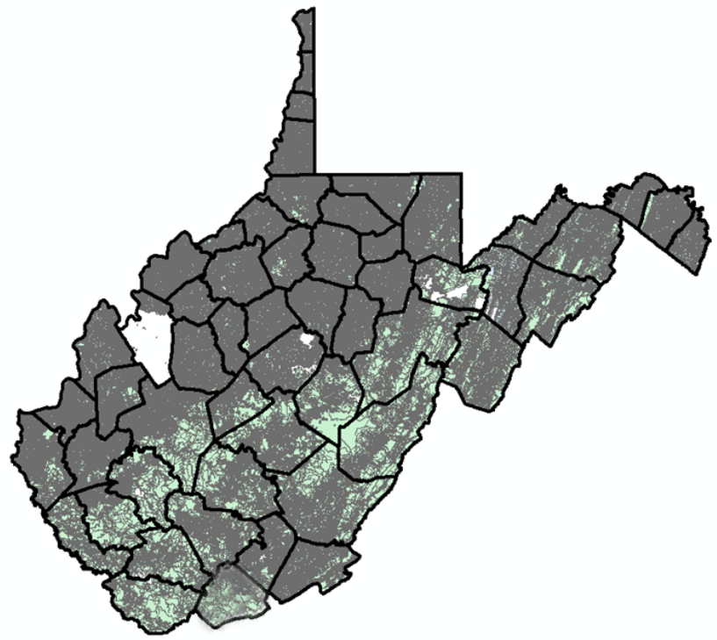
Statewide Digital Parcel File
606 Tax Districts
5% or 33 tax districts have incomplete or no digital parcel boundaries
Digital Parcel Sources
Assessor Offices
E-911 Offices
State Tax Department

Slide 2
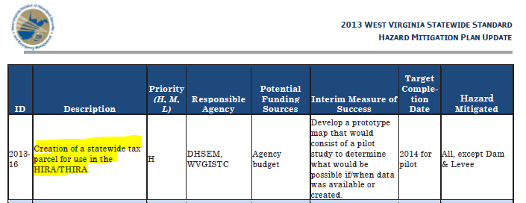
Statewide Digital Parcel File
High Priority
of
2013 State Hazard Mitigation Plan

Slide 3
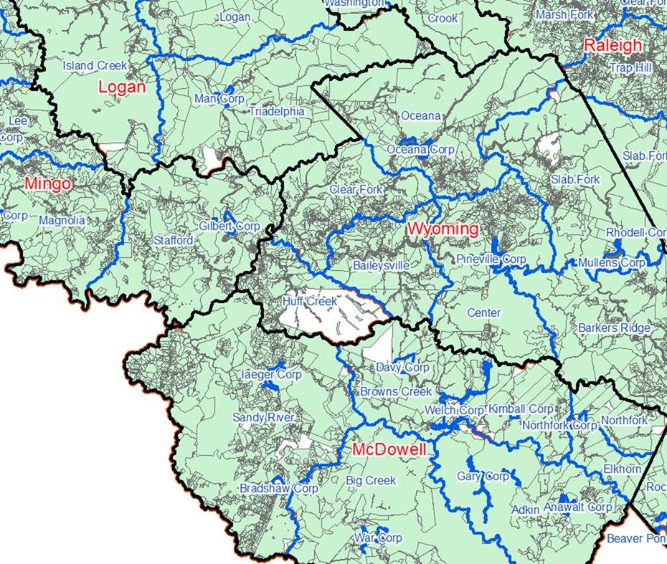
Statewide Digital Parcel File
# | Missing/ Obsolete Data Parcels
1 | Boone
2 | Braxton
3 | Calhoun
4 | Clay
5 | Jackson
6 | Logan
7 | McDowell
8 | Roane
9 | Tucker
10 | Tyler
11 | Wirt
12 | Wyoming
What is the estimated cost for digital tax maps?
$3.00 per parcel for full tax map conversion in accordance with WV Tax Map Rule 189CSR3
Cost estimate of $420K to achieve a current and accurate Digital Parcel Boundary file

Slide 4
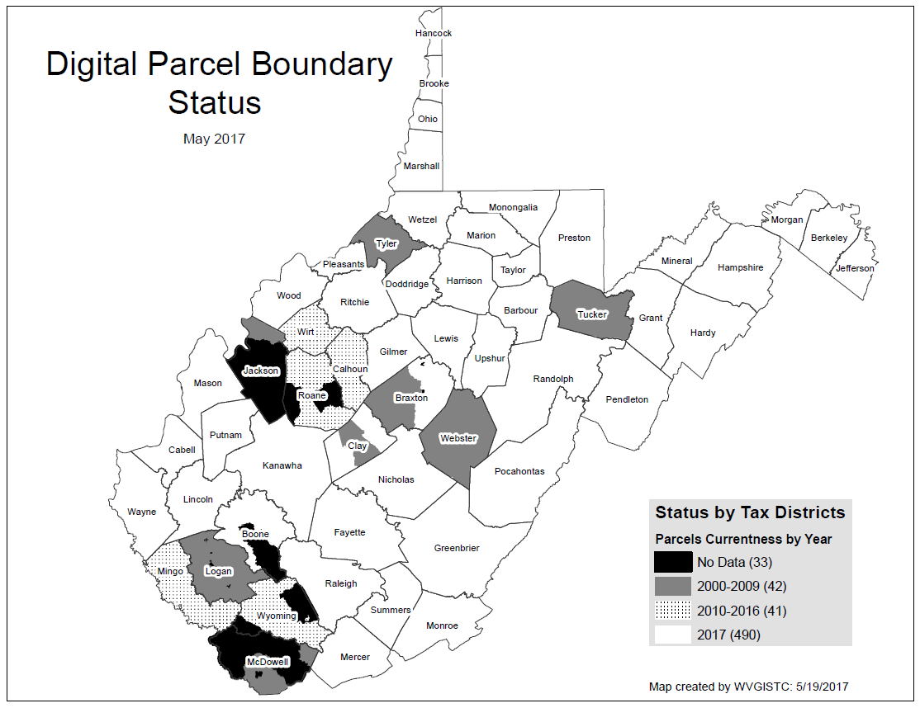
Statewide Digital Parcel File
# | Missing/ Obsolete Data Parcels
1 | Boone
2 | Braxton
3 | Calhoun
4 | Clay
5 | Jackson
6 | Logan
7 | McDowell
8 | Roane
9 | Tucker
10 | Tyler
11 | Wirt
12 | Wyoming
Estimated cost of $420K to achieve a current, accurate, and maintained Digital Parcel Boundary file
SB 588 – As of July 5 will cost about $25 instead of $165,000 to acquire Statewide Parcel File

Slide 5
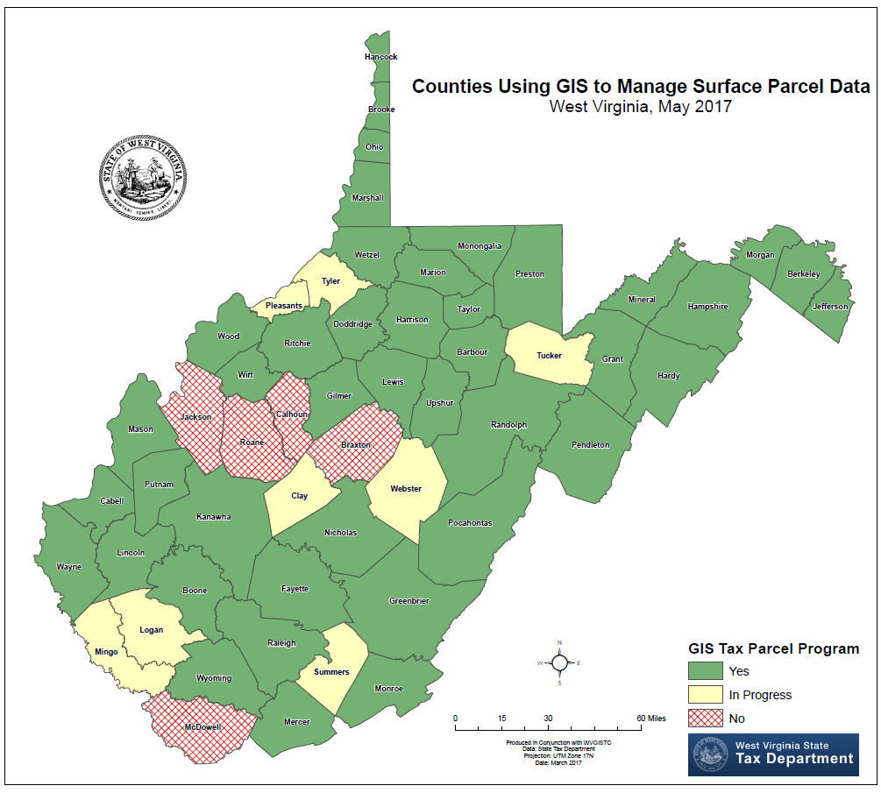
Counties using GIS

Slide 6
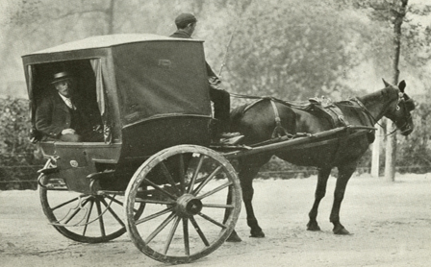
Paper to Digital Tax Maps
Mapper: “I was apprehensive four years ago when our newly elected assessor decided to digitize our parcel mapping system; but with the work done by the mapping contractor then and their continual assistance today, I cannot imagine returning to the manual system.” Source: 2017 Tax Map Survey
MANUAL (Paper) TRANSITION DIGITAL
5 counties 7 counties 43 counties
Manual drafting of tax maps is becoming obsolete!!!
There are no schools that teach manual drafting skills
Manual drafting supplies are becoming scarce
Tax Division may remove itself from drafting contract services

Slide 7
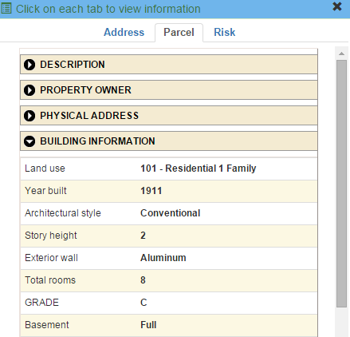
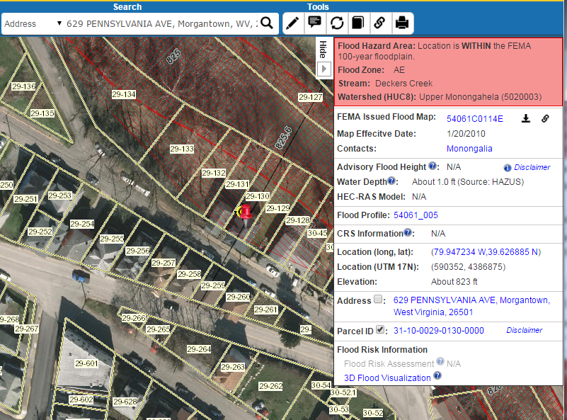
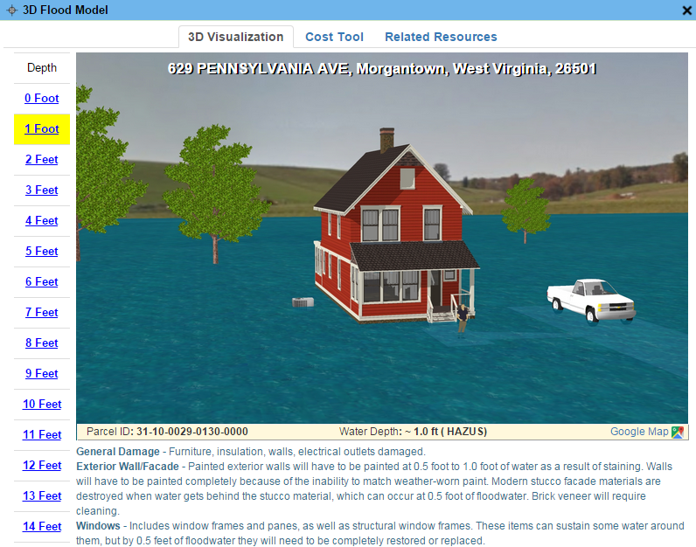
Parcels link to Owner/Building Info
629 PENNSYLVANIA AVE, Morgantown, WV, 26501
https://www.mapwv.gov/flood/map/?wkid=102100&x=-8899684&y=4811867&l=13&v=0
Residential or Farm Property

Slide 8
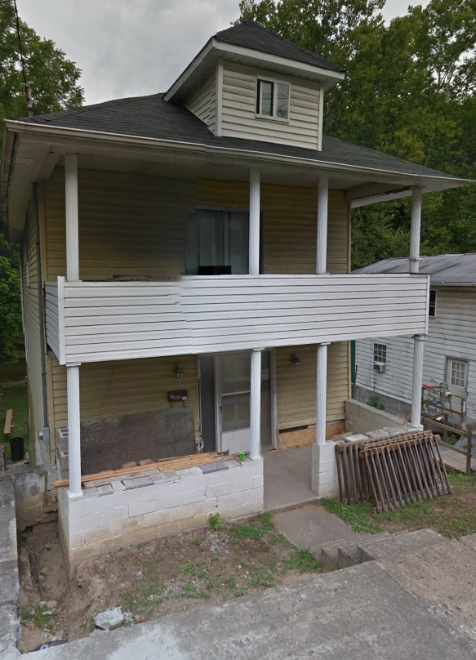
Parcels link to Owner/Building Info
Residential or Farm Property
DESCRIPTION
GIS Parcel ID | 31-10-0029-0130-0000
Legal Description | BL 12-1/2 LOT 10
Acreage (deed) | 0.0373
Tax Year | 2015
Tax Class | 4
Deed Book / Page | 1259 / 45
PROPERTY OWNER(S)
Property Owner(s) | Smith John
629 PENNSYLVANIA AVE, Morgantown, WV, 26501
https://www.mapwv.gov/flood/map/?wkid=102100&x=-8899684&y=4811867&l=13&v=0
BUILDING INFORMATION
Property Class Type | R- Residential
Land Use | 101 - Residential 1 Family
Year Built | 1911
Architectural style | Conventional
Exterior Wall | Aluminum
Stories | 2
Total Rooms | 8
Building Grade | C
Basement Type | Full
Structure Area | 1,320
Building (card) Number | 1
# of main BLDGs (cards) | 1
APPRAISED VALUES
Land Appraisal | $33,200
Building Appraisal | $29,000
Total Appraisal | $62,200

Slide 9
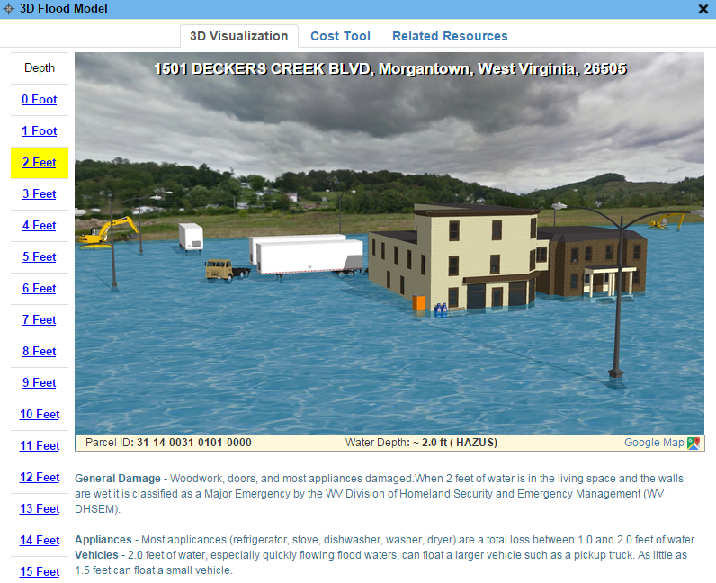
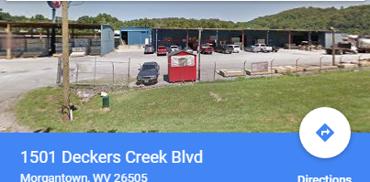
Parcels link to Owner/Building Info
Commercial or Industrial Property
DESCRIPTION | 84 Lumber
GIS Parcel ID | 31-14-0031-0101-0000
Legal Description | 5.0922 AC;SABRATON
Acreage (deed) | 5.09
Deed Book / Page | 1376 / 234
PROPERTY OWNER(S)
Property Owner(s) | SPIRIT SPE PORTFOLIO
1501 DECKERS CREEK BLVD, Morgantown, West Virginia, 26505
https://www.mapwv.gov/flood/map/?v=0&pid=31-14-0031-0101-0000
BUILDING INFORMATION
Property Class Type | C- Commercial
Land Use | 373 - Retail-Single Occupancy
Year Built | 1994
Stories | 2
Exterior Wall | Brick or Stone
Construction Type | Pre-Engineered Steel
Building Grade | D+
Basement Type | None
Business Living Area | 15,255
Cubic Feet | 292,380
Use Type | 34-Retail Store, 82- Multi-Use Office
COST VALUES
Other Bldg/Yard Values | $67,020
Commercial Value | $227,700
APPRAISED VALUES
Land Appraisal | $378,800
Building Appraisal | $294,700
Total Appraisal | $673,500

Slide 10
Assessment Building Info
West Virginia Parcel Property Class Breakdown for Tax Year 2017
Code | Property Class | # of Parcels | Percent (%)
R | Residential | 1,164,470 | 79.61%
F | Farm | 121,384 | 8.30%
A | Apartment | 3,222 | 0.22%
C | Commercial | 65,784 | 4.50%
I | Industrial | 3,105 | 0.21%
X | Exempt | 97,773 | 6.68%
U | Utility | 192 | 0.01%
Other | Not classified | 6,837 | 0.47%
 |  | 1,462,767 | 100.00%
Assessment records are important for building inventories and are used to estimate the total building exposure ($) and building loss ($) for multi-hazards. Often building inventories and corresponding loss estimates are organized by property class.

Slide 11
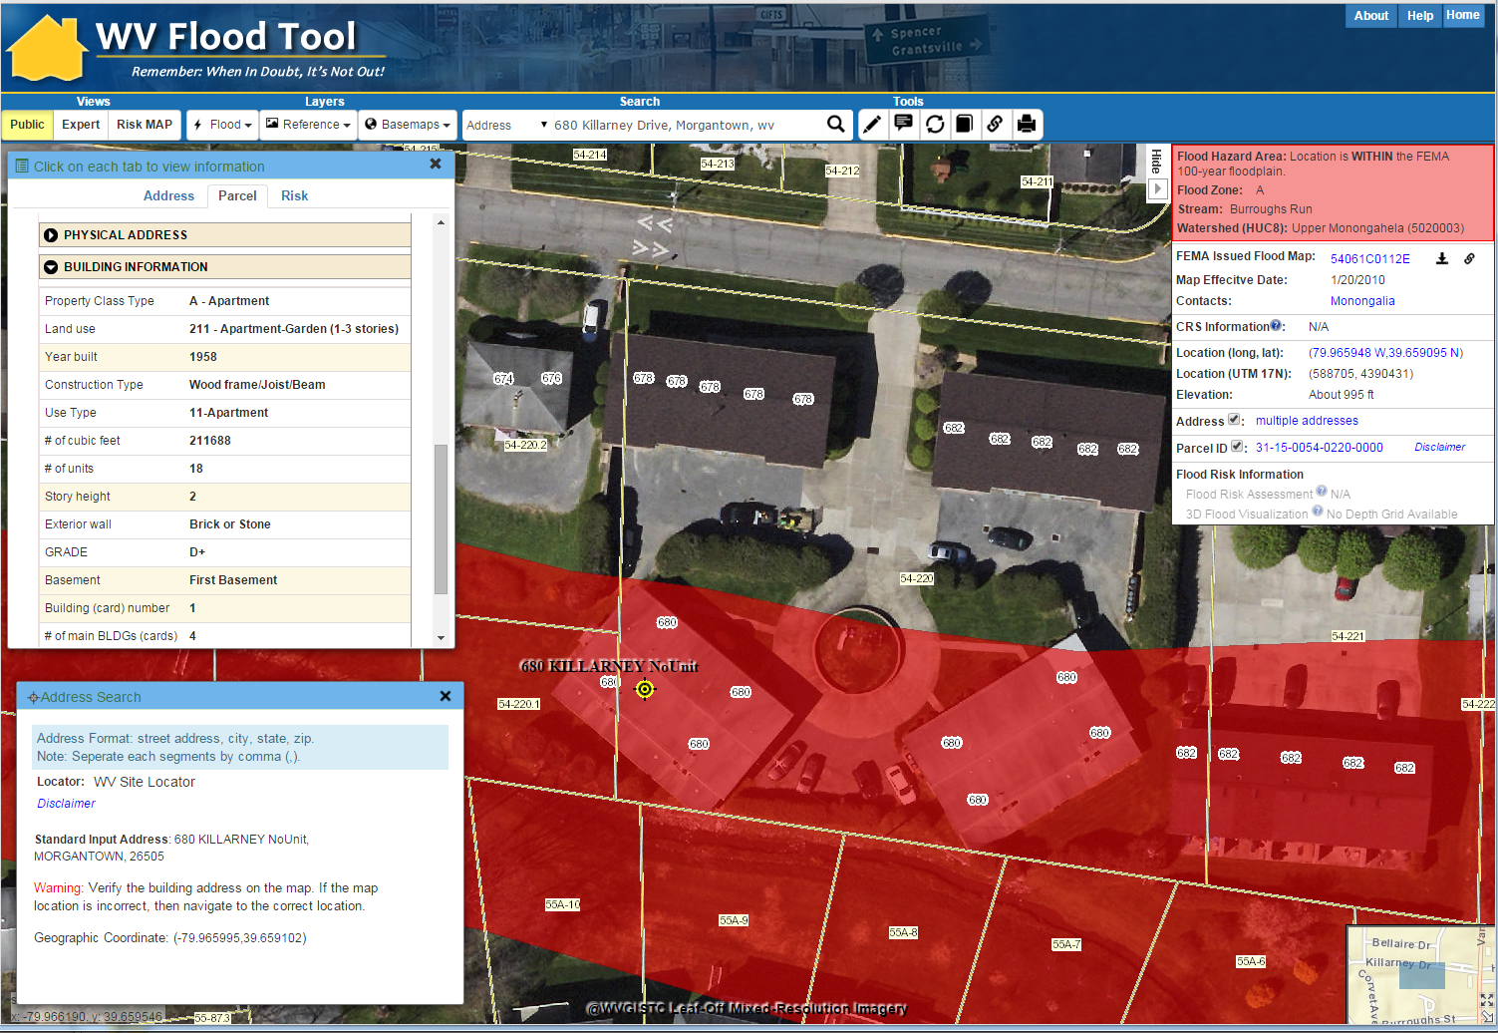
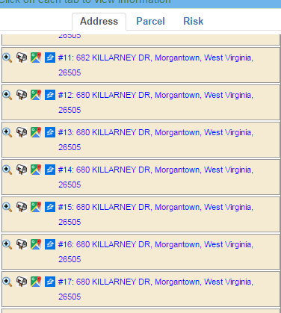
Addresses Link to Parcels
https://www.mapwv.gov/flood/map/?wkid=102100&x=-8901769&y=4816526&l=13&v=0
Parcel Building Info
1
3
2
3
2
Multi-Unit Addresses
1
Site Address Match

Slide 12
Statewide Digital Parcel File
606 Tax Districts
5% or 33 tax districts have incomplete or no digital parcel boundaries
Digital Parcel Sources
Assessor Offices
E-911 Offices
State Tax Department

