Slide 1
Goal 4: Statewide Depth Grid
Depth grids are important for (1) water depth visualization in the WV Flood Tool and for (2) estimating building damage costs using Hazus-MH flood loss software. Its is preferred to use more accurate depth grids from various sources than a generalized depth grid from the Hazus Enhanced Quick Look tool.
Depth Grid Sources
Risk MAP Studies (HEC-RAS hydraulic models)
Model-Backed Zone A Studies (HEC-RAS hydraulic models)
FIS X-Sections to Water Elevation Conversion (no models)
Water surface elevations derived from x-sections of detailed flood studies

Slide 2
Depth Grids (Regulatory versus Planning)
Regulatory | Planning
Risk MAP Studies (Upper Mon, Tug Fork, etc.) | Hazus Enhanced Quick Look Tool
Advisory Flood Heights (Model-backed A Studies) | Statewide Hazus Level 1
FIS X-Sections(???????) Conversion | FIS X-Sections(???????) Conversion
Questions:
Is Region III interested in creating a uniform statewide depth grid for regulatory flood determinations from multiple sources that is consistent across flood hazard zones (AE, A, etc.) and matches with the official flood zone boundaries?
What about depth grids from FIS X-Sections to Water Elevation Conversion? Is this endeavor worthwhile? Should it be shown in the regulatory (Expert View) or planning (RiskMAP) view of the WV Flood Tool?

Slide 3
Depth Grid Sources
Model-Backed A Zone Depth Grid
Risk MAP Study Depth Grid (model based)
Depth Grid generated from
FIS x-sections

Slide 4
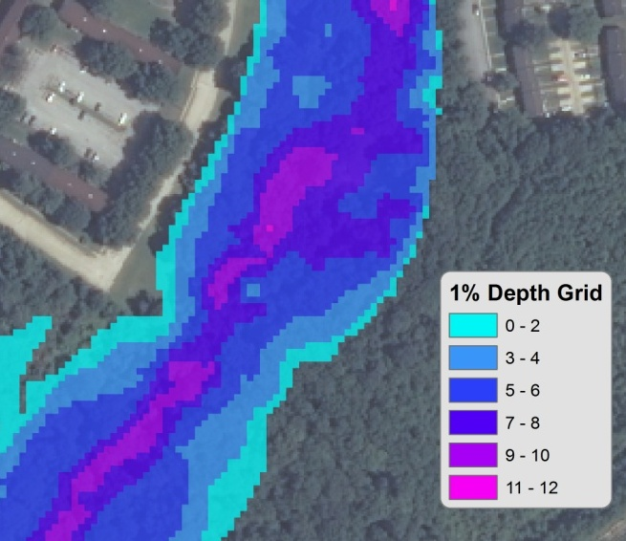
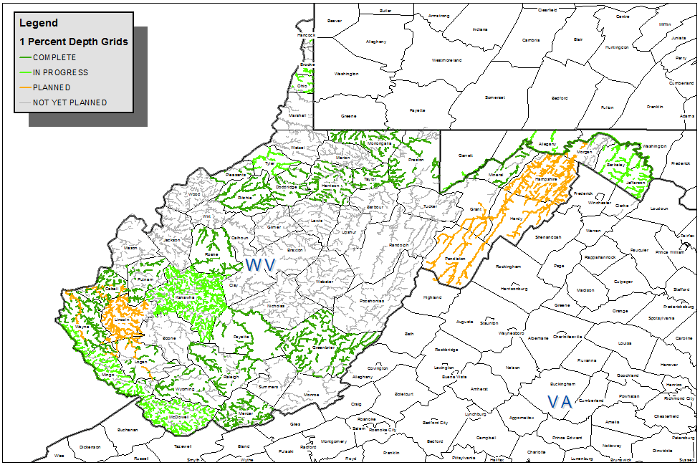
Tracking Flood Risk Products in GIS - Depth Grids – 1% Annual Chance
Did you know?
A million dollars has been dedicated for Model-Backed A Zone Depth Grids in West Virginia
Courtesy of Lee Brancheau, FEMA Region III

Slide 5
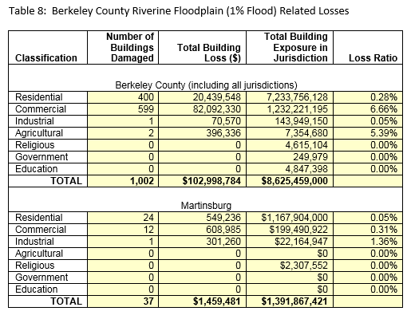
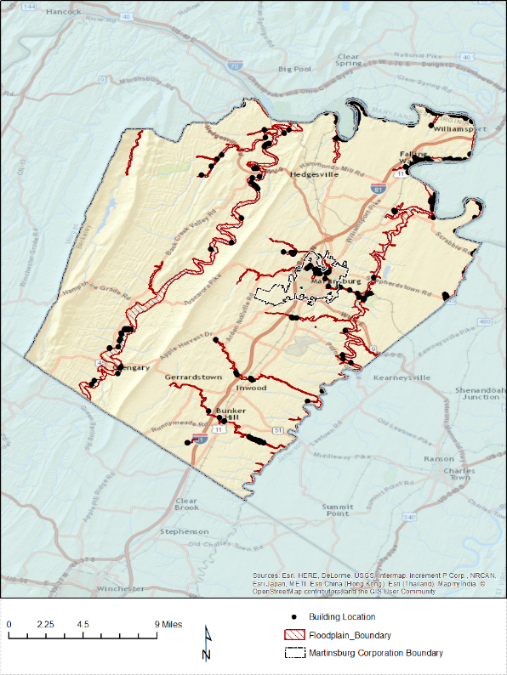
Building Damage Loss Estimates $$$
197 Rodeo Dr.
197 Rodeo Dr.

Slide 6
Parcel/Address Identity Info
CAMA Building
Data
Exposure/
Replacement Cost (BI)
County ID | 2 (Berkeley)
Parcel ID | 04037M001300000000
Street Address | 197 Rodeo Drive
City | Martinsburg
Zip Code | 25403
Deed or GIS Acreage | 2.3 Acres
Legal Description | LOT 13 SOUTH SEC PHASE II
Property Owner(s) | XXXXXXXXXXXXXXXX
Tax Year | 2015
Tax Card | 1
Tax Class | 2
Land Use Code | 101
STORIES | 2
Exterior Wall – Construction Type | 7
Style | 8
Year Built | 2010
Total Rooms | 8
AREASUM | 3,981
GRADE – Building Condition | A-
Basement – Foundation Type & First Floor Height | 4
DWELVAL | 398,400
OBYVAL | 8,450
COMVAL | 0
ReplCost | 506,940
ContCost | 603,075
BldgArea | 3,981
hzOccCode | Res1
NumStories | 2
YearBuilt | 2010
BldgConstruction | Brick
BldgCondition | High
BldgFoundation | Basement
FirstFloorHt | 4
CAMA
Assessment Data
Damage Estimates (UDF)
BldgDmgPct | 51.6
BldgLossUSD | 261,354
ContDmgPct | 47.9
ContLossUSD | 121,326
Land Appraisal | 55,100
Building Appraisal | 321,700
Total Appraisal | 376,800
A unique parcel identifier links assessment/building data, replacement costs, and damage loss estimates for each structure

Slide 7
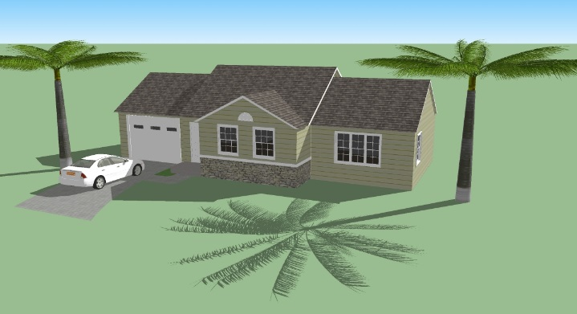
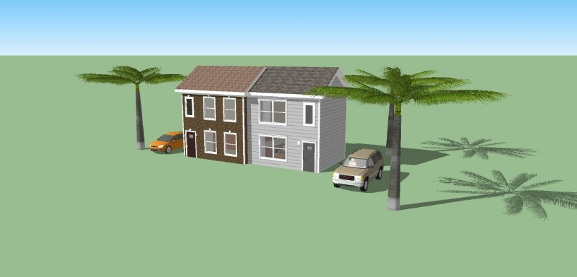
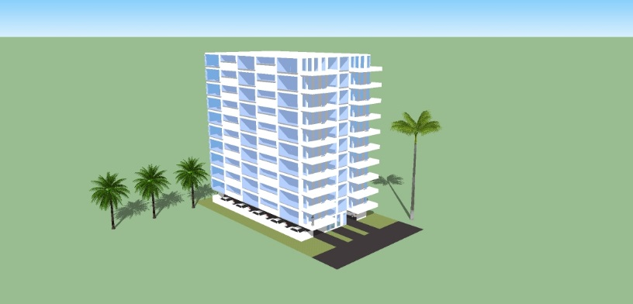
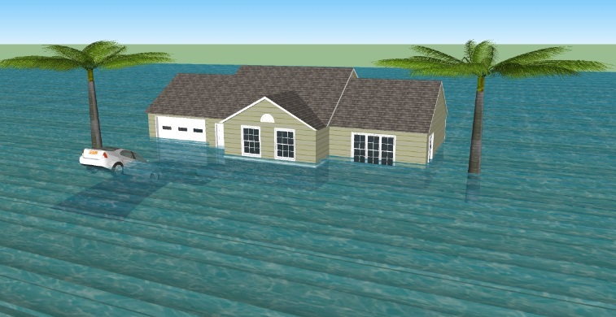
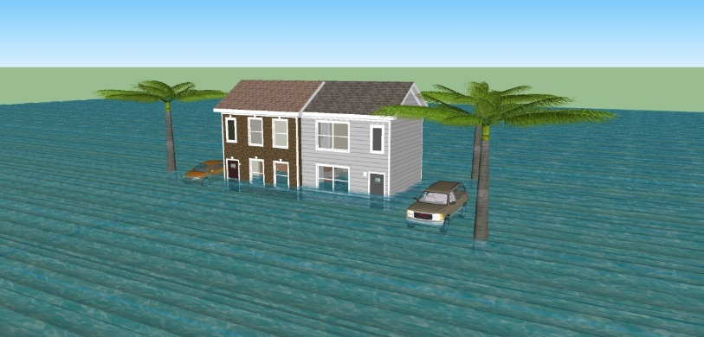
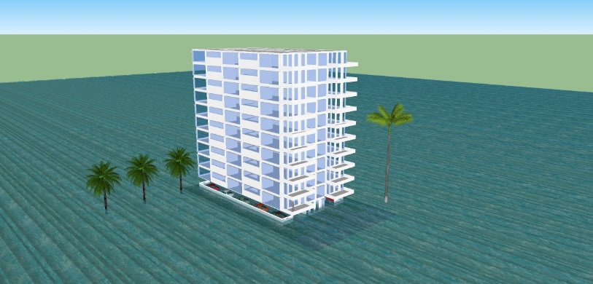
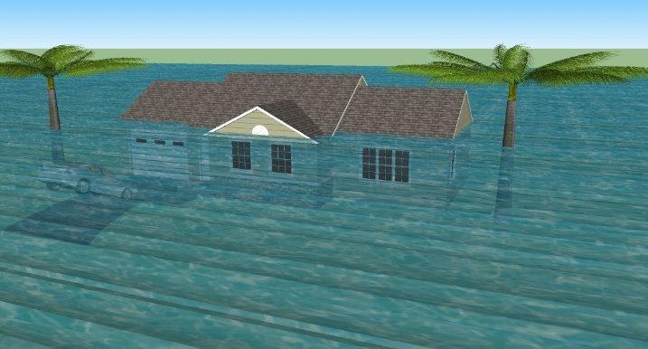
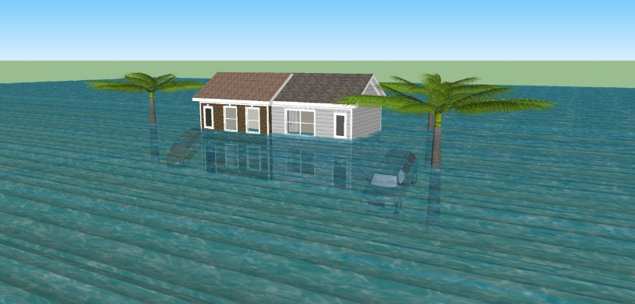
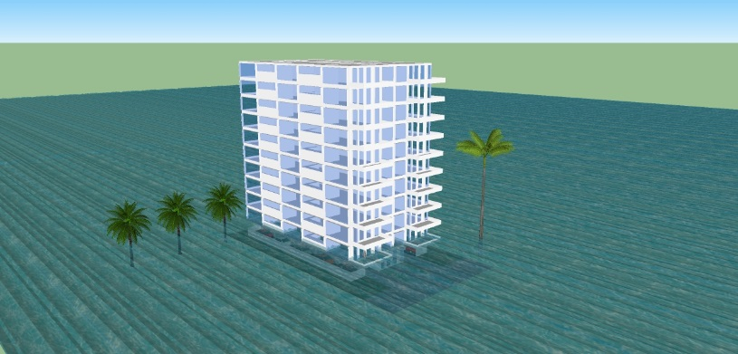
3D Flood Visualization – Individual Structures
One-Story Home Two-Story Duplex High Rise Apartment
WATER DEPTH
0 Feet
4 Feet
12 Feet
Courtesy of Pinellas County Emergency Management, Florida (http://egis.pinellascounty.org/apps/stormsurgeprotector/index.html)
Notes:
Duplex 0 3/4/5 11/13
Apartment Building
Hotel

Slide 8
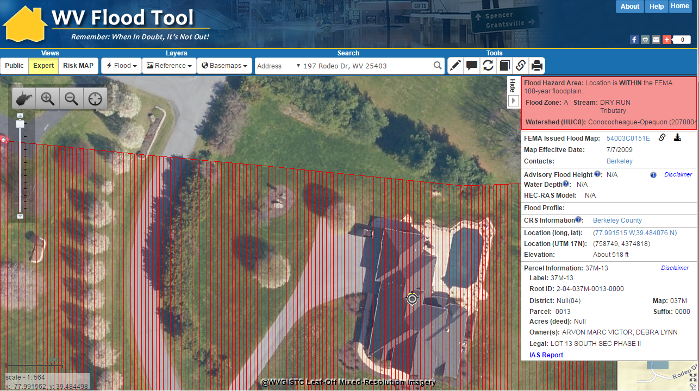
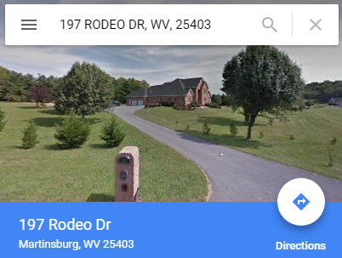
1% Flood Impact, 11-ft. Water Depth
3D Flood Visualization of Structure at
197 Rodeo Drive
WV Flood Tool Conceptual Slide

Slide 9
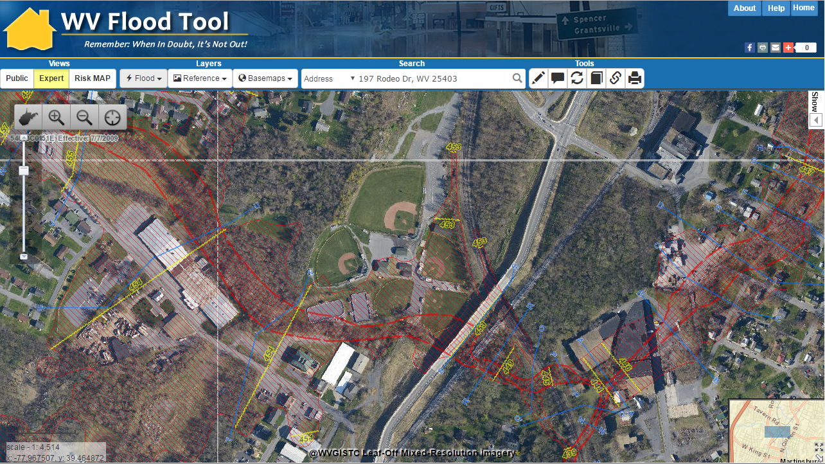
3D Flood Visualization – Neighborhood
Baltimore Street, Martinsburg, WV
3D Northwest View
3D
WV Flood Tool Conceptual Slide

