Slide 2
WV Flood Tool Upgrades
www.mapWV.gov/Flood
Flood Query Results Panel
External Links
Shared Links
Building-Specific Risk Assessments
3D Flood Visualizations
Improved Data Layers
Flood Layers
Advisory Floodplains
Mitigated/Buyout Properties
Local Data (parcels, addresses, imagery, elevation)
Parcel Search
Other Enhancements
Future Enhancements
24 April 2017

Slide 3
Tax Map Products
 | Individual Finished Tax Maps | Web Finished Tax Maps | Digital Parcel File (subset of Digital Tax Map)
Map Content | Parcel Boundary Parcel Identifier Parcel Dimensions Lot Boundaries Contextual Information | Parcel Boundary Parcel Identifier Parcel Dimensions (most viewers) Lot Boundaries (most viewers) | Parcel Boundary Parcel Identifier
Coverage | Statewide* | 30 Counties with Web Viewers | 95% State Coverage**
Current | Yes | Yes | Varies by County
Source | County Assessors | County Assessors | Assessors, E-911, MLMP
Map System | Digital/Manual (80%/20%) | Digital (GIS) | Digital (GIS)
Static or Dynamic | Static - viewed as paper map or fixed image | Dynamic - interactive web maps with online tools | Dynamic - interactive web maps with online tools
Linkable to IAS | No | Yes | Yes
Seamless | No | Yes | Yes
Aerial Photos | No | Yes | Yes
Formats | Paper or Digital (PDF, JPEG) Print-Ready images | Web Map Services | Shapefiles, Geodatabase, CAD Files, Web Map Services
* All paper tax maps are scanned to a digital image-file format by the Tax Department for statewide coverage
** Varying source years when created

Slide 4
Tax Map Products
 | Individual Finished Tax Maps | Web Finished Tax Maps | Digital Parcel File (subset of Digital Tax Map)
Map Content | Parcel Boundary Parcel Identifier Parcel Dimensions Lot Boundaries Contextual Information | Parcel Boundary Parcel Identifier Parcel Dimensions (most viewers) Lot Boundaries (most viewers) | Parcel Boundary Parcel Identifier
Coverage | Statewide* | 30 Counties with Web Viewers | 95% State Coverage**
Current | Yes | Yes | Varies by County
Source | County Assessors | County Assessors | Assessors, E-911, MLMP
Map System | Digital/Manual (80%/20%) | Digital (GIS) | Digital (GIS)
Static or Dynamic | Static - viewed as paper map or fixed image | Dynamic - interactive web maps with online tools | Dynamic - interactive web maps with online tools
Linkable to IAS | No | Yes | Yes
Seamless | No | Yes | Yes
Aerial Photos | No | Yes | Yes
Formats | Paper or Digital (PDF, JPEG) Print-Ready images | Web Map Services | Shapefiles, Geodatabase, CAD Files, Web Map Services
* All paper tax maps are scanned to a digital image-file format by the Tax Department for statewide coverage
** Varying source years when created

Slide 5
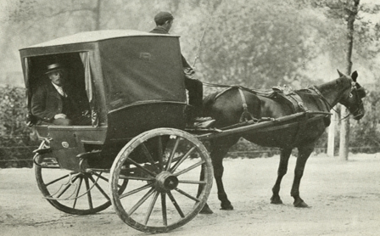

Slide 6
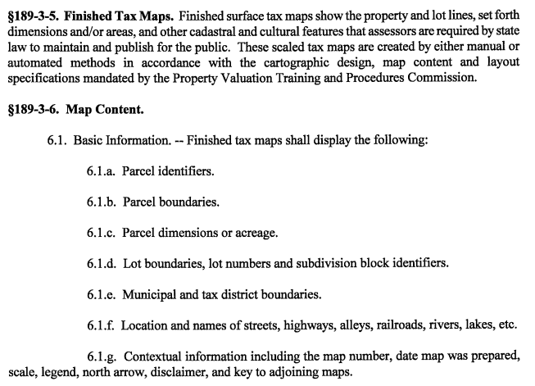
WV Flood Tool Upgrades
189-3 Statewide Procedures for the Maintenance and Publishing of Surface Tax Maps
www.mapWV.gov/Flood
24 April 2017

Slide 7
WV Flood Tool Upgrades
189-3 Statewide Procedures for the Maintenance and Publishing of Surface Tax Maps
www.mapWV.gov/Flood
24 April 2017

Slide 8
Multi-County Parcel & IAS Requests
55 C
55 Counties
State Agencies
Private Sector
Public
Non Profits
24 April 2017

