Slide 1
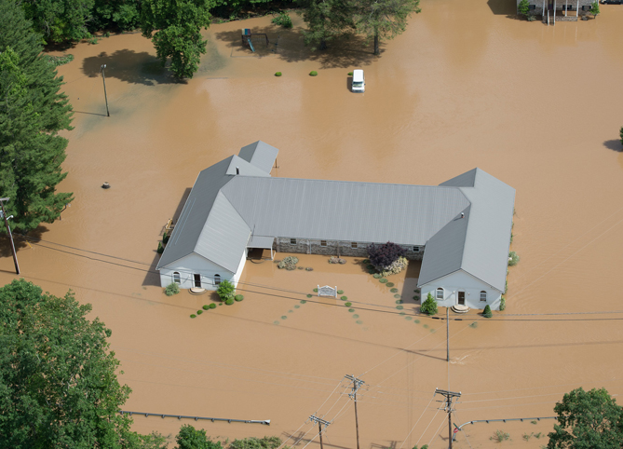
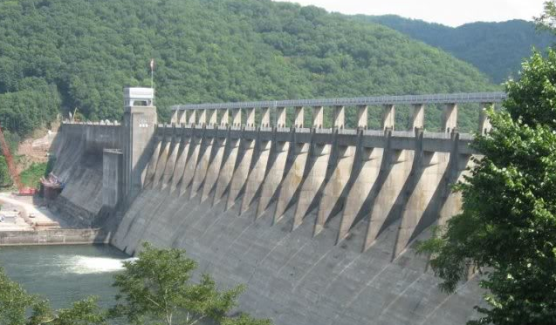
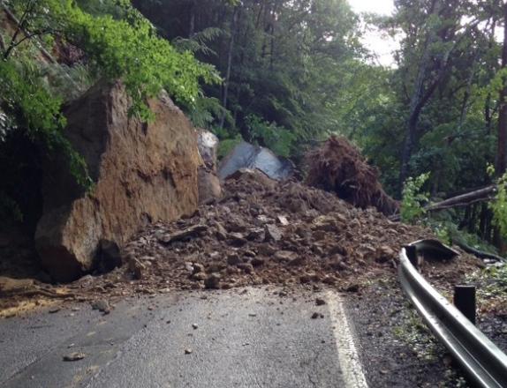
A Statewide Approach to Risk Studies WVU Multi-Hazard Risk Assessment Proposal
Floods
Dam / Levee Failures
Landslides
Kurt Donaldson & Eric Hopkins
WV GIS Technical Center
West Virginia University
27 October 2016
Technical Support to Local Natural Hazard Mitigation Planning for Flood, Landslide, and Dam/Levee Failure
Notes:
WV Map indicating population density

Slide 2
PROJECT OVERVIEW
Risk Assessments for Local Hazard Mitigation Plans (55 Counties)
Riverine 1% Annual Chance Flood
Dam/Levee Failure (led by USACE)
Landslides
Detailed Building Inventories (State-Level Integration)
GIS Parcels – 55 county assessor GIS parcel files standardized and integrated
Centralized CAMA/Assessment Records for building characteristics
GIS Addresses – WV DHSEM Statewide Addressing & Mapping System
Risk Assessments Published on State/Federal GeoPlatforms
State GeoPlatform (WV Flood Tool - www.mapWV.gov/Flood)
Federal GeoPlatform (www.geoplatform.gov)
Preliminary Proposal Accepted by State Hazard Mitigation Office
Funding proposed through Hazard Mitigation Grant Program (HMGP)

Slide 3
PROJECT HISTORY
2014 | Project concept initiated by Cynthia McCoy, FEMA Region III
2015 | West Virginia selected by FEMA for Building Inventory Tool pilot
2015 | The Polis Center at IUPUI Completes Project Workflow for Hazus-MH Model Building Inventory for West Virginia
2016 | Flood and Landslide Risk Assessment studies completed for pilot county
2016 | Preliminary proposal accepted by State Hazard Mitigation Office for state technical support services to regional and local governments for Local Hazard Mitigation Plans

Slide 4
Goal 1: Communication and Training Network
Establish a communication and training network for exchanging risk assessment information and technical skills among local, state, federal, and other entities.
Multi-Agency Coordination
Risk Assessment Lifecycle

Slide 5
Risk
Assessment Lifecycle
Start Early - Best Practice!
Local Hazard Mitigation Plan updates should begin a minimum of one year in advance, preferably two years before the expiration date
Diagram courtesy of Cynthia McCoy, FEMA Region X

Slide 6
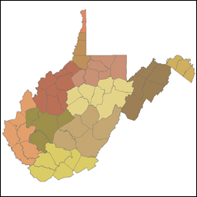
Multi-Agency Coordination
55 Counties
11 Regional Planning & Development Councils
Federal Agencies
State Agencies
Universities
Regional Councils
Local Counties
Private Companies

Slide 7
Goal 2: Exchange Best Available Data
Exchange the best available risk assessment data among local, state, and federal GeoPlatforms. Incorporate historical flood data into risk assessment studies. Use online map validation tools for local communities to validate risk assessment data.
Best Available Risk Assessment Data
Historical Flood Data
Online Map Validation Tools

Slide 8
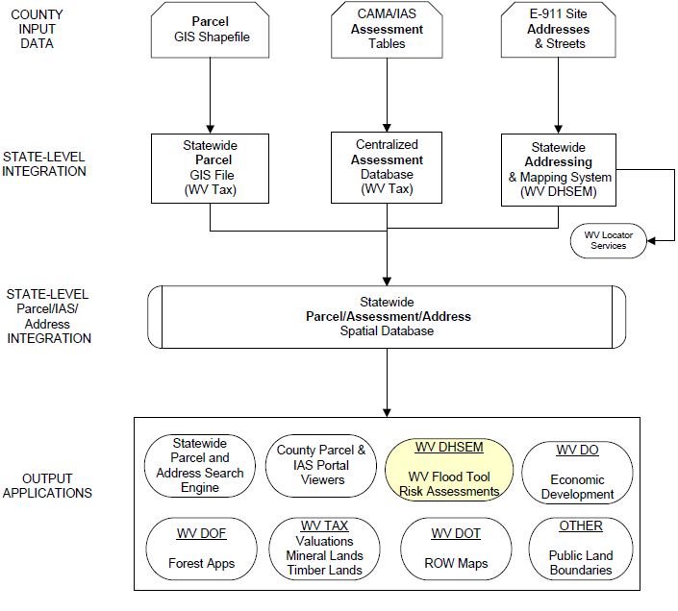
Best Available Site-Specific Data
GIS Parcels
CAMA Records
GIS Addresses
What is the “sweet spot” for comprehensive information about structures and ownership?
Answer: Statewide integration of multiple data sources, especially (1) parcels, (2) CAMA assessment records, and (3) E-911 addresses
Parcel/Assessment/Address Spatial Database

Slide 9
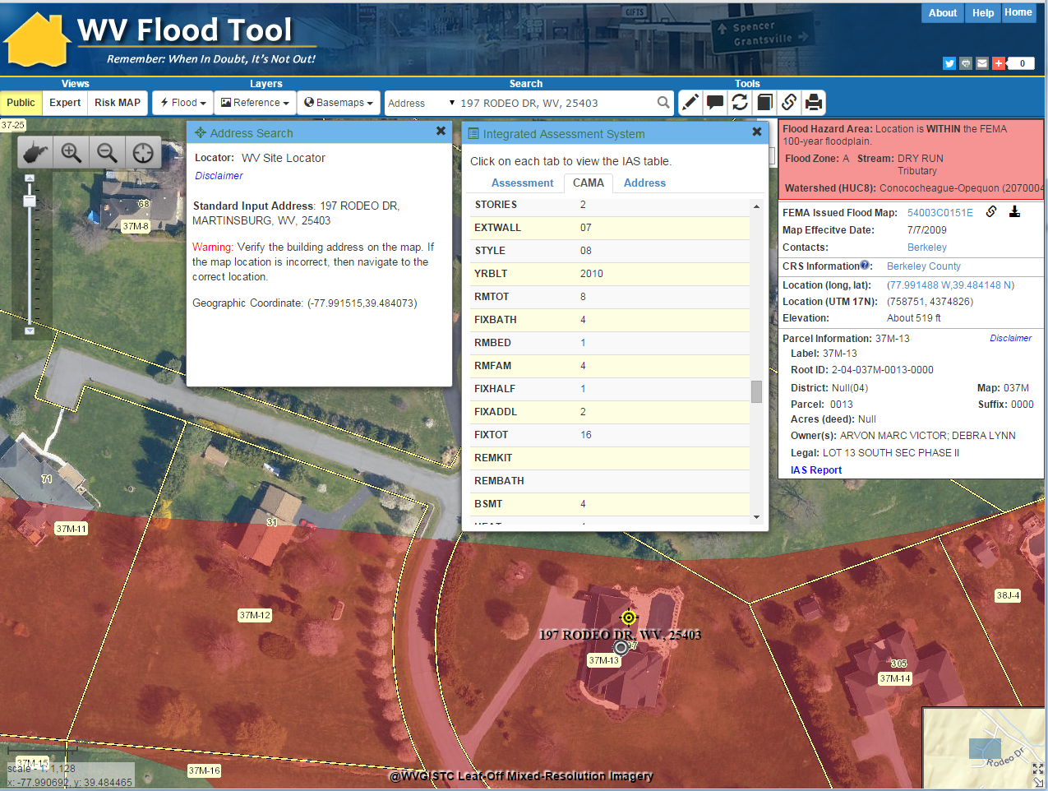
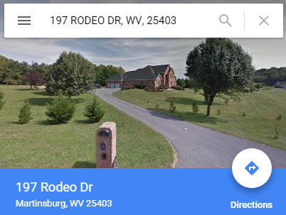
Seamless Data Integration
FEMA MAP LINK
Local Data Sources
GIS ADDRESS
OWNER
INFO
GEOCODE ADDRESS
GEOCODE ADDRESS
CAMA
BLDG
INFO
GIS PARCEL
2016 AERIAL PHOTOS
CAMA Assessment
AERIAL PHOTOS
197 Rodeo Drive, Martinsburg, WV
External Map Links
GOOGLE MAP LINK
GOOGLE MAP LINK
GIS ADDRESS
GIS PARCEL
FEMA MAP LINK
WV Flood Tool Beta

Slide 10
Goal 3: Statewide Building Inventories
Create a statewide inventory of all buildings and facilities exposed (with replacement costs) in flood hazard, dam/levee failure, and landslide susceptibility zones.

Slide 11
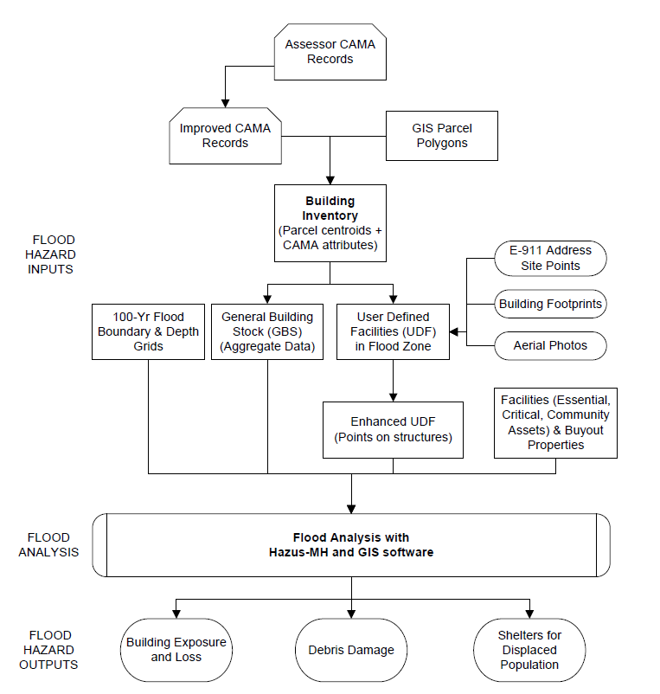
Work Flow for Building Inventory & Flood Risk Assessments
Building Inventory
(site specific)
GBS (aggregate buildings)
UDF (individual buildings)
Building
Inventory
Hazus GBS and UDF Inventory Data. The General Building Stock (aggregate buildings) and User Defined Facilities (individual buildings) are derived from the Building Inventory.

Slide 12
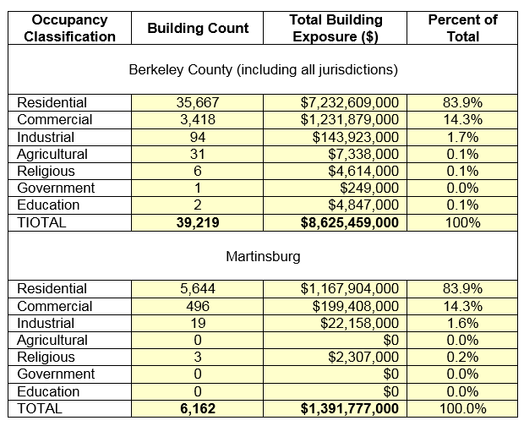
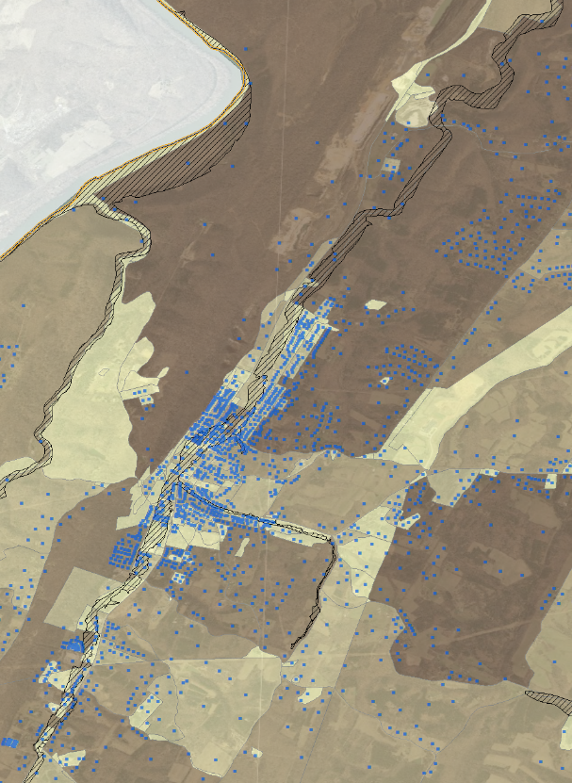
Building Inventory Exposure ($) for Multi-Hazards

Slide 13
Goal 4: Statewide Depth Grid
Depth grids are important for (1) water depth visualization in the WV Flood Tool and for (2) estimating building damage costs using Hazus-MH flood loss software. Its is preferred to use more accurate depth grids from various sources than a generalized depth grid from the Hazus Enhanced Quick Look tool.
Depth Grid Sources
Risk MAP Studies (HEC-RAS hydraulic models)
Model-Backed Zone A Studies (HEC-RAS hydraulic models)
FIS X-Sections to Water Elevation Conversion (no models)
Water surface elevations derived from x-sections of detailed flood studies

Slide 14
Depth Grid Sources
Model-Backed A Zone Depth Grid
Risk MAP Study Depth Grid (model based)
Depth Grid generated from
FIS x-sections

Slide 15
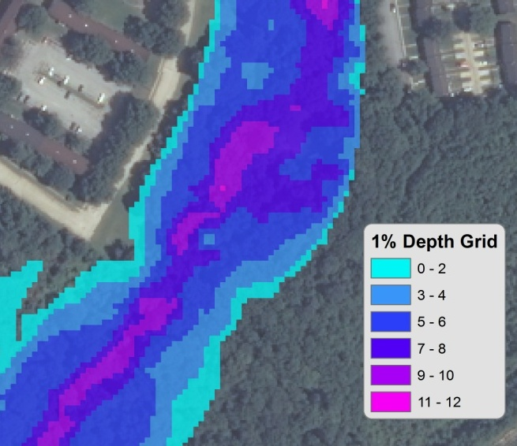
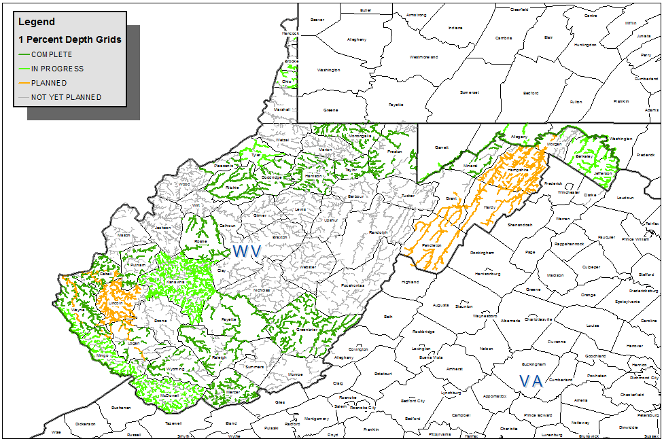
Tracking Flood Risk Products in GIS - Depth Grids – 1% Annual Chance
Did you know?
A million dollars has been dedicated for Model-Backed A Zone Depth Grids in West Virginia
Courtesy of Lee Brancheau, FEMA Region III

Slide 16
Goal 5: County-Level Risk Assessments
Perform county-level risk assessments for 55 counties using site-site specific building inventories.
Riverine Floods (1% Annual Chance)
Dam/Levee Failure
Landslides

Slide 17
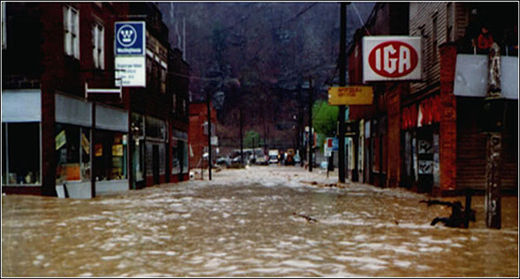
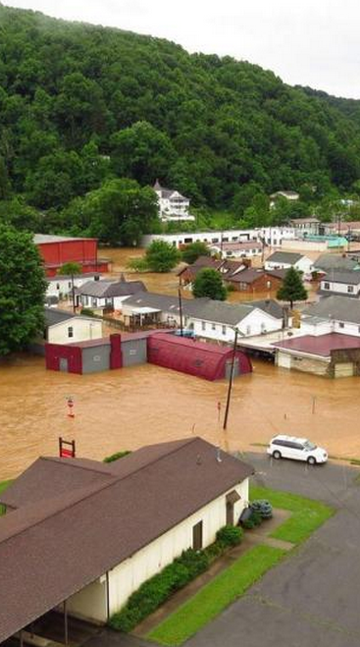
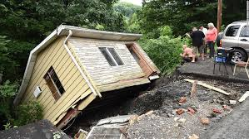
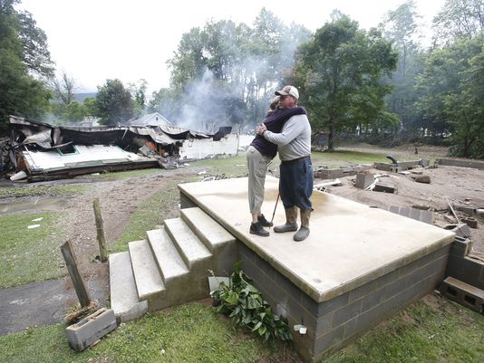
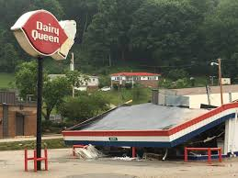
Devastating 2016 June Flood

Slide 18
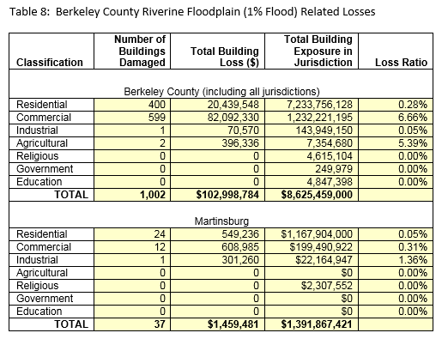
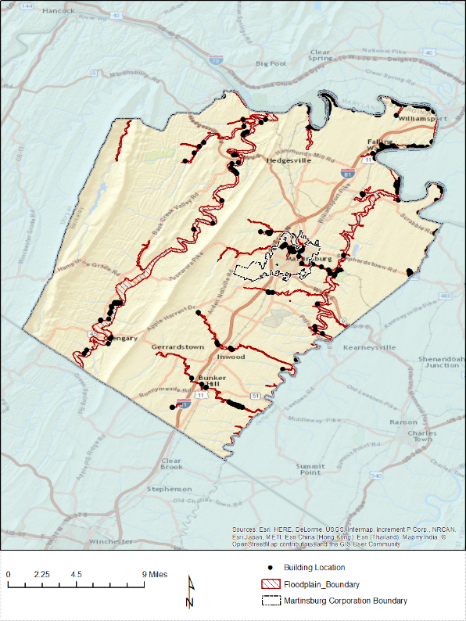
Building Damage Loss Estimates $$$
197 Rodeo Dr.
197 Rodeo Dr.

Slide 19
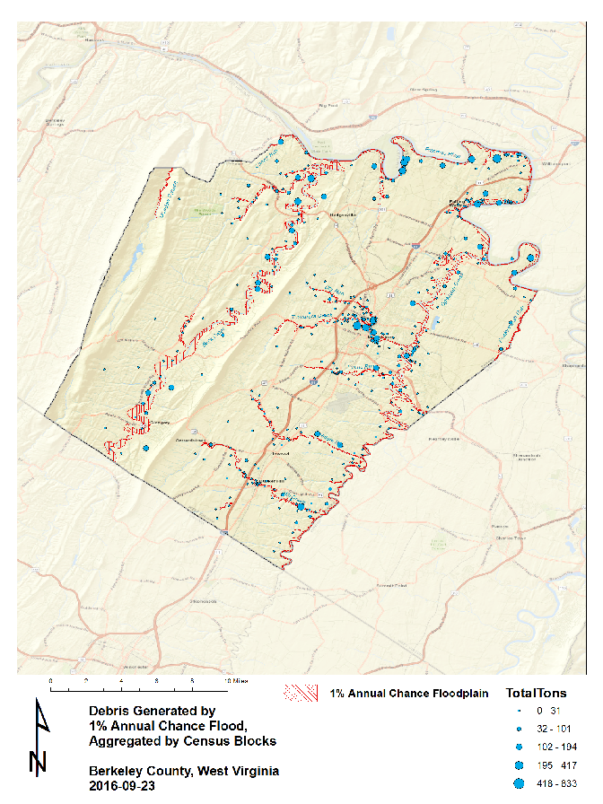
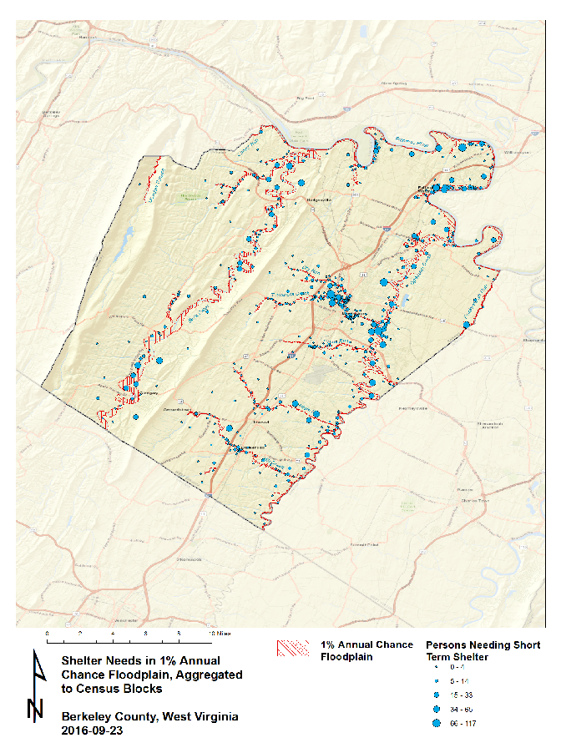
Debris Generated
Shelters Needed

Slide 20
Dam/Levee Failure Risk Assessment
Goals
Prioritize dam inspections in accordance with risk and those that do not have an EAP digitized
Integrate Dam and Levee safety action class (class 1 - 5) for every USACE dam and levee into HIRA and THIRA.
Produce documentaries about/on aging dam structures around endangered communities (Develop a list of potential dams on which to focus).
Create a task force to address levee safety in West Virginia (Coordination between NRCS and USACE on levee safety issues).
Bluestone Dam
In recent years, it was discovered that Bluestone Dam would be unable to pass the Probable Maximum Flood possible at the site, which could cause failure of the dam. To remedy the problem, the U.S. Army Corps of Engineers has undertaken a Dam Safety Assurance program for Bluestone.

Slide 21
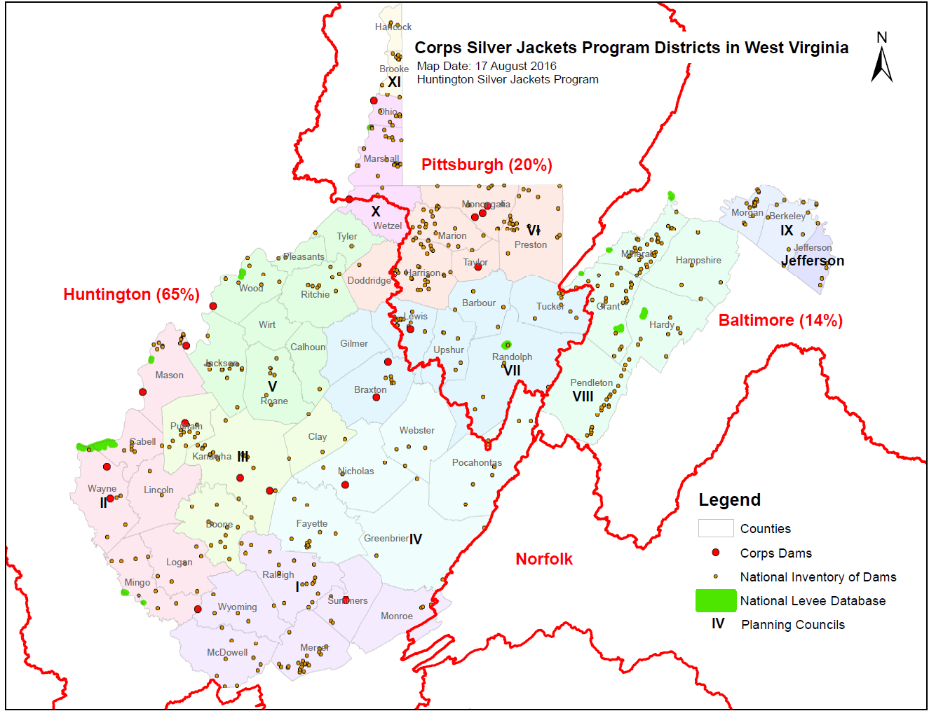
Dam/Levee Failure – USACE Technical Lead
Joe Trimboli MSc CFM
U.S. Army Corps of Engineers
Silver Jackets WV Liaison http://wvsj.us/

Slide 22
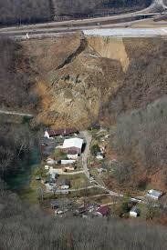
Landslide Risk Assessment
Goals
Develop a landslide inventory
Create valid landslide models for specific WV regions
Generate county-level resolution landslide maps
Create an interactive web map application for displaying landslide models and landslide variables
Use the new landslide models and information to update the State Hazard Mitigation Plan
Did you know?
Landslides are the #2 Hazard in West Virginia
2015 Yeager Airport Slide

Slide 23
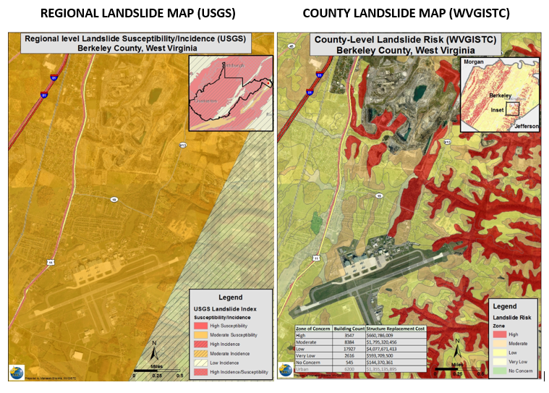
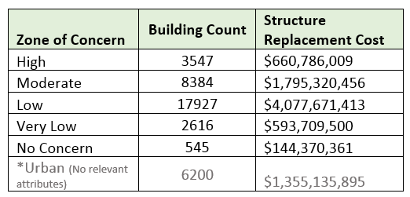
Landslide
Risks
Buildings Exposed to Landslide Risks
Risk Assessment table showing building counts along with estimated replacement costs in landslide zones of concern
Landslide susceptibility map showing generalized USGS map and detailed WVGISTC map

Slide 24
Goal 6: Identify Data Gaps
Review and identify data gaps for key GIS data layers for risk assessment studies (parcels, addresses, imagery, elevation, flood layers, critical infrastructure, etc.).
Provide recommendations to the appropriate organizations to improve data management and governance.

Slide 25
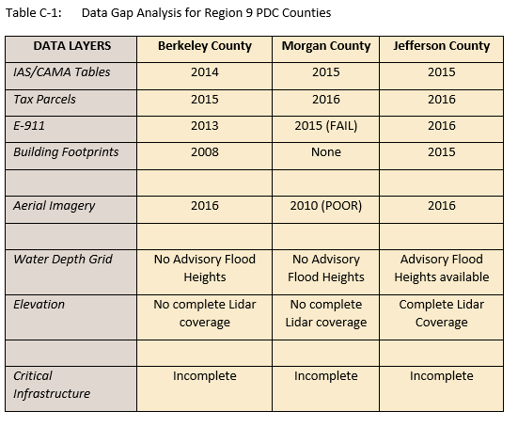
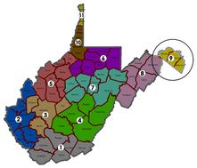
Data Gap Analysis
Data Gap Analysis for Region 9 Counties located in the Eastern Panhandle of West Virginia

Slide 26
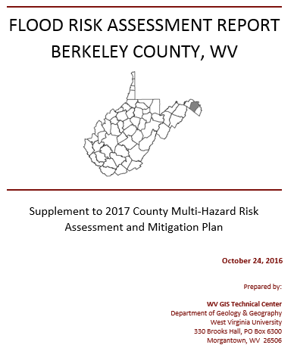
Goal 7: Publish Risk Assessment Reports
Publish supplemental risk assessment reports for local and state hazard mitigation plans.

Slide 27
Goal 8: Publish Model Data
Publish input and output model data associated with risk assessments on state and federal GeoPlatforms.
FEMA and USACE GeoPlatforms
State GeoPlatforms
WV Flood Tool
State Data Clearinghouse

Slide 28
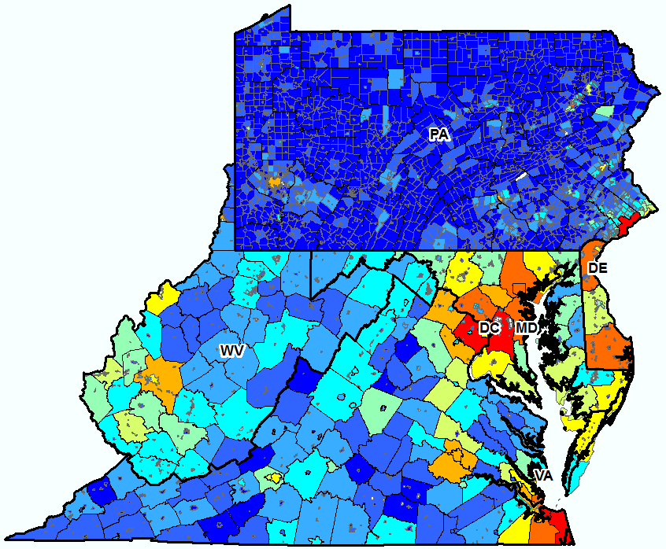
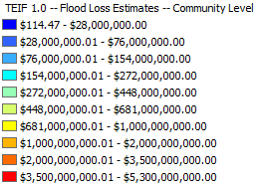
FEMA’s Total Exposure in Floodplain (TEIF)
http://bit.ly/1r1vRBg
More detailed flood risk assessments from local mitigation plans can be vertically integrated to state and federal GeoPlatforms.
Courtesy of Lee Brancheau, FEMA Region III

Slide 29
Goal 9: RiskMAP View of WV Flood tool
Upload 2D/3D flood risk and dam failure maps to the RiskMAP View of the WV Flood Tool (www.mapWV.gov/Flood).
Provide a web planning tool to estimate physical building damage, debris removal, and temporary shelter needs.
This flood risk assessment information permits communities or individual property owners to decide how to allocate resources for the most effective and efficient response and recovery, and to prioritize mitigation measures to reduce future loss.

Slide 30
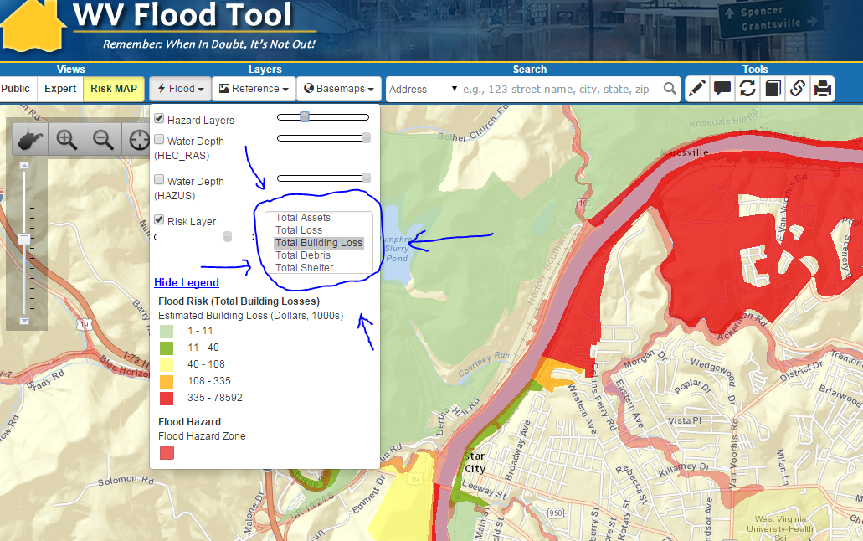
RiskMAP View: Hazus Level 2 Data
Total Assets Exposed
Building Damage
Debris Removal
Shelters Needed
Update RiskMAP View with more detailed Hazus Level 2 “User Modified” Data for Building Damage Estimates, Debris Removal, and Shelter Needs

Slide 31
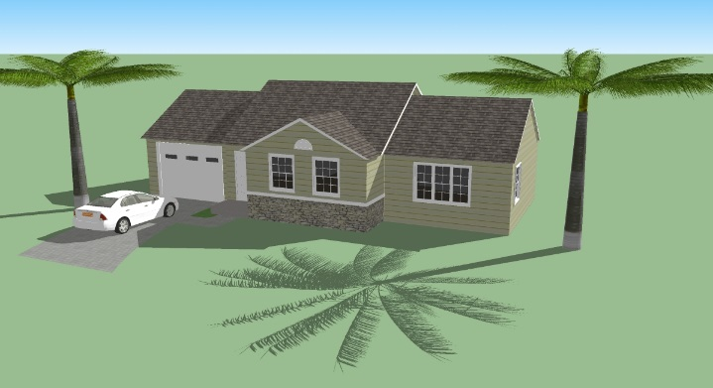
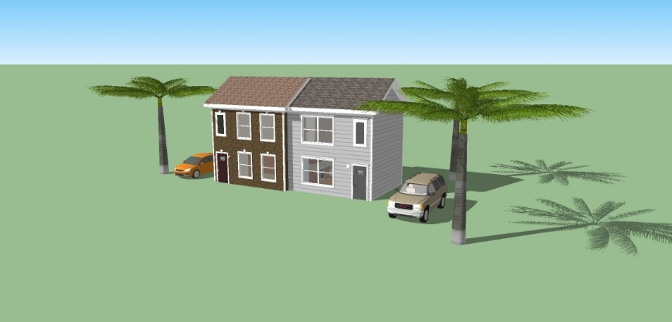
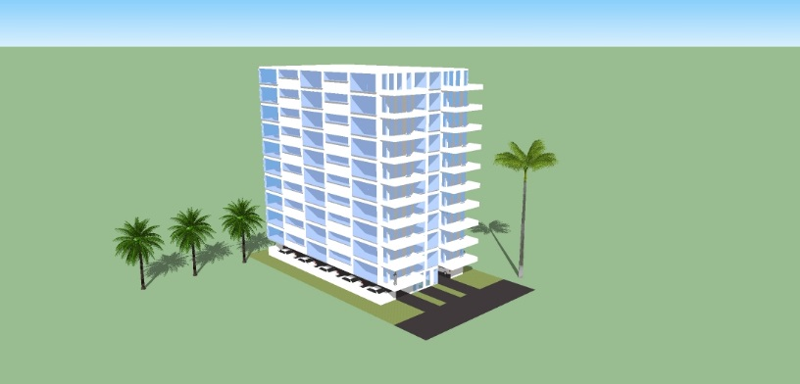
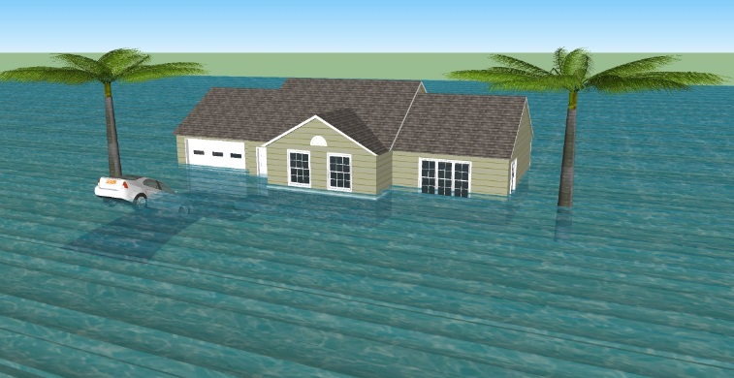
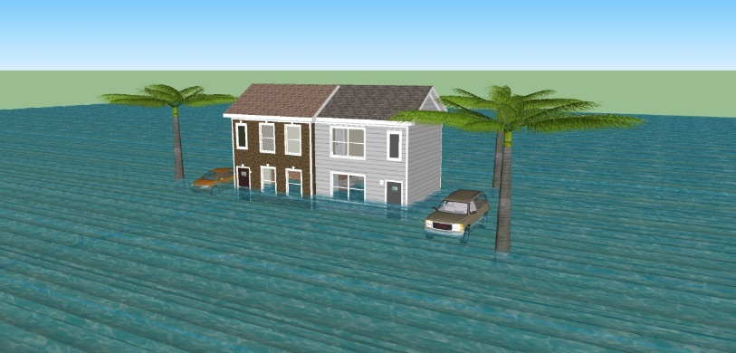
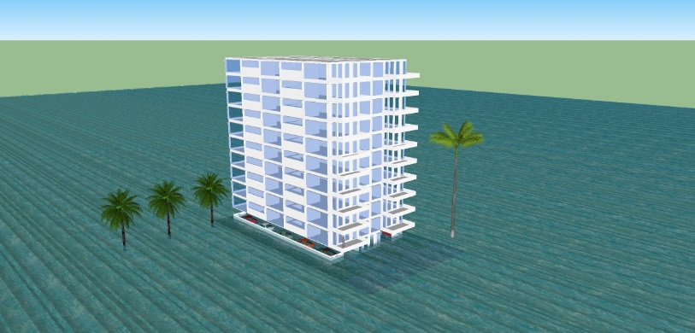
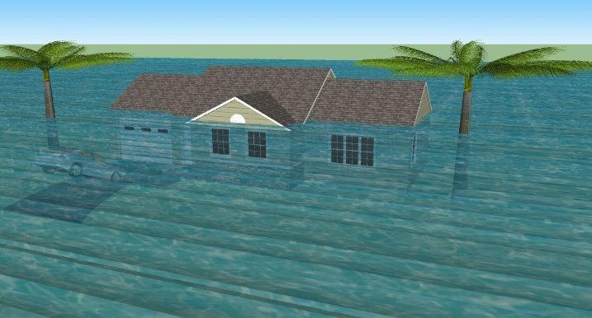
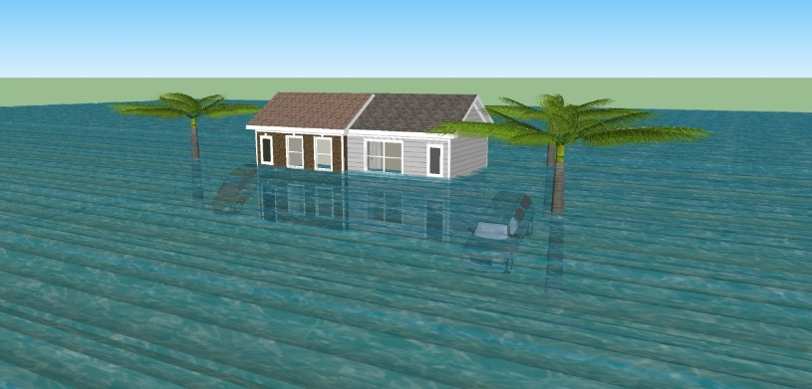
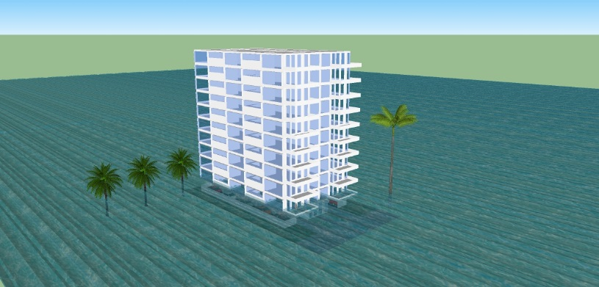
3D Flood Visualization – Individual Structures
One-Story Home Two-Story Duplex High Rise Apartment
WATER DEPTH
0 Feet
4 Feet
12 Feet
Courtesy of Pinellas County Emergency Management, Florida (http://egis.pinellascounty.org/apps/stormsurgeprotector/index.html)
Notes:
Duplex 0 3/4/5 11/13
Apartment Building
Hotel

Slide 32
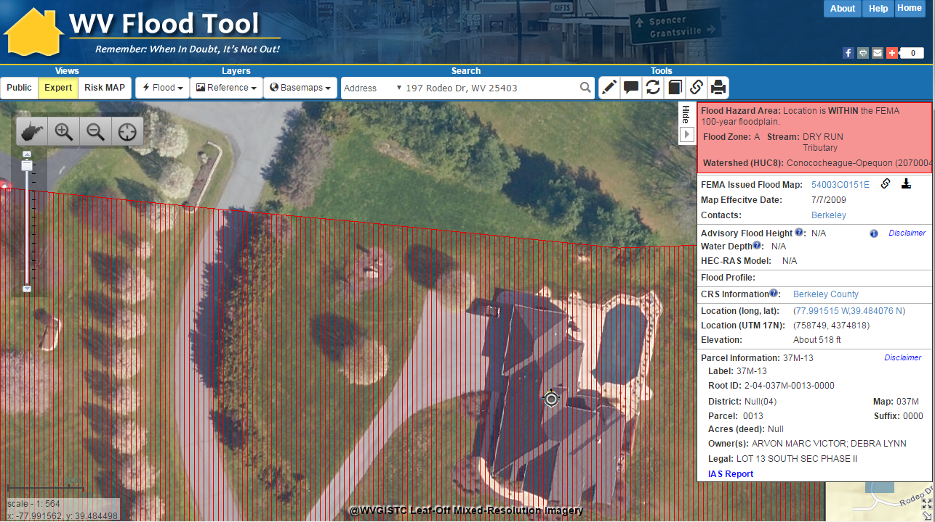
1% Flood Impact, 11-ft. Water Depth
3D Flood Visualization of Structure at
197 Rodeo Drive
WV Flood Tool Conceptual Slide

Slide 33
Parcel/Address Identity Info
CAMA Building
Data
Exposure/
Replacement Cost (BI)
County ID | 2 (Berkeley)
Parcel ID | 04037M001300000000
Street Address | 197 Rodeo Drive
City | Martinsburg
Zip Code | 25403
Deed or GIS Acreage | 2.3 Acres
Legal Description | LOT 13 SOUTH SEC PHASE II
Property Owner(s) | XXXXXXXXXXXXXXXX
Tax Year | 2015
Tax Card | 1
Tax Class | 2
Land Use Code | 101
STORIES | 2
Exterior Wall – Construction Type | 7
Style | 8
Year Built | 2010
Total Rooms | 8
AREASUM | 3,981
GRADE – Building Condition | A-
Basement – Foundation Type & First Floor Height | 4
DWELVAL | 398,400
OBYVAL | 8,450
COMVAL | 0
ReplCost | 506,940
ContCost | 603,075
BldgArea | 3,981
hzOccCode | Res1
NumStories | 2
YearBuilt | 2010
BldgConstruction | Brick
BldgCondition | High
BldgFoundation | Basement
FirstFloorHt | 4
CAMA
Assessment Data
Damage Estimates (UDF)
BldgDmgPct | 51.6
BldgLossUSD | 261,354
ContDmgPct | 47.9
ContLossUSD | 121,326
Land Appraisal | 55,100
Building Appraisal | 321,700
Total Appraisal | 376,800
A unique parcel identifier links assessment/building data, replacement costs, and damage loss estimates for each structure

Slide 34
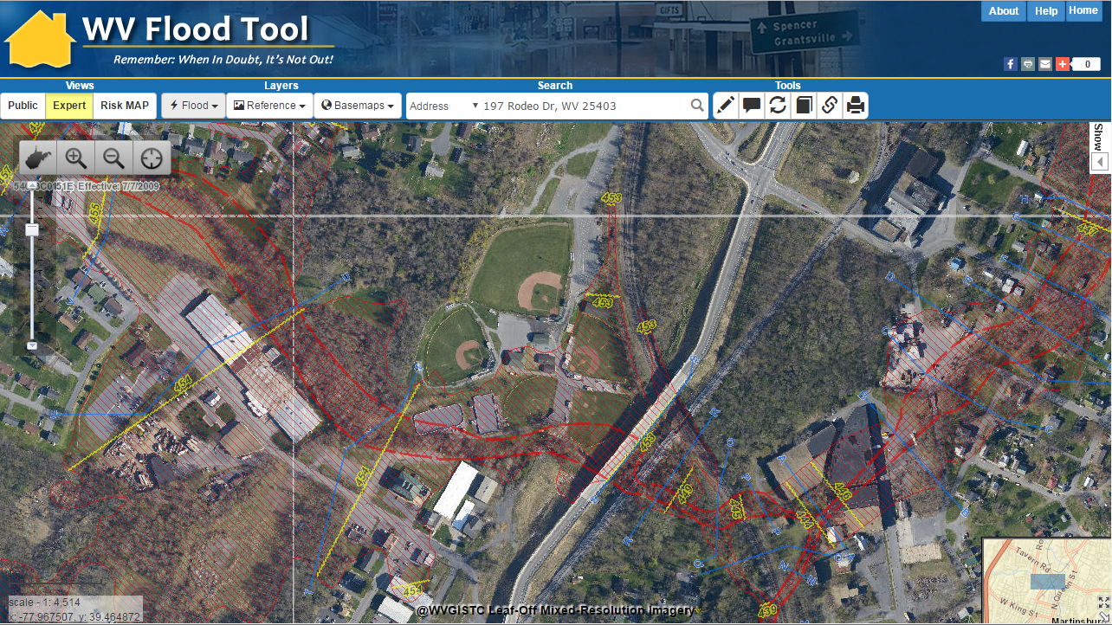
3D Flood Visualization – Neighborhood
Baltimore Street, Martinsburg, WV
3D Northwest View
3D
WV Flood Tool Conceptual Slide

Slide 35
Resources: WV Flood Risk Reports
October 2016 | Flood Risk Assessment Supplement to 2017 Region 9 Planning and Development Council Hazard Mitigation Plans – WV GIS Technical Center Berkeley County, WV ftp://ftp.wvgis.wvu.edu/pub/temp/FEMA/FRA/Berkeley_FloodRiskRpt_20161026.pdf Morgan county, WV ftp://ftp.wvgis.wvu.edu/pub/temp/FEMA/FRA/Morgan_FloodRiskRpt_20161026.pdf

Slide 36
Resources: Previous NCR HUG Calls
Dec. 2013 | Total Exposure in Floodplain (TEIF) 2.0 – Glenn Locke, Tetra Tech http://www.usehazus.com/uploads/forum/December192013_NationalCapitolRegionHUG_Presentaiton_FINAL.pdf http://www.usehazus.com/ncrhug
March 2015 | Cook County HMP Risk Assessment – Carol Bauman, Tetra Tech http://www.usehazus.com/uploads/forum/March262015_NationalCapitolRegionHUG_Presentaiton.pdf
Feb. 2016 | Multi-Hazard Risk Assessment Lifecycle Cradle-to-Cradle - Rethinking the Way We Use Risk Assessments – Cynthia McCoy, FEMA Region X http://www.usehazus.com/uploads/forum/February252016_NationalCapitolRegionHUG_Presentaiton2.pdf
March 2016 | Data Creation Geared to the World as We Know it! – Steve Kocsis, Cambria County, PA GIS Center; Visualization of the Month – 3D Flood Impact http://www.usehazus.com/uploads/forum/March312016_NationalCapitolRegionHUG_Presentaiton.pdf

Slide 37
FUTURE DIRECTIONS
Officially Start Project in 2017
Refine Building Inventory Tool
Better integration of parcels/assessment records with E-911 addresses
Review CAMA default values/null values/assumptions
Null values for certain building characteristics of commercial and industrial properties
Tax-Exempt Properties
Upgrade to current Hazus-MH software version
Upgrade RiskMAP View of WV Flood Tool
Add Hazus Level 2 Data (building loss estimates, debris removal, shelter needs)
At-Risk Structures in Flood Zones
Display parcel/assessment/address and building loss info for individual structures
Create 3D flood visualizations of at-risk structures
Incorporate flood/levee inundation maps
Coordinate with Technical Partners
Statewide Depth Grid, Dam/Levee Assessments, Landslide Model Validation, etc.

Slide 38
SPECIAL THANKS
Special thanks for support from FEMA
WV Division of Homeland Security and Emergency Management The Polis Center at Indiana University–Purdue University Indianapolis

Slide 39
CONTACT INFORMATION
Kurt Donaldson GIS Manager WV GIS Technical Center West Virginia University kdonalds@wvu.edu
Eric Hopkins GIS Specialist WV GIS Technical Center West Virginia University Eric.Hopkins@mail.wvu.edu

