Slide 1
AE Non-Restudy Advisory Floodplain Redelineation and Flood Depth Grid Pilot Study: Clear Fork, Guyandotte River Wyoming County, West Virginia West Virginia GIS Technical Center June 2017

Slide 2
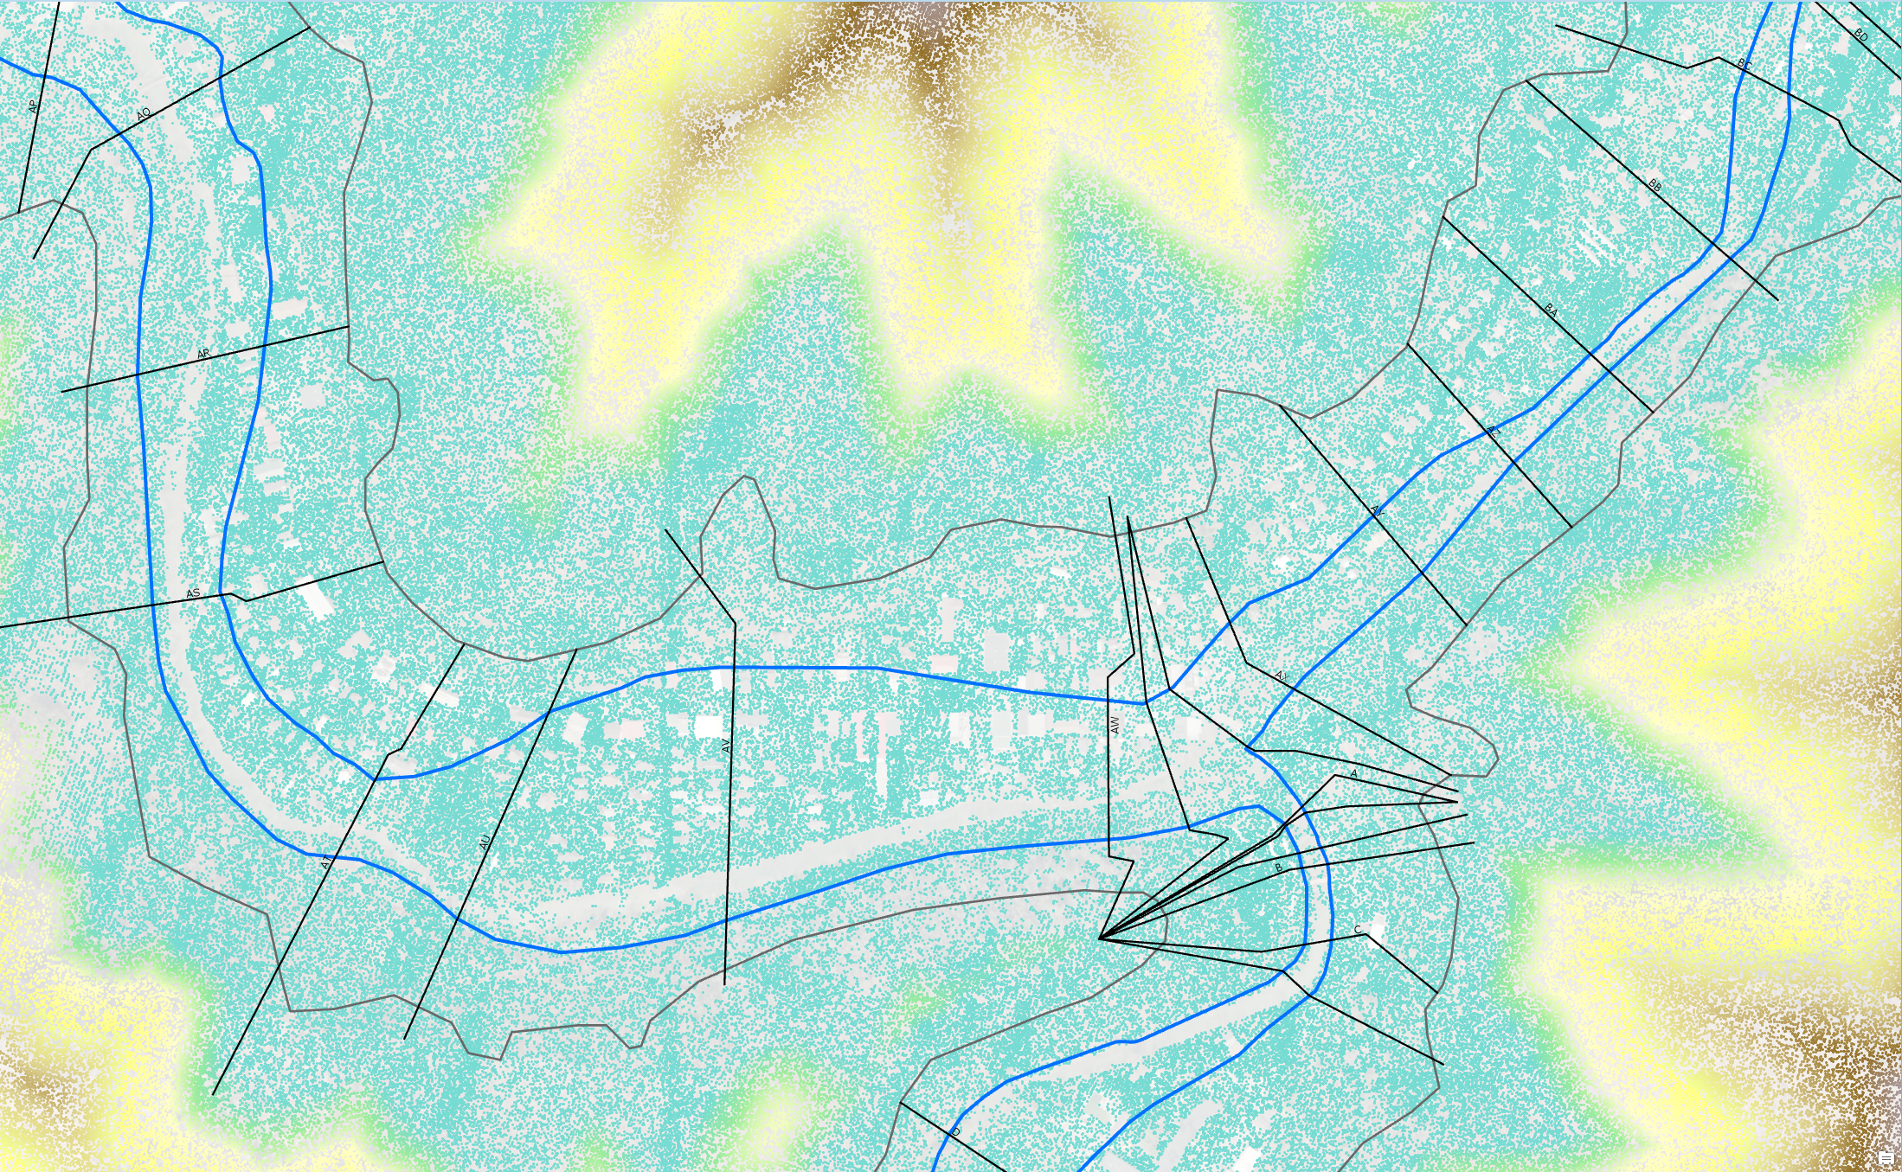
Lidar Elevation Data
Location: Oceana, WV
https://www.mapwv.gov/flood/map/?wkid=102100&x=-9086441&y=4536103&l=9&v=1
Effective 1%
Floodplain
Extended
XS Line
Analysis
Buffer
Notes:
DEP Lidar LAS dataset – bare earth points. XS lines extended to/beyond buffer.

Slide 3
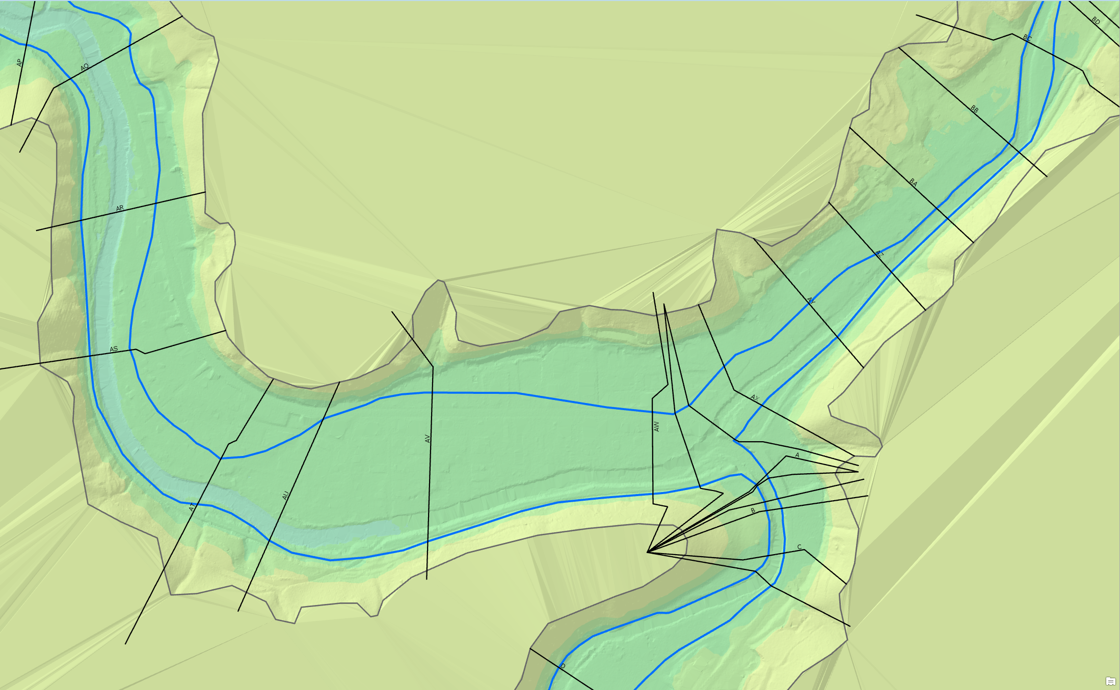
Ground Surface TIN from Lidar
Location: Oceana, WV
https://www.mapwv.gov/flood/map/?wkid=102100&x=-9086441&y=4536103&l=9&v=1
Notes:
Ground surface TIN created from LAS dataset points, displayed with effective XS and SFHA

Slide 4
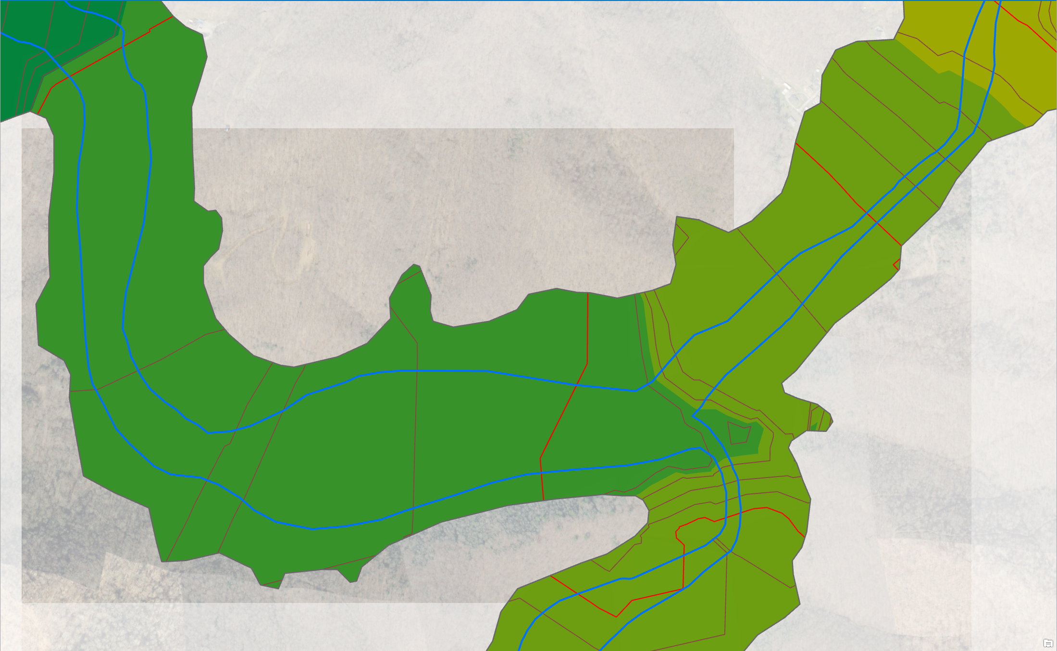
Flood Water Surface from XS
Location: Oceana, WV
https://www.mapwv.gov/flood/map/?wkid=102100&x=-9086441&y=4536103&l=9&v=1
TIN Elevation
Contour
(Not XS!)
Notes:
1% Flood water surface created from cross section lines.

Slide 5
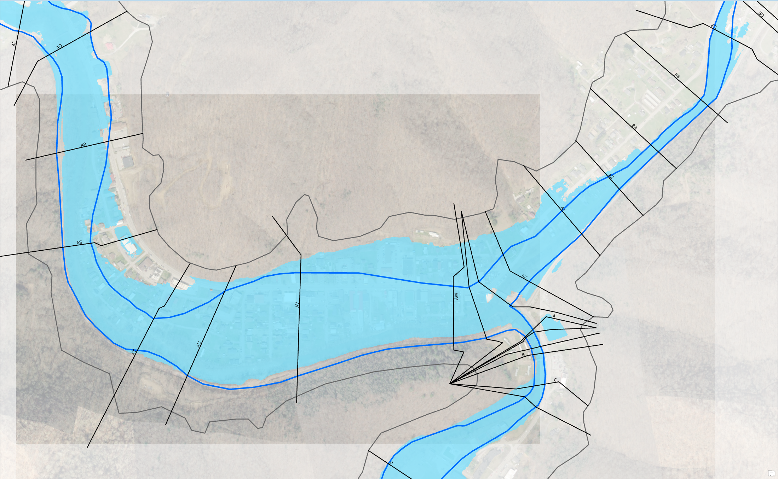
Redelineated Floodplain
Location: Oceana, WV
https://www.mapwv.gov/flood/map/?wkid=102100&x=-9086441&y=4536103&l=9&v=1
Notes:
Redelineated 1% floodplain represents above ground portion of water surface when laid over ground surface.

Slide 6
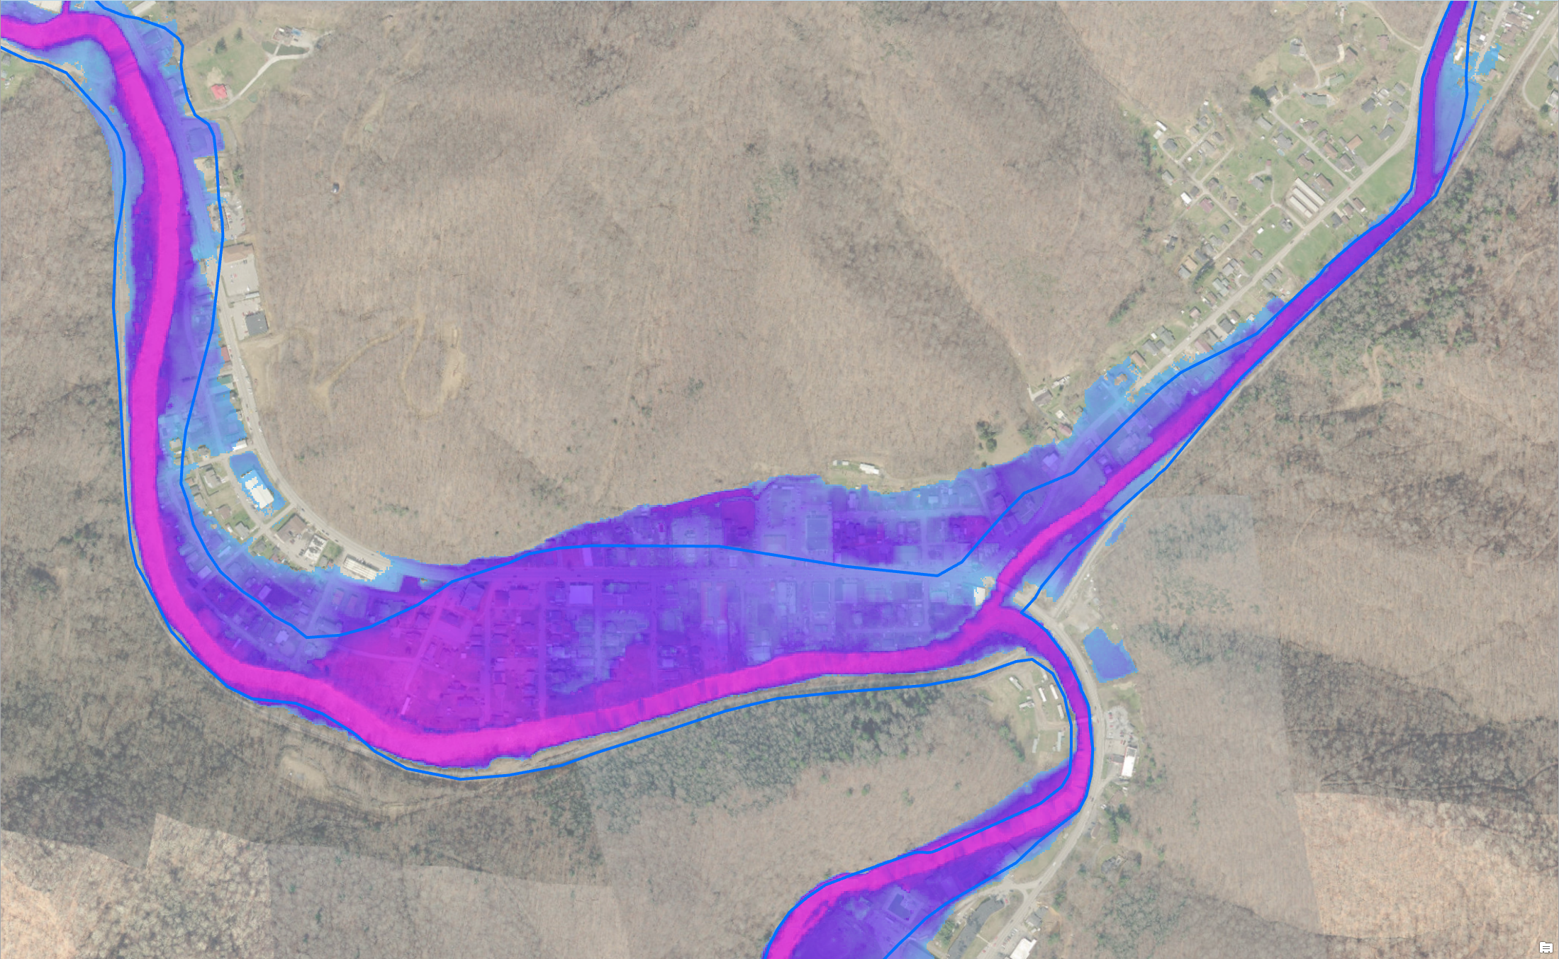
Advisory AE Depth Grid
Notes:
Advisory AE Depth Grid derived from effective cross sections and new ground elevation.

Slide 7
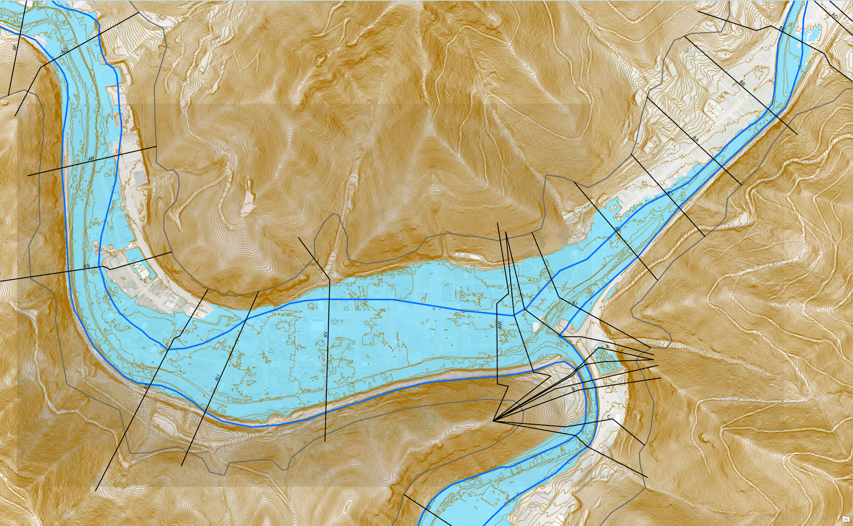
Redelineated Floodplain, Contours
Location: Oceana, WV
https://www.mapwv.gov/flood/map/?wkid=102100&x=-9086441&y=4536103&l=9&v=1
Notes:
Redelineated 1% floodplain with effective 1% floodplain and XS lines. Contour lines (1-meter) from DEP lidar.

Slide 8
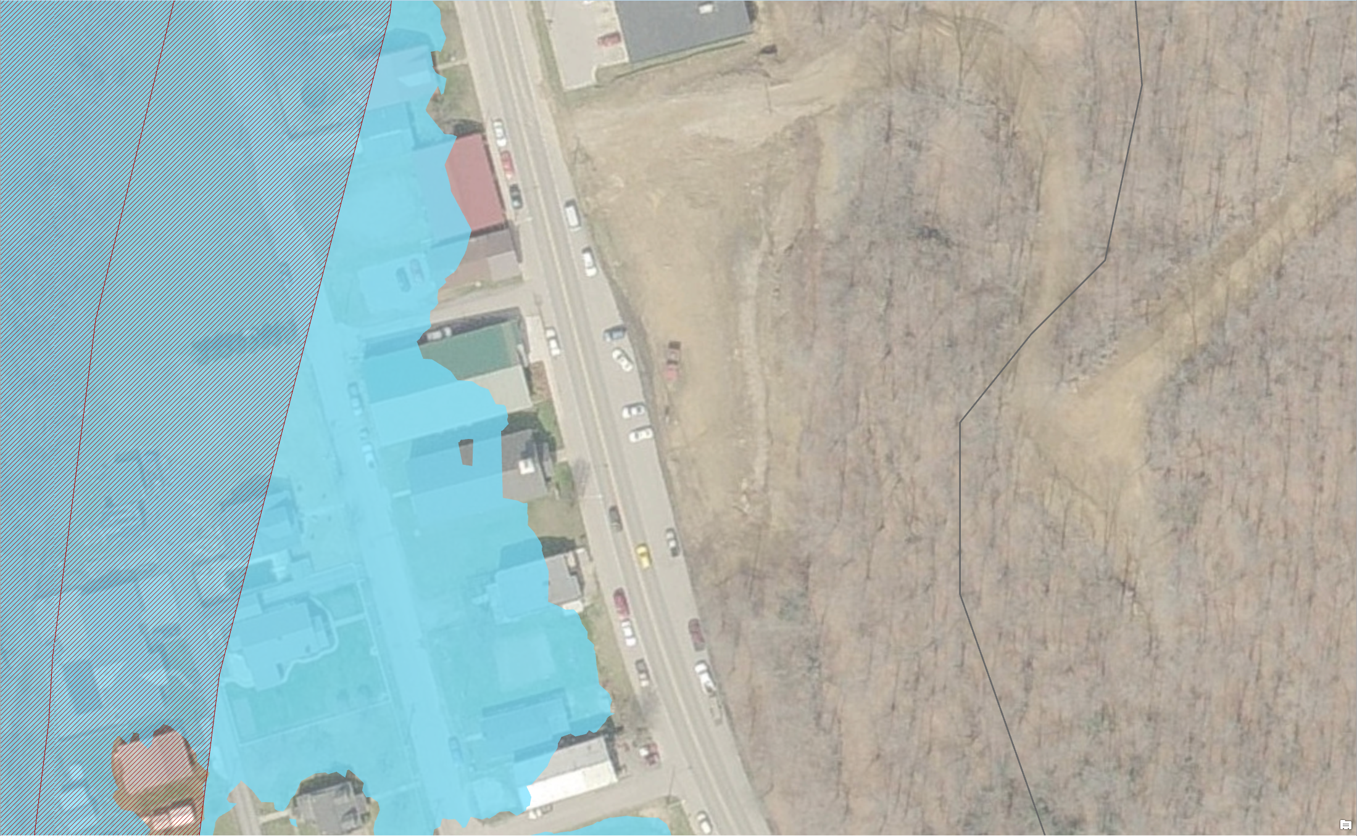
New Structures IN Redelineated FP
Location: Oceana, WV
https://www.mapwv.gov/flood/map/?wkid=102100&x=-9087471&y=4536293&l=12&v=1
Notes:
Multiple structures out of effective, in advisory AE floodplain.

Slide 9
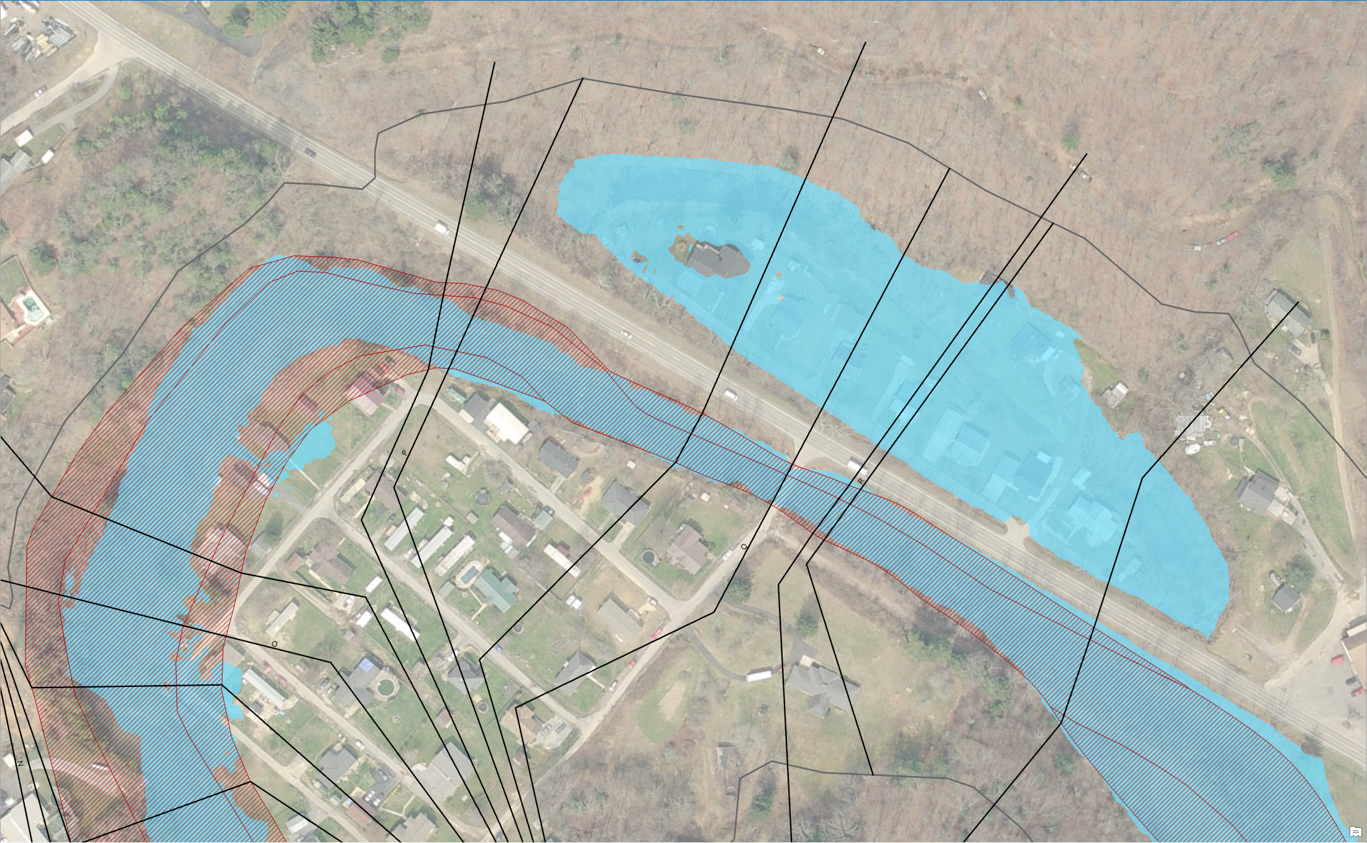
New Structures IN Redelineated FP
Location: Laurel Fork, Wyoming County, WV
https://www.mapwv.gov/flood/map/?wkid=102100&x=-9085599&y=4533928&l=11&v=1
Notes:
Multiple structures in backwater not included in effective floodplain.

Slide 10
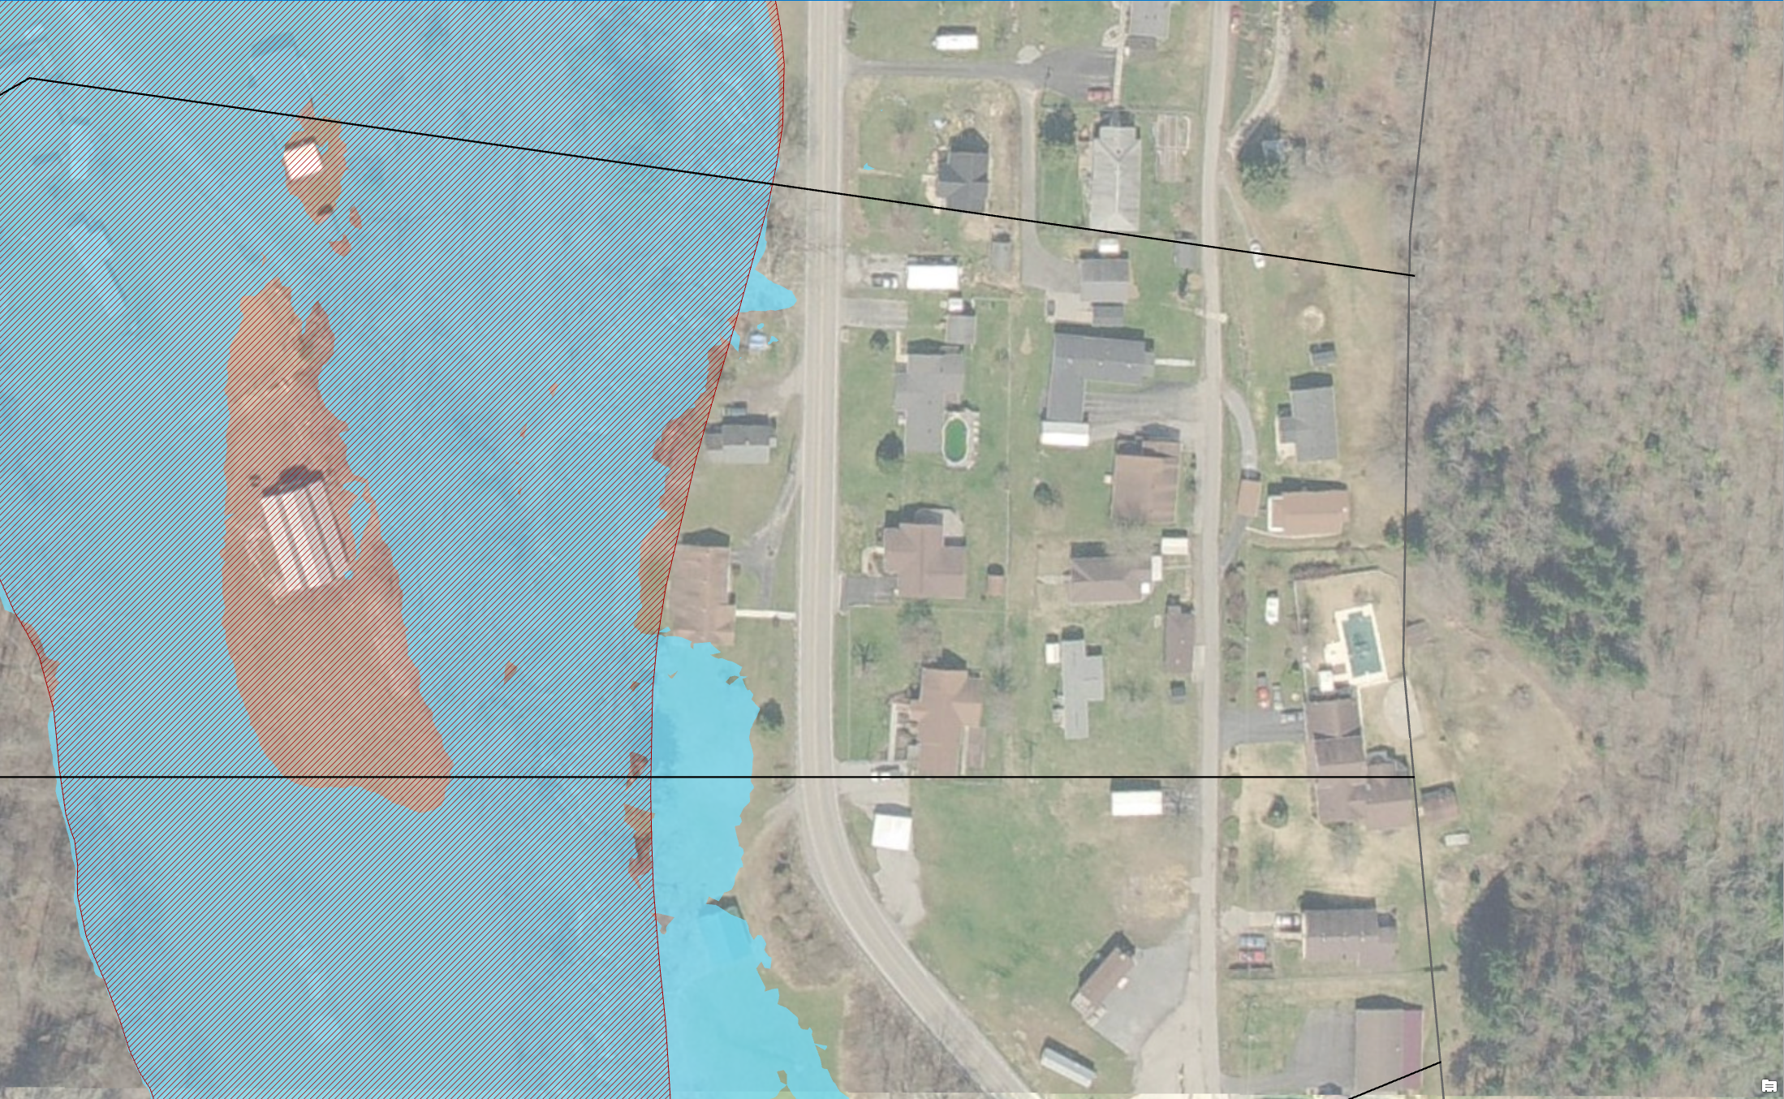
Structure Removed from New FP
Location: Laurel Fork, Wyoming County, WV
https://www.mapwv.gov/flood/map/?wkid=102100&x=-9075604&y=4536094&l=10&v=1
Notes:
Structure in effective 1% floodplain shown out of advisory AE based on updated elevation data.

Slide 11
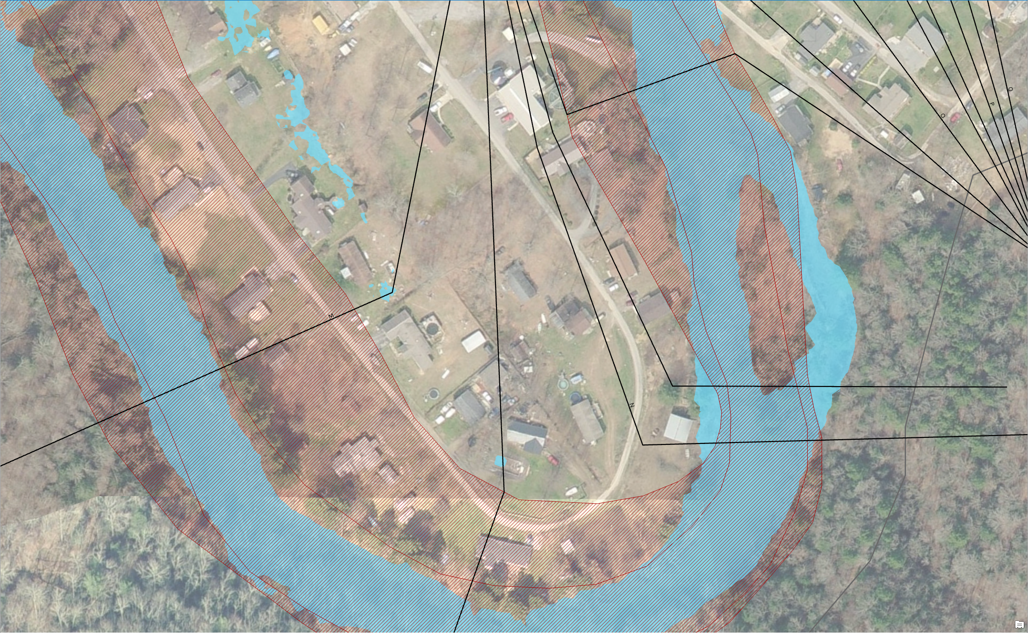
Structures Removed from New FP
Location: Laurel Fork, Wyoming County, WV
https://www.mapwv.gov/flood/map/?wkid=102100&x=-9086194&y=4533631&l=11&v=1
Notes:
Multiple structures shown as IN effective 1% floodplain now shown as outside Advisory AE floodplain.

Slide 12
Contact Information:
WVU GIS Technical Center
Eric Hopkins ehopkins@wvu.edu, phone: 304-293-9463
Kurt Donaldson kurt.donaldson@mail.wvu.edu, phone: 304-293-9467

