Slide 1
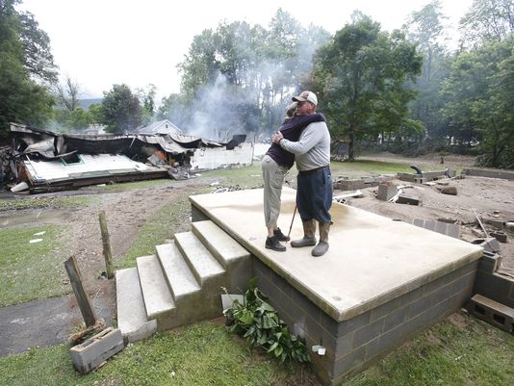
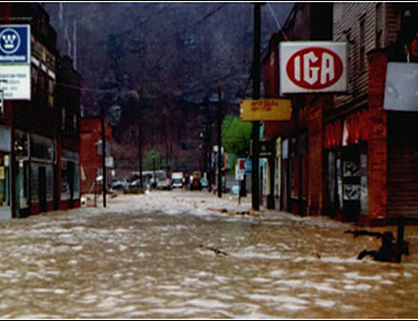
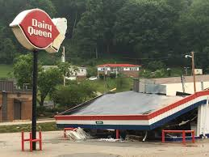
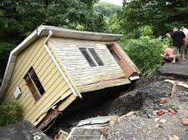
West Virginia Flood Tool & Statewide Flood Risk Assessment
Kurt Donaldson, GISP, CFM Manager WV GIS Technical Center West Virginia University kdonalds@wvu.edu February 26, 2020 2020 Interagency Flood Risk Management Training Seminars
← Devastating June 2016 Flood

Slide 2
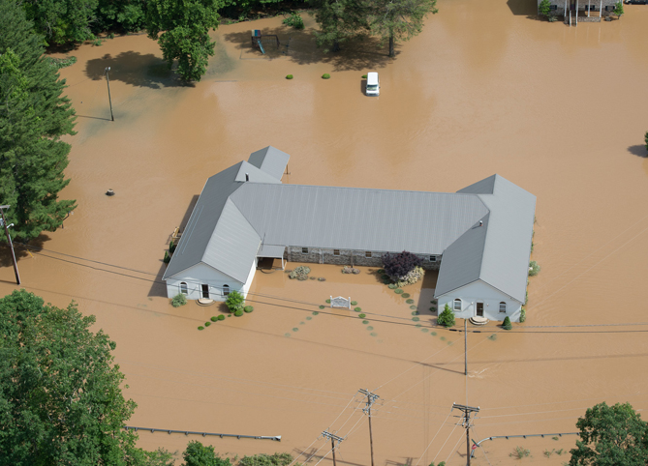
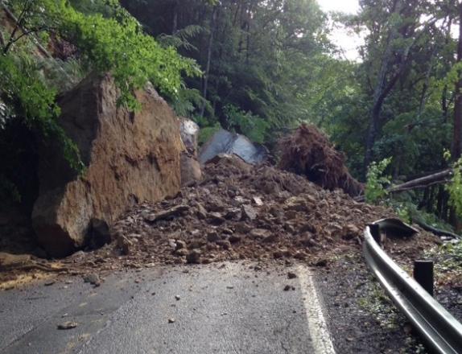
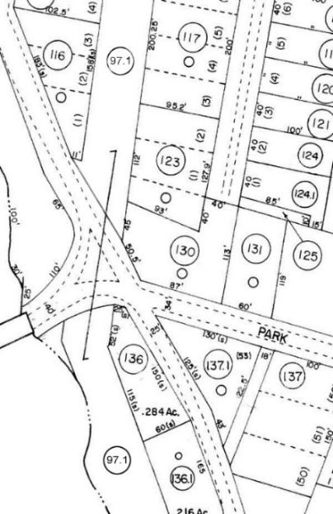
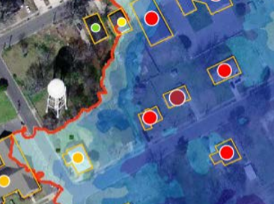
A Statewide Approach to Risk Studies Multi-Hazard Risk Assessments
Hazard Mitigation Grant Project
Flood Risk #1 WV Hazard
Landslide Risk #2 WV Hazard
Reference Data Development
Inventory of Building-Level Flood-Risk Structures
Statewide
Budget Breakdown
Notes:
WV Map indicating population density

Slide 3
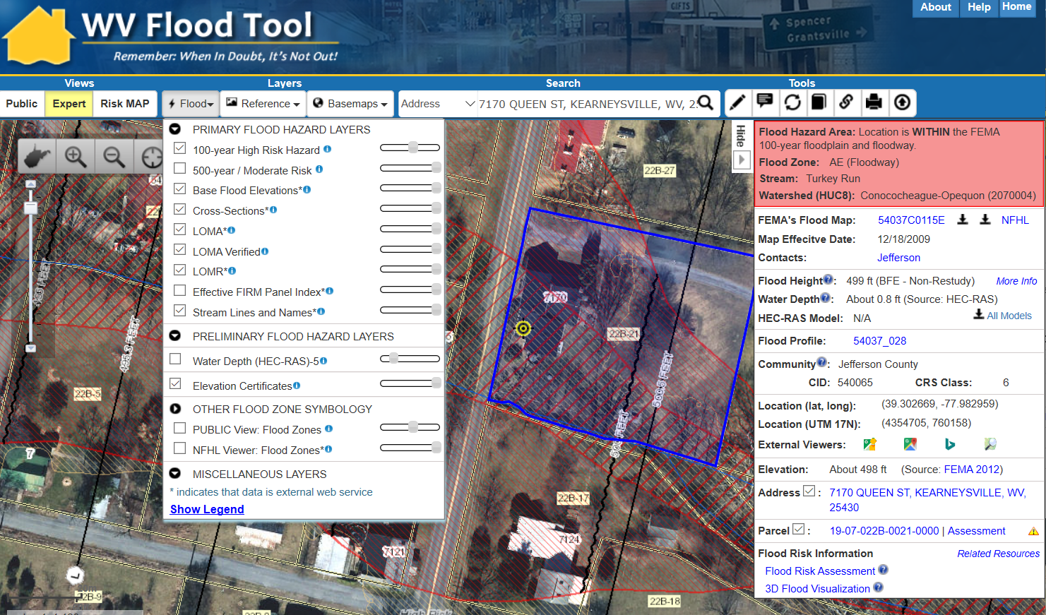
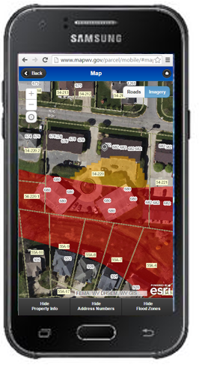
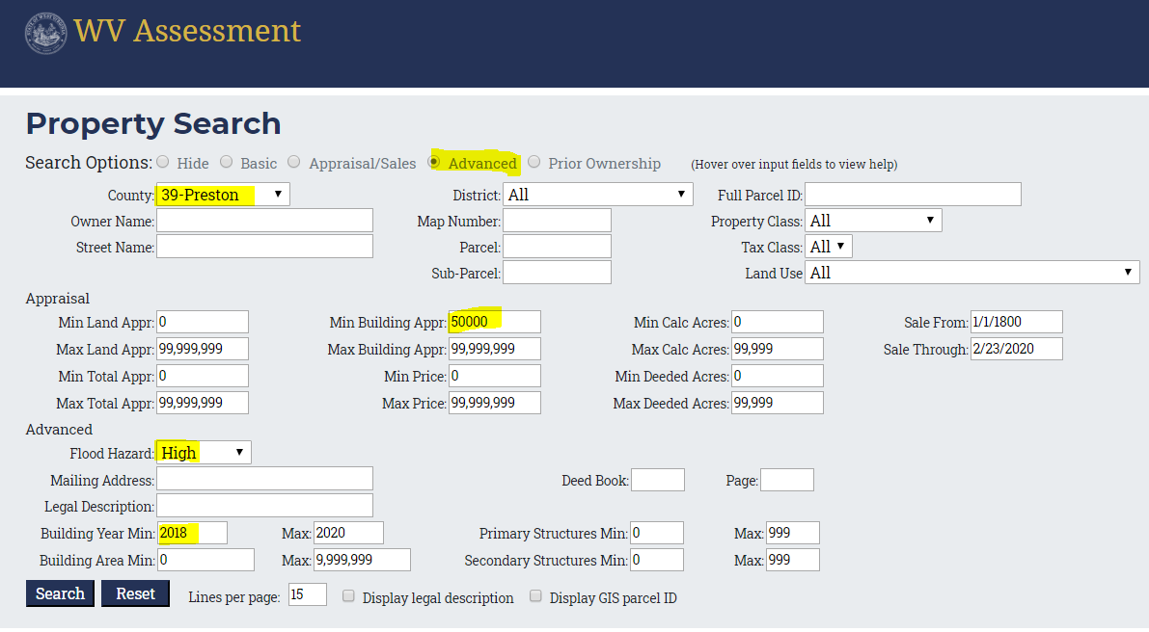
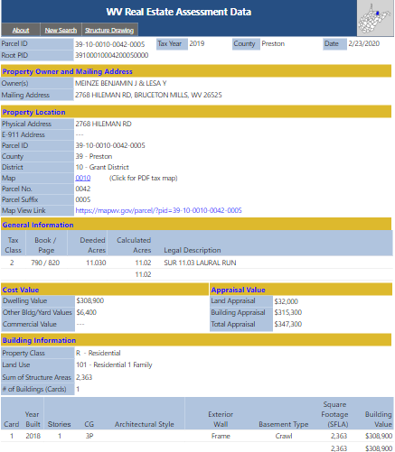
WV Flood Tool
Flood Tool: Desktop
(1) Flood Tool: Desktop Version https://www.mapwv.gov/flood
(2) Flood Tool: Mobile Version https://www.mapwv.gov/flood/mmap
Public resource applications that support floodplain management and flood reduction activities
Mobile
(3) Property Search and Assessment Report https://www.mapwv.gov/property
Web Parcel Report
Query search on flood hazard zones and state assessment records
New development
Prior ownership

Slide 4
Interagency Coordination – Flood Risk
No single agency has all the answers but leveraging multiple programs and perspectives can provide a cohesive solution
MAPPING
FEMA R3
State NFIP
SHMO
ASSESSMENT
FEMA R3
FEMA Hazus Team
State NFIP / SHMO
USACE Silver Jackets
PLANNING
FEMA R3
SHMO
State NFIP
CRS/NFIP
FEMA R3
CRS/ISO
USACE Silver Jackets
State NFIP / SHMO
GIS
FEMA R3
WVDHSEM GIS
USACE Silver Jackets

Slide 5
WV Flood Tool
Flood Tool Views
(www.mapwv.gov/flood)
Public View for general public
Expert View for floodplain managers
RiskMAP View for flood risk planners

Slide 6
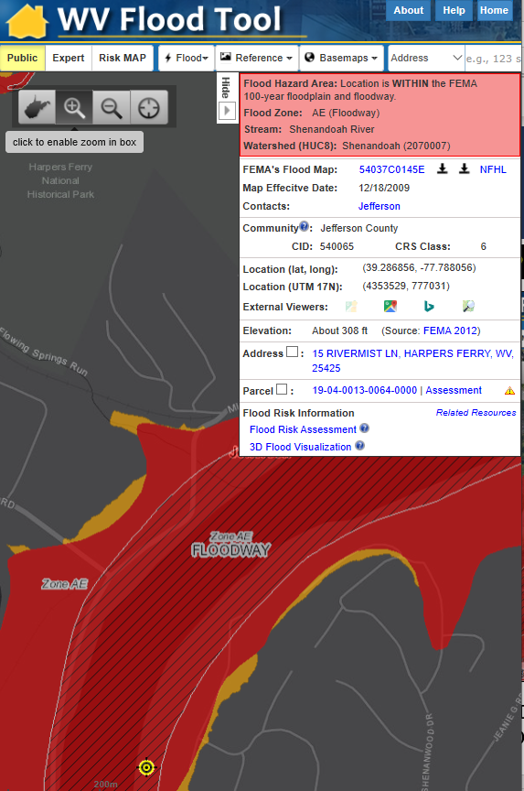
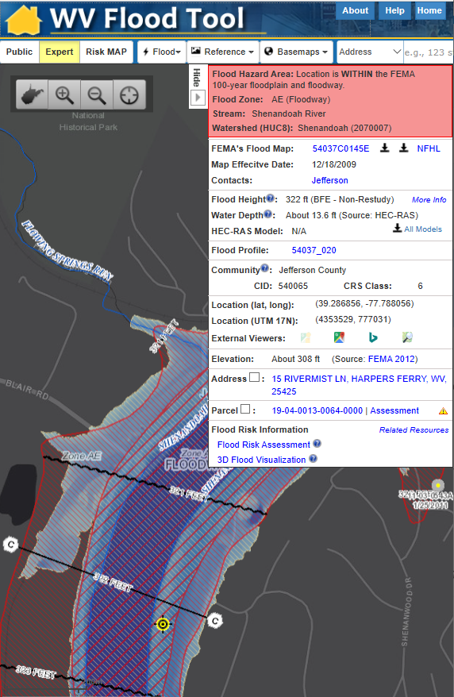
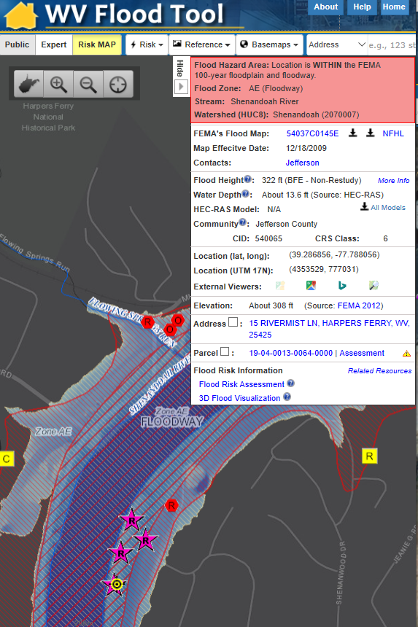
WV Flood Tool Views
Public View
Expert View
RiskMAP View
Quick Determination if IN or Out of Flood Zone
Floodplain Management and Permits, Disaster Assessments
Building-Specific Flood Risk Assessments

Slide 7
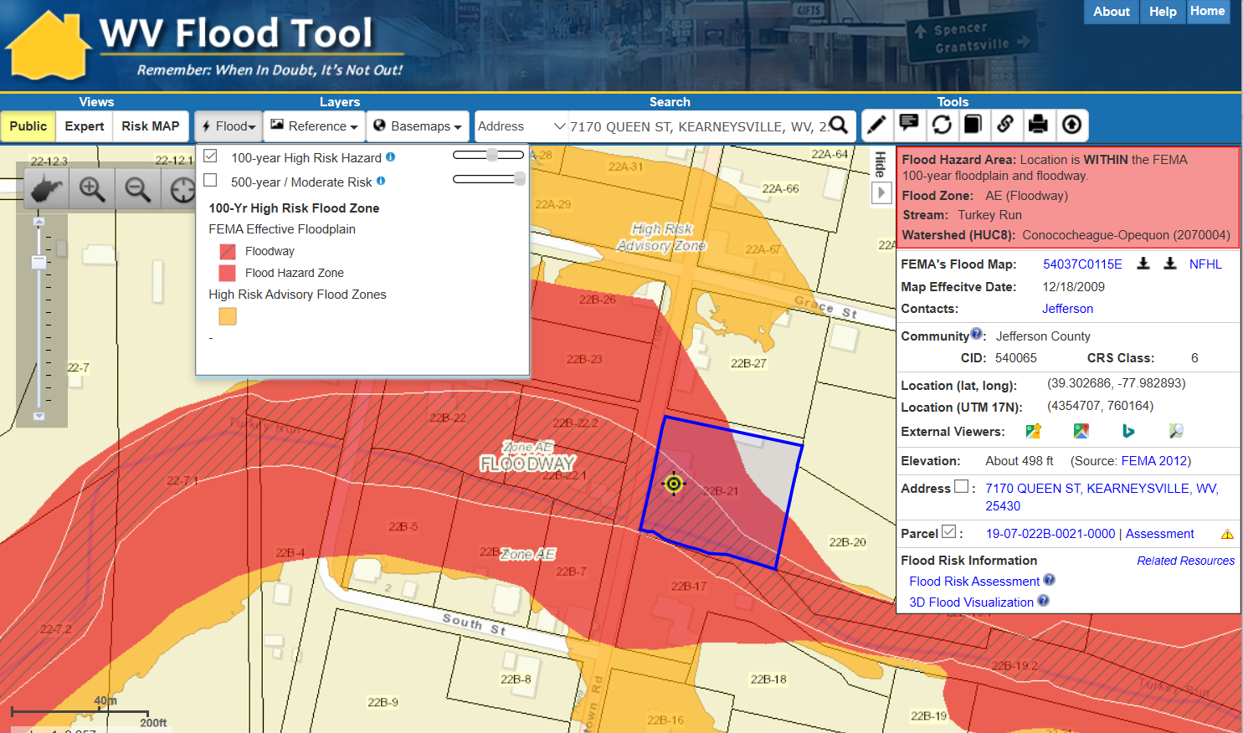
WV Flood Tool – Public View
Public View
https://www.mapwv.gov/flood/map/?v=0&pid=19-07-022B-0021-0000

Slide 8
WV Flood Tool – Expert View
Expert View
https://www.mapwv.gov/flood/map/?v=1&pid=19-07-022B-0021-0000

Slide 9
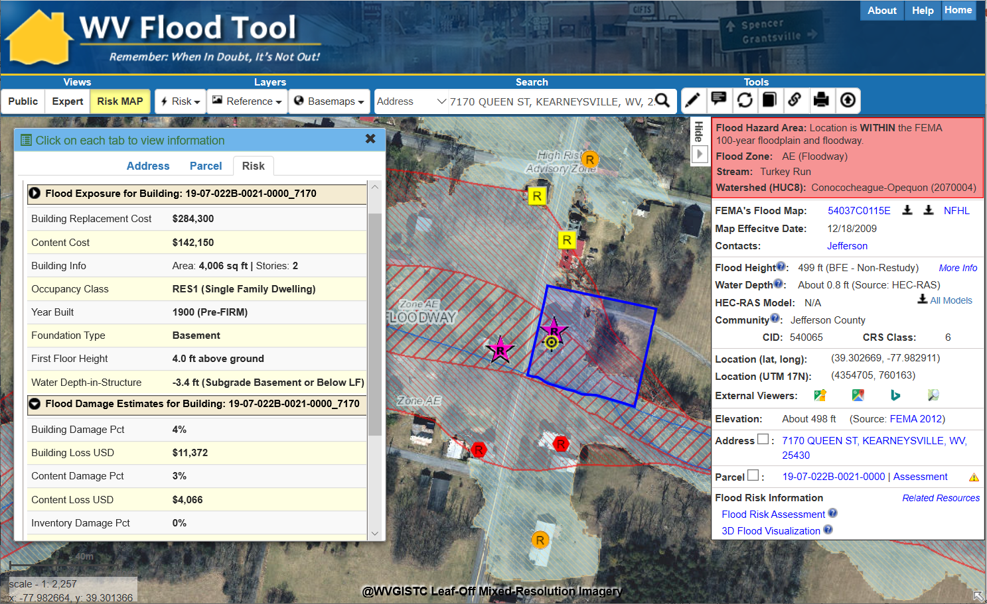
WV Flood Tool – RiskMAP View
RiskMAP View
https://www.mapwv.gov/flood/map/?v=1&pid=19-07-022B-0021-0000

Slide 10
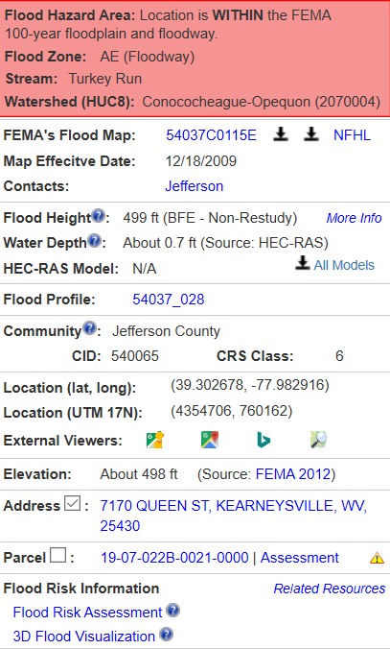
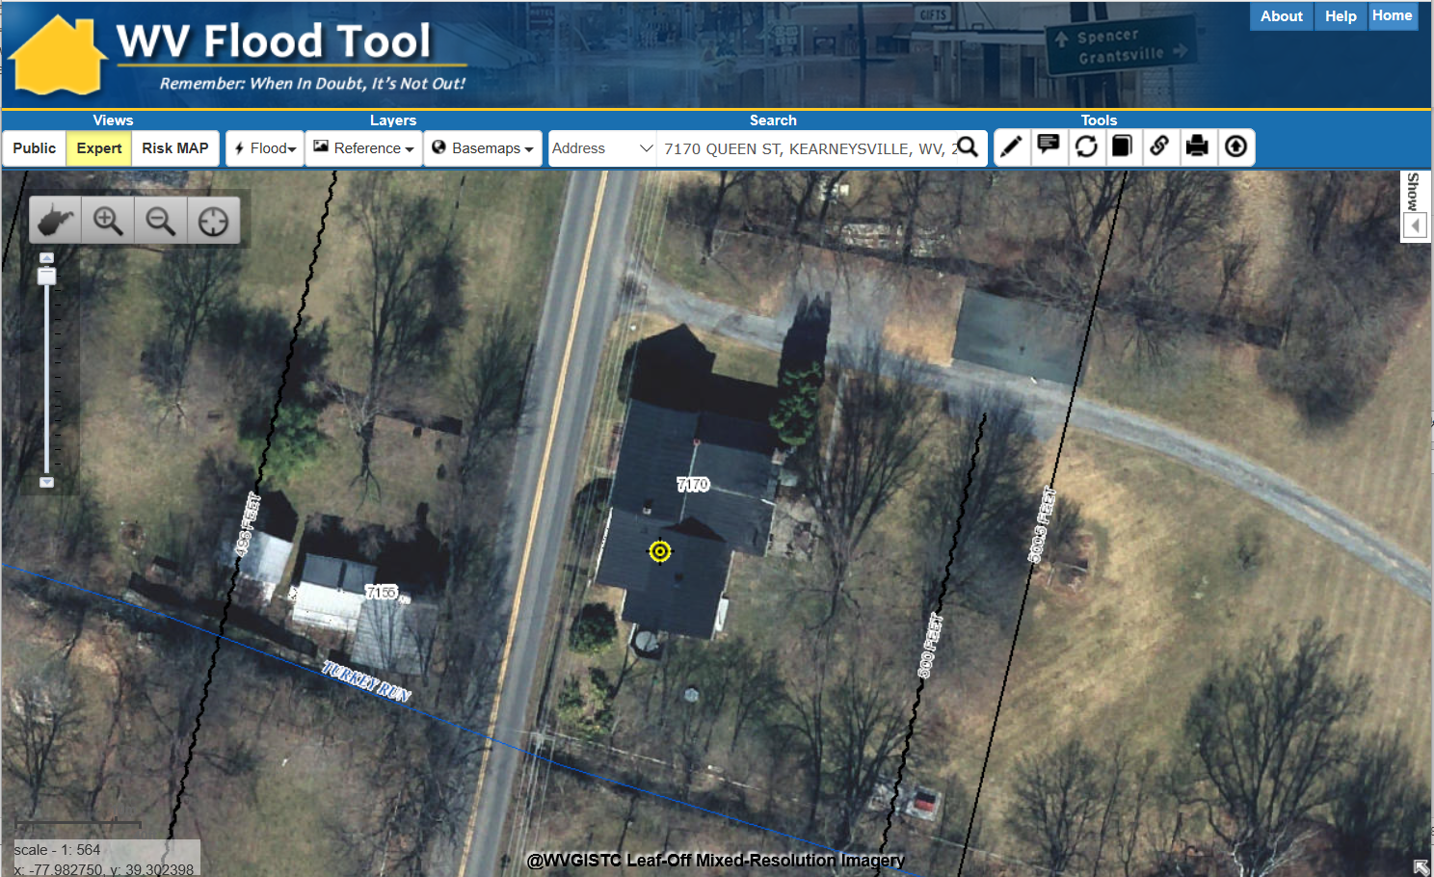
Flood Query Results Panel
# | Each Location Query Answers:
1 | In Flood Hazard Area? Flood Zone? Floodway?
2 | Stream & Watershed names?
3 | FEMA Issued Flood Map / NFHL links?
4 | Floodplain Manager Contact?
5 | Flood Height value or information?
6 | Water Depth value and source?
7 | HEC-RAS Model available?
8 | Flood Profile available?
9 | CRS community information?
10 | Coordinate x,y location?
11 | External Map Viewer Links?
12 | Ground elevation value and source?
13 | E-911 Address (link to address info)
14 | Parcel ID (link to property info)
15 | Flood risk assessment info?
16 | 3D flood visualization?
1
2
3
4
5
7170
Queen Street
6
7
8
9
10
11
12
13
14
Click Here
15
16
Parcel ID Web Link: https://www.mapwv.gov/flood/map/?v=1&pid=19-07-022B-0021-0000

Slide 11
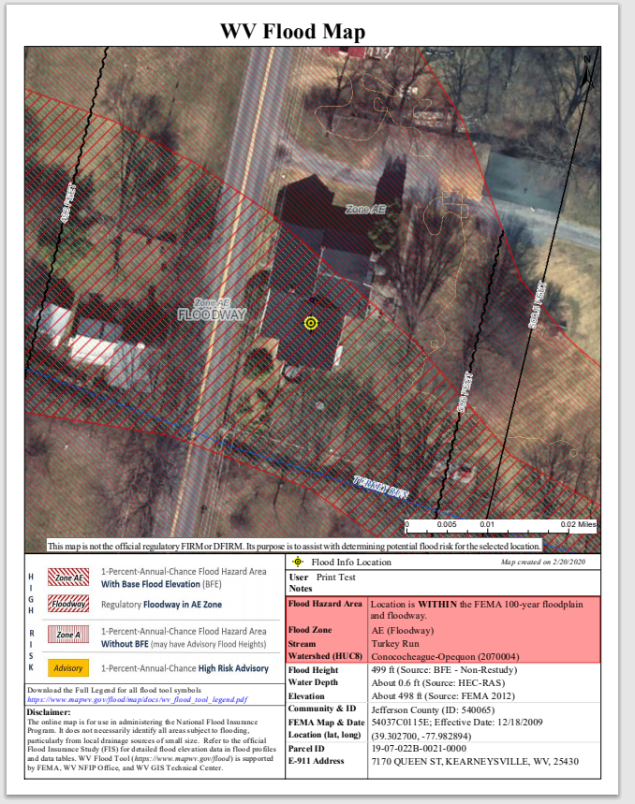
Print Out for Permits, LOMAs, etc.
Print Flood Query Results

Slide 12
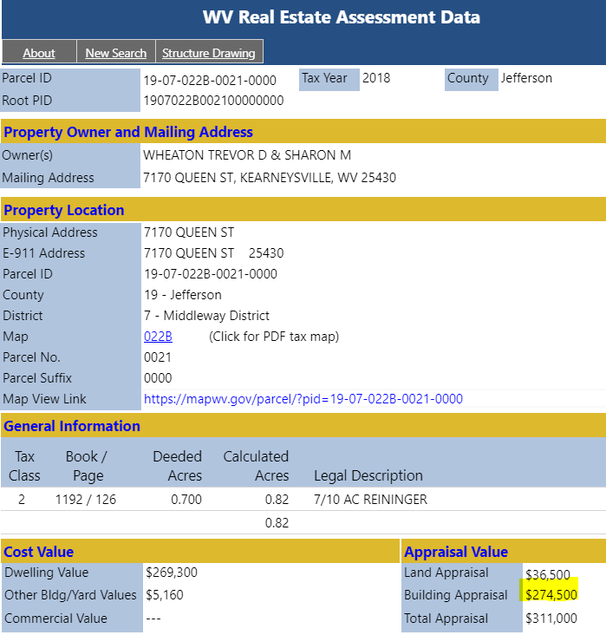
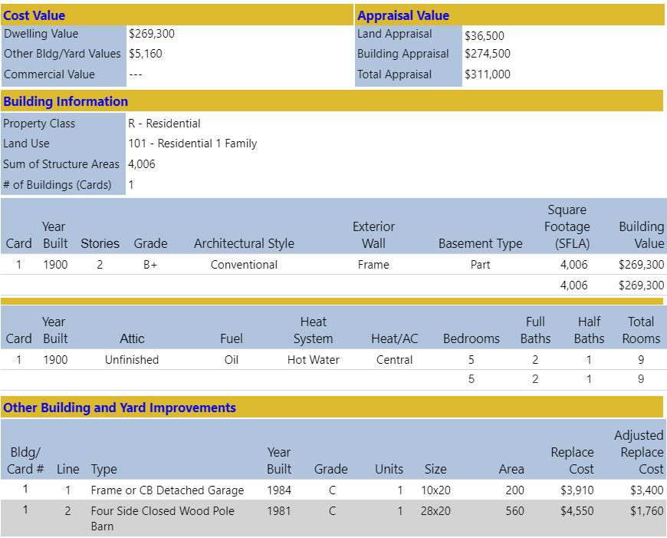
Building 19-07-022B-0021-0000_7170
Main Building Information
Owner and Property Location
Outbuildings
Legal Description
Cost Values
Property Intersect Flood Zone
Web Parcel Assessment Report for Building Identification, Building Characteristics, and Cost Values

Slide 13
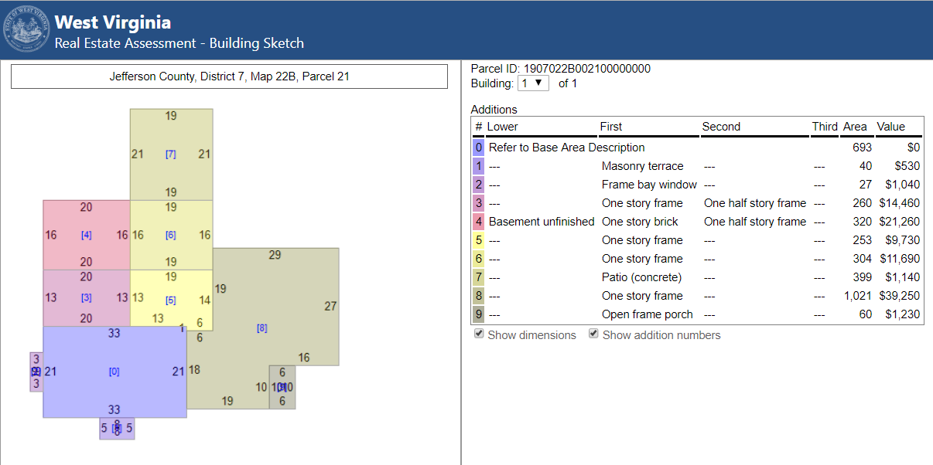
Building 19-07-022B-0021-0000_7170
Building Sketch Diagram (main area and additions)
Building Sketches from parcel assessment records are available for all Residential and Farm properties. Very useful for Building Identification.

Slide 14
Data Privacy at State Level
West Virginia Statewide Parcel Files and Attributes in Public Domain: The local and state governments have the authority to share property owner names and addresses with the public (Senate Bill 588). For example, West Virginia’s parcel assessment data which includes names and addresses is publicly accessible; only sensitive information like phone numbers or security alarm information are redacted by the WV Property Tax Division before release. Both the WV Property Tax Division and county assessors are co-custodians of the parcel map files and assessment records. All the West Virginia parcel data and assessment information can be downloaded from the State Data Clearinghouse.

Slide 15
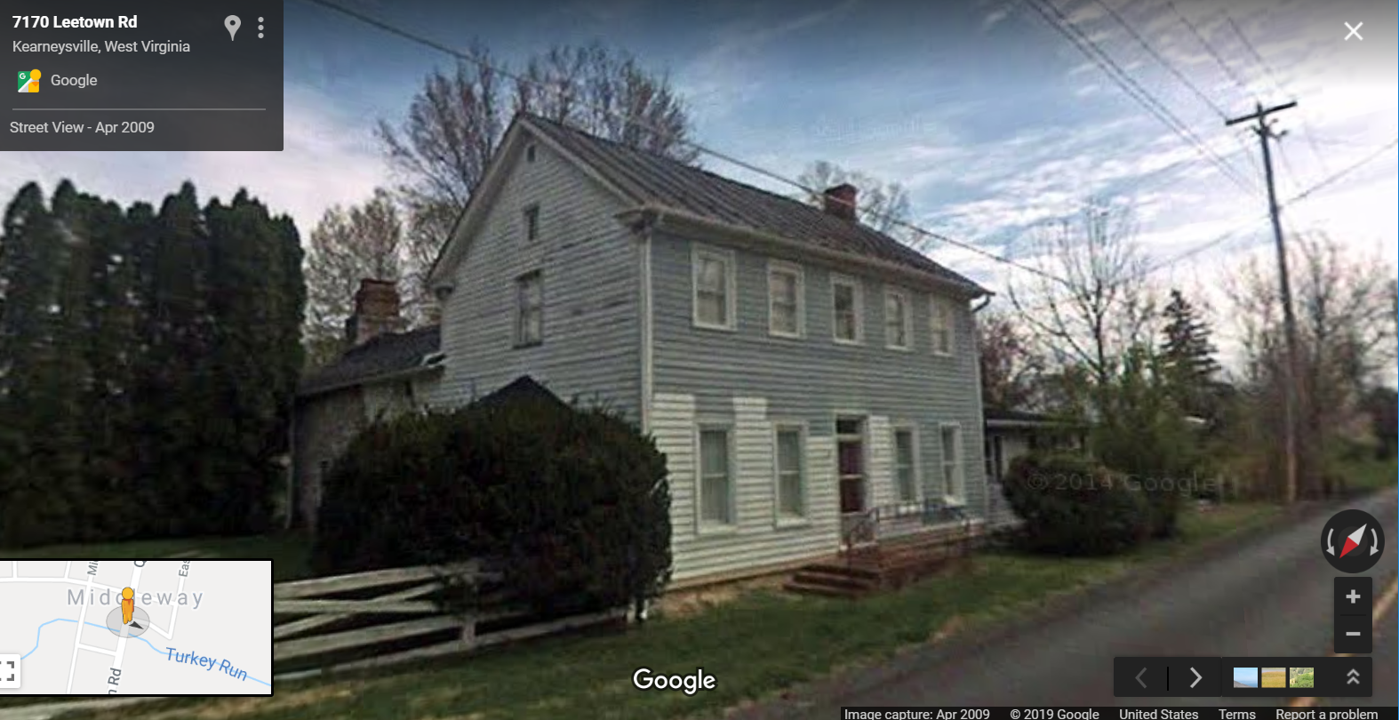
Building 19-07-022B-0021-0000_7170
Building 19-07-022B-0021-0000_7170
Flood Tool External Link to Google Street View
Flood Tool External Link to Google Street View

Slide 16
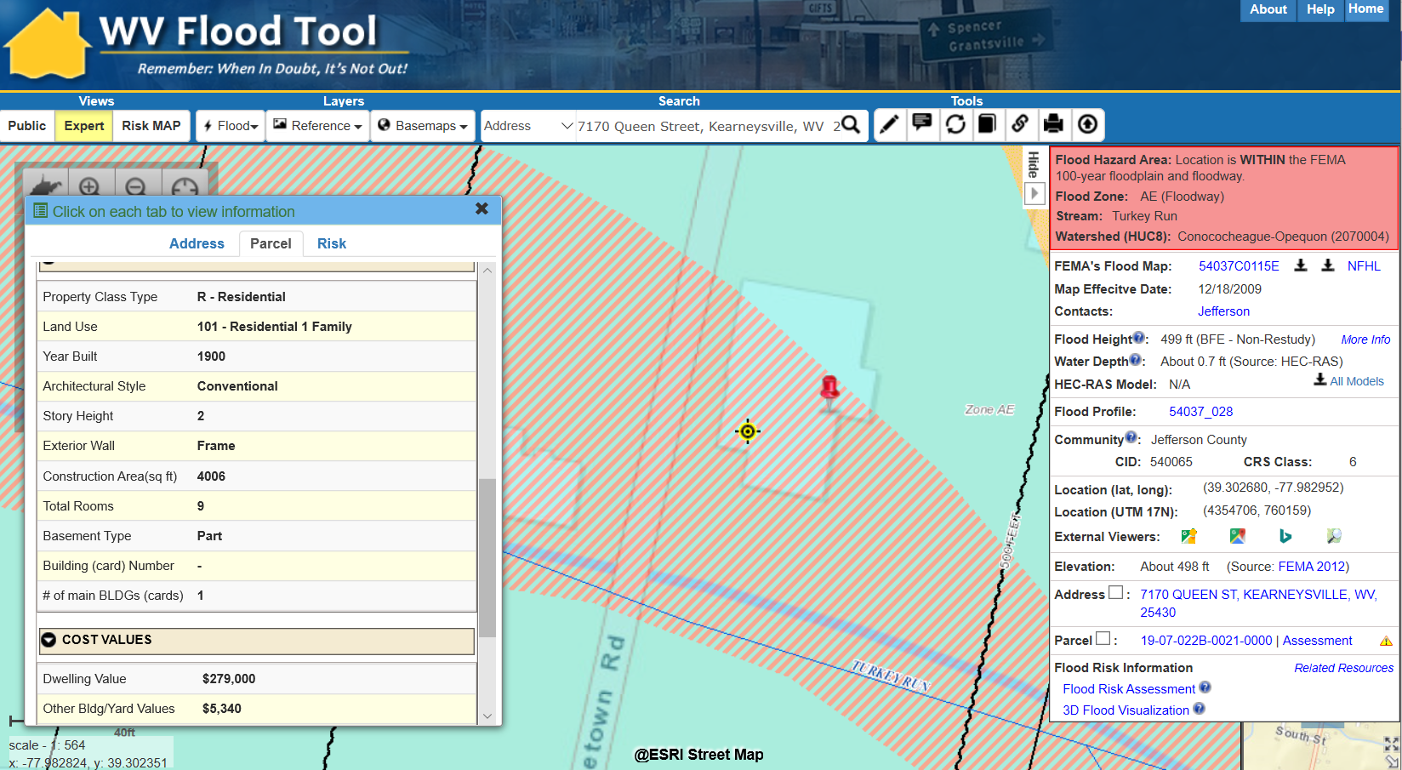
Information Links
FEMA Flood Maps
Flood Profile
Street View Picture
Elevation Metadata
Property Info
Bldg. Flood Risk
https://www.mapwv.gov/flood/map/?v=1&pid=19-07-022B-0021-0000

Slide 17
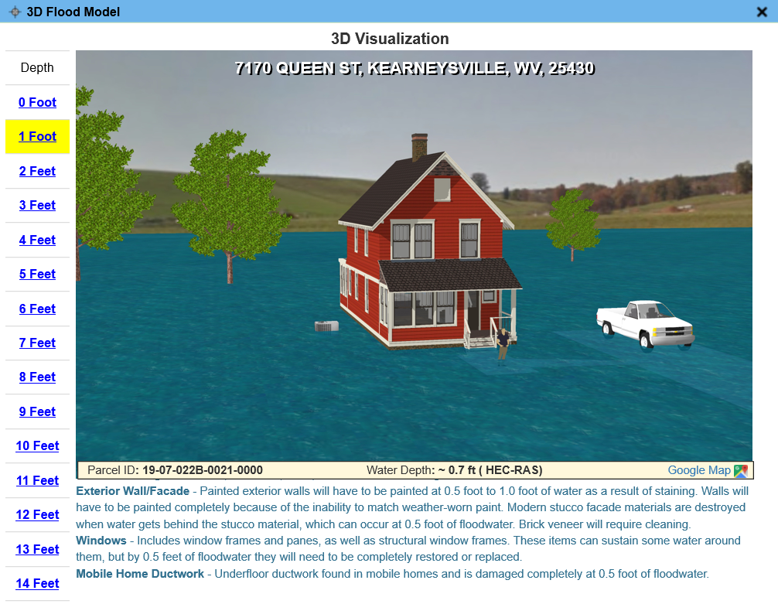
3D Flood Visualization
Building 19-07-022B-0021-0000_7170

Slide 18
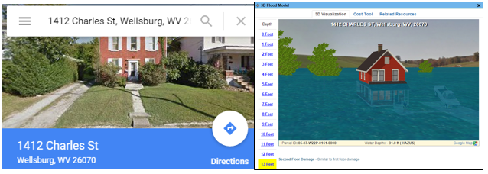
3D Flood Visualizations
Brooke County
https://www.mapwv.gov/flood/map/?v=1&pid=05-07-W22P-0161-0000
1412 Charles St, Wellsburg, WV, 26070, Parcel ID: 05-07-W22P-0161-0000
“This is the coolest thing ever….thank you!!!”
Source: 3D Flood Visualization Comment from Terri Jo Bennett, CFM, Upshur County Building Permit, Floodplain and Addressing and Mapping Coordinator
Upshur County
https://www.mapwv.gov/flood/map/?v=0&pid=49-05-0003-0031-0000
673 Vicksburg RD, Buckhannon, WV, 26201, Parcel ID: 49-05-0003-0031-0000

Slide 19
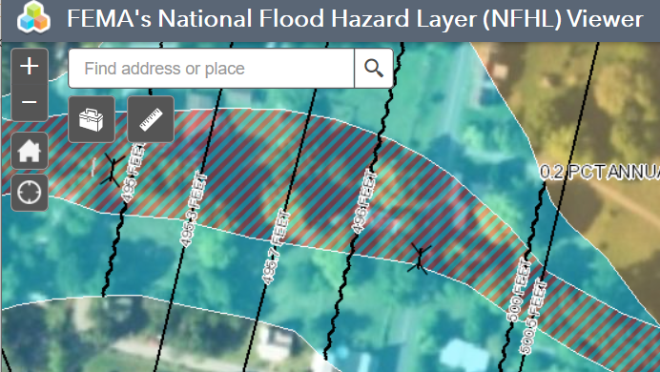
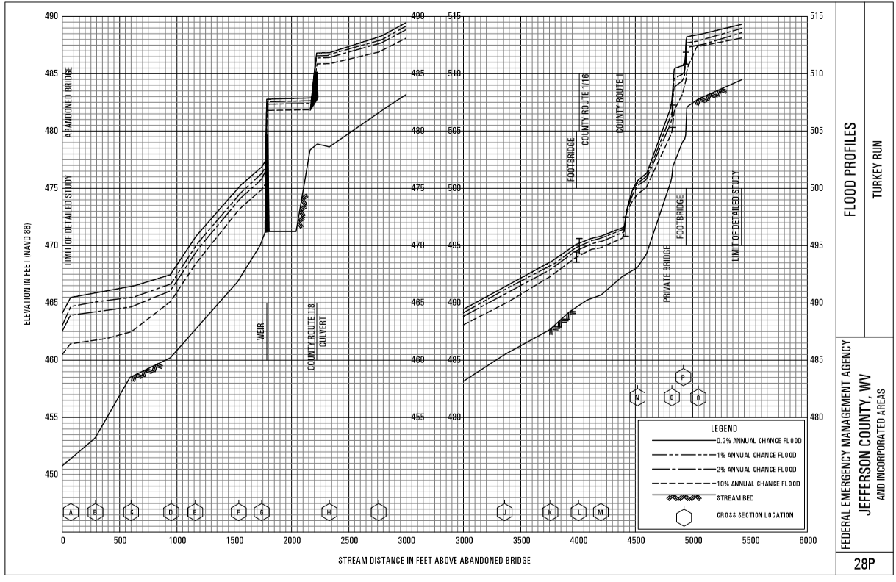
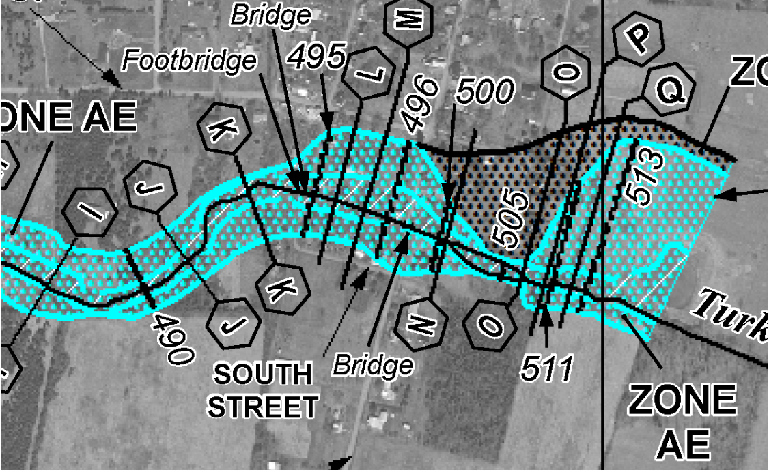
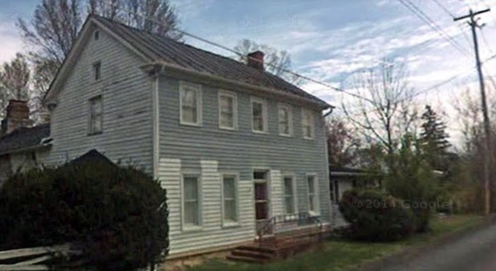
External Links
FEMA’s NFHL Viewer
Flood Profile
FEMA Issued Flood Map
Street View Image
Building 19-07-022B-0021-0000_7170
https://www.mapwv.gov/flood/map/?v=1&pid=19-07-022B-0021-0000

Slide 20
Other WV Flood Tool Features
WV Flood Tool
Flood Operational Layers
Flood Zone Programming Sequence
Multiple Flood Zone Symbology Types
High Resolution Elevation Data
Unique Building Identifier
WV Property Viewer & Search
Uses of Flood Tool

Slide 21
Flood Layers
FLOOD LAYERS | Public View for general public | Expert View floodplain managers | RiskMAP View flood risk reduction
Flood Hazard/Management Layers NFHL Flood Areas (Effective and Preliminary) High-Risk Advisory Flood Zones Base Flood Elevations LOMAs / LOMRs Panel Index (link to FEMA issued map) Structures, Levees, Mile Markers* Flood Elevation Certificates | Yes Yes No No No No No | Yes Yes Yes Yes Yes Yes Yes | Yes Yes Yes Yes Yes Yes Yes
Flood Risk Flood Water Depths (HEC-RAS model-backed) Other Water Depths (Hazus, USGS HWM) Historical High-Water Marks (points) Levees Dams Exposure to Buildings and Facilities Future Map Conditions Building-Specific Flood Risk Assessments | No No No No No No No No | Yes No No Yes No No No No | Yes Yes Yes Yes Yes Yes Yes Yes
Property Mitigation Open Space Preservation | No | No | Yes
Flood Prediction USGS Real-Time Stream Gages* | No | No | Yes
Italics Text = To Be Added in Future * External Agency Web Map Services

Slide 22
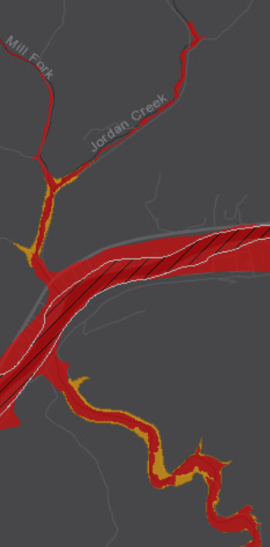
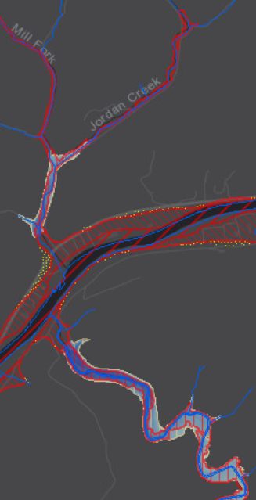
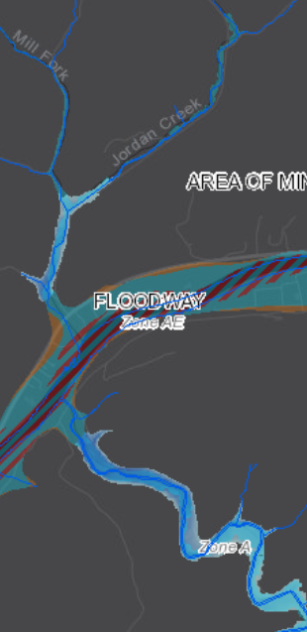
Multiple Flood Zone Symbology Types
PUBLIC View
EXPERT View
NFHL View
High Risk Regulatory (red) and Non-Regulatory (orange)
Depth Grid Underlies Flood Zones
NFHL Viewer

Slide 23
Flood Zone Determination Sequence
HIGH:
100-YR Effective Floodplain
HIGH:
Preliminary Flood Hazard Zones (AE or A)
MODERATE: 500-YR Effective Floodplain & Levee Reduced Risk
MODERATE:
Within 75-ft of Flood Zone
LOW:
No identified Flood Risk
HIGH:
Non-Regulatory
Updated AE
HIGH:
Non-Regulatory
Advisory A
Flood zone determination sequence important for programming logic
WV Flood Tool first checks query location for High Risk flood zones, then Moderate Risk flood zones.

Slide 24
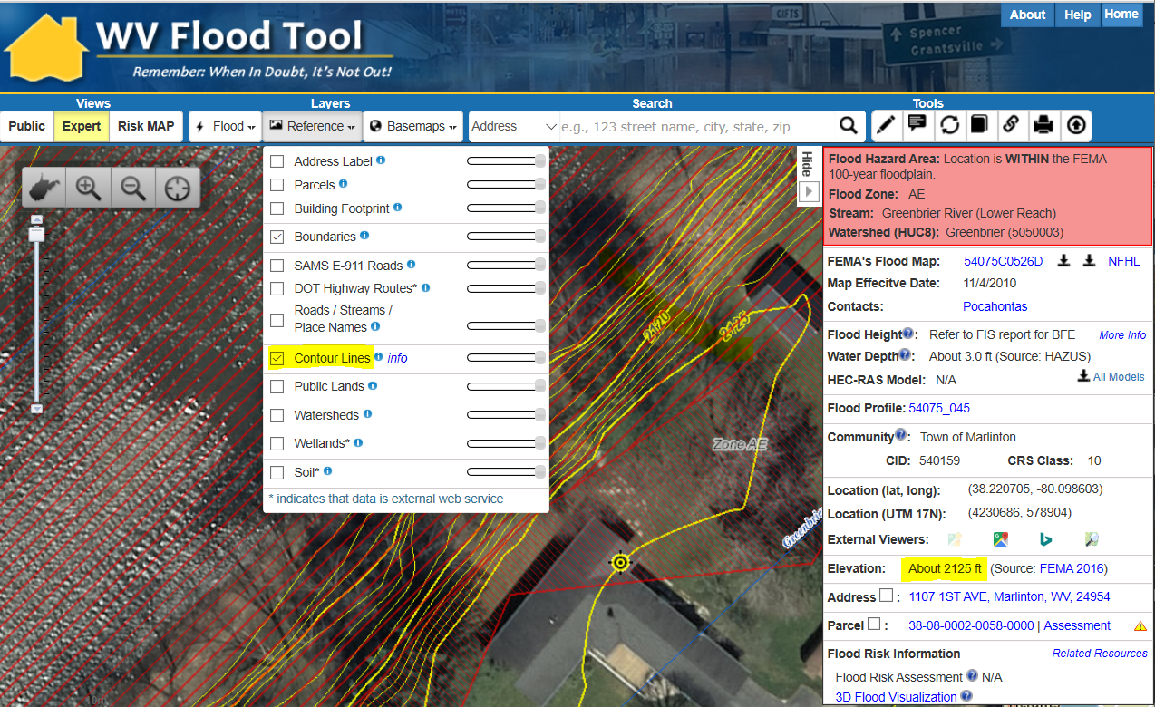
Ground Elevation
http://www.mapwv.gov/floodtest/?wkid=102100&x=-8916536&y=4610651&l=13&v=1
Source: FEMA 2016
1-FOOT CONTOUR ELEVATION VALUE OF 2125 FEET MATCHES 1-METER GRID SURFACE ELEVATION OF 2125 FEET DISPLAYED IN QUERY RESULTS PANEL
FEMA LiDAR-Derived Products: 1-M DEM and 1-Ft. Contour

Slide 25
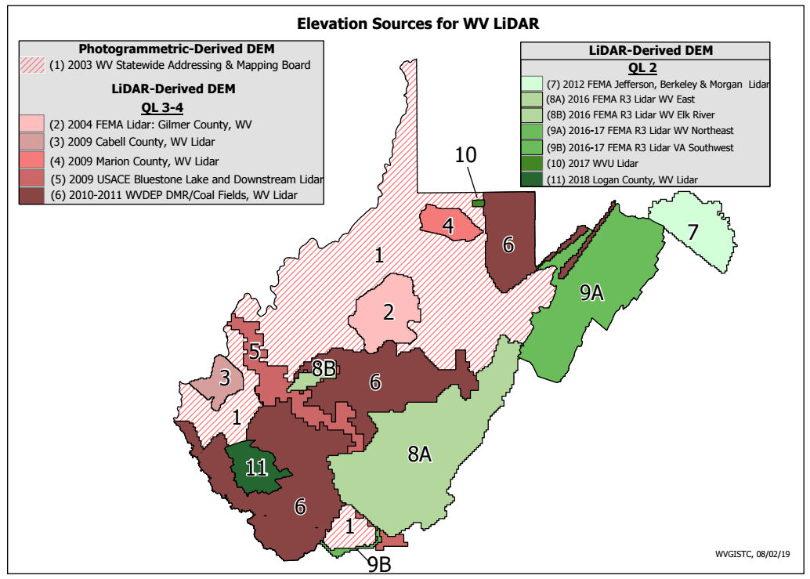
Elevation Source
Source Table
Source Graphic
Elevation Metadata
FEMA is purchasing Statewide QL2 LiDAR
WV Elevation Source Listing and Graphic: https://www.mapwv.gov/floodtest/docs/WV_FloodTool_ElevationSource_Metadata.pdf

Slide 26
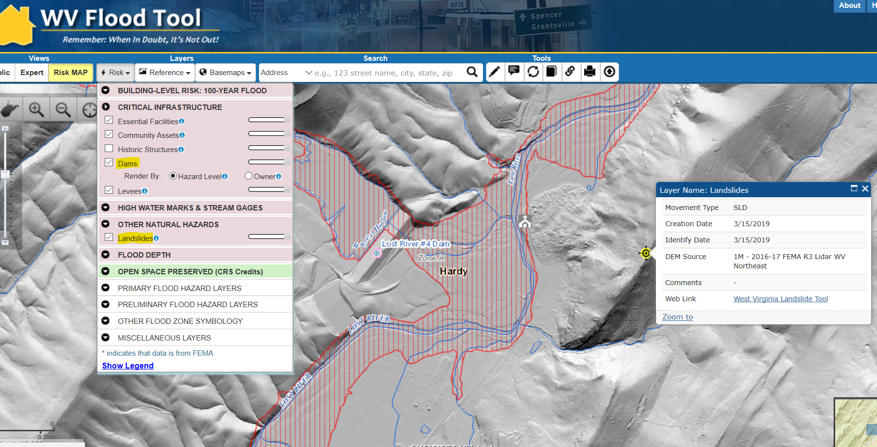
Dams and Landslides
Landslide
Dam
https://www.mapwv.gov/flood/map/?wkid=102100&x=-8771562&y=4715438&l=7&v=2
Dam and Landslide Risk Layers in RiskMAP View Hardy County, West Virginia

Slide 27
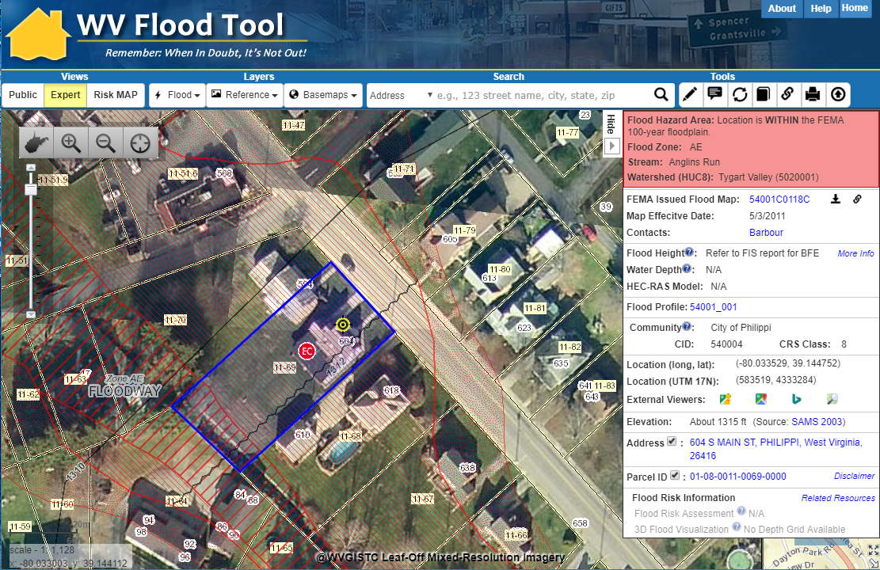
Property Identification
SHARE LINK
604 Main St, Philippi, WV 26416
X,Y COORD.
ADDRESS
PARCEL
Share Link: https://www.mapwv.gov/flood/map/?wkid=102100&x=-8909292&y=4742427&l=12&v=1

Slide 28
Unique Building Identifier
Collect multiple spatial identifiers to verify location
Parcel | 01-08-0011-0069-0000
01 | - | 08 | - | 0011 | - | 0069 | - | 0000
County |  | District |  | Map |  | Parcel |  | Suffix
Address | 604 S Main St, Philippi, West Virginia, 26416
Building Identifier | 01-08-0011-0069-0000_604
X,Y Coordinate | 39.144752, -80.033529
Google Plus Code (11-digit) | 86FX4XV8+VHF
Share MAP URL Link | https://www.mapwv.gov/flood/map/?wkid=102100&x=-8909292&y=4742427&l=12&v=1
Share Parcel Assessment URL Link | http://www.mapwv.gov/Assessment/Detail/?PID=01080011006900000000
Notes: Owner Name from assessment records and Building Pictures (elevation certificates) can be helpful for property identification purposes
Proper Building and Property Identifiers are important for exchanging building-level data efficiently among local, state, and federal partners (including UDFs, LOMAs, Mitigated Buyout Properties, Elevation Certificates, Repetitive Loss Structures, etc.)
= Unique Identifiers

Slide 29
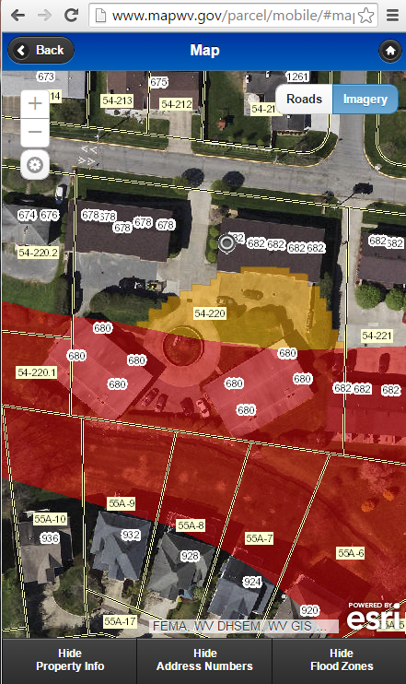
WV Property App (Companion Product)
Web Visits
Detailed Property Report
Property Viewer
WV Property Viewer www.mapwv.gov/parcel WV Property Search www.mapwv.gov/ property
Property Search Tool

Slide 30
Flood Tool Applications
Floodplain Management
Property Identification
Property Search Tools
Flood Determinations
NFIP / Community Rating System
Risk Mapping, Assessment, and Planning
Risk Identification and Mapping
Risk Assessment
Risk Mitigation & Planning
Risk Communications
Disaster Assessment

Slide 31
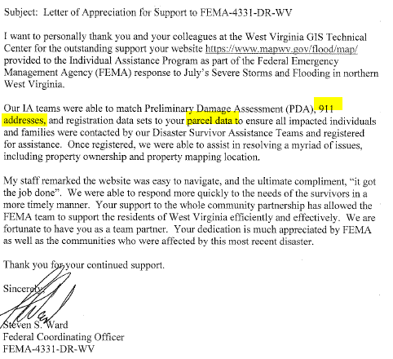
WV Flood Tool
Disaster Assessments
FEMA Letter dated September 29, 2017, about WV Flood Tool support for Disaster Assessments

Slide 32
WV Silver Jackets Team
Building Level Risk Assessments
Validate Primary Structures
First Floor Heights
New Development
High Risk Potential Dams
Identify communities downstream of High-Risk dams
Dam Warning and Safety System
Credits for FEMA’s Community Rating System (CRS) Program

Slide 33
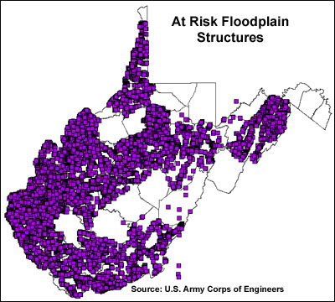
Silver Jackets: Activity 1
Building Inventories
Nearly 20 years ago more than 80,000 structures in the floodplain were inventoried by the Pittsburgh District Army Corps of Engineers using statewide 1996-99 1-meter resolution Digital Orthophoto Quarter Quads. A combination of FEMA's Q3 and DFIRM floodplain data (available for 37 of the 55 counties) was overlaid onto DOQQ's.
<< USACE Inventoried Floodplain Structures >>
http://wvgis.wvu.edu/data/dataset.php?ID=230

Slide 34
Site-Specific Building Inventories
BUILDING INVENTORY
Historical Flood Inundation / Flood Registry
NFIP Repetitive Loss (Internal Use Only)
HAZUS Flood Loss Estimates
Elevation Certificates
Flood Proof or Mitigated Structures
SFHA Building Counts
Levee/Dam Failure Inundation Studies
Building Inventories important for flood reduction activities

Slide 35
Statewide Building Inventories
https://www.mapwv.gov/flood/map/?wkid=102100&x=-9070843&y=4497058&l=11&v=2
1998 Aerial Imagery
2018 Aerial Imagery
Elkhorn Creek, McDowell County
2002 USACE Inventory

Slide 36
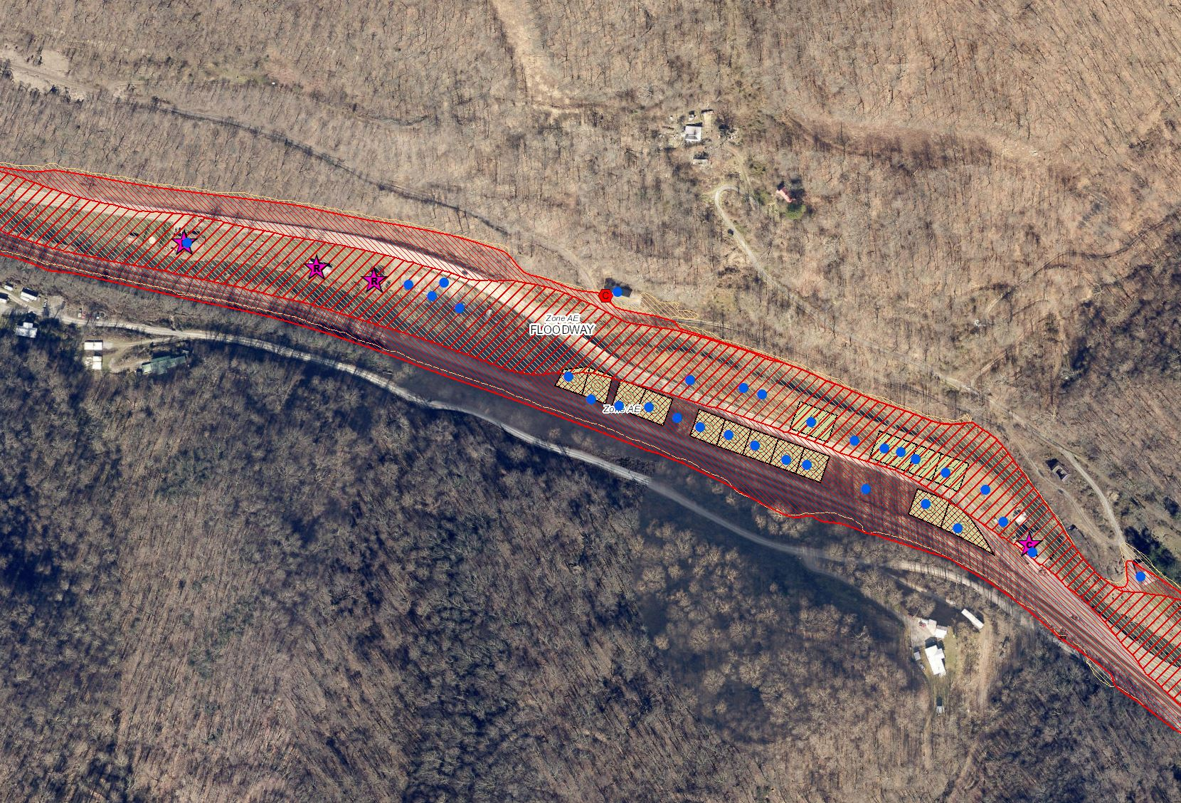
USACE 2002 Building Inventory
https://www.mapwv.gov/flood/map/?wkid=102100&x=-9069713&y=4496689&l=10&v=2
Buyout Properties
2002 USACE Inventory
Elkhorn Creek, McDowell County

Slide 37
Building-Level Flood Risk Assessments
DATA INPUTS
GIS Reference & Elevation Data Flood Studies Depth & WSEL Grids Building Stock
BUILDING INVENTORY & ACCURACY IMPROVEMENTS Building Location
Building Attributes
COMMUNITY ENGAGEMENT & FIELD ACCURACY CHECKS
Floodplain Managers
Local Govt. Officials
Building-Level Flood Risk Assessments support:
Hazard Mitigation Plans
Floodplain Management
Community Assisted Visits
Community Rating System
1
Benefits
More detailed and accurate assessments
Automated scripts generate outputs quickly
Cost savings through efficiencies
Helps multiple stakeholders
Comprehensive Building Risk Database
4
2
Building-Level Assessment Cycle (Flood-Risk Assessment GIS)
3
DATA OUTPUTS
Building Level Community Level
3D Visualizations
Published to WV Flood Tool
Methodology
Consistent methodology statewide
Semi-automated workflows
Continuous cycle to improve and update assessments

Slide 38
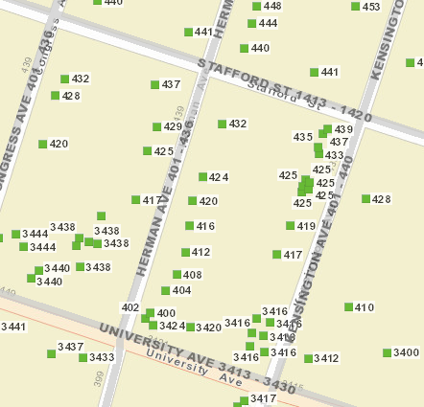
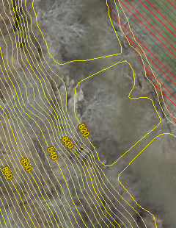
GIS Data Development
Parcels Site Addresses Aerial Imagery Elevation
1
DATA INPUTS
GIS Reference & Elevation Data Flood Studies Depth & WSEL Grids Building Stock
Migrate six counties from paper to digital parcels
Flood-risk communities with missing or incorrect E-911 addresses
County Leaf-off imagery no older than 5 years
Statewide 1-meter DEM and 1-ft. contours. Flood Studies, Depth & WSEL Grids
Parcels, Assessment Records, Aerial Imagery important for pinpointing flood-risk structures

Slide 39
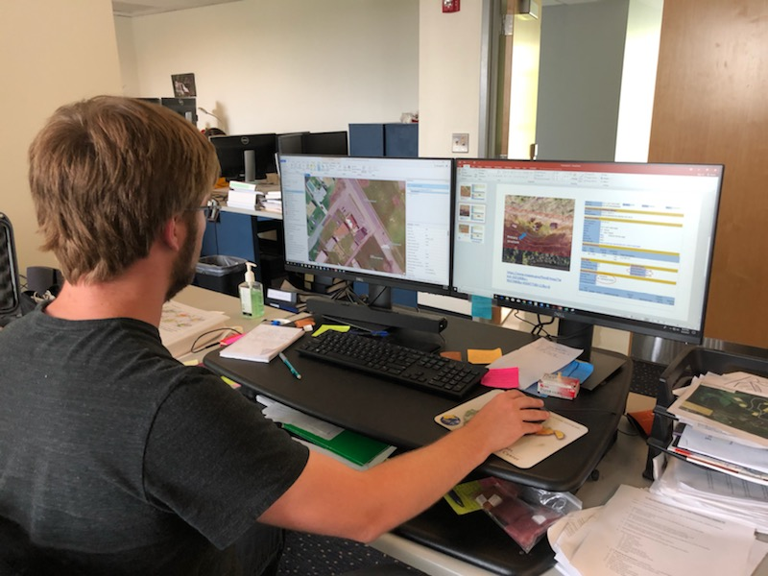
Building Inventory
2
BUILDING INVENTORY & ACCURACY IMPROVEMENTS Building Location
Building Attributes
GIS Specialist conducting Building Inventory

Slide 40
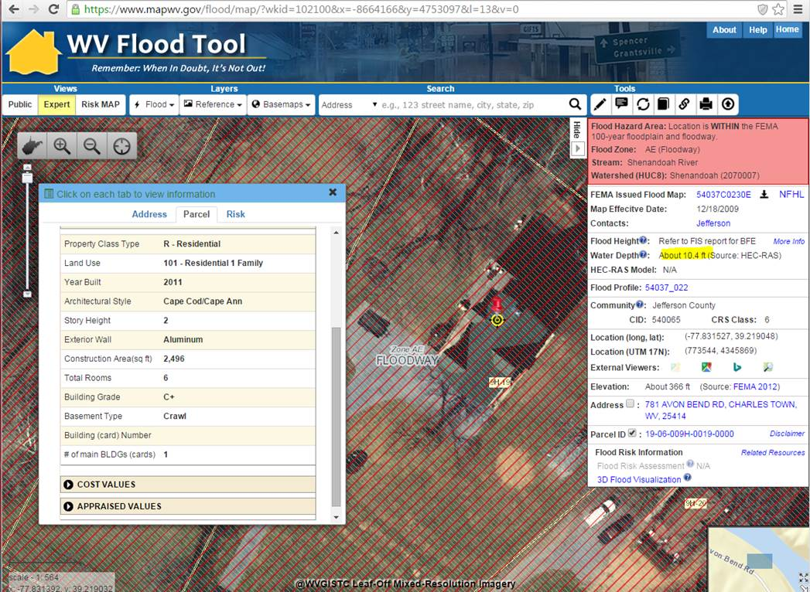
Building 19-07-022B-0021-0000_7170
Building ID: 19-07-022B-0021-0000_7170
10 ft. Water Depth
Built 2011
Crawl Basement
<< 781 Avon Bend Road, Charles Town, WV 25414 >>
https://www.mapwv.gov/flood/map/?wkid=102100&x=-8664166&y=4753097&l=13&v=0

Slide 41
Hazus Flood Loss Estimation Program
A GIS-based natural hazard analysis tool developed and freely distributed by FEMA
Slide courtesy of FEMA

Slide 42
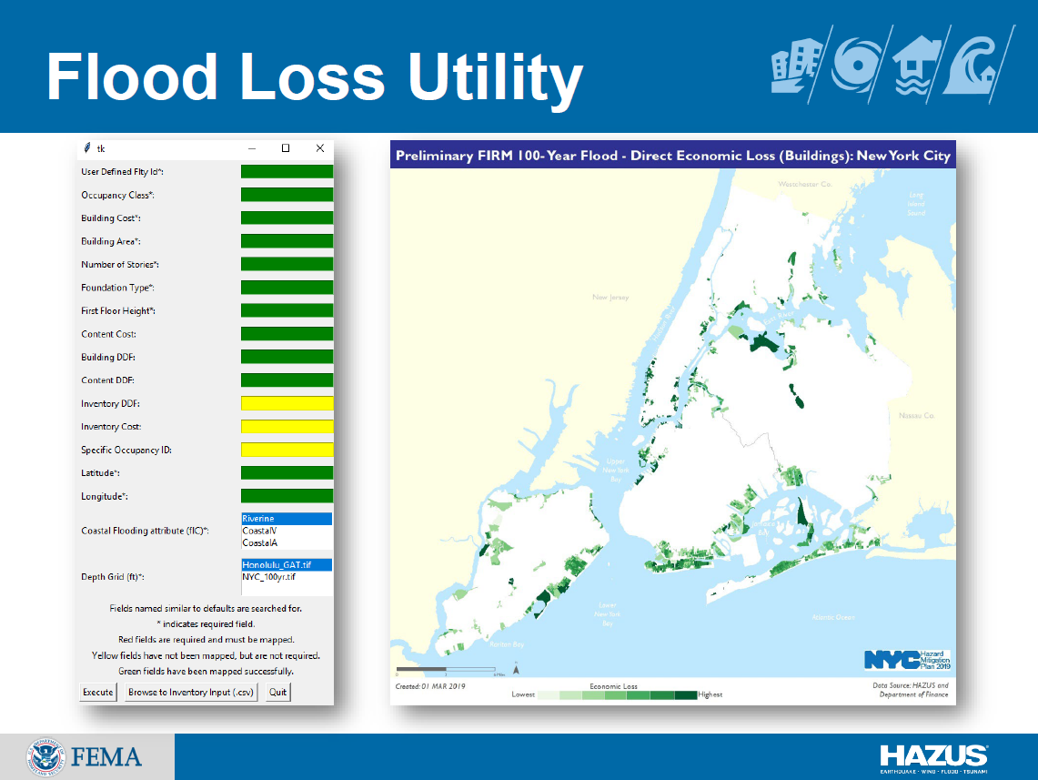
Hazus Flood Loss Estimation Program
FEMA’s new OpenHazus Flood Loss Utility.
It works! Very beneficial for project!
Slide courtesy of FEMA

Slide 43
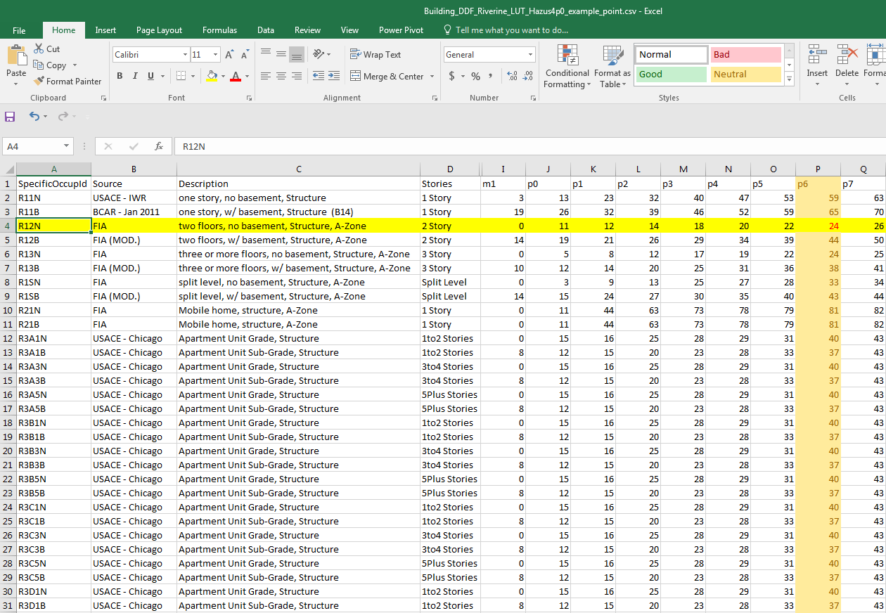
Depth-Damage Function (DDF) Values

Slide 44
Post-FIRM Structure in Floodway
Building ID | 19-06-009H-0019-0000_781
Full E-911 Address | 781 AVON BEND RD, CHARLES TOWN, WV, 25414
Full Owner Address | 9299 ALL SAINTS RD, LAUREL, MD 20723
GIS Parcel ID | 19-06-009H-0019-0000
Lat | 39.218996
Long | -77.83151391
Plus Code | 87F46599+H9X
WV Flood Tool Link | https://mapwv.gov/flood/map/?wkid=102100&x=-8664164.49652&y=4753089.59353&l=13&v=0
WV Parcel Assessment Link | https://mapwv.gov/Assessment/Detail/?PID=1906009H001900000000
CID | 540065
Community Name | JEFFERSON COUNTY *
Stream Name | Shenandoah River
Watershed (HUC8) | Shenandoah (2070007)
Flood Zone Designation | Effective 100 yr Zone AE - Floodway
Floodway | Yes
Year Built | 2011
FIRM Status | Post-FIRM
Hazard Occupancy Code | RES1
Stories | 2
Basement Type | Crawl
First Floor Height | 4.0
Building Appraisal | $170,200
Structure Area | 2496
Flood Depth Value | 9.8
Flood Depth Source | HEC-RAS
WSEL Value | 376.0
WSEL Source | UAE
Ground Elevation | 366.2
Ground Elevation Source | 2012 FEMA Jefferson, Berkeley & Morgan Lidar
Grade | C+
Tax Class | 2
Land Use Description | Residential 1 Family
Exterial Wall Type | Aluminum
Building ID | 19-06-009H-0019-0000_781
Full E-911 Address | 781 AVON BEND RD, CHARLES TOWN, WV, 25414
GIS Parcel ID | 19-06-009H-0019-0000
Plus Code | 87F46599+H9X
WV Flood Tool Link | https://mapwv.gov/flood/map/?wkid=102100&x=-8664164.49652&y=4753089.59353&l=13&v=0
WV Parcel Assessment Link | https://mapwv.gov/Assessment/Detail/?PID=1906009H001900000000
Full Owner Address | 9299 ALL SAINTS RD, LAUREL, MD 20723
Occ | RES1
Cost | 170200
NumStories | 2
FoundationType | 5
FirstFloorHt | 4
Area | 2496
UserDefinedFltyId | 453
Latitude | 39.218996
Longitude | -77.83151391
Depth_Grid | 9.825653
Depth_in_Struc | 5.825653076
flExp | 1
SOID | R12N
BDDF_ID | 107
BldgDmgPct | 23.7
BldgLossUSD | $40,254
ContentCostUSD | $85,100.00
CDDF_ID | 23.00
ContDmgPct | 37.95
ContentLossUSD | $32,299
DebrisID | RES1NBFT4
Debris_Tot
Restor_Days_Min | 270
Restor_Days_Max | 450
GridName | AFH_wm.tif
3
DATA OUTPUTS
Building Level Community Level
3D Visualizations
Published to WV Flood Tool
Building Inputs
Water Depth Input
OpenHazus FAST Utility Building Impact Output

Slide 45
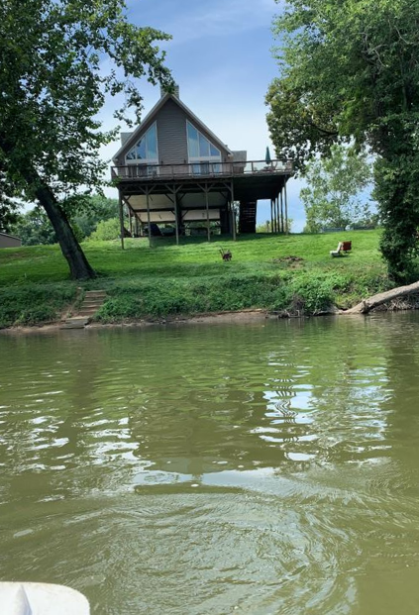
Field Verification
Field Verification of the structure located at 781 Avon Bend Road in Charles Town along the Shenandoah River in the Regulatory Floodway reveals that this Post-FIRM (2011) structure is built on a piles foundation. The Foundation Type/First Floor Height will be changed in the Building Inventory and the OpenHazus Flood Assessment Structure Tool (FAST) utility executed again for this structure.
The estimated Base Flood Water Depth for this structure is 10 feet.
781 Avon Bend Road, Charles Town, WV 25414 Building ID 19-06-009H-0019-0000_781
WV Flood Tool Link: https://mapwv.gov/flood/map/?wkid=102100&x=-8664165&y=4753090&l=13&v=1
Field Verification is important to improve the accuracy of certain properties!
Field Verified from Shenandoah River

Slide 46
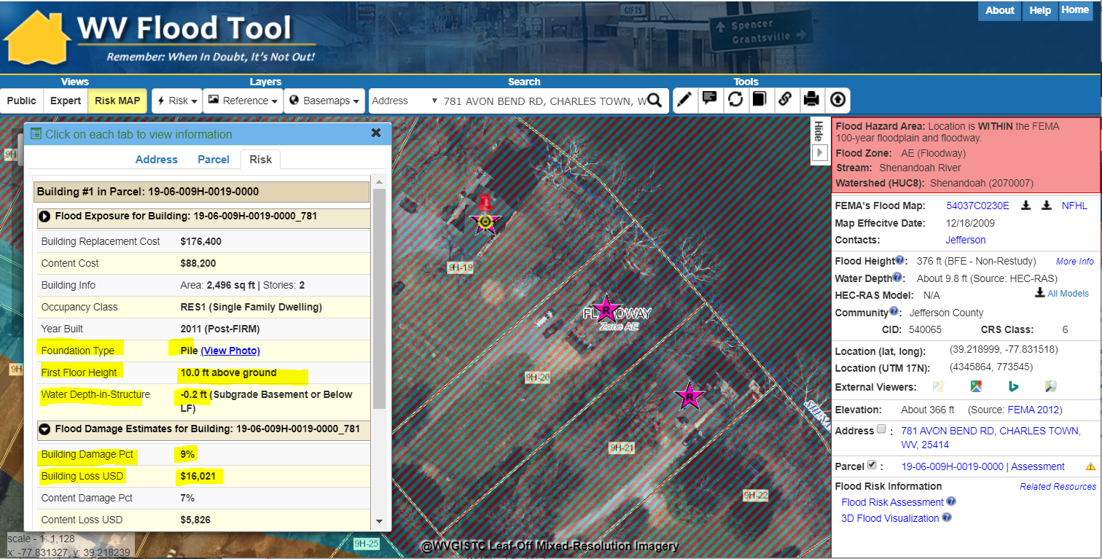
Field Verification
Modified Foundation Type and First Floor Height – Rerun Hazus Flood Loos Model
4
COMMUNITY ENGAGEMENT & FIELD ACCURACY CHECKS
Floodplain Managers
Local Govt. Officials
781 Avon Bend Road, Charles Town, WV 25414 Parcel ID: 19-06-009H-0019-0000 Building ID: 19-06-009H-0019-0000_781 WV Flood Tool Link: https://mapwv.gov/flood/map/?wkid=102100&x=-8664165&y=4753090&l=13&v=1

Slide 47
Validate Building Risk Assessments
• Flood Depth Grid
• Water Surface Elevation Grid
• High-Risk Advisory Flood Zones
• Buildings: Future Map Conditions
o Structure Verified LOMAs
• Buildings: Flood Exposure
o Building Replacement Cost
o Essential Facilities
o Community Assets
o Historical Structures
• Buildings: New Development & Basement
o Pre-FIRM / Post-FIRM
o Basement (First-Floor Height)
• Buildings: Damage Loss Estimate (Hazus)
o Percent Damage
o Dollars Loss
Silver Jackets: Activity 1

Slide 48
Flood Risk Products
RISK LAYER | CATEGORY | GRAPHICAL OR TABLE FORMATS
1% Chance Flood Event (100-Year)
Flood Depth Grid Model-Backed Hazus | Flood Risk Grid
Water Surface Elevation Grid Base Flood Elevations Advisory BFEs | Flood Risk Grid
Preliminary NFHL Changes Since Last FIRM (CSLF) | Flood Zone Changes
High-Risk Advisory Flood Zones (Non-Regulatory) | Flood Zone Changes

Slide 49
Flood Risk Products (Cont.)
RISK LAYER | CATEGORY | GRAPHICAL OR TABLE FORMATS
1% Chance Flood Event (100-Year)
Buildings: Future Map Conditions Map In SFHA Map Out SFHA No Change Floodway Buildings: LOMA Verified | Building-Level Risk Flood Zone Changes

Slide 50
Flood Risk Products (Cont.)
RISK LAYER | CATEGORY | GRAPHICAL OR TABLE FORMATS
1% Chance Flood Event (100-Year)
Buildings: Exposed to Flooding Building Replacement Cost Essential Facilities Community Assets Historical | Building-Level Risk
Buildings: New Development & Basement Pre-FIRM (red) Post-FIRM (purple) Basement (black dot) (First Floor Height) | Building-Level Risk

Slide 51
Silver Jackets: Activity 2
Identify Communities Downstream of High-Risk Dams

Slide 52
High Risk Dams

Slide 53
Community Boundaries / Statistical Units
232 incorporated areas
+55 unincorporated areas 287 Communities + 8 split communities 295 Statistical Geographies
295 Statistical Geographies form 287 Communities which form
55 Counties which form
11 PDC Regions which form
1 Statewide Flood Risk Assessment
SPLIT COMMUNITY ( ) | COUNTY 1 | COUNTY 2
Alderson | Greenbrier | Monroe
Huntington | Cabell | Wayne
Montgomery | Fayette | Kanawha
Nitro | Kanawha | Putnam
Paden City | Tyler | Wetzel
Smithers | Fayette | Kanawha
Wheeling | Marshall | Ohio
Weirton | Brooke | Hancock
95% of WV Municipalities have Special Flood Hazard Areas (SFHA)

Slide 54
Communities Downstream of HH Dams
 |  |  |  |  |  | Downstream Communities (C1, C2, C3…n)
# | DAM NAME | RIVER | CITY | OWNER NAME | MAX. STORAGE | C1 | C2 | C3 | C4 | C5 | C6
1 | BLUESTONE DAM | NEW RIVER | HINTON | CELRH | 631000 | Hinton | Summers | Raleigh | Fayette | Thurmond | Oak Hill
2 | SUMMERSVILLE DAM | GAULEY RIVER | SWISS | CELRH | 413400 | Nicholas | Fayette | Gauley Bridge | Smithers | Montgomery | Kanawha
3 | TYGART DAM | TYGART RIVER | GRAFTON | CELRP | 355000 | Taylor | Grafton | Marion | Pleasant Valley | White Hall | Fairmont
4 | SUMMERSVILLE DAM - DIKE NO. 2 | GAULEY RIVER | SUMMERSVILLE | CELRH | 283400 | Nicholas | Fayette | Gauley Bridge | Smithers | Montgomery | Kanawha
5 | SUTTON DAM | ELK RIVER | SUTTON | CELRH | 265300 | Braxton | Sutton | Gassaway | Clay | Clay | Kanawha
6 | SUMMERSVILLE DAM - DIKE NO. 1 | GAULEY RIVER | SUMMERSVILLE | CELRH | 233400 | Nicholas | Fayette | Kanawha | Clay | Gauley Bridge | Smithers
7 | R D BAILEY DAM | GUYANDOT RIVER | JUSTICE | CELRH | 203700 | Wyoming | Mingo | Logan | Man | Logan | West Logan
8 | STONEWALL JACKSON DAM | WEST FORK | BROWNSVILLE | CELRP | 145000 | Lewis | Weston | Harrison | West Milford | Clarksburg | Lumber- port
9 | EAST LYNN DAM | TWELVEPOLE CREEK | EAST LYNN | CELRH | 82500 | Wayne | Wayne | Ceredo | Kenova | Huntington | (?)
10 | BURNSVILLE LAKE DAM | LITTLE KANAWHA RIVER | BURNSVILLE | CELRH | 65900 | Braxton | Burnsville | Gilmer | Sand Fork | Glenville | Calhoun
11 | BEECH FORK LAKE DAM | BEECH FORK OF TWELVE POLE CK. | LAVALETTE | CELRH | 37540 | Wayne | Ceredo | Kenova | Cabell | Huntington | (?)
Communities downstream of USACE High Hazard Dams

Slide 55
High Hazard Dams
Community Rating System (CRS)
** COUNTIES UNINCORPORATED **
Berkeley | 3
Greenbrier | 5
Fayette | 13
Hampshire | 1
Jefferson | 0
Kanawha | 19
Morgan | 15
Putnam | 8
** MUNICIPALITIES **
Buckhannon | 0
Charleston | 10
Martinsburg | 1
Parsons | 1
Philippi | 1
total Counties Unincorporated | 64
total Municipalities | 13
total HR DAMs - CRS communities | 77
percentage | 21%
West Virginia CRS Communities Downstream of High Hazard Dams

Slide 56
Silver Jackets: Activity 3
Community Rating System
As a part of the National Flood Insurance Program (NFIP), the Community Rating System is a voluntary incentive program that recognizes and encourages community floodplain management activities that exceed the minimum NFIP requirements.
As a result, flood insurance premium rates are discounted to reflect the reduced flood risk resulting from the community actions meeting the three goals of the Community Rating System
CRS 600 Series: Warning and Response
The 600 series of activities within the National Flood Insurance Program’s (NFIP) Community Rating System (CRS) is focused on linkages between a community’s emergency management mission/program and its voluntary CRS activities. These credited activities focus on the life safety aspect of a community’s floodplain management program, particularly its emergency management flood warning programs and can result in additional CRS discounts for your citizens

Slide 57
CRS Activity 630- Dams
REQUIREMENTS
Advance notification of an impending flood (threat recognition)
Warnings issued to the threatened population (warning)
Steps taken to protect life and reduce losses (operations)
Coordination with critical facilities (critical facilities planning)
PARTICIPATING ORGANIZATIONS
USACE (Dam Owner)
FEMA (CRS Program Coordinator)
ISO / CRS Specialist
State Dam Safety Office
State NFIP / SHMO
WV GIS Technical Center
Emergency Management Office
Floodplain Manager / Risk Planner

Slide 58
State-Based CRS Points
BASIC SCENARIO FOR ALL COMMUNITIES
CRS Series | CRS Activity | CRS Element | CRS Credit
Public Information Activities | 310 | Elevation Certificates | 38
Public Information Activities | 320 | Map Information Services | 90
Mapping and Regulations | 430 | Freeboard 2 Ft. (Higher Regulatory Standards) | 225
Mapping and Regulations | 440 | Additional Map Data (Flood Data Maintenance) | 154
Flood Damage Reduction Activities | 510 | Floodplain Management Planning (Hazard Mitigation Plan) | 100
 |  | Basic Scenario Points for West Virginia | 607
POTENTIAL ADDITIONAL CRS POINTS
CRS Series | CRS Activity | CRS Element | CRS Credit Points
Public Information Activities | 350 | Flood Protection Information on Website | 77
Mapping and Regulations | 410 | Advisory BFE (New Study) | 130
Mapping and Regulations | 420 | Open Space Preservation | 1,950
Flood Damage Reduction Activities | 520 | Acquisition & Relocation of Buildings | 2,250
Warning and Response | 630 | High Hazard Dams | 160
 |  | Potential Maximum Points | 4,567
CRS Program Data and Impact Adjustments
Program Data and Impact Adjustments | Section
Buildings in the SFHA (bSF) | 213a, 222
Acreage of the SFHA (aSFHA) | 213a, 222

Slide 59
CRS Activity 630 - Dams
Source: 2017 CRS Coordinator’s Manual (Page 630-1)
https://www.fema.gov/media-library-data/1493905477815-d794671adeed5beab6a6304d8ba0b207/633300_2017_CRS_Coordinators_Manual_508.pdf

Slide 60
CRS Activity 630- Dams
Source: 2017 CRS Coordinator’s Manual (Page 630-4)

Slide 61
Building Inventories – Deficient Dams

Slide 62
Building Inventories – Deficient Dams

Slide 63
Building Inventories – Deficient Dams

Slide 64
Flood Risk Development Team
Full and Part-Time Staff
Xiannian Chen GIS Programmer
Jim Schindling Database Programmer
Kevin Kuhn GIS Analyst / Address-Parcel Specialist
Frank LaFone Systems Administrator
Kurt Donaldson Manager
WV GIS Technical Center West Virginia University Morgantown, WV http://wvgis.wvu.edu
Maneesh Sharma GIS Analyst / Flood Risk Specialist
Kevin Shrader GRA Building Inventory, Flood Visualization
Yibing Han
GIS Programmer
Eric Hopkins GIS Analyst / Flood Risk Specialist
Behrang Bidadian GRA
Shelter Models

Slide 65
Contact Information
WVU GIS Technical Center, West Virginia University Kurt Donaldson, GIS Manager kurt.donaldson@mail.wvu.edu, phone: (304) 293-9467
Maneesh Sharma, GIS Analyst
Maneesh.Sharma@mail.wvu.edu, phone (304) 293-9466
Eric Hopkins, GIS Analyst Eric.Hopkins@mail.wvu.edu, phone: (304) 293-9463

