Slide 1
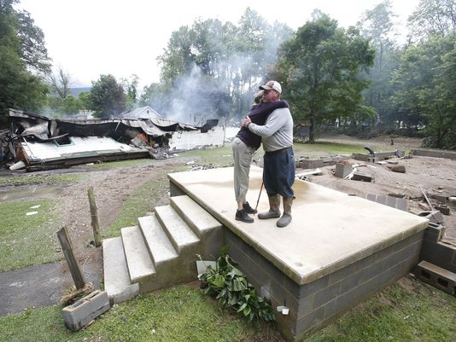
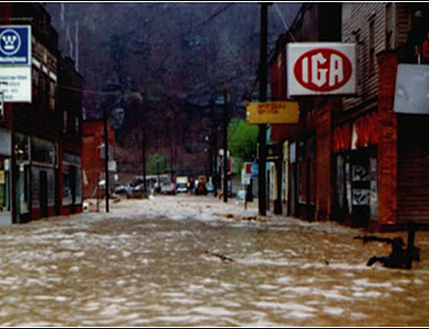
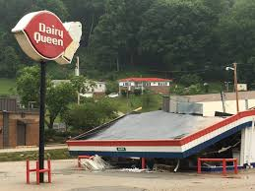
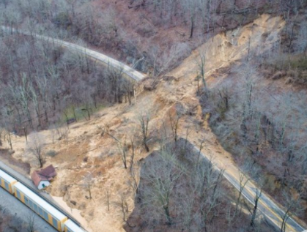
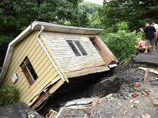
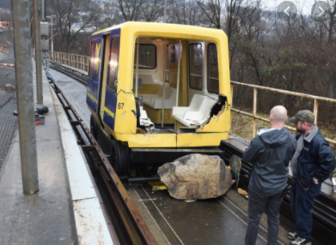
Climate Tools Overview and Panel – West Virginia
Kurt Donaldson
WV GIS Technical Center West Virginia University July 28, 2022

Slide 2
Climate Change Web Tools
Riverine Flood Hazard #1 hazard of State Hazard Mitigation Plan
Web Tools: WV Flood Tool (www.mapwv.gov/flood) & WV Property Viewer
Current Focus: 1% Annual Chance (100-yr) flood event
Climate Change Models: Incorporate higher flood depths (500-yr flood, BFE + 2’ & 3’, climate change models)
Risk Communications: Show higher risks and various mitigation measures
Estimate higher building damage losses due to climate change
Show 3D flood visualizations with climate change scenarios
New Structures: Build to higher freeboard standard to increase resiliency
Existing Structures: Identify building stock suitable for mitigation measures
Landslide Hazard #2 hazard of State Hazard Mitigation Plan
Web Tools: WV Landslide Tool (www.mapwv.gov/landslide) & WV Flood Tool
Current Focus: Statewide Landslide Susceptibility Map
Climate Change Models: Incorporate rainfall intensity-duration thresholds
Risk Communications: Predict when landslides may occur

Slide 3
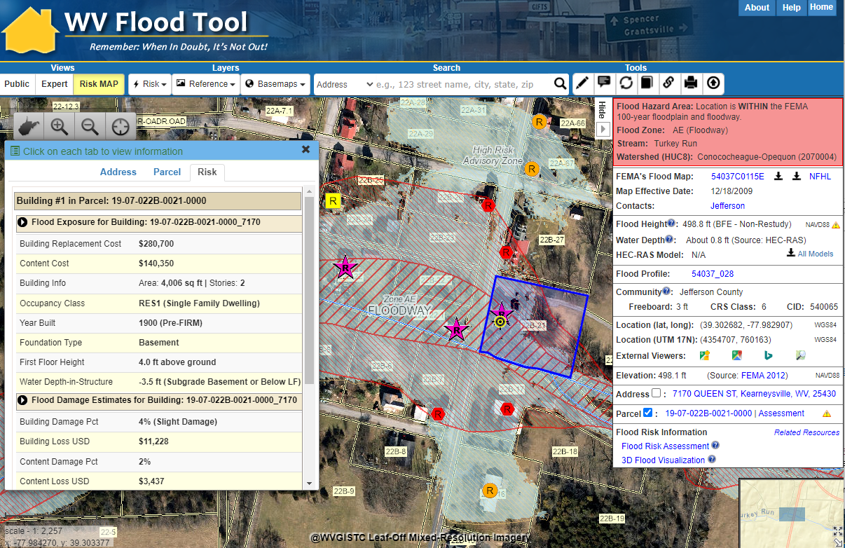
Climate Scenario Damage Estimates
Building Loss Estimate (100-Yr)
Loss estimates for climate scenarios can be added
Flood Risk Assessment Building Link
Flood Risk Building Info
100-Yr Damage Loss Estimate
Concept Slide
RiskMAP View
https://www.mapwv.gov/flood/map/?v=1&pid=19-07-022B-0021-0000

Slide 4
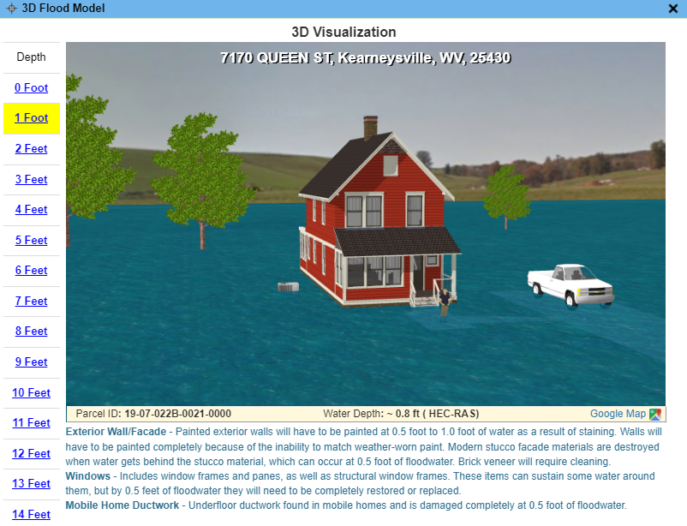
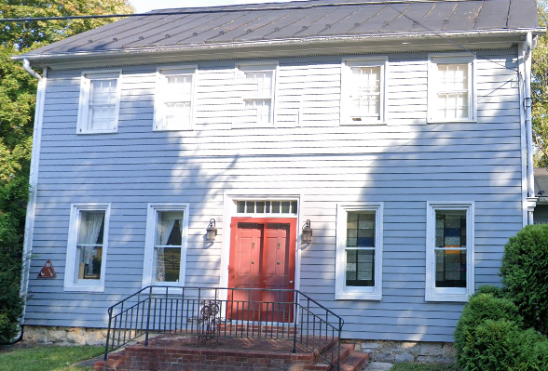
Climate Change 3D Visualizations
Flood Depth
Building ID: 19-07-022B-0021-0000_7170
FEMA 100-Yr
FEMA 500-Yr
2052 Climate Model
Add 3D Visualizations Depths for FEMA 500-Yr and 2052 Climate Model
Concept Slide

Slide 5
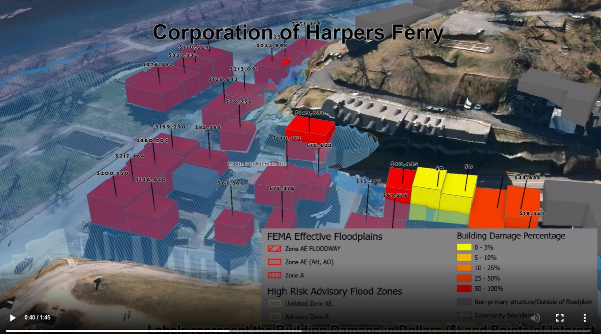
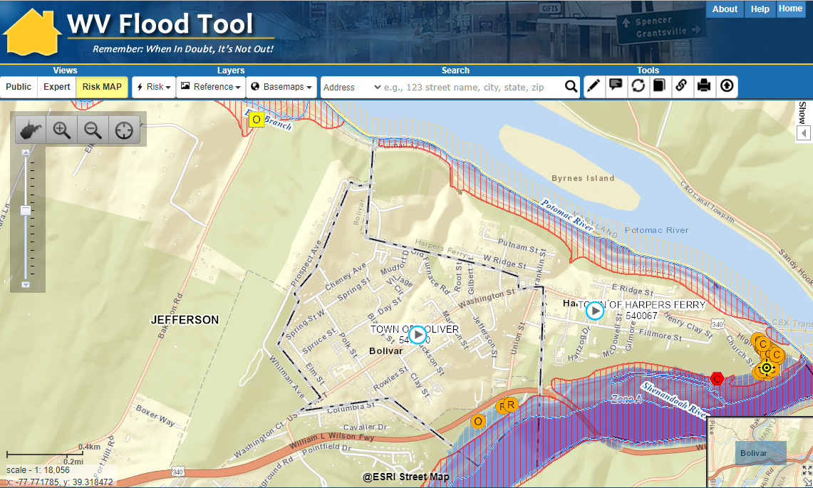
Climate Change 3D Visualizations
Baltimore Street, Martinsburg, WV
100-yr Flood Event
3D Movie Play Button
Add Climate Change Models for 3D Loss Estimates
Harpers Ferry
<<Map Link (turn movie layer on) >>
<< Harpers Ferry Flood Risk 3D Visualization Movie >>

Slide 6
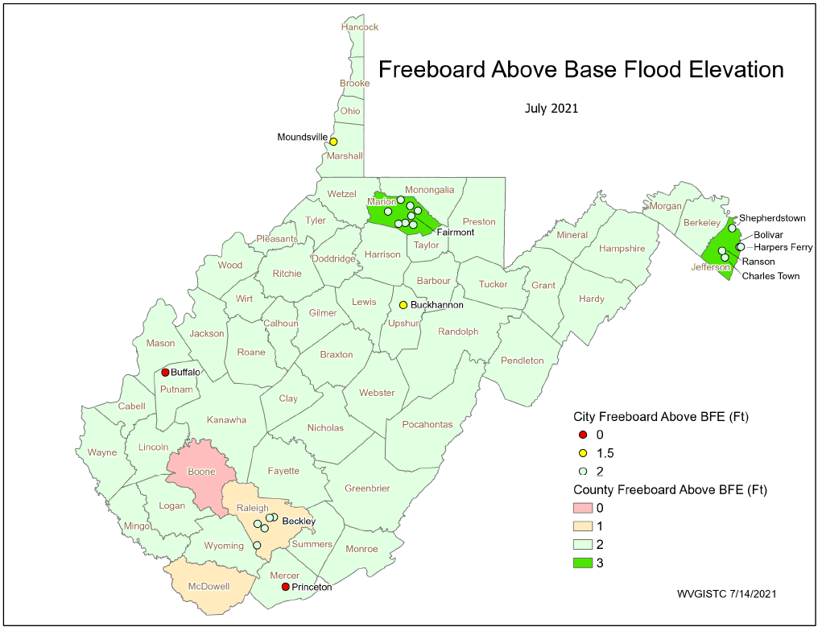
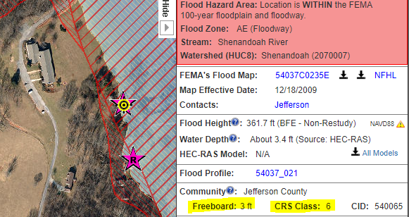
Build to Higher Standard (Freeboard)
Jefferson County Unincorporated has a freeboard requirement of 3 feet and CRS Class 6 rating
Jefferson County
The WV Flood Tool’s query panel displays the community’s Freeboard and CRS Class
WV Flood Tool Map Link
Source Graphic
RISK COMMUNICATIONS
Build new structures to higher freeboard standard for changing climate conditions

Slide 7
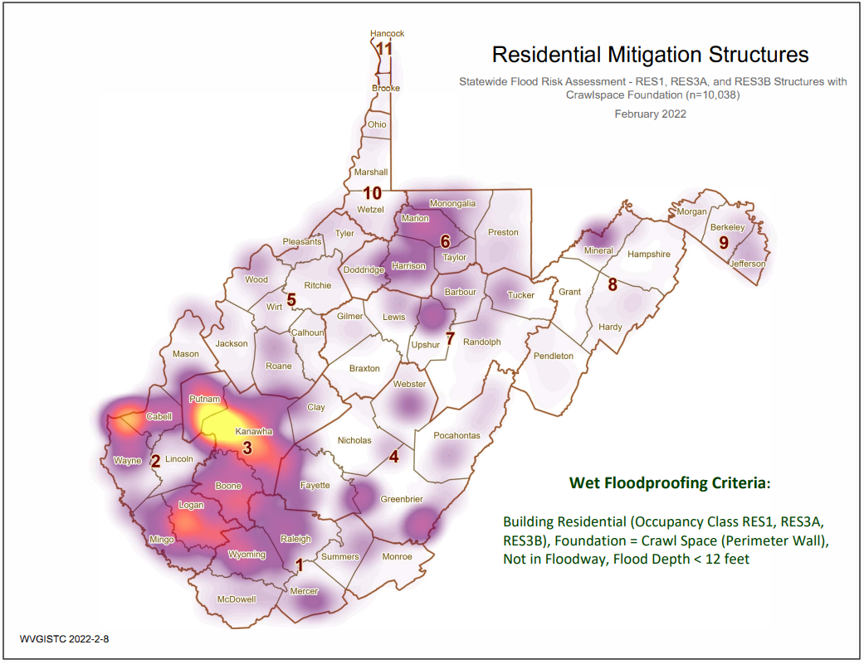
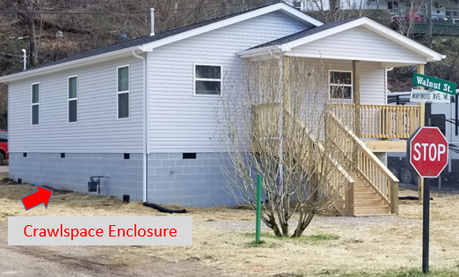
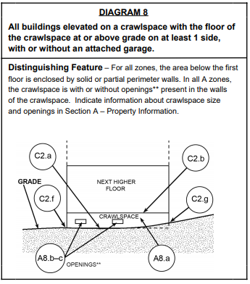
Mitigate Existing Structures
RISK COMMUNICATIONS To increase resiliency to changing climate conditions, identify residential structures with crawl space foundations that could qualify for flood vents
Source Graphic
Source: Statewide Building-Level Risk Assessment

Slide 8
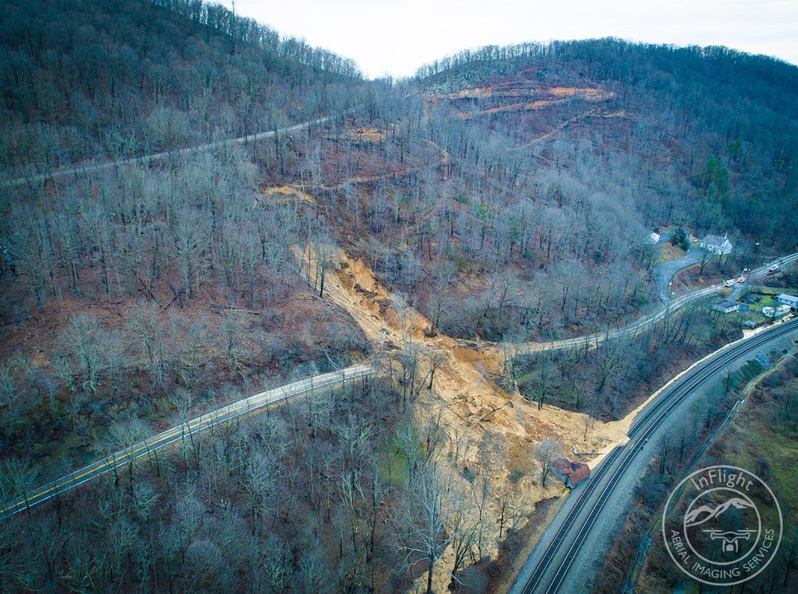
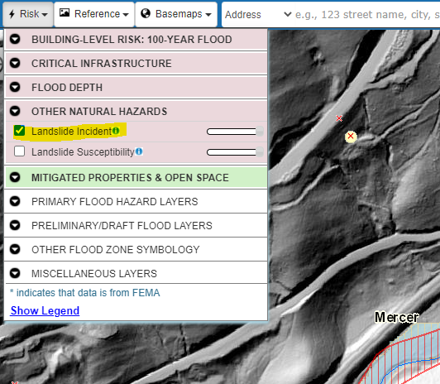
Landslide Hazard
Landslide Incidents | Landslide Susceptibility | Landslide Methodology Scholarly Paper (2020)
2019 Slide Route 112
near Ingleside, WV (Mercer County)
Landslide Web Map Link: https://www.mapwv.gov/flood/map/?wkid=102100&x=-9034072&y=4480092&l=10&v=2

Slide 9
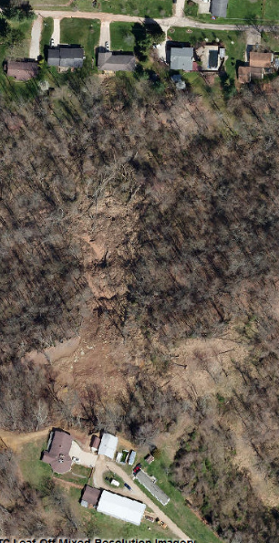
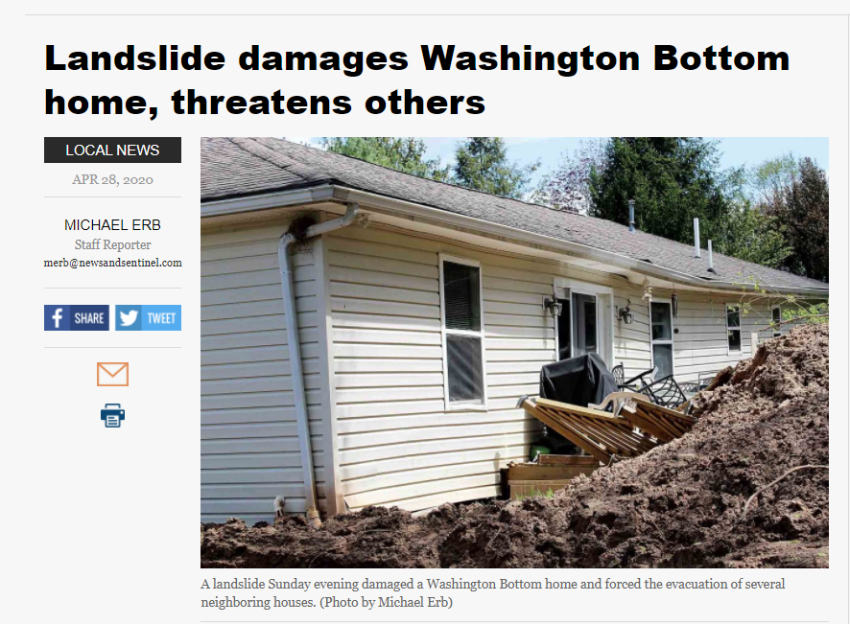
Landslide Susceptibility
Web Map Link
Landslide Reports/ Maps
Impacted Home
Higher Risk
Landslide Susceptibility Zone
April 2020 Landslide
Wood County Impacted home moved from foundation
Landslide Susceptibility
Spring 2020 Aerial Imagery

Slide 10
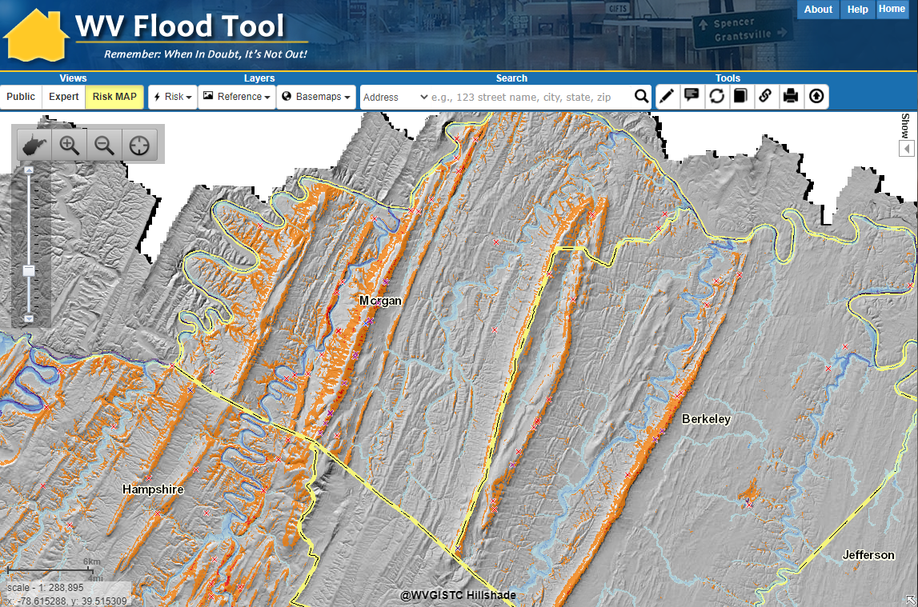
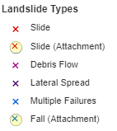
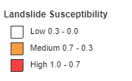
Landslides and Climate Change
RISK COMMUNICATIONS For landslide prone areas, predict when higher incidents of landslides may occur based on rain intensity-duration thresholds
Incorporate Climate Change Data
https://www.mapwv.gov/flood/map/?wkid=102100&x=-8704711&y=4796138&l=4&v=2

Slide 11
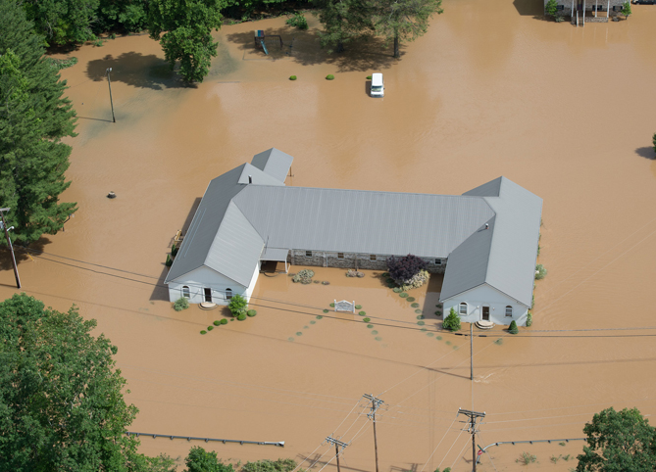
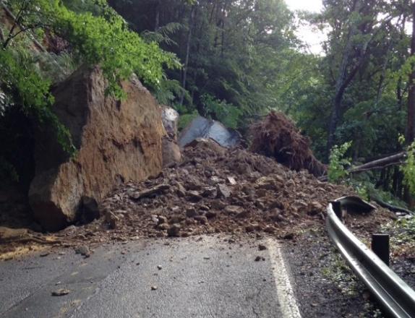
Contact Information
WVU GIS Technical Center, West Virginia University Kurt Donaldson, Manager kurt.donaldson@mail.wvu.edu, phone: (304) 293-9467 Maneesh Sharma, GIS Analyst
Maneesh.Sharma@mail.wvu.edu, phone (304) 293-9466
Flood Risk #1 WV Hazard
Landslide Risk #2 WV Hazard

