Slide 1
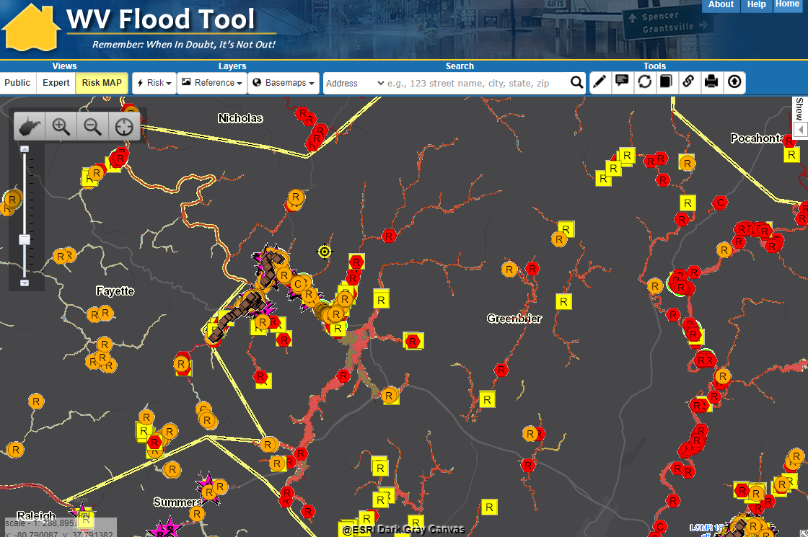
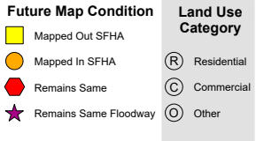
GIS Data & Mapping for RISK REDUCTION
WV Risk Reduction Consultation
Kurt Donaldson, WVU
3/22/2023

Slide 2

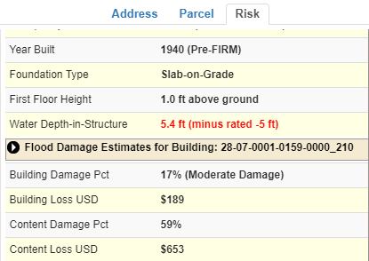
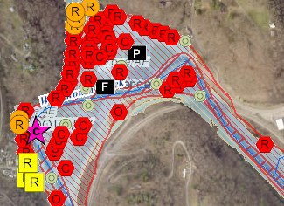
WV Building-Level Flood Risk Assessment
BUILDING INVENTORY
Primary Building
Identification &
Hazus Attributes
Essential Facilities & Community Assets
FLOOD LOSS MODELS
Open Hazus FAST
Flood Depths
Building Damage Estimates
COMMUNITY ENGAGEMENT
Risk Assessment
Data Verification
Mitigation Actions Identified
BLDG. LEVEL RISK ASSESSMENT (BLRA) DATABASE
Building Level & Community Level Outputs
Building-Level Flood Risk Assessments support:
Hazard Mitigation Plans
Floodplain Management
Community Assisted Visits
Community Rating System
BLRA Cycle and Methodology
1
Benefits
More detailed and accurate assessments
Automated scripts generate outputs quickly
Cost savings through efficiencies
Helps multiple stakeholders
Comprehensive Building Risk Spatial Database
4
Building-Level Risk Assessment (BLRA) Cycle
2
3
Methodology
Consistent methodology statewide
Semi-automated workflows
Continuous cycle to improve and update assessments
Tabular Output
Map Output
Published to WV Flood Tool

Slide 3
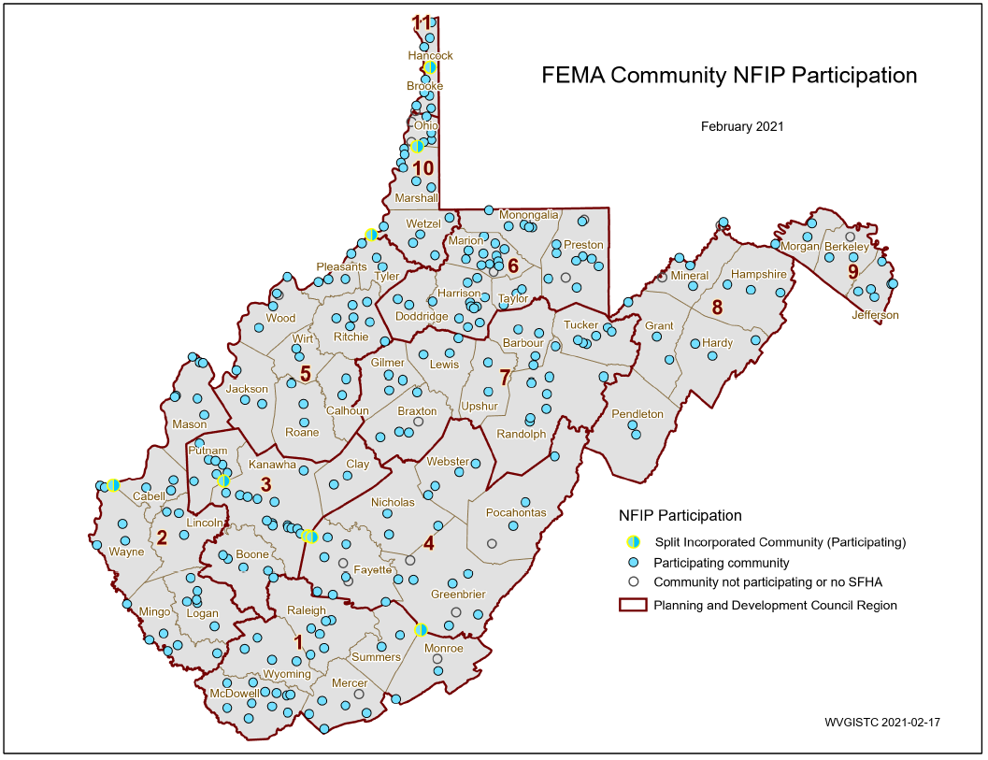
Statewide Riverine Flood Hazard Assessment
213 incorporated areas
+55 unincorporated areas
268 NFIP Communities
+18 no SFHA communities
286 WV Communities
+ 8 split communities
294 Statistical Geographies
294 Statistical Geographies form
286 Communities which form
55 Counties which form
11 PDC Regions which form
1 Statewide Flood Risk Assessment
94% of WV Communities have Special Flood Hazard Areas (SFHA)
26 Flood-Prone Communities in
Region 4 (5 counties)
Rainelle
SPLIT COMMUNITY | COUNTY 1 | COUNTY 2
Alderson | Greenbrier | Monroe
Huntington | Cabell | Wayne
Montgomery | Fayette | Kanawha
Nitro | Kanawha | Putnam
Paden City | Tyler | Wetzel
Smithers | Fayette | Kanawha
Wheeling | Marshall | Ohio
Weirton | Brooke | Hancock
White Sulphur Springs
PDF Map

Slide 4
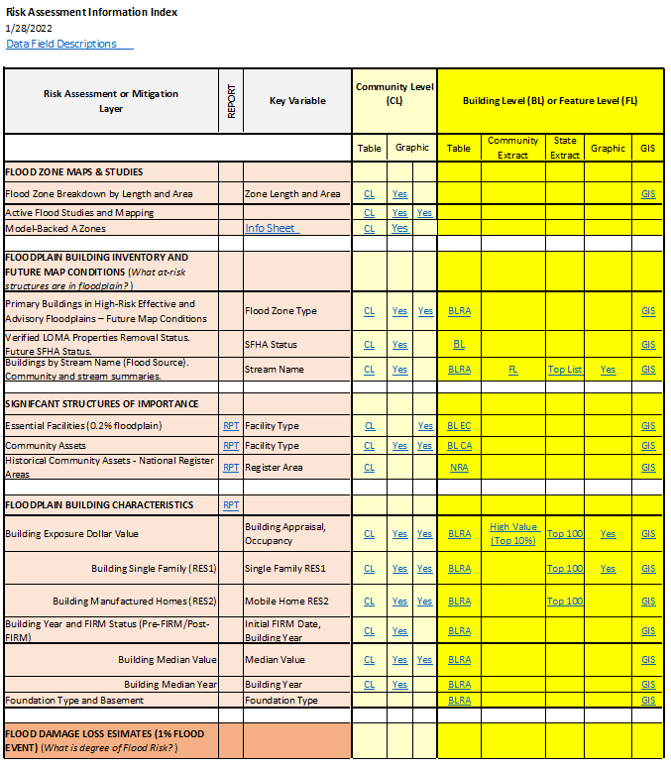
Risk Assessment Data & Maps
Use the Risk Information Index to access Data and Products
Building Level Risk Assessment (BLRA) Products
GIS Files
Tables (Excel)
  Community Level
  Building (and Feature) Levels with links to online maps
    Table Extracts
    Top Lists
Maps
  Interactive Web Maps
  Graphics and Maps
Reports (Word Docs)
3D Flood Visualizations
Most of the risk assessment data can be viewed on the RiskMAP View of the WV Flood Tool

Slide 5
WV Flood Resilience Framework
West Virginia Flood Resilience Framework (WVFRF)
Flood Risk Factors
Flood Resilience Factors
Hazard
(Riverine Flood Models, Flood Characteristics)
Frequency
Depth
Duration
Velocity
Rise/Fall
Pre-Disaster Community Planning & Cross-Organizational Coordination
Community-Engaged Flood Risk Visualizations & Communication
Household Flood Insurance
Community Rating System (CRS) Participation
Structure-Level Mitigation
Floodplain Management
Post-Disaster Recovery Assessments
Other Mitigation Measures
Exposure
Human
Physical
Vulnerability
Institutional
Social
Physical
Tools for Building Community Flood Resilience

Slide 6
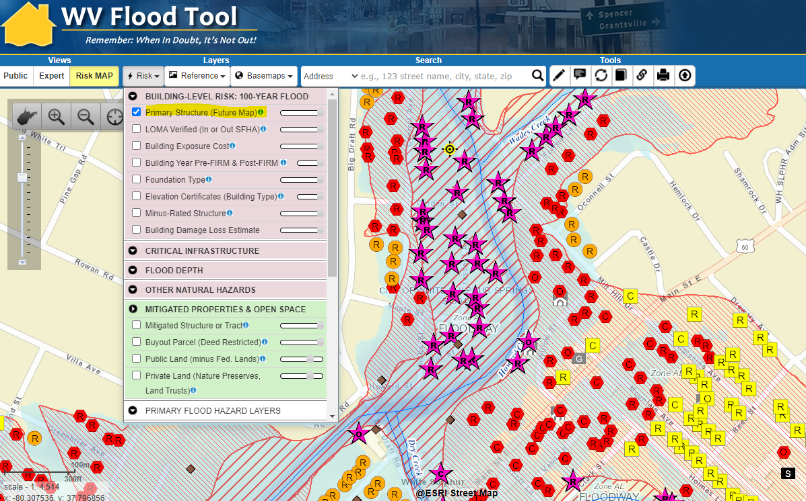
Floodplain Building-Level Risk
High-Risk Effective & Advisory
1%-Annual-Chance (100-Yr) Floodplains
BUILDING SCALE
Most Risk Assessment and Mitigation Layers are displayed on the RiskMAP View of the WV Flood Tool

Slide 7
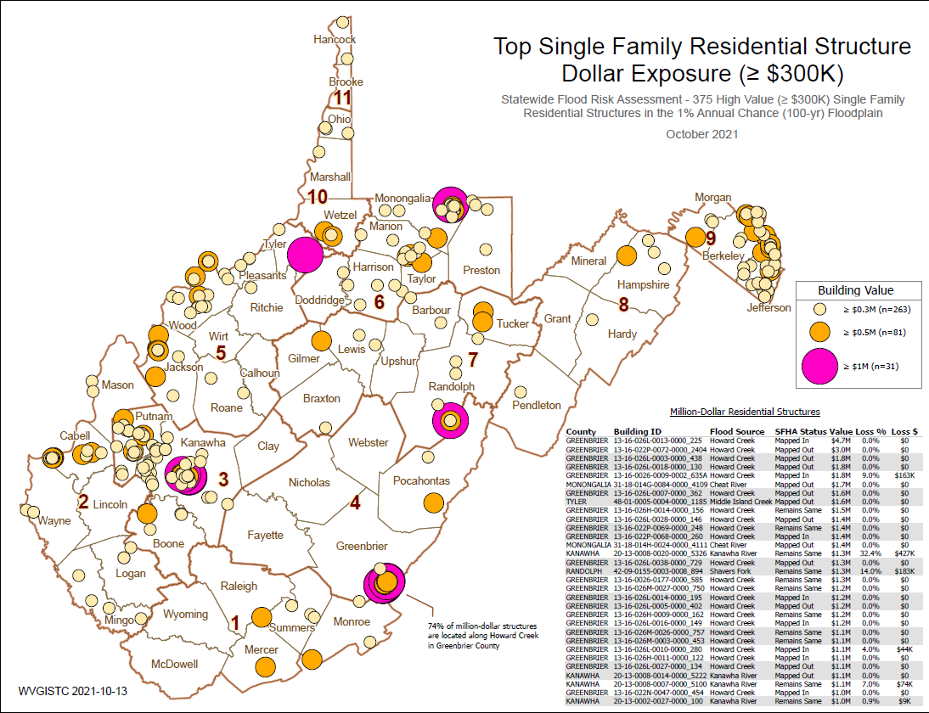
Residential: Top Single-Family $ Exposure
STATEWIDE SCALE
graphical & tabular
74% of million-dollar RESIDENTIAL structures in State are located along Howard Creek in Greenbrier County
Howard Creek

Slide 8
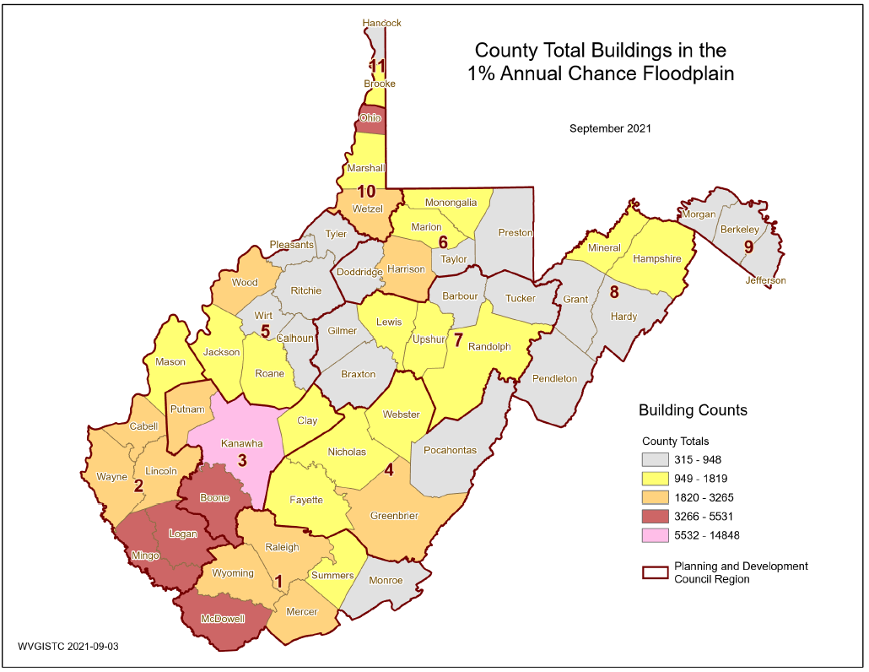
Building Counts in 1% Floodplain
County-Wide
Primary structures located in high-risk effective and advisory 1%-annual-chance (100 year) floodplains
COUNTY SCALE
graphical
1,074
1,056
948
1,819
2,225
Greenbrier County (Region 4) has the most buildings in the 1% Annual Chance Floodplain

Slide 9
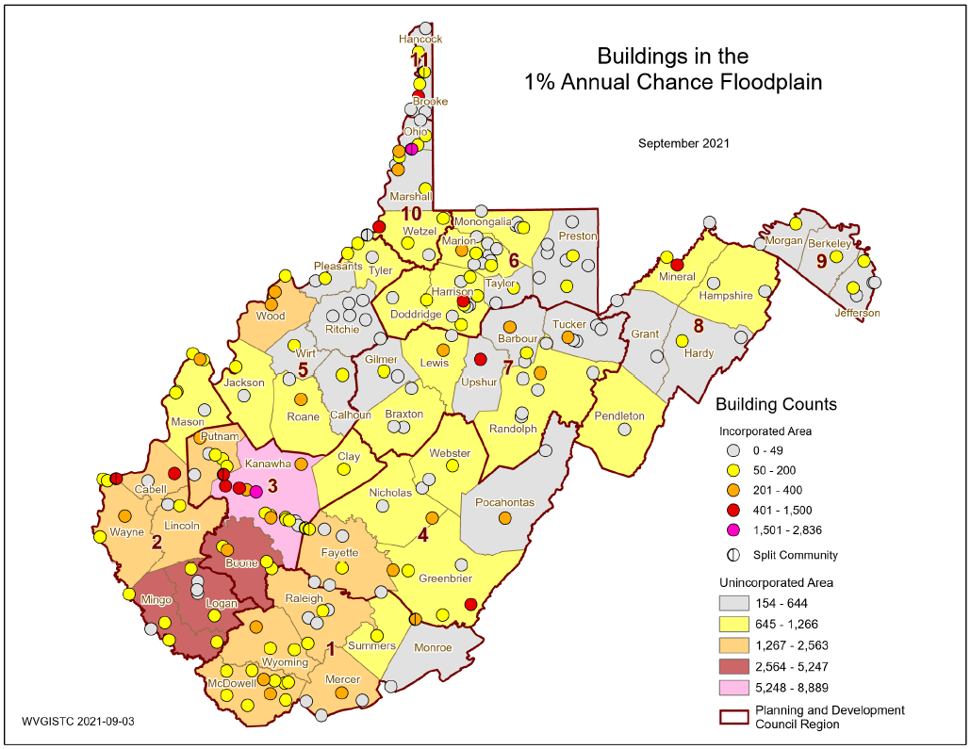
Building Counts in 1% Floodplain
Community-Wide
Region 4 has a total of 7,123 structures in the high-risk effective and advisory 1%-annual-chance (100 yr.) floodplains valued at $525,285 million. Greenbrier County (ranked 15th in the State) has the highest countywide building count in the region.
Primary structures located in high-risk effective and advisory 1%-annual-chance (100 year) floodplains
COMMUNITY SCALE
graphical
Rainelle
White Sulphur Springs
White Sulphur Springs (Region 4) has the most buildings in the 1% Annual Chance Floodplain. Rainelle has the most structures mapped into SFHA.

Slide 10
R4 Community Buildings Risk by Flood Zone
Region 4 Table
Community-Level Flood Zone Breakdown
Risk Assessment:
According to future flood maps, Fayette, Greenbrier, and Pocahontas counties have many structures being mapped into the higher risk 1%-annual-chance floodplain. Rainelle has the most mapped-in structures because of an error on the 2012 maps.
Webster Unincorporated and Richwood Incorporated have the most structures in the floodway. The new 2023 FEMA maps increase the number of floodways structures for White Sulphur Springs. Buildings in the main channel of the river or stream, or close to the flood source, will be subject to the greatest flood depths, highest velocities, and greatest debris potential.
REGIONAL &
COMMUNITY SCALES
tabular

Slide 11






Residential versus Non-Residential
Community | RESIDENTIAL |  |  |  |  | COMMERCIAL NON-RESIDENTIAL |  | OTHER NON-RESIDENTIAL |  | TOTAL BUILDING VALUE
Community Name | # | % Count |  | Value ($) | % Value | # | Value ($) | # | Value ($) | # | Value ($) | Rank¹
Ansted | 1 | 100.0% |  | $66K | 100.0% | 0 | $0K | 0 | $0K | 1 | $66K | 19
Fayette County* | 1425 | 93.2% |  | $50,385K | 66.9% | 57 | $6,523K | 47 | $18,398K | 1529 | $75,307K | 2
Gauley Bridge | 21 | 46.7% |  | $869K | 27.4% | 24 | $2,302K | 0 | $0K | 45 | $3,171K | 11
Meadow Bridge | 21 | 91.3% |  | $695K | 96.8% | 2 | $23K | 0 | $0K | 23 | $718K | 16
Montgomery** | 13 | 86.7% |  | $1,083K | 25.2% | 1 | $1,000K | 1 | $2,215K | 15 | $4,298K
Mount Hope | 32 | 84.2% |  | $787K | 65.1% | 4 | $101K | 2 | $322K | 38 | $1,210K | 14
Oak Hill | 50 | 90.9% |  | $2,262K | 95.3% | 5 | $111K | 0 | $0K | 55 | $2,373K | 12
Pax | 32 | 82.1% |  | $925K | 67.9% | 3 | $98K | 4 | $340K | 39 | $1,362K | 13
Smithers** | 63 | 85.1% |  | $2,064K | 55.8% | 8 | $837K | 3 | $796K | 74 | $3,698K
FAYETTE | 1658 | 91.1% |  | $59,136K | 64.1% | 104 | $10,994K | 57 | $22,071K | 1819 | $92,201K | 2
Alderson** | 121 | 84.6% |  | $6,485K | 56.7% | 17 | $1,028K | 5 | $3,931K | 143 | $11,443K | 5**
Falling Springs | 3 | 100.0% |  | $157K | 100.0% | 0 | $0K | 0 | $0K | 3 | $157K | 18
Greenbrier County* | 1101 | 93.1% |  | $103,297K | 77.7% | 68 | $6,511K | 13 | $23,065K | 1182 | $132,873K | 1
Rainelle | 253 | 74.4% |  | $8,392K | 55.4% | 78 | $5,751K | 9 | $1,006K | 340 | $15,149K | 4
Ronceverte | 34 | 50.7% |  | $1,354K | 4.5% | 32 | $4,436K | 1 | $24,000K | 67 | $29,790K | 3
Rupert | 58 | 93.5% |  | $2,321K | 73.2% | 2 | $291K | 2 | $561K | 62 | $3,173K | 10
White Sulphur Springs | 375 | 87.6% |  | $18,910K | 36.4% | 42 | $5,144K | 11 | $27,940K | 428 | $51,994K | 1
GREENBRIER | 1945 | 87.4% |  | $140,916K | 57.6% | 239 | $23,161K | 41 | $80,503K | 2225 | $244,580K | 1
Nicholas County* | 624 | 90.2% |  | $21,060K | 68.1% | 42 | $6,646K | 26 | $3,230K | 692 | $30,936K | 4
Richwood | 265 | 80.5% |  | $7,518K | 55.8% | 47 | $1,399K | 17 | $4,556K | 329 | $13,473K | 6
Summersville | 23 | 63.9% |  | $1,497K | 11.3% | 11 | $1,657K | 2 | $10,109K | 36 | $13,263K | 7
NICHOLAS | 912 | 86.3% |  | $30,075K | 52.1% | 100 | $9,703K | 45 | $17,895K | 1057 | $57,672K | 5
Durbin | 23 | 85.2% |  | $645K | 72.4% | 2 | $157K | 2 | $89K | 27 | $891K | 15
Marlinton | 286 | 75.1% |  | $15,309K | 44.3% | 82 | $9,635K | 13 | $9,586K | 381 | $34,529K | 2
Pocahontas County* | 502 | 93.0% |  | $23,166K | 84.7% | 23 | $2,460K | 15 | $1,731K | 540 | $27,358K | 5
POCAHONTAS | 811 | 85.5% |  | $39,120K | 62.3% | 107 | $12,252K | 30 | $11,406K | 948 | $62,779K | 4
Addison | 107 | 84.9% |  | $3,855K | 32.7% | 15 | $3,053K | 4 | $4,892K | 126 | $11,799K | 8
Camden-On-Gauley | 13 | 61.9% |  | $263K | 45.9% | 4 | $32K | 4 | $279K | 21 | $573K | 17
Cowen | 28 | 80.0% |  | $814K | 15.4% | 4 | $92K | 3 | $4,375K | 35 | $5,281K | 9
Webster County* | 839 | 94.1% |  | $25,759K | 51.1% | 27 | $2,685K | 26 | $21,957K | 892 | $50,400K | 3
WEBSTER | 987 | 91.9% |  | $30,690K | 45.1% | 50 | $5,861K | 37 | $31,502K | 1074 | $68,053K | 3
SUMMARY | 6,313 | 88.5% |  | $299,937K | 56.3% | 600 | $61,971K | 210 | $163,376K | 7,123 | $525,285K
Alderson (Greenbrier/Monroe) Split Community Total:
Alderson** | 175 | 0.0% | $8,869K |  | 60.4% | 24 | $1,482K | 10 | $4,332K | 209 | $14,683K | 5
REGION 4 Communities
– Values & Rankings
tabular
Building Dollar Exposure Report:
Residential versus Non-Residential
¹ Group Rank on Community Type: County, Unincorporated, Incorporated. Table ranking by Region and not Statewide.

Slide 12
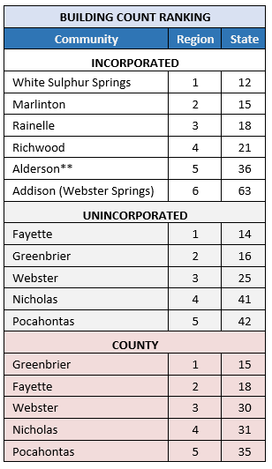
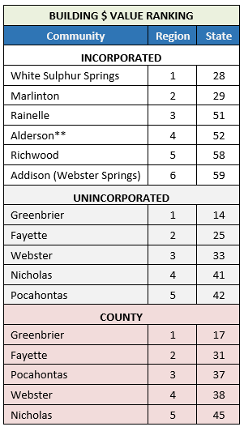
Building Risk by Community Type
Risk Assessment:
White Sulphur Springs INCORPORATED AREA has the highest 1% flood zone building counts and dollar exposure
REGIONAL
and
STATE Rankings
tabular
Fayette and Greenbrier UNINCORPORATED AREAS have the highest building counts and dollar exposure, respectively.
Greenbrier COUNTY has the highest building counts and dollar exposure
Highest number of primary structures in the 1% floodplain:
White Sulphur Springs (incorporated)
Fayette County Unincorporated (unincorporated area)
Greenbrier County (countywide)
Highest building dollar exposure in the 1% floodplain:
White Sulphur Springs (incorporated)
Greenbrier County Unincorporated (unincorporated)
Greenbrier County (countywide)
** Split Community
Source: Region 4 Community-Level Building Exposure Table

Slide 13
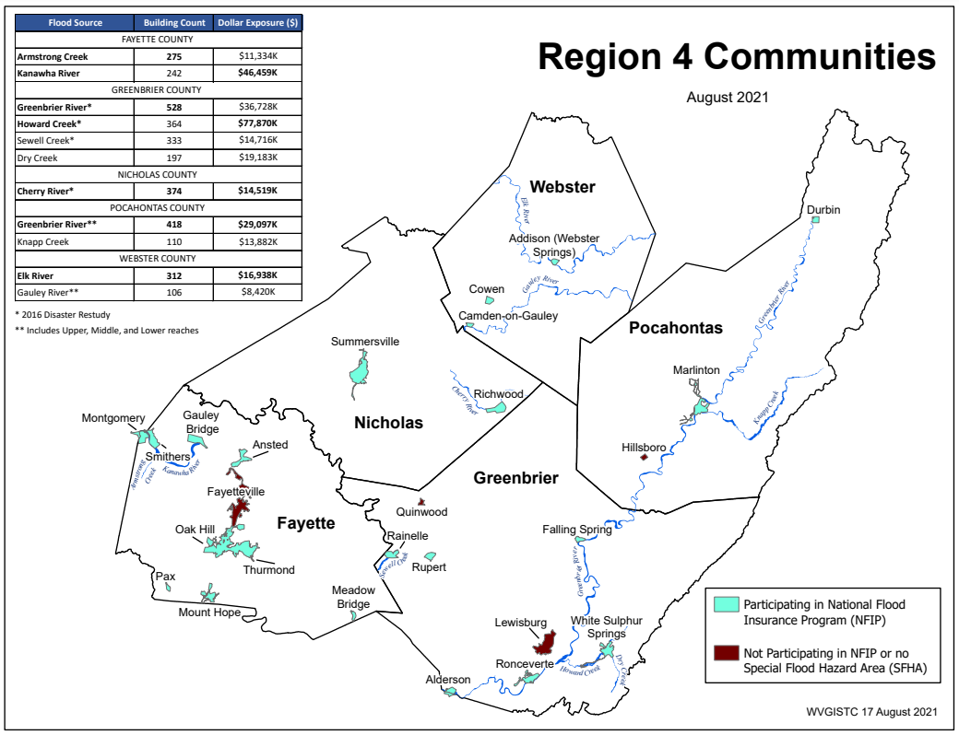
Building Risk by Flood Source (Region 4)
Building Counts and Building Exposure $ Values by Stream Name
Flood Sources | Building Count | Dollar Exposure ($)
FAYETTE COUNTY
Armstrong Creek | 275 | $13,334K
Kanawha River | 242 | $46,459K
GREENBRIER COUNTY
Greenbrier River* | 528 | $60,728K
Howard Creek* | 364 | $94,870K
Sewell Creek* | 333 | $14,716K
Dry Creek | 197 | $19,183K
NICHOLAS COUNTY
Cherry River* | 374 | $15,719K
POCAHONTAS COUNTY
Greenbrier River** | 418 | $29,097K
Knapp Creek | 110 | $13,882K
WEBSTER COUNTY
Elk River | 312 | $16,938K
Gauley River** | 106 | $8,420K
* 2016 Disaster Restudy
Greenbrier River in Region 4 has the most structures in the 1%-annual-chance floodplain
Greenbrier River totals for Greenbrier and Pocahontas counties: 946 buildings in 1% floodplain, $90M dollar exposure
Howard Creek in Greenbrier County has the highest building dollar exposure of all communities in Region 4
Computed for 1% (100-yr) floodplain
RA Tables: Buildings by River/Stream Name
REGION & FLOOD SOURCE SCALES
Region 4 PDF Map Primary Flood Sources

Slide 14
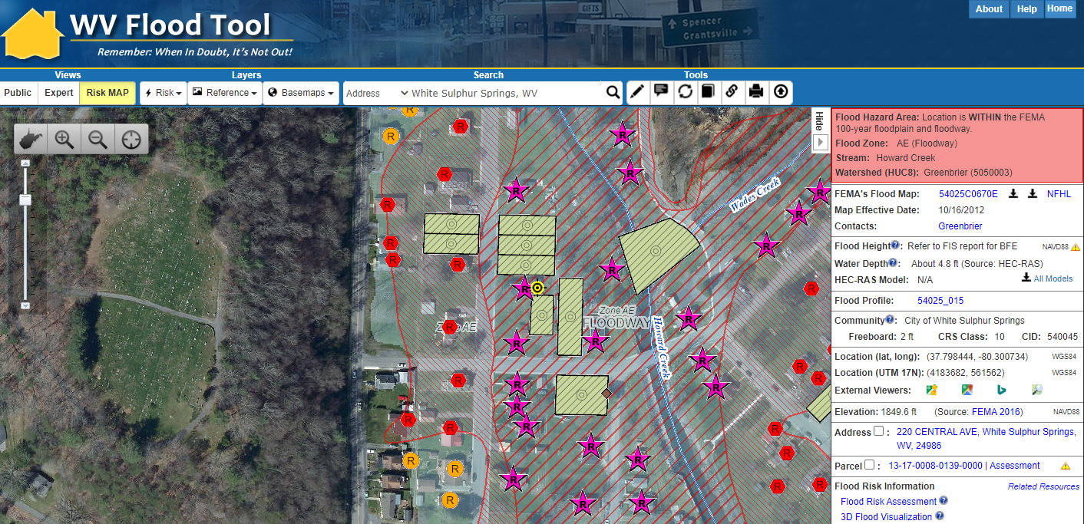
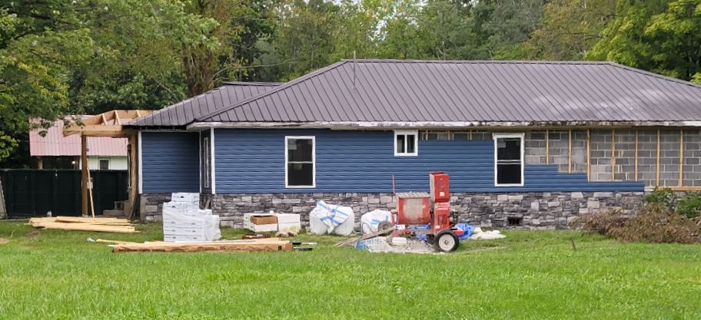
GRAPHICAL VIEW: WV Flood Tool’s Risk Map
Residential Structure in Floodway
Bldg. 13-17-0008-0139-0000
Buyout Property
Street View Image
Notes:
Segment 1. Visualizing flood risk and resiliency factors graphically on the WV Flood Tool
The WV GIS Technical Center provided support for visualizing and quantifying various flood risk and resiliency factors facing flood-prone communities in Greenbrier County. In this example, flood visualizations allow property owners to view building damage estimates for unmitigated structures.
<< GROUP 1: WV Flood Tool Slide 1 - building flood depth visualization >>
Both flood risk and resiliency factors – like exposed building value, building damage loss estimates, and mitigated properties – allow the public and communities to engage and provide feedback with detailed flood impact studies.
<< GROUP 1: WV Flood Tool Slide 2 - building damage loss estimate >>
Flood risk factors can be viewed graphically at the building level on the WV Flood Tool….
<< GROUP 1: WV Flood Tool Slide 3 – Flood Tool graphic >>

Slide 15
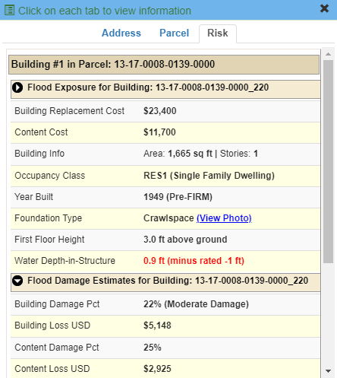
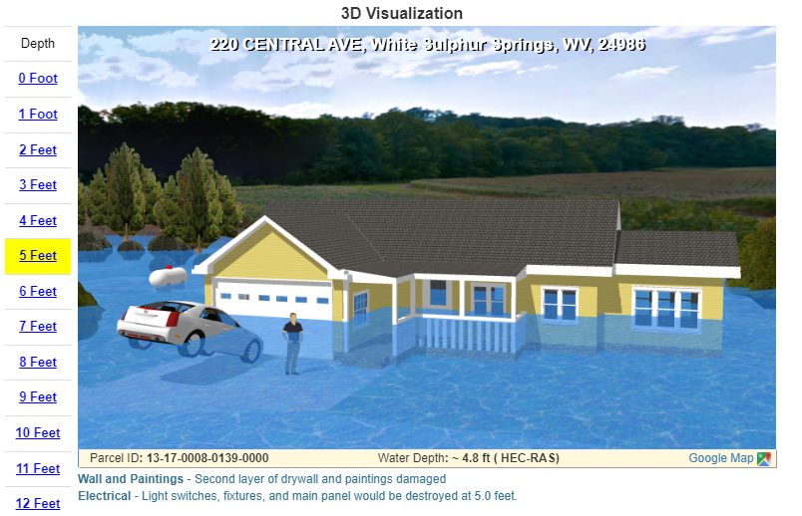
Visualizations - WV Flood Tool
Building
Exposure
Base Flood Depth – 3D Visualization
HAZUS Loss Estimate
Notes:
Segment 1. Visualizing flood risk and resiliency factors graphically on the WV Flood Tool
The WV GIS Technical Center provided support for visualizing and quantifying various flood risk and resiliency factors facing flood-prone communities in Greenbrier County. In this example, flood visualizations allow property owners to view building damage estimates for unmitigated structures.
<< GROUP 1: WV Flood Tool Slide 1 - building flood depth visualization >>
Both flood risk and resiliency factors – like exposed building value, building damage loss estimates, and mitigated properties – allow the public and communities to engage and provide feedback with detailed flood impact studies.
<< GROUP 1: WV Flood Tool Slide 2 - building damage loss estimate >>
Flood risk factors can be viewed graphically at the building level on the WV Flood Tool….
<< GROUP 1: WV Flood Tool Slide 3 – Flood Tool graphic >>

Slide 16








STATISTICAL VIEW: Community Risk Dashboard
FLOOD RISK FACTORS
Hazard
Ratio of Floodplain to Community Area: 9.2%
Incorporated Community Median: 10.2%
Federally Declared Flood Disasters in Greenbrier County since 1989: 9
Statewide County Median: 12
Rainelle,
WV
Greenbrier County
Exposure
Physical
Human
Total Buildings in High-Risk Floodplains: 338
Incorporated Community Median: 59
Estimated Population
Residing in High-Risk
Floodplains: 582
Incorporated Community Median: 114
Newly Mapped in Structures: 329
Newly Mapped out Structures: 0
Total Building Value in Floodplains: $16,120K
Incorporated Community Median: $6,417K
Estimated Population Displaced by Flooding:
492
Incorporated Community Median: 56
Total At-Risk Residential Structures: 251
Incorporated Community Median: 44
Total Estimated Building Loss: $997K
Incorporated Community Median: $240K
Estimated Population in Need of Short-Term Shelters: 123
Incorporated Community Median: 12
Vulnerability
Mobile Homes
in Floodplains: 14
Incorporated Community Median: 5
Critical Buildings in Floodplains (Essential Facilities and Non-Historical Community Assets): 8
Incorporated Community Median: 3
Renters Ratio
in Floodplains: 39%
Incorporated Community Med.: 35%
Social Vulnerability Index (SVI)
of Greenbrier County: 0.55
Statewide County Median: 0.48
Notes:
Segment 2. Flood risk factor statistics summarized by a Community Flood Risk Dashboard
Or these risk factors can be summarized statistically at the community level by a flood risk dashboard. This community risk dashboard of Rainelle, WV, summarizes hazard, exposure, and vulnerability statistics for the built-environment and population in the high-risk flood zones. Community risk indicators of special concern are highlighted along with the rationale of why these particular risk factors make the community more vulnerable to flood hazards.
<< GROUP 2: Community Flood Risk Dashboard >>

Slide 17







Social Vulnerability Indicators
White Sulphur Springs and Rainelle
Vulnerability Indicators |  | White Sulphur Springs | Rainelle | State Ratio | National Ratio
 | Poverty Rate | 14.4% | 37.0% | 17.3% | 12.9%
 | Unemployment Rate | 21.4% | 33.6% | 23.8% | 14.7%
 | Vulnerable Ages Ratio | 41.7% | 39.8% | 30.8% | 28.3%
 | Disability Ratio | 17.8% | 26.9% | 18.7% | 13.0%
 | Population Growth Ratio | -9.1% | -20.9% | -3.2% | 7.4%
 | Renter-Occupied Ratio | 42.8% | 43.0% | 26.8% | 36.0%
 | Housing Values Less than $50K Housing Median Value | 3.9% $125,700 | 37.5% $59,400 | 16.9% $119,600 | 6.6% $229,800
Social Vulnerabilities
Risk Factor Findings
The red texts show more than 5% of difference, to the vulnerability side, from the state ratios.

Slide 18
Building Physical Exposure / Vulnerability
White Sulphur Springs and Rainelle
Category | Exposure Indicator | White Sulphur Springs | Rainelle | Ratio* in WV Incorporated Areas (2021)
Buildings by Flood Zone (Count & Value) | Total Primary Building Count in Floodplain | 423 (Rank***: 12th) | 338 (Rank: 18th) | 59 (Median)
 | Building Ratio b/w Floodplain & Community Total | 26% | 34% | 9%
 | Total Primary Building Value in Floodplain of Community | $40,881K (Rank: 16th) | $16,120K | $6,417K (Median)
 | Median Building Value in Floodplain | $49K | $38K | $42K
 | Building Count in Floodway** (High Velocity) | 65 (Rank: 13th) | 9 | 12 (Avg.)
 | Percent Building Count in Floodway** (High Velocity & Depth) | 15% | 3% | 8%
 | New Maps: Bldgs. “Mapped In” SFHA | 72 (Rank: 12th) | 329 (Rank: 3rd) | 19 (Avg.)
 | New Maps: Bldgs. % Count “Mapped In” SFHA | 17% | 97% | 14%
 | New Maps: Bldgs. “Mapped Out” SFHA | 118 (Rank: 8th) | 0 | 19 (Avg.)
 | New Maps: Bldgs. % Count “Mapped Out” SFHA | 28% | 0% | 14%
Building
Exposure
Risk Factor Findings

Slide 19
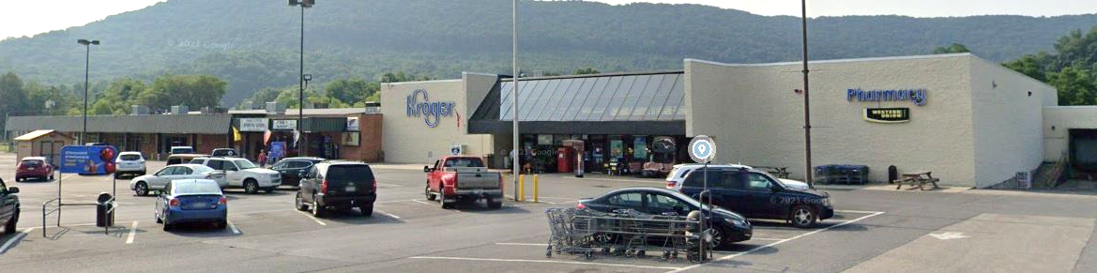
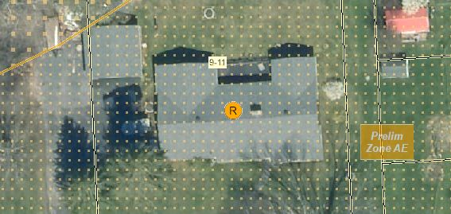
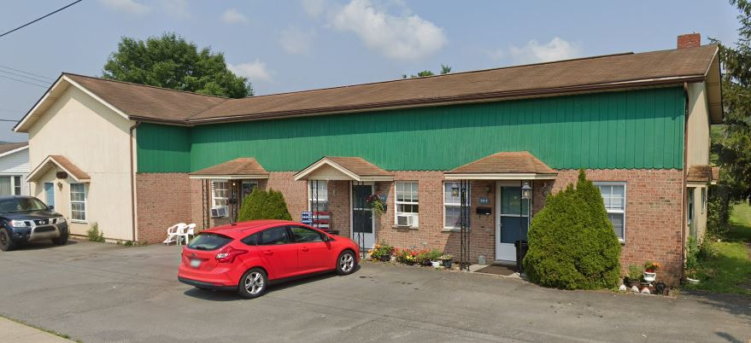
Building Exposure, High-Value Structures
Rainelle
Highest Value:
Building ID: 13-13-0004-0194-0000_506
Hazard Occupancy Class:
FIRM Status: Post-FIRM (1994)
regulated to Pre-FIRM
Appraised Value: $1,443,900
Flood Tool Link (New flood study mapped-in SFHA)
Hi-Value
Structures
Highest Residential (RESx) Value:
Building ID: 13-13-0009-0011-0000_242
Hazard Occupancy Class: RES1 (Residential 1 Family)
FIRM Status: Pre-FIRM (1967)
Appraised Value: $107,400
Flood Tool Link (New flood study mapped-in SFHA)
Highest Apartment Building Value:
Building ID: 13-13-0005-0341-0000_249
Hazard Occupancy Class: RES3B (Multi-Family 3-4 Units)
FIRM Status: Pre-FIRM (1960)
Appraised Value: $63,900
Flood Tool Link (New flood study mapped-in SFHA)

Slide 20
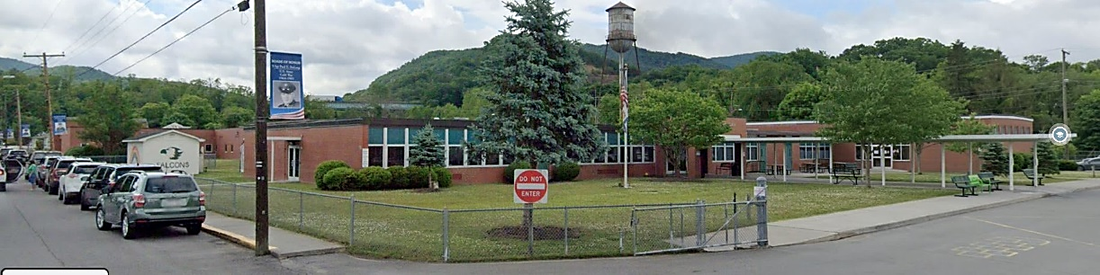
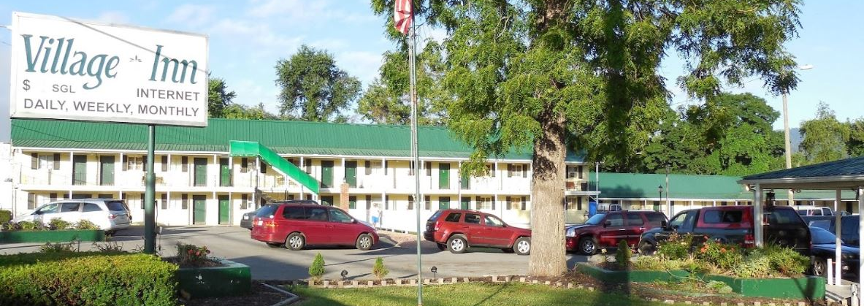
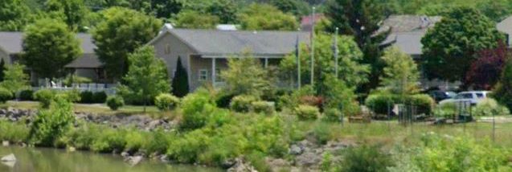
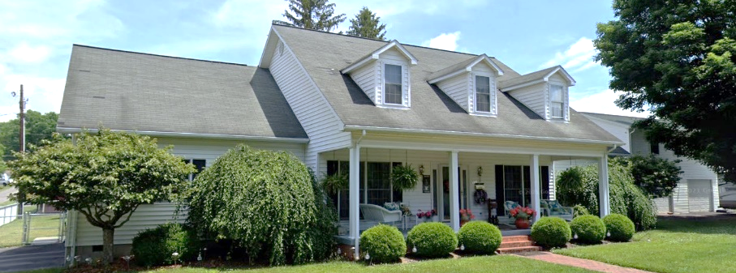
Building Exposure, High-Value Structures
White Sulphur Springs
Highest Value:
Building ID: 13-17-0009-0342-0000_150 (WSS Elementary)
Hazard Occupancy Class: EDU1 (School)
FIRM Status: Post-FIRM (2003)
Appraised Value: $8,542,982
Flood Tool Link (New flood study mapped-out SFHA)
Highest Residential (RESx) Value:
Building ID: 13-17-0011-0246-0000_559
Hazard Occupancy Class: RES4 (Hotel/Motel - Low Rise)
FIRM Status: Pre-FIRM (1951)
Appraised Value: $254,400
Flood Tool Link (New flood study mapped-in SFHA)
Hi-Value
Structures
Highest Apartment Building Value:
Building ID: 13-17-0009-0054-0001_767
Hazard Occupancy Class: RES3B (Multi-Family 3-4 Units)
FIRM Status: Pre-FIRM (1950)
Appraised Value: $227,600
Flood Tool Link
Highest Single-Family Value:
Building ID: 13-17-0008-0523-0000_192
Hazard Occupancy Class: RES1 (Residential 1 Family)
FIRM Status: Post-FIRM (1993)
Appraised Value: $192,700
Flood Tool Link

Slide 21
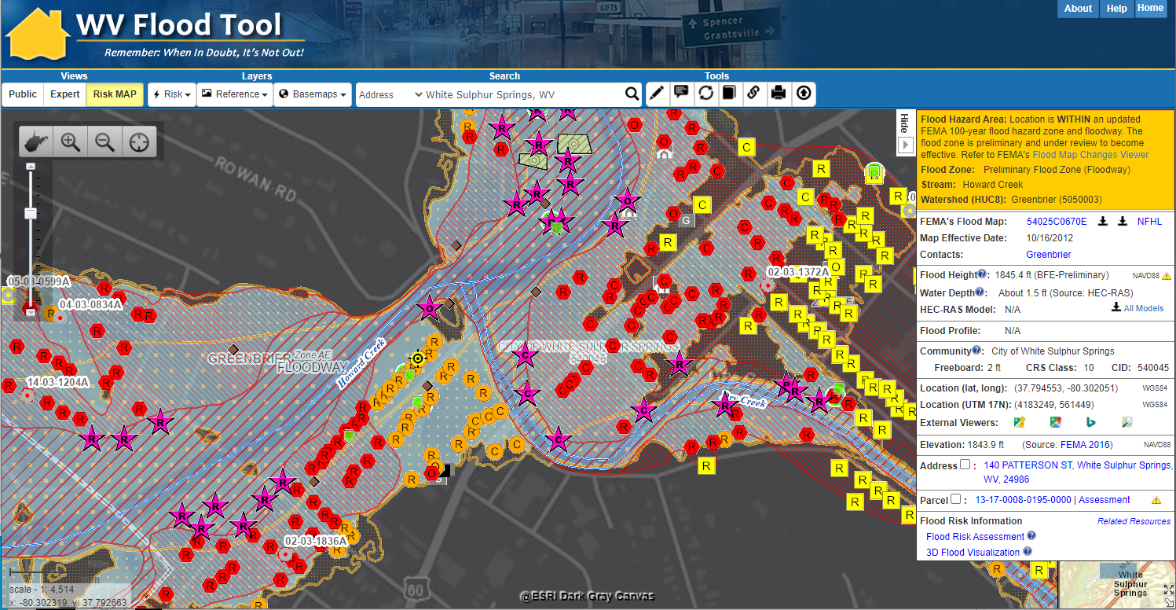
Structures in Floodway
White Sulphur Springs
More Structures mapped into Floodway on new maps
Risk Factor Findings
Structures in Floodway

Slide 22
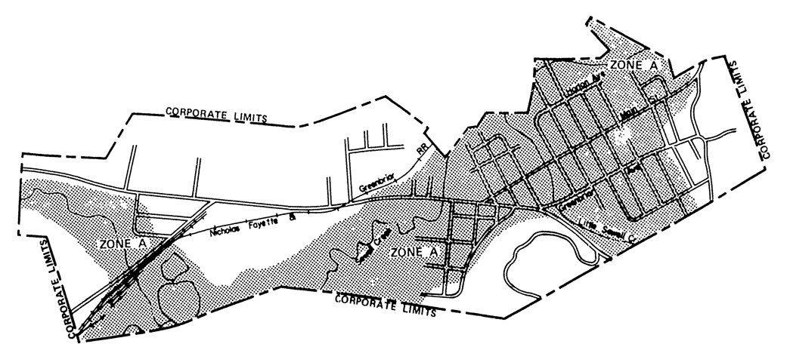
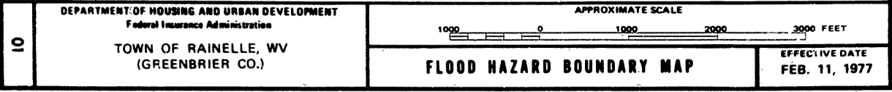
Rainelle 1977 FHBM
Structures in SFHA
Map Accuracy is important!
Low map accuracy for 1977 map –
no detailed flood zones
https://map1.msc.fema.gov/firm?id=540228

Slide 23
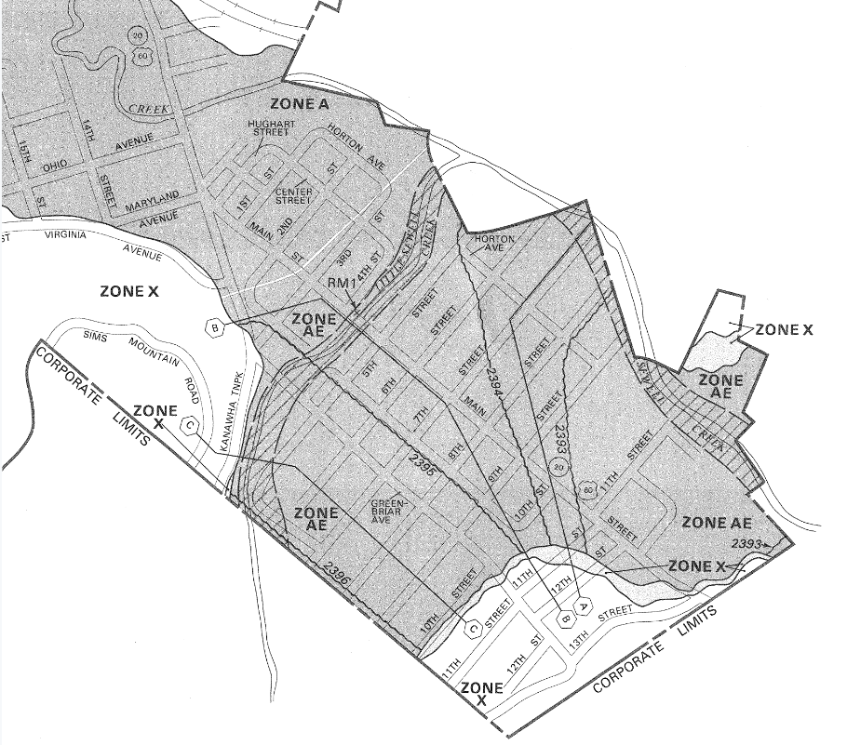

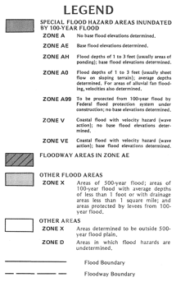
Rainelle 1987 FIRM
Structures in SFHA
Map Accuracy
Improved with Base Flood Elevations
https://map1.msc.fema.gov/firm?id=5402280001A

Slide 24
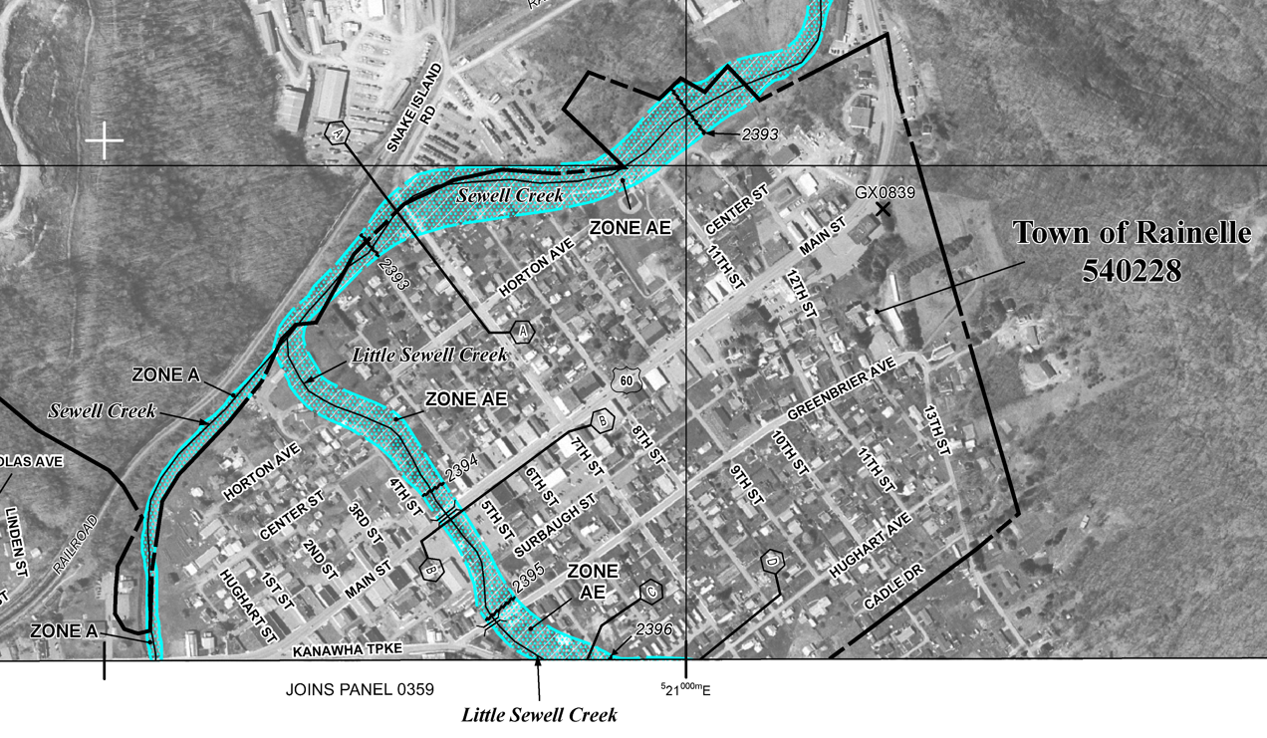

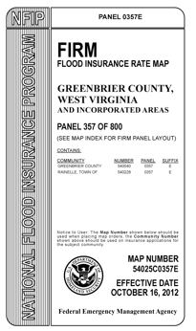
Rainelle 2012 FIRM (Incomplete)
Structures in SFHA
Map Accuracy
Incomplete
https://map1.msc.fema.gov/firm?id=54025C0357E
Incomplete mapping of SFHA resulted in:
Residents underinsured for major flood in 2016
FEMA damage assessments not conducted outside the SFHA
Only the floodway was shown on FEMA’s 2012 Flood Insurance Rate Map (FIRM). The floodway fringe, a major portion of the Special Flood Hazard Area (SFHA) that previously covered Rainelle, significantly narrowed and was not included in the 2012 FIRM.

Slide 25
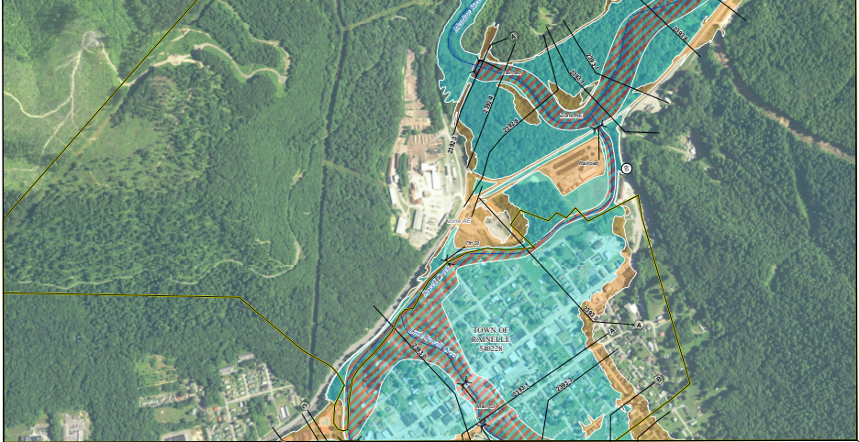
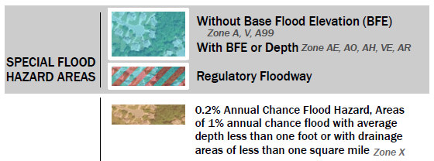
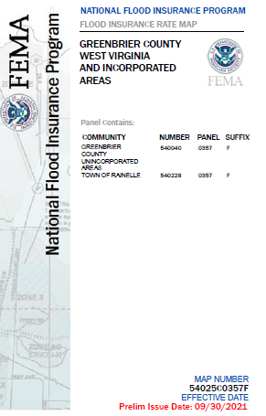

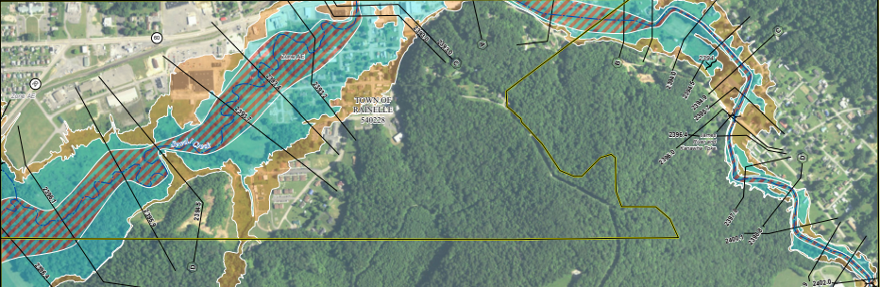
Rainelle 2022 Preliminary FIRM (Effective 2023)
Structures in SFHA
Map Accuracy
Complete and Significantly More Accurate
Panels FIRM Index and Panels

Slide 26
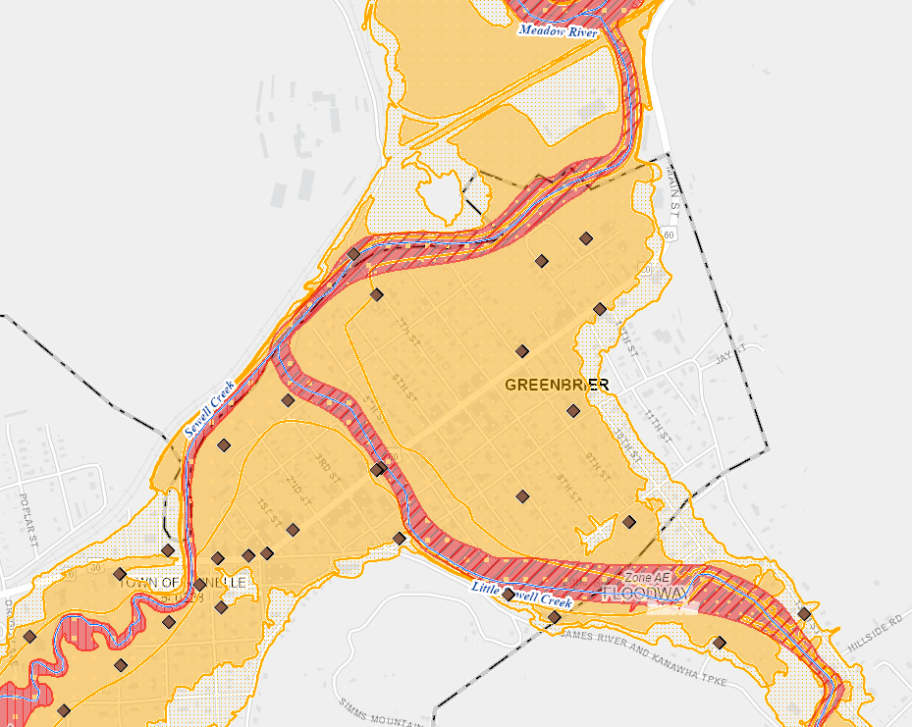
Rainelle 2022 Preliminary FIRM
2012 FIRM (floodway only mapped)
The Special Flood Hazard Area (SFHA) is the land in the floodplain subject to a one percent (100-year) or greater chance of flooding in any given year
2022 FIRM (floodway and fringe)
High Risk Flood Zones for
1%-chance (100-yr) flood
Expanded SFHA increases 143 acres
Risk Factor Findings
2022 Flood Map: Total acreage of high-risk flood zones increased significantly by 143 acres
Rainelle
WV Flood Tool

Slide 27
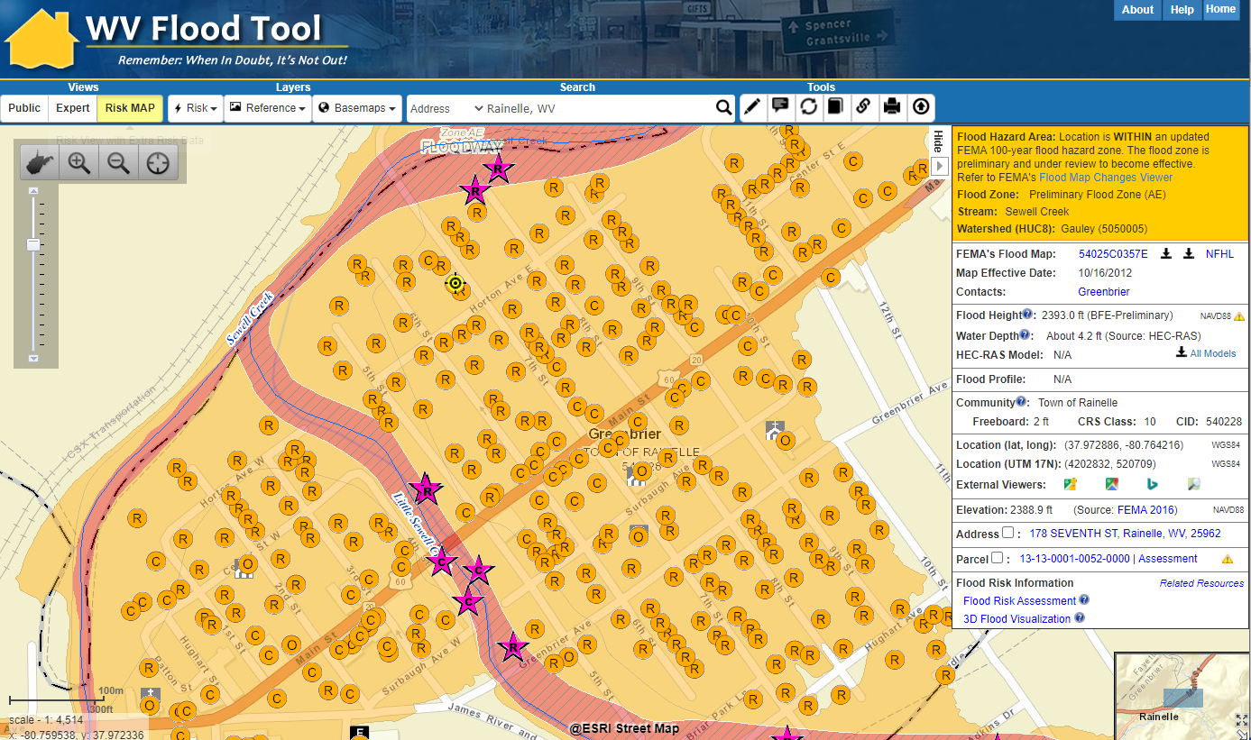
Preliminary NFHL (Rainelle, WV)
329 Structures Mapped into Higher Risk SFHA
Risk Factor Findings
Rainelle, Greenbrier County
Example of mapped in structures to new SFHA from Preliminary Flood Study of Rainelle, WV. Mapped in structures (orange circles) and flood loss estimates are updated in the statewide Building Level Risk Assessment (BLRA).

Slide 28
FINDINGS: Building Exposure / Vulnerability
White Sulphur Springs and Rainelle
Category | Exposure Indicator | White Sulphur Springs | Rainelle | Ratio* in WV Incorporated Areas (2021)
Building Ownership | Owner Occupied Residential Buildings in Floodplain | 205 | 152 | 65%
 | Percent Owner Occupied Residential Buildings in Floodplain | 48% | 45%
Building Occupancy and Value | Residential Building Count in Floodplain | 370 (Rank: 12th) | 251 | 44
 | Percent Count Residential Building in Floodplain | 87% | 74% | 81%
 | Non-Residential Building Count in Floodplain | 53 | 87 (Rank: 11th) | 12
 | Percent Count Non-Residential Bldgs. in Floodplain | 13% | 26% | 19%
 | Residential Building Value in Floodplain | $20,321K (Rank: 16th) | $9,265K | $2,105K
 | Percent Residential Value in Floodplain | 50% | 57% | 31%
 | Non-Residential Building Value in Floodplain | $20,560K | $6,757K | $2,988K
 | Percent Non-Residential Value in Floodplain | 50% | 44% | 69%
 | Mobile Homes in Floodplain | 4 | 14 | 5
 | Percent Mobile Homes in Residential Buildings in Floodplain | 1% | 4% | 11%
Building
Exposure
Risk Factor Findings

Slide 29
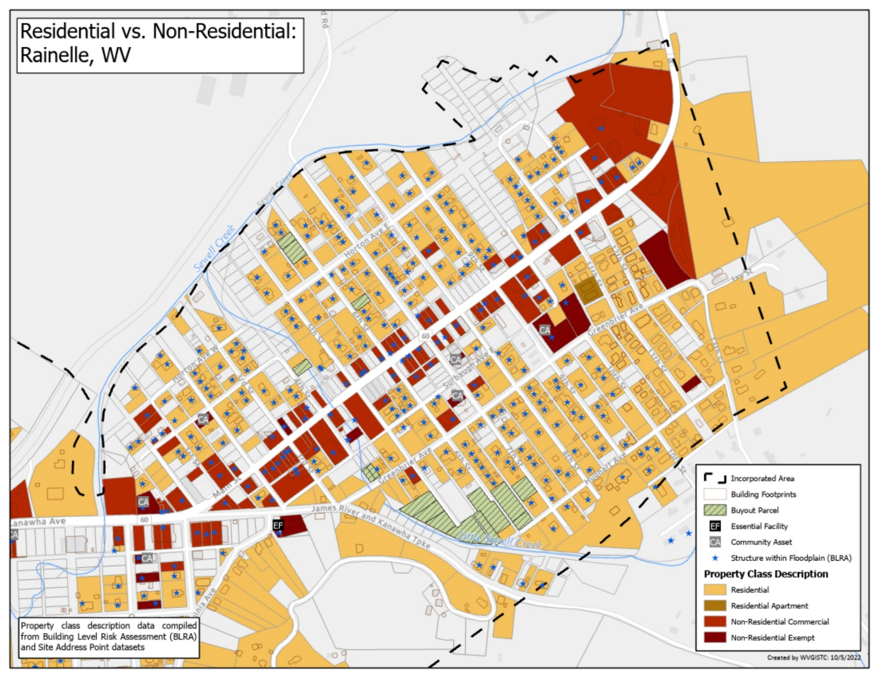
Residential vs. Non-Residential Parcels
Rainelle
Non-Residential Structures
Risk Factor Findings
Non-residential structures typically are more challenging to mitigate

Slide 30
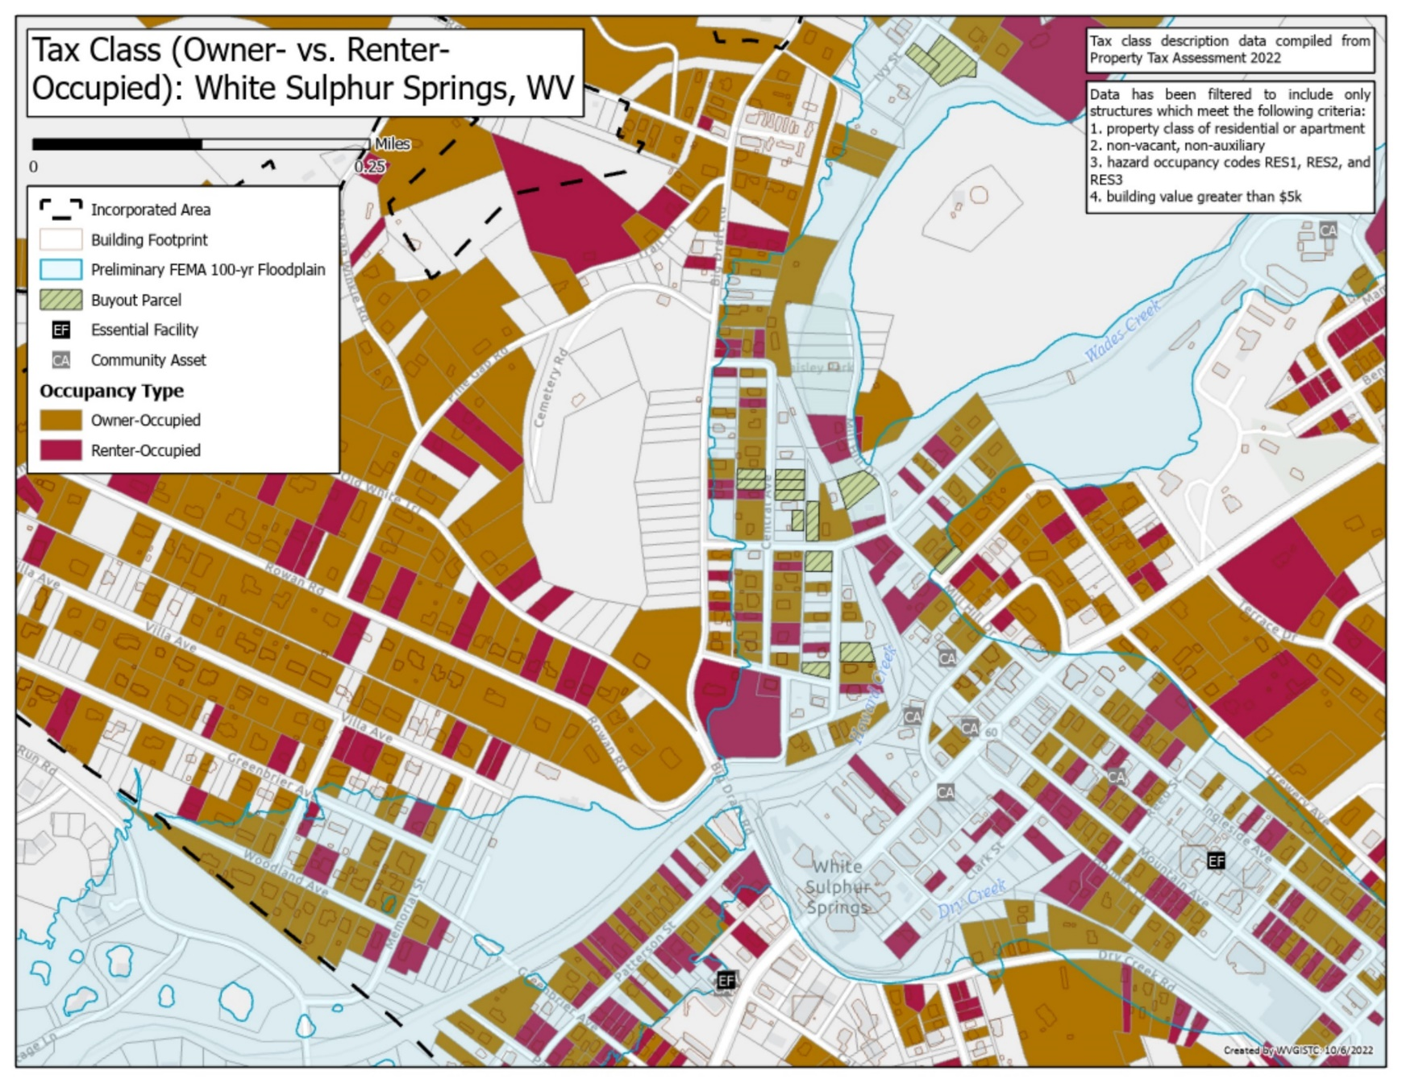
Tax Class, Owner- vs. Renter-Occupied Parcels
White Sulphur Springs
Renter Occupied
Risk Factor Findings
Rental structures and tenants typically are more vulnerable to flooding

Slide 31
FINDINGS: Building Exposure / Physical Vulnerability
White Sulphur Springs and Rainelle
Category | Exposure Indicator | White Sulphur Springs | Rainelle | Median & Ratio in WV Incorporated Areas (2021)
Building Year Construction/ FIRM Status | Median Construction Year in Floodplain | 1940 | 1950 | 1947
 | % Pre-FIRM Structures (includes “unknown”) | 88% | 77% | 77%
 | % Post-FIRM Structures (also “mapped-in SFHA” Post-FIRM structures regulated to Pre-FIRM) | 12% | 23% | 13%
Physical Structural Vulnerability (Basements, Stories, & Value) | Primary Buildings with Basements in Floodplain | 93 | 27 | 37%
 | Percent Count Buildings with Basements in Floodplain | 22% | 8%
 | One-Story Residential Buildings in Floodplain | 334 | 292 | 69%
 | Percent Count One-Story Residential Buildings in Floodplain | 79% | 86%
 | Red Tag: Dilapidated/Vacant Residential & Commercial Buildings | 14 | 49 | Not available
Building
Exposure
Risk Factor Findings
Before 8/1/1978
Before 11/19/1987
After 8/1/1978
Before 11/19/1987
* For numbers and dollar values, used median, or average where the median was zero or too low, in the state’s 213 incorporated areas
** Floodway includes both the effective and advisory floodways (2012 & 2022 checked manually)
*** Ranks mentioned based on the BLRA data of April 2022 where the community is among the top 20 incorporated areas in WV
The red texts show large difference, to the risk side, from the state ratios.
The green texts show large difference, to the resilience side, from the state ratios.

Slide 32
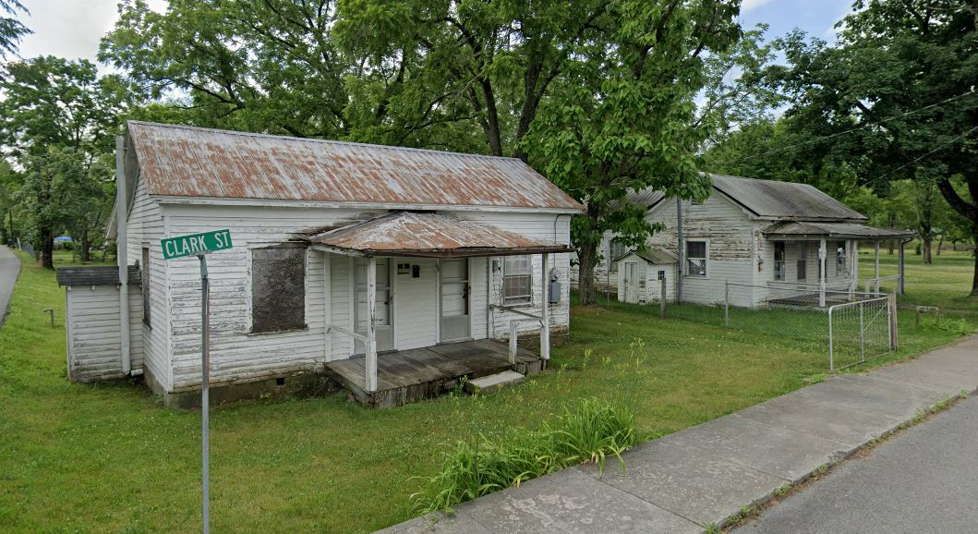
Exposure, Examples of Low Valued Structures in Floodplain
White Sulphur Springs
Low Value Structures
Building IDs: 13-17-0009-0270-0000_208 & 13-17-0009-0269-0000_196
Flood Tool Link

Slide 33
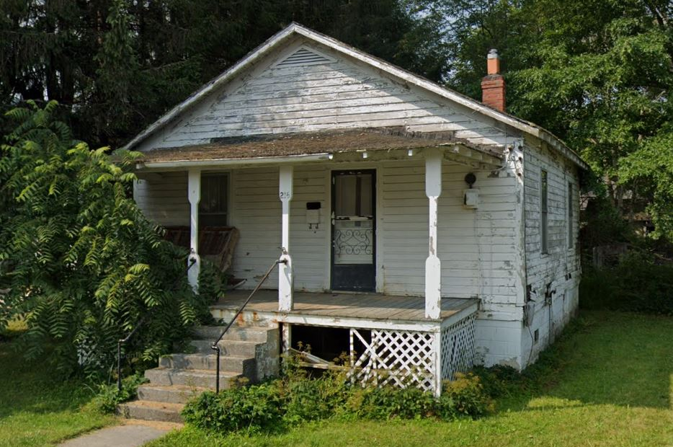
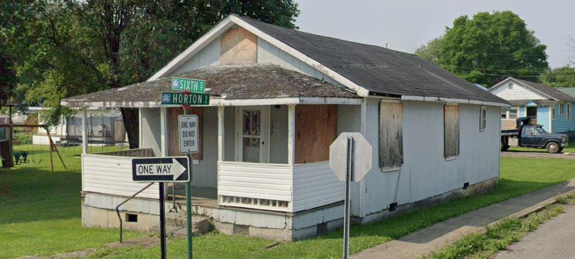
Exposure, Examples of Low Valued Structures in Floodplain
Rainelle
Low Value Structures
Building ID: 13-13-0001-0176-0000_214
Flood Tool Link
Building ID: 13-13-0001-0127-0000_178
Flood Tool Link

Slide 34
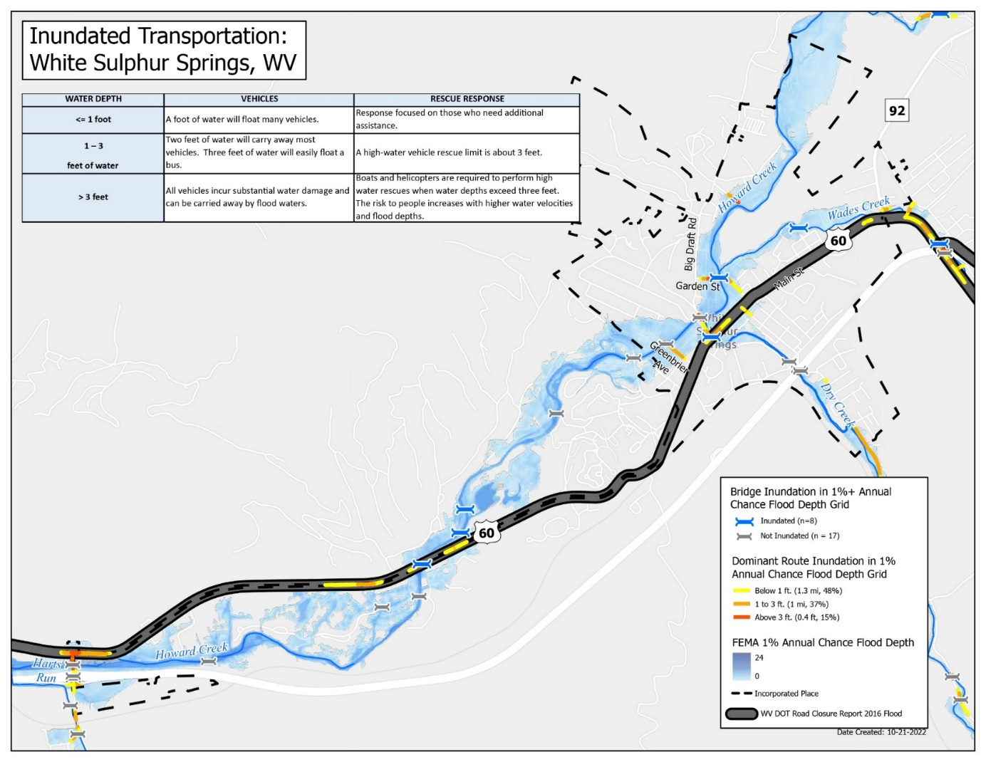
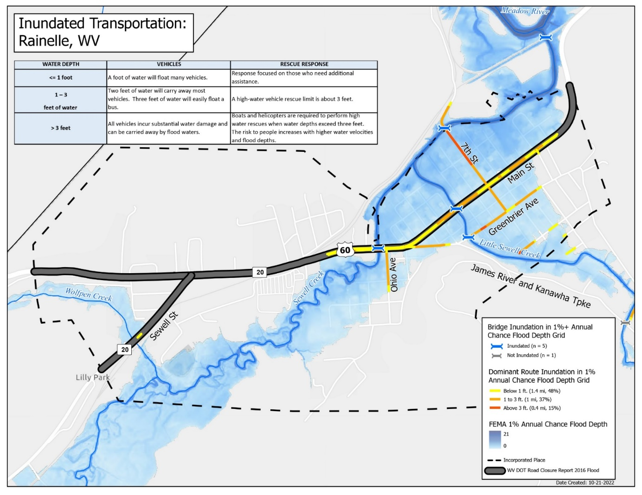
Infrastructure Exposure, Inundated Transportation
White Sulphur Springs
Road Inundation
U.S. Route 60 inundated for 1% Annual (100-year) Chance Flood

Slide 35
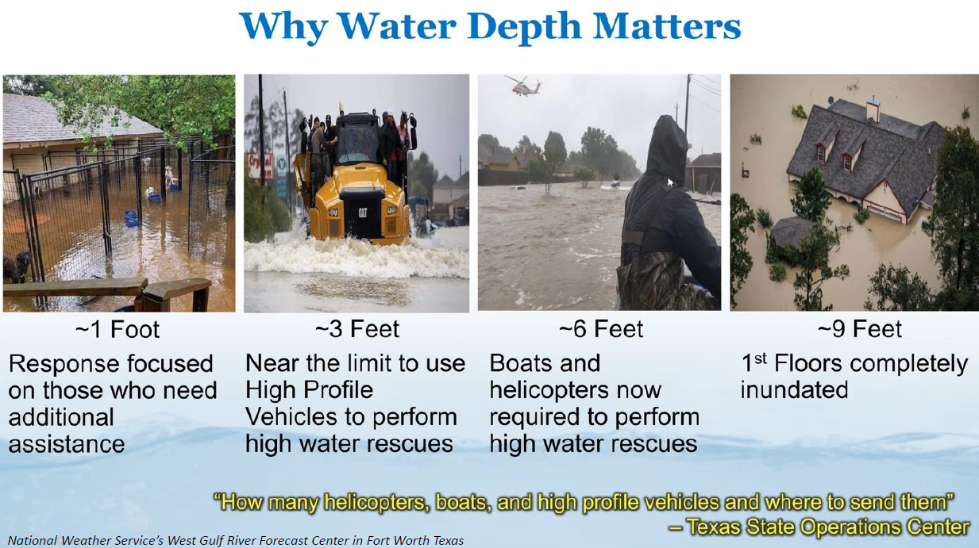
Transportation Infrastructure Inundation

Slide 36

Human Exposure
White Sulphur Springs and Rainelle
Category | Exposure Indicator | White Sulphur Springs | Rainelle | Median & Ratio in WV Incorporated Areas (2021)
Human Exposure | Estimated Population Residing in High-Risk Flood Zones | 1026 | 582 | 114
 | Percentage of Population Residing in High-Risk Flood Zones | 39% | 43% | 10%
Human Exposure
Risk Factor Findings
The red texts show large difference, to the risk side, from the state ratios.

Slide 37
Physical Flood Loss (Hazus Flood Damage Estimates)
White Sulphur Springs and Rainelle
Category | Loss Indicator | White Sulphur Springs | Rainelle | Rate* in WV Incorporated Areas (2021)
Physical (Building) Loss By 1%-Annual-Chance Flood Event | TEIF Building Dollar Loss Estimates | $1,225K | $997K | $1,246K (Avg.)
 | TEIF Building Loss Ratio | 3% | 6% | 10%
 | Median Individual Building Damage | $3K | $2K | $7K (Median)
 | Substantial Damage (>50%) Estimates | 0 (Hazus 1% Flood) 89 in 2016 Flood | 1 (Hazus) | 7 (Avg.)
 | Percent Substantial Damage Estimates | 0% | 0% | 6% (Avg.)
 | Moderate Damage (10-50%) Estimates | 78 98 in 2016 Flood | 109 | 47 (Avg.)
 | Percent Moderate Damage Estimates | 18% | 32% | 34% (Avg.)
 | Building Debris Removal Estimates | 450 ton | 814 ton | 165 ton (Median)
 | Number of Previous Paid Losses | 89 | 152 (Rank**: 20th) | 63 (Avg.)
 | Dollar Amount of Previous Insurance Claims | $2,975K (Rank: 15th) | $3,720K (Rank: 10th) | $845K (Avg.)
 | Number of Repetitive Loss Structures | 2 | 23 | 3 (Median)
Physical
Loss Estimates
Risk Factor Findings

Slide 38
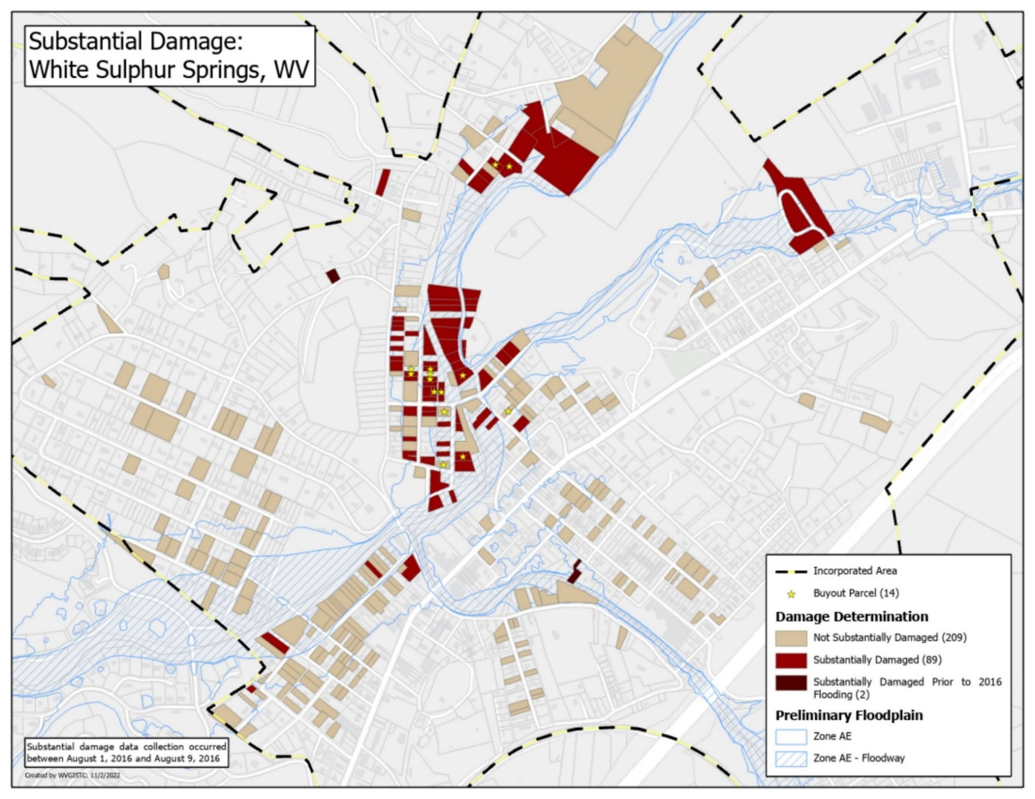
Substantial Damage (2016 Flood – Field Surveys)
White Sulphur Springs
89 Substantial Damaged
Structures
2016 Flood

Slide 39
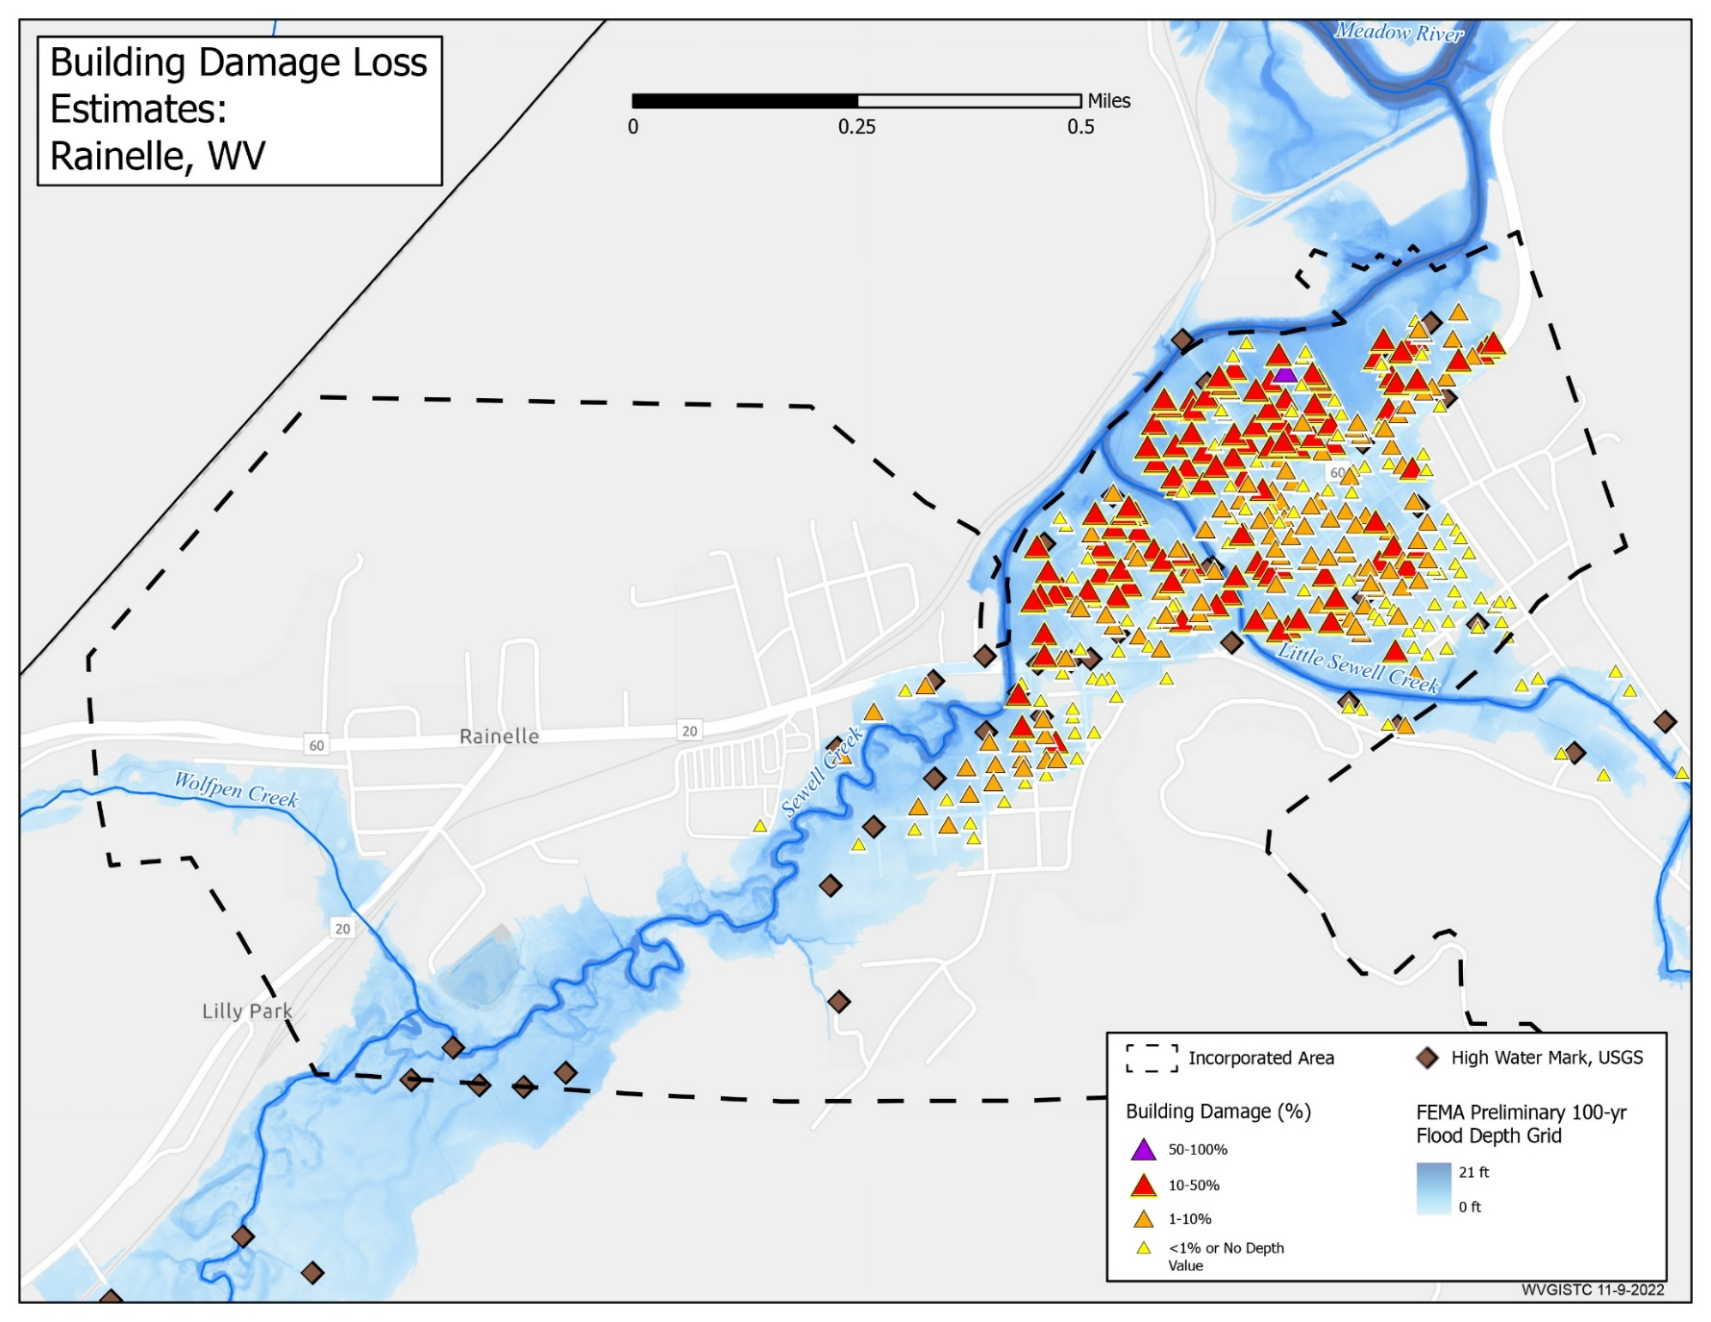
Building Damage Loss Estimates
Rainelle
Substantial Damage
Estimates
Hazus Loss Models for 1% Annual Chance (100-yr) Flood

Slide 40
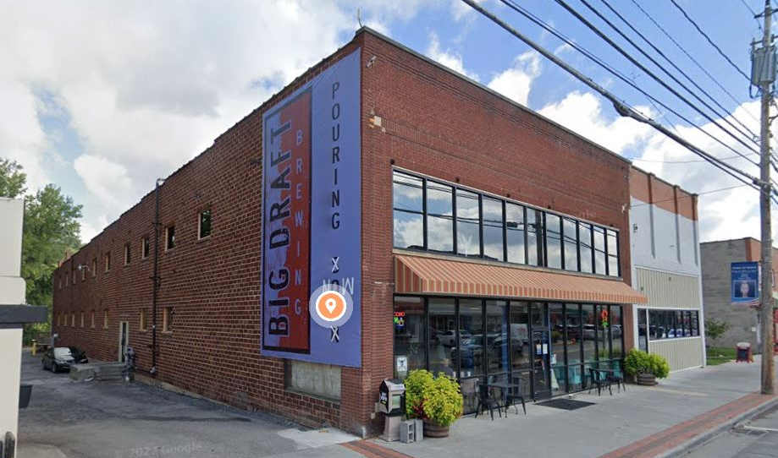
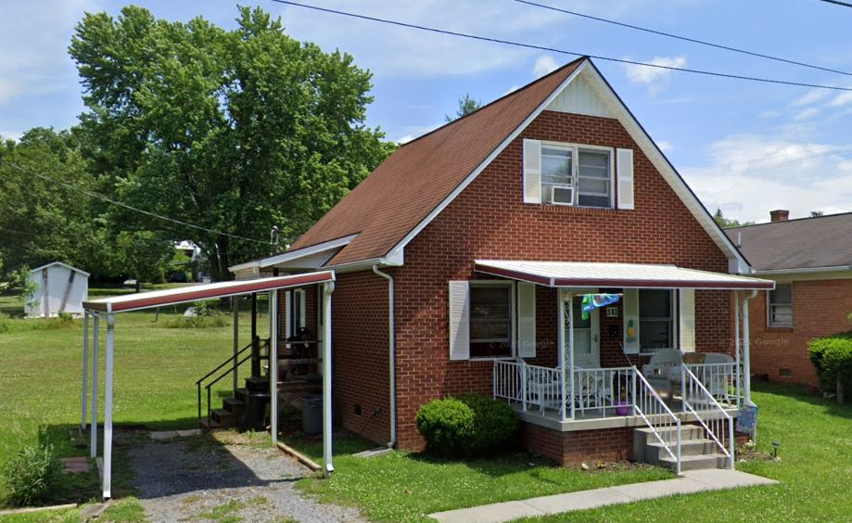
Structures with High Building Loss
White Sulphur Springs
Highest Building Loss (USD)
in White Sulphur Springs:
Building ID: 13-17-0008-0186-0000_703
Hazard Occupancy Class: COM8 (Restaurant)
FIRM Status: Pre-FIRM (1968)
Water Depth in Structure: 1.2 ft (minus rated -1 ft)
Appraised Value: $1,422,200
Estimated Building Loss: $133,687
Building Damage Percentage: 10%
Flood Tool Link
Structure
Damage
Loss
Estimates
Highest Building Damage Percentage
in White Sulphur Springs:
Building ID: 13-17-0008-0435-0000_382
Hazard Occupancy Class: RES1 (Residential 1 Family)
FIRM Status: Post-FIRM (1988)
Water Depth in Structure: 3.9 ft (minus rated -4 ft)
Appraised Value: $62,200
Estimated Building Loss: $28,799
Building Damage Percentage: 46%
Flood Tool Link

Slide 41
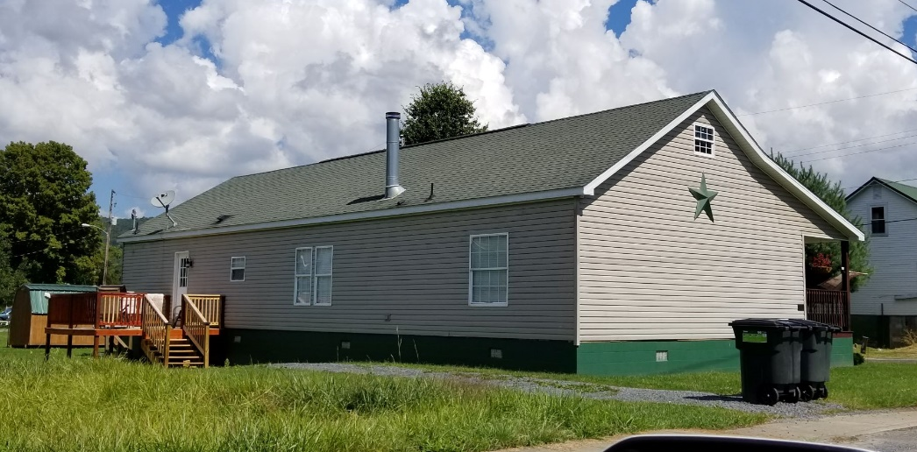

Structures with High Building Loss
Rainelle
Highest Building Loss (USD)
in Rainelle:
Building ID: 13-13-0001-0077-0000_144
Hazard Occupancy Class: RES1 (Residential 1 Family)
FIRM Status: Post-FIRM regulated to Pre-FIRM (2005)
Water Depth in Structure: 3.7 ft (minus rated -4 ft)
Appraised Value: $92,800
Estimated Building Loss: $41,667
Building Damage Percentage: 45%
Flood Tool Link
Structure
Damage
Loss
Estimates
Highest Building Damage Percentage
in Rainelle:
Building ID: 13-13-0001-0091-0000_435
Hazard Occupancy Class: RES2 (Mobile Home)
FIRM Status: Pre-FIRM (1973)
Water Depth in Structure: 2.7 ft (minus rated -3 ft)
Appraised Value: $11,600
Estimated Building Loss: $8,120
Building Damage Percentage: 70%
Flood Tool Link

Slide 42
Human Flood Loss
White Sulphur Springs and Rainelle
Category | Loss Indicator | White Sulphur Springs | Rainelle | Rate* in WV Incorporated Areas (2021)
Human Loss By 1%-Annual-Chance Flood Event | Displaced Population Estimates | 481 (Rank: 17th) | 492 (Rank: 16th) | 173 (Avg.)
 | Estimated Population in Need of Short-Term Shelter | 104 (Rank: 18th) | 123 (Rank: 14th) | 37 (Avg.)
Population Displacement Estimates
Risk Factor Findings
* For numbers and dollar values, used median, or average where the median was zero or too low, in the state’s 213 incorporated areas
** Ranks mentioned based on the BLRA data of April 2022 where the community is among the top 20 incorporated areas in WV
The red texts show large difference, to the risk side, from the state ratios.
The green texts show large difference, to the resilience side, from the state ratios.

Slide 43
Criteria, Rationale, and Data Sources
Exposure Indicator | Criteria | Rationale | Data Source
Total Primary Building Count in Floodplain | All primary insurable structures in the Special Flood Hazard Area (SFHA)* or 100-year floodplain | Higher number of buildings in the floodplain indicates higher physical and human exposure and flood risk in a community. | BLRA of 10/19/2022 (based on 2022 tax assessment) & FEMA FIRM (2012 & 2022)
Building Ratio b/w Floodplain & Community Total | Ratio of the primary buildings in the floodplain to all E911 addresses in community |  | BLRA of 10/19/2022 (based on 2022 tax assessment) & E911 Addresses from Statewide Addressing and Mapping System (SAMS) 2021
Total Primary Building Value in Floodplain of Community | Sum & median appraised values of all primary structures in floodplains | Higher building values increase substantial damage thresholds and mitigation reconstruction costs. | BLRA of 10/19/2022 (based on 2022 tax assessment) & FEMA FIRM (2012 & 2022)
Median Building Value in Floodplain
Building Count in Floodway (High Velocity & Depth) | Primary buildings intersecting either floodways of 2012 or 2022 (effective or advisory) | Buildings in the main floodway channel of the river or stream, or close to the flood source, will be subject to the greatest flood depths, highest velocities, and greatest debris potential. | BLRA of 10/19/2022 (based on 2022 tax assessment) & FEMA FIRM (2012 & 2022)
Percent Count in Floodway (High Velocity & Depth)
Count Mapped in SFHA | Primary buildings that most likely will be included in the SFHA when future FEMA Restudies are done and new FIRMs become effective. | Communities should review all "mapped-in" structures. Homeowners are at higher risk to flooding and should be contacted about Flood Insurance Preferred Risk Policies and other potential mitigation measures. | BLRA of 10/19/2022 (based on 2022 tax assessment) & FEMA FIRM (2012 & 2022)
Percent Count Mapped in SFHA
Count Mapped out SFHA | Primary buildings no longer located within the high-risk flood zones of 2022 | The flood risk has only been reduced, not removed and flood insurance coverage is still recommended. | BLRA of 10/19/2022 (based on 2022 tax assessment) & FEMA FIRM (2012 & 2022)
Percent Count Mapped out SFHA
Owner Occupied Residential Buildings in Floodplain | Residential buildings occupied by owners (tax class 2) | Renters may not have flood insurance and be at higher risk. Renters may have less long-term commitment to the community. | BLRA of 10/19/2022 (based on 2022 tax assessment)
Percent Owner Occupied Residential Buildings in Floodplain
Rationale & Metadata
for
Risk Factor Findings
* SFHA includes both the high-risk effective and advisory 1%-annual chance floodplains.

Slide 44
Flood Characteristics
Flood Characteristics Impacting Community
Frequency: Probability that a flood of a specific size will be equaled or exceeded in any given year
  5-, 10-, 20-, 25-, 50-, 100-, and 500-year flood elevations (above sea level) refer to expected water levels of the 20%, 10%, 5%, 4%, 2%, 1%, and 0.2% annual chance flood events. A 1000-yr flood has a 0.1% chance of happening in any given year.
  FEMA’s 1%+ flood elevations measure how high the 100-year flood could be given the statistical uncertainties in flood modeling. It represents the upper 84-percent confidence limit of the statistical error for calculating the 1-percent annual chance event.
  The relative frequency of any given flood (e.g., 5-year or 10-year) serves as a useful reference point when selecting a mitigation options and evaluating cost effectiveness.
Depth: Flood depth or water surface elevation above the ground surface
  Critical during design considerations, as it is often the primary factor in evaluating the potential for flood damage
  Flood depth sources include flood models and high-water marks which measure the degree of flooding
Velocity: Speed at which the floodwaters are flowing
  Flowing water often causes erosion and scour, as well as debris impacts and hydrodynamic forces.
  FEMA’s detailed engineering studies provide river/stream flows
Duration: Measure of how long water remains above normal levels.
  Prolonged contact with floodwaters may make some mitigation measures, including dry flood-proofing, inappropriate because of the increased chance of seepage and potential structural failure.
  Long periods of inundation are more likely to cause greater damage to structural members and finishes than short periods of flooding.
Rate of Floodwater Rise and Fall: Floodwater that rises very quickly with little or now warning
  Steep topography and locations with small drainage areas may experience flash flooding in which floodwater can rise very quickly with little or no warning.
  High-velocity water flows usually accompany flash floods and preclude certain types of flood mitigation measures, especially those requiring human intervention
  Rapid rates of the rise and fall of floodwater can also lead to unequal hydrostatic pressures on a building. The probability of unequal hydrostatic pressures increases when building exteriors are designed to be watertight
Historical Information: Use past information like the high-water marks of the 2016 Flood as an indication of the nature and severity of effects likely to occur during future events.
Hazard Characteristics
Risk Factor Findings
Source: FEMA 2013

Slide 45
Flood Characteristics
Category | Flood Characteristic | White Sulphur Springs | Rainelle
Frequency (new flood maps) | Probability that a flood of a specific size will be equaled or exceeded in any given year
 | FEMA Flood Models: 10-, 25-, 50-, 100-, 100+, and 500-year flood elevations. FEMA’s 1%+ flood elevations measure how high the 100-year flood could be given the statistical uncertainties in flood modeling (upper 84-percent confidence limit). | See models | See models
 | First Street Foundation Flood Models: 5-, 20-, 100-, and 500-year flood elevations. Climate models based on 2052 or 30 years in the future. | See models | See models
Depth | Flood depth or water surface elevation above the ground surface. Source USGS high-water marks. | 6 feet | 8 feet
Velocity | Speed at which the floodwaters are flowing | High | Moderate
Duration | Measure of how long water remains above normal levels | 24 hours | 72 hours
Rise and Fall | Floodwater that rises very quickly with little or no warning | Quick Rise | Quick Rise
Riverine Hazard
Risk Factor Findings
Notes: Flood characteristics are based on the 2016 flood and FEMA’s new flood studies

Slide 46



Rainelle: Sewell Creek Flood Study Profile
2022 Preliminary 1% Base Flood (100-Yr) Elevation 1850.7 ft for Building 13-17-0009-0026-0000_138
New 2022 FEMA Maps
The 2012 FEMA flood maps were incomplete in that the high-risk flood areas were not fully mapped. The floodplain narrowed significantly and most of the town was no longer in the Special Flood Hazard Area (SFHA).
The 2022 base flood elevation (100-yr) for a majority of Rainelle between 1st and 14th Streets is 2,393 feet. A similar base flood elevation was mapped for the 1987 flood maps for structures northwest of Main Street (U.S. 60).
The “1-percent plus” is a measure of how high the 1% flood could be given the statistical uncertainties in flood modeling. The backwater flooding from Meadow River results in more uncertainty of the flood model and thus a wider confidence level. The 1%+ flood elevation is six feet higher than 1% elevation and same as the 02%.
High-Water Backwater Inundation & Duration
Risk Factor Findings
Confluence of Little Sewell Creek
Confluence of Wolfren Creek
182 7th Street
(Bldg.13-13-0001-0054-0000_182
2016 Flood
2,396.4 ft.
(BFE + 3.4 ft. to reach HWM)
The "Regulatory Floodway" is the channel of a river or other watercourse and the adjacent land areas that must be reserved in order to discharge the base flood without cumulatively increasing the water surface elevation more than a designated height. Source: FEMA
Sewell Creek 2022 Flood Study Profile

Slide 47

WSS: Howard Creek Flood Study Profile
2022 Preliminary 1% Base Flood (100-Yr) Elevation 1850.7 ft for Building 13-17-0009-0026-0000_138
Flood Velocity
Debris and Ponding at Bridges
Risk Factor Findings
Preliminary 2022 FEMA Maps
2022 Base Flood Elevation increased 1 to 1.5 feet from the 2012 FEMA Map between Dry Creek Bridge (Big Draft Rd) and Wades Creek Bridge (Garden St)
Confluence of Dry Creek
Confluence of Wades Creek
For bridges shown on the flood profile, the structure is represented by an “I” symbol. The top of the bridge symbol represents the top of road and the bottom of the symbol represents the low chord (or low steel) of the bridge.
Bldg. 13-17-0009-0026-0000_138
1% WSEL 1850.7 ft.
3.5’ ponding upslope
of Big Draft Bridge
1.5’ ponding upslope
of Garden Street Bridge
2016 Flood
1,852.5 ft.
(BFE + 1.8 ft. to reach HWM)
https://data.wvgis.wvu.edu/pub/NSF/FloodProfiles/54025CV002B.pdf#page=43
FEMA FIS Technical Reference 2019

Slide 48
FEMA & FSF Models: Frequency and Magnitude
Frequency: Probability that a flood of a specific size will be equaled or exceeded in any given year.
5-, 10-, 20-, 25-, 50-, 100-, and 500-year flood elevations (above sea level) refer to expected water levels of the 20%, 10%, 5%, 4%, 2%, 1%, and 0.2% annual chance flood events.
FEMA |  |  |  |  | First Street Foundation (FSF)
Return period or Flood Size | Annual Probability | Cumulative Probability - Flooding at least once over 30 years | FEMA Risk Description |  | Return period or Flood Size (2022, 2037, 2052)* | Annual Probability (flooding at least 1 cm) | Cumulative Probability - Flooding at least once over 30 years | First Street Risk Description
 | 0.2% + 1 ft. |  | Risk
500 yr (1 in 500) | 0.2% | 6% | Moderate Risk |  | 500 yr (1 in 500) | 0.2% | >0% | Any Risk
100 yr (1 in 100) Plus confidence error | 1%+
100 yr (1 in 100) | 1% | 26% | High Risk |  | 100 yr (1 in 100) | 1% | >26% | Substantial Risk
50 yr (1 in 50) | 2% | 45% | High Risk
25 yr (1 in 25) | 4% | 71% | High Risk
 |  |  |  |  | 20 yr (1 in 20) | 5% | >85%
10 yr (1 in 10) | 10% | 96% | High Risk
 |  |  |  |  | 5 yr (1 in 5) | 20% | >99% | Almost Certain Risk
Climate scenarios: Above High-Water Marks, BFE + freeboard amount (2 to 4 ft.), 1%+ and 0.2% Return Periods
Climate scenarios available for 3 flood depth years (2022-today, 2037-15 years, 2052-30 years)
Riverine Hazard Models
2022 Flood Study Sources: FEMA and First Street Foundation (FSF)

Slide 49

FEMA Flood Models: Likelihood and Magnitude
FEMA Flood Models –
Flood Frequency
Risk Factor Findings

Slide 50

FSF Flood Models: Likelihood and Magnitude
FSF Flood Models –
Flood Frequency
Risk Factor Findings

Slide 51


FEMA and FSF Model Comparison - 1% Annual (100-yr) Chance
FEMA & FSF Flood Hazard Models: 100-yr Flood Frequency

Slide 52

2016 Flood Drone Video (Rainelle, WV)
Flood Depth
& Extent
Risk Factor Findings
Video Link
Notes: Drone Video flood elevation: 2,392.5 ft.; Base Flood (100-yr elevation) is 2,930.0 ft., or a half foot above video footage; 2016 Flood Elevation high-water mark: 2,396.4 ft. (about 4 feet higher than video); 500-yr Flood elevation is 2,399.0 ft. or 6.5 feet above video elevation.

Slide 53


FEMA 10% Annual Chance (10-year) Rainelle, WV
0 ft.
FLOOD DEPTH
35 ft.
96% probability of flooding at least once over 30 years
Notes:
FEMA 10year Aerial.
Segment 3. Viewshed-scale flood visualizations at different flood frequencies and magnitudes
Flood visualization products effectively communicate various flood characteristics to the public. Inundation maps at the viewshed or bird’s eye level portray riverine flood models of different flood frequencies and magnitudes. Flood models can be visualized at the community or viewshed map scale as seen here…
<< GROUP 3: Flood Visualization at Viewshed Level (5 slides) >>
Flood Visualizations and movies are performed at different map scales from viewshed views seen here to the flood impacts at the building level.

Slide 54

FEMA 4% Annual Chance (25-year) Rainelle, WV
0 ft.
FLOOD DEPTH
35 ft.
71% probability of flooding at least once over 30 years
Notes:
FEMA 25year Aerial

Slide 55

FEMA 2% Annual Chance (50-year) Rainelle, WV
0 ft.
FLOOD DEPTH
35 ft.
45% probability of flooding at least once over 30 years
Notes:
FEMA 50year Aerial

Slide 56

FEMA 1% Annual Chance (100-year) Rainelle, WV
0 ft.
FLOOD DEPTH
35 ft.
26% probability of flooding at least once over 30 years
Notes:
FEMA 100year Aerial

Slide 57

FEMA 0.2% Annual Chance (500-year) Rainelle, WV
0 ft.
FLOOD DEPTH
35 ft.
6% probability of flooding at least once over 30 years
Notes:
FEMA 500year Aerial

Slide 58


Mitigation Reconstruction (Rainelle, WV)
First Floor Height BELOW: FEMA/FSF 0.2-percent chance (500-yr) floods
First Floor Height ABOVE: FEMA 1% Chance (100-yr) flood; 2016 Flood HWM
Flood Depths marked on Mitigated Structure
FEMA
First Street Foundation (FSF)
USGS 2016 Flood High Water Mark
12.2’ (FSF 0.2% / 500-Yr )
9.9’ (FEMA; 0.2% / 500-Yr)
6.5’ (2016 High Water)
3.9’ (FEMA 1% / 100-Yr)
Flood Visualization (8 ft.)
Notes:
Segment 4. Building-scale flood visualizations at different flood frequencies and magnitudes
Or different flood depths or flood elevations can be visualized at the building level. New FEMA flood maps for the town of Rainelle reveal that the mitigated structure above is a risk for the 1%+ (100-yr plus) and 0.2-percent chance (500-yr) floods. Field verification of communities in Greenbrier County show that for most mitigation reconstruction implemented since the 2016 flood, residential structures - like this one in Rainelle shown here - were elevated to the proper design flood elevation in accordance with local floodplain management regulations. However, flood models show that certain elevated structures are still vulnerable to riverine flooding, such as a major 500-yr flood event or for models impacted by climate change.
<< GROUP 4 Flood Visualization at Building Level (4 slides) >>

Slide 59

Flood Visualization 4 feet
First Floor Height ABOVE: 1% Chance (100-yr) flood

Slide 60

Flood Visualization 7 feet
First Floor Height ABOVE: 2016 Flood High Water Mark

Slide 61

Flood Visualization 10 feet
First Floor Height BELOW: 0.2% Chance (500-yr) Flood Models

Slide 62

WSS Mitigation Reconstruction
First Floor Height (FFH) ABOVE 1-percent chance (100-yr) flood
First Floor BELOW 2016 HWM; 1%+,0.2-percent chance (500-yr) floods
 | HEIGHT (ft.)
BUILDING
First Flood Height | 6.4
Freeboard (FBD) | 2.0
FLOOD DEPTH
FSF 20% (5-Yr) | 3.4
FEMA 1% (100-Yr) | 5.4
FSF 1% (100-Yr) | 5.7
FEMA 1%+; Climate (BFE + 1ft) | 6.4
2016 Flood HWM | 6.5
FEMA 0.2% (500-Yr) | 7.2
FEMA 100-Yr + FBD | 7.4
FSF 0.2% (500-Yr) | 7.4
7.2’ (FEMA 0.2% / 500-Yr )
7.4’ (FEMA 1% / 100-Yr + 2’ FBD)
7.4’ (FSF 0.2% / 500-Yr)
6.5’ (2016 High Water)
6.4’ (FEMA 1%+; Climate BFE+1)
5.4’ (FEMA 1% / 100-Yr)
Building 13-17-0009-0026-0000_138
3.4’ (FSF 20% / 5-Yr)
138 Mill Street, White Sulphur Springs, WV, 24986
FLOOD DEPTHS:
FEMA
First Street Foundation (FSF)
USGS 2016 Flood High Water Mark

Slide 63


Flood Mitigation Map
White Sulphur Springs
Map
Legend

Slide 64


Pre-Disaster 2016 Aerial View
White Sulphur Springs
Imagery of June 2016
Flood
Resiliency Factors
Image courtesy of Google Earth Pro

Slide 65



Structures Removed Post-Disaster
White Sulphur Springs
Imagery of June 2016
Building REMOVED (Vacant Parcel)
Image courtesy of Google Earth Pro & Google Street View

Slide 66



Structures Acquired for Buyouts
White Sulphur Springs
Imagery of Oct. 2019
Buyout Property
ACQUISITION or Buyout Property
Image courtesy of Google Earth Pro & Google Street View

Slide 67


Structures Repaired (Non-Mitigated)
White Sulphur Springs
Imagery of Oct. 2019
Substantially Damaged Structure Repaired
REPAIRED of Substantially Damaged (>50%) Building
Image courtesy of Google Earth Pro & Google Street View

Slide 68



Structures Reconstructed (Mitigated) Reconstruction)
White Sulphur Springs
Imagery of Oct. 2019
Elevated Structure (with flood vents)
Mitigation RECONSTRUCTION
Image courtesy of Google Earth Pro & Google Street View

Slide 69

Mitigated and Non-Mitigated Properties
White Sulphur Springs
Imagery of Oct. 2019
Flood
Resiliency Factors
Building REMOVED (Vacant Parcel)
ACQUISITION or Buyout Property
REPAIRED of Substantially Damaged (>50%) Building
Mitigation RECONSTRUCTION
Image courtesy of Google Earth Pro

Slide 70



Examples of Mitigation Reconstruction
in White Sulphur Springs
Building ID: 13-17-0009-0009-0000_148
Flood Tool Link
Building ID: 13-17-0009-0009-0000_148
Flood Tool Link
Building ID: 13-17-0008-0152-0000_195
Flood Tool Link

Slide 71



Example of Mitigation Reconstruction
in Rainelle
Building ID: 13-13-0005-0165-0000_256
Flood Tool Link
Building ID: 13-13-0001-0069-0000_108
Flood Tool Link
Building ID: 13-13-0001-0054-0000_182
Flood Tool Link

Slide 72




Partial Mitigation Examples
Elevated
No flood vents
Mechanicals at ground level
Flood vents < 1ft from ground
Elevated (potentially to BFE), but not to DFE (highest depth for structure = 2.5 ft)
Mechanicals at ground level
354 Horton Ave. E, Rainelle, WV, 25962
Some flood vents < 1 ft from ground
Some vents > 1ft from ground; Elevated but not to BFE (3.4 ft)
Mechanicals at ground level
Flood vents < 1 ft from ground
Mechanicals elevated
Elevated, but not to BFE (3.9 ft)
184 Central Venue, White Sulphur Springs, WV, 24986
190 Crescent Avenue, White Sulphur Springs, WV, 24986

Slide 73
Unmitigated Example
in White Sulphur Springs
First Floor Height (FFH) BELOW FEMA 1-percent chance (100-yr) flood
First Floor BELOW 2016 HWM; 1%+,0.2-percent chance (500-yr) floods
 | HEIGHT (ft.)
BUILDING
First Floor Height | 2.0
Freeboard (FBD) | 2.0
FLOOD DEPTH
FSF 20% (5-Yr) | 0.0
FSF 1% (100-Yr) | 1.5
FSF 0.2% (500-Yr) | 3.4
FEMA 1% (100-Yr) | 4.0
2016 Flood HWM | 4.0
FEMA 1%+ (Climate) | 4.5
FEMA 0.2% (500-Yr) | 5.3
FEMA 100-Yr + FBD | 6.0
6.0’ (FEMA 1% / 100-Yr + 2’ FBD)
4.5’ (FEMA 1%+; Climate)
5.3’ (FEMA 0.2% / 500-Yr )
4.0’ (FEMA 1% / 100-Yr)
3.4’ (FSF 0.2% / 500-Yr)
4.0’ (2016 High Water)
1.5’ (FSF 1% / 100-Yr)
220 Central Avenue, White Sulphur Springs, WV, 24986
Building 13-17-0008-0139-0000_220
FLOOD DEPTHS:
FEMA
First Street Foundation (FSF)
USGS 2016 Flood High Water Mark

Slide 74

Unmitigated Example
in Rainelle
First Floor Height (FFH) BELOW FEMA 1-percent chance (100-yr) flood
First Floor BELOW 2016 HWM; 1%+,0.2-percent chance (500-yr) floods
 | HEIGHT (ft.)
BUILDING
First Floor Height | 0.0
Freeboard (FBD) | 2.0
FLOOD DEPTH
FSF 20% (5-Yr) | 2.1
FEMA 1% (100-Yr) | 4.0
FEMA 100-Yr + FBD | 6.0
FSF 1% (100-Yr) | 8.1
2016 Flood HWM | 8.3
FEMA 0.2% (500-Yr) | 9.9
FEMA 1%+ (Climate) | 10.1
FSF 0.2% (500-Yr) | 12.1
12.1’ (FSF 0.2% / 500-Yr)
9.9’ (FEMA 0.2% / 500-Yr )
10.1’ (FEMA 1%+; Climate)
8.1’ (FSF 1% / 100-Yr)
8.3’ (2016 High Water)
6.0’ (FEMA 1% / 100-Yr + 2’ FBD)
4.0’ (FEMA 1% / 100-Yr)
2.1’ (FSF 1% / 100-Yr)
Building 13-13-0001-0047-0000_166
166 7th Street, Rainelle, WV, 25962
FLOOD DEPTHS:
FEMA
First Street Foundation (FSF)
USGS 2016 Flood High Water Mark

Slide 75

Rainelle Relocation Community

Slide 76

WSS Relocation Community

Slide 77

Damage (2016 Flood) and Mitigation
Freeland Ave., White Sulphur Springs

Slide 78
Community Recovery: Building Value
White Sulphur Spring
Rainelle
COMMUNITY | 2015 | 2016 | 2017 | 2018 | 2019 | 2020 | 2021 | 2022
Rainelle (n=326) | 13.1 Million | 13.3 Million | 5.0 Million | 9.4 Million | 11.0 Million | 11.1 Million | 11.3 Million | 12.3 Million
White Sulphur Springs (n=409) | 22.6 Million | 23.0 Million | 13.4 Million | 21.5 Million | 22.4 Million | 22.9 Million | 26.2 Million | 29.2 Million

Slide 79



New Streamgages
in White Sulphur Springs and Rainelle

Slide 80

Rainelle: Building Design Flood Elevation
70% of structures in Rainelle are currently not built to DFE
Risk Factor Findings

Slide 81

WSS: Building Design Flood Elevation
42% of structures in Rainelle are currently not built to DFE
Risk Factor Findings

Slide 82


Areas of Mitigation Interests /
Repetitive Loss Areas
Repetitive Loss Areas
Substantial Damage Estimates
High-Water Marks
Buyout Properties
https://www.mapwv.gov/flood/map/?wkid=102100&x=-8669471&y=4802931&l=9&v=2

Slide 83

Areas of Mitigation (AoMI) Interest
PDF Map
PDF Map

Slide 84
Mitigation Measures
Category | Mitigation Indicator | White Sulphur Springs | Rainelle
Mitigated Structures | Mitigation Reconstruction or Elevated Structures to Design Flood Elevation (DFE) | 14 | 39
 | Rehabilitated/Repaired Structures | 394 | 278
 | Unmitigated Low Value Structures | 14 | 47
 | Structures Removed (vacant parcel) | 49 | 41
Open Space Preservation | Buyout Parcels (Deed Restricted) | 16 | 18
 | Community-Owned Vacant Parcels | 66 | 88
 | Area of Open Space Preservation (OSP) | 5 Acres | 3 Acres
 | Ratio of Open Space Preservation (OSP to SFHA) | 2.6% | 4.5%
Building Value Recovery | Net Value 2016-2022 Tax Assessment Value | + $6.1 Million | - $1.0 Million
Loss Avoidance 100-year Flood | Loss Avoidance by Elevating or Removing Structures (preliminary results) | $2.6 million | $2.3 million

Slide 85
Mitigation Measures (continued)
Category | Mitigation Indicator | White Sulphur Springs | Rainelle
Resiliency to Future Floods | Percent Residential Structures in 100-year floodplain NOT elevated to Design Flood Elevation (DFE) | 42% | 70%
Higher Standards | Freeboard (safety elevation factor above BFE) | 2 ft. | 2 ft.
 | Community Rating System (above min. requirements) | No | No
Floodplain Management | Incorporated Place a compacted floodplain management area to enforce floodplain ordinance | Yes | Yes
 | Continuity of operations and immediate response to disasters | Yes | No
 | Record keeping (permits, EC’s, substantial damage) | Yes | No
Flood Insurance | Number of Policies 2019 | 133 | 44
Risk Communications | Flood Risk Disclosure Laws in West Virginia | F grade | F grade
 | Outreach to property owners about changes to flood maps (mapped in/mapped out of SFHA) | ? | ?

Slide 86


Community Engagement
White Sulphur Springs, WV (11/17/2022)
Rainelle, WV (11/18/2022)
Feedback desired from Focus Groups:
  What lessons were learned from the immediate response and longer-term recovery from the 2016 flood?
  What priorities are needed for a stronger flood response and recovery plan in the event of a future flood?
Feedback of Flood Study Products:
  Flood Characteristics and Models
  Flood Risk Assessment (vulnerability, exposure, loss)
  Mitigation Maps
  Flood Visualization Tools
Notes:
The last partnership example with other university faculty highlights social scientist Jamie Shinn’s National Science Foundation research about the recovery and resiliency of two small communities in Greenbrier County – White Sulphur Springs and Rainelle – that were devastated by the 2016 flood. This research also supports a Community Outreach and Mitigation Strategies (COMS) project sponsored by FEMA Region III and the State Emergency Management Division to evaluate how various flood protection measures like mitigation reconstruction will adapt to the future impacts of climate change.
Last week, focus group meetings were led by Professor Shinn for these two communities to assess lessons learned from the 2016 flood and to identify ways to build resilience to future floods. The WV GIS Technical Center provided support by quantifying various risk factors facing these disadvantaged communities. This included presenting flood characteristics and new flood maps, vulnerability analysis, and quantifying mitigation measures implemented to date.

Slide 87



Statewide Landslide Hazard Assessment
Impacted Home
WV Flood Tool
Higher Risk
WV Landslide Tool
April 2020 Landslide
Wood County, WV
Impacted home moved from foundation
Landslide Susceptibility Zone
A statewide landslide susceptibility (high, moderate, low risk) map was created from FEMA-purchased QL2 LiDAR data
Landslide Susceptibility
Spring 2020 Imagery
Notes:
The state hazard mitigation plan identifies landslides as the number two hazard in West Virginia after flooding. A random forest machine learning model was developed by geography professor Aaron Maxwell to identify the variables that were most important for predicting landslide occurrence. A geologist and soil scientist from WVU were also partners of the research team to create the statewide landslide susceptibility map. These landslide susceptibility maps are accessible online and support local and state hazard mitigation plans.

