Slide 1
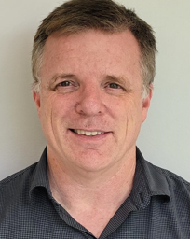
Kurt Donaldson
Insert photo
Manager
West Virginia GIS Technical Center
West Virginia University
FEMA Coffee Break: Utilizing University Partnerships in Hazard Mitigation Planning
November 23, 2022
Notes:
Kurt Donaldson is the manager of the WV GIS Technical Center located at West Virginia University. Since 2003, Mr. Donaldson has been a cooperating technical partner in support of FEMA’s NFIP and Risk MAP programs.

Slide 2

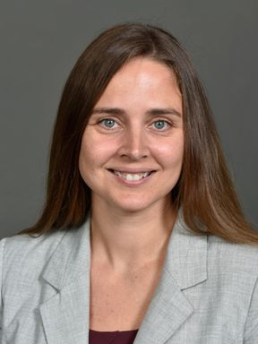
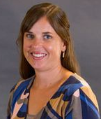
WVU Faculty Supporting Hazard Mitigation Projects
Partnerships among faculty members expand the subject matter expertise for hazard mitigation planning
HAZARD MITIGATION PROJECT | FUNDING SOURCE | FACULTY MEMBER | ORGANIZATION & EXPERTISE | LINK
Statewide Risk Assessments | HMGP, CTP | Kurt Donaldson | WVU GIS Technical Center (online interactive map viewing applications, TEIF/TEAL¹ risk assessments, flood visualizations) | WV Flood Tool Statewide RA Products & Data WV Region 3 Plan w TEIF data
Landslide Susceptibility Modeling | HMGP | Aaron Maxwell | WVU Geography Professor (landslide modeling, machine learning, remote sensing) | Published Landslide Paper
Flood Buyouts | NRCS | Katherine Garvey | WVU Land Use and Sustainability Law Clinic (legal and planning services) | Region 3 Resilience Report WV Public Broadcasting
Community Recovery and Resiliency | NSF | Jamie Shinn | WVU Geography Professor (social science, community engagement) | WV Public Broadcasting
¹ Total Exposure in Floodplain (TEIF), Total Exposure Area Landslide (TEAL)
Notes:
The following slides will show three examples of how the WV GIS Technical Center has partnered with other researchers, specifically Aaron Maxwell for statewide landslide susceptibility mapping, Kat Garvey for identifying flood buyouts in McDowell County, and Jamie Shinn for studying the recovery and resiliency of two small vulnerable communities in Greenbrier County. Web links in this table provide more information about these noteworthy partnership contributions from the other university research team members.

Slide 3
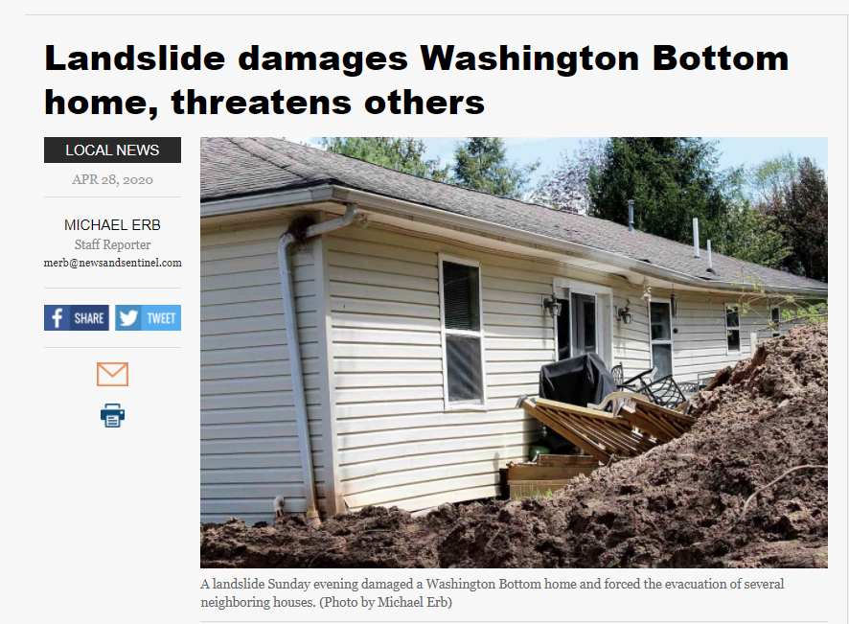
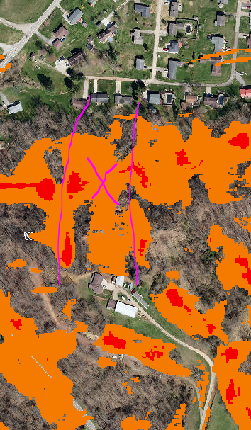
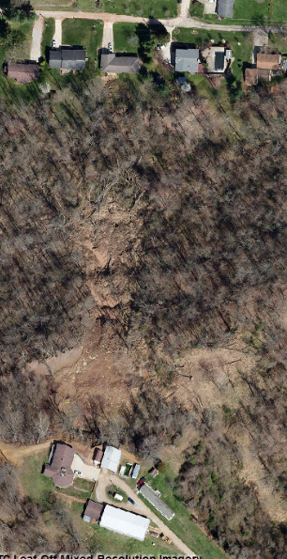
Example 1: Landslide Hazard Risk Assessment
Impacted Home
WV Flood Tool
Higher Risk
WV Landslide Tool
April 2020 Landslide
Wood County, WV
Impacted home moved from foundation
Landslide Susceptibility Zone
A statewide landslide susceptibility (high, moderate, low risk) map was created from FEMA-purchased QL2 LiDAR data
Landslide Susceptibility
Spring 2020 Imagery
Notes:
The state hazard mitigation plan identifies landslides as the number two hazard in West Virginia after flooding. A random forest machine learning model was developed by geography professor Aaron Maxwell to identify the variables that were most important for predicting landslide occurrence. A geologist and soil scientist from WVU were also partners of the research team to create the statewide landslide susceptibility map. These landslide susceptibility maps are accessible online and support local and state hazard mitigation plans.

Slide 4
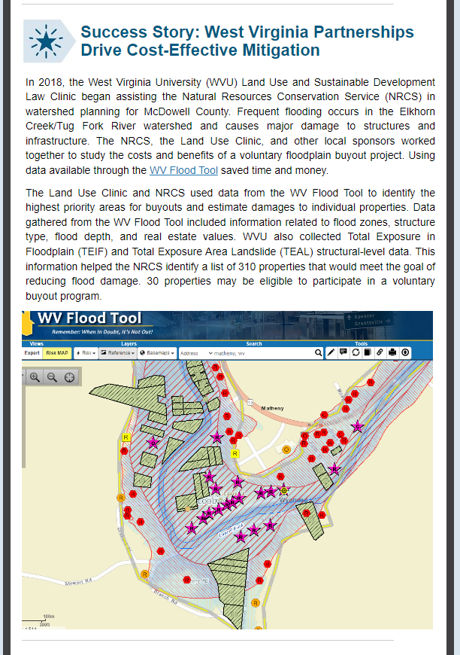
Example 2: Voluntary Floodplain Buyout Mitigation
FEMA R3 Resiliency Report | WVPBS | Buyout Report
WV Flood Tool: Building-Level Risk Assessments
Risk assessments using FEMA’s Hazus methodology helped NRCS identify 310 properties in McDowell County for flood buyouts
Notes:
Another partnership involved WVU’s Land Use-Law Clinic and the NRCS in identifying voluntary floodplain buyouts in McDowell County. The Law Clinic and NRCS used data from the WV Flood Tool to identify the highest priority areas for flood buyouts. Data gathered from the WV Flood Tool included information related to flood zones, structure type, flood depth, and real estate values. This month the U.S. Department of Agriculture announced that it will commit $2.8 million dollars in support of the flood buyouts identified in the flood reduction plan.

Slide 5
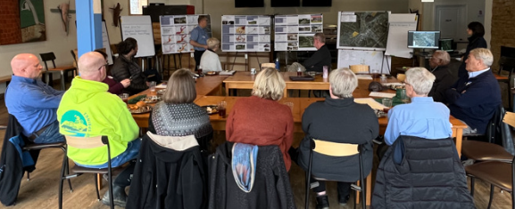
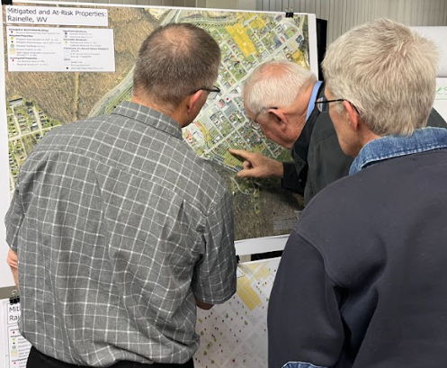
Example 3: Community Hazard Planning (Focus Group Meetings)
White Sulphur Springs, WV (11/17/2022)
Rainelle, WV (11/18/2022)
Feedback desired from Focus Groups:
  What lessons were learned from the immediate response and longer-term recovery from the 2016 flood?
  What priorities are needed for a stronger flood response and recovery plan in the event of a future flood?
Feedback of Flood Study Products:
  Flood Characteristics and Models
  Flood Risk Assessment (vulnerability, exposure, loss)
  Mitigation Maps
  Flood Visualization Tools
Notes:
The last partnership example with other university faculty highlights social scientist Jamie Shinn’s National Science Foundation research about the recovery and resiliency of two small communities in Greenbrier County – White Sulphur Springs and Rainelle – that were devastated by the 2016 flood. This research also supports a Community Outreach and Mitigation Strategies (COMS) project sponsored by FEMA Region III and the State Emergency Management Division to evaluate how various flood protection measures like mitigation reconstruction will adapt to the future impacts of climate change.
Last week, focus group meetings were led by Professor Shinn for these two communities to assess lessons learned from the 2016 flood and to identify ways to build resilience to future floods. The WV GIS Technical Center provided support by quantifying various risk factors facing these disadvantaged communities. This included presenting flood characteristics and new flood maps, vulnerability analysis, and quantifying mitigation measures implemented to date.

Slide 6
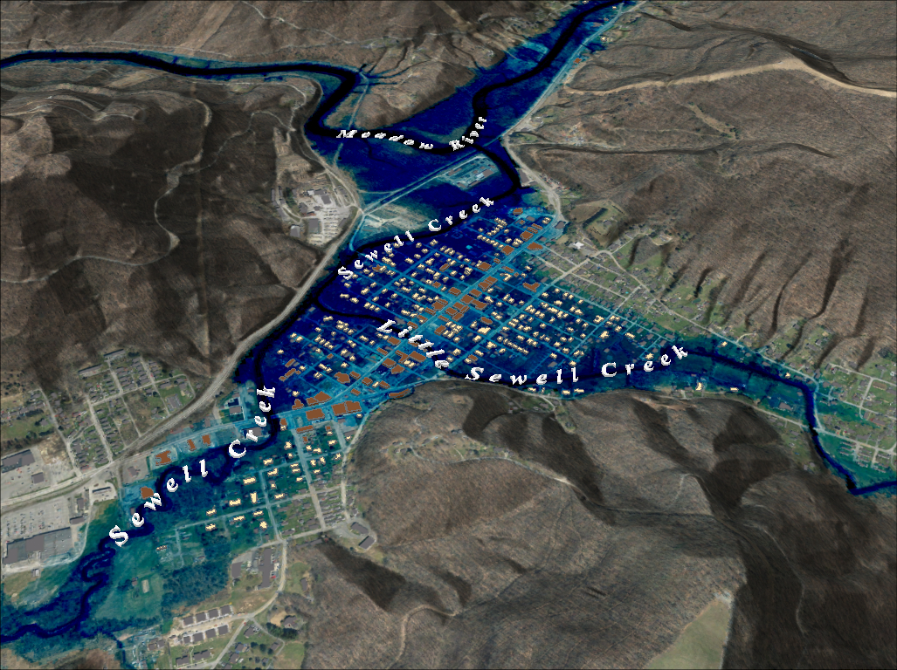


Example 3: Community Hazard Planning (Flood Characteristics)
FEMA 1%+ Annual Chance (Rainelle, WV)
Category | Flood Characteristic (in context to 2016 Flood) | White Sulphur Springs | Rainelle
Frequency (new flood maps) | Probability that a flood of a specific size will be equaled or exceeded in any given year. FEMA Flood Models (new): 10-, 25-, 50-, 100-, 100+, and 500-year flood elevations. First Street Foundation Flood Models: 5-, 20-, 100-, and 500-year flood elevations. | 2016 Flood Between 100- and 500-year FEMA Climate BFE+6ft FSF Climate 2052 or 30 years in the future | 2016 Flood Between 100- and 500-year FEMA Climate BFE+1ft FSF Climate 2052 or 30 years in the future
Depth | Flood depth. Source USGS high-water marks | 6 feet | 8 feet
Velocity | Speed at which the floodwaters are flowing | High | Moderate
Duration | Measure of how long water remains above normal levels | 24 hours | 72 hours
Rise and Fall | Floodwater that rises very quickly with little or no warning | Quick Rise | Quick Rise
Climate
Change
26% probability of flooding at least once over 30 years
Notes:
New flood maps and flood characteristics were presented at the community meetings in the context of the 2016 flood. The community of Rainelle is vulnerable to higher flood depths for an extended period of time, while White Sulphur Springs is subject to greater flood velocity flows that rise and fall quickly. Incorporated into the riverine flood analysis are climate change models that show an anticipated increase in flooding over time.

Slide 7
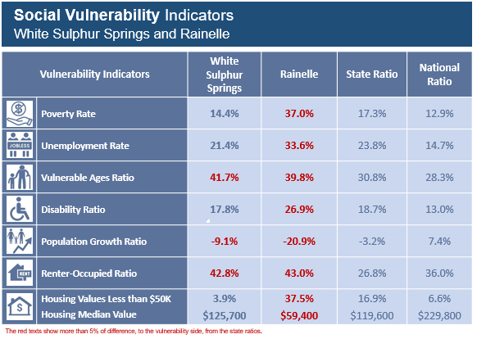
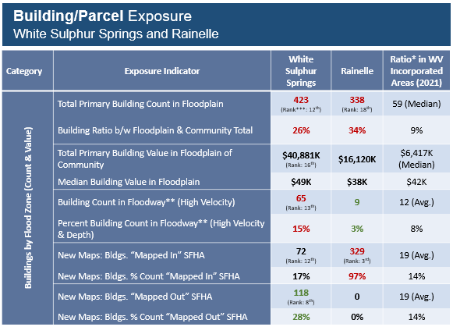
Example 3: Community Hazard Planning (Risk Indicators)
Vulnerability, Exposure, and Hazus Loss Indicators
for the disadvantaged communities of Rainelle and White Sulphur Springs
Notes:
Social vulnerability, exposure, and loss estimates were presented at the community meetings. Risk indicators of special concern are signified by red text, contrasted with state and national statistics, and the rationale explained on why particular risk factors make the community more vulnerable to flood hazards.

Slide 8
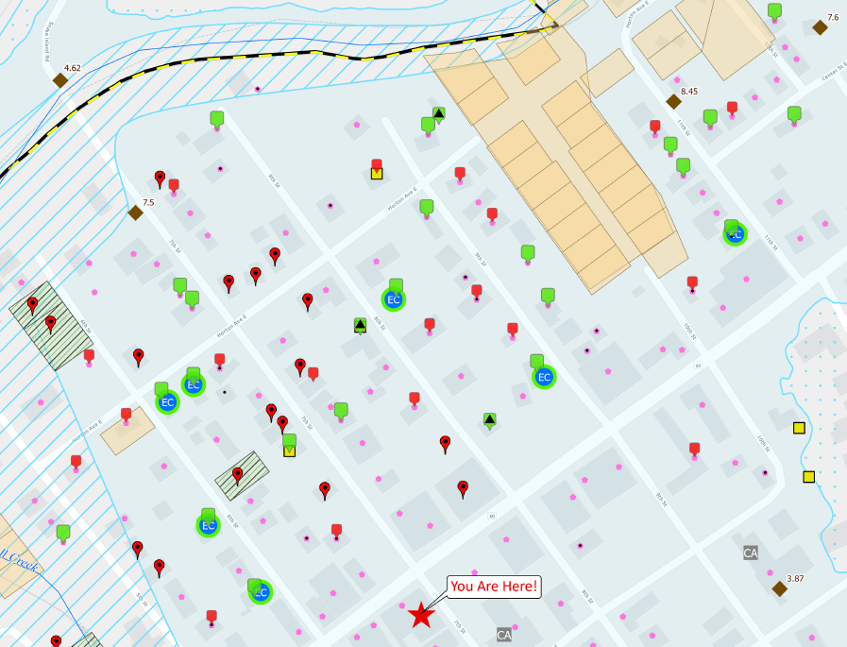
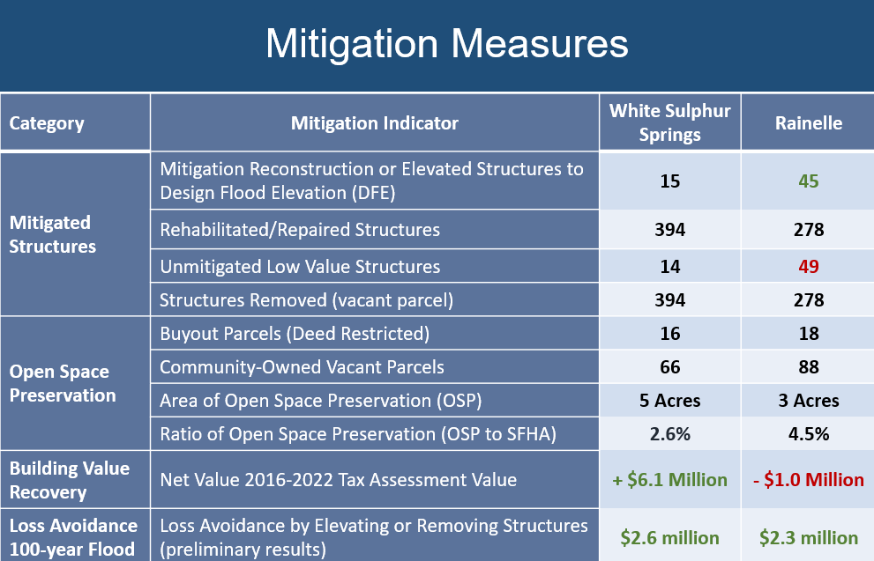
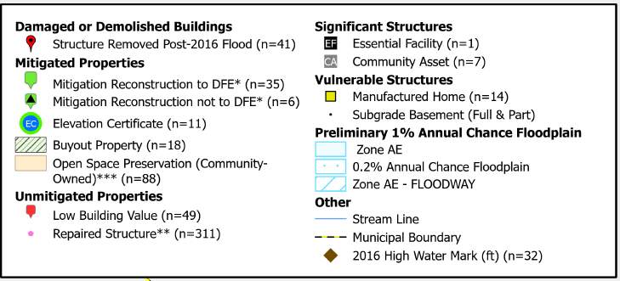
Example 3: Community Hazard Planning (Mitigation Measures)
Mitigation Map
(Rainelle, WV)
Field verification and analysis of mitigation measures implemented by property owners and the community in context of the 2016 flood and local floodplain management regulations
Notes:
Mitigated measures implemented since the 2016 flood by the community were field verified and evaluated in accordance with the local floodplain management regulations. Field verification of both communities show that for most mitigation reconstruction projects, the new structures were built to the proper design flood elevations. However, field surveys shows that substantially damaged residential structures were often repaired but not elevated above the base flood elevation, and thus in violation of FEMA’s 50% Rule. To measure a community’s recovery and resiliency to future floods, the net cumulative tax assessment of floodplain building values pre- and post-disaster, along with loss avoidance studies of elevated structures and property buyouts, were calculated.

Slide 9
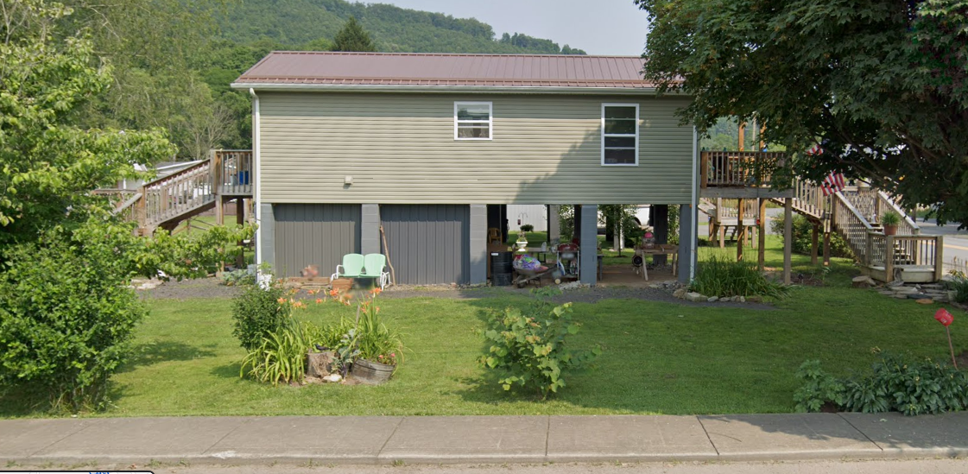
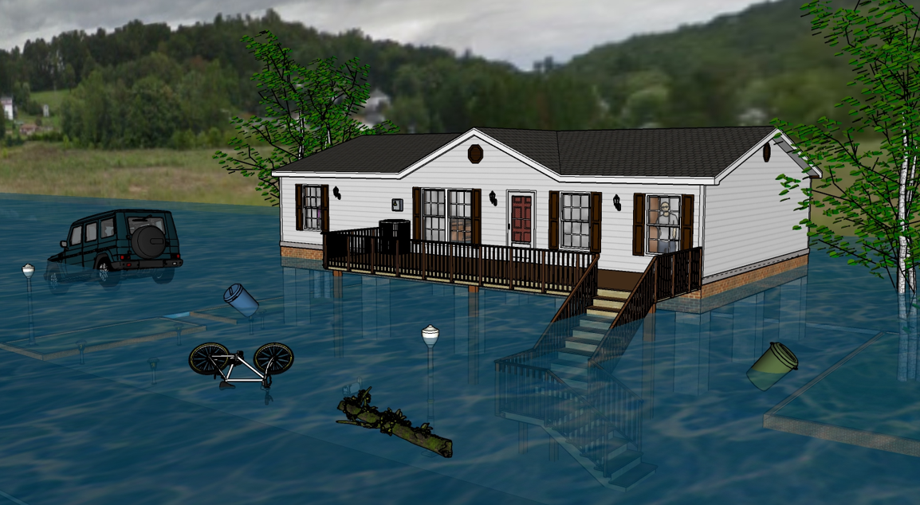
Mitigation Reconstruction: Resiliency to Future Floods (Climate Change)
 | HEIGHT (ft.)
BUILDING
First Flood Height | 9
Freeboard (FBD) | 2
FLOOD DEPTH
FSF 20% (5-Yr) | 2.3
FEMA 1% (100-Yr) | 3.9
FEMA 100-Yr + 2.0 Ft. Freeboard | 5.9
2016 Flood HWM | 6.5
FSF 1% (100-Yr) | 8.2
FEMA 1%+, 0.2% | 9.9
FSF 0.2% (500-Yr) | 12.2
Flood Depths marked on Mitigated Structure
FEMA
Building 13-13-0001-0054-0000_182
First Street Foundation (FSF)
USGS 2016 Flood High Water Mark
12.2’ (FSF 0.2% / 500-Yr )
9.9’ (FEMA 1%+ / 100-Yr; 0.2%)
8.2’ (FSF 1% / 100-Yr)
6.5’ (2016 High Water)
5.9’ (FEMA 1% + 2’ FBD)
3.9’ (FEMA 1% / 100-Yr)
2.3’ (FSF 20% / 5-Yr)
The Design Flood Elevation (DFE) should be the BFE plus 2 feet of freeboard. The DFE should also be above the high-water marks of the 2016 flood plus freeboard.
Flood Visualization (8 ft.)
182 Seventh Street, Rainelle, WV, 25962
How well are mitigated structures protected from changing environmental factors due to climate change? The new FEMA flood maps for Rainelle reveal that the mitigated structure above is a risk for the 1%+ (100-yr) and 0.2-percent chance (500-yr) floods.
Notes:
Both the findings and community feedback from this Greenbrier flood study project will be published in a report and submitted to the state and FEMA. This includes determining how well mitigated structures are protected from the impacts of climate change. Flood visualizations can be used to portray how protection measures like mitigation reconstruction will adapt to the future impacts of climate change.
In summary, partnerships among faculty members expand the subject matter expertise for hazard mitigation planning. Without support from other academic partners at West Virginia University, the scope of activities and accomplishments for various hazard mitigation projects would not be possible.

