Slide 1
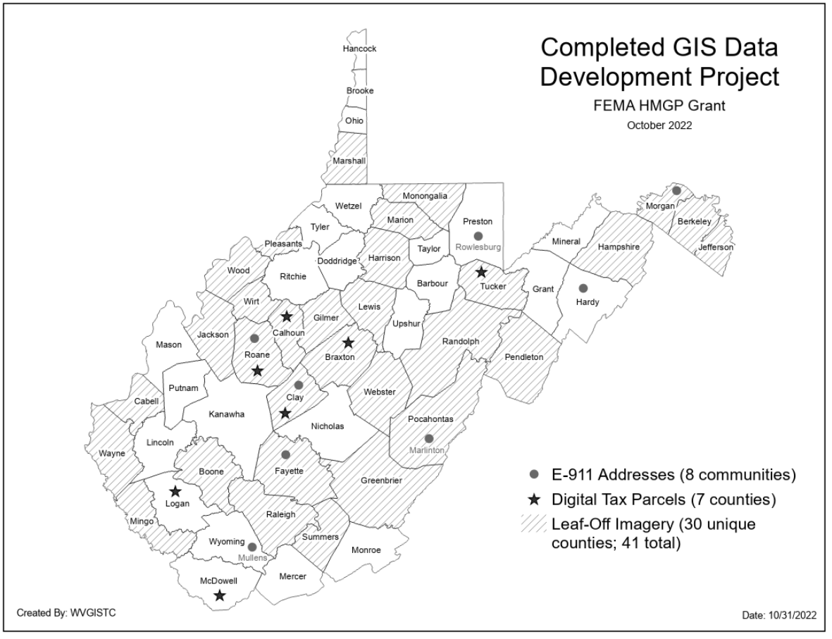
State Contracts for GIS Development
Completed GIS
Data Development Projects: Parcels, E-911 Addresses, & Aerial Imagery

Slide 2
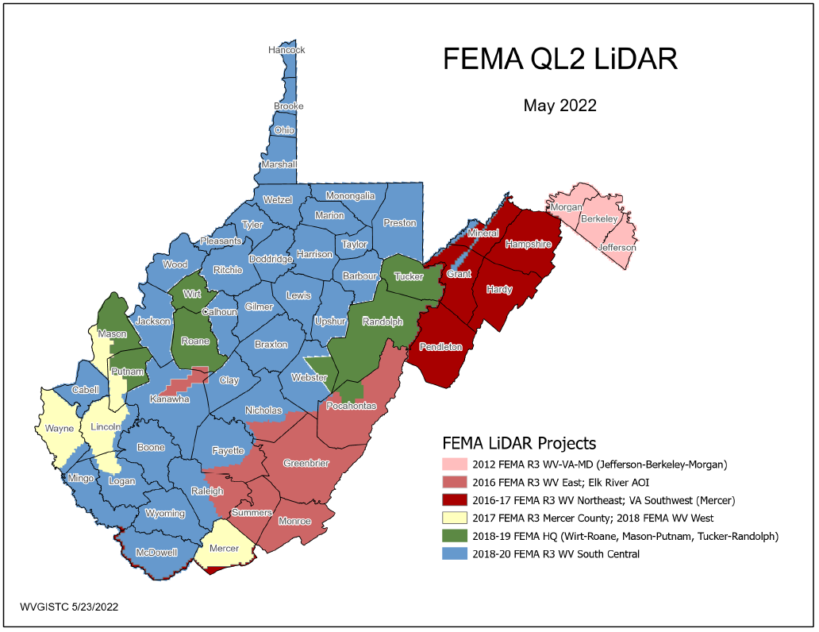
FEMA Purchased LiDAR Coverage
This past decade FEMA purchased $10 million QL2 LiDAR (2012-2020) consisting of six major project acquisitions
2020
2012
2017
2019
Quality 2 (QL2) LiDAR support 1-foot contours
2017
2016
2020
PDF Map

Slide 3
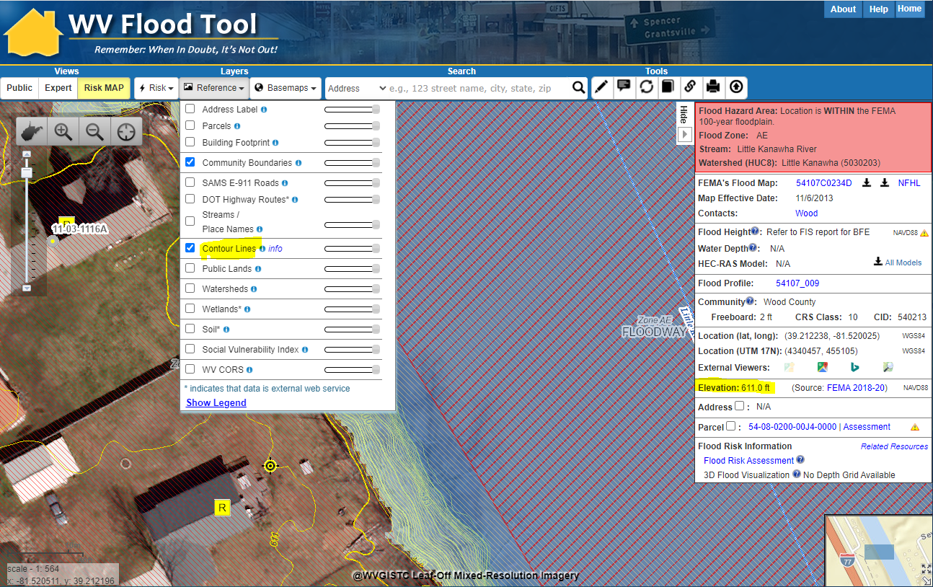
Ground Elevation: 1-ft. Contours
Make Contour Lines visible under REFERENCE LAYERS
1-FOOT CONTOUR ELEVATION VALUE OF 600 FEET MATCHES 1-METER GRID SURFACE ELEVATION OF 611 FEET DISPLAYED IN QUERY RESULTS PANEL
1-ft Contours Display at two Highest Zoom Levels (1:564 and 1:282 Map Scales)
Elevation: 611 ft.
Source: FEMA 2018-20
611 ft.
WV Flood Tool Link
High-resolution contours published for all counties
FEMA LiDAR-Derived Products: 1-Meter DEM and 1-Foot Contours

Slide 4
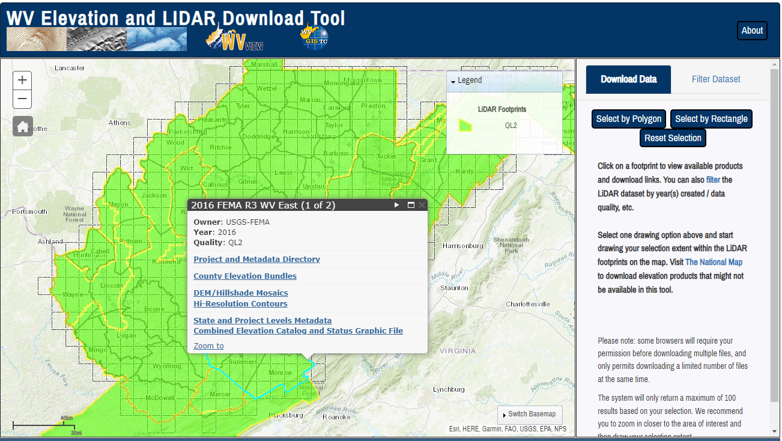
Elevation (High Resolution)
Statewide Elevation Products on WV Property Viewer and WV Flood Tool
Classified Lidar point cloud files
1-ft Contours cached to 1:282 Map Scale (2-ft. contours for Morgan-Berkeley-Jefferson)
1-meter Digital Elevation Model (created from LiDAR and breaklines)
Hillshade (grayscale 3D representation of the surface) and Slope
View products on WV Flood Tool and Property Viewer
Source Elevation Metadata: https://www.mapwv.gov/lidar-metadata
WV Elevation Download Tool: https://www.mapwv.gov/elevation
County Elevation Bundles (Lidar Point Cloud, Contours, DEM, Hillshade, Slope)
DEM Hillshade Mosaics
Hi-Resolution Contours
Compressed LiDAR LAS Files
State and Project Levels Metadata
USGS Elevation Download:
DEMs and Lidar point cloud files can be downloaded from the USGS National Map Download site as well

Slide 5
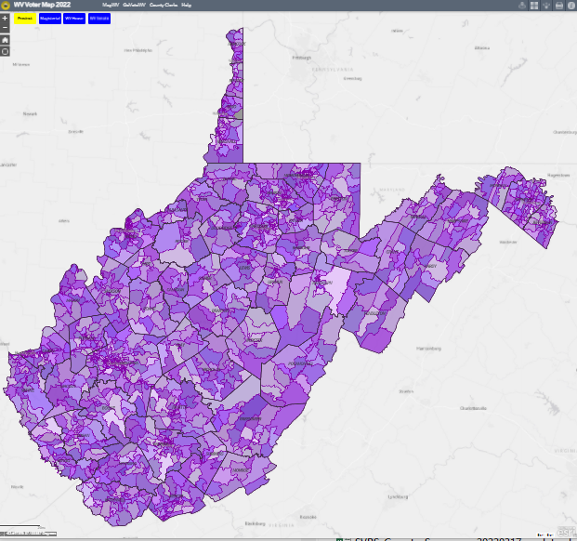
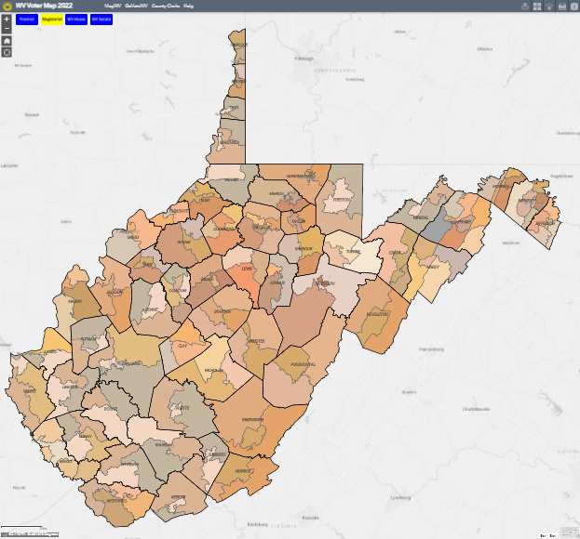
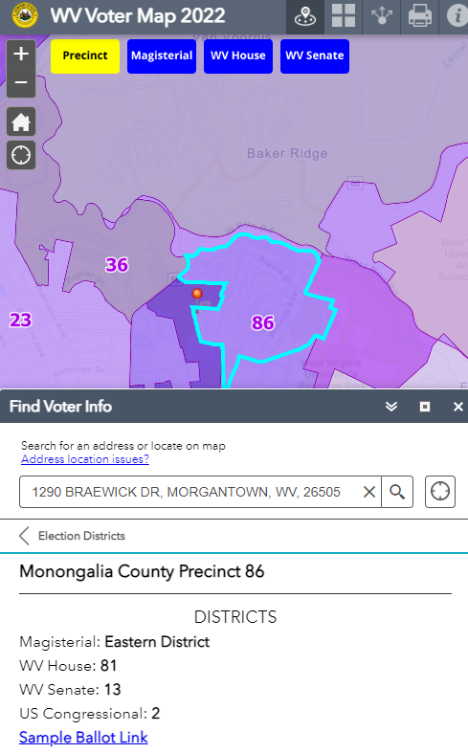
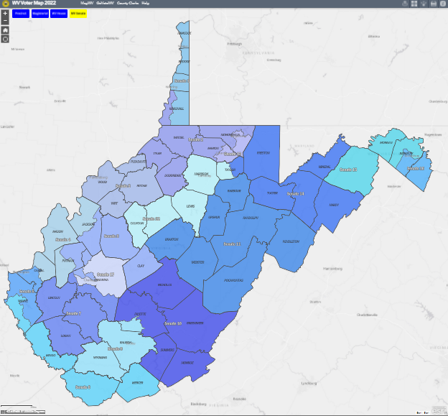
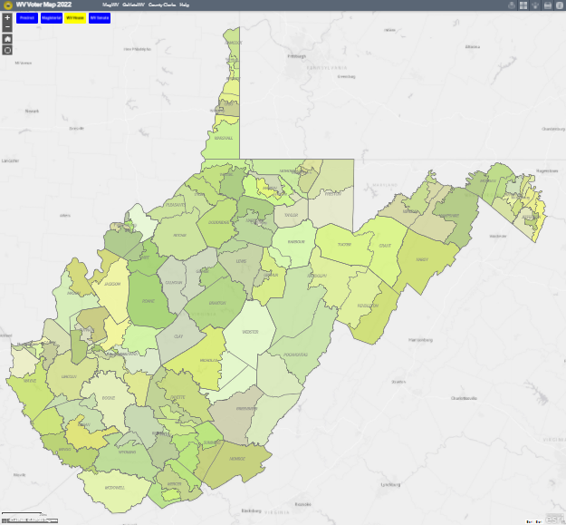
WV Voter Map 2022 (Public)
Find Voter Info function
Default View

Slide 6
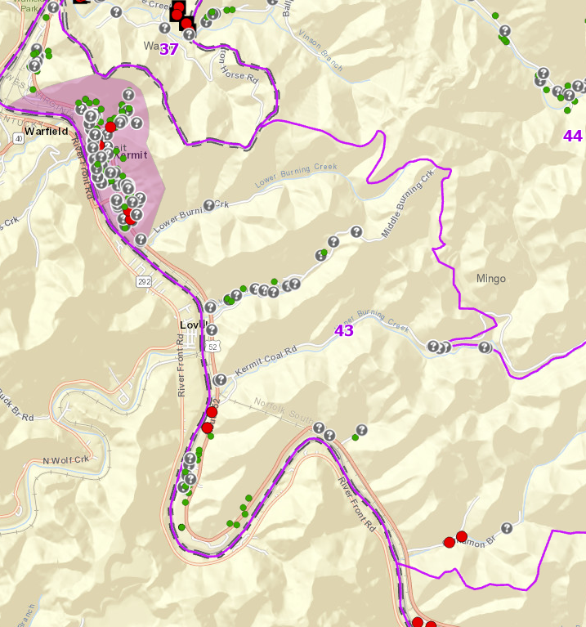
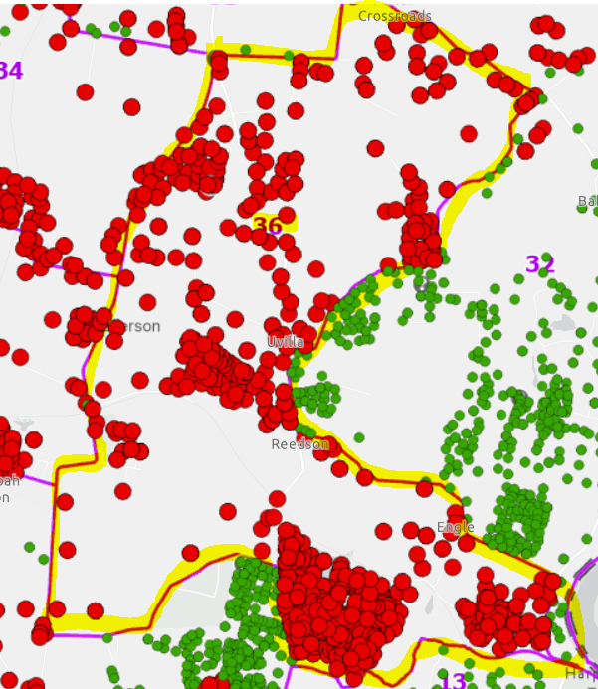
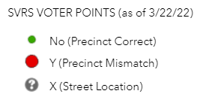
Redistricting of Voting Precincts
In 2022, West Virginia joined the increasing number of states leveraging geospatial technologies for its Statewide Voter Registration System and Redistricting
Precinct 43
Precinct 36

Slide 7
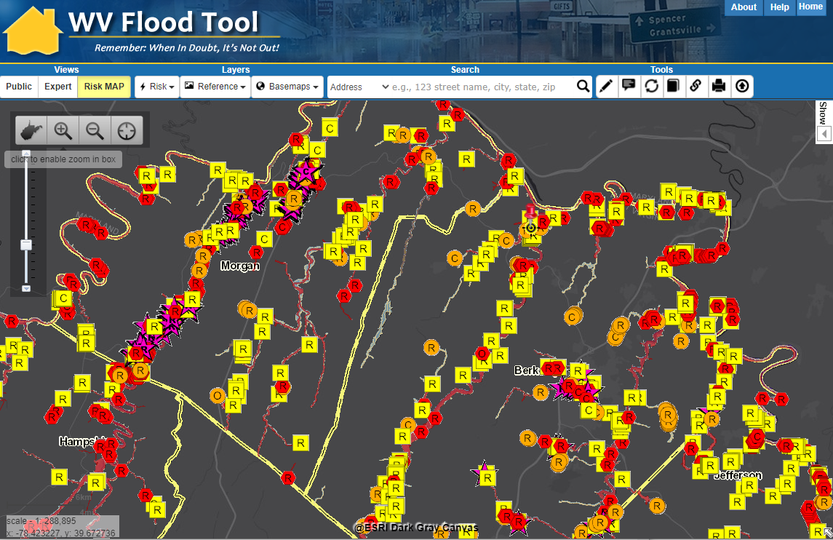
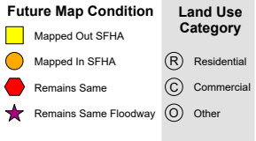
Statewide Flood Risk Assessment
Updated the building-level risk assessments of more than 98,000 structures in high-risk floodplains on the WV Flood Tool
Vulnerability Risk Assessment
https://www.mapwv.gov/flood/map/?wkid=102100&x=-8680577&y=4786710&l=3&v=2

Slide 8
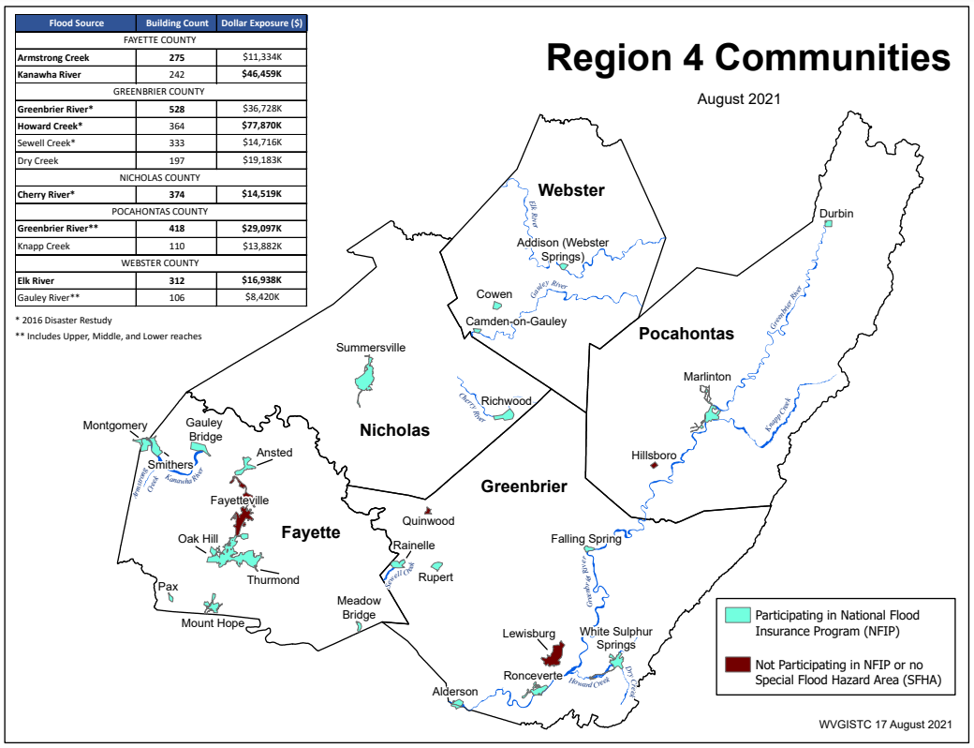
Building Risk by Flood Source
Building Counts and Building Exposure $ Values by Stream Name
Flood Sources | Building Count | Dollar Exposure ($)
FAYETTE COUNTY
Armstrong Creek | 275 | $13,334K
Kanawha River | 242 | $46,459K
GREENBRIER COUNTY
Greenbrier River* | 528 | $60,728K
Howard Creek* | 364 | $94,870K
Sewell Creek* | 333 | $14,716K
Dry Creek | 197 | $19,183K
NICHOLAS COUNTY
Cherry River* | 374 | $15,719K
POCAHONTAS COUNTY
Greenbrier River** | 418 | $29,097K
Knapp Creek | 110 | $13,882K
WEBSTER COUNTY
Elk River | 312 | $16,938K
Gauley River** | 106 | $8,420K
* 2016 Disaster Restudy
Greenbrier River totals for Greenbrier and Pocahontas counties: 946 buildings in 1% floodplain, $90M dollar exposure
Greenbrier River in Region 4 has the most structures in the 1%-annual-chance floodplain
Howard Creek in Greenbrier County has the highest building dollar exposure of all communities in Region 4
Computed for 1% (100-yr) floodplain
RA Tables: Buildings by River/Stream Name
Region 4 PDF Map Primary Flood Sources

Slide 9
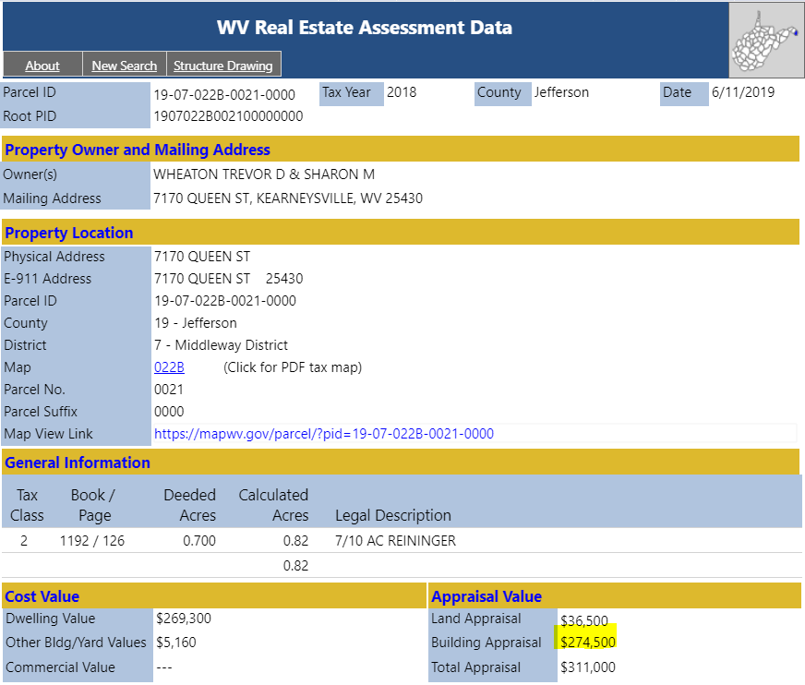
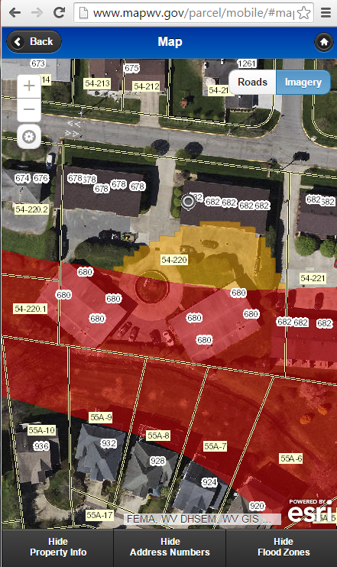
WV Property Applications
Web Visits
Detailed Property Report
Property Viewer
Parcel Property Viewer
Flood Tool
WV Property Viewer www.mapwv.gov/parcel WV Property Search www.mapwv.gov/ assessment
Property Search Tool

