Slide 1
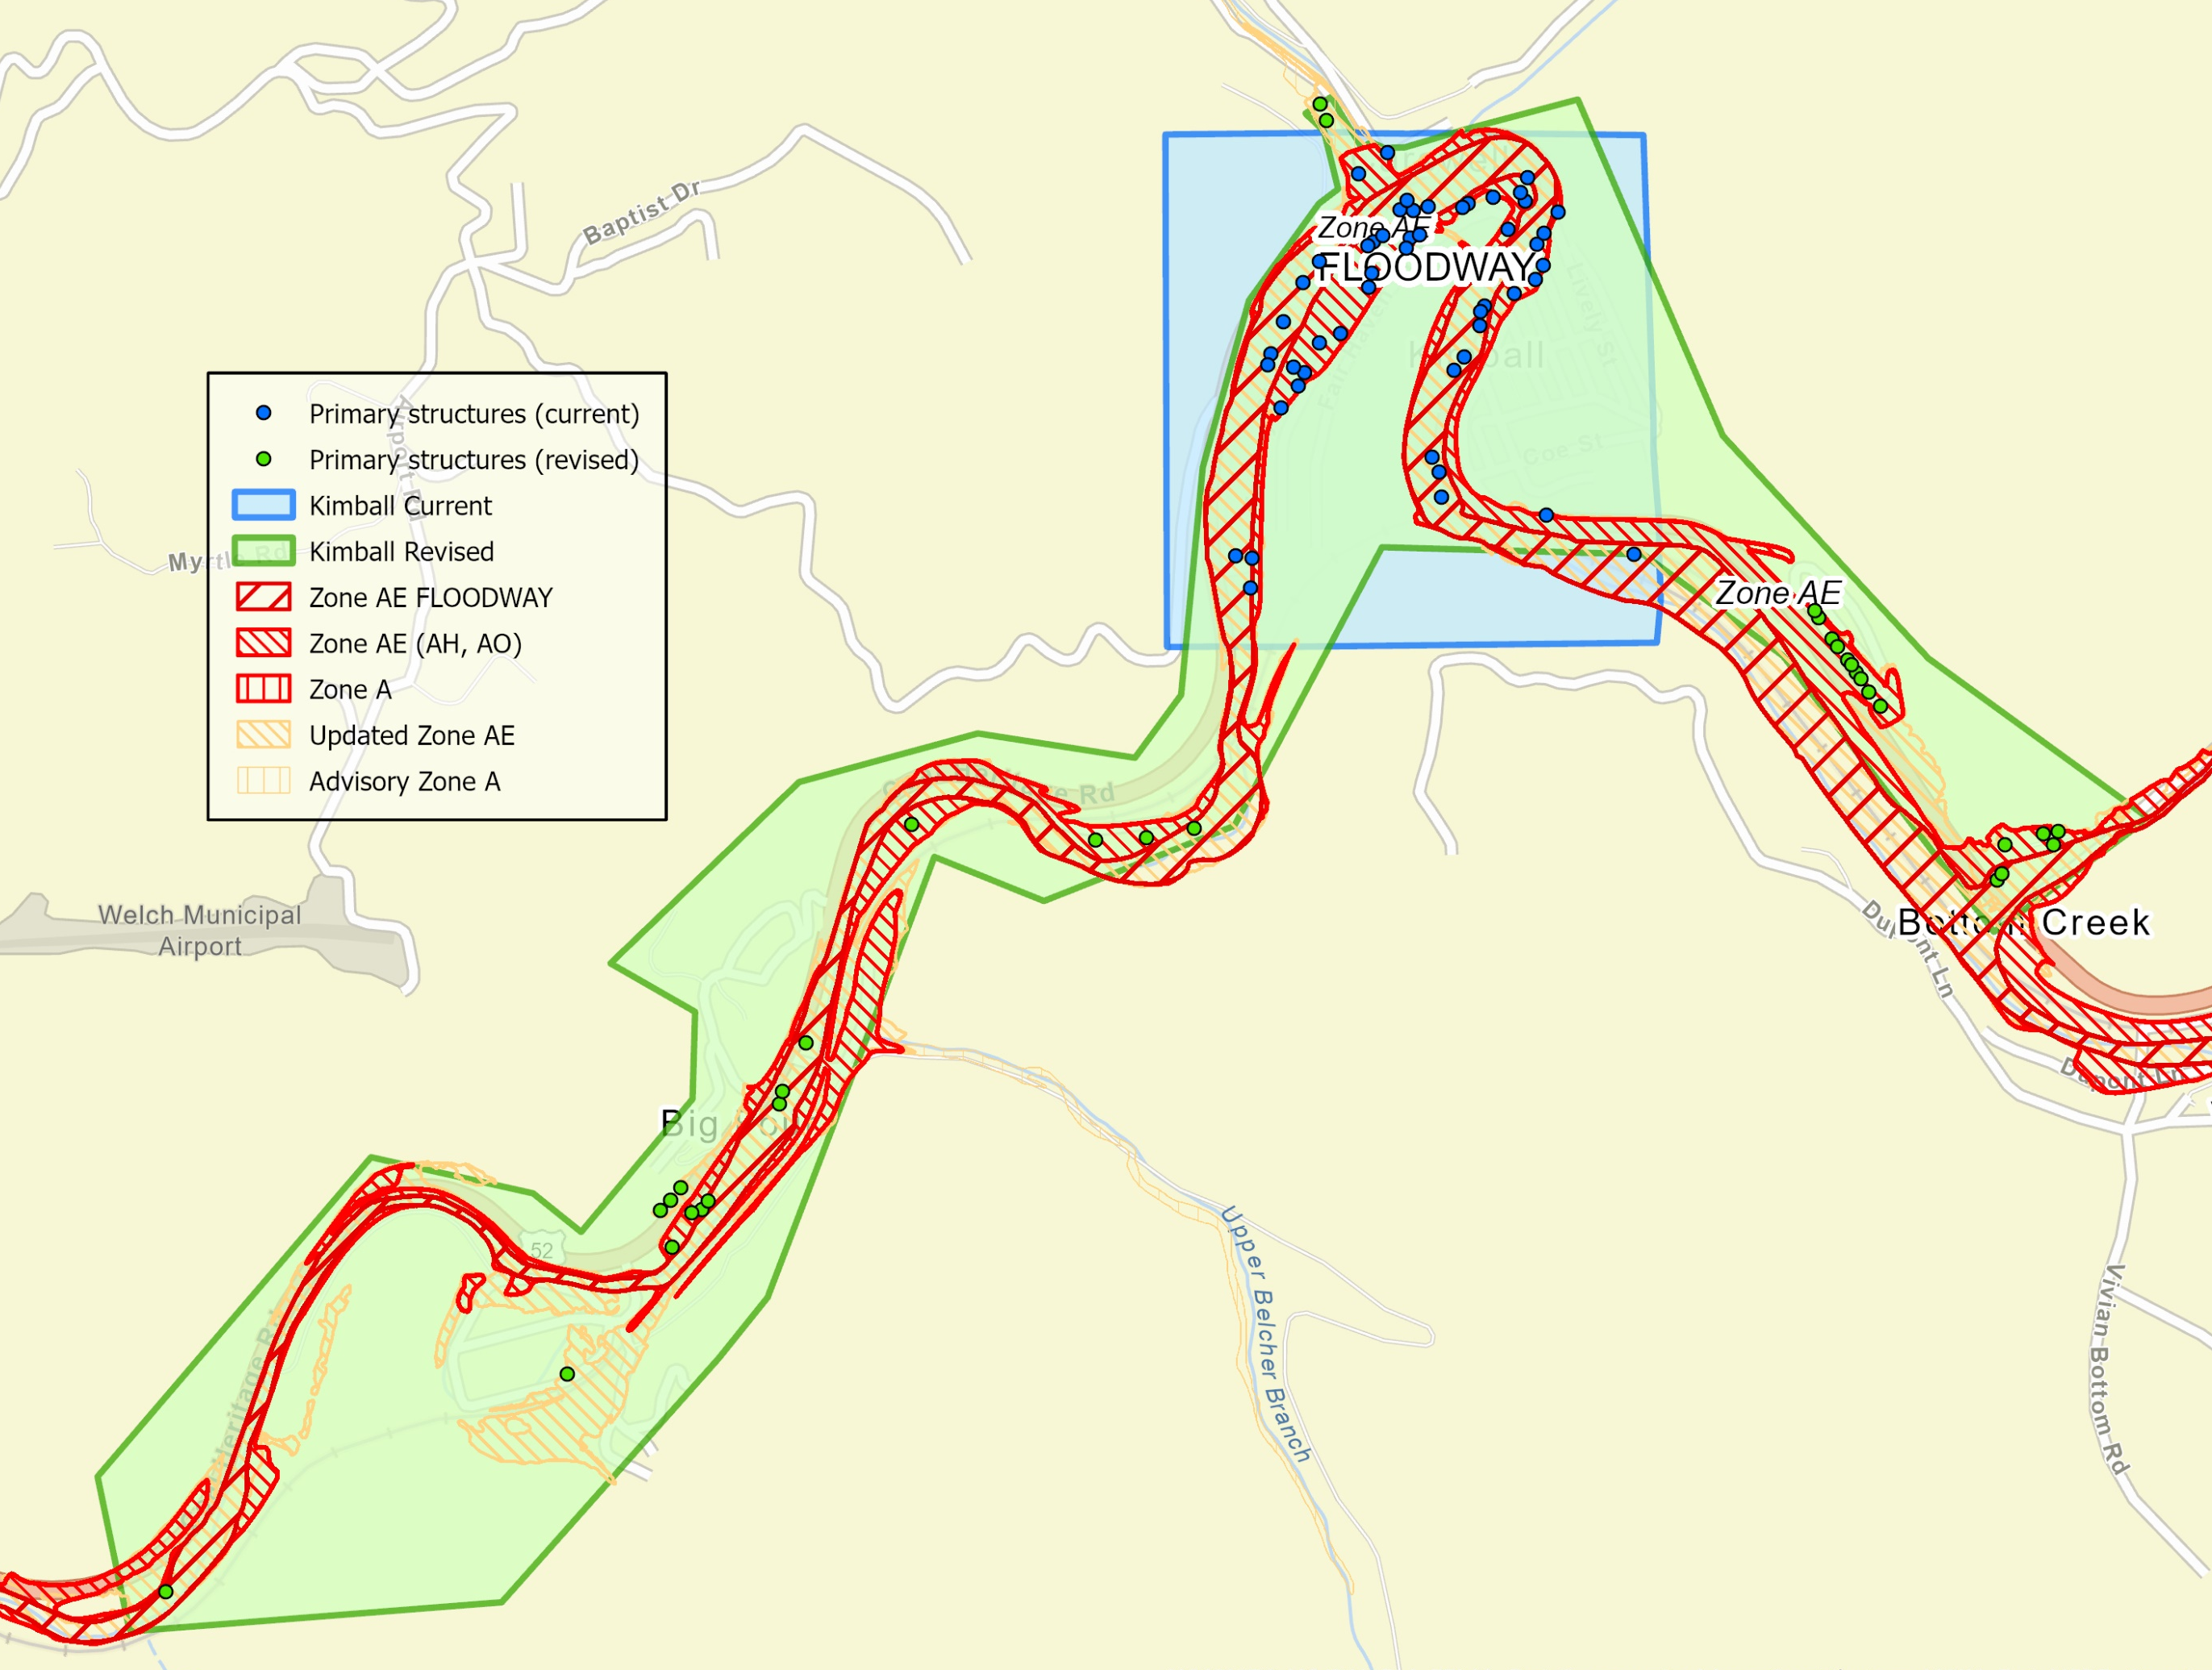
Kimball Municipal Boundary
Current vs. Revised
51 primary structures in current Kimball municipality
85 primary structures in revised Kimball municipality
New boundary = additional 34 primary structures within Kimball are in a flood zone

