Slide 1
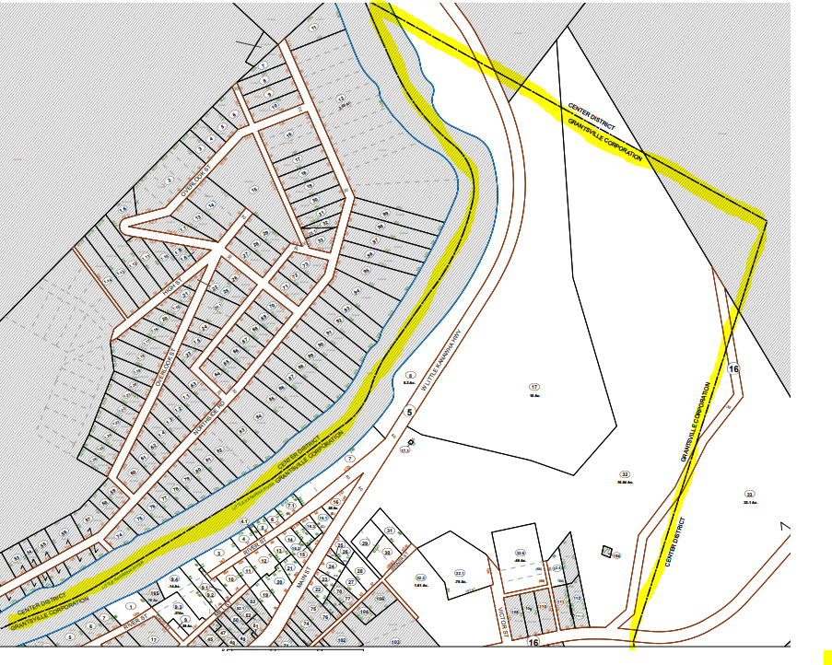
Grantsville: Tax Map 2-1
Tax Map 2-1 https://data.wvgis.wvu.edu/pub/Clearinghouse/planningLanduseCadastres/wv_tax_maps/PDF/07_Calhoun_County/02_Grantsville_Corp/02-0001.pdf

Slide 2
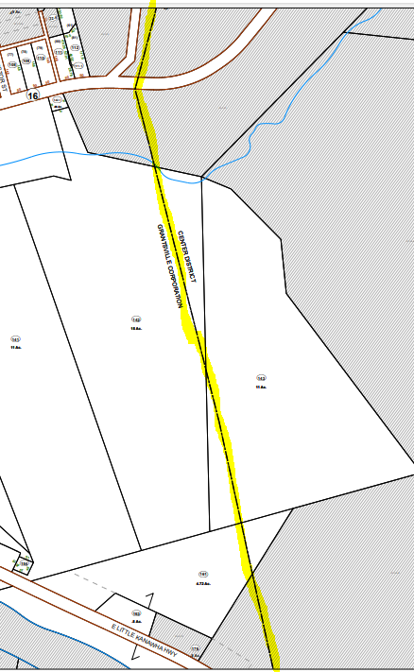
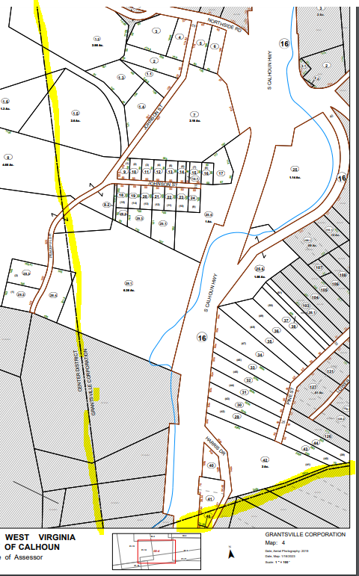
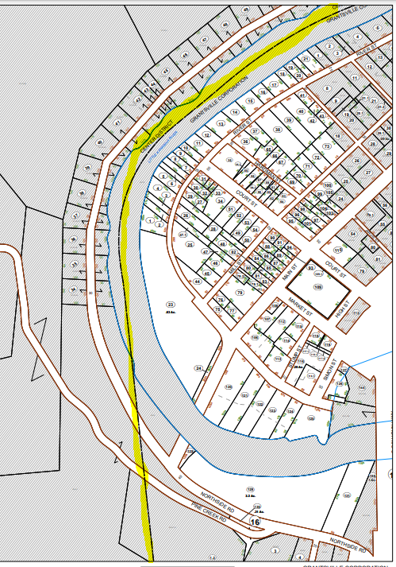
Grantsville: Tax Map 2-2 & 2-3 & 2-4
Tax Map 2-2 https://data.wvgis.wvu.edu/pub/Clearinghouse/planningLanduseCadastres/wv_tax_maps/PDF/07_Calhoun_County/02_Grantsville_Corp/02-0002.pdf
Tax Map 2-3 https://data.wvgis.wvu.edu/pub/Clearinghouse/planningLanduseCadastres/wv_tax_maps/PDF/07_Calhoun_County/02_Grantsville_Corp/02-0003.pdf
Tax Map 2-4 https://data.wvgis.wvu.edu/pub/Clearinghouse/planningLanduseCadastres/wv_tax_maps/PDF/07_Calhoun_County/02_Grantsville_Corp/02-0004.pdf

Slide 3
Grantsville: Tax Map 2-2 & 2-3 & 2-4
Tax Map 2-2 https://data.wvgis.wvu.edu/pub/Clearinghouse/planningLanduseCadastres/wv_tax_maps/PDF/07_Calhoun_County/02_Grantsville_Corp/02-0002.pdf
Tax Map 2-3 https://data.wvgis.wvu.edu/pub/Clearinghouse/planningLanduseCadastres/wv_tax_maps/PDF/07_Calhoun_County/02_Grantsville_Corp/02-0003.pdf
Tax Map 2-4 https://data.wvgis.wvu.edu/pub/Clearinghouse/planningLanduseCadastres/wv_tax_maps/PDF/07_Calhoun_County/02_Grantsville_Corp/02-0004.pdf

Slide 4
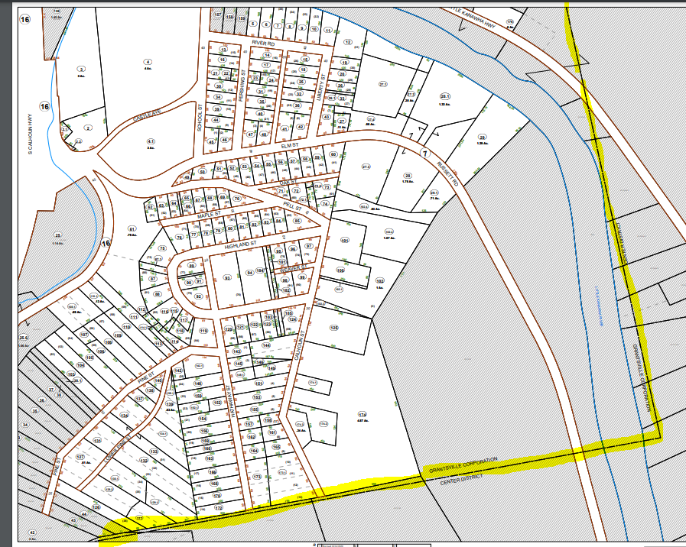
Grantsville: Tax Map 5
Tax Map 2-5 https://data.wvgis.wvu.edu/pub/Clearinghouse/planningLanduseCadastres/wv_tax_maps/PDF/07_Calhoun_County/02_Grantsville_Corp/02-0005.pdf
Index https://data.wvgis.wvu.edu/pub/Clearinghouse/planningLanduseCadastres/wv_tax_maps/PDF/07_Calhoun_County/02_Grantsville_Corp/

