Slide 1
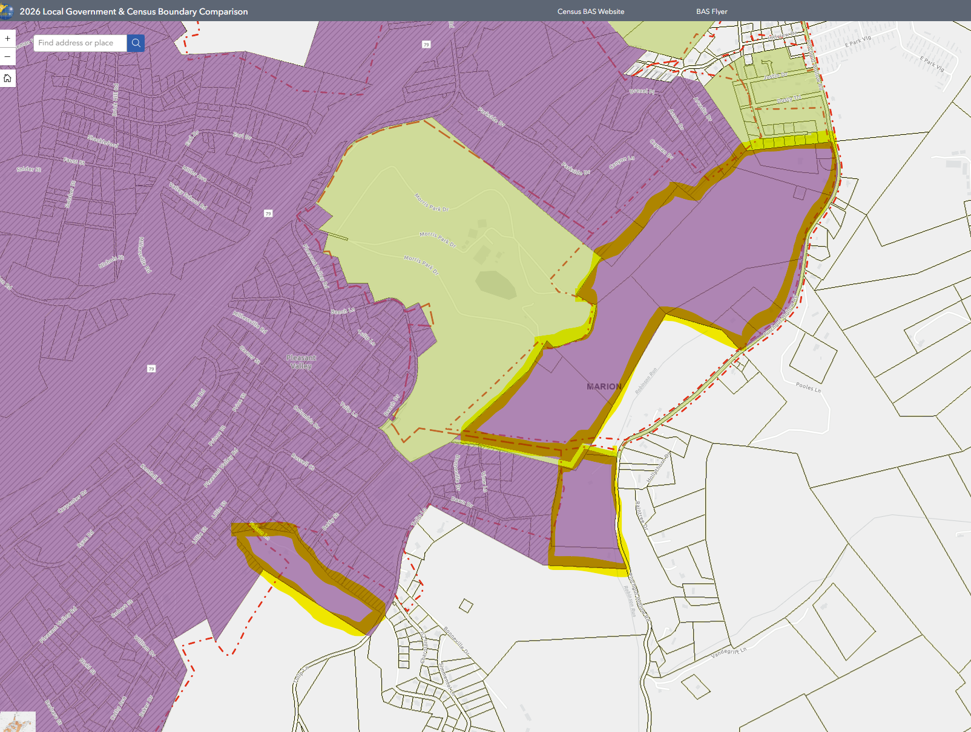
COGO of FAIRMONT’S MORRIS PARK ANNEXATION to improve spatial accuracy of Fairmont and Pleasant Valley shared city boundaries
City of
Fairmont
MORRIS PARK
City of
PLEASANT VALLEY
Online Map View

