Slide 1
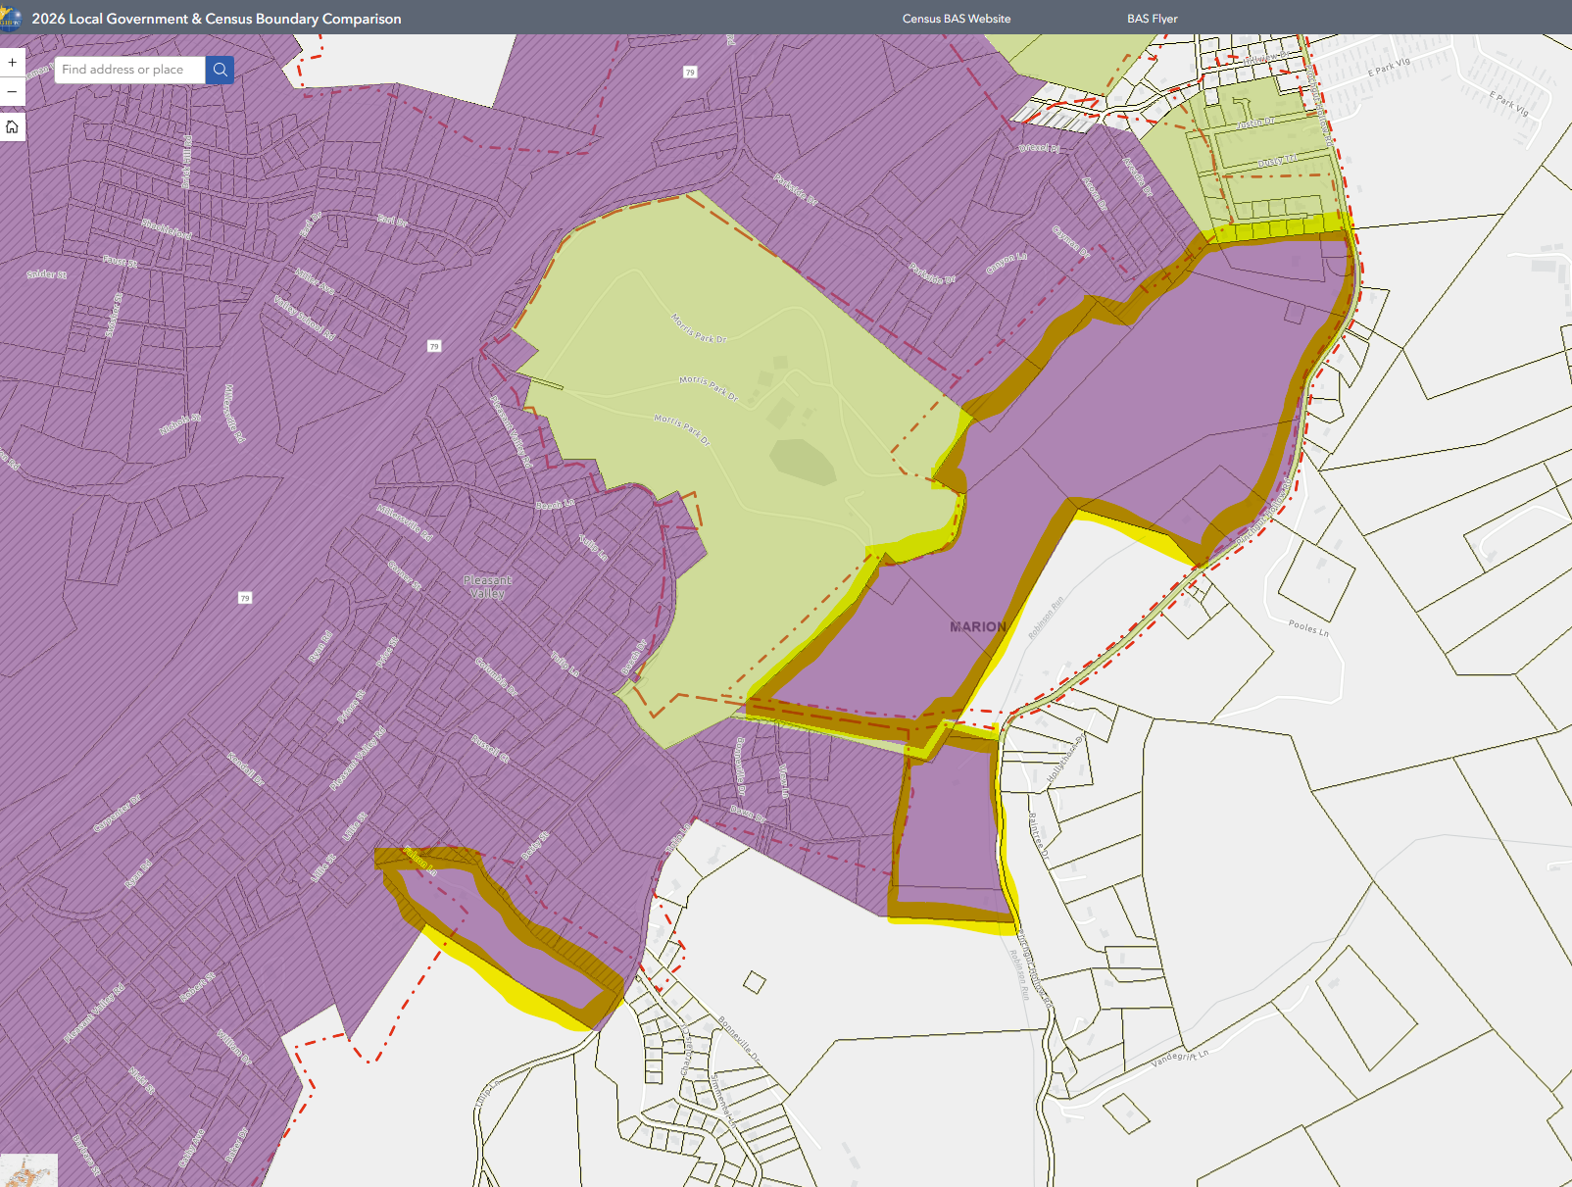
Three Pleasant Valley Annexations in 2003 extending city boundary eastward
City of
Fairmont
Annex Area B
Ordinance 17A
98.06 acres
14 May 2003
City of
PLEASANT VALLEY
Annex Area C
Ordinance 17B
15.91 acres
14 May 2003
Annex Area D
Ordinance 17C
11.65 acres
14 May 2003
Online Map View

