Slide 1
2021 WHITE HALL ANNEXATION
Location: NASA BLVD, First Exchange Bank
Commission Order Number: 1285-530
Effective Date: 8 July 2021
Acreage: 2.51 acres

Slide 2
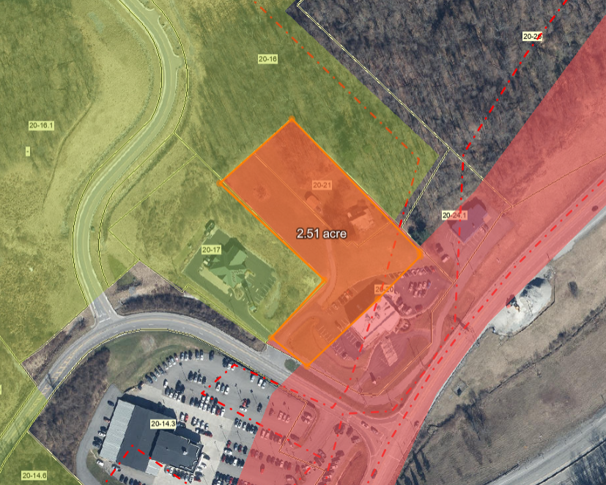

Slide 3
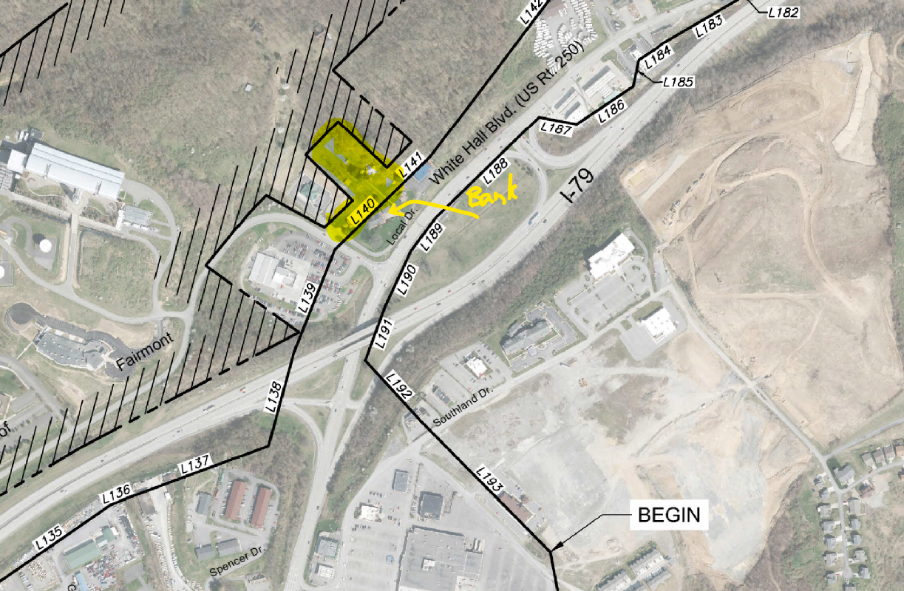

Slide 4
Other Supporting Documents
2001 Boundary Map of town with metes and bounds survey calls
1992 Articles of Incorporation with legal description

