Slide 1
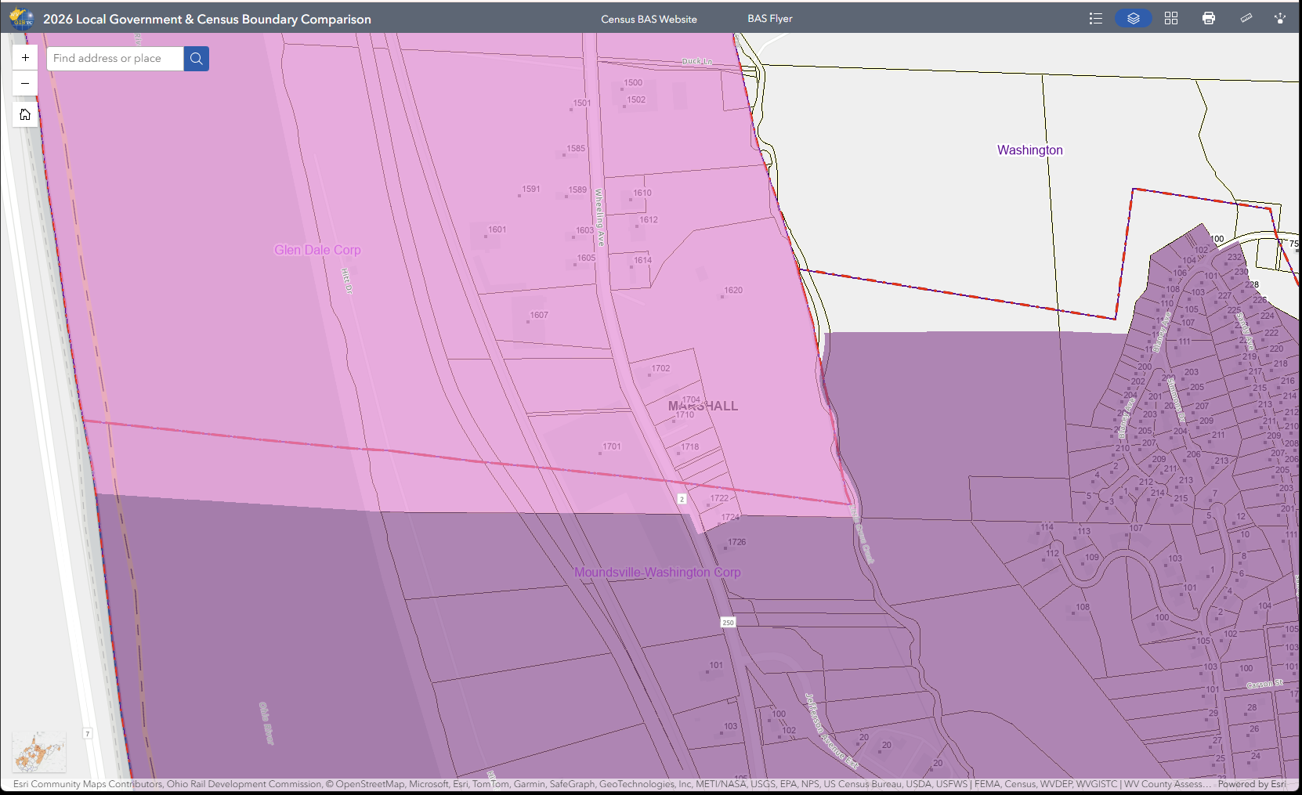
Glen Dale city
Incorrect Census Boundary
Glen Dale Boundary
Moundsville Boundary
Moundsville city
Online Map Viewer Link

Slide 2
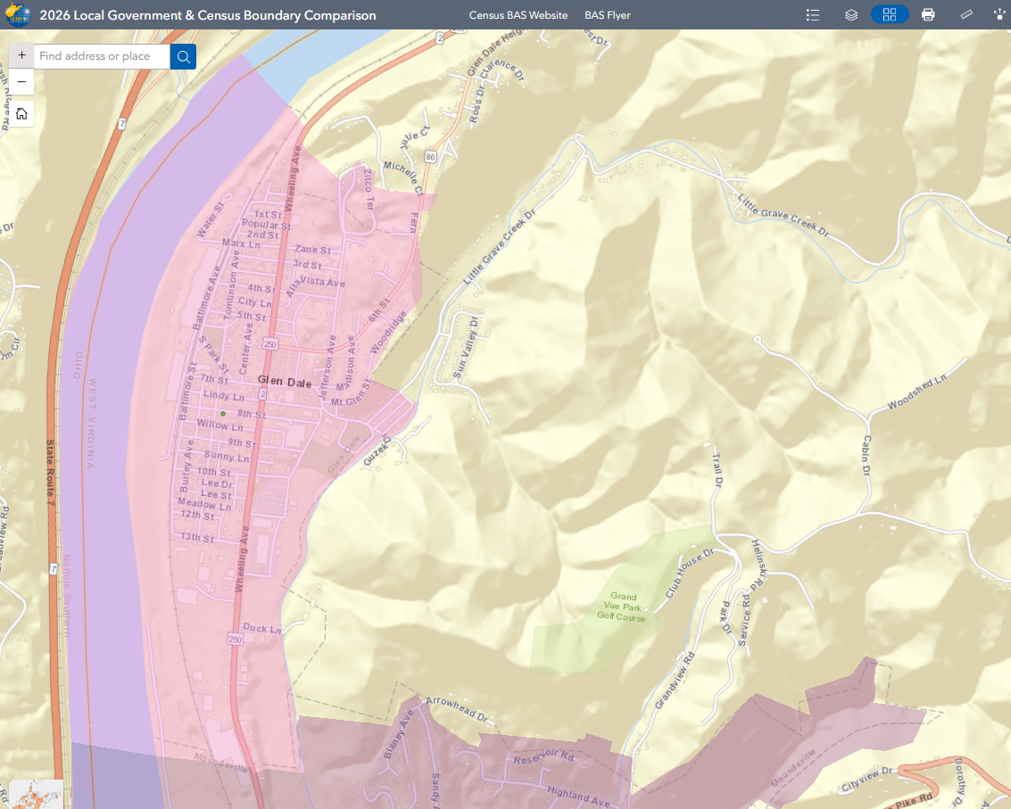
Glen Dale city
Online Map Viewer Link
Glen Dale Boundary
Moundsville Boundary
Moundsville city

