Slide 1
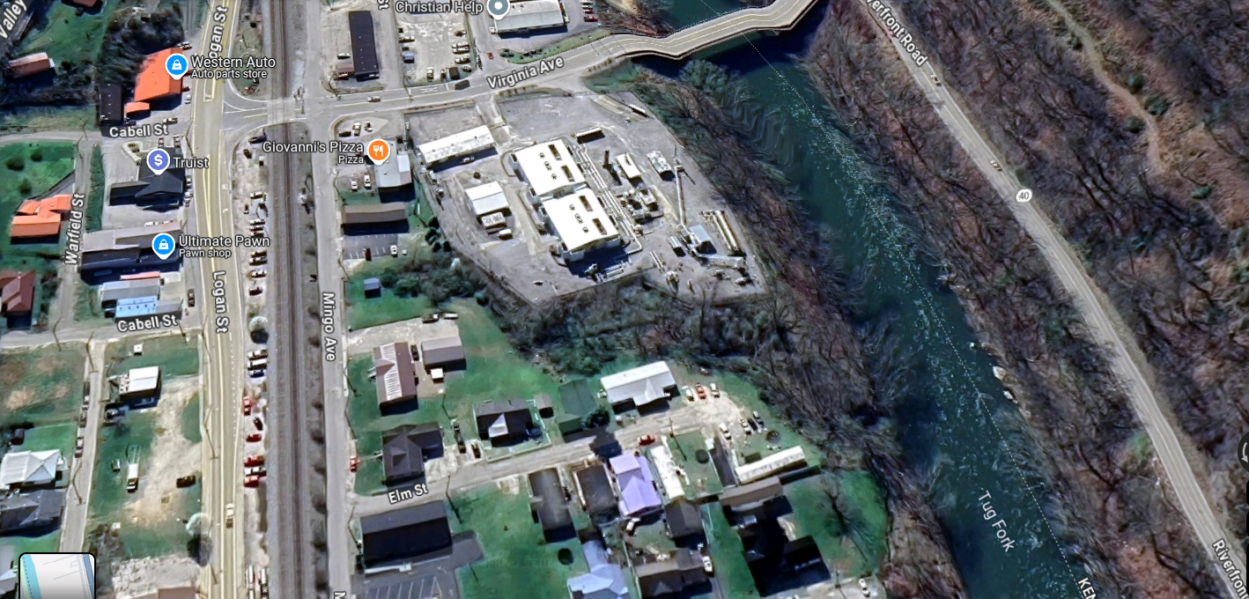
Parcel 30-12-0001-0287-0000
Google View
Commercial Buildings elevated on Fill

Slide 2
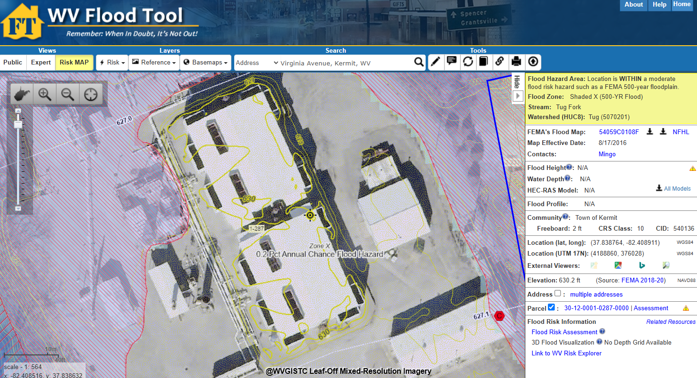
Parcel 30-12-0001-0287-0000
WV Flood Tool
Commercial Buildings elevated on Fill

Slide 3
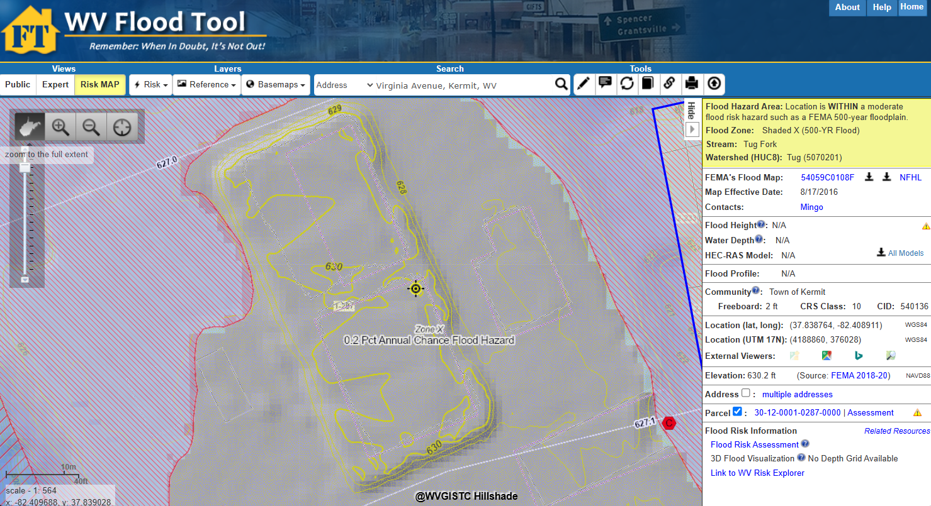
Parcel 30-12-0001-0287-0000
WV Flood Tool
Commercial Buildings elevated on Fill
BFE
New 2020 Structure Footprint
BFE

