Slide 1
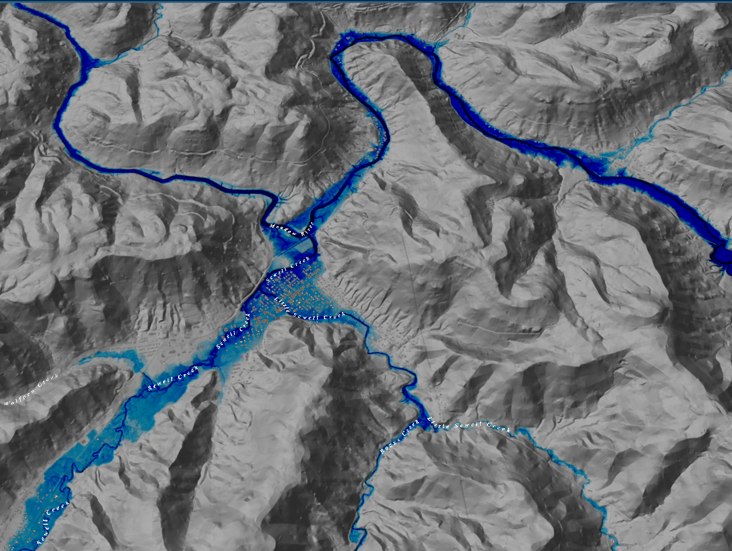
FEMA Flood Depth
Legend
Rainelle, WV
0ft
FLOOD DEPTH
35ft

Slide 2
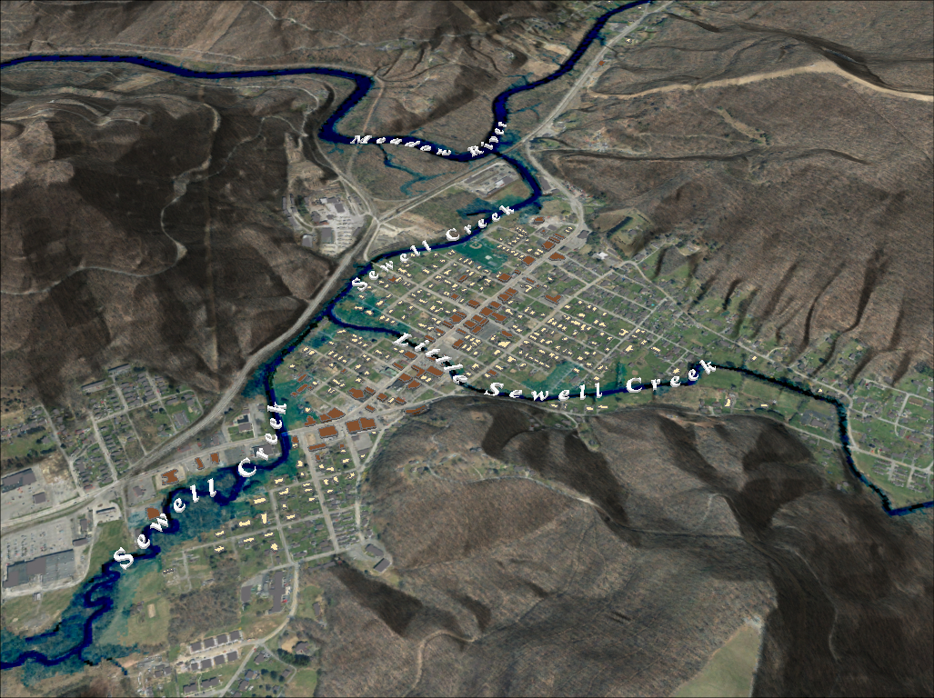
Notes:
FEMA 10year Aerial

Slide 3
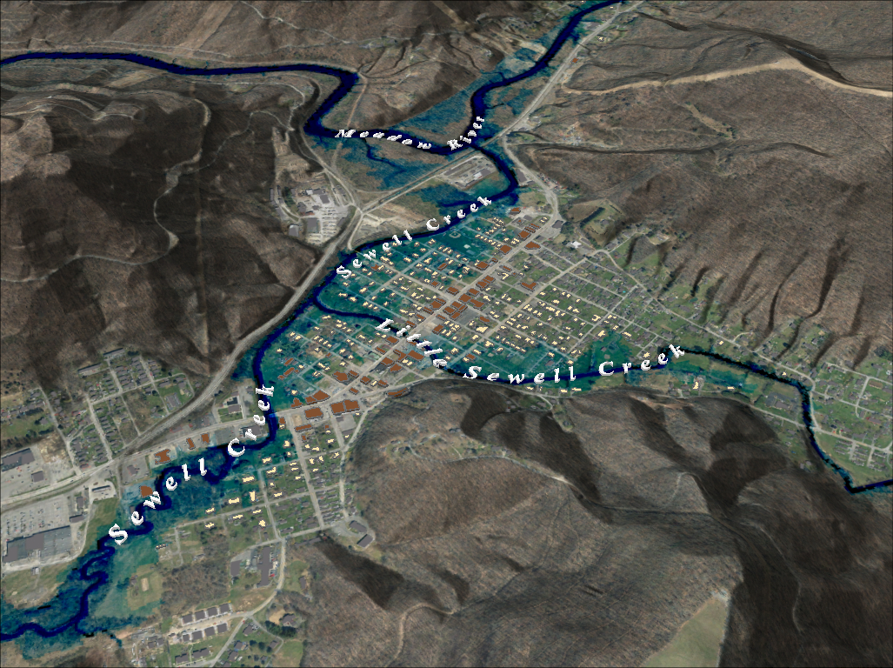
Notes:
FEMA 25year Aerial

Slide 4
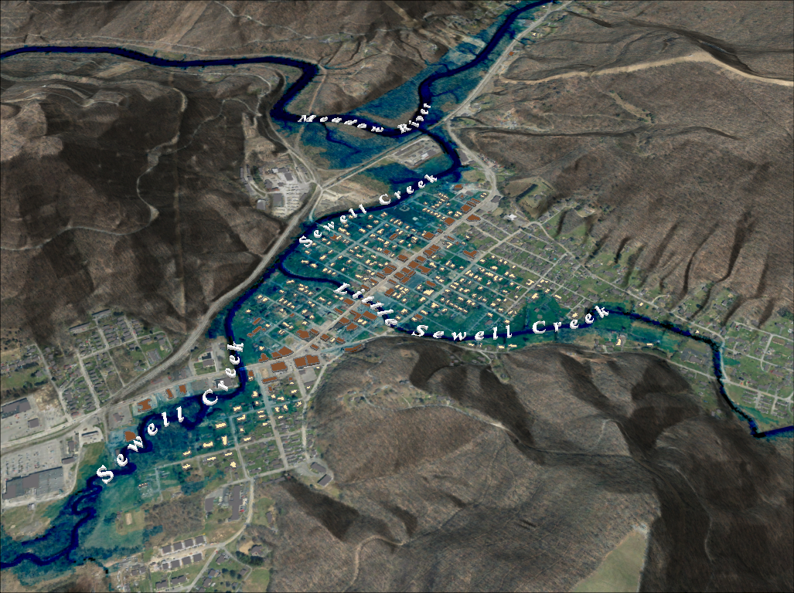
Notes:
FEMA 50year Aerial

Slide 5
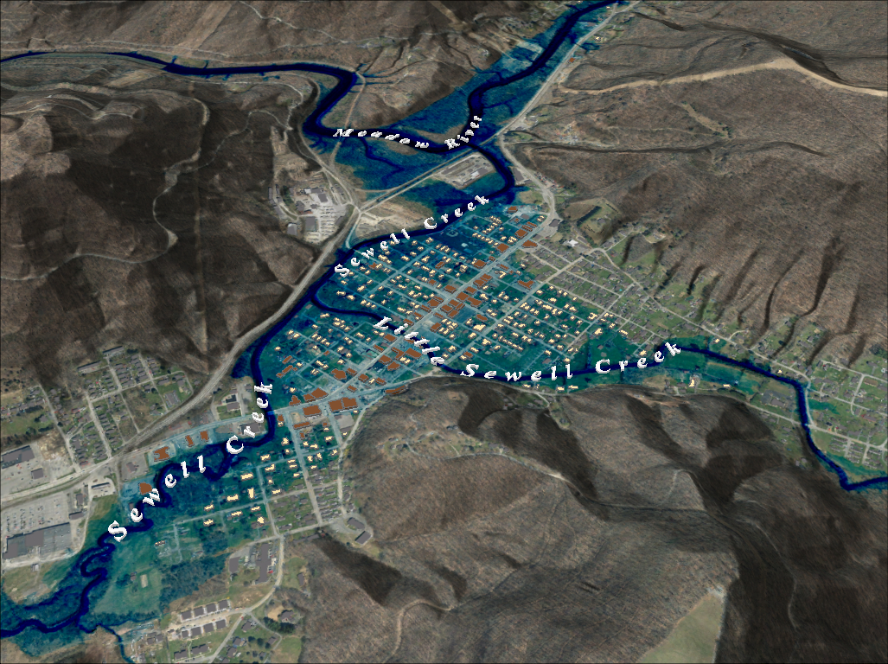
Notes:
FEMA 100year Aerial

Slide 6
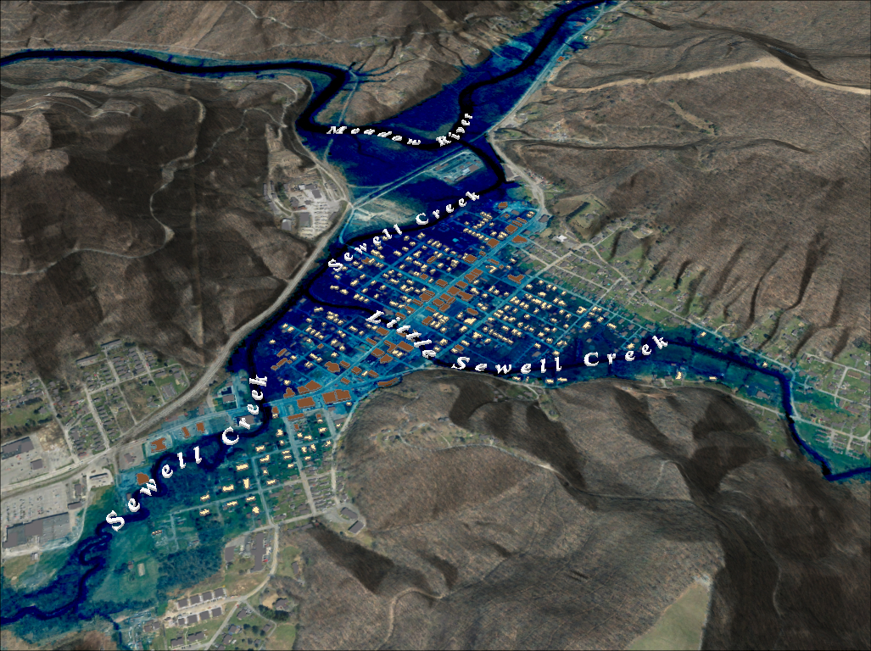
Notes:
FEMA 100year PLUS Aerial

Slide 7
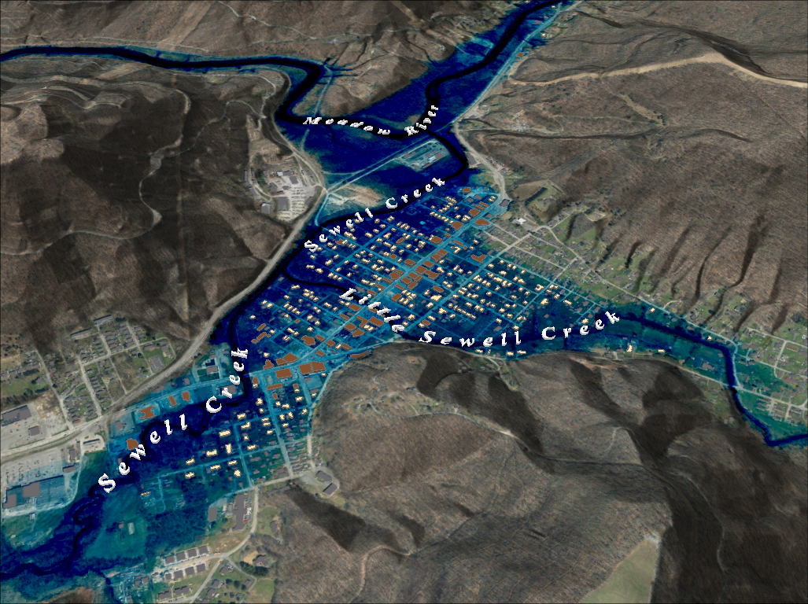
Notes:
FEMA 500year Aerial

Slide 8
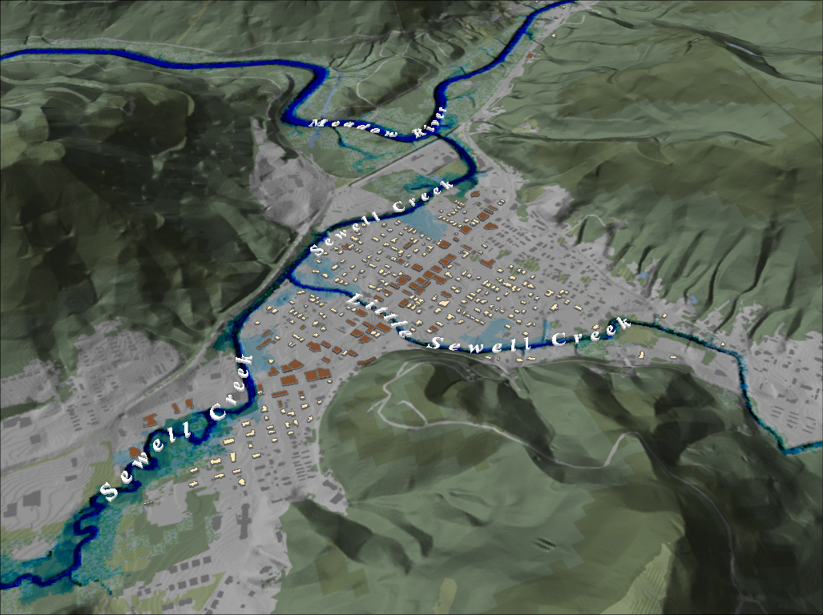
Notes:
FEMA 10 year NLCD Hillshade

Slide 9
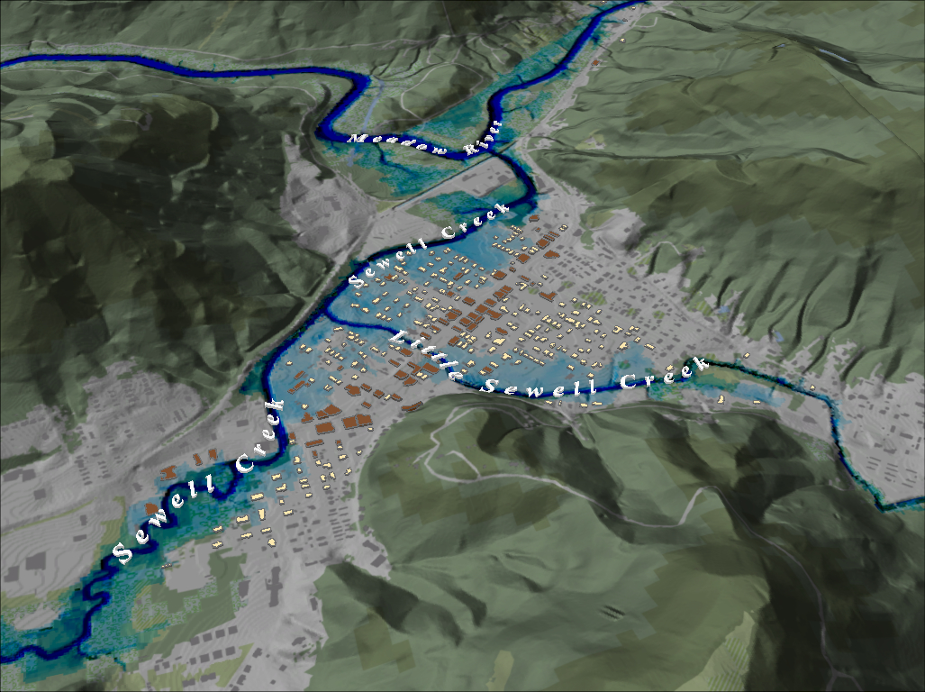
Notes:
FEMA 25 year NLCD Hillshade

Slide 10
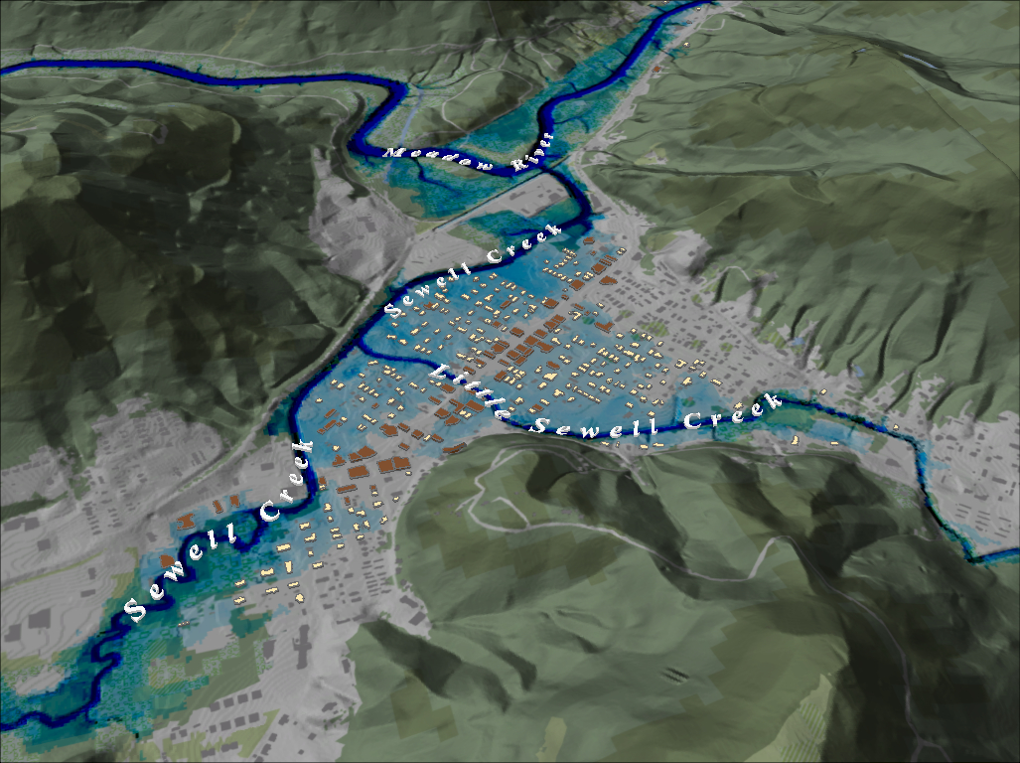
Notes:
FEMA 50 year NLCD Hillshade

Slide 11
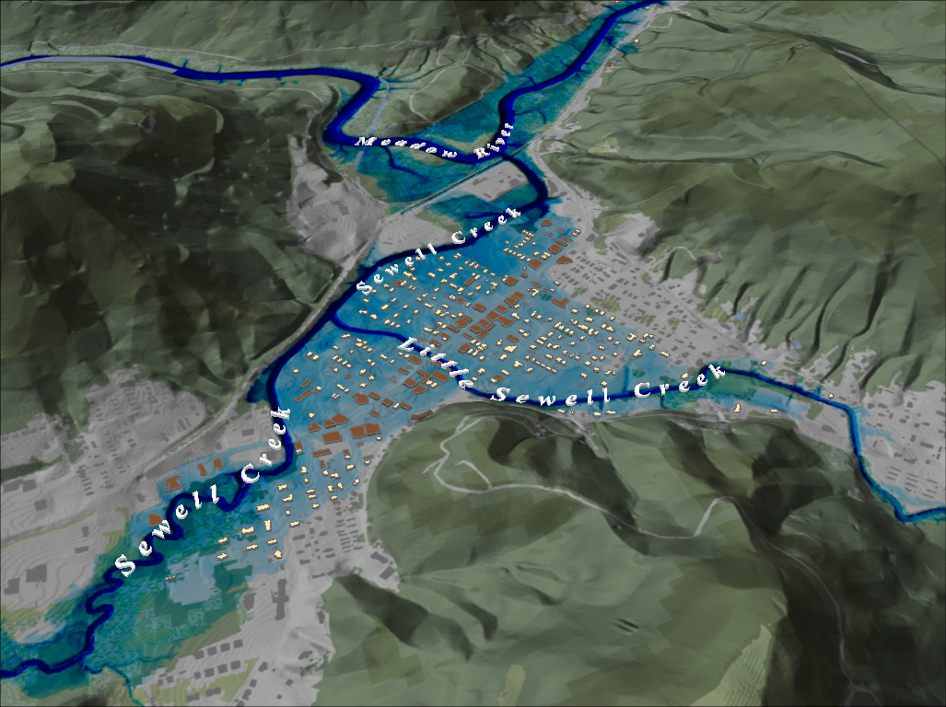
Notes:
FEMA 100 year NLCD Hillshade

Slide 12
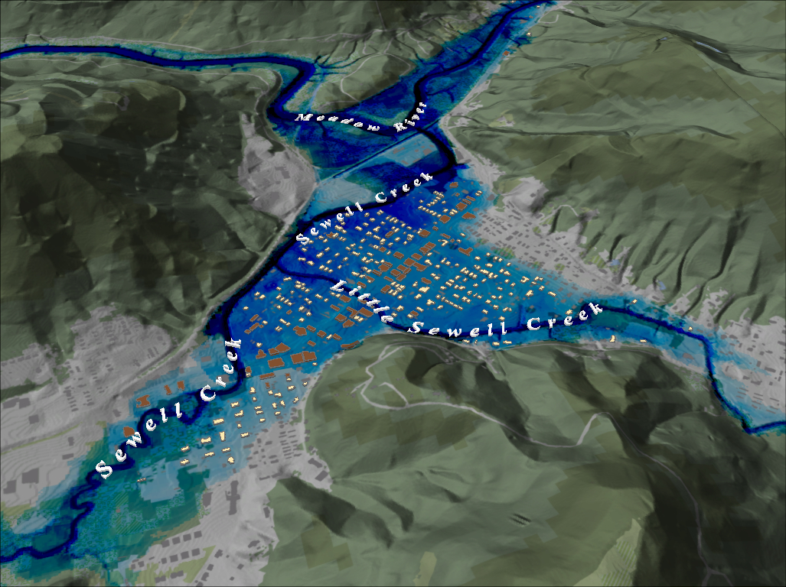
Notes:
FEMA 100 year PLUS NLCD Hillshade

Slide 13
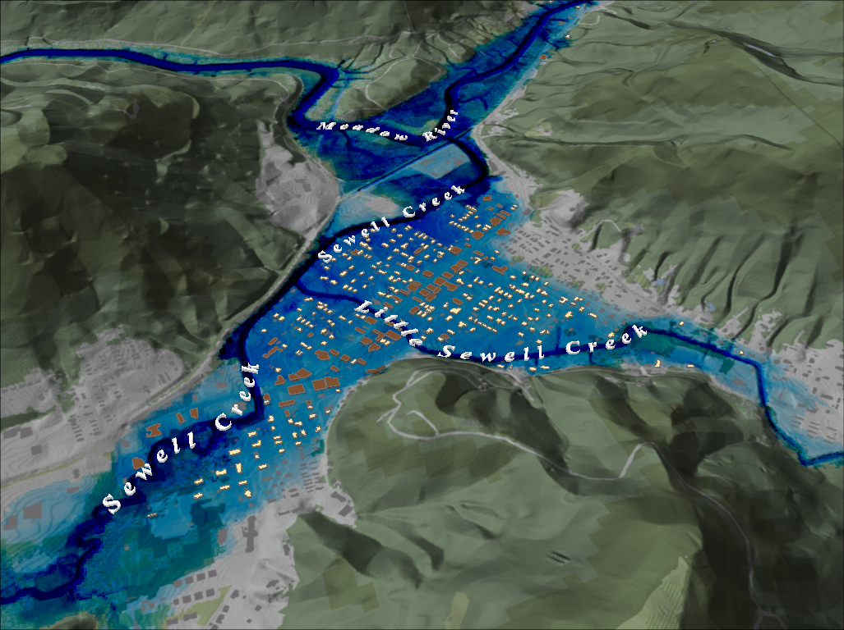
Notes:
FEMA 500 year NLCD Hillshade

Slide 14
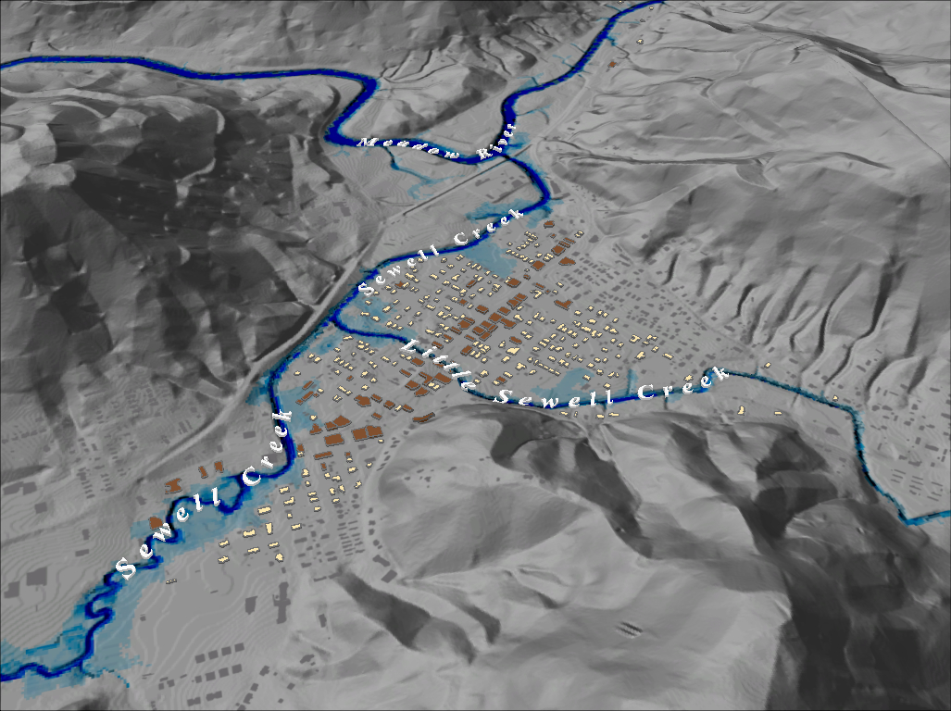
Notes:
FEMA 10 year Grey Hillshade

Slide 15
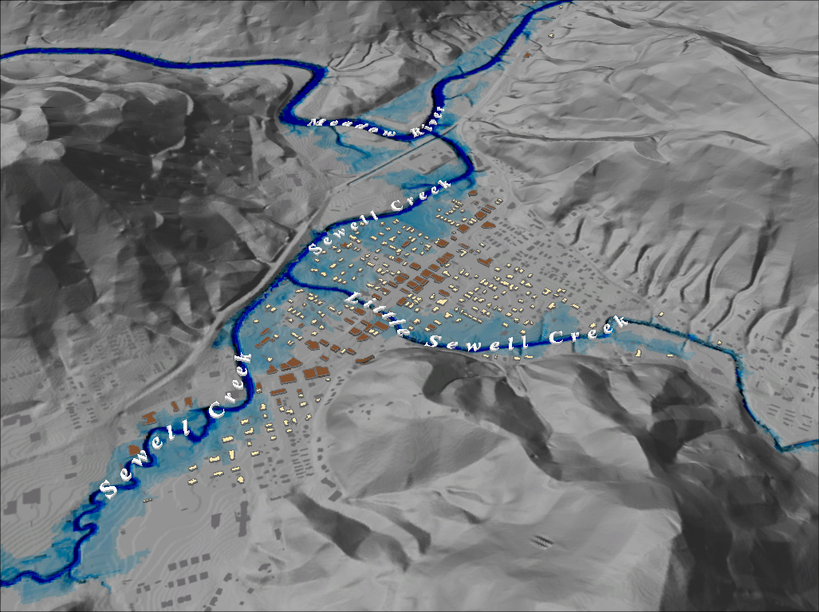
Notes:
FEMA 25 year Grey Hillshade

Slide 16
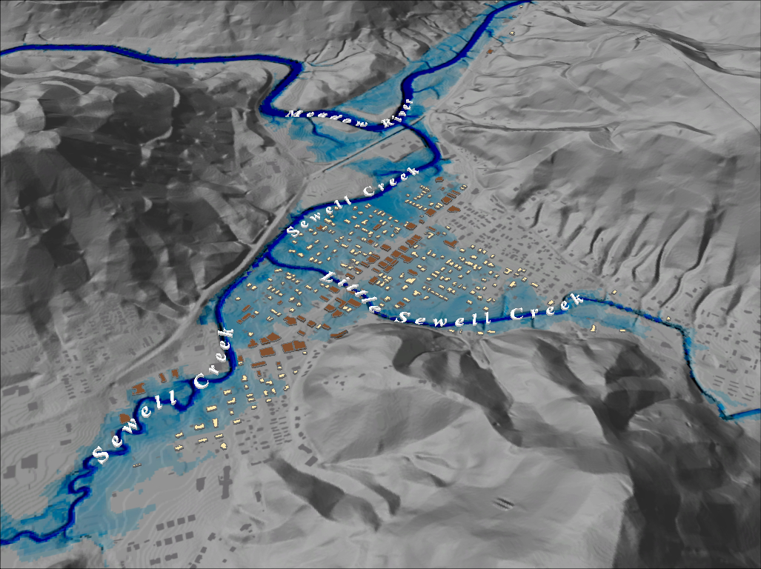
Notes:
FEMA 50 year Grey Hillshade

Slide 17
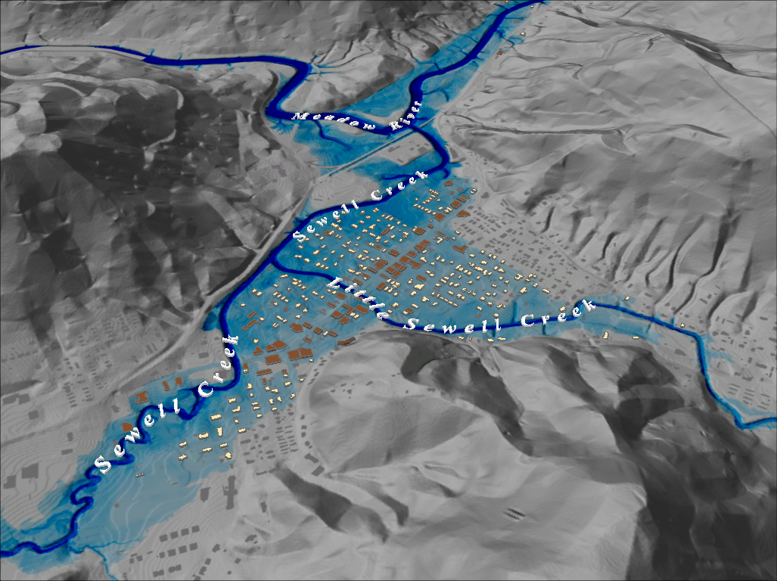
Notes:
FEMA 100 year Grey Hillshade

Slide 18
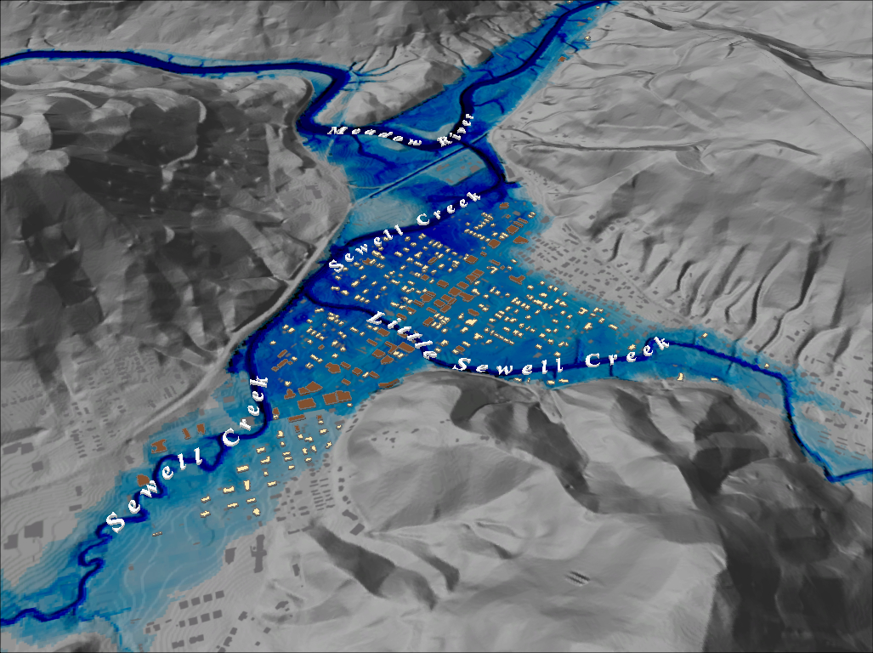
Notes:
FEMA 100 year PLUS Grey Hillshade

Slide 19
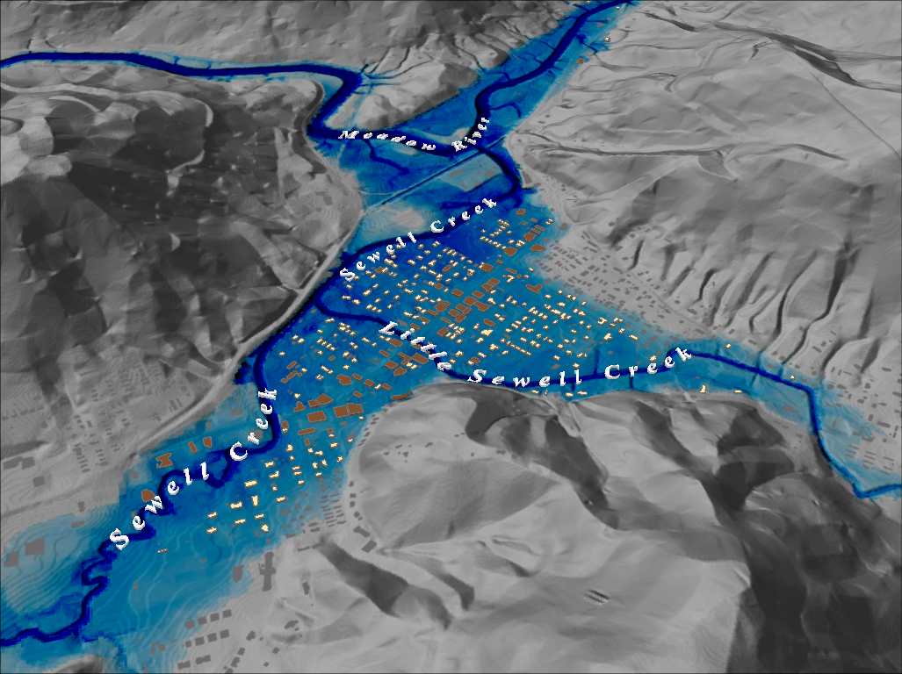
Notes:
FEMA 500 year Grey Hillshade

