Slide 1
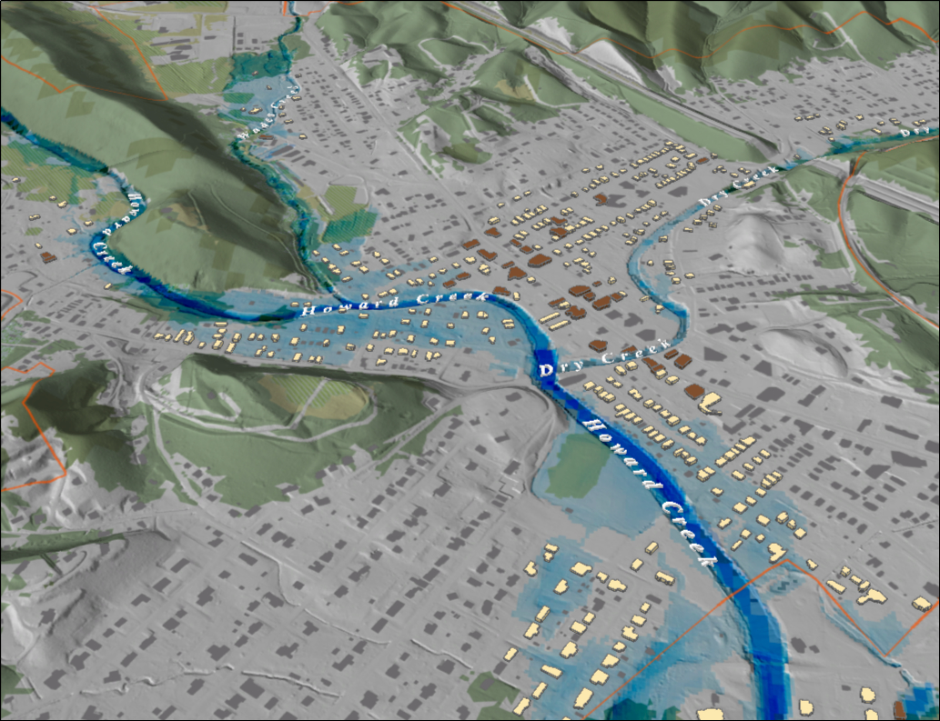
Notes:
White Sulfur Springs FEMA 10yr Hillshade

Slide 2
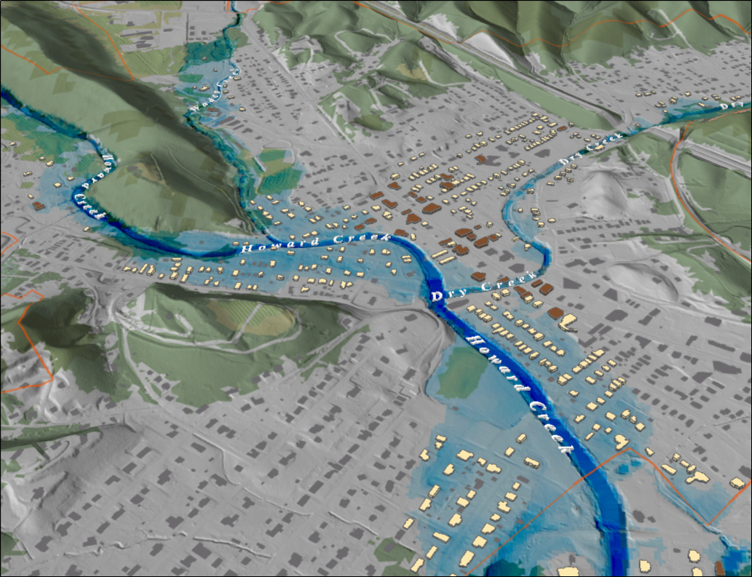
Notes:
White Sulfur Springs FEMA 25yr Hillshade

Slide 3
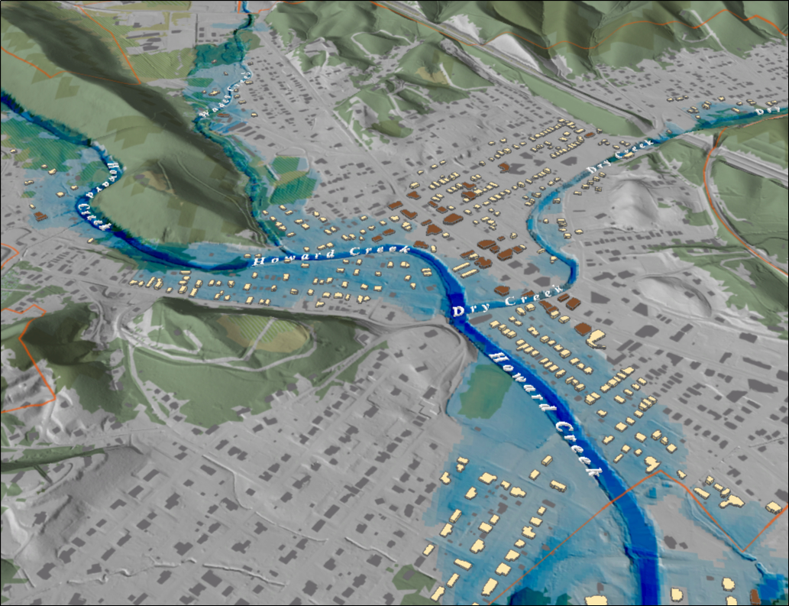
Notes:
White Sulfur Springs FEMA 50yr Hillshade

Slide 4
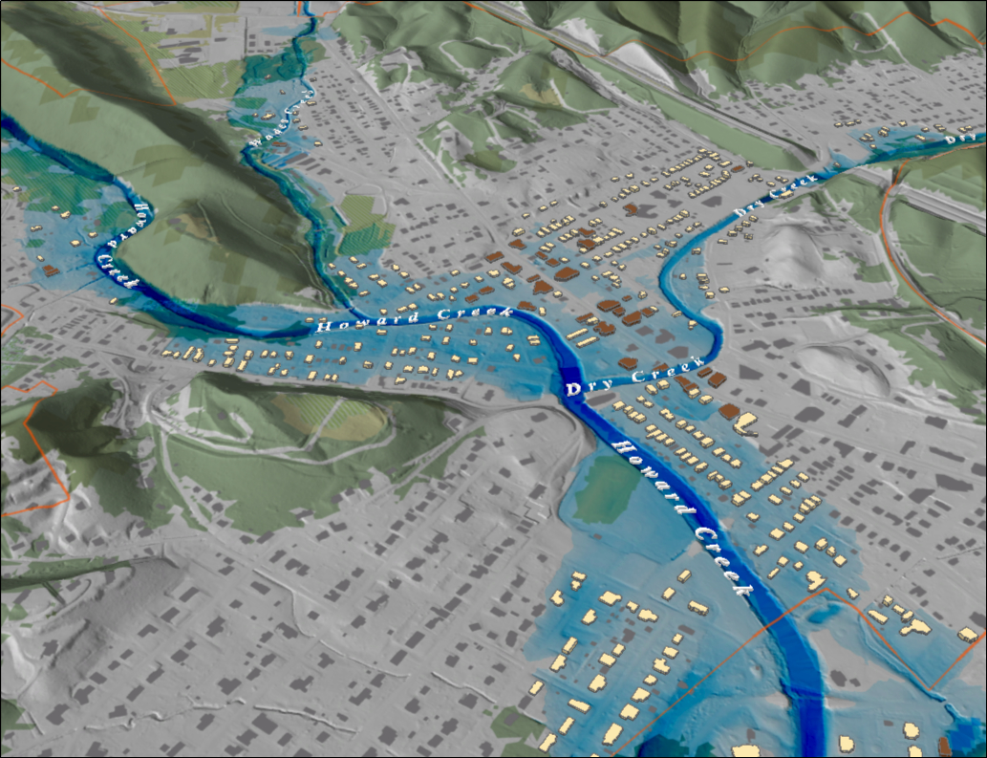
Notes:
White Sulfur Springs FEMA 100yr Hillshade

Slide 5
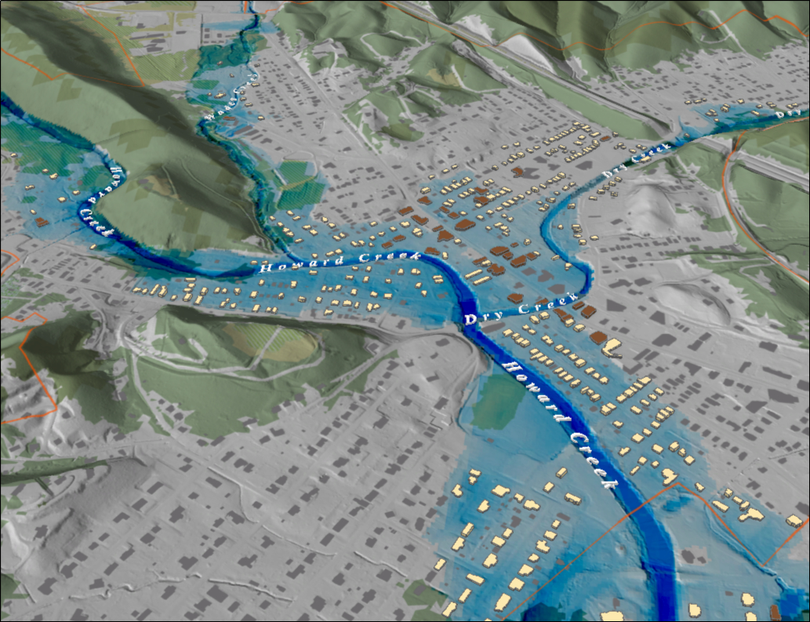
Notes:
White Sulfur Springs FEMA 100yr PLUS Hillshade

Slide 6
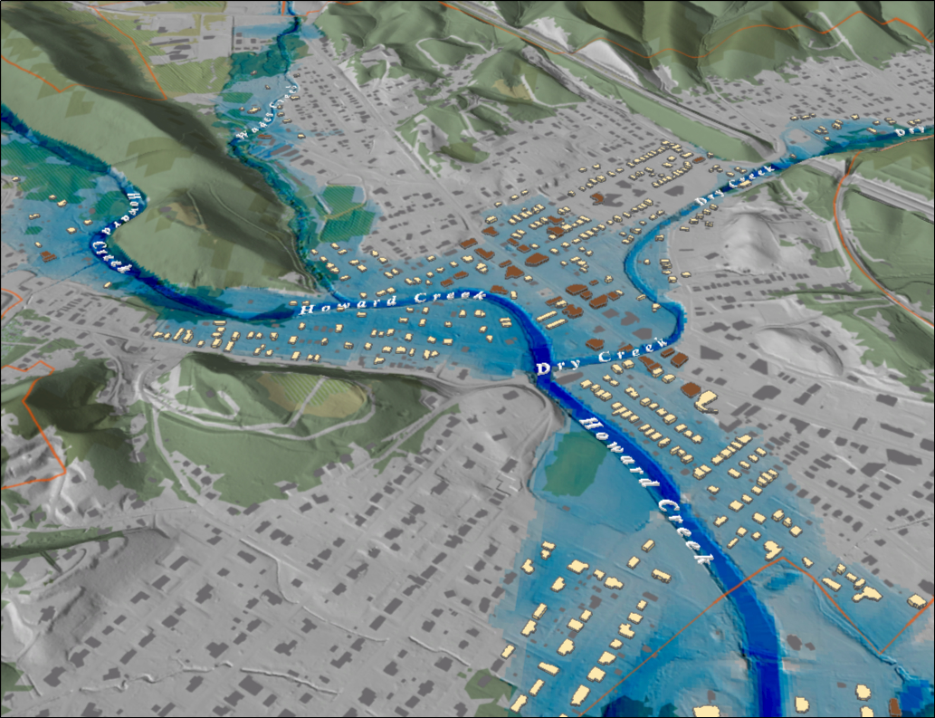
Notes:
White Sulfur Springs FEMA 500yr Hillshade

Slide 7
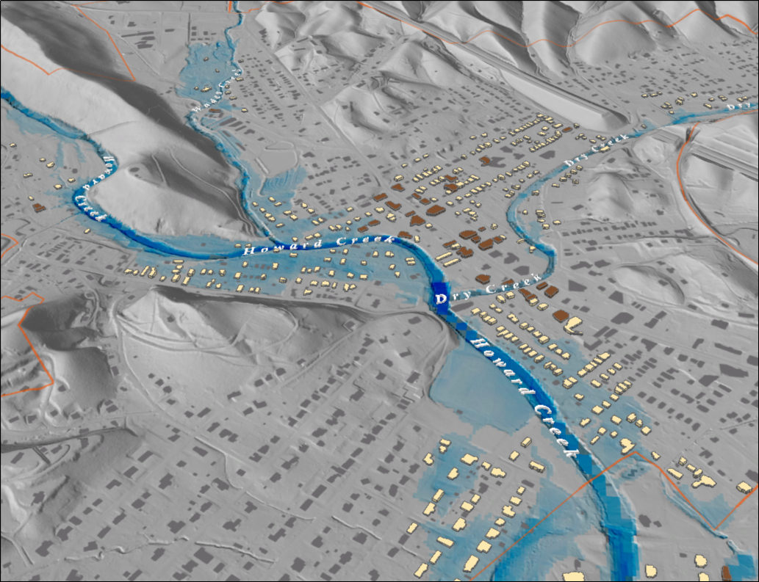
Notes:
White Sulfur Springs FEMA 10yr Grey

Slide 8
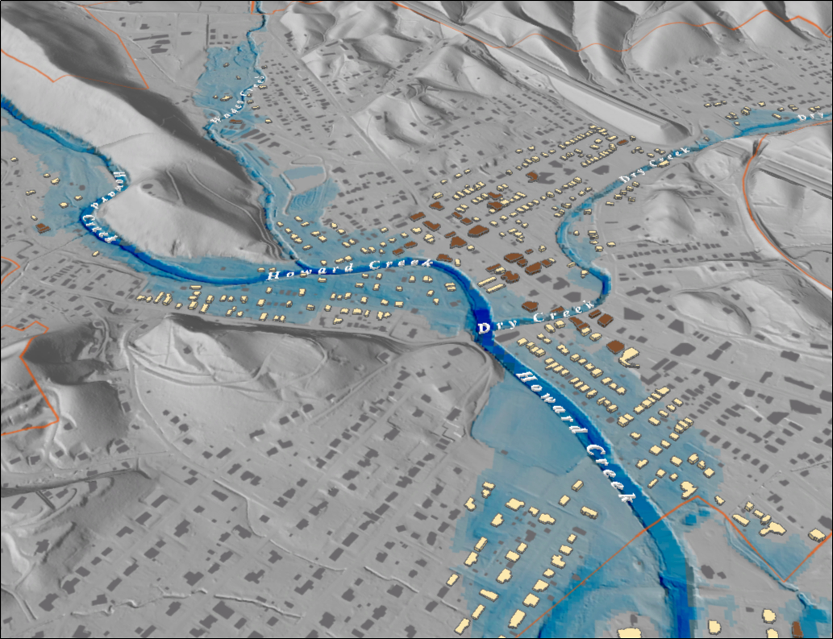
Notes:
White Sulfur Springs FEMA 25yr Grey

Slide 9
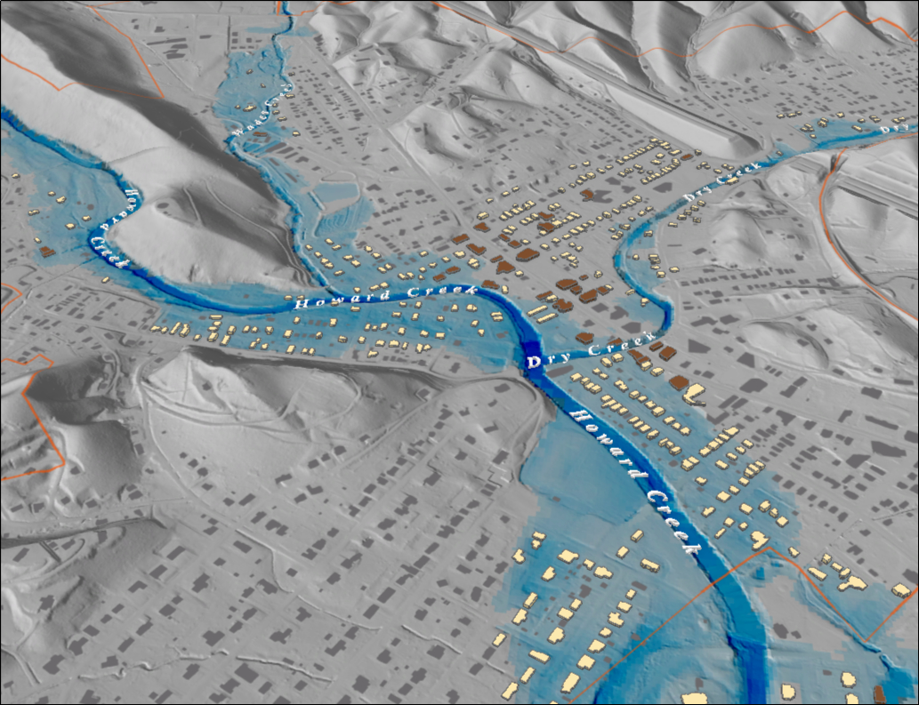
Notes:
White Sulfur Springs FEMA 50yr Grey

Slide 10
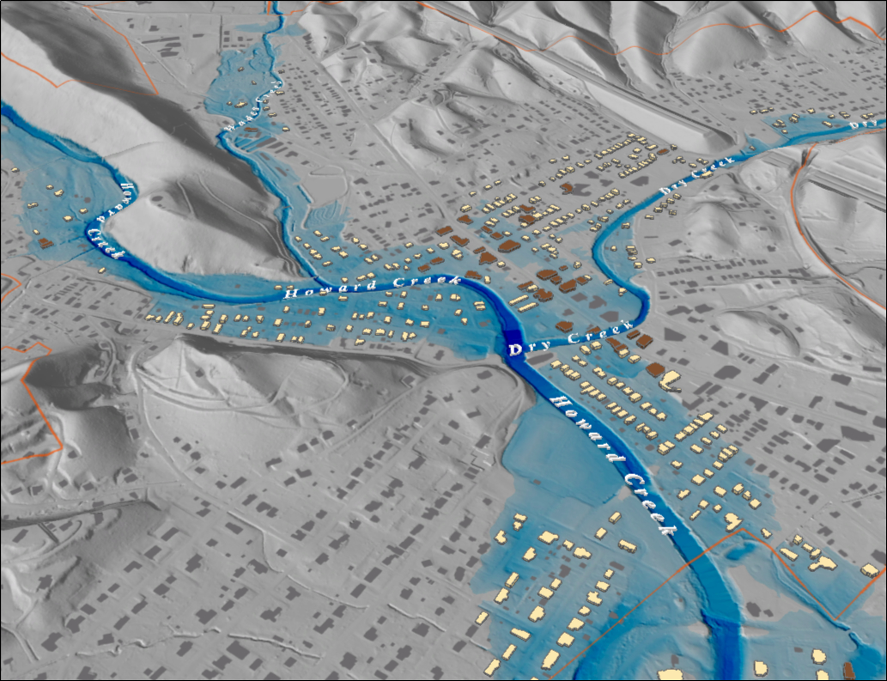
Notes:
White Sulfur Springs FEMA 100yr Grey

Slide 11
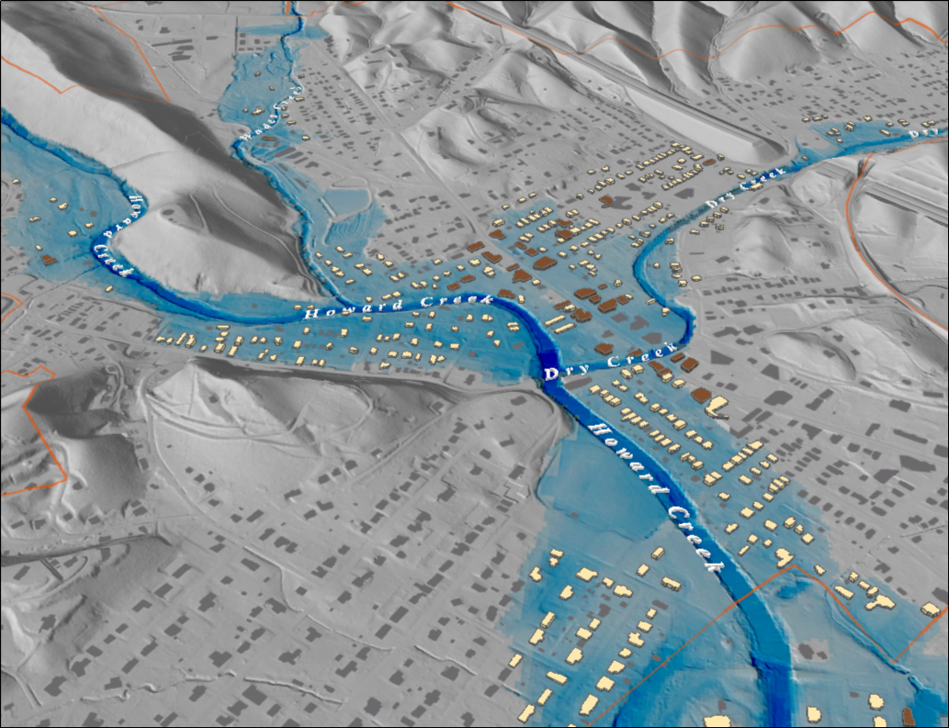
Notes:
White Sulfur Springs FEMA 100yr PLUS Grey

Slide 12
Notes:
White Sulfur Springs FEMA 500yr Grey

Slide 13
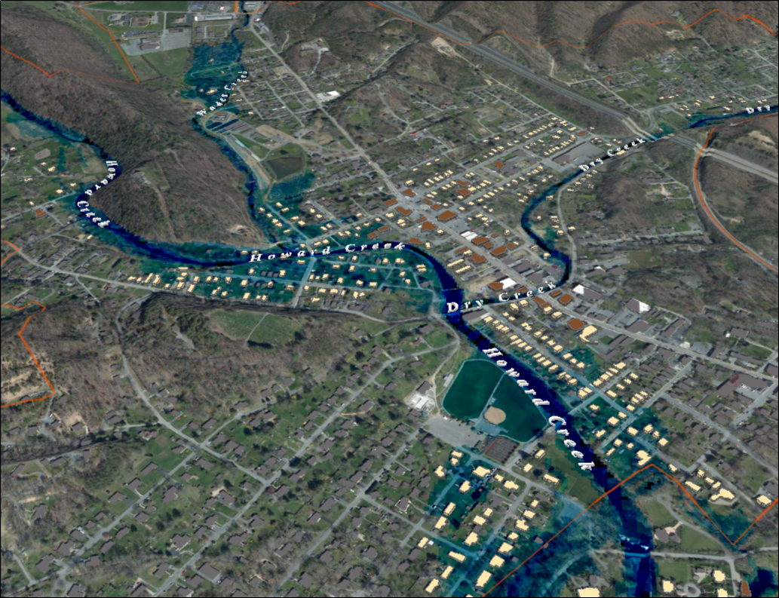
Notes:
White Sulfur Springs FEMA 10yr Aerial

Slide 14
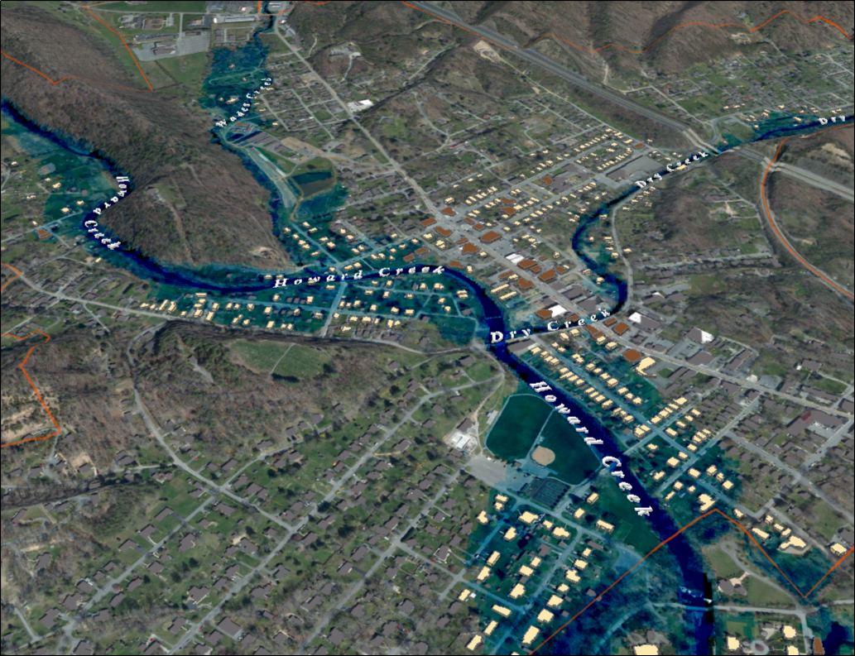
Notes:
White Sulfur Springs FEMA 25yr Aerial

Slide 15
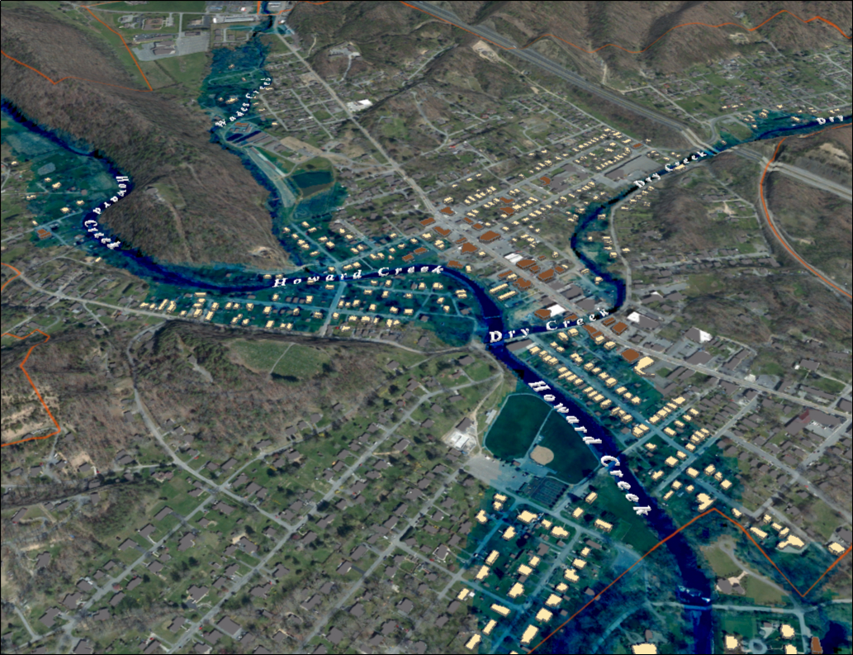
Notes:
White Sulfur Springs FEMA 50yr Aerial

Slide 16
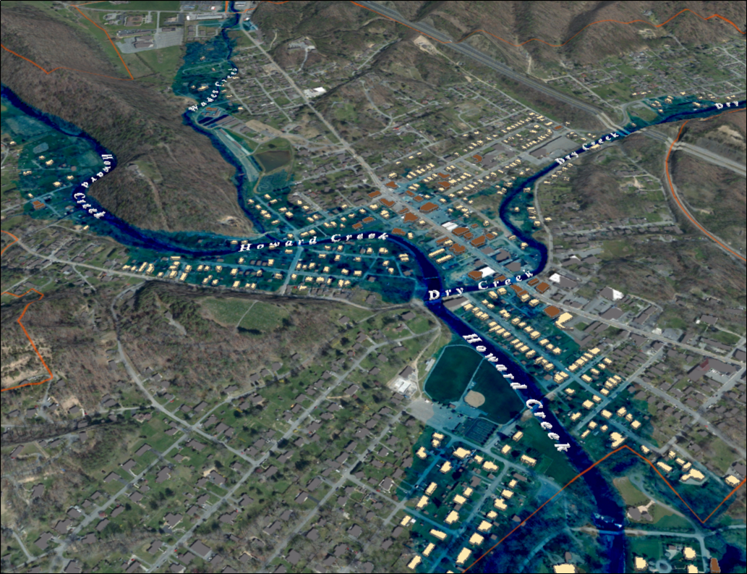
Notes:
White Sulfur Springs FEMA 100yr Aerial

Slide 17
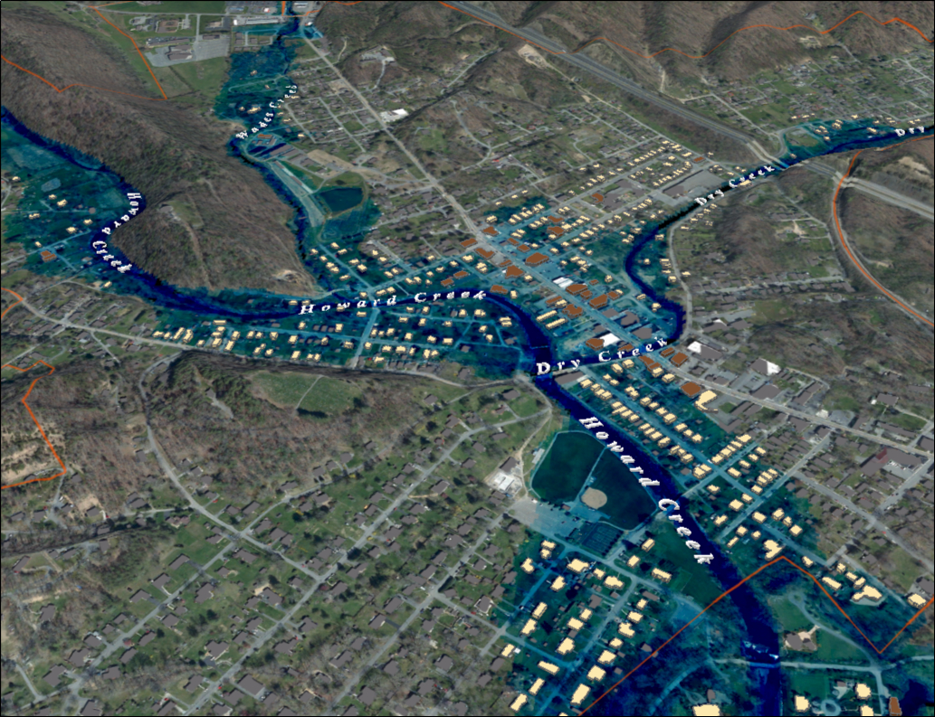
Notes:
White Sulfur Springs FEMA 100yr PLUS Aerial

Slide 18
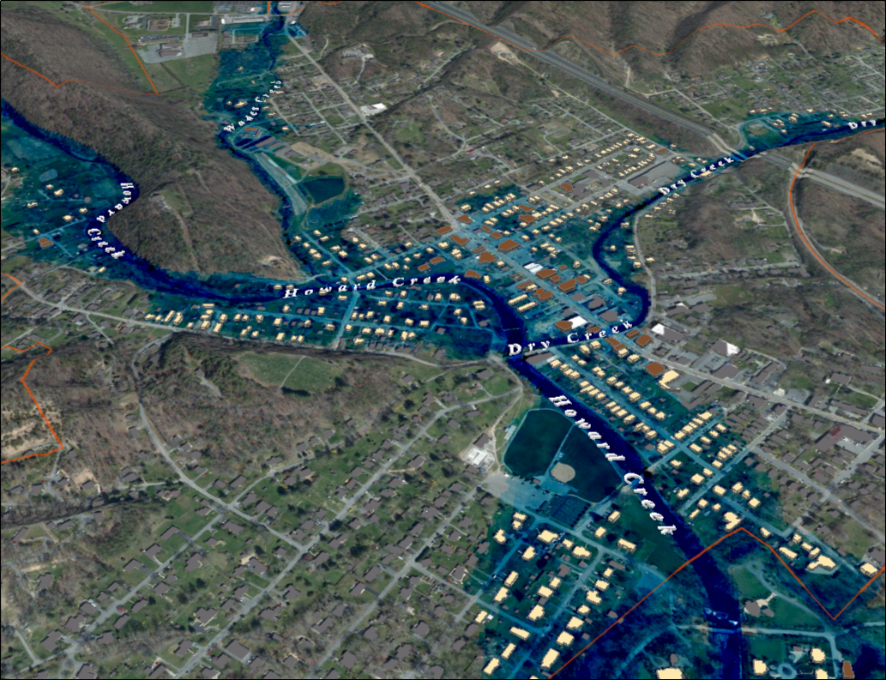
Notes:
White Sulfur Springs FEMA 500yr Aerial

