Slide 1
Flood Characteristics
Category | Flood Characteristic | White Sulphur Springs | Rainelle
Frequency (new flood maps) | Probability that a flood of a specific size will be equaled or exceeded in any given year
 | FEMA Flood Models: 10-, 25-, 50-, 100-, 100+, and 500-year flood elevations. FEMA’s 1%+ flood elevations measure how high the 100-year flood could be given the statistical uncertainties in flood modeling (upper 84-percent confidence limit). | See models | See models
 | First Street Foundation Flood Models: 5-, 20-, 100-, and 500-year flood elevations. Climate models based on 2052 or 30 years in the future. | See models | See models
Depth | Flood depth or water surface elevation above the ground surface. Source USGS high-water marks. | 6 feet | 8 feet
Velocity | Speed at which the floodwaters are flowing | High | Moderate
Duration | Measure of how long water remains above normal levels | 24 hours | 72 hours
Rise and Fall | Floodwater that rises very quickly with little or no warning | Quick Rise | Quick Rise
Notes: Flood characteristics are based on the 2016 flood and FEMA’s new flood studies

Slide 2
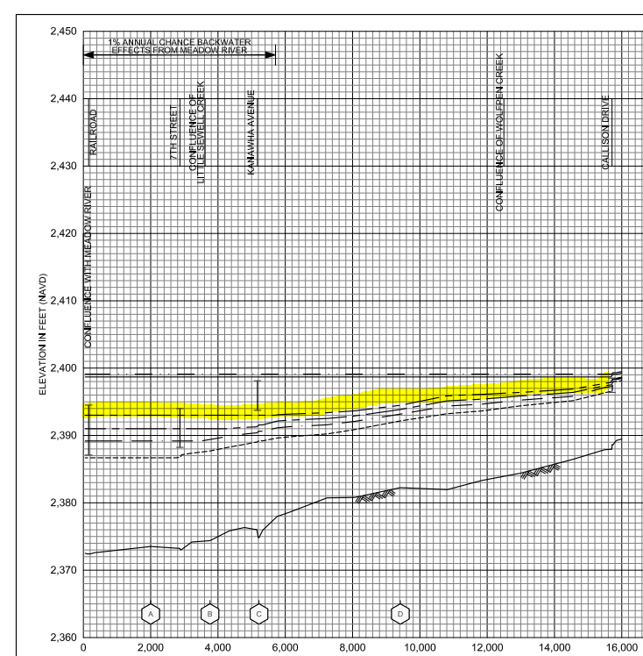
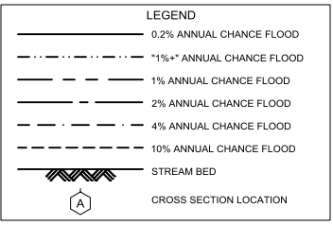
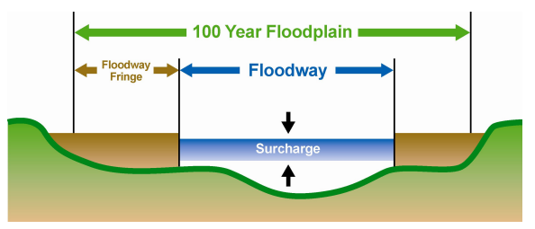
Sewell Creek Flood Study Profile
2022 Preliminary 1% Base Flood (100-Yr) Elevation 1850.7 ft for Building 13-17-0009-0026-0000_138
New 2022 FEMA Maps
The 2012 FEMA flood maps were incomplete in that the high risk flood areas were not fully mapped. The floodplain narrowed significantly and most of the town was no longer in the Special Flood Hazard Area (SFHA).
The 2022 base flood elevation (100-yr) for a majority of Rainelle between 1st and 14th Streets is 2,393 feet. A similar base flood elevation was mapped for the 1987 flood maps for structures northwest of Main Street (U.S. 60).
The “1-percent plus” is a measure of how high the 1% flood could be given the statistical uncertainties in flood modeling. The backwater flooding from Meadow River results in more uncertainty of the flood model and thus a wider confidence level. The 1%+ flood elevation is six feet higher than 1% elevation and same as the 02%.
Confluence of Little Sewell Creek
Confluence of Wolfren Creek
182 7th Street (Bldg.13-13-0001-0054-0000_182
2016 Flood
2,396.4 ft. (BFE + 3.4 ft. to reach HWM)
The "Regulatory Floodway" is the channel of a river or other watercourse and the adjacent land areas that must be reserved in order to discharge the base flood without cumulatively increasing the water surface elevation more than a designated height. Source: FEMA
Sewell Creek 2022 Flood Study Profile

Slide 3
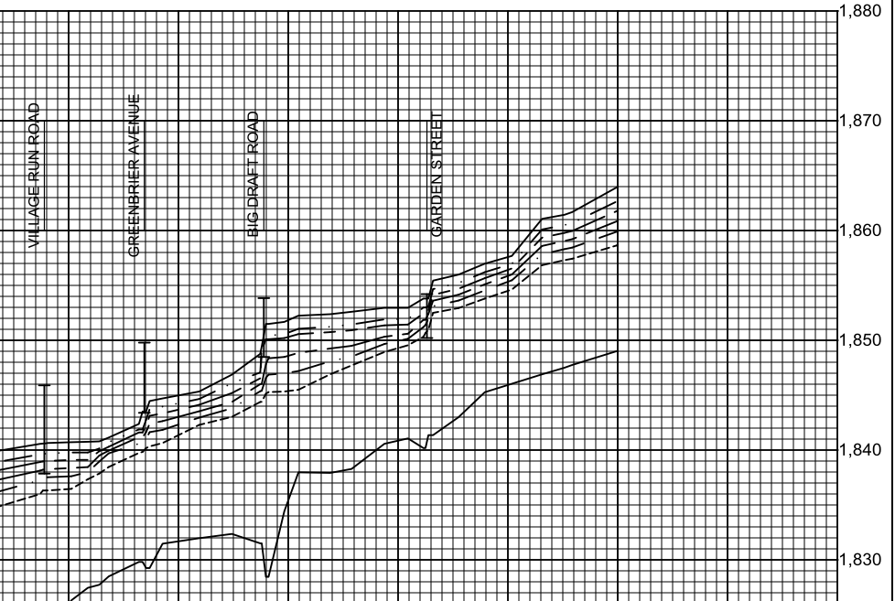
Howard Creek Flood Study Profile
2022 Preliminary 1% Base Flood (100-Yr) Elevation 1850.7 ft for Building 13-17-0009-0026-0000_138
Preliminary 2022 FEMA Maps
2022 Base Flood Elevation increased 1 to 1.5 feet from the 2012 FEMA Map between Dry Creek Bridge (Big Draft Rd) and Wades Creek Bridge (Garden St)
Confluence of Dry Creek
Confluence of Wades Creek
For bridges shown on the flood profile, the structure is represented by an “I” symbol. The top of the bridge symbol represents the top of road and the bottom of the symbol represents the low chord (or low steel) of the bridge.
Bldg. 13-17-0009-0026-0000_138 1% WSEL 1850.7 ft.
3.5’ ponding upslope
of Big Draft Bridge
1.5’ ponding upslope
of Garden Street Bridge
2016 Flood
1,852.5 ft. (BFE + 1.8 ft. to reach HWM)
https://data.wvgis.wvu.edu/pub/NSF/FloodProfiles/54025CV002B.pdf#page=43
FEMA FIS Technical Reference 2019

Slide 4
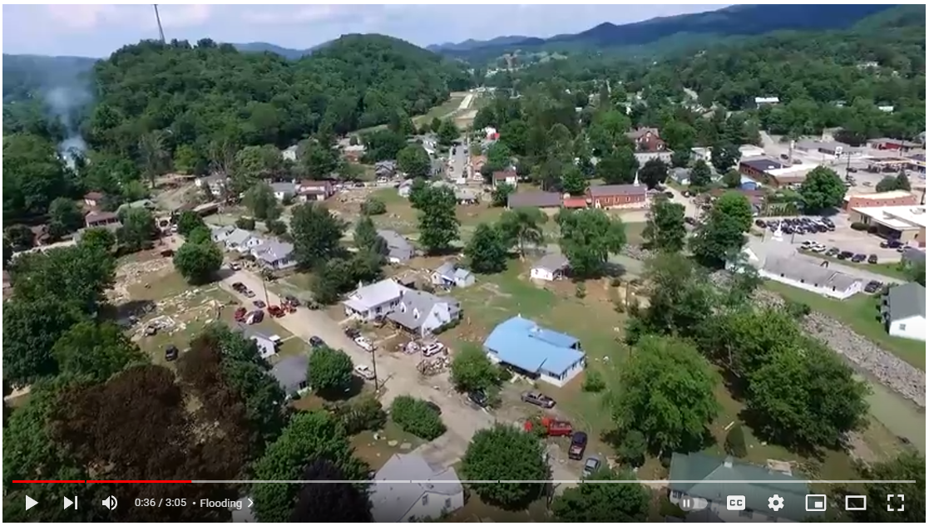
2016 Damage Video (White Sulphur Springs)
Video Link

Slide 5
Flood Characteristics
Flood Characteristics Impacting Community
Frequency: Probability that a flood of a specific size will be equaled or exceeded in any given year
5-, 10-, 20-, 25-, 50-, 100-, and 500-year flood elevations (above sea level) refer to expected water levels of the 20%, 10%, 5%, 4%, 2%, 1%, and 0.2% annual chance flood events. A 1000-yr flood has a 0.1% chance of happening in any given year.
FEMA’s 1%+ flood elevations measure how high the 100-year flood could be given the statistical uncertainties in flood modeling. It represents the upper 84-percent confidence limit of the statistical error for calculating the 1-percent annual chance event.
The relative frequency of any given flood (e.g., 5-year or 10-year) serves as a useful reference point when selecting a mitigation options and evaluating cost effectiveness.
Depth: Flood depth or water surface elevation above the ground surface
Critical during design considerations, as it is often the primary factor in evaluating the potential for flood damage
Flood depth sources include flood models and high water marks which measure the degree of flooding
Velocity: Speed at which the floodwaters are flowing
Flowing water often causes erosion and scour, as well as debris impacts and hydrodynamic forces.
FEMA’s detailed engineering studies provide river/stream flows
Duration: Measure of how long water remains above normal levels.
Prolonged contact with floodwaters may make some mitigation measures, including dry flood-proofing, inappropriate because of the increased chance of seepage and potential structural failure.
Long periods of inundation are more likely to cause greater damage to structural members and finishes than short periods of flooding.
Rate of Floodwater Rise and Fall: Floodwater that rises very quickly with little or now warning
Steep topography and locations with small drainage areas may experience flash flooding in which floodwater can rise very quickly with little or no warning.
High-velocity water flows usually accompany flash floods and preclude certain types of flood mitigation measures, especially those requiring human intervention
Rapid rates of the rise and fall of floodwater can also lead to unequal hydrostatic pressures on a building. The probability of unequal hydrostatic pressures increases when building exteriors are designed to be watertight
Historical Information: Use past information like the high-water marks of the 2016 Flood as an indication of the nature and severity of effects likely to occur during future events.
Source: FEMA 2013

Slide 6
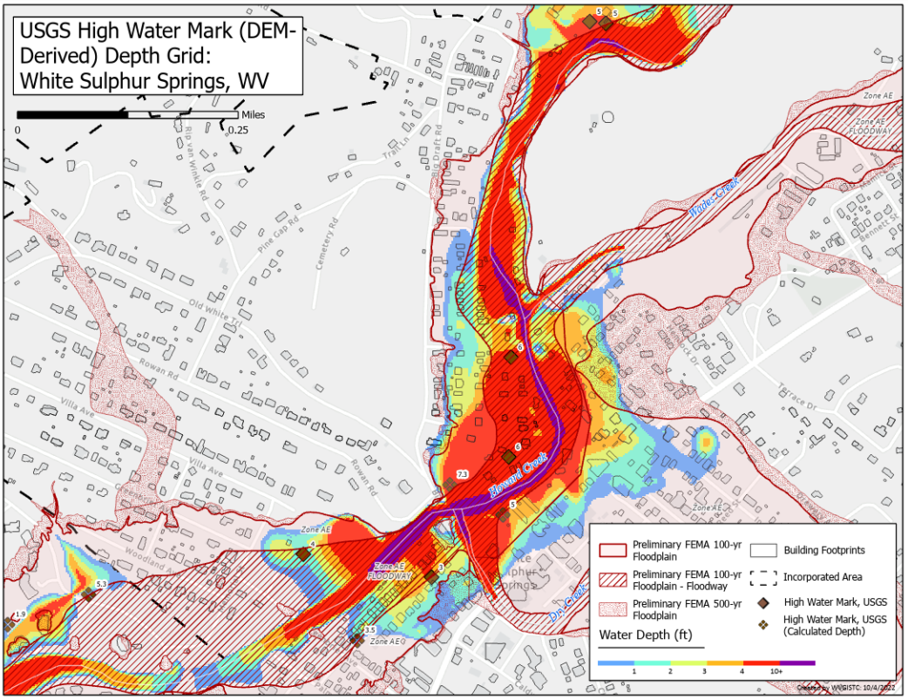
USGS High Water Marks: 2016 Flood Depths

Slide 7
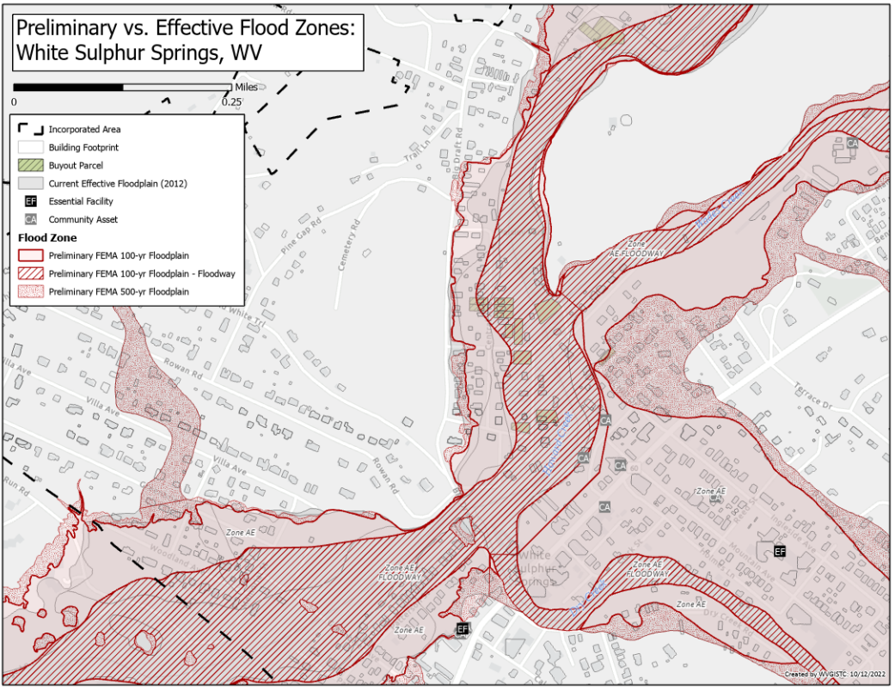
Preliminary FEMA Flood Maps Effective 2023

Slide 8
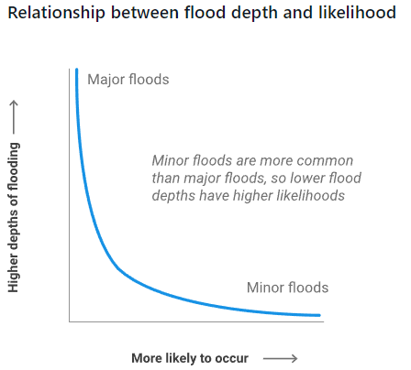
Flood Frequency
Frequency: Probability that a flood of a specific size will be equaled or exceeded in any given year.
5-, 10-, 20-, 25-, 50-, 100-, and 500-year flood elevations (above sea level) refer to expected water levels of the 20%, 10%, 5%, 4%, 2%, 1%, and 0.2% annual chance flood events.
FEMA |  |  |  |  |  | First Street Foundation (FSF)
Return Period (Likelihood) and Flood Size (Magnitude) | Annual Probability | Cumulative Probability - Flooding at least once over 30 years | FEMA Risk Description | Climate Model |  | Return Period and Flood Size (2022, 2037, 2052)* | Annual Probability (flooding at least 1 cm) | Cumulative Probability - Flooding at least once over 30 years | First Street Risk Description | Climate Model
 |  |  |  |  |  | 5 yr (1 in 5) | 20% | >99% | Almost Certain Risk | Yes (2052)
10 yr (1 in 10) | 10% | 96% | High Risk
 |  |  |  |  |  | 20 yr (1 in 20) | 5% | >85% | High Risk | Yes (2052)
25 yr (1 in 25) | 4% | 71% | High Risk
50 yr (1 in 50) | 2% | 45% | High Risk
100 yr (1 in 100) | 1% | 26% | High Risk |  |  | 100 yr (1 in 100) | 1% | >26% | Substantial Risk | Yes (2052)
100 yr (1 in 100) Plus | 1%+ | 26% | High Risk | Yes
500 yr (1 in 500) | 0.2% | 6% | Moderate Risk |  |  | 500 yr (1 in 500) | 0.2% | >0% | Any Risk | Yes (2052)
Climate scenario based on 100-yr plus upper confidence limit |  |  |  |  |  | Climate scenario based on 2052 or 30 years in the future
2022 Flood Study Sources: FEMA and First Street Foundation (FSF)

Slide 9
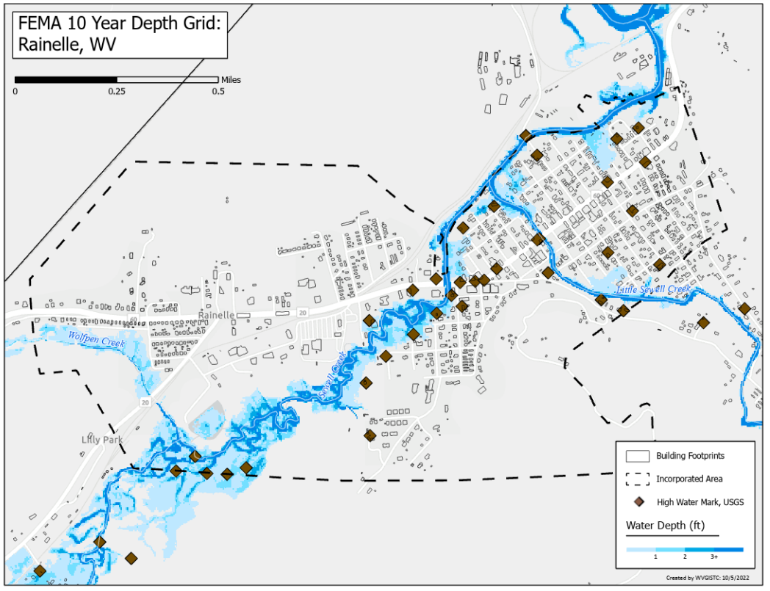
FEMA Flood Model: 10-Year Flood Depth

Slide 10
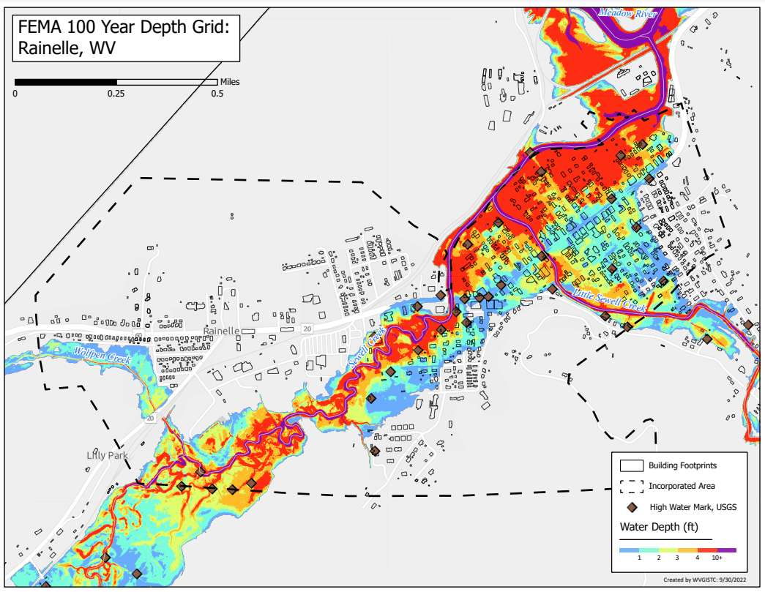
FEMA Flood Model: 100-Year Flood Depth

Slide 11
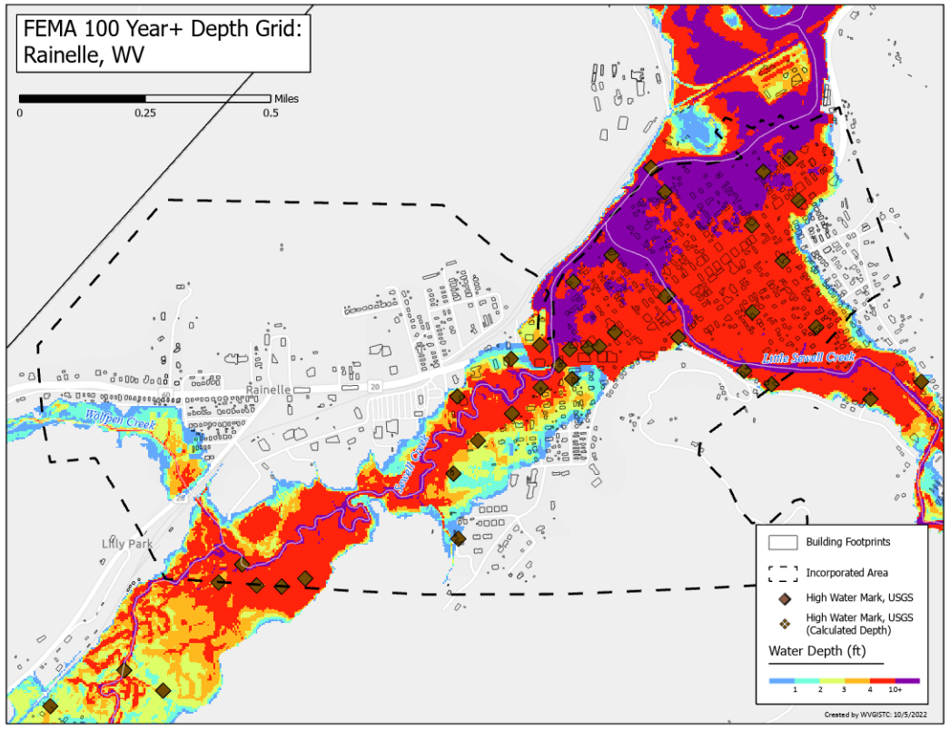
FEMA Flood Model: 100-Year Plus Flood Depth
Climate
Change

Slide 12
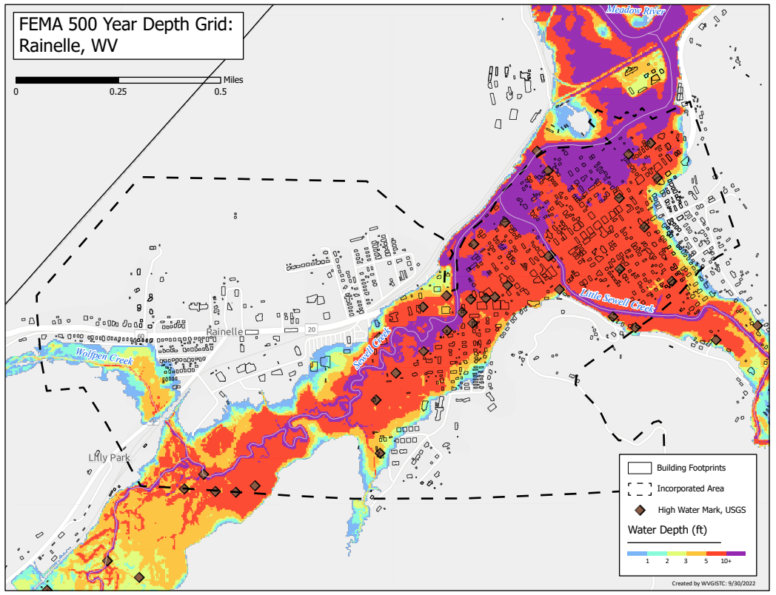
FEMA Flood Model: 500-Year Flood Depth

Slide 13
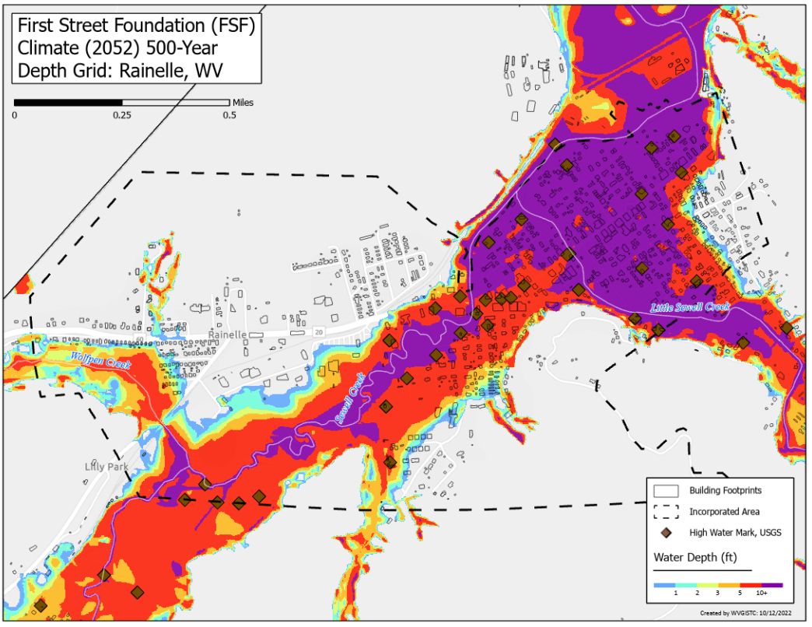
FSF Flood Model: 500-Year Flood Depth 2052
Climate
Change

Slide 14
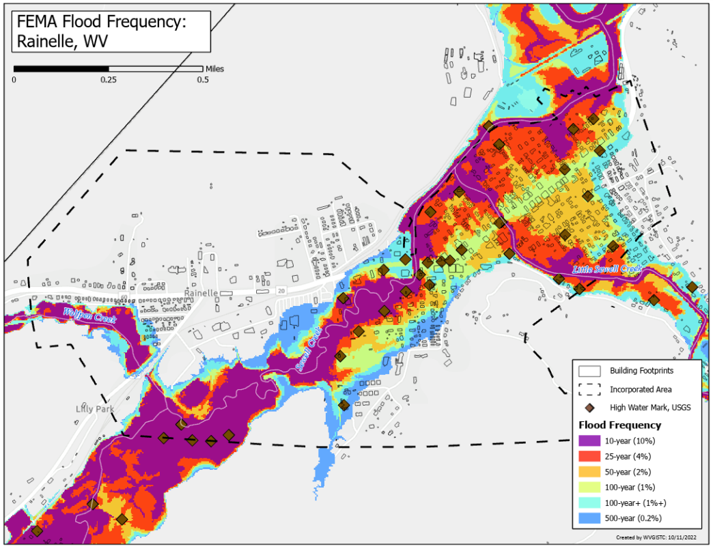
FEMA Flood Models: Likelihood and Magnitude

Slide 15
FEMA Flood Models: Likelihood and Magnitude

Slide 16
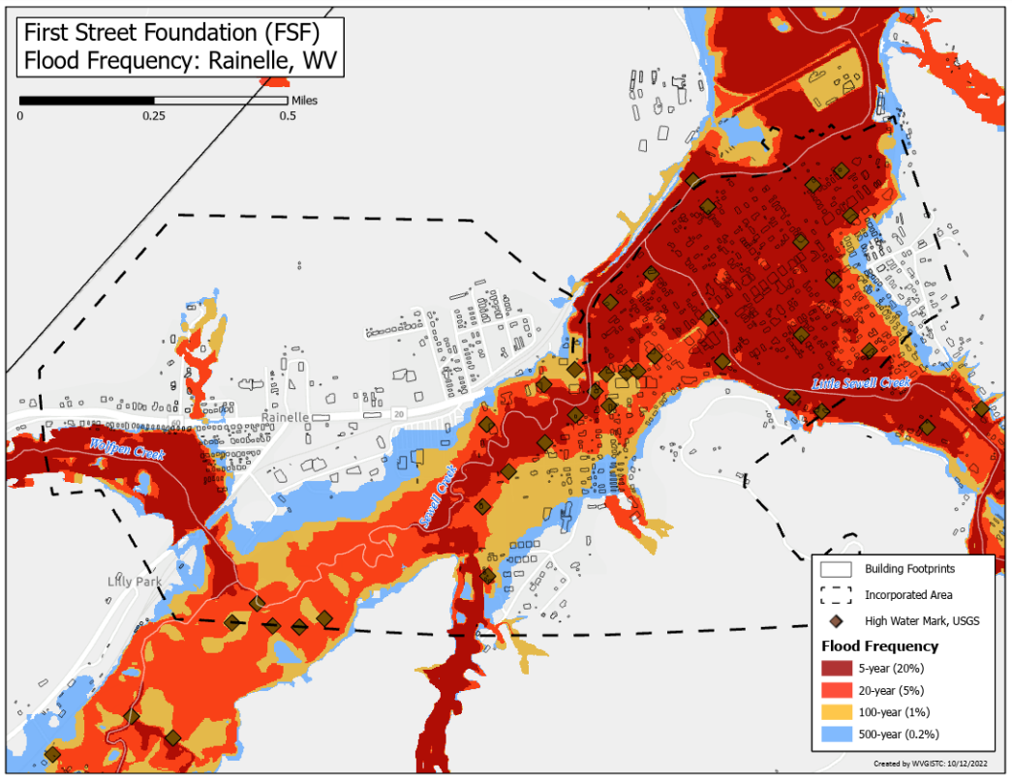
FSF Flood Models: Likelihood and Magnitude

Slide 17
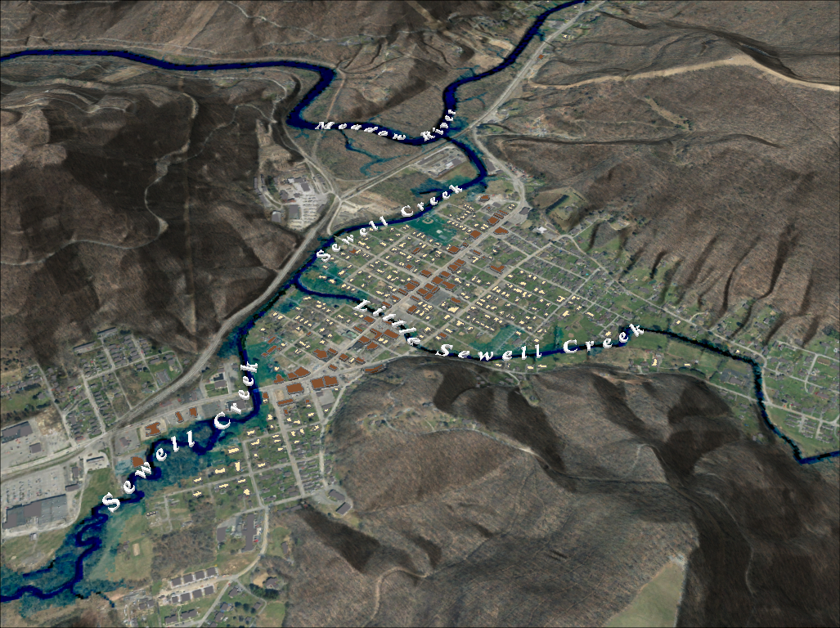
FEMA 10% Annual Chance (10-year) Rainelle, WV
0 ft.
FLOOD DEPTH
35 ft.
96% probability of flooding at least once over 30 years
Notes:
FEMA 10year Aerial

Slide 18
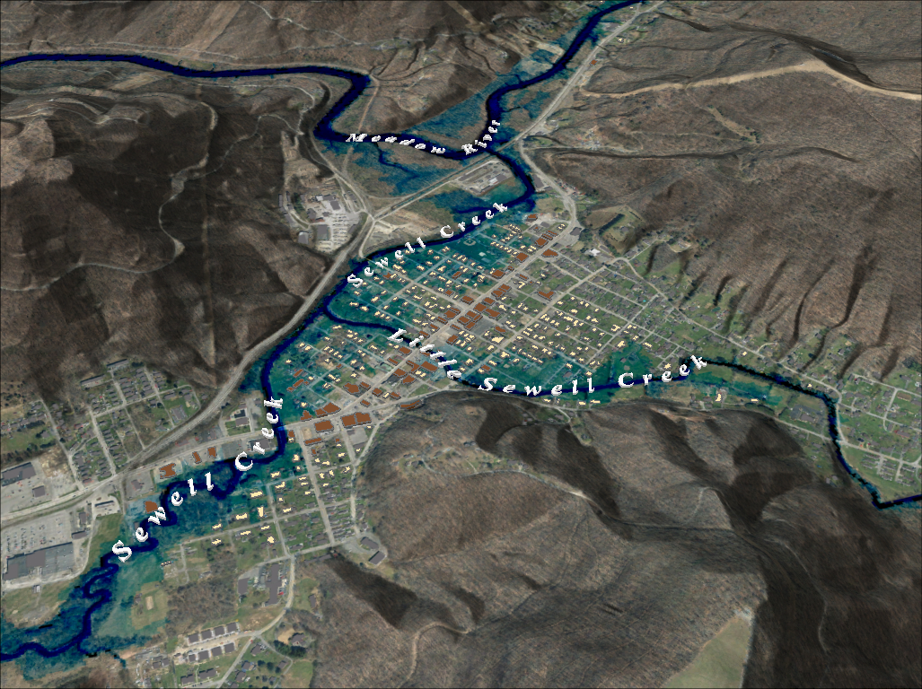
FEMA 4% Annual Chance (25-year) Rainelle, WV
0 ft.
FLOOD DEPTH
35 ft.
71% probability of flooding at least once over 30 years
Notes:
FEMA 25year Aerial

Slide 19
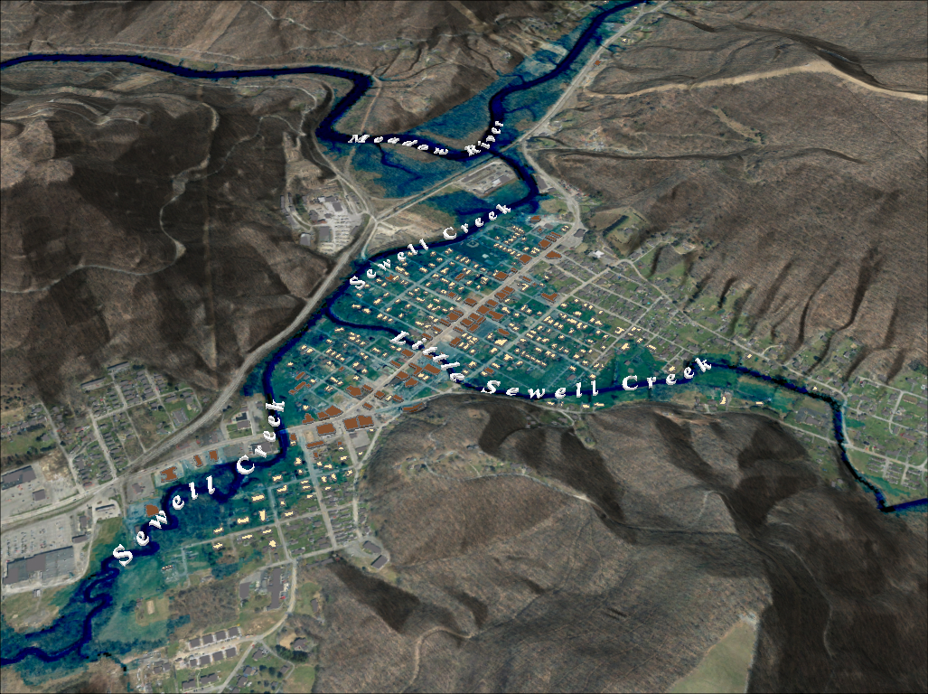
FEMA 2% Annual Chance (50-year) Rainelle, WV
0 ft.
FLOOD DEPTH
35 ft.
45% probability of flooding at least once over 30 years
Notes:
FEMA 50year Aerial

Slide 20
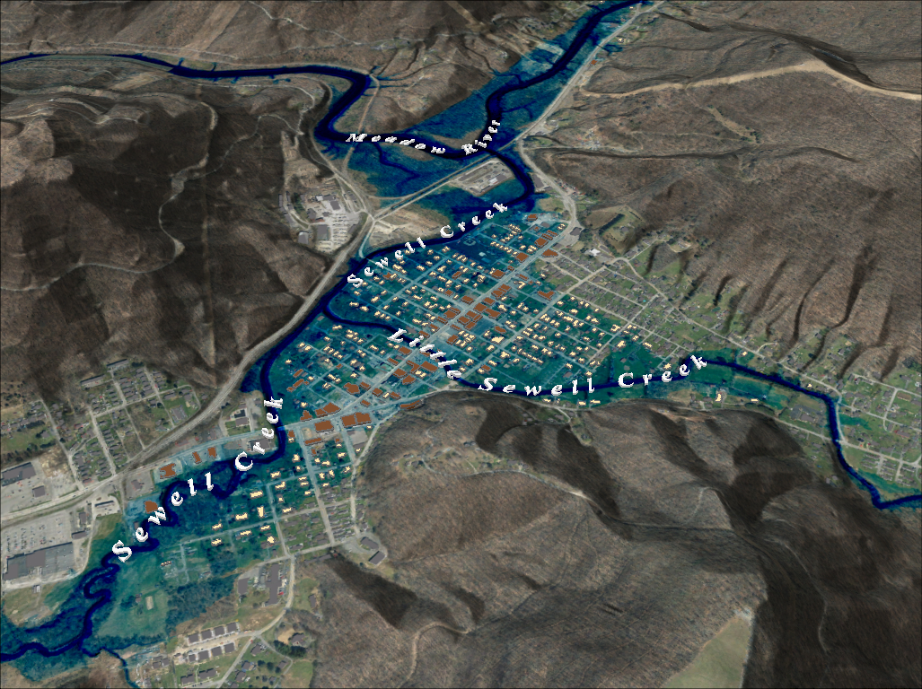
FEMA 1% Annual Chance (100-year) Rainelle, WV
0 ft.
FLOOD DEPTH
35 ft.
26% probability of flooding at least once over 30 years
Notes:
FEMA 100year Aerial

Slide 21
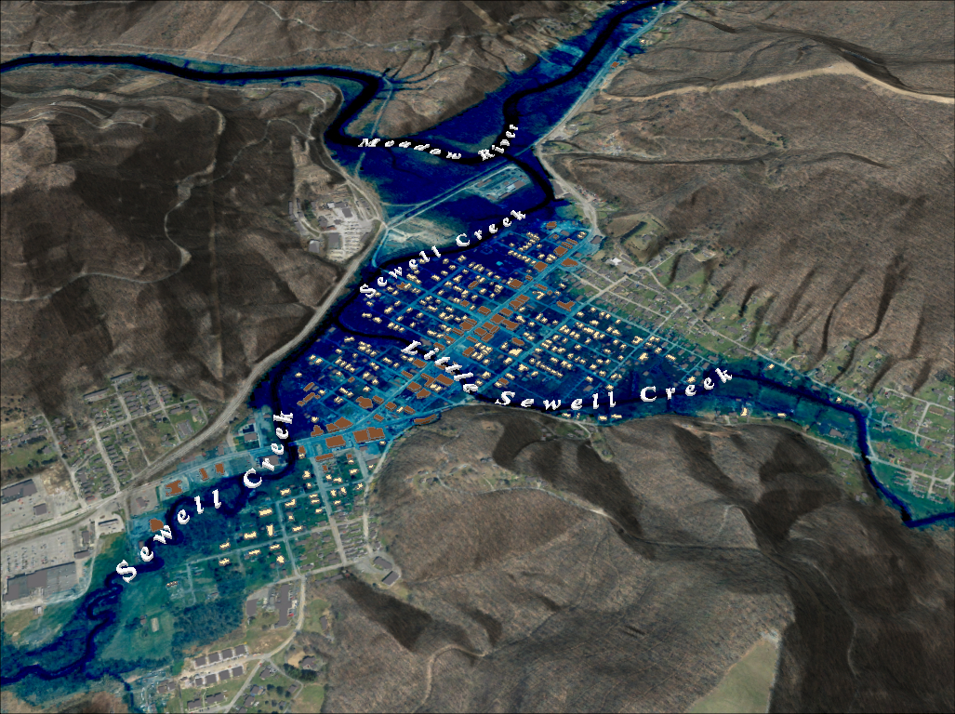
FEMA 1%+ Annual Chance (100-year) Rainelle, WV
Climate
Change
0 ft.
FLOOD DEPTH
35 ft.
26% probability of flooding at least once over 30 years
Notes:
FEMA 100year PLUS Aerial

Slide 22
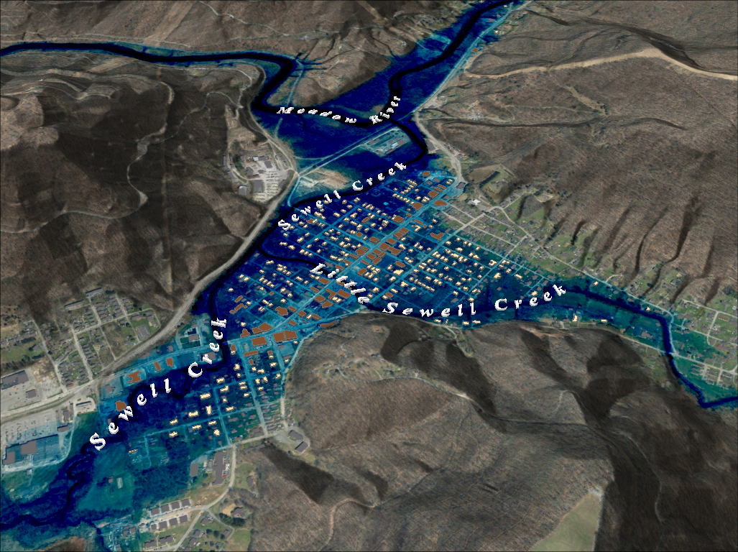
FEMA 0.2% Annual Chance (500-year) Rainelle, WV
0 ft.
FLOOD DEPTH
35 ft.
6% probability of flooding at least once over 30 years
Notes:
FEMA 500year Aerial

Slide 23
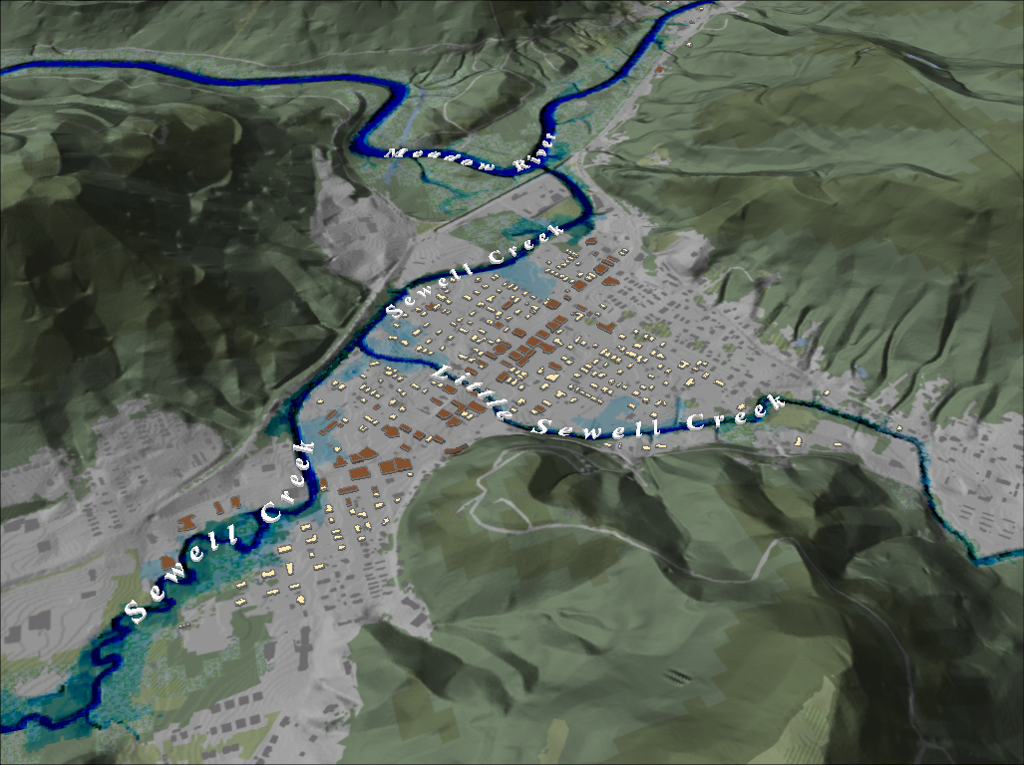
FEMA 10% Annual Chance (10-year) Rainelle, WV
Notes:
FEMA 10 year NLCD Hillshade

Slide 24
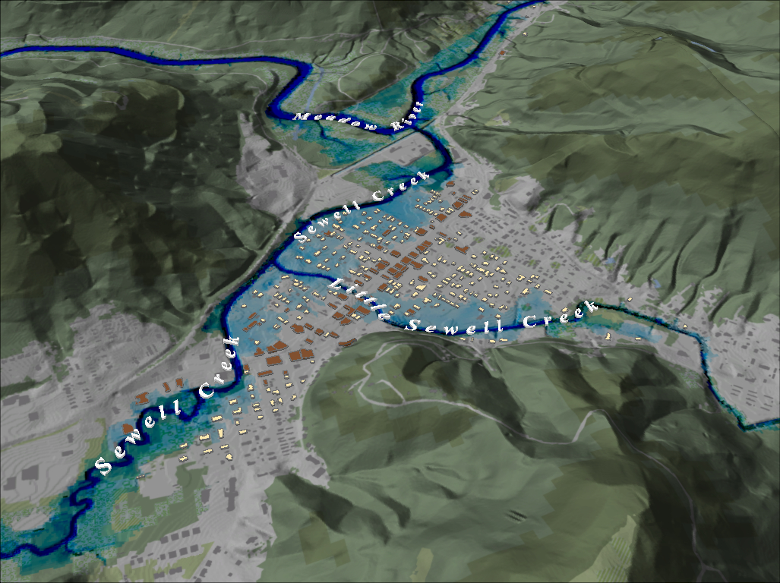
FEMA 4% Annual Chance (25-year) Rainelle, WV
Notes:
FEMA 25 year NLCD Hillshade

Slide 25
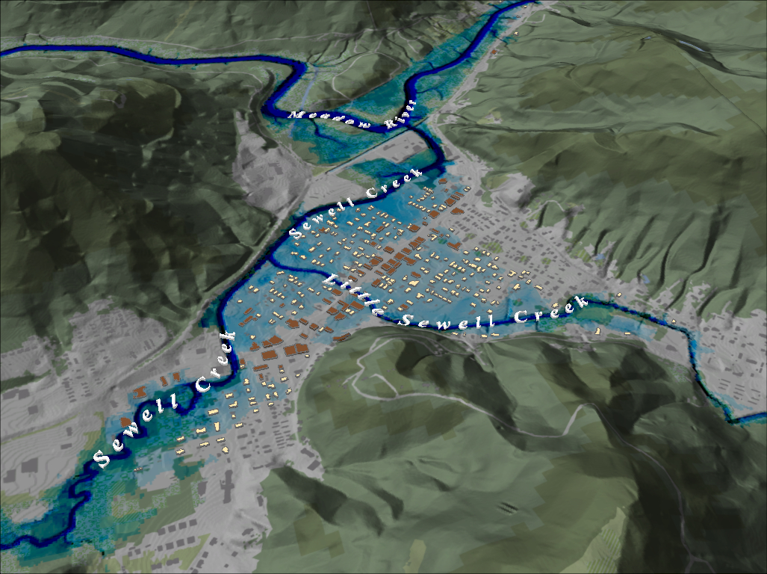
FEMA 2% Annual Chance (50-year) Rainelle, WV
Notes:
FEMA 50 year NLCD Hillshade

Slide 26
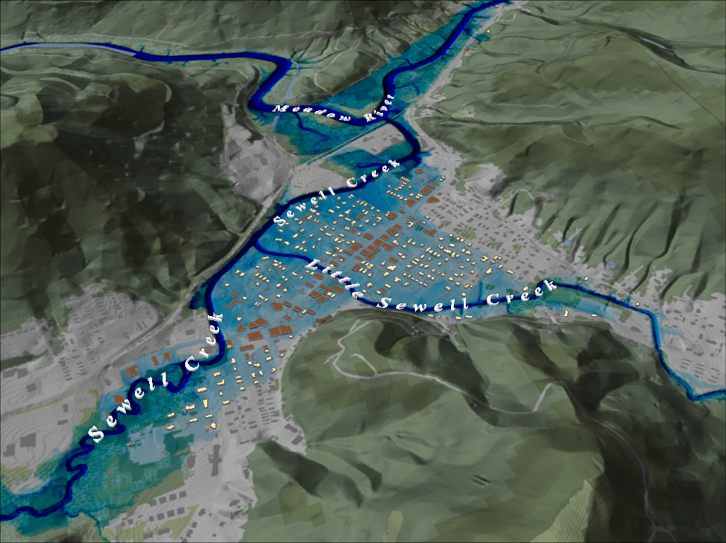
FEMA 1% Annual Chance (100-year) Rainelle, WV
Notes:
FEMA 100 year NLCD Hillshade

Slide 27
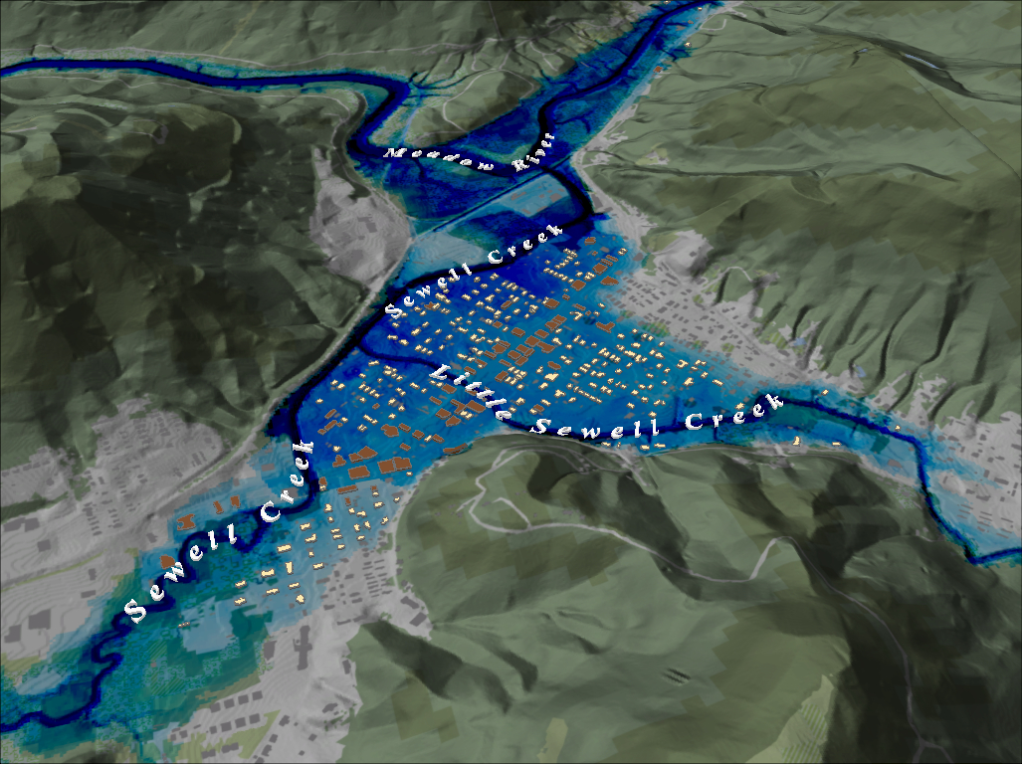
FEMA 1%+ Annual Chance (100-year) Rainelle, WV
Notes:
FEMA 100 year PLUS NLCD Hillshade

Slide 28
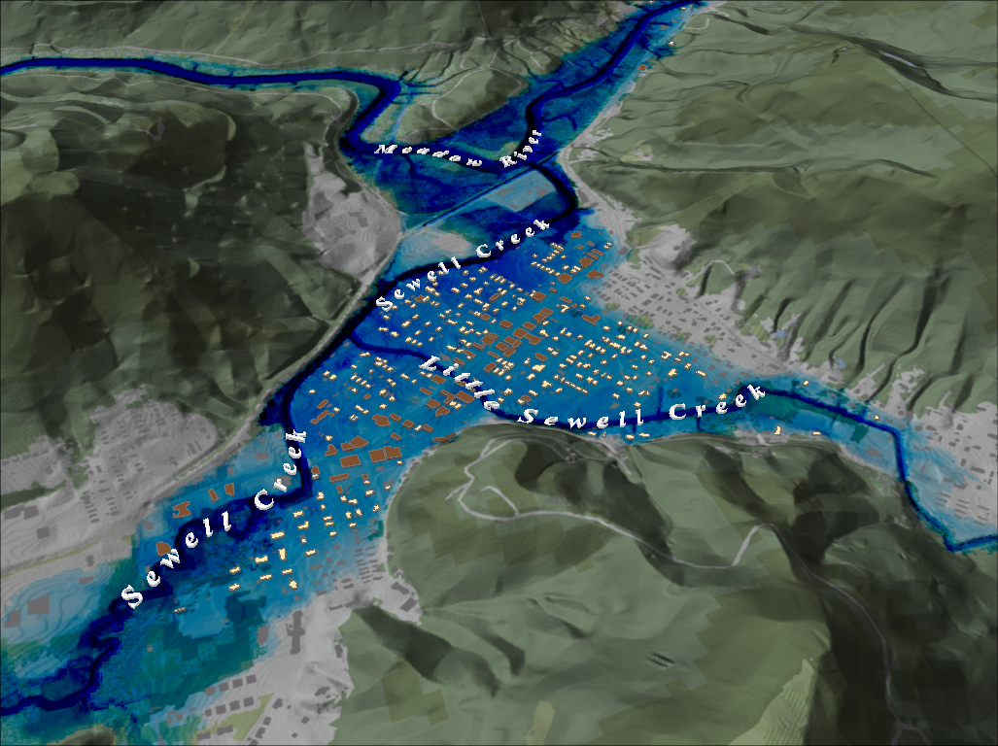
FEMA 0.2% Annual Chance (500-year) Rainelle, WV
Notes:
FEMA 500 year NLCD Hillshade

Slide 29
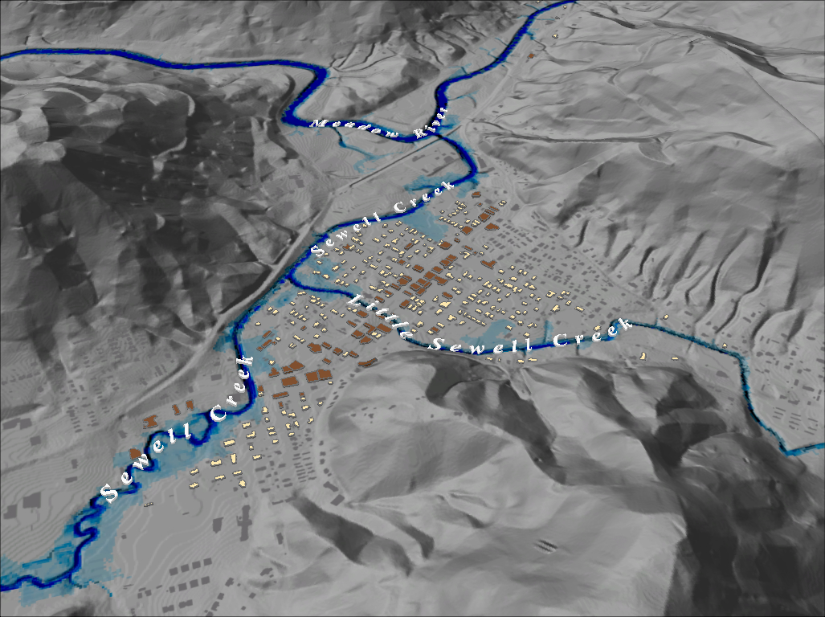
FEMA 10% Annual Chance (10-year) Rainelle, WV
Notes:
FEMA 10 year Grey Hillshade

Slide 30
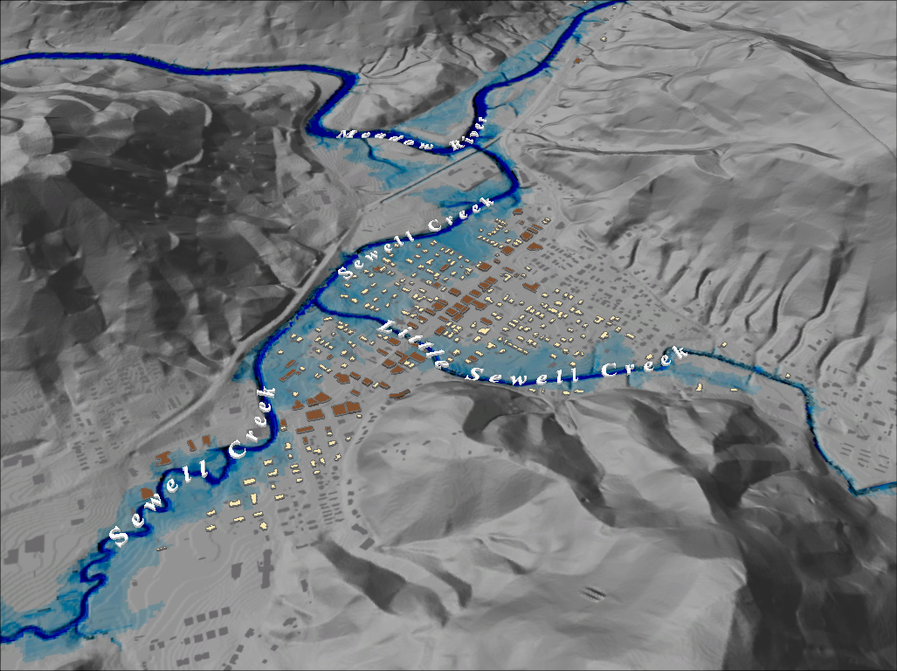
FEMA 4% Annual Chance (25-year) Rainelle, WV
Notes:
FEMA 25 year Grey Hillshade

Slide 31
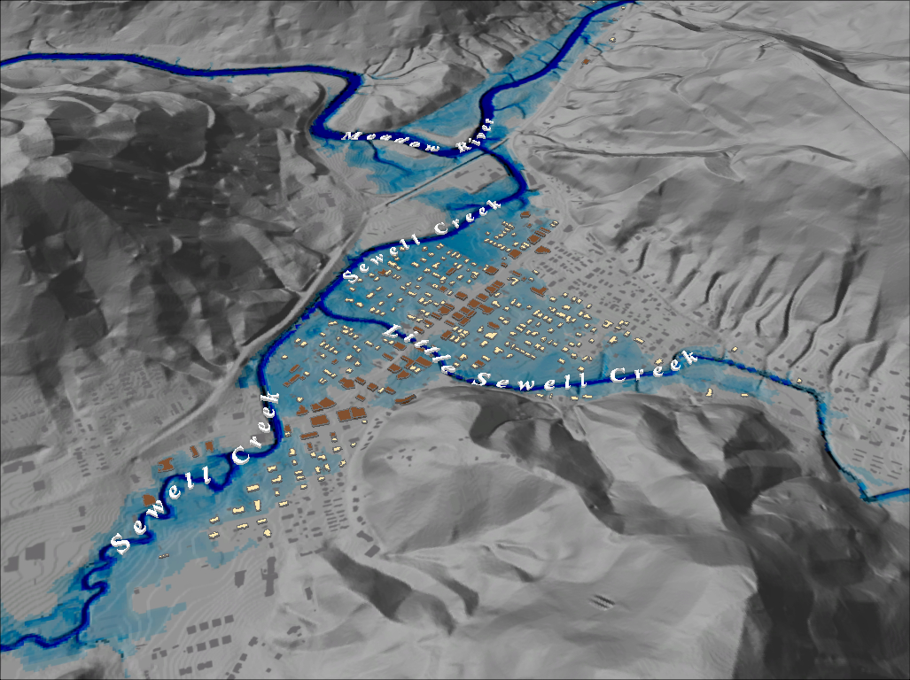
FEMA 2% Annual Chance (50-year) Rainelle, WV
Notes:
FEMA 50 year Grey Hillshade

Slide 32
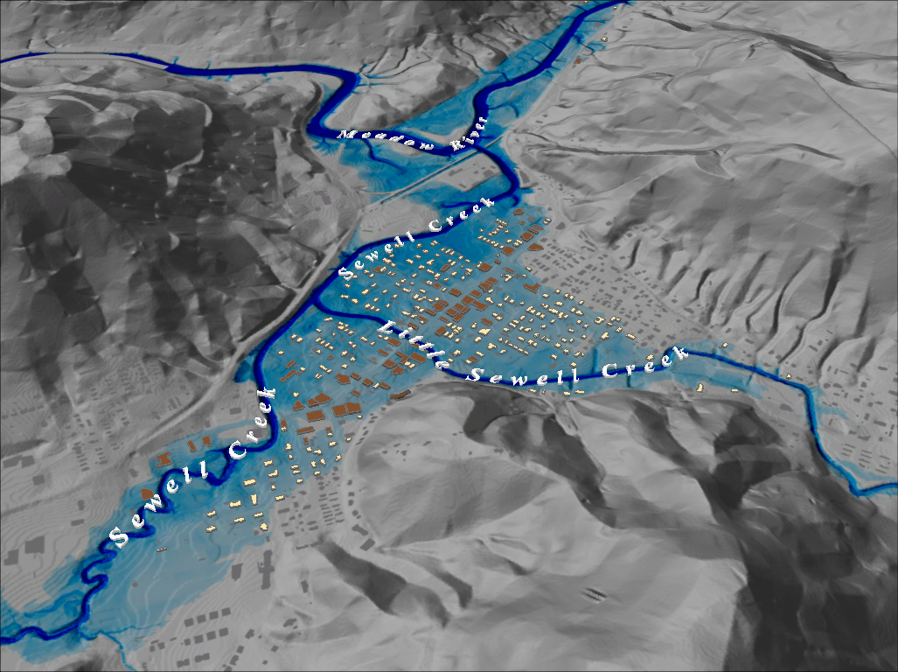
FEMA 1% Annual Chance (100-year) Rainelle, WV
Notes:
FEMA 100 year Grey Hillshade

Slide 33
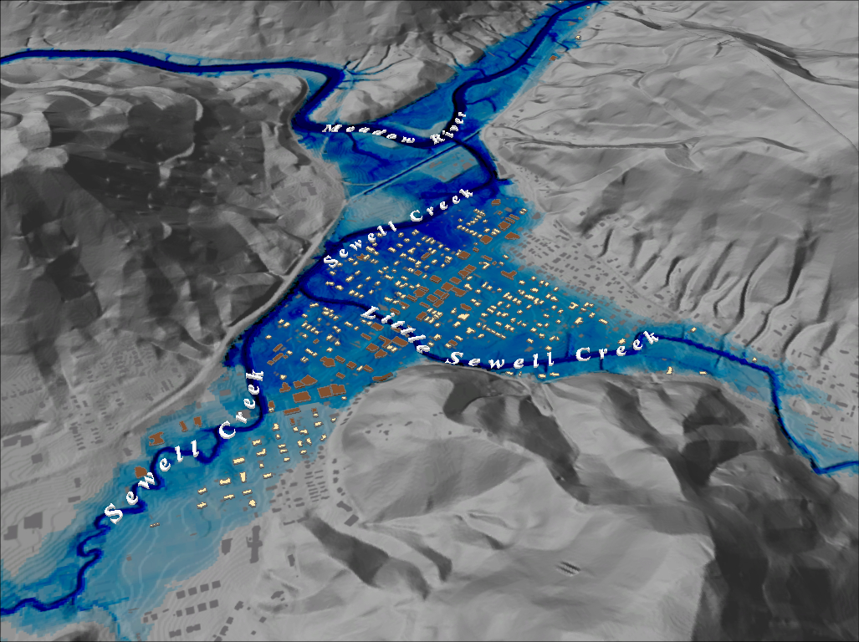
FEMA 1%+ Annual Chance (100-year) Rainelle, WV
Notes:
FEMA 100 year PLUS Grey Hillshade

Slide 34
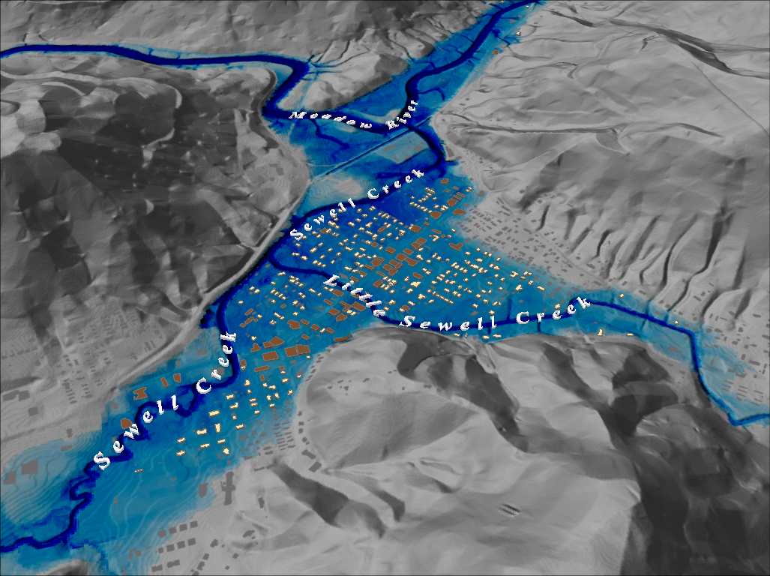
FEMA 0.2% Annual Chance (500-year) Rainelle, WV
Notes:
FEMA 500 year Grey Hillshade

