Slide 1
Flood Characteristics
Category | Flood Characteristic | White Sulphur Springs | Rainelle
Frequency (new flood maps) | Probability that a flood of a specific size will be equaled or exceeded in any given year
 | FEMA Flood Models: 10-, 25-, 50-, 100-, 100+, and 500-year flood elevations. FEMA’s 1%+ flood elevations measure how high the 100-year flood could be given the statistical uncertainties in flood modeling (upper 84-percent confidence limit). | See models | See models
 | First Street Foundation Flood Models: 5-, 20-, 100-, and 500-year flood elevations. Climate models based on 2052 or 30 years in the future. | See models | See models
Depth | Flood depth or water surface elevation above the ground surface. Source USGS high-water marks. | 6 feet | 8 feet
Velocity | Speed at which the floodwaters are flowing | High | Moderate
Duration | Measure of how long water remains above normal levels | 24 hours | 72 hours
Rise and Fall | Floodwater that rises very quickly with little or no warning | Quick Rise | Quick Rise
Notes: Flood characteristics are based on the 2016 flood and FEMA’s new flood studies

Slide 2
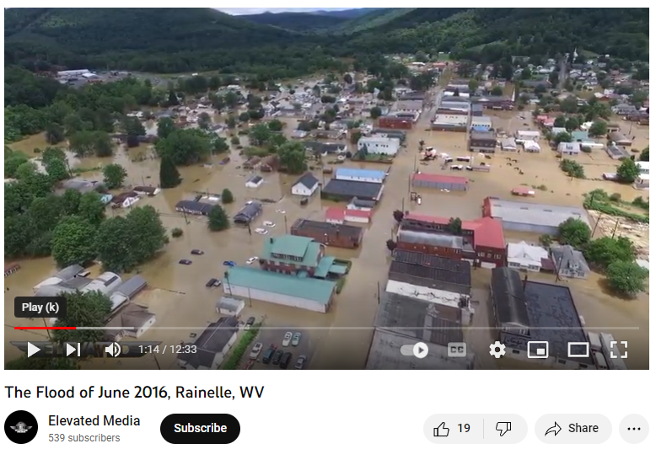
2016 Flood Drone Video (Rainelle, WV)
Video Link
Notes: Drone Video flood elevation: 2,392.5 ft.; Base Flood (100-yr elevation) is 2,930.0 ft., or a half foot above video footage; 2016 Flood Elevation high-water mark: 2,396.4 ft. (about 4 feet higher than video); 500-yr Flood elevation is 2,399.0 ft. or 6.5 feet above video elevation.

Slide 3
Flood Characteristics
Flood Characteristics Impacting Community
Frequency: Probability that a flood of a specific size will be equaled or exceeded in any given year
  5-, 10-, 20-, 25-, 50-, 100-, and 500-year flood elevations (above sea level) refer to expected water levels of the 20%, 10%, 5%, 4%, 2%, 1%, and 0.2% annual chance flood events. A 1000-yr flood has a 0.1% chance of happening in any given year.
  FEMA’s 1%+ flood elevations measure how high the 100-year flood could be given the statistical uncertainties in flood modeling. It represents the upper 84-percent confidence limit of the statistical error for calculating the 1-percent annual chance event.
  The relative frequency of any given flood (e.g., 5-year or 10-year) serves as a useful reference point when selecting a mitigation options and evaluating cost effectiveness.
Depth: Flood depth or water surface elevation above the ground surface
  Critical during design considerations, as it is often the primary factor in evaluating the potential for flood damage
  Flood depth sources include flood models and high water marks which measure the degree of flooding
Velocity: Speed at which the floodwaters are flowing
  Flowing water often causes erosion and scour, as well as debris impacts and hydrodynamic forces.
  FEMA’s detailed engineering studies provide river/stream flows
Duration: Measure of how long water remains above normal levels.
  Prolonged contact with floodwaters may make some mitigation measures, including dry flood-proofing, inappropriate because of the increased chance of seepage and potential structural failure.
  Long periods of inundation are more likely to cause greater damage to structural members and finishes than short periods of flooding.
Rate of Floodwater Rise and Fall: Floodwater that rises very quickly with little or now warning
  Steep topography and locations with small drainage areas may experience flash flooding in which floodwater can rise very quickly with little or no warning.
  High-velocity water flows usually accompany flash floods and preclude certain types of flood mitigation measures, especially those requiring human intervention
  Rapid rates of the rise and fall of floodwater can also lead to unequal hydrostatic pressures on a building. The probability of unequal hydrostatic pressures increases when building exteriors are designed to be watertight
Historical Information: Use past information like the high-water marks of the 2016 Flood as an indication of the nature and severity of effects likely to occur during future events.
Source: FEMA 2013

Slide 4
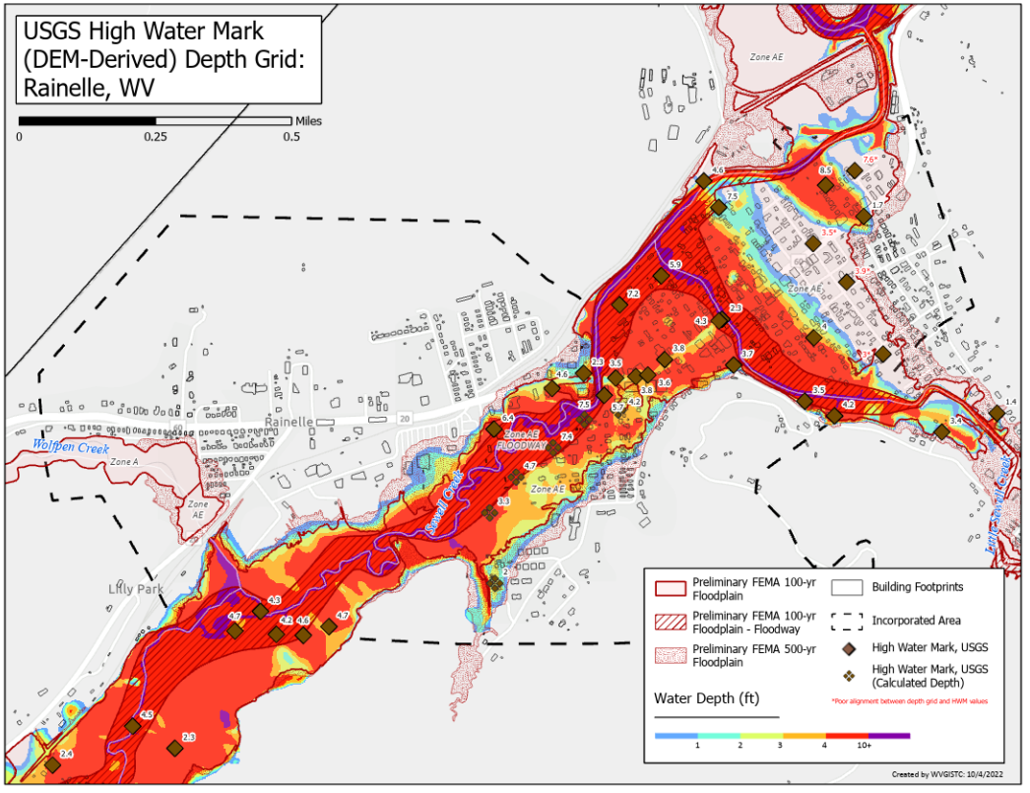
USGS High Water Marks: 2016 Flood Depths

Slide 5
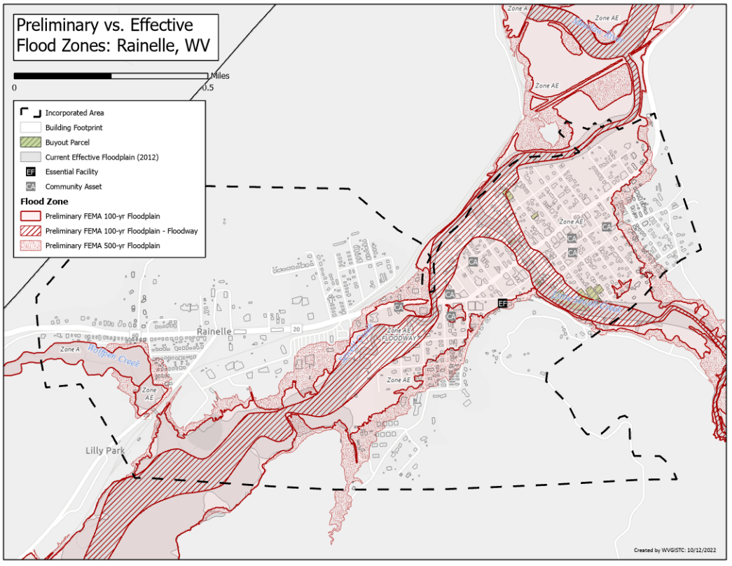
Preliminary FEMA Flood Maps Effective 2023

Slide 6
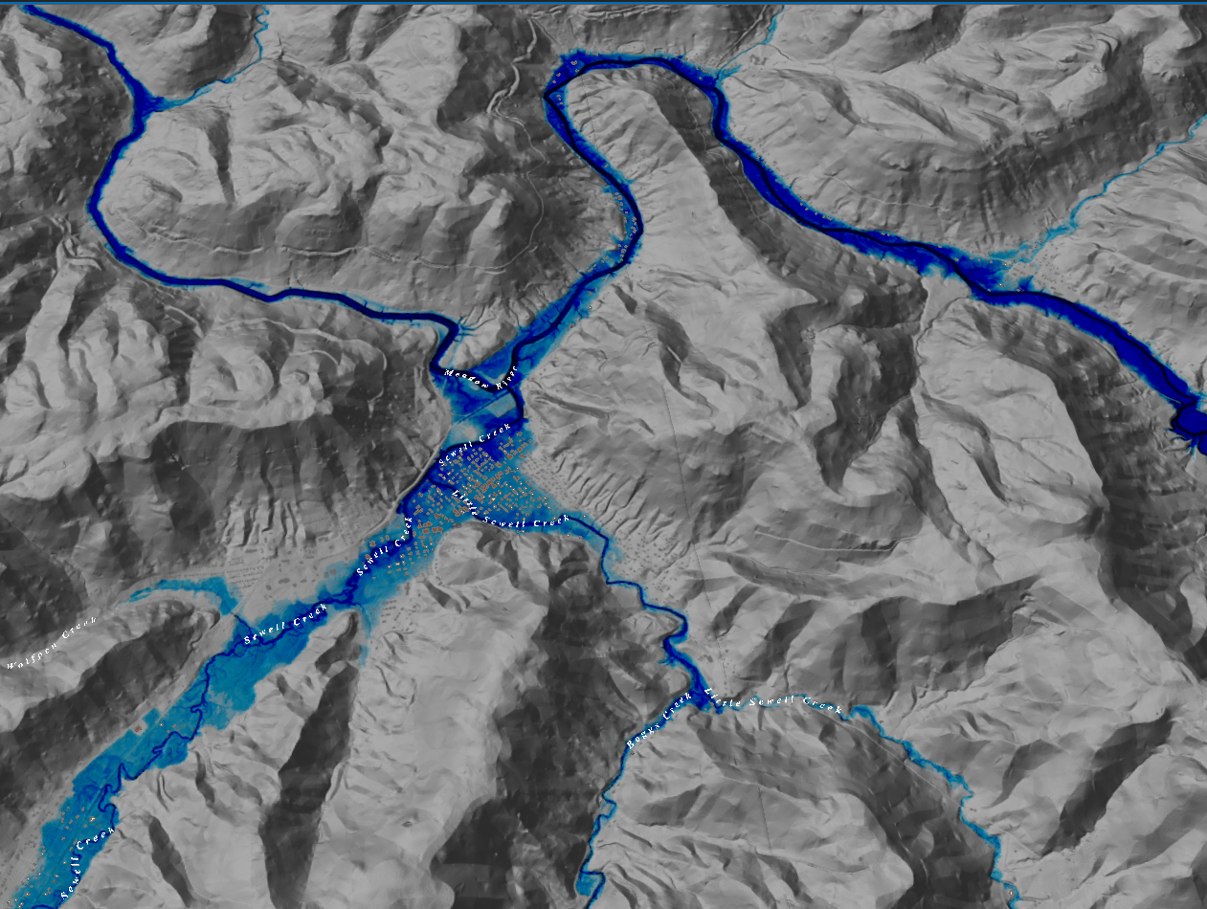
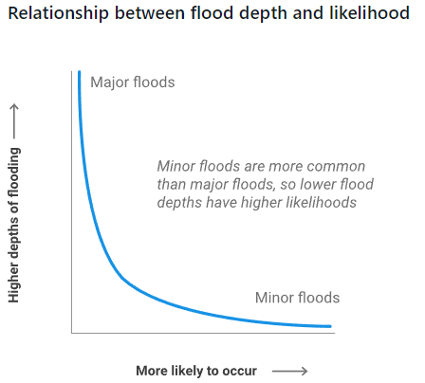
FEMA Flood Models: Likelihood and Magnitude
Rainelle, WV
FEMA
Return Period (Likelihood) and Flood Size (Magnitude) | Annual Probability | Cumulative Probability - Flooding at least once over 30 years | FEMA Risk Description | Climate Model
10 yr (1 in 10) | 10% | 96% | High Risk
25 yr (1 in 25) | 4% | 71% | High Risk
50 yr (1 in 50) | 2% | 45% | High Risk
100 yr (1 in 100) | 1% | 26% | High Risk
100 yr (1 in 100) Plus | 1%+ | 26% | High Risk | Yes
500 yr (1 in 500) | 0.2% | 6% | Moderate Risk

Slide 7
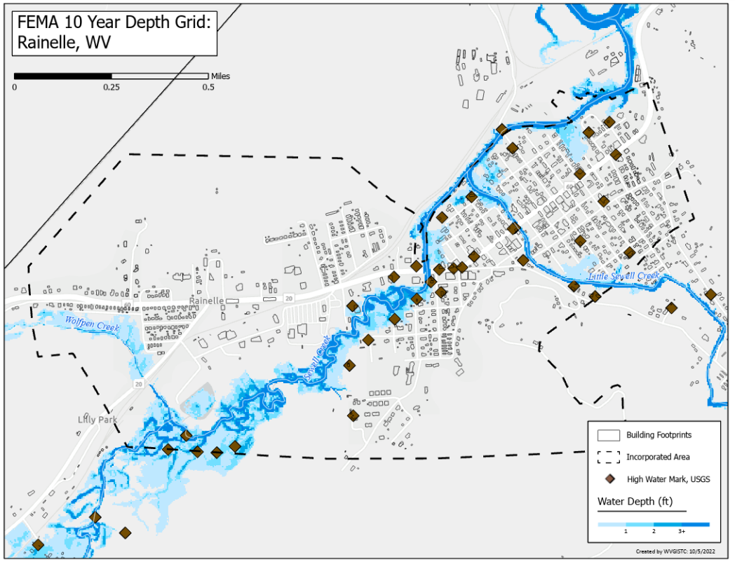
FEMA Flood Model: 10-Year Flood Depth

Slide 8
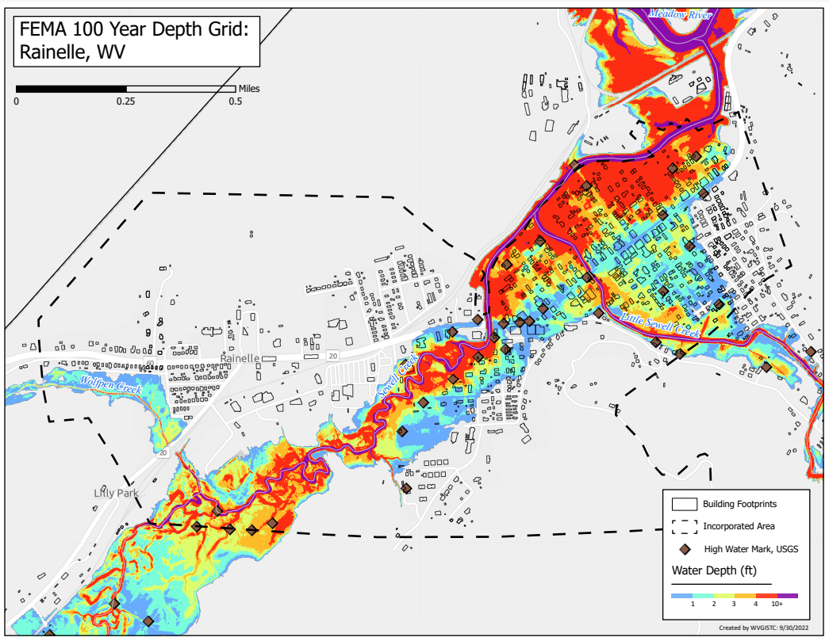
FEMA Flood Model: 100-Year Flood Depth

Slide 9
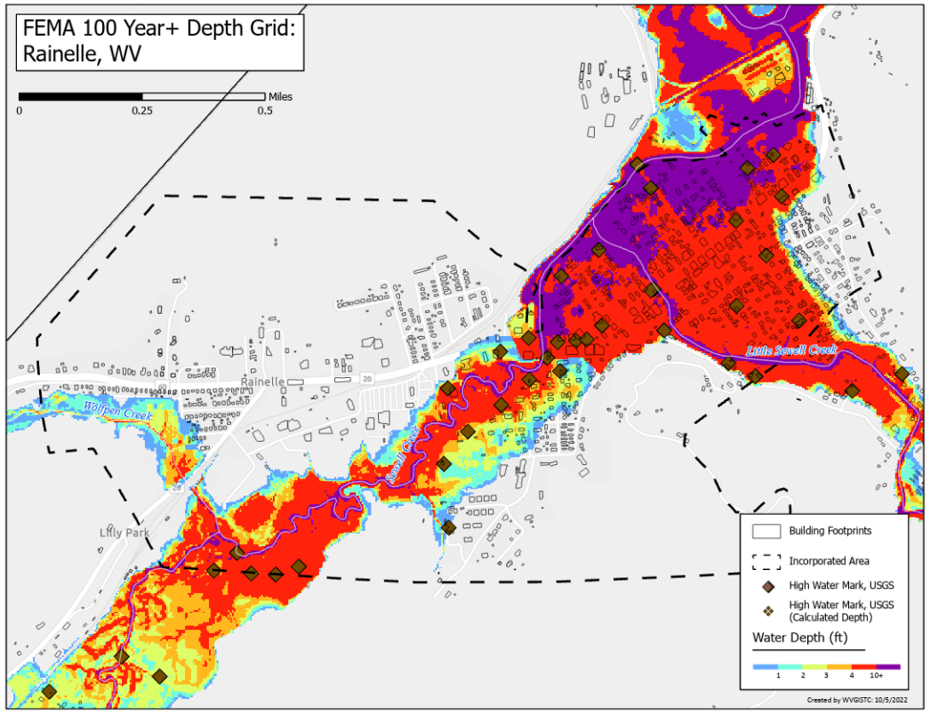
FEMA Flood Model: 100-Year Plus Flood Depth
Climate
Change

Slide 10
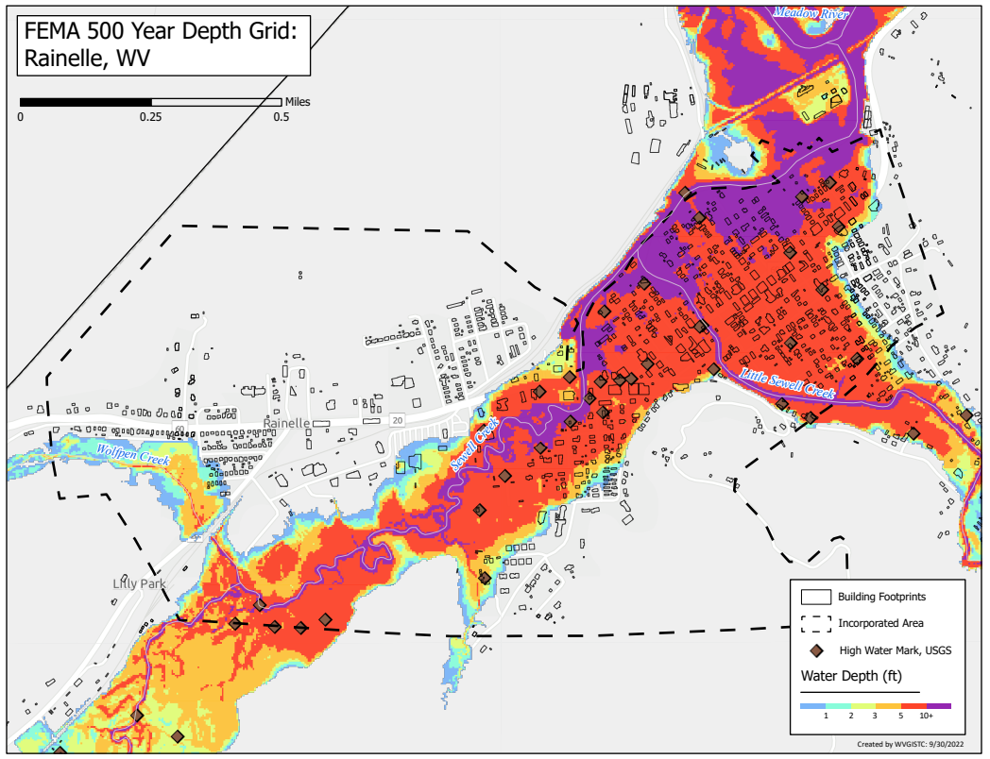
FEMA Flood Model: 500-Year Flood Depth

Slide 11
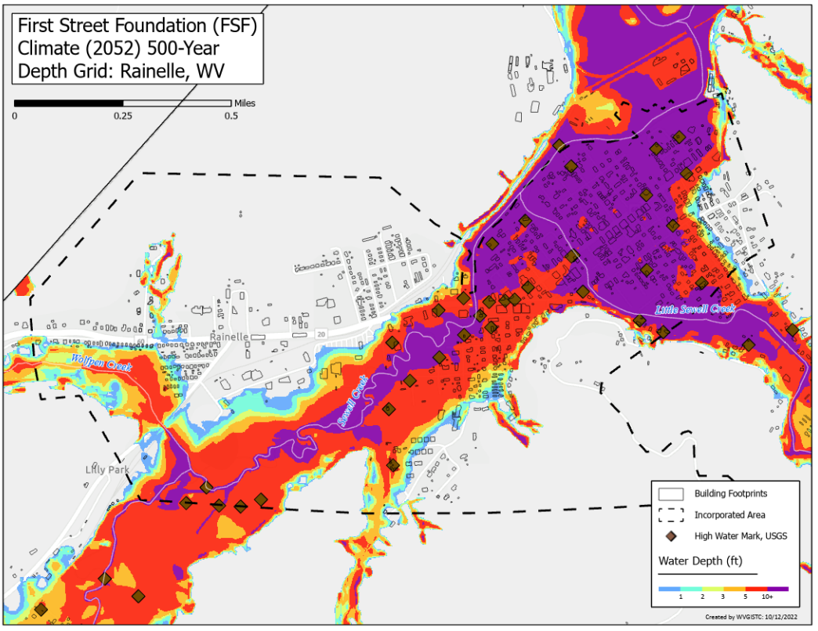
FSF Flood Model: 500-Year Flood Depth 2052
Climate
Change

Slide 12
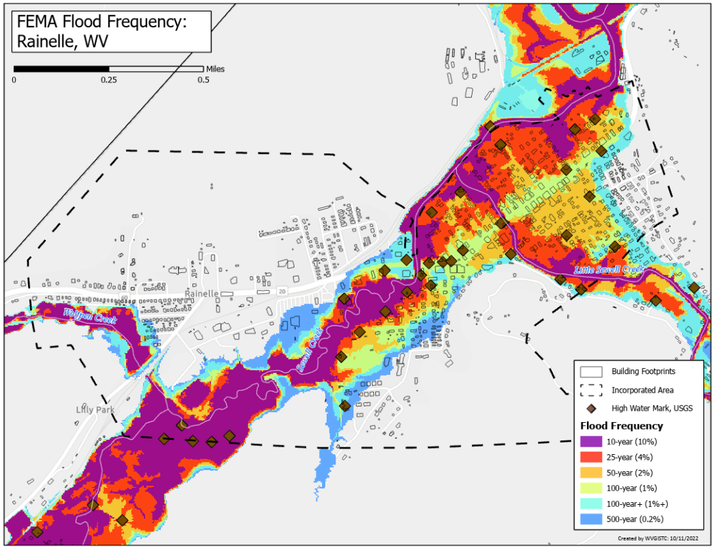
FEMA Flood Models: Likelihood and Magnitude

Slide 13
FEMA Flood Models: Likelihood and Magnitude

Slide 14
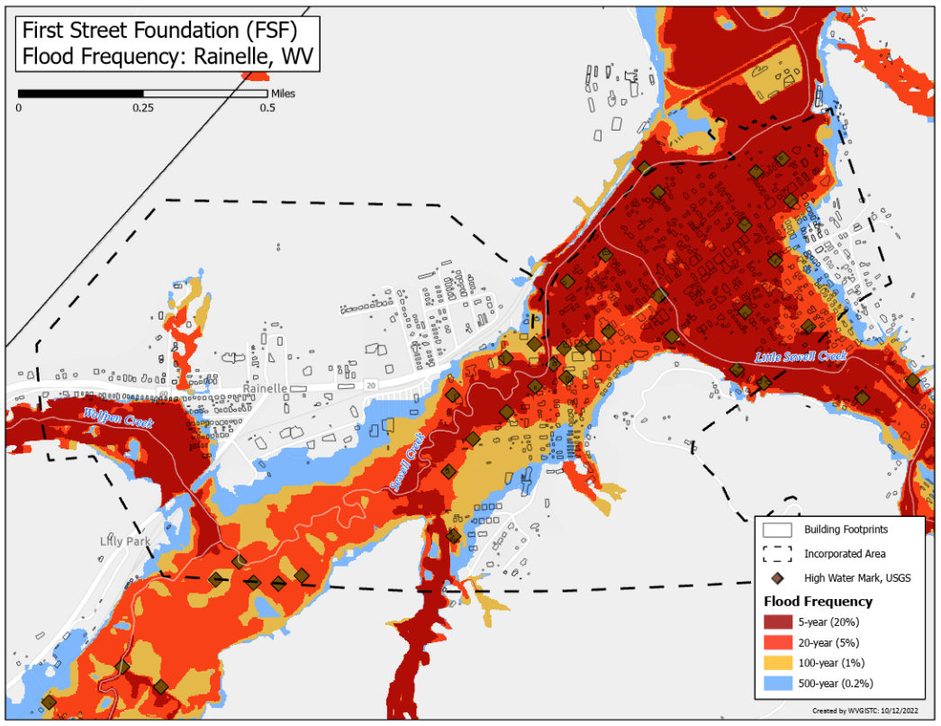
FSF Flood Models: Likelihood and Magnitude

Slide 15
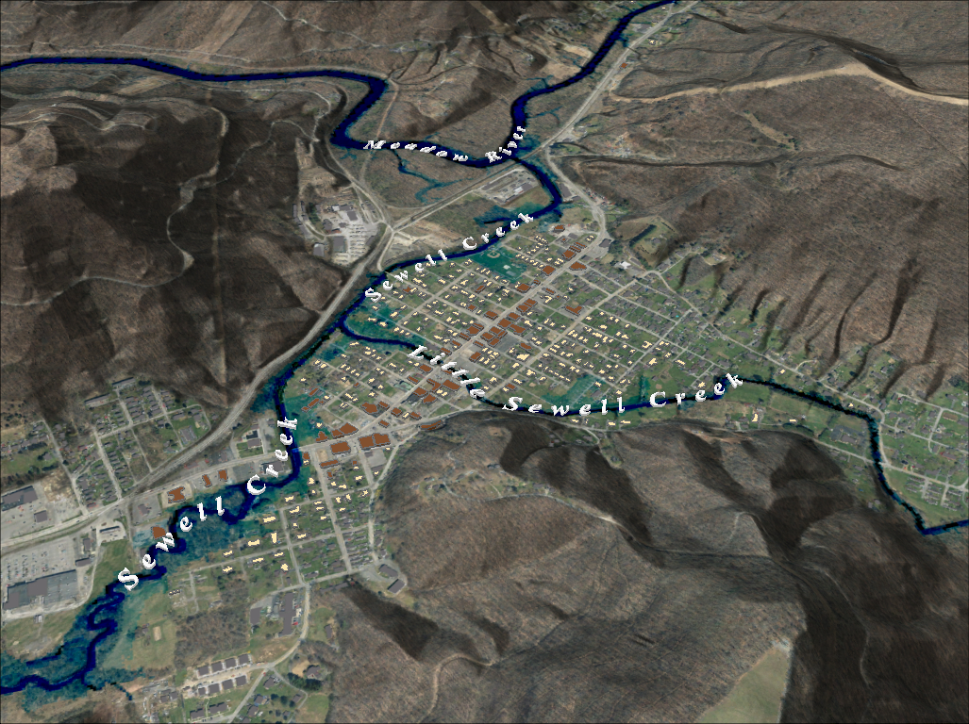

FEMA 10% Annual Chance (10-year) Rainelle, WV
0 ft.
FLOOD DEPTH
35 ft.
96% probability of flooding at least once over 30 years
Notes:
FEMA 10year Aerial

Slide 16
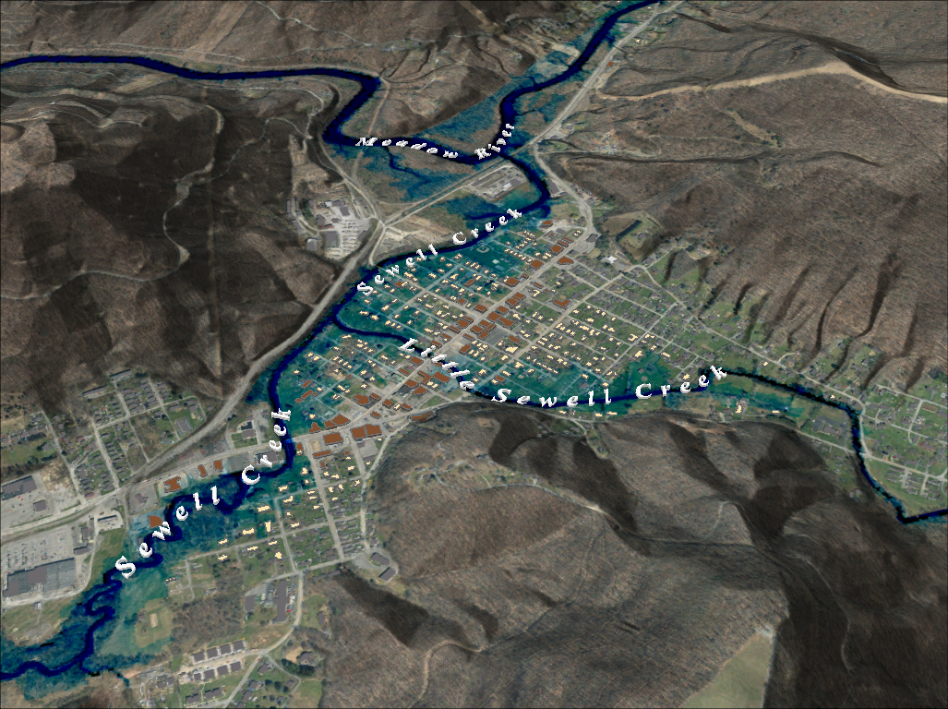
FEMA 4% Annual Chance (25-year) Rainelle, WV
0 ft.
FLOOD DEPTH
35 ft.
71% probability of flooding at least once over 30 years
Notes:
FEMA 25year Aerial

Slide 17
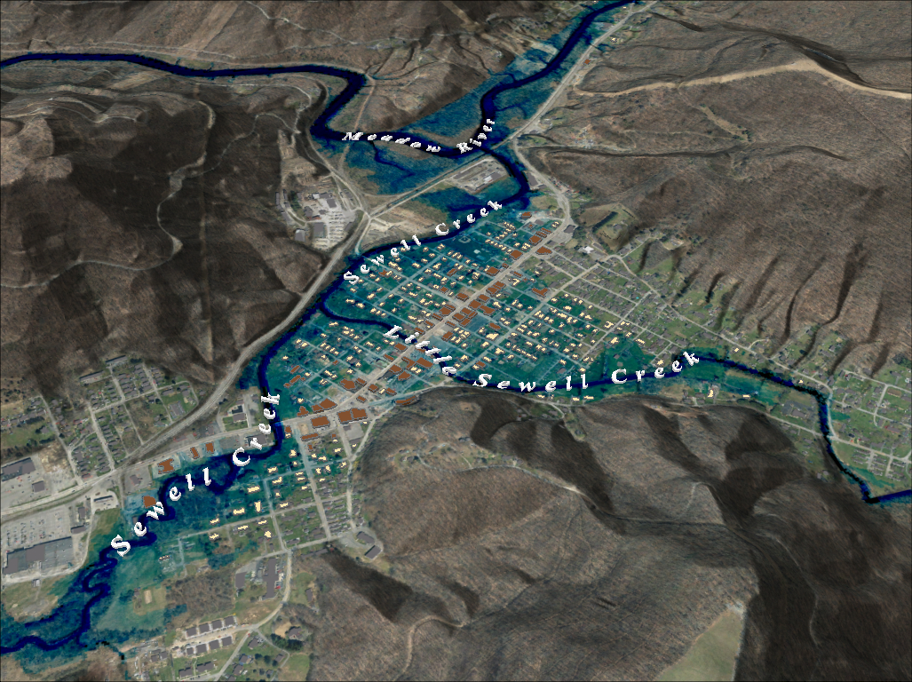
FEMA 2% Annual Chance (50-year) Rainelle, WV
0 ft.
FLOOD DEPTH
35 ft.
45% probability of flooding at least once over 30 years
Notes:
FEMA 50year Aerial

Slide 18
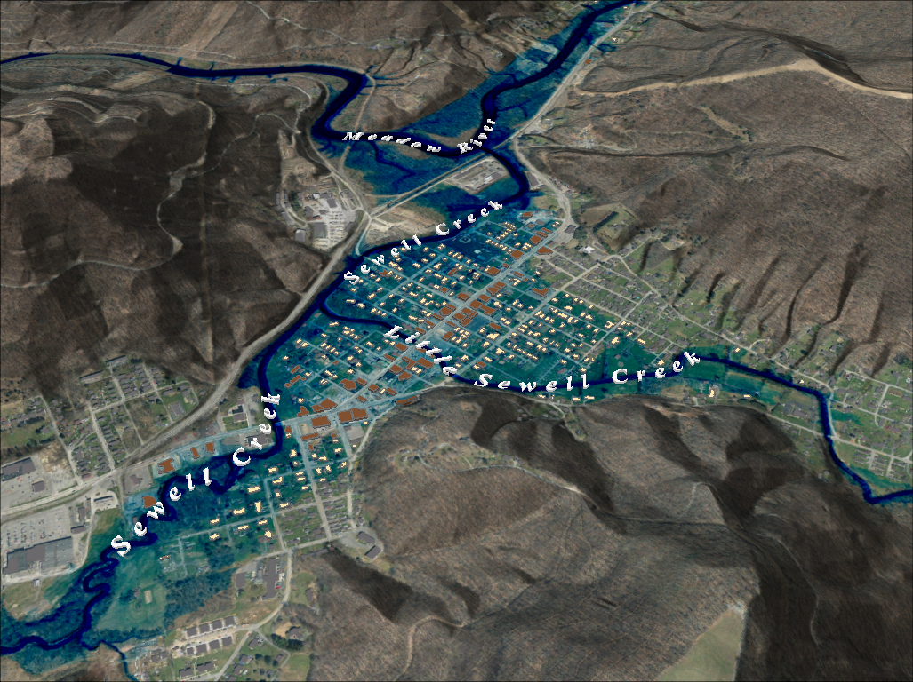
FEMA 1% Annual Chance (100-year) Rainelle, WV
0 ft.
FLOOD DEPTH
35 ft.
26% probability of flooding at least once over 30 years
Notes:
FEMA 100year Aerial

Slide 19
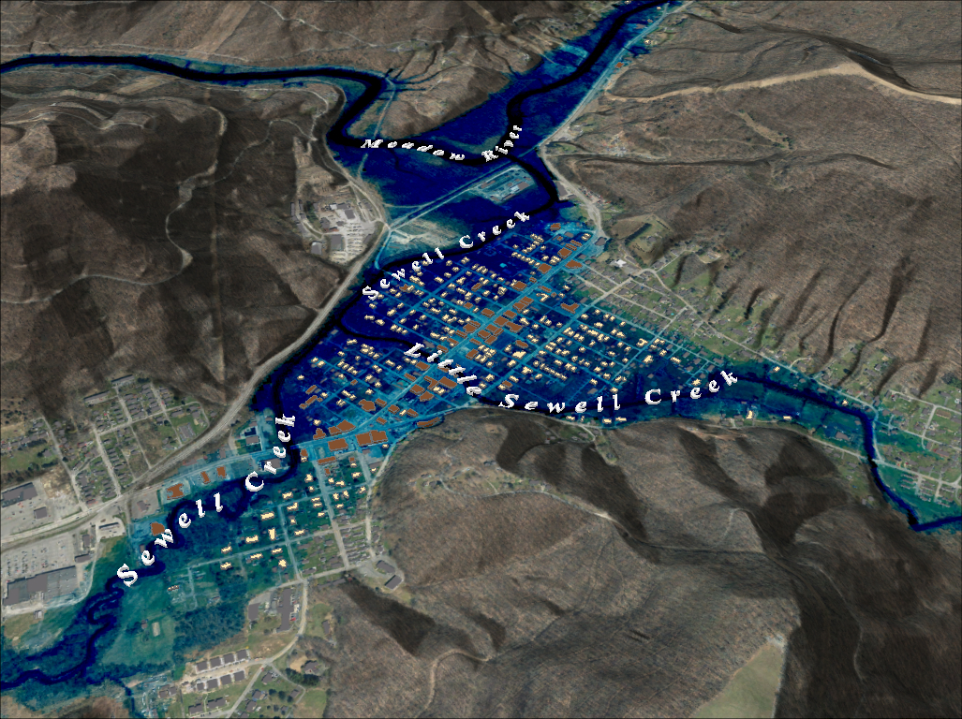
FEMA 1%+ Annual Chance (100-year) Rainelle, WV
Climate
Change
0 ft.
FLOOD DEPTH
35 ft.
26% probability of flooding at least once over 30 years
Notes:
FEMA 100year PLUS Aerial

Slide 20
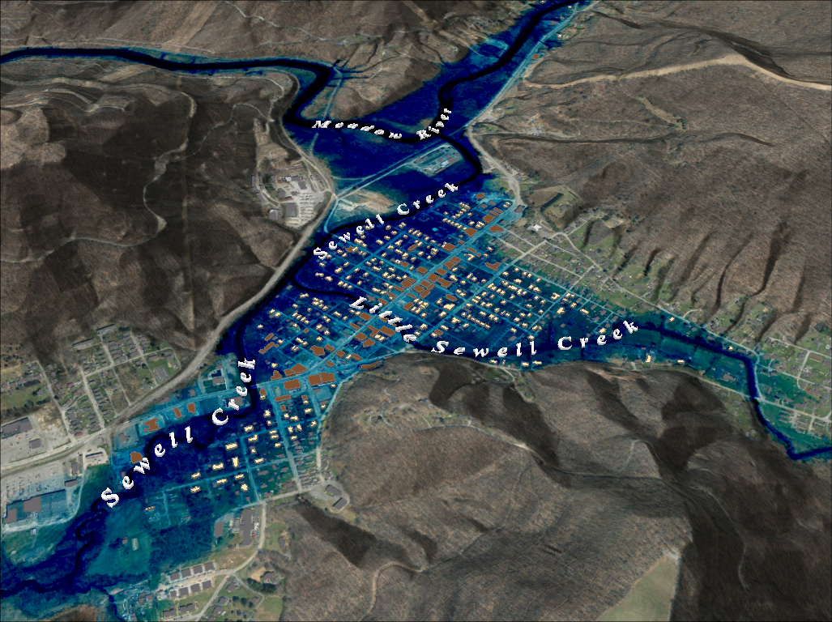
FEMA 0.2% Annual Chance (500-year) Rainelle, WV
0 ft.
FLOOD DEPTH
35 ft.
6% probability of flooding at least once over 30 years
Notes:
FEMA 500year Aerial

Slide 21
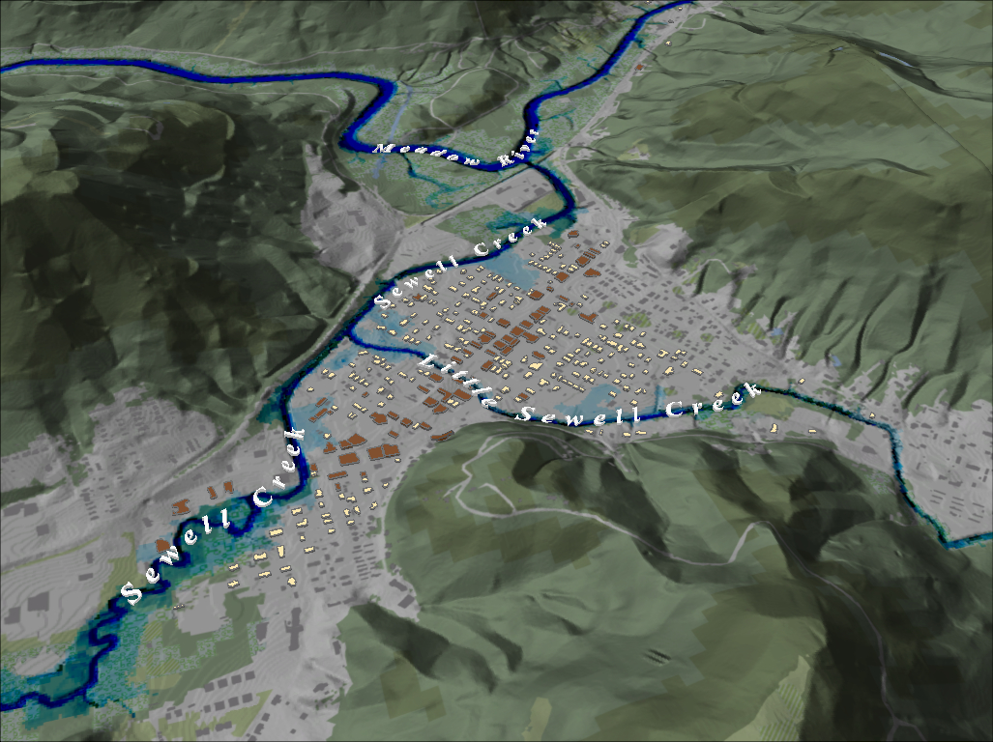
FEMA 10% Annual Chance (10-year) Rainelle, WV
Notes:
FEMA 10 year NLCD Hillshade

Slide 22
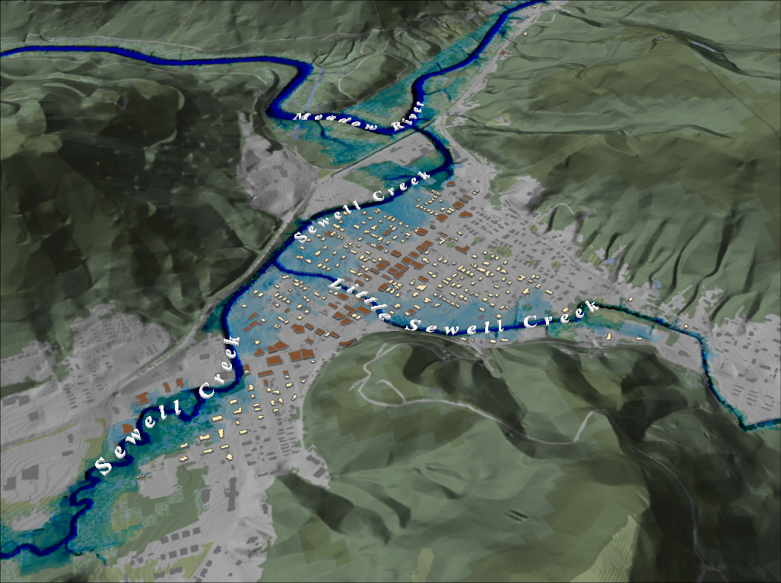
FEMA 4% Annual Chance (25-year) Rainelle, WV
Notes:
FEMA 25 year NLCD Hillshade

Slide 23
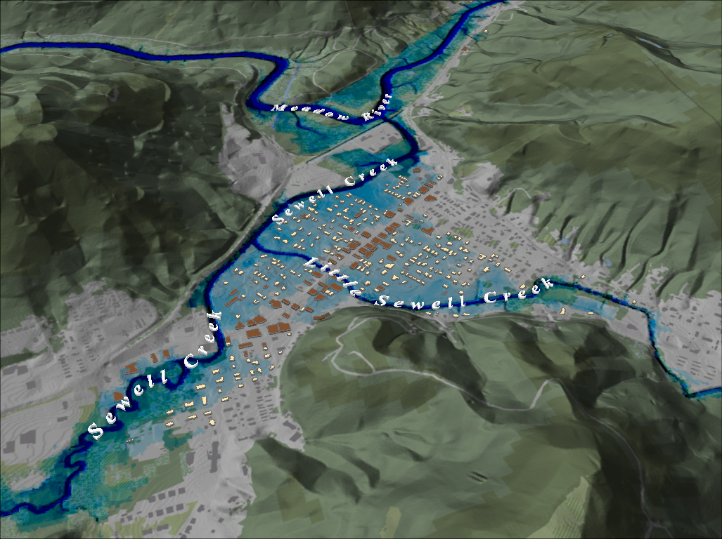
FEMA 2% Annual Chance (50-year) Rainelle, WV
Notes:
FEMA 50 year NLCD Hillshade

Slide 24
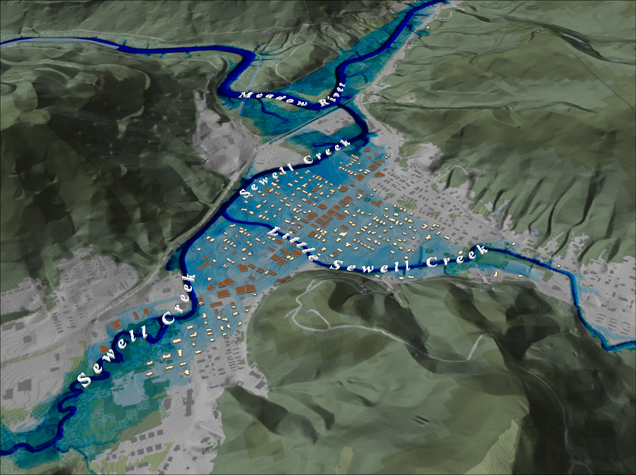
FEMA 1% Annual Chance (100-year) Rainelle, WV
Notes:
FEMA 100 year NLCD Hillshade

Slide 25
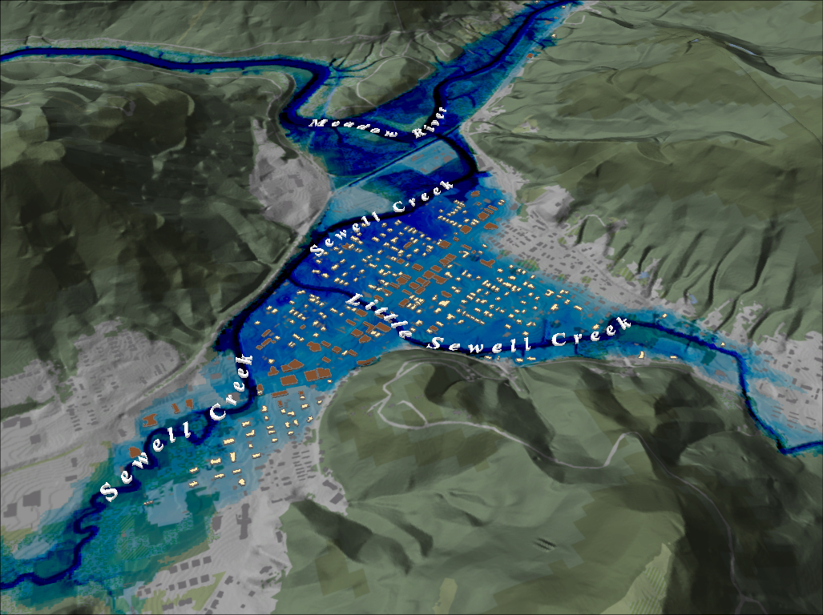
FEMA 1%+ Annual Chance (100-year) Rainelle, WV
Notes:
FEMA 100 year PLUS NLCD Hillshade

Slide 26
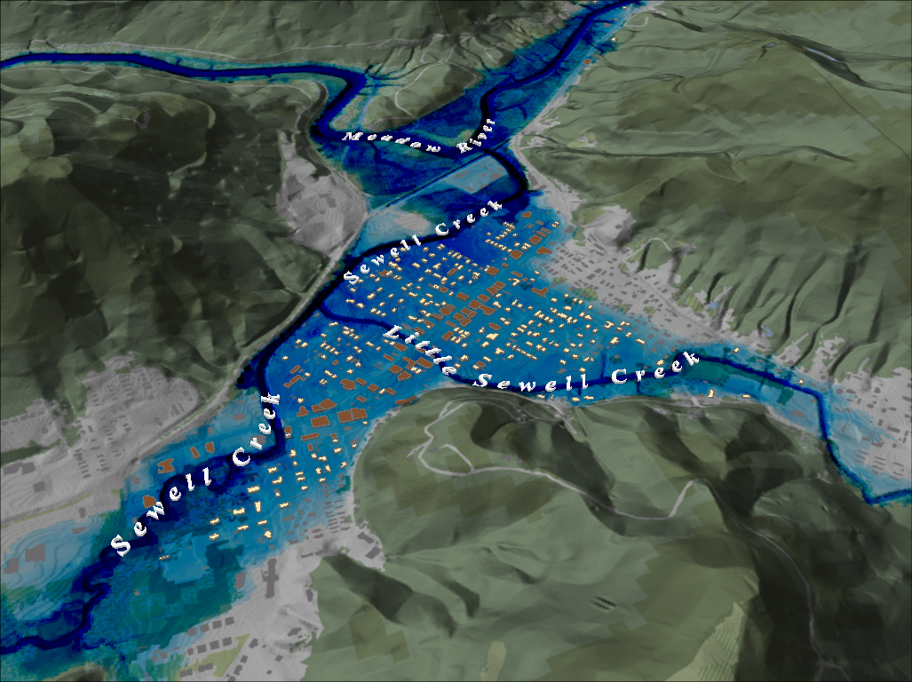
FEMA 0.2% Annual Chance (500-year) Rainelle, WV
Notes:
FEMA 500 year NLCD Hillshade

Slide 27
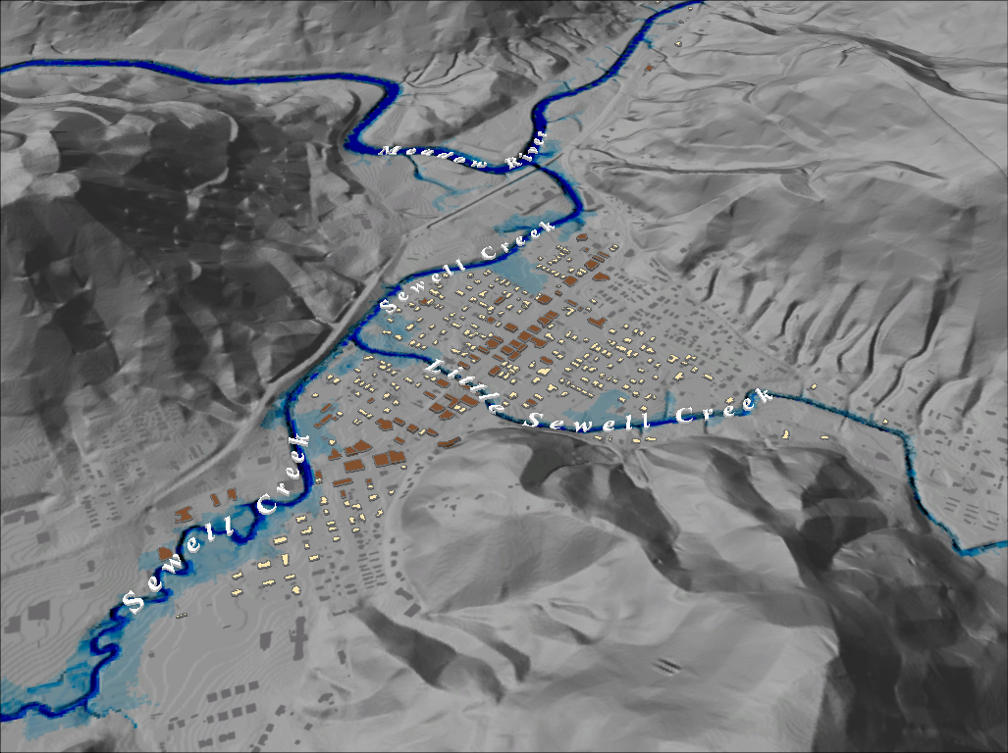
FEMA 10% Annual Chance (10-year) Rainelle, WV
Notes:
FEMA 10 year Grey Hillshade

Slide 28
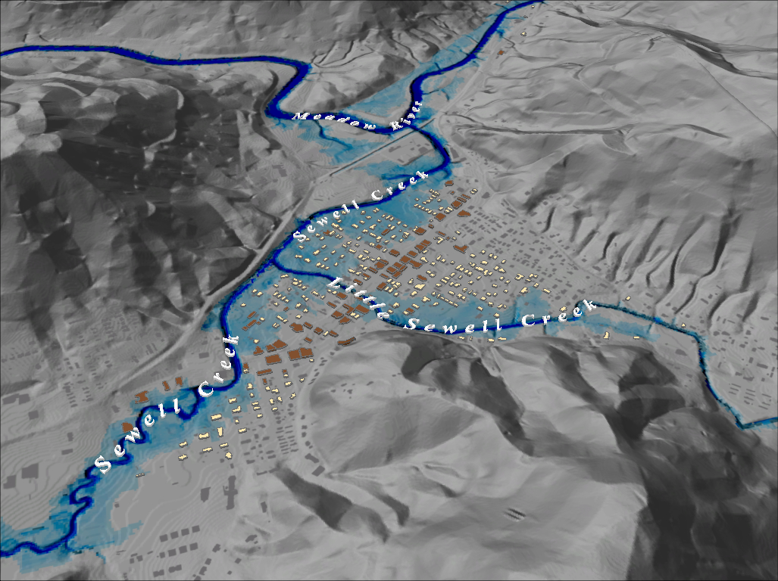
FEMA 4% Annual Chance (25-year) Rainelle, WV
Notes:
FEMA 25 year Grey Hillshade

Slide 29
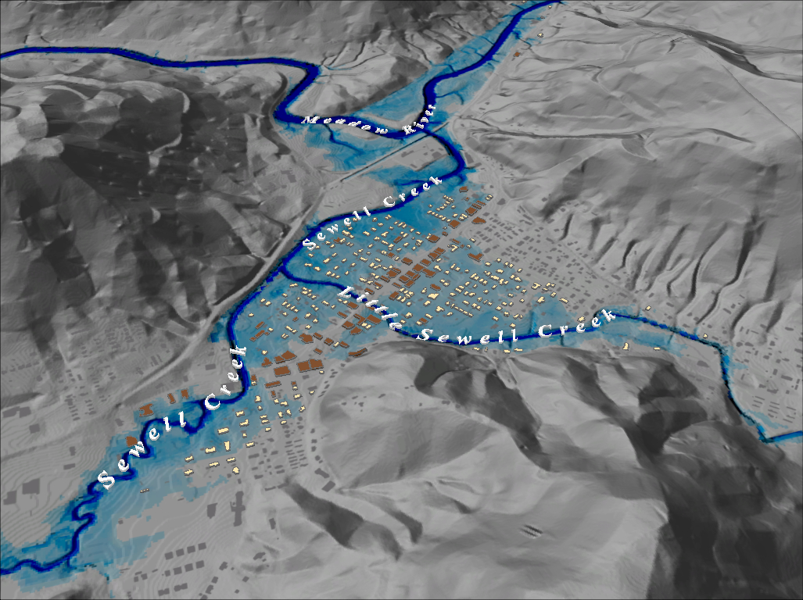
FEMA 2% Annual Chance (50-year) Rainelle, WV
Notes:
FEMA 50 year Grey Hillshade

Slide 30
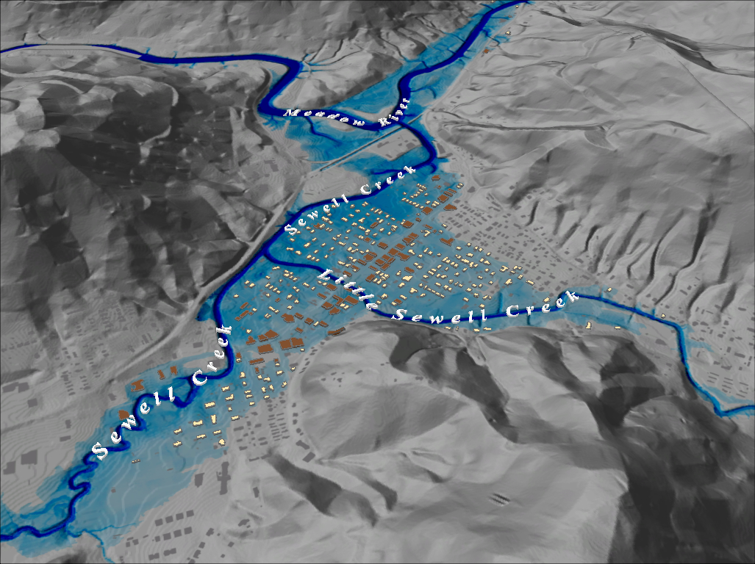
FEMA 1% Annual Chance (100-year) Rainelle, WV
Notes:
FEMA 100 year Grey Hillshade

Slide 31
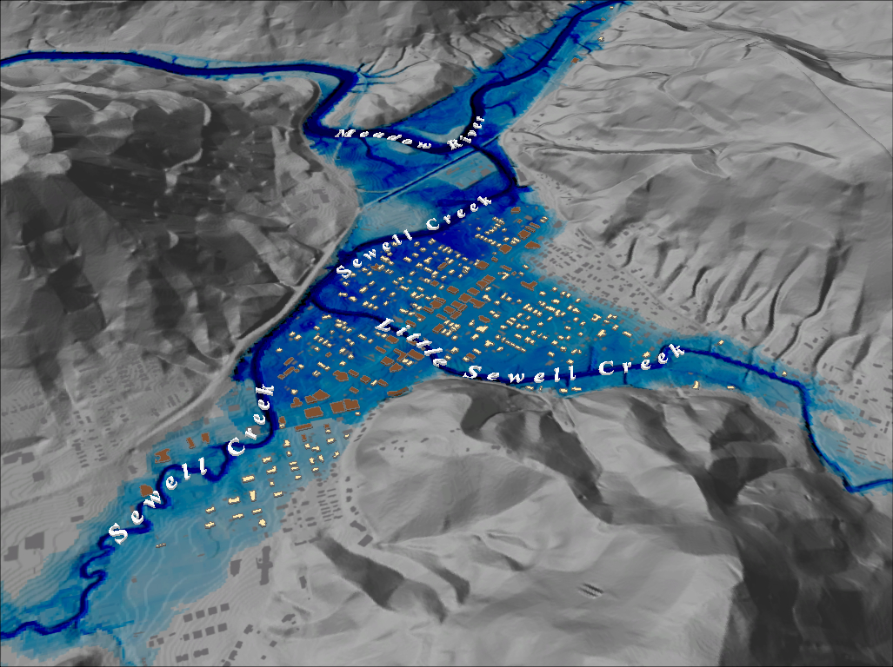
FEMA 1%+ Annual Chance (100-year) Rainelle, WV
Notes:
FEMA 100 year PLUS Grey Hillshade

Slide 32
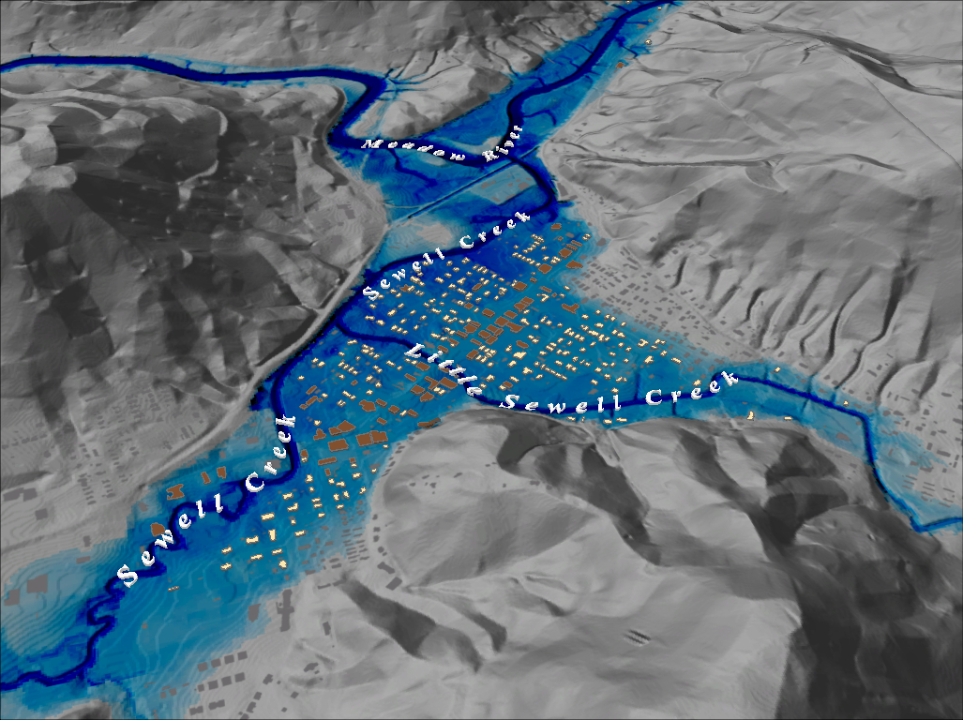
FEMA 0.2% Annual Chance (500-year) Rainelle, WV
Notes:
FEMA 500 year Grey Hillshade

