Slide 1
Flood Characteristics
Category | Flood Characteristic | White Sulphur Springs | Rainelle
Frequency (new flood maps) | Probability that a flood of a specific size will be equaled or exceeded in any given year
 | FEMA Flood Models: 10-, 25-, 50-, 100-, 100+, and 500-year flood elevations. FEMA’s 1%+ flood elevations measure how high the 100-year flood could be given the statistical uncertainties in flood modeling (upper 84-percent confidence limit). | See models | See models
 | First Street Foundation Flood Models: 5-, 20-, 100-, and 500-year flood elevations. Climate models based on 2052 or 30 years in the future. | See models | See models
Depth | Flood depth or water surface elevation above the ground surface. Source USGS high-water marks. | 6 feet | 8 feet
Velocity | Speed at which the floodwaters are flowing | High | Moderate
Duration | Measure of how long water remains above normal levels | 24 hours | 72 hours
Rise and Fall | Floodwater that rises very quickly with little or no warning | Quick Rise | Quick Rise
Notes: Flood characteristics are based on the 2016 flood and FEMA’s new flood studies

Slide 2
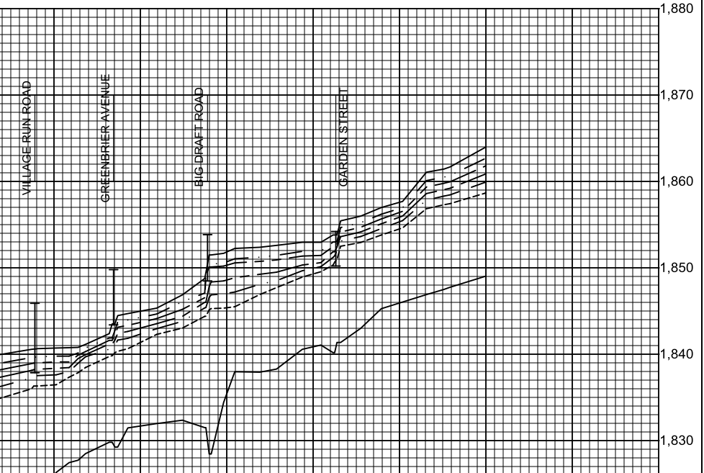
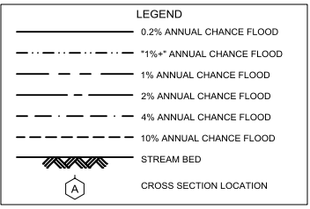
Howard Creek Flood Study Profile
2022 Preliminary 1% Base Flood (100-Yr) Elevation 1850.7 ft for Building 13-17-0009-0026-0000_138
Preliminary 2022 FEMA Maps
2022 Base Flood Elevation increased 1 to 1.5 feet from the 2012 FEMA Map between Dry Creek Bridge (Big Draft Rd) and Wades Creek Bridge (Garden St)
Confluence of Dry Creek
Confluence of Wades Creek
For bridges shown on the flood profile, the structure is represented by an “I” symbol. The top of the bridge symbol represents the top of road and the bottom of the symbol represents the low chord (or low steel) of the bridge.
Bldg. 13-17-0009-0026-0000_138
1% WSEL 1850.7 ft.
3.5’ ponding upslope
of Big Draft Bridge
1.5’ ponding upslope
of Garden Street Bridge
2016 Flood
1,852.5 ft.
(BFE + 1.8 ft. to reach HWM)
https://data.wvgis.wvu.edu/pub/NSF/FloodProfiles/54025CV002B.pdf#page=43
FEMA FIS Technical Reference 2019

Slide 3
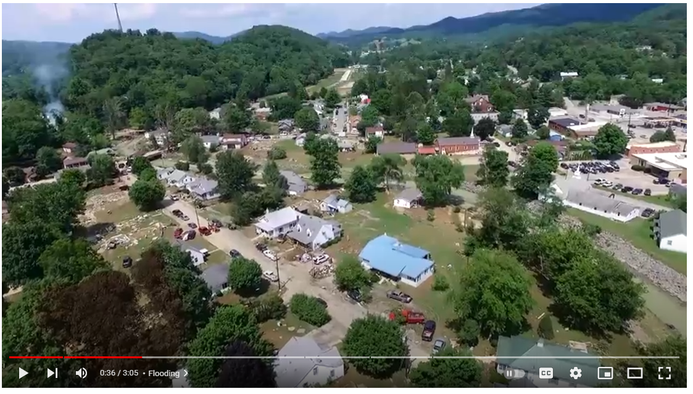
2016 Damage Video (White Sulphur Springs)
Video Link

Slide 4
Flood Characteristics
Flood Characteristics Impacting Community
Frequency: Probability that a flood of a specific size will be equaled or exceeded in any given year
  5-, 10-, 20-, 25-, 50-, 100-, and 500-year flood elevations (above sea level) refer to expected water levels of the 20%, 10%, 5%, 4%, 2%, 1%, and 0.2% annual chance flood events. A 1000-yr flood has a 0.1% chance of happening in any given year.
  FEMA’s 1%+ flood elevations measure how high the 100-year flood could be given the statistical uncertainties in flood modeling. It represents the upper 84-percent confidence limit of the statistical error for calculating the 1-percent annual chance event.
  The relative frequency of any given flood (e.g., 5-year or 10-year) serves as a useful reference point when selecting a mitigation options and evaluating cost effectiveness.
Depth: Flood depth or water surface elevation above the ground surface
  Critical during design considerations, as it is often the primary factor in evaluating the potential for flood damage
  Flood depth sources include flood models and high water marks which measure the degree of flooding
Velocity: Speed at which the floodwaters are flowing
  Flowing water often causes erosion and scour, as well as debris impacts and hydrodynamic forces.
  FEMA’s detailed engineering studies provide river/stream flows
Duration: Measure of how long water remains above normal levels.
  Prolonged contact with floodwaters may make some mitigation measures, including dry flood-proofing, inappropriate because of the increased chance of seepage and potential structural failure.
  Long periods of inundation are more likely to cause greater damage to structural members and finishes than short periods of flooding.
Rate of Floodwater Rise and Fall: Floodwater that rises very quickly with little or now warning
  Steep topography and locations with small drainage areas may experience flash flooding in which floodwater can rise very quickly with little or no warning.
  High-velocity water flows usually accompany flash floods and preclude certain types of flood mitigation measures, especially those requiring human intervention
  Rapid rates of the rise and fall of floodwater can also lead to unequal hydrostatic pressures on a building. The probability of unequal hydrostatic pressures increases when building exteriors are designed to be watertight
Historical Information: Use past information like the high-water marks of the 2016 Flood as an indication of the nature and severity of effects likely to occur during future events.
Source: FEMA 2013

Slide 5
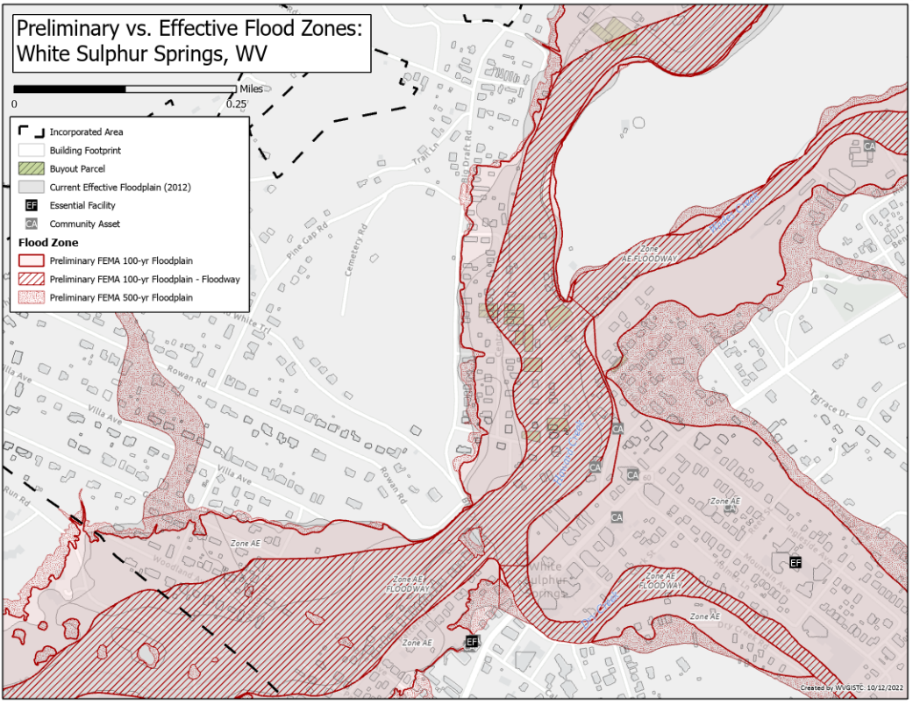
Preliminary FEMA Flood Maps Effective 2023

Slide 6
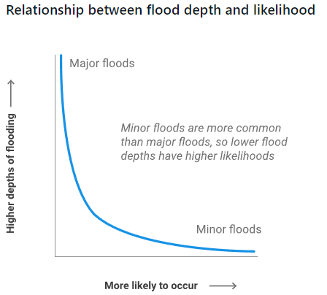
Flood Frequency
Frequency: Probability that a flood of a specific size will be equaled or exceeded in any given year.
5-, 10-, 20-, 25-, 50-, 100-, and 500-year flood elevations (above sea level) refer to expected water levels of the 20%, 10%, 5%, 4%, 2%, 1%, and 0.2% annual chance flood events.
FEMA |  |  |  |  |  | First Street Foundation (FSF)
Return Period (Likelihood) and Flood Size (Magnitude) | Annual Probability | Cumulative Probability - Flooding at least once over 30 years | FEMA Risk Description | Climate Model |  | Return Period and Flood Size (2022, 2037, 2052)* | Annual Probability (flooding at least 1 cm) | Cumulative Probability - Flooding at least once over 30 years | First Street Risk Description | Climate Model
 |  |  |  |  |  | 5 yr (1 in 5) | 20% | >99% | Almost Certain Risk | Yes (2052)
10 yr (1 in 10) | 10% | 96% | High Risk
 |  |  |  |  |  | 20 yr (1 in 20) | 5% | >85% | High Risk | Yes (2052)
25 yr (1 in 25) | 4% | 71% | High Risk
50 yr (1 in 50) | 2% | 45% | High Risk
100 yr (1 in 100) | 1% | 26% | High Risk |  |  | 100 yr (1 in 100) | 1% | >26% | Substantial Risk | Yes (2052)
100 yr (1 in 100) Plus | 1%+ | 26% | High Risk | Yes
500 yr (1 in 500) | 0.2% | 6% | Moderate Risk |  |  | 500 yr (1 in 500) | 0.2% | >0% | Any Risk | Yes (2052)
Climate scenario based on 100-yr plus upper confidence limit |  |  |  |  |  | Climate scenario based on 2052 or 30 years in the future
2022 Flood Study Sources: FEMA and First Street Foundation (FSF)

Slide 7
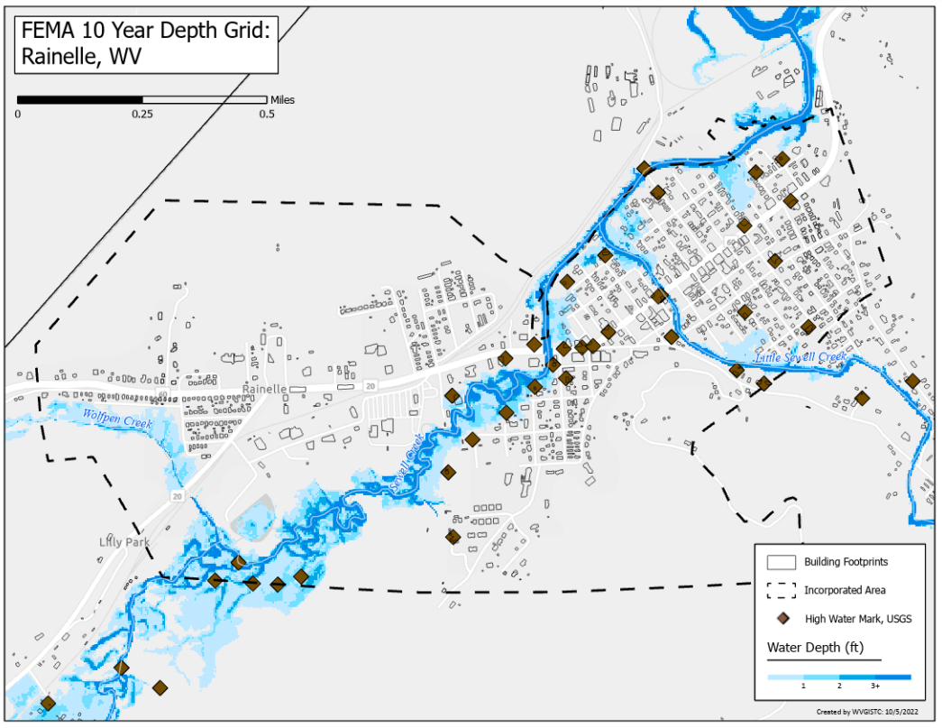
FEMA Flood Model: 10-Year Flood Depth

Slide 8
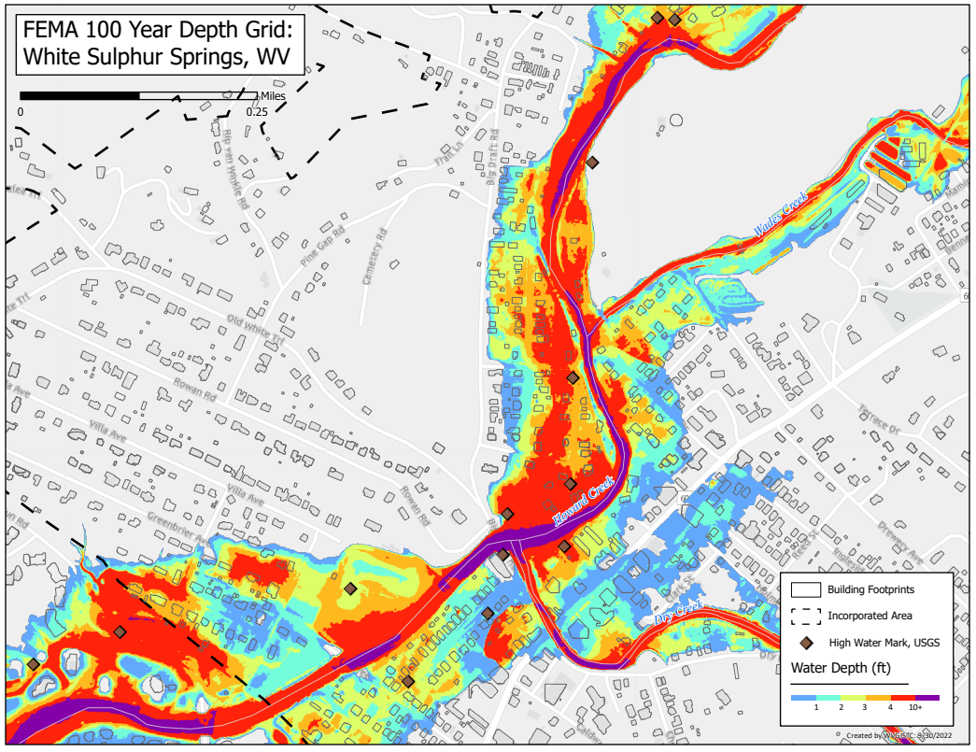
FEMA Flood Model: 100-Year Flood Depth

Slide 9
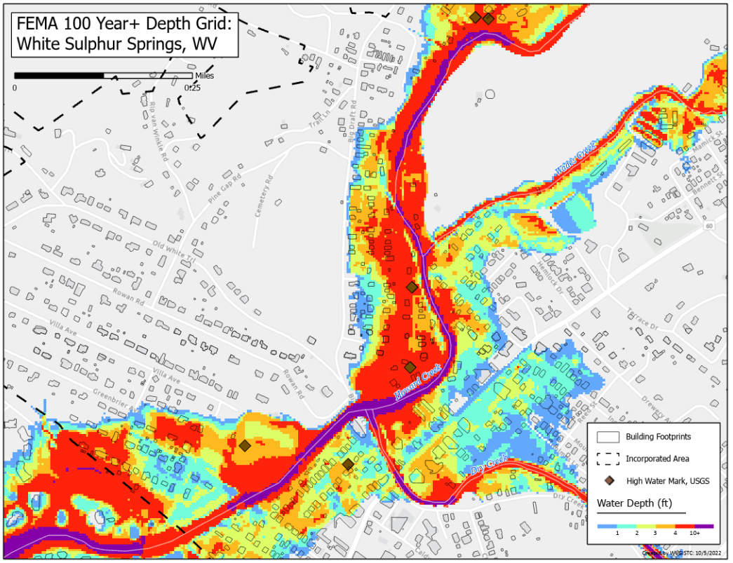
FEMA Flood Model: 100-Year Plus Flood Depth
Climate
Change

Slide 10
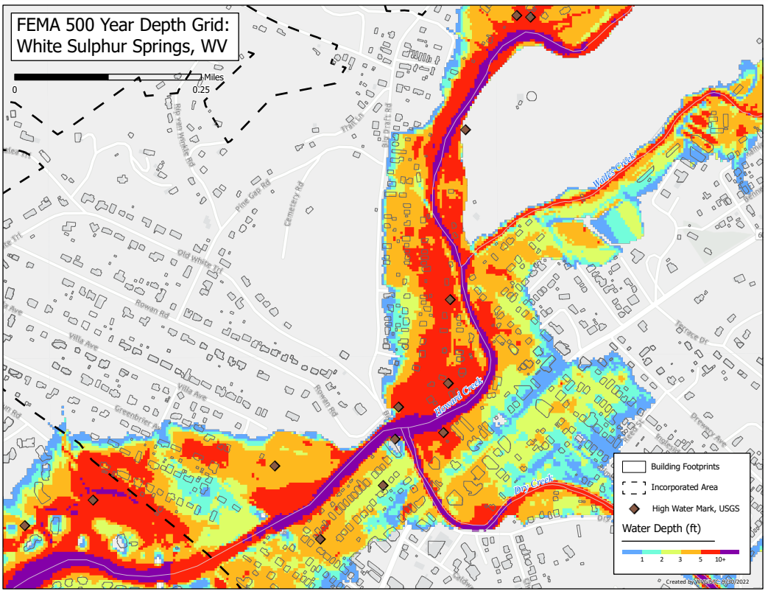
FEMA Flood Model: 500-Year Flood Depth

Slide 11
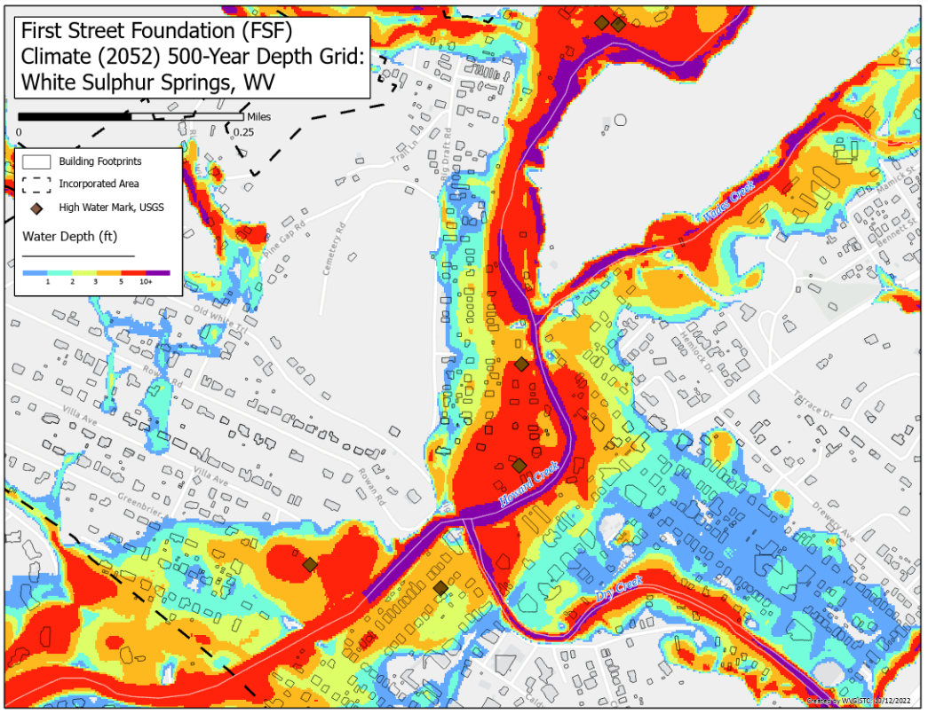
FSF Flood Model: 500-Year Flood Depth 2052
Climate
Change

Slide 12
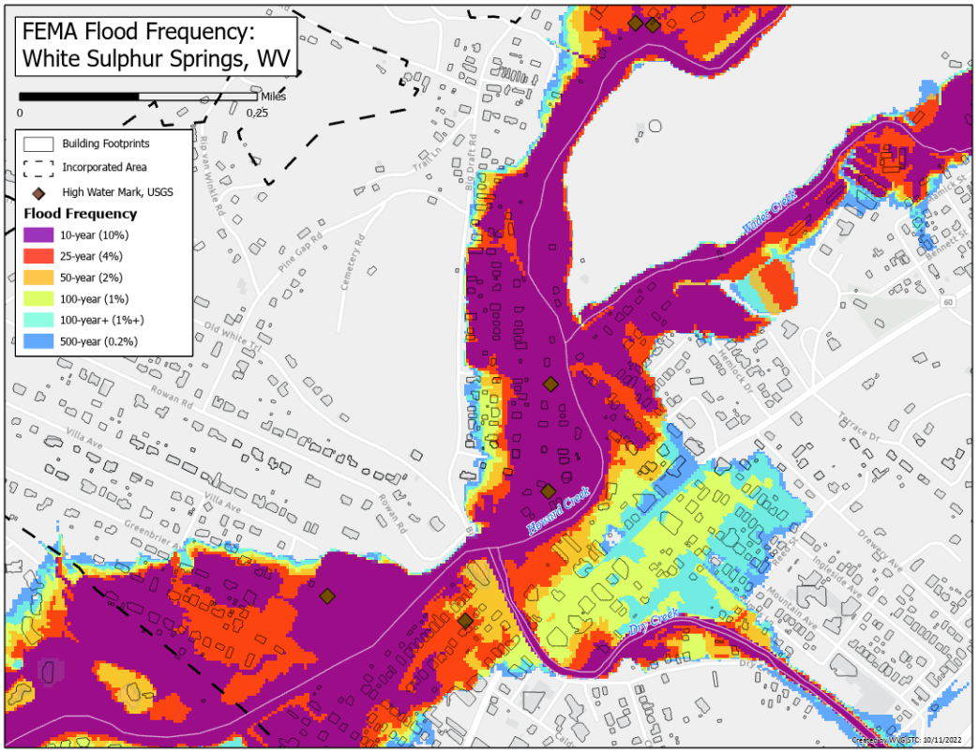
FEMA Flood Models: Likelihood and Magnitude

Slide 13
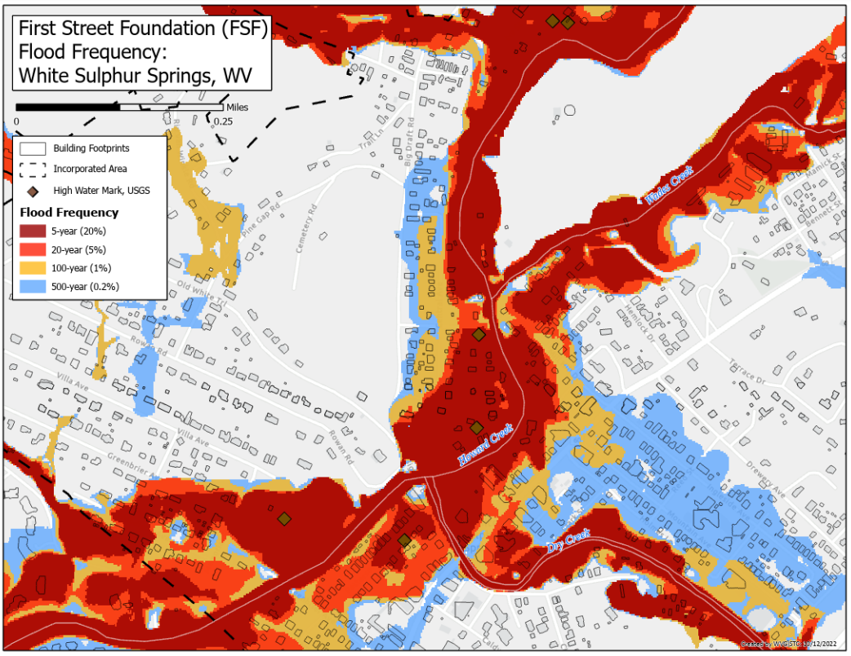
FSF Flood Models: Likelihood and Magnitude

Slide 14
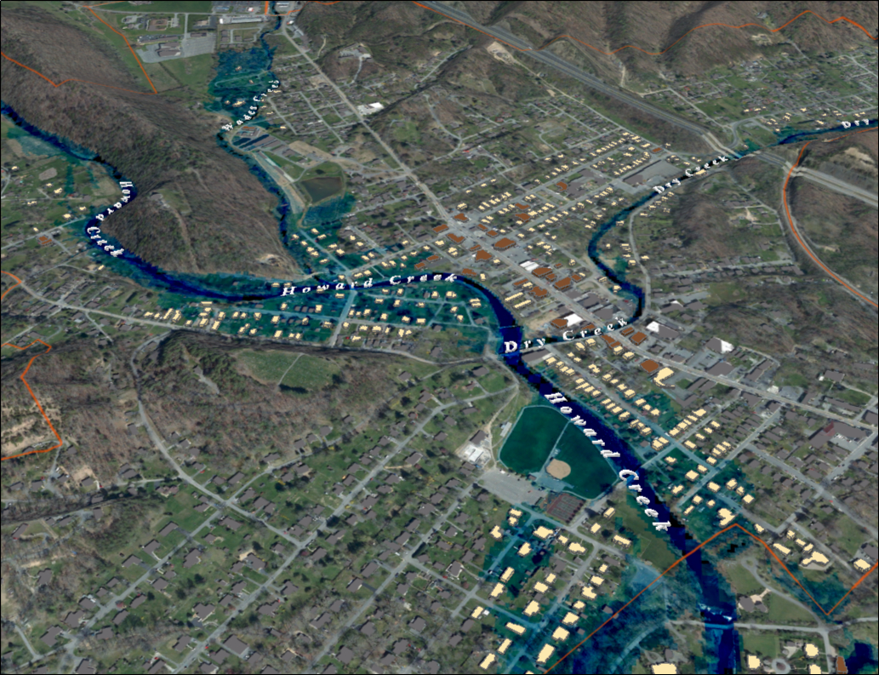

FEMA 10% Annual Chance (10-year) White Sulphur Springs, WV
96% probability of flooding at least once over 30 years
0 ft.
FLOOD DEPTH
35 ft.
Notes:
White Sulfur Springs FEMA 10yr Aerial

Slide 15
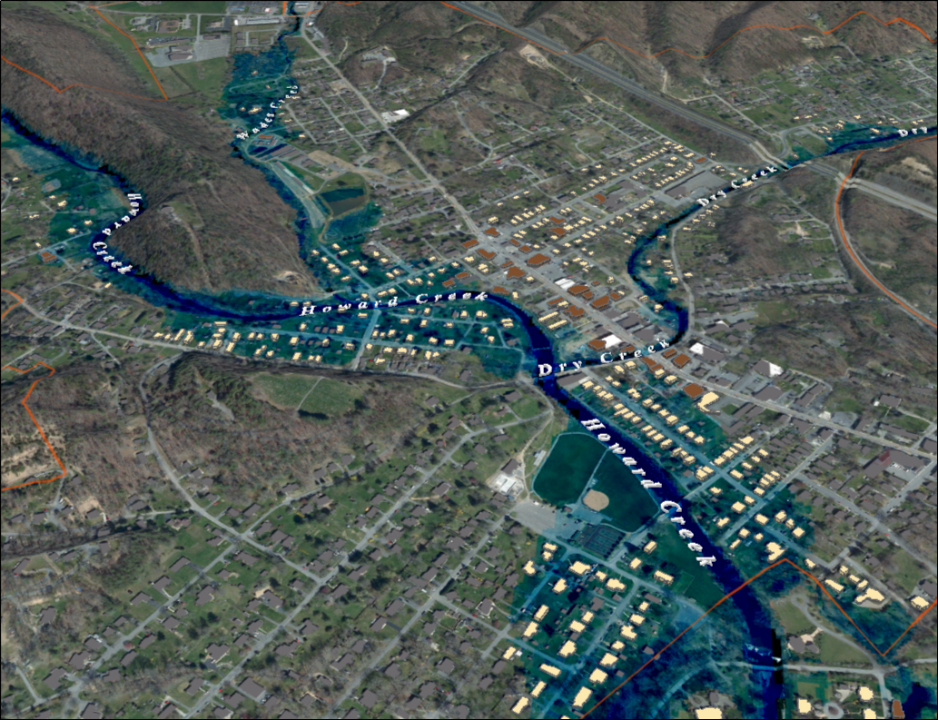
FEMA 4% Annual Chance (25-year) White Sulphur Springs, WV
71% probability of flooding at least once over 30 years
0 ft.
FLOOD DEPTH
35 ft.
Notes:
White Sulfur Springs FEMA 25yr Aerial

Slide 16
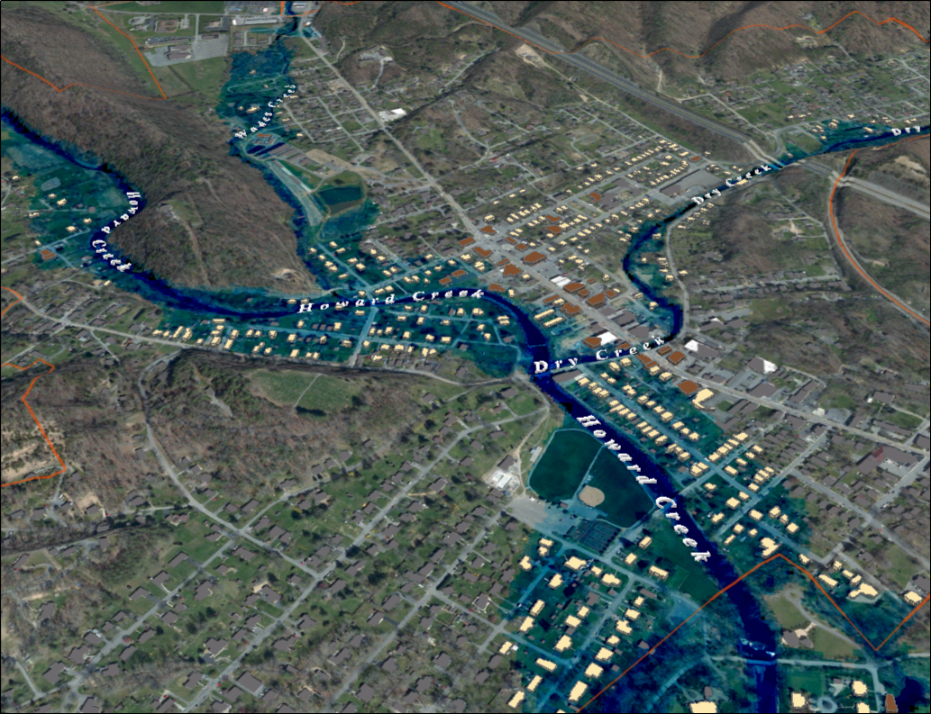
FEMA 2% Annual Chance (50-year) White Sulphur Springs, WV
45% probability of flooding at least once over 30 years
0 ft.
FLOOD DEPTH
35 ft.
Notes:
White Sulfur Springs FEMA 50yr Aerial

Slide 17
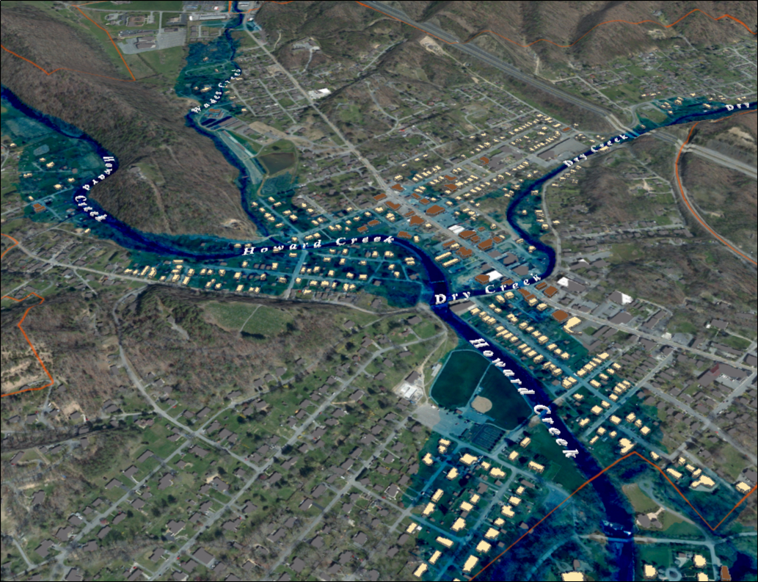
FEMA 1% Annual Chance (100-year) White Sulphur Springs, WV
26% probability of flooding at least once over 30 years
0 ft.
FLOOD DEPTH
35 ft.
Notes:
White Sulfur Springs FEMA 100yr Aerial

Slide 18
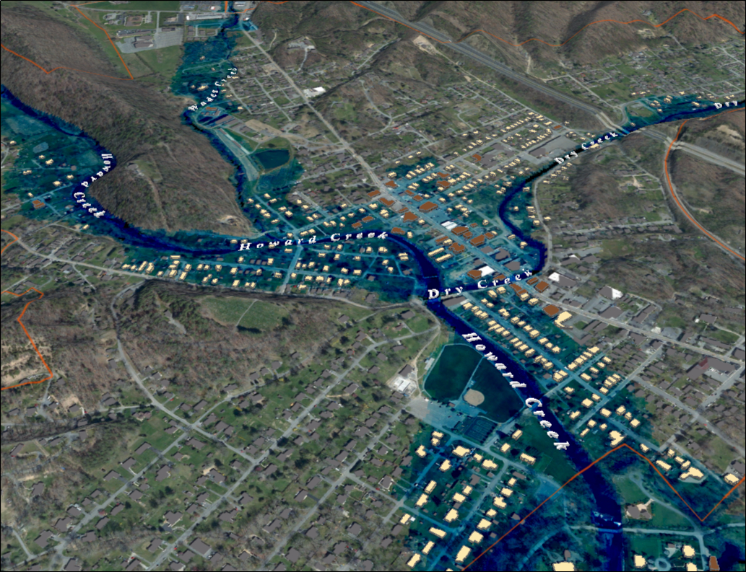
FEMA 1%+ Annual Chance (100-year) White Sulphur Springs, WV
26% probability of flooding at least once over 30 years
Climate
Change
0 ft.
FLOOD DEPTH
35 ft.
Notes:
White Sulfur Springs FEMA 100yr PLUS Aerial

Slide 19
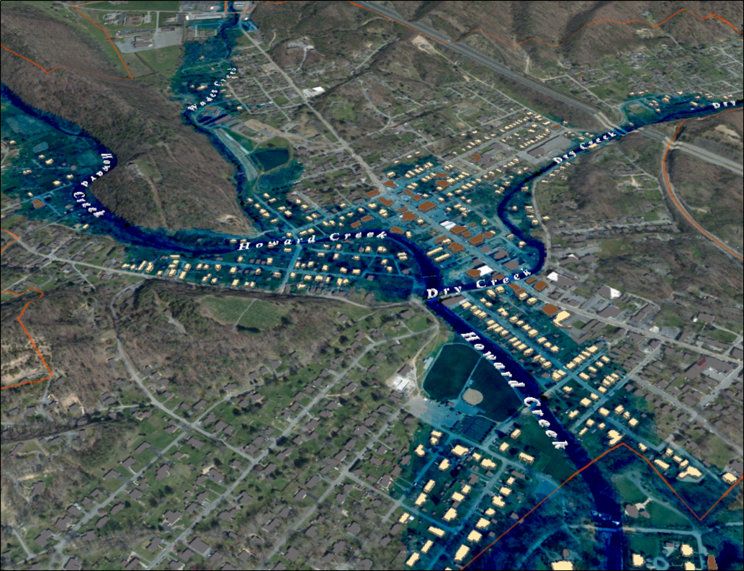
FEMA 0.2% Annual Chance (500-year) White Sulphur Springs, WV
6% probability of flooding at least once over 30 years
0 ft.
FLOOD DEPTH
35 ft.
Notes:
White Sulfur Springs FEMA 500yr Aerial

Slide 20
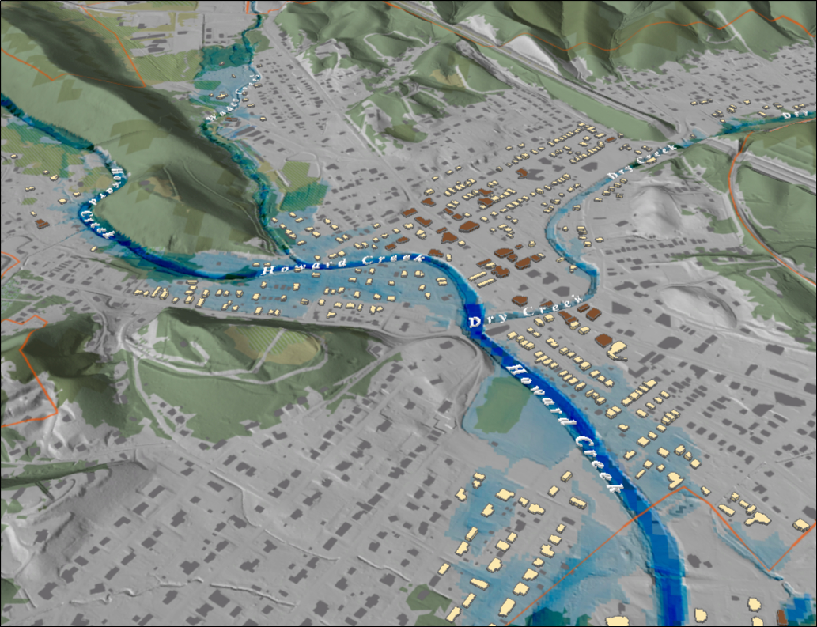
FEMA 10% Annual Chance (10-year) White Sulphur Springs, WV
Notes:
White Sulfur Springs FEMA 10yr Hillshade

Slide 21
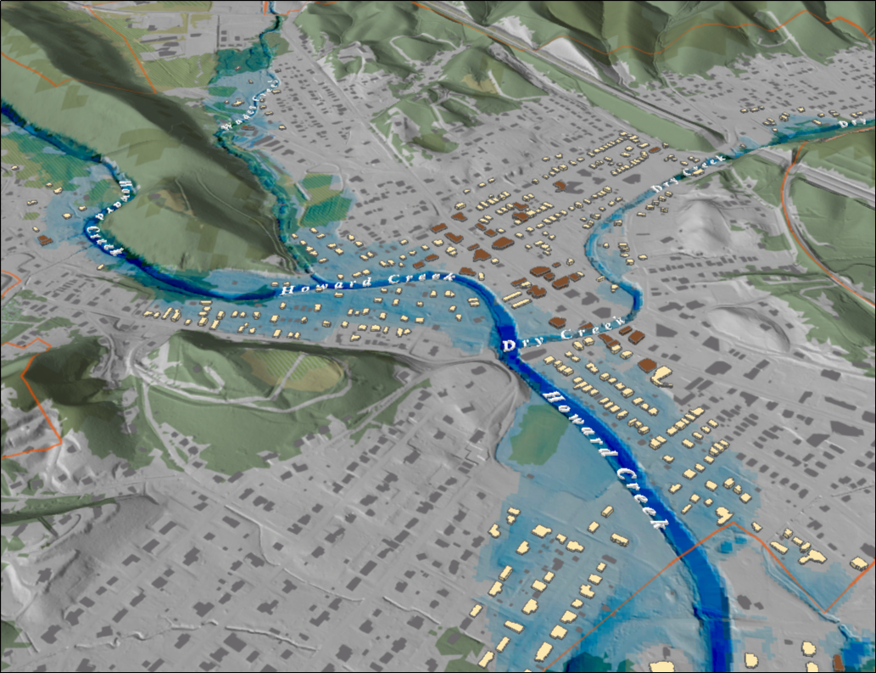
FEMA 4% Annual Chance (25-year) White Sulphur Springs, WV
Notes:
White Sulfur Springs FEMA 25yr Hillshade

Slide 22
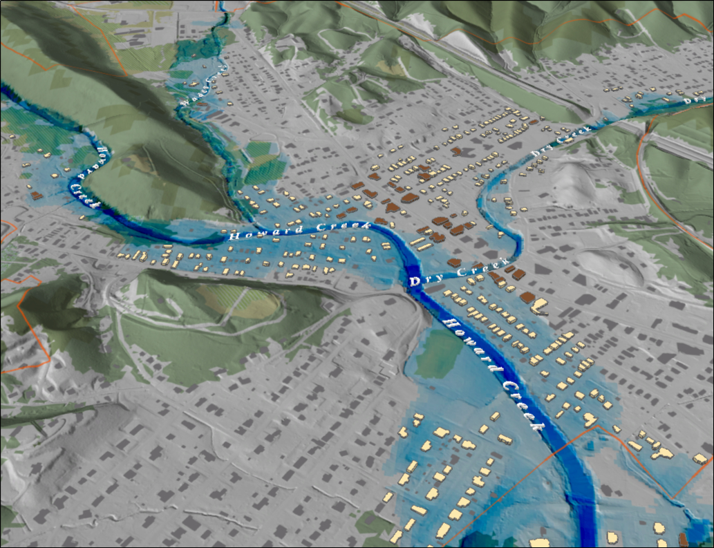
FEMA 2% Annual Chance (50-year) White Sulphur Springs, WV
Notes:
White Sulfur Springs FEMA 50yr Hillshade

Slide 23
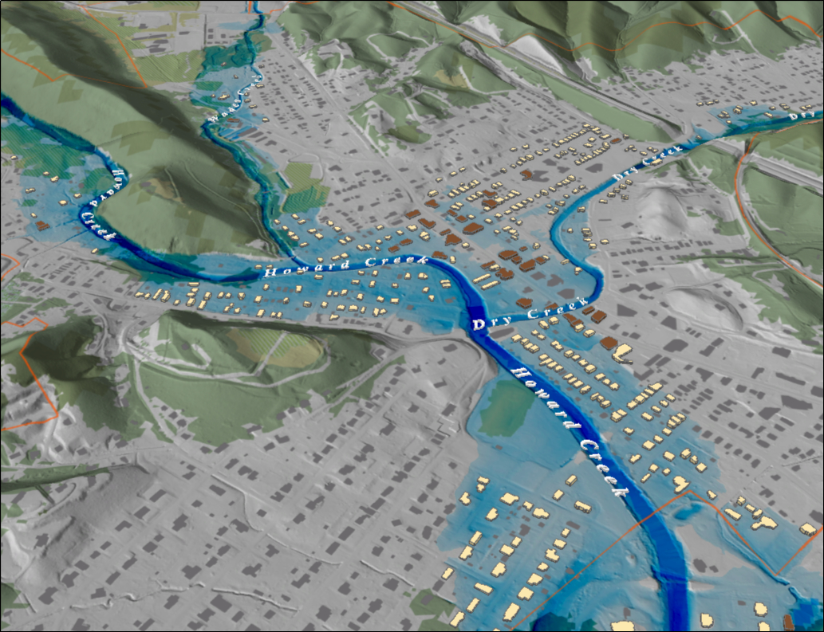
FEMA 1% Annual Chance (100-year) White Sulphur Springs, WV
Notes:
White Sulfur Springs FEMA 100yr Hillshade

Slide 24
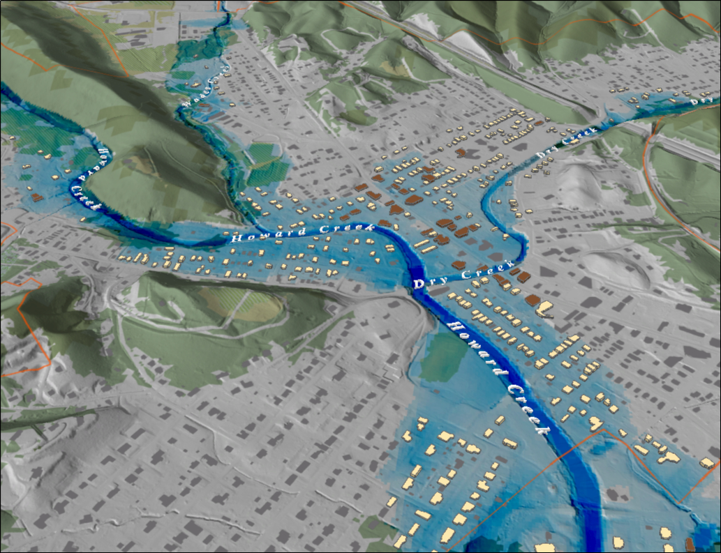
FEMA 1%+ Annual Chance (100-year) White Sulphur Springs, WV
Notes:
White Sulfur Springs FEMA 100yr PLUS Hillshade

Slide 25
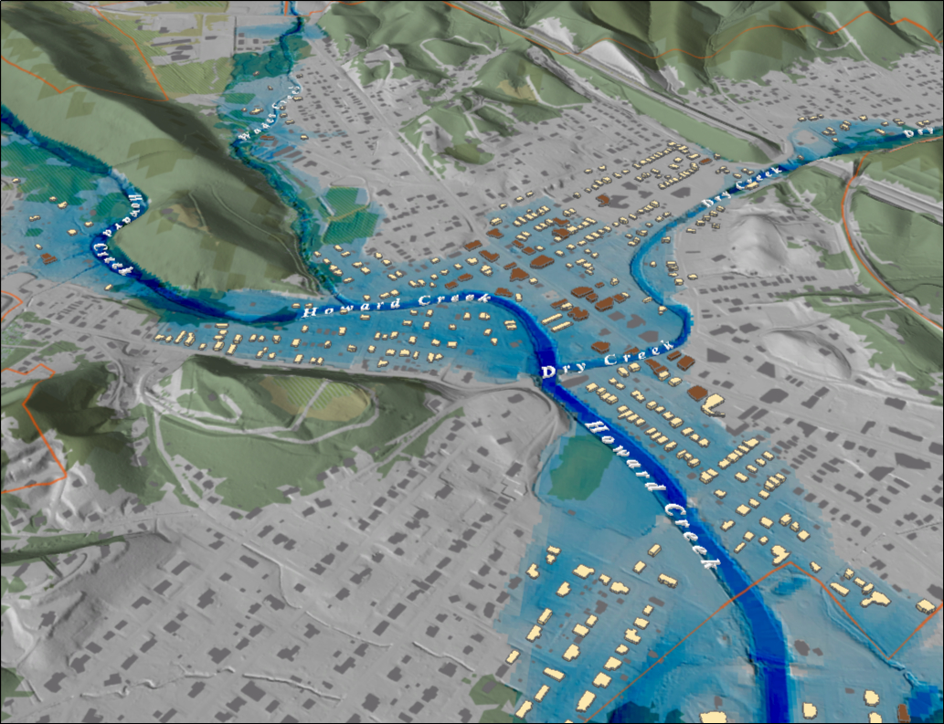
FEMA 0.2% Annual Chance (500-year) White Sulphur Springs, WV
Notes:
White Sulfur Springs FEMA 500yr Hillshade

Slide 26
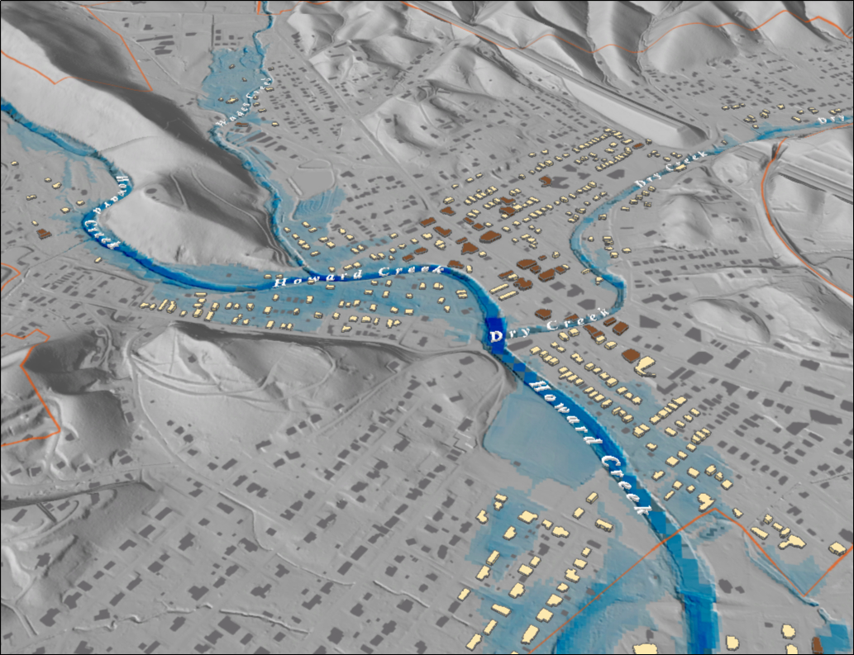
FEMA 10% Annual Chance (10-year) White Sulphur Springs, WV
Notes:
White Sulfur Springs FEMA 10yr Grey

Slide 27
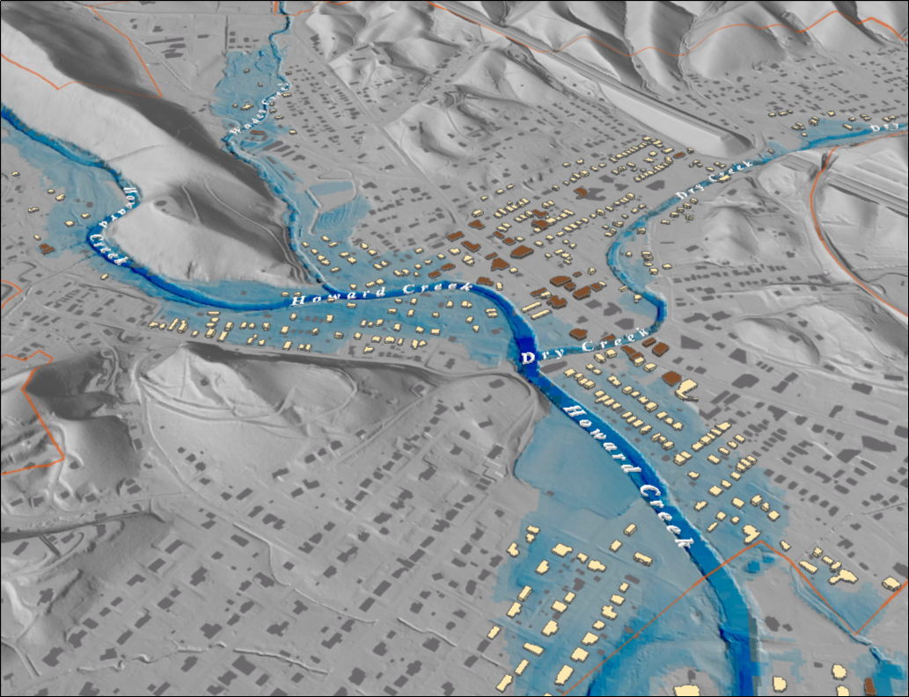
FEMA 4% Annual Chance (25-year) White Sulphur Springs, WV
Notes:
White Sulfur Springs FEMA 25yr Grey

Slide 28
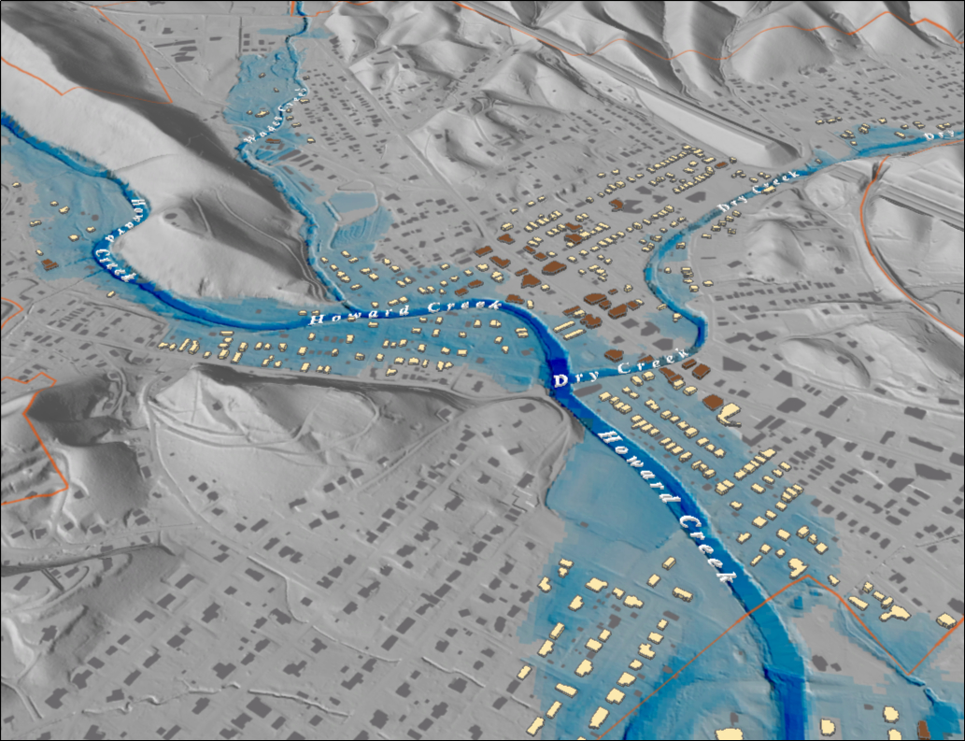
FEMA 2% Annual Chance (50-year) White Sulphur Springs, WV
Notes:
White Sulfur Springs FEMA 50yr Grey

Slide 29
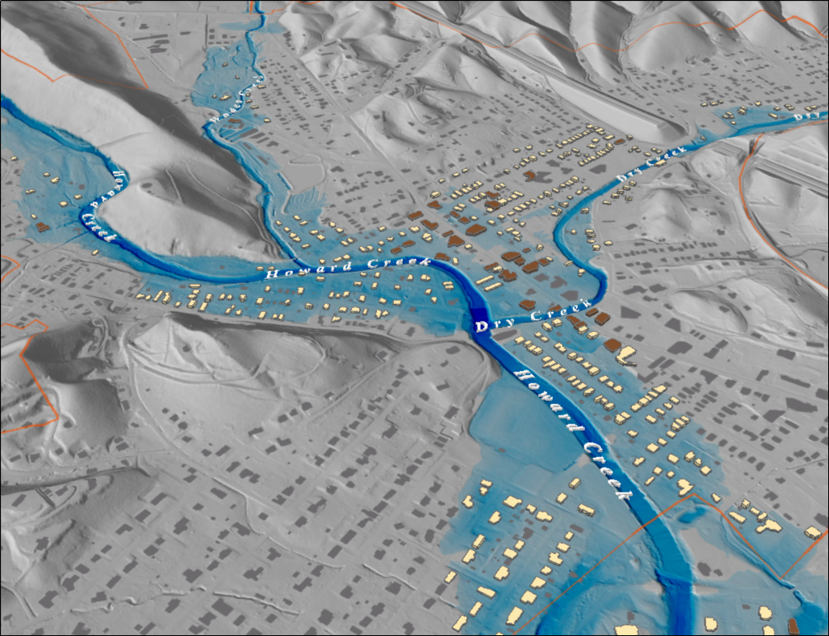
FEMA 1% Annual Chance (100-year) White Sulphur Springs, WV
Notes:
White Sulfur Springs FEMA 100yr Grey

Slide 30
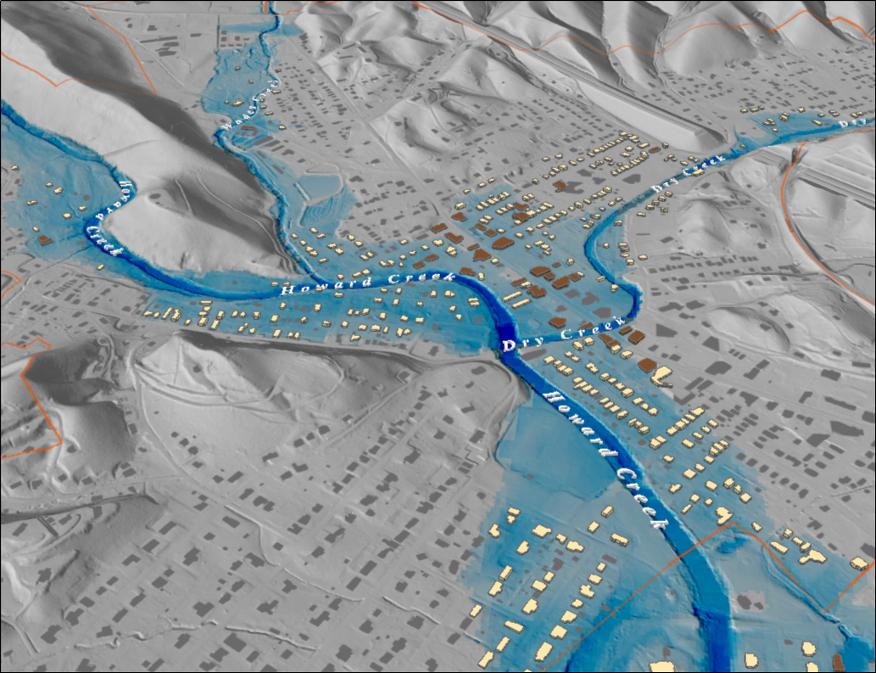
FEMA 1%+ Annual Chance (100-year) White Sulphur Springs, WV
Notes:
White Sulfur Springs FEMA 100yr PLUS Grey

Slide 31

FEMA 0.2% Annual Chance (500-year) White Sulphur Springs, WV
Notes:
White Sulfur Springs FEMA 500yr Grey

