Slide 1
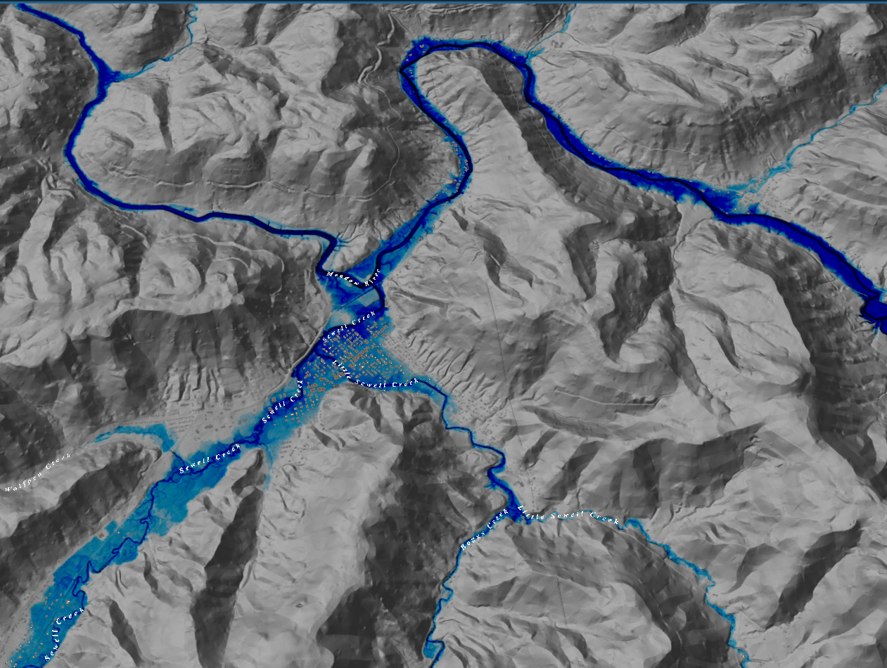
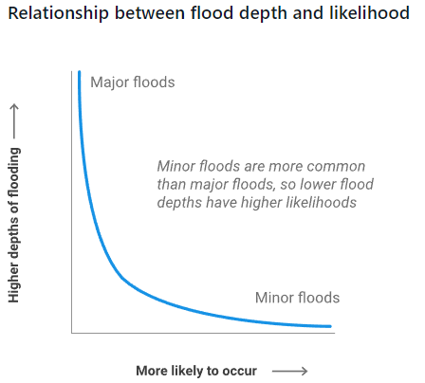
FEMA Flood Models: Likelihood and Magnitude
Rainelle, WV
FEMA
Return Period (Likelihood) and Flood Size (Magnitude) | Annual Probability | Cumulative Probability - Flooding at least once over 30 years | FEMA Risk Description | Climate Model
10 yr (1 in 10) | 10% | 96% | High Risk
25 yr (1 in 25) | 4% | 71% | High Risk
50 yr (1 in 50) | 2% | 45% | High Risk
100 yr (1 in 100) | 1% | 26% | High Risk
100 yr (1 in 100) Plus | 1%+ | 26% | High Risk | Yes
500 yr (1 in 500) | 0.2% | 6% | Moderate Risk

Slide 2
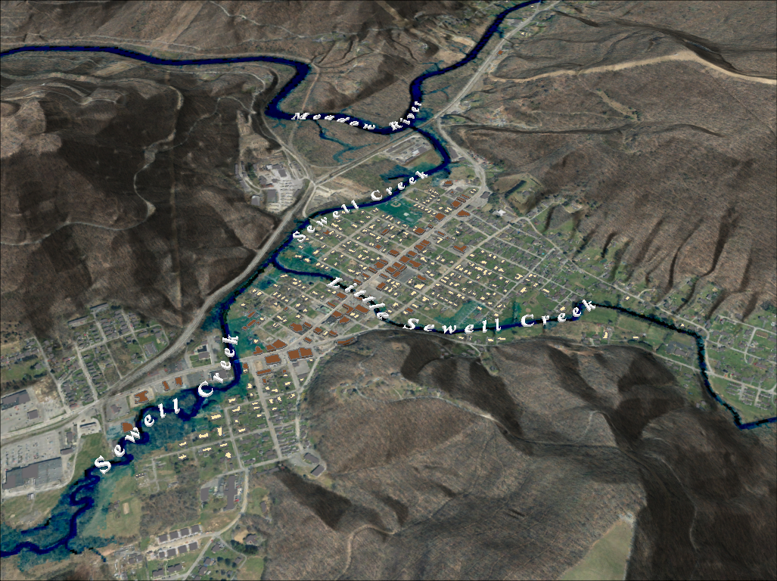
FEMA 10% Annual Chance (10-year) Rainelle, WV
0 ft.
FLOOD DEPTH
35 ft.
96% probability of flooding at least once over 30 years
Notes:
FEMA 10year Aerial

Slide 3
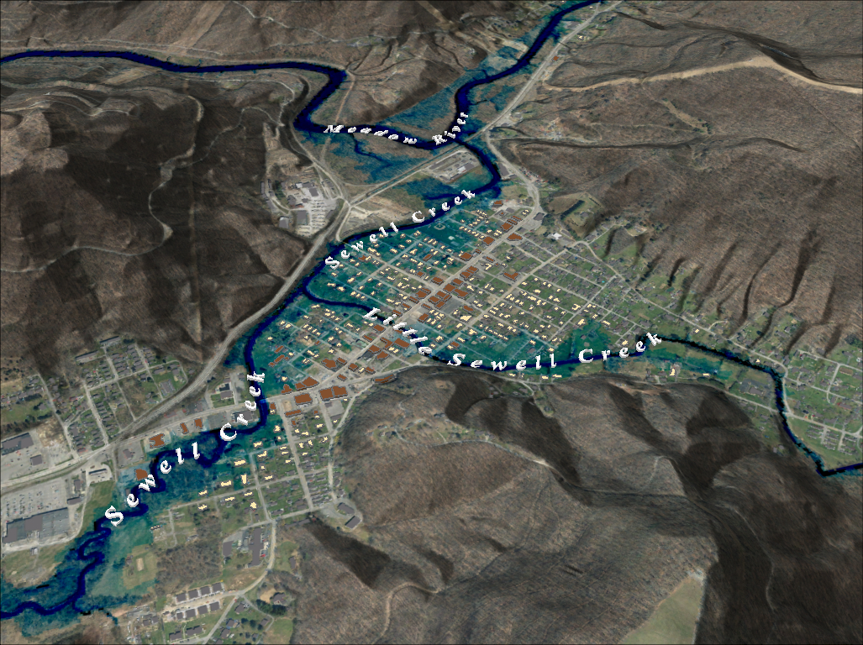
FEMA 4% Annual Chance (25-year) Rainelle, WV
0 ft.
FLOOD DEPTH
35 ft.
71% probability of flooding at least once over 30 years
Notes:
FEMA 25year Aerial

Slide 4
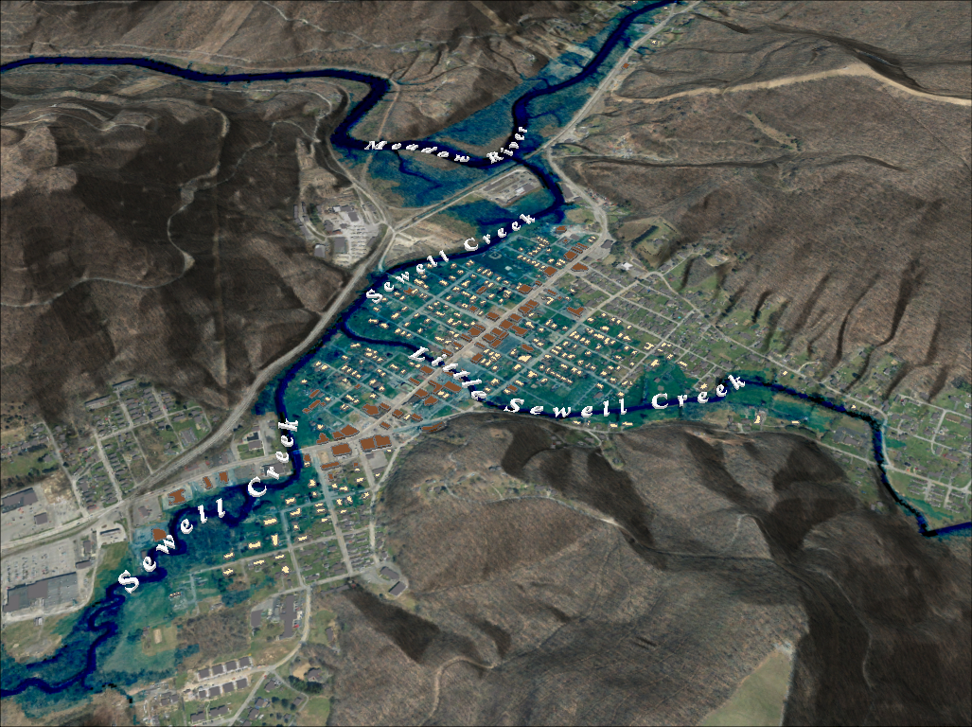
FEMA 2% Annual Chance (50-year) Rainelle, WV
0 ft.
FLOOD DEPTH
35 ft.
45% probability of flooding at least once over 30 years
Notes:
FEMA 50year Aerial

Slide 5
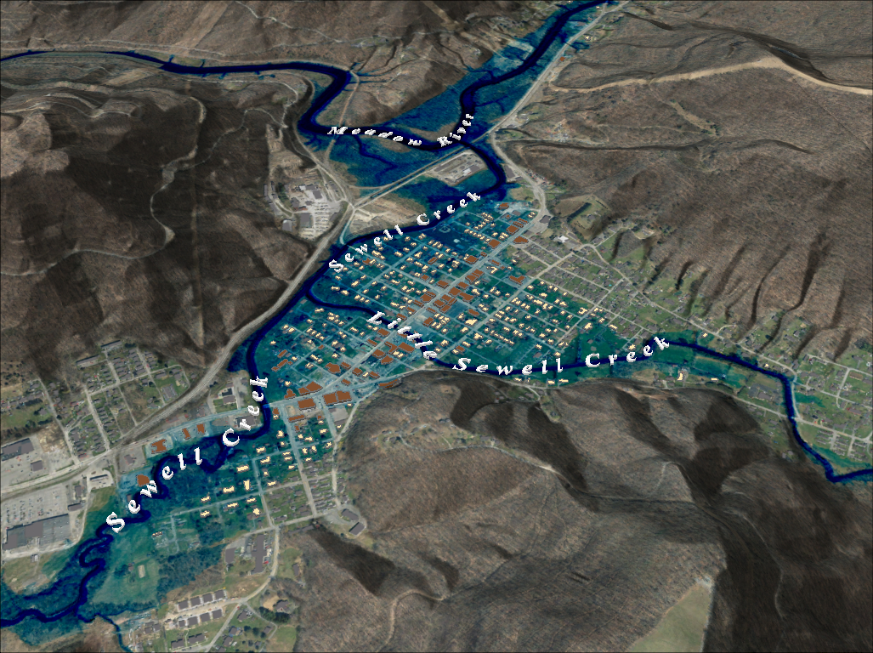
FEMA 1% Annual Chance (100-year) Rainelle, WV
0 ft.
FLOOD DEPTH
35 ft.
26% probability of flooding at least once over 30 years
Notes:
FEMA 100year Aerial

Slide 6
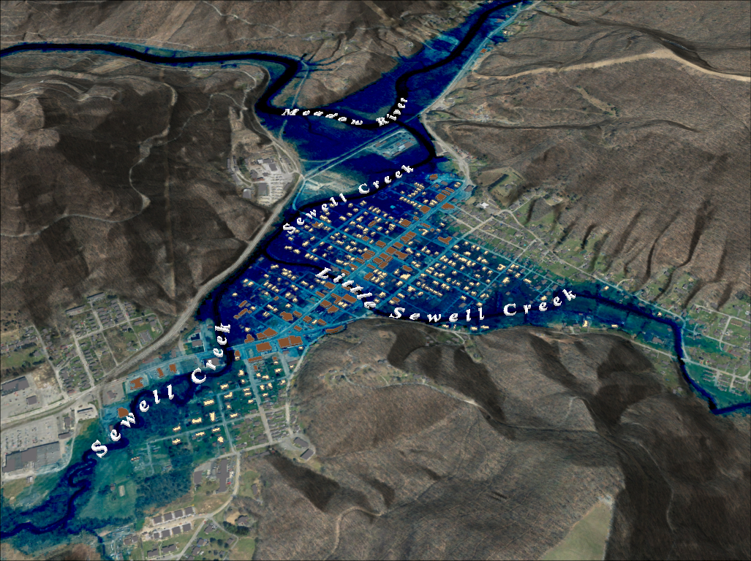
FEMA 1%+ Annual Chance (100-year) Rainelle, WV
Climate
Change
0 ft.
FLOOD DEPTH
35 ft.
26% probability of flooding at least once over 30 years
Notes:
FEMA 100year PLUS Aerial

Slide 7
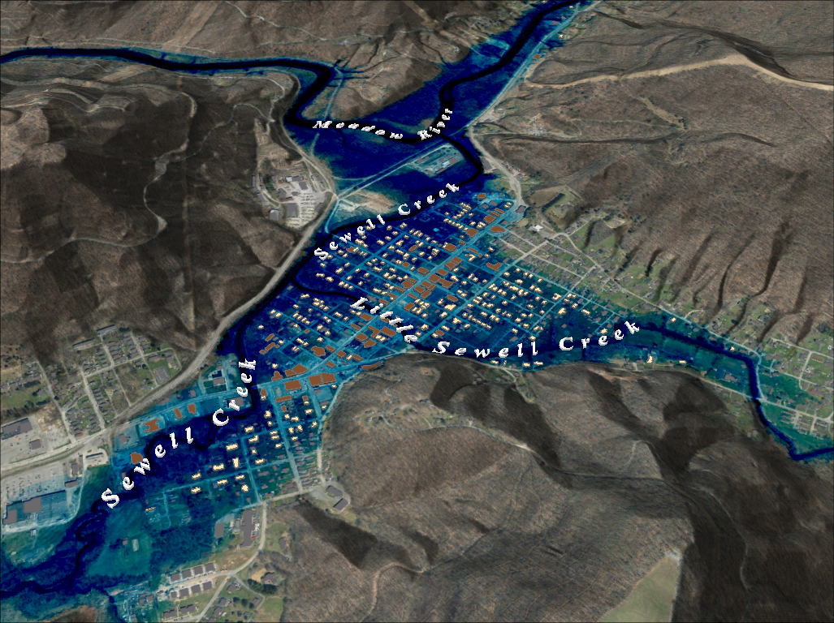
FEMA 0.2% Annual Chance (500-year) Rainelle, WV
0 ft.
FLOOD DEPTH
35 ft.
6% probability of flooding at least once over 30 years
Notes:
FEMA 500year Aerial

Slide 8
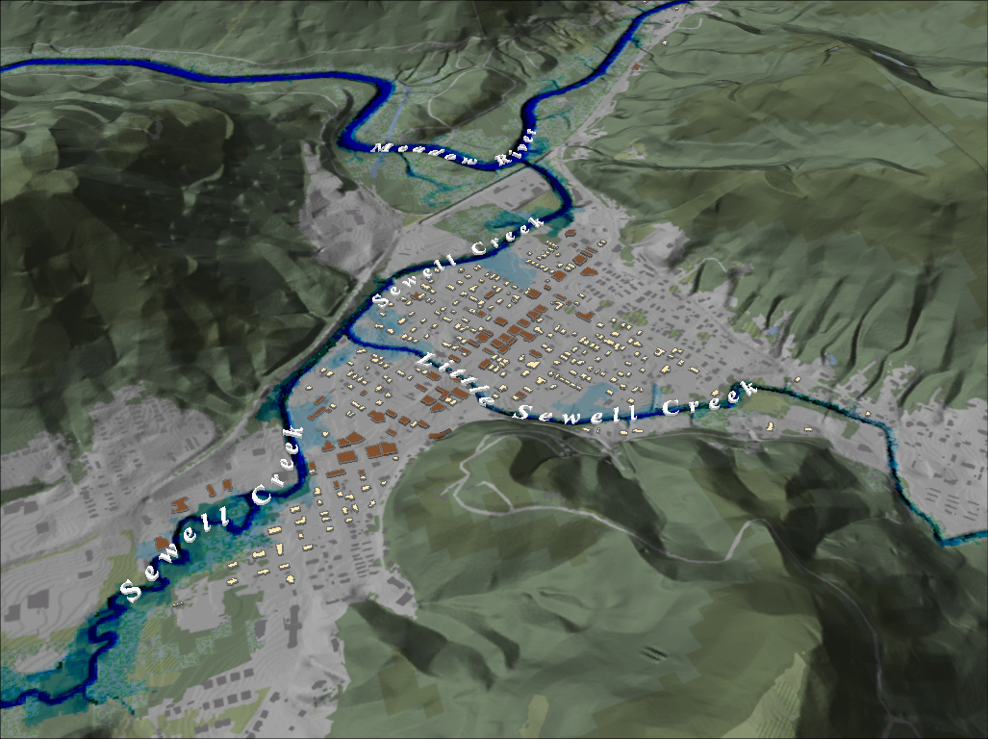
FEMA 10% Annual Chance (10-year) Rainelle, WV
Notes:
FEMA 10 year NLCD Hillshade

Slide 9
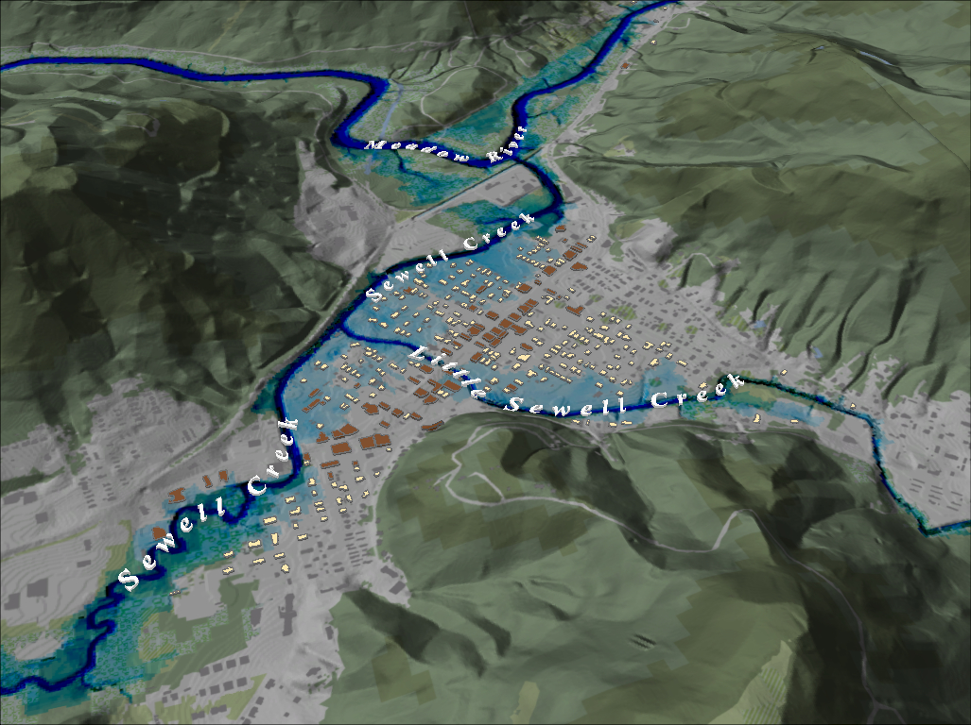
FEMA 4% Annual Chance (25-year) Rainelle, WV
Notes:
FEMA 25 year NLCD Hillshade

Slide 10
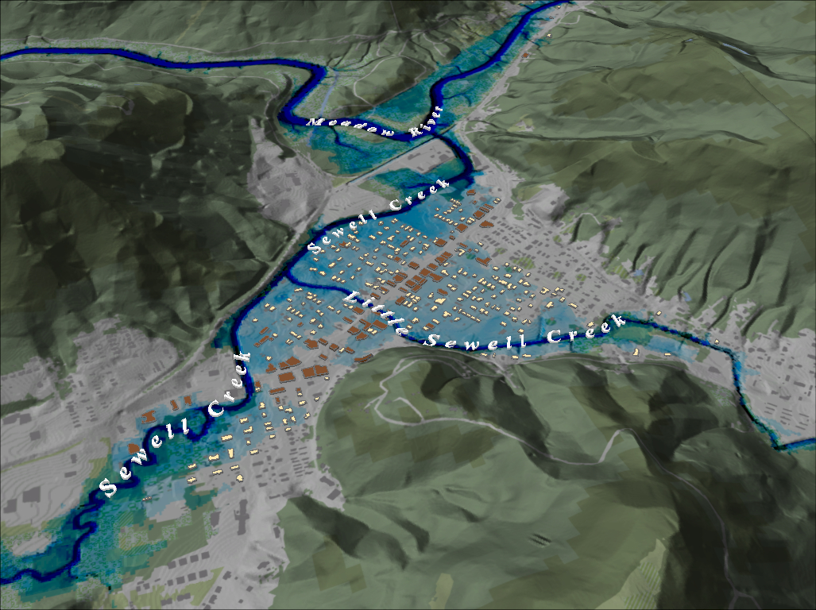
FEMA 2% Annual Chance (50-year) Rainelle, WV
Notes:
FEMA 50 year NLCD Hillshade

Slide 11
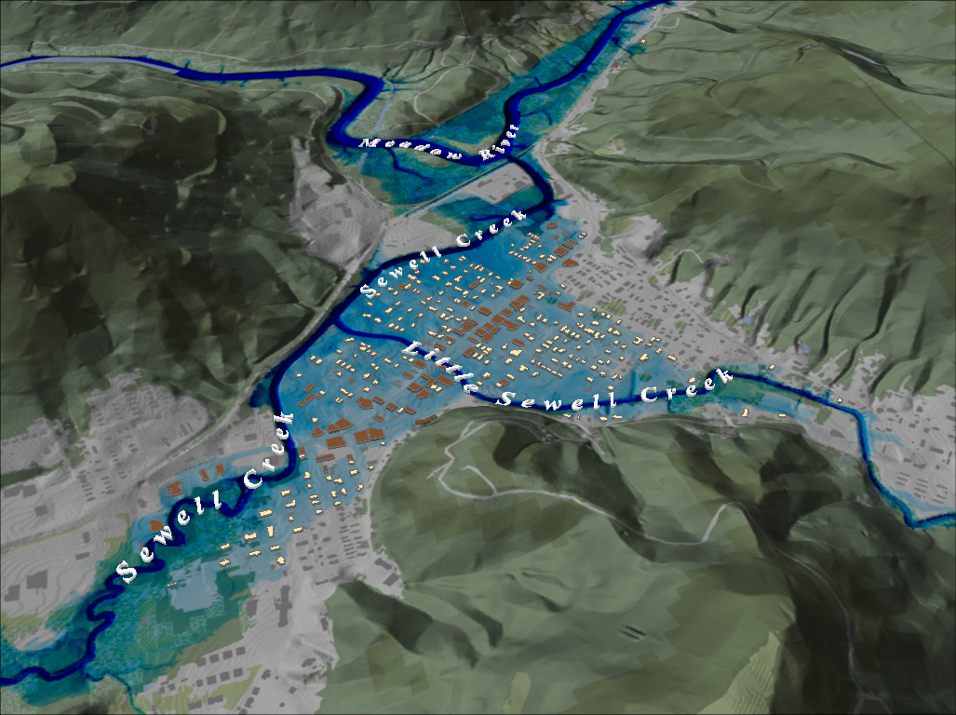
FEMA 1% Annual Chance (100-year) Rainelle, WV
Notes:
FEMA 100 year NLCD Hillshade

Slide 12
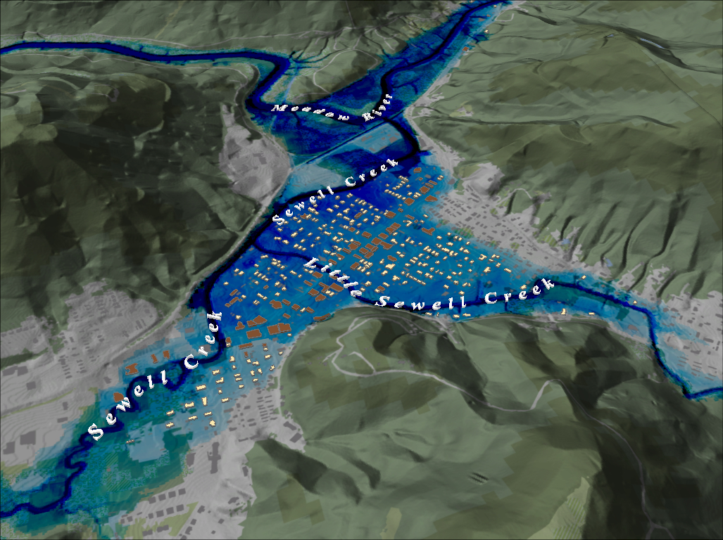
FEMA 1%+ Annual Chance (100-year) Rainelle, WV
Notes:
FEMA 100 year PLUS NLCD Hillshade

Slide 13
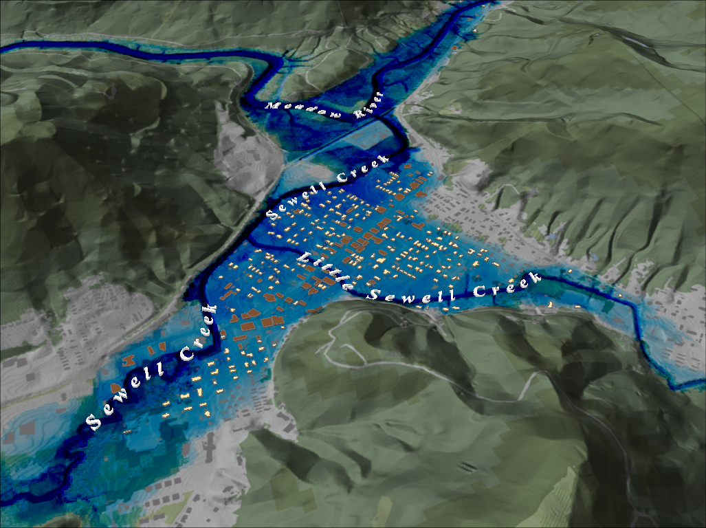
FEMA 0.2% Annual Chance (500-year) Rainelle, WV
Notes:
FEMA 500 year NLCD Hillshade

Slide 14
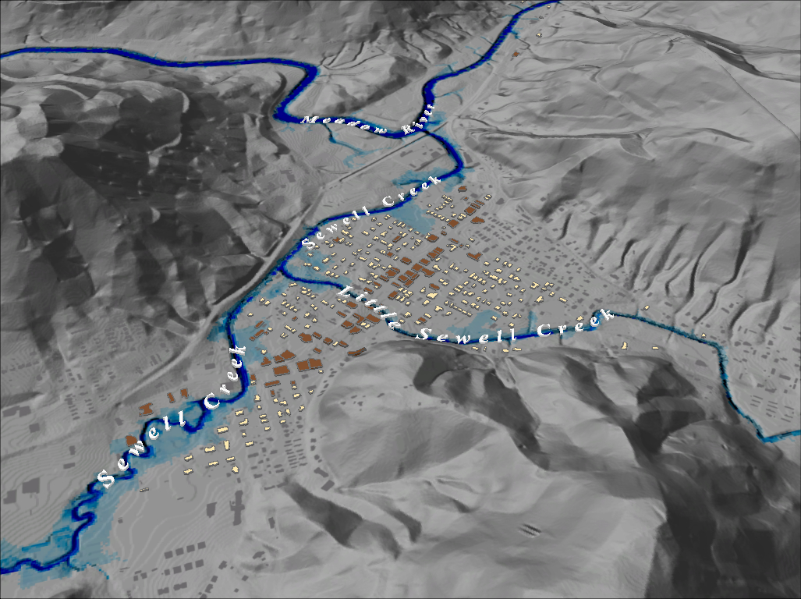
FEMA 10% Annual Chance (10-year) Rainelle, WV
Notes:
FEMA 10 year Grey Hillshade

Slide 15
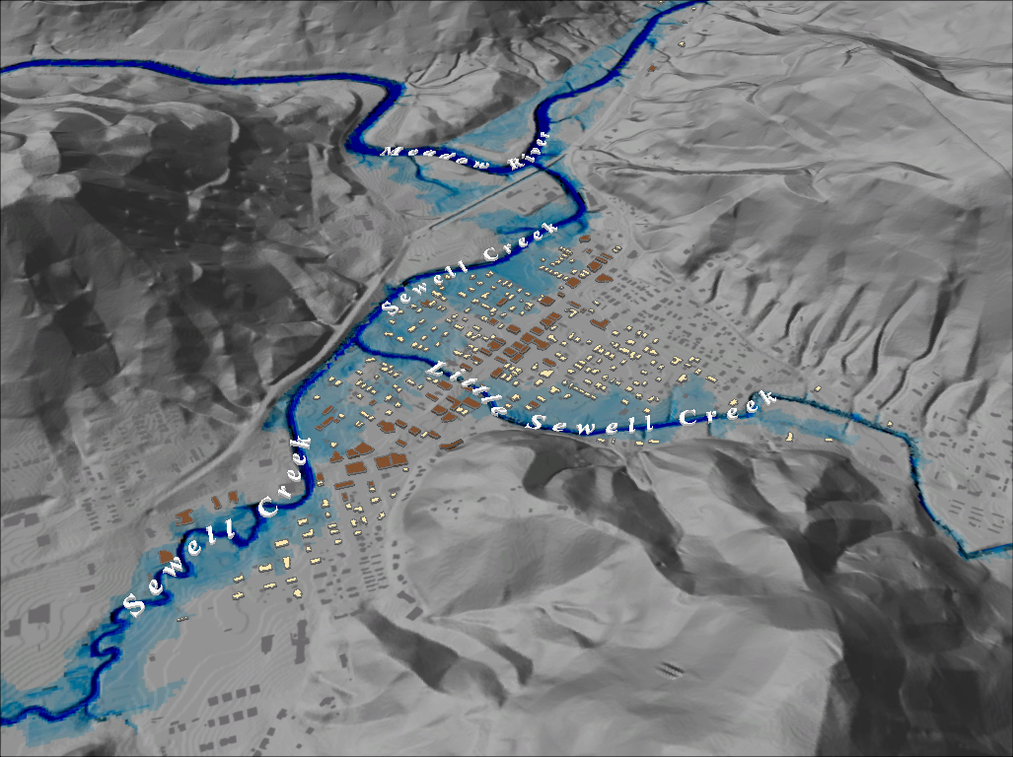
FEMA 4% Annual Chance (25-year) Rainelle, WV
Notes:
FEMA 25 year Grey Hillshade

Slide 16
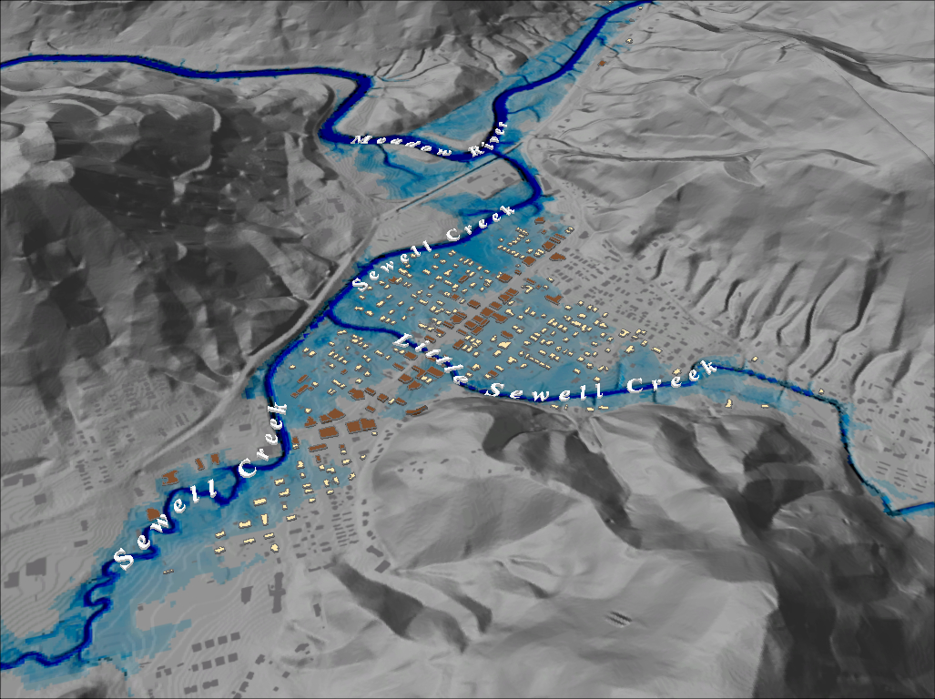
FEMA 2% Annual Chance (50-year) Rainelle, WV
Notes:
FEMA 50 year Grey Hillshade

Slide 17
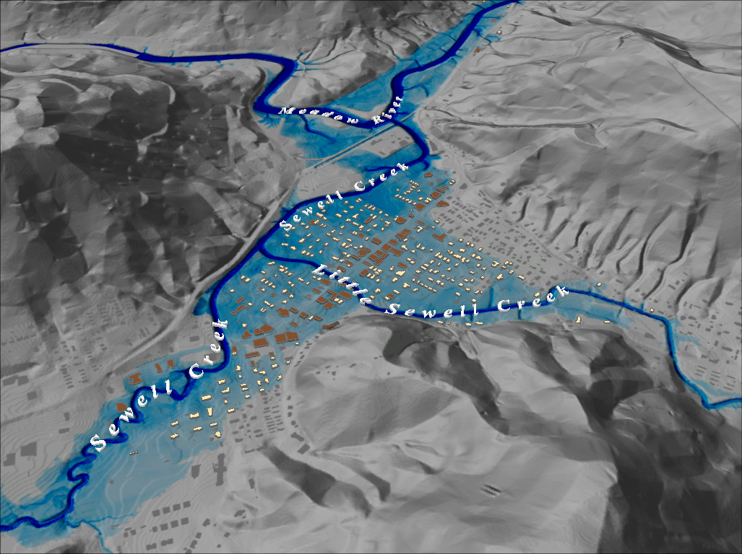
FEMA 1% Annual Chance (100-year) Rainelle, WV
Notes:
FEMA 100 year Grey Hillshade

Slide 18
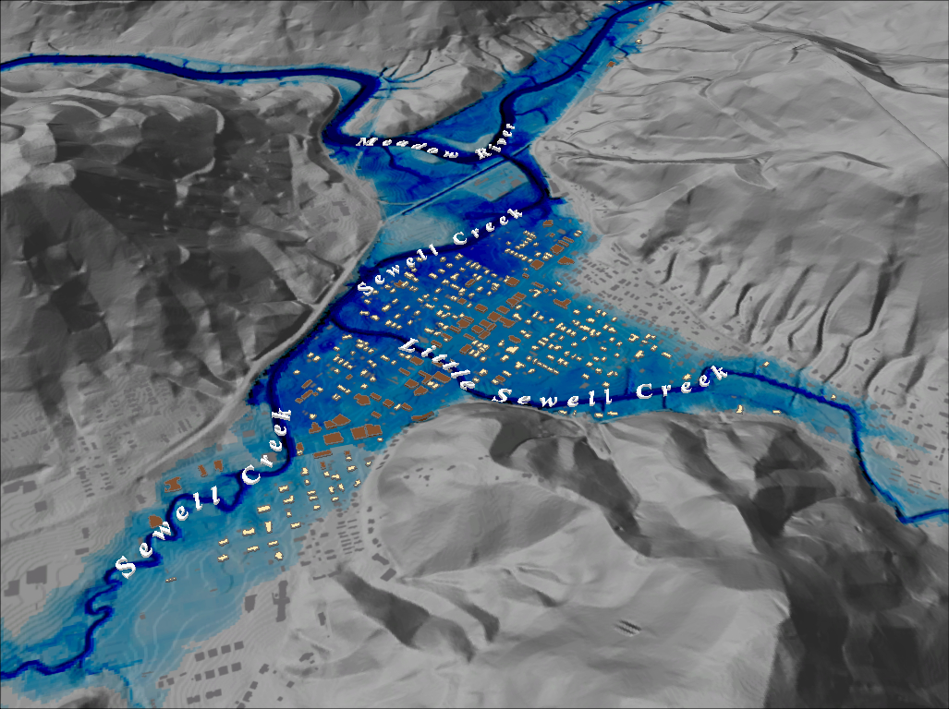
FEMA 1%+ Annual Chance (100-year) Rainelle, WV
Notes:
FEMA 100 year PLUS Grey Hillshade

Slide 19
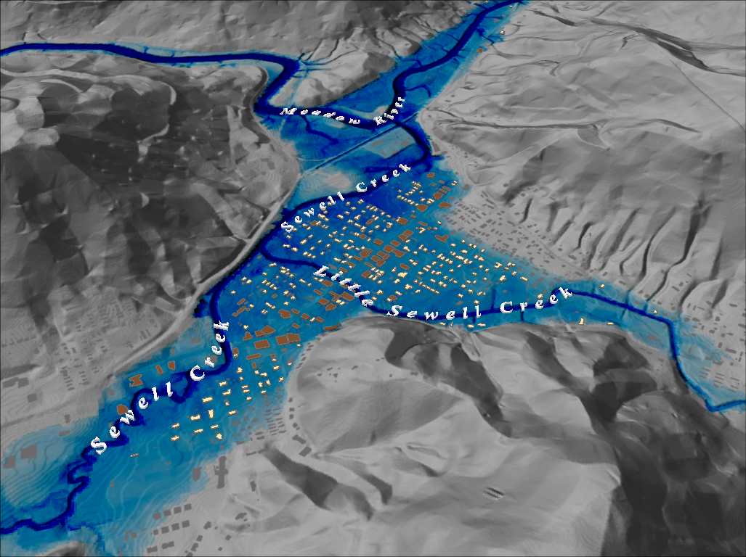
FEMA 0.2% Annual Chance (500-year) Rainelle, WV
Notes:
FEMA 500 year Grey Hillshade

