Slide 1
Mitigation
White Sulphur Springs and Rainelle
Category | Mitigation Indicator | White Sulphur Springs | Rainelle | Ratio* in WV Incorporated Areas (2021)
Mitigated Structures | Total Elevated Structures, Reconstruction to Design Flood Elevation (DFE) | 14 | 38 | Not ready yet
 | Percent Structures Elevated to DFE in Total Residential Buildings | 3% | 11% | Not ready yet
 | Loss Avoidance by Elevating Structures | $2,119K | $1,816K | Not ready yet
Open Space | Buyout Parcels (Deed Restricted) | 14 | 16 | 641 (Total)
 | Area of Open Space Preservation (OSP) | 5 Acres | 3 Acres | 5 (Avg.)
 | Ratio of Open Space Preservation (OSP to SFHA) | 2.6% | 4.5% | 5%
Flood Insurance | Number of Policies 2019 | 133 | 44 | 29 (Avg.)
* For numbers, used total or average where the median was zero or too low, in the state’s 213 incorporated areas
The red texts show large difference, to the risk side, from the state ratios.
The green texts show large difference, to the resilience side, from the state ratios.

Slide 2
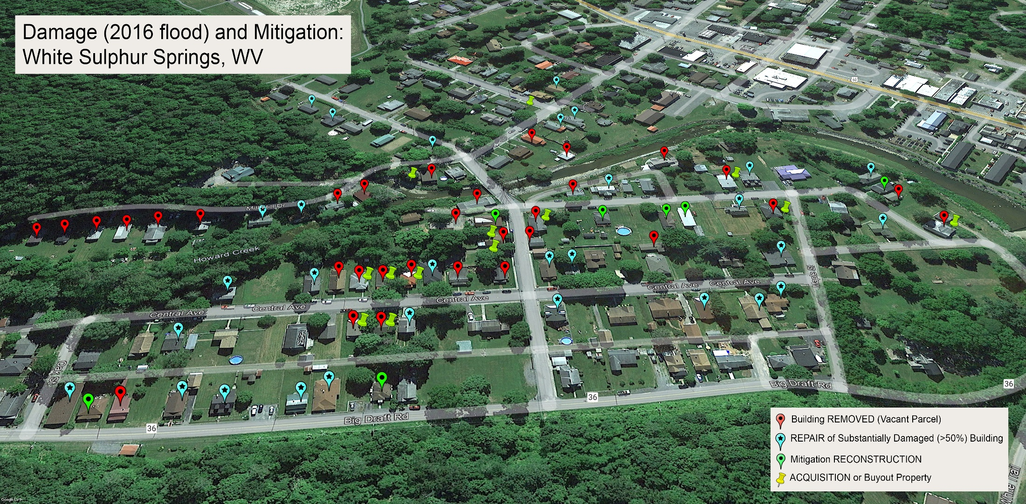
Example Areas of Focus
in White Sulphur Springs

Slide 3
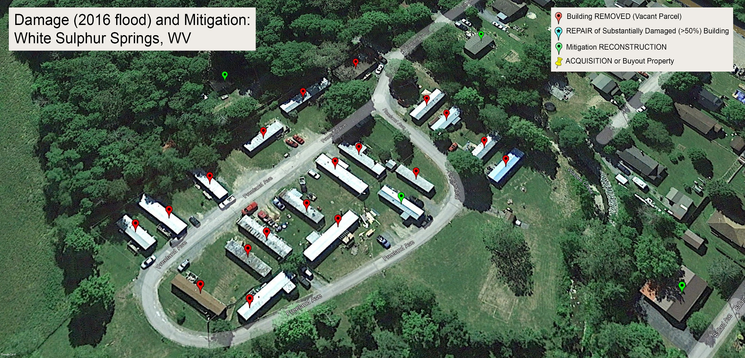
Example Areas of Focus
in White Sulphur Springs…

Slide 4
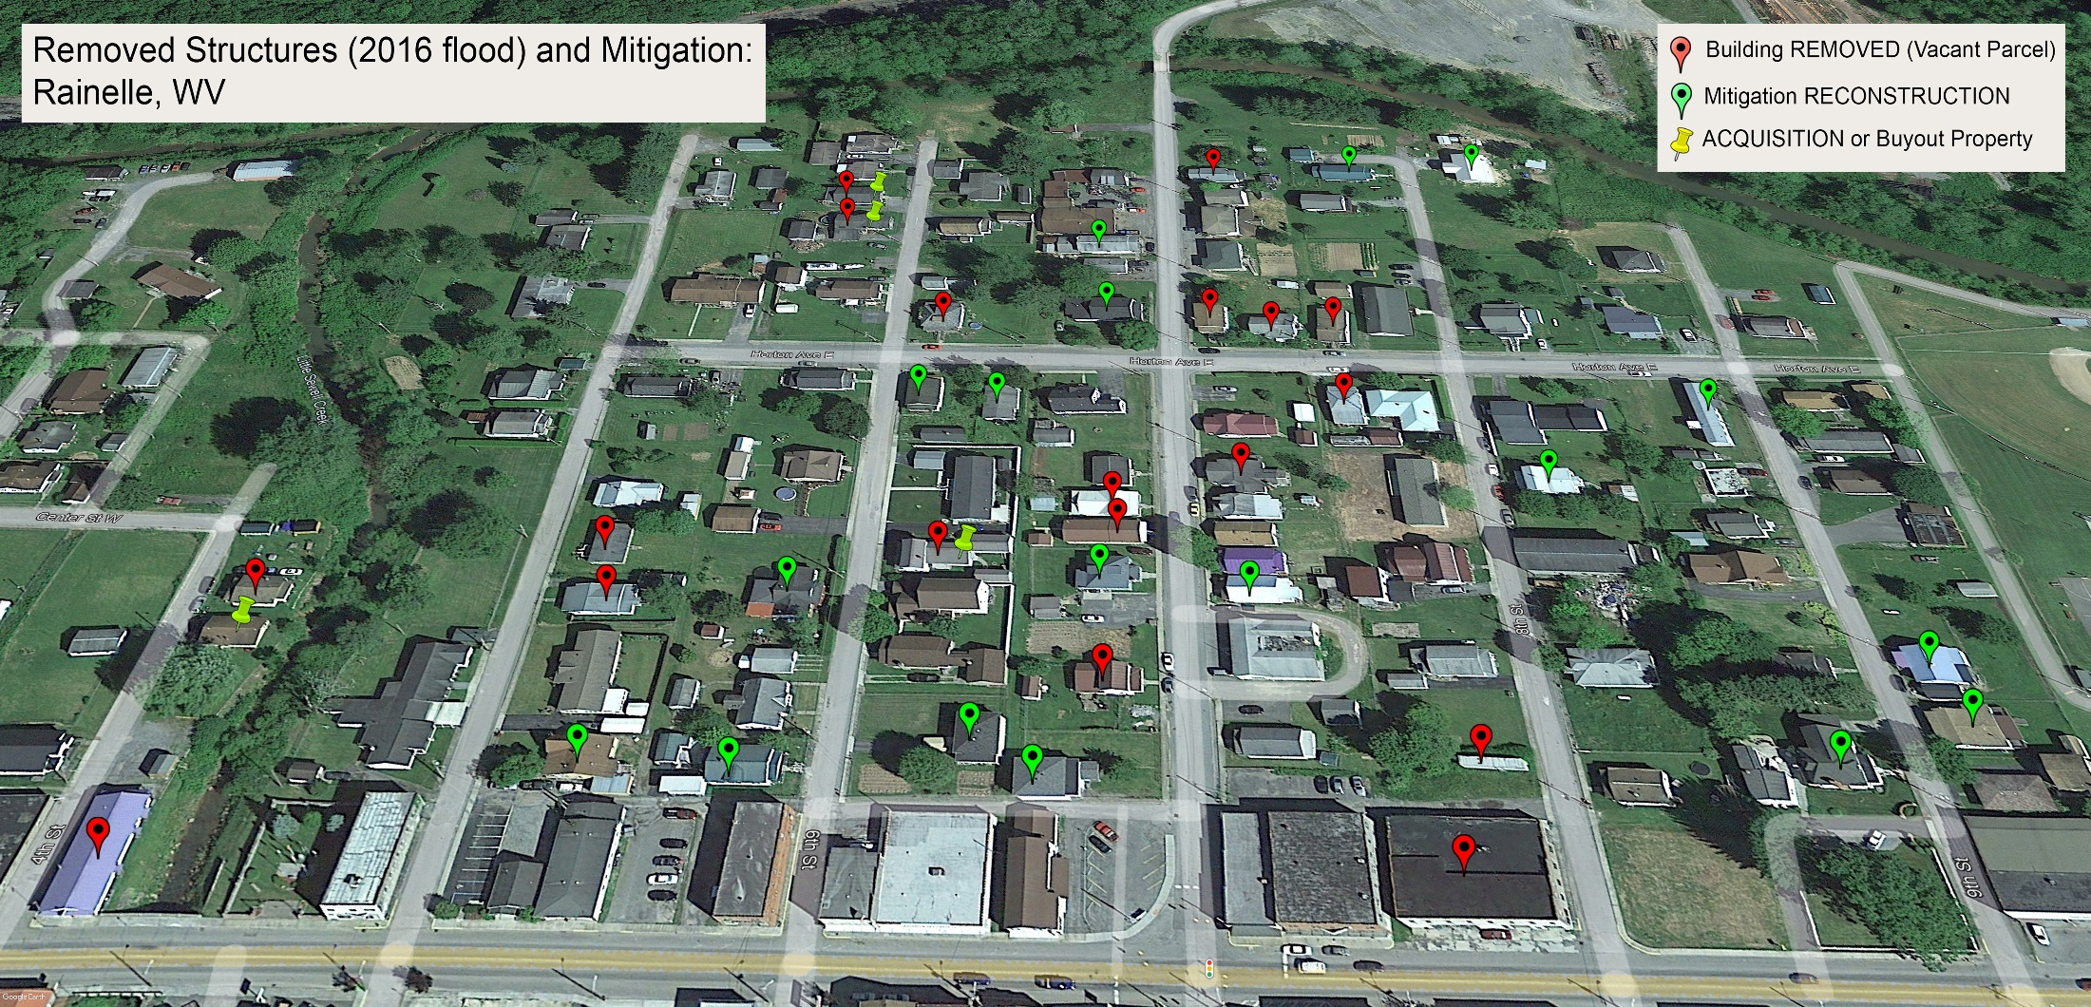
Example Areas of Focus
in Rainelle

Slide 5
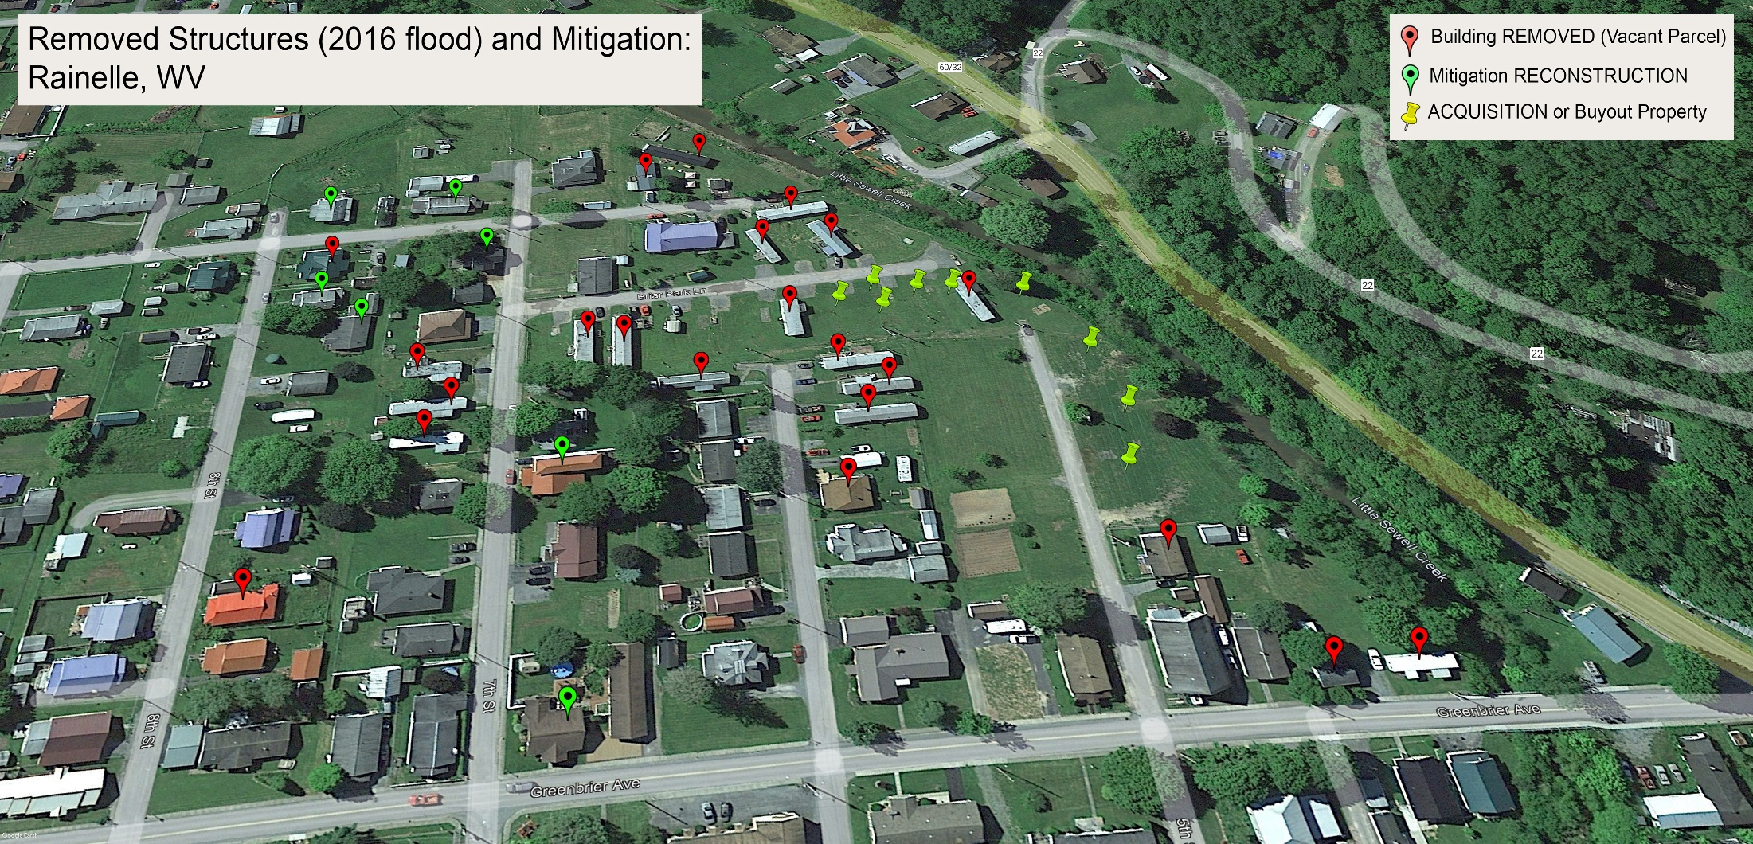
Example Areas of Focus
in Rainelle…

Slide 6
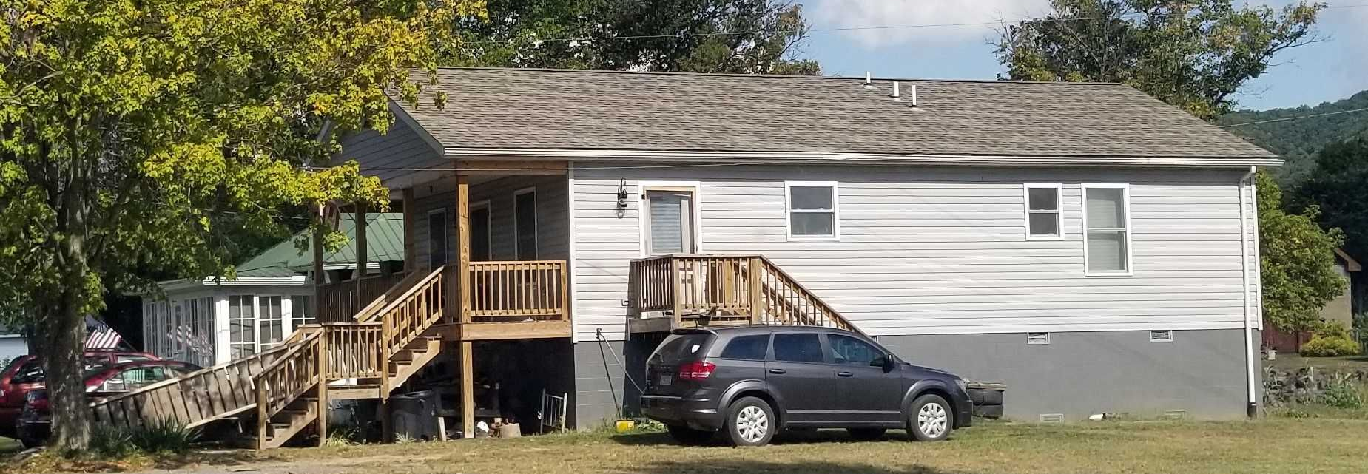
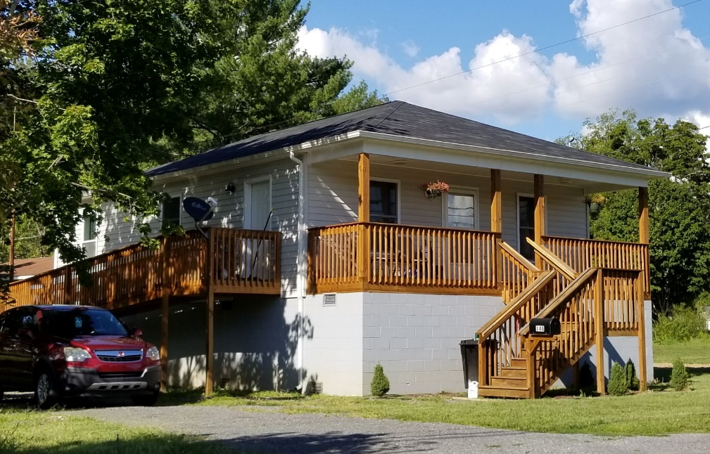
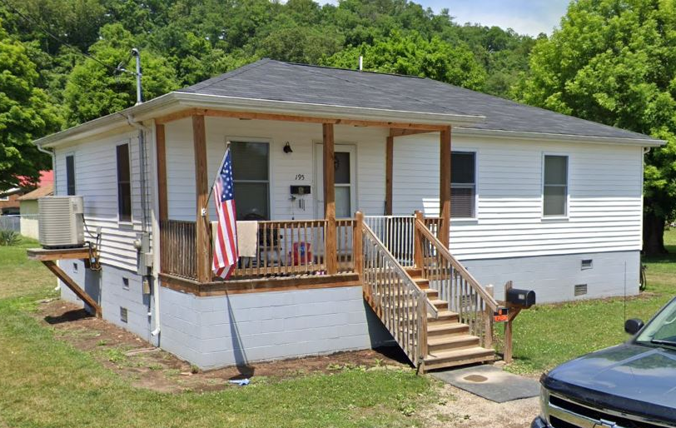
Examples of Elevated Structures
in White Sulphur Springs
Building ID: 13-17-0009-0009-0000_148
Flood Tool Link
Building ID: 13-17-0009-0009-0000_148
Flood Tool Link
Building ID: 13-17-0008-0152-0000_195
Flood Tool Link

Slide 7
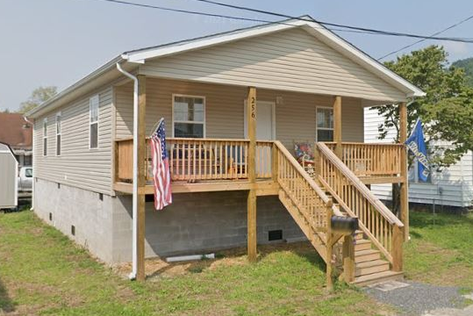
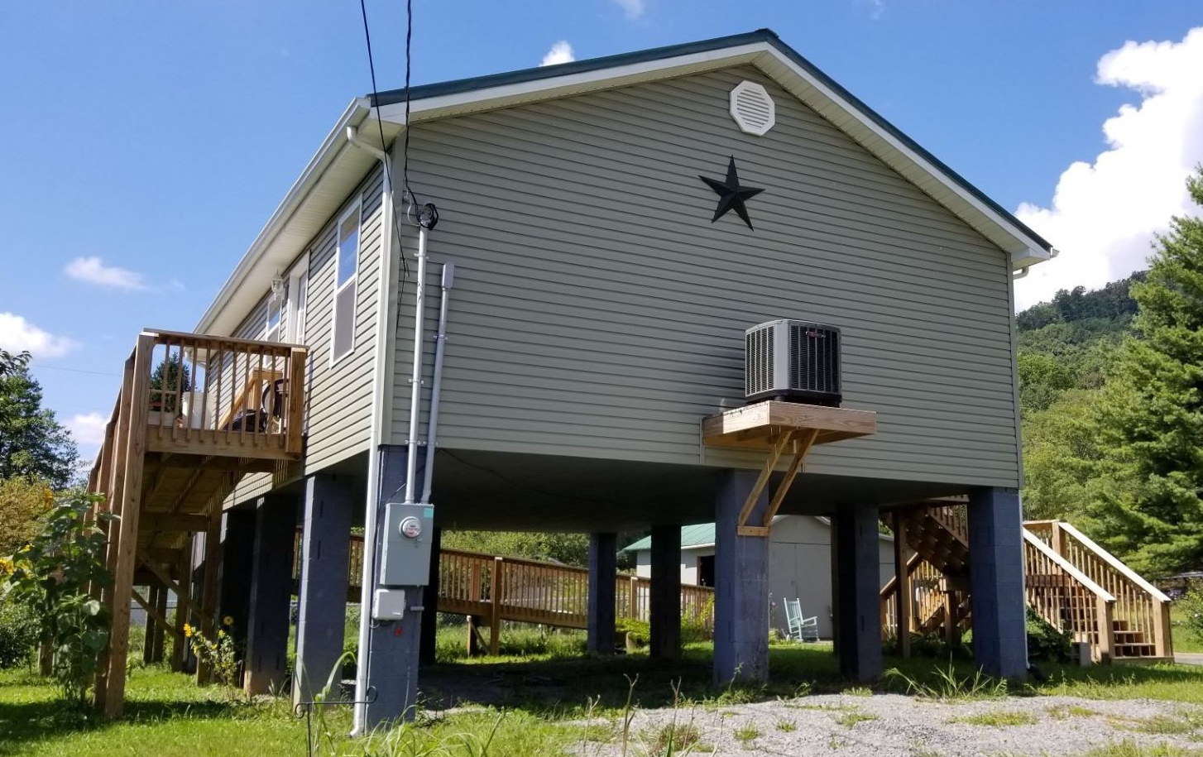
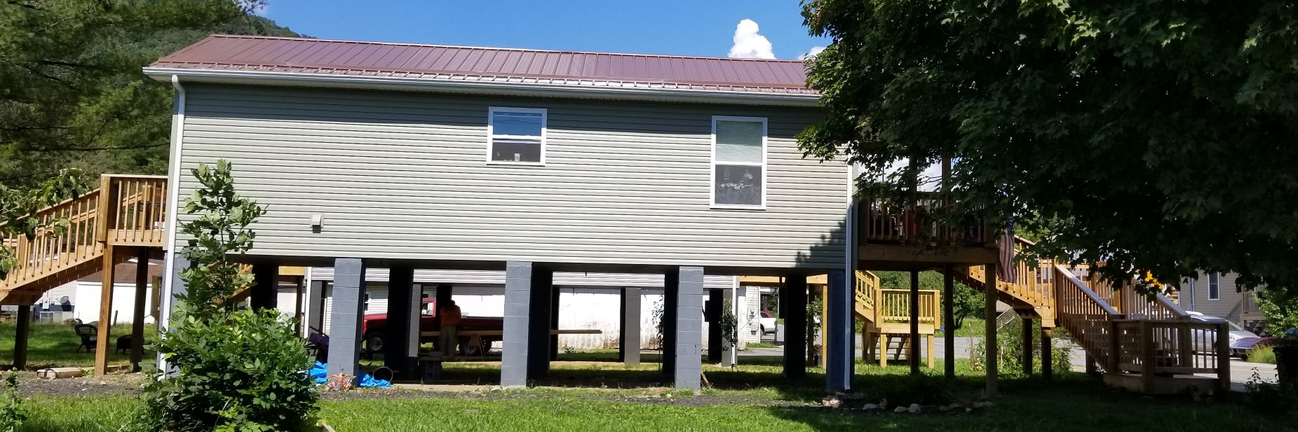
Example of Elevated Structures
in Rainelle
Building ID: 13-13-0005-0165-0000_256
Flood Tool Link
Building ID: 13-13-0001-0069-0000_108
Flood Tool Link
Building ID: 13-13-0001-0054-0000_182
Flood Tool Link

Slide 8
Criteria, Rationale, and Data Sources
Mitigation Indicator | Criteria | Rationale | Data Source
Total Elevated Structures, Reconstruction to Design Flood Elevation (DFE) | Number of newly Constructed or remodeled structures elevated to Design Flood Elevation (DFE) (2 ft above the BFE) on open or closed foundations | A comprehensive inventory of mitigated structures results in more accurate building level risk assessments and shows how communities have applied flood adaptive measures in response to major flood events. | Elevation certificates, building pictures (step 7” rise, cinder block 8”), and major post-disaster mitigation reconstruction projects (1977 and 2016 floods)
Percent Structures Elevated to DFE in Total Residential Buildings | Percentage of the elevated structures in the total residential buildings in SFHA
Loss Avoidance by Elevating Structures | Difference between loss estimates in communities using the Hazus model with the first floor height of 1 ft (not elevated) and elevated to DFE (2 ft above BFE) | With significant investment being made in mitigation by elevating, demonstrating cost-effectiveness is crucial for continued support. Loss Avoidance Studies (LAS) quantify the losses avoided (also known as damage prevented or benefits) due to the implementation of the projects. | BLRA of 10/19/2022 (based on 2022 tax assessment), Total Exposure in Floodplain (TEIF), Building percent damage estimate values, Depth grids
Buyout Parcels | Number of verified buyout land parcels located within floodplains that experience frequent flooding and damage due to flood events altered, purchased, or have deed restrictions placed upon them by FEMA or other agencies | Buyout properties can prevent loss of life and property damage. Property owners/communities with public lands in floodplains are compensated for their land, and the land usually becomes public green space or restored to its natural floodplain function. | Data of Natural Resources Conservation Service (NRCS) to identify the verified buyout parcels with floodplain easements

Slide 9
Criteria, Rationale, and Data Sources
Mitigation Indicator | Criteria | Rationale | Data Source
Area of Open Space Preservation (OSP) | Area of preserved open spaces with no existing buildings or structures, filling, large pavement, or other encroachment to flood flows located in the community’s regulatory floodplains including the SFHA as shown on the community’s Flood Insurance Rate Map (FIRM) attached with a signed statement by a public or creditable private owner or some regulations on the parcel preventing from construction, fillings, or other encroachments on flood flows in the future. | Open Space Preservation restores the floodplain to its natural function and provides opportunities for credits from FEMA’s Community Rating System (CRS). | Data of Natural Resources Conservation Service (NRCS) for buyout properties & FEMA FIRM (2012 & 2022)
Ratio of Open Space Preservation (OSP to SFHA) | Ratio of the preserved open spaces in the impact adjusted Special Flood Hazard Area (SFHA) (after removing waterbodies larger than 10 acres in addition to the federally owned lands).
Number of Policies | Number of flood insurance policies in force in the community | Although higher number of policies in force can equate to a riskier area, it can show more mitigation policies in force. | Community Information System (CIS) 2019

