Slide 1
Building/Parcel Exposure
White Sulphur Springs and Rainelle
Category | Exposure Indicator | White Sulphur Springs | Rainelle | Ratio* in WV Incorporated Areas (2021)
Buildings by Flood Zone (Count & Value) | Total Primary Building Count in Floodplain | 423 (Rank***: 12th) | 338 (Rank: 18th) | 59 (Median)
 | Building Ratio b/w Floodplain & Community Total | 26% | 34% | 9%
 | Total Primary Building Value in Floodplain of Community | $40,881K (Rank: 16th) | $16,120K | $6,417K (Median)
 | Median Building Value in Floodplain | $49K | $38K | $42K
 | Building Count in Floodway** (High Velocity) | 65 (Rank: 13th) | 9 | 12 (Avg.)
 | Percent Building Count in Floodway** (High Velocity & Depth) | 15% | 3% | 8%
 | New Maps: Bldgs. “Mapped In” SFHA | 72 (Rank: 12th) | 329 (Rank: 3rd) | 19 (Avg.)
 | New Maps: Bldgs. % Count “Mapped In” SFHA | 17% | 97% | 14%
 | New Maps: Bldgs. “Mapped Out” SFHA | 118 (Rank: 8th) | 0 | 19 (Avg.)
 | New Maps: Bldgs. % Count “Mapped Out” SFHA | 28% | 0% | 14%

Slide 2
Building/Parcel Exposure
White Sulphur Springs and Rainelle
Category | Exposure Indicator | White Sulphur Springs | Rainelle | Ratio* in WV Incorporated Areas (2021)
Building Ownership | Owner Occupied Residential Buildings in Floodplain | 205 | 152 | 65%
 | Percent Owner Occupied Residential Buildings in Floodplain | 48% | 45%
Building Occupancy and Value | Residential Building Count in Floodplain | 370 (Rank: 12th) | 251 | 44
 | Percent Count Residential Building in Floodplain | 87% | 74% | 81%
 | Non-Residential Building Count in Floodplain | 53 | 87 (Rank: 11th) | 12
 | Percent Count Non-Residential Bldgs. in Floodplain | 13% | 26% | 19%
 | Residential Building Value in Floodplain | $20,321K (Rank: 16th) | $9,265K | $2,105K
 | Percent Residential Value in Floodplain | 50% | 57% | 31%
 | Non-Residential Building Value in Floodplain | $20,560K | $6,757K | $2,988K
 | Percent Non-Residential Value in Floodplain | 50% | 44% | 69%
 | Mobile Homes in Floodplain | 4 | 14 | 5
 | Percent Mobile Homes in Residential Buildings in Floodplain | 1% | 4% | 11%

Slide 3
Building/Parcel Exposure
White Sulphur Springs and Rainelle
Category | Exposure Indicator | White Sulphur Springs | Rainelle | Median & Ratio in WV Incorporated Areas (2021)
Building Year Construction/ FIRM Status | Median Construction Year in Floodplain | 1940 | 1950 | 1947
 | % Pre-FIRM Structures (includes “unknown”) | 88% | 77% | 77%
 | % Post-FIRM Structures (also “mapped-in SFHA” Post-FIRM structures regulated to Pre-FIRM) | 12% | 23% | 13%
Physical Structural Vulnerability (Basements, Stories, & Value) | Primary Buildings with Basements in Floodplain | 93 | 27 | 37%
 | Percent Count Buildings with Basements in Floodplain | 22% | 8%
 | One-Story Residential Buildings in Floodplain | 334 | 292 | 69%
 | Percent Count One-Story Residential Buildings in Floodplain | 79% | 86%
 | Red Tag: Dilapidated/Vacant Residential & Commercial Buildings | 14 | 49 | Not available
Before 8/1/1978
Before 11/19/1987
After 8/1/1978
Before 11/19/1987
* For numbers and dollar values, used median, or average where the median was zero or too low, in the state’s 213 incorporated areas
** Floodway includes both the effective and advisory floodways (2012 & 2022 checked manually)
*** Ranks mentioned based on the BLRA data of April 2022 where the community is among the top 20 incorporated areas in WV
The red texts show large difference, to the risk side, from the state ratios.
The green texts show large difference, to the resilience side, from the state ratios.

Slide 4
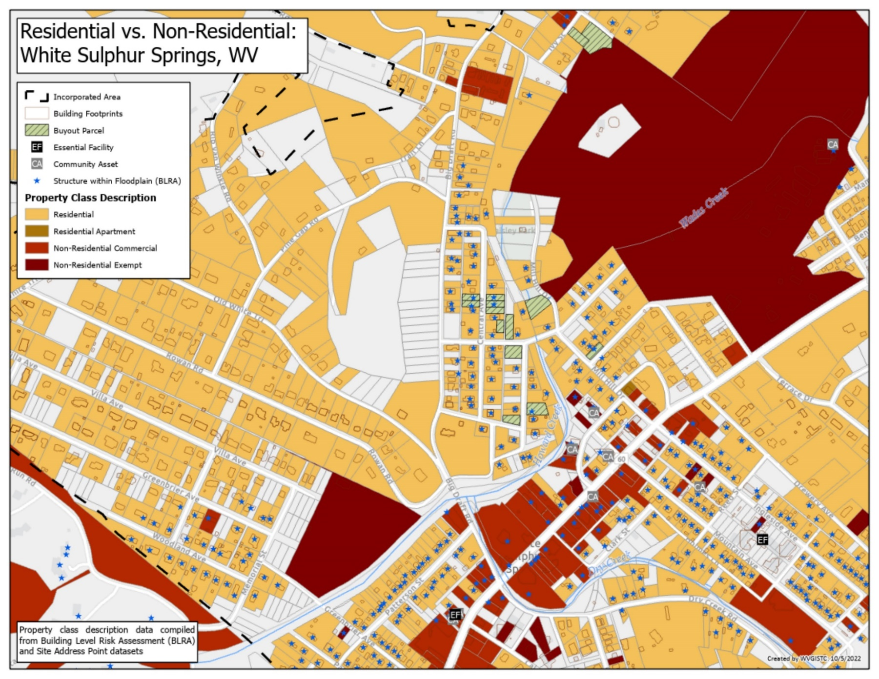
Residential vs. Non-Residential
White Sulphur Springs

Slide 5
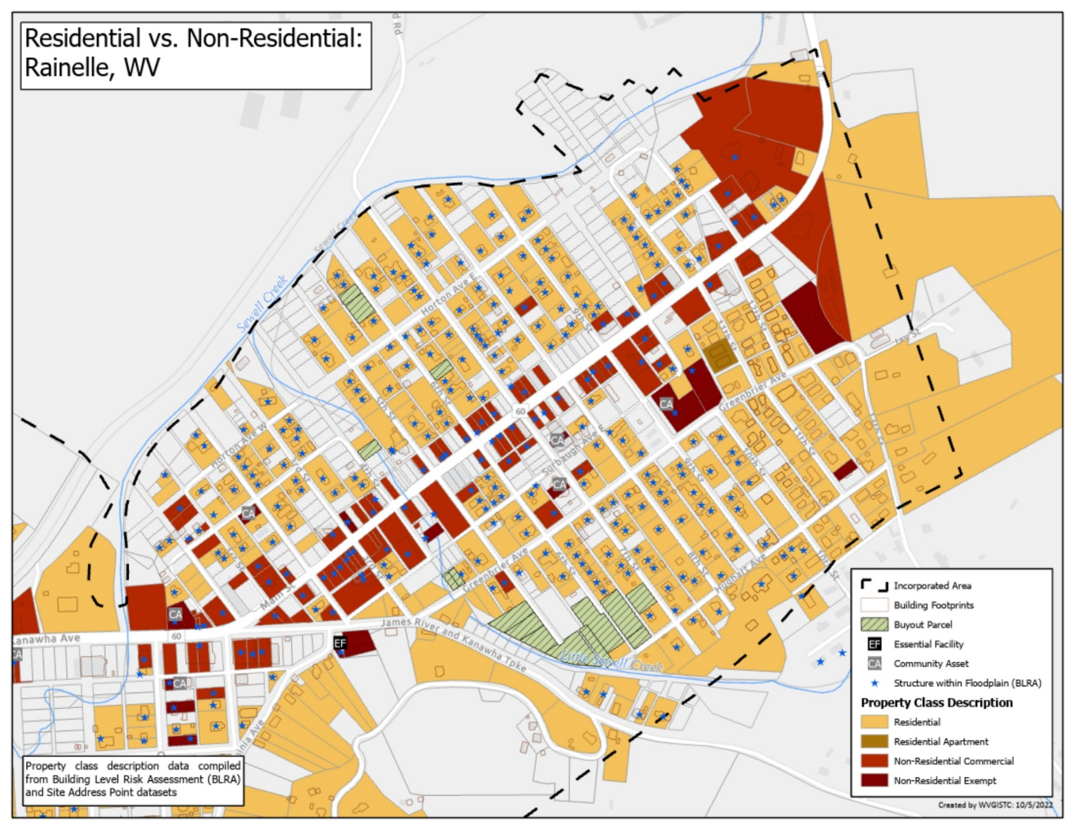
Residential vs. Non-Residential
Rainelle

Slide 6
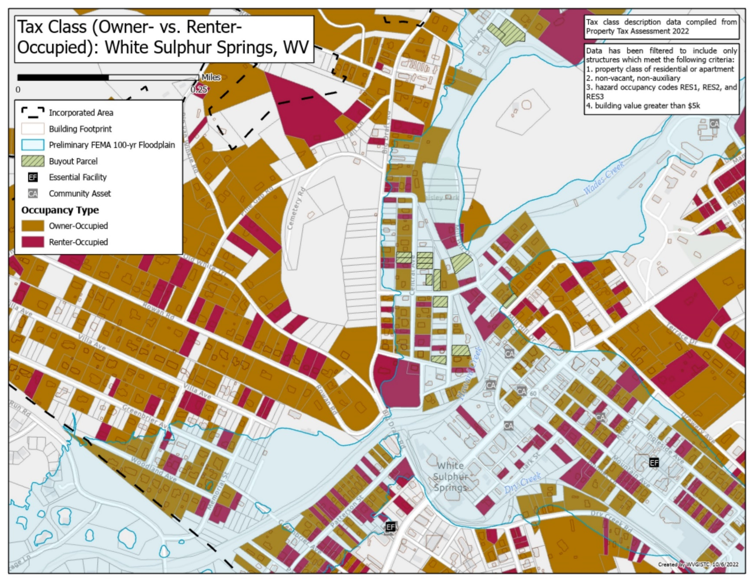
Tax Class, Owner- vs. Renter-Occupied
White Sulphur Springs

Slide 7
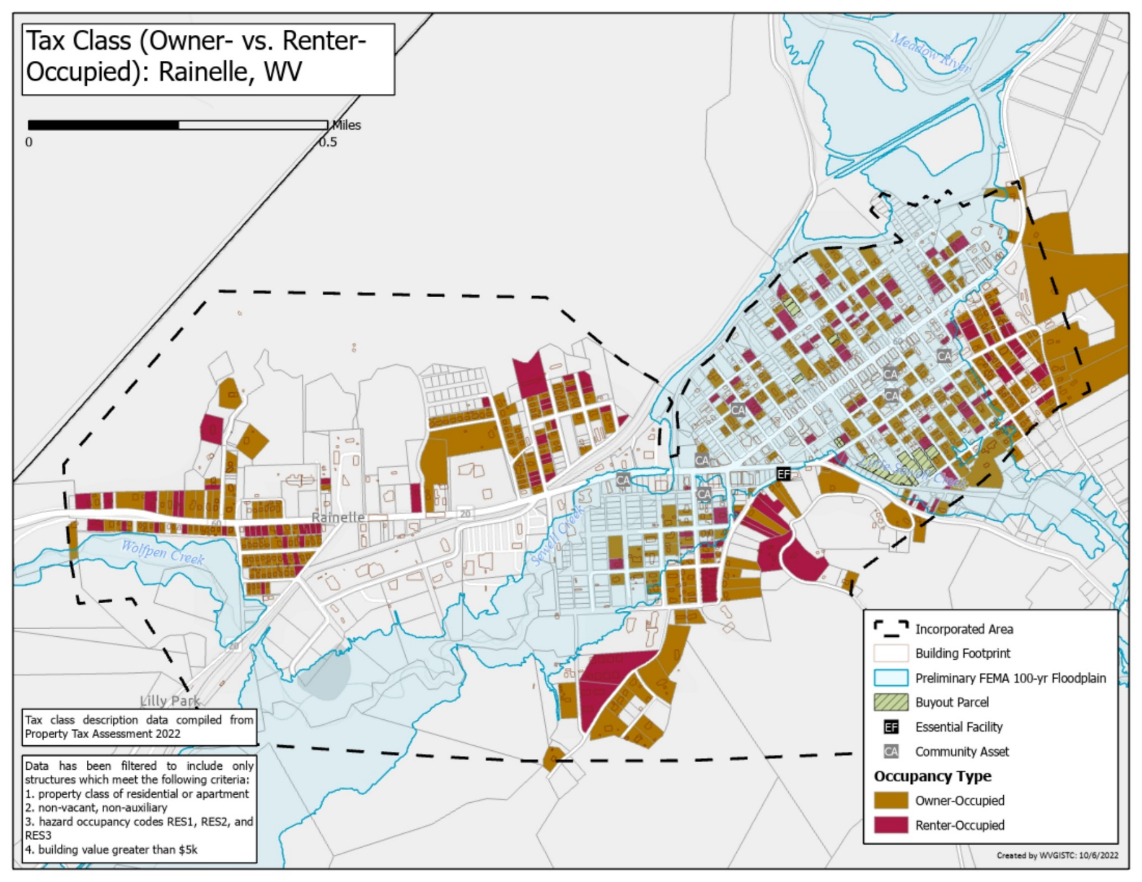
Tax Class, Owner- vs. Renter-Occupied
Rainelle

Slide 8
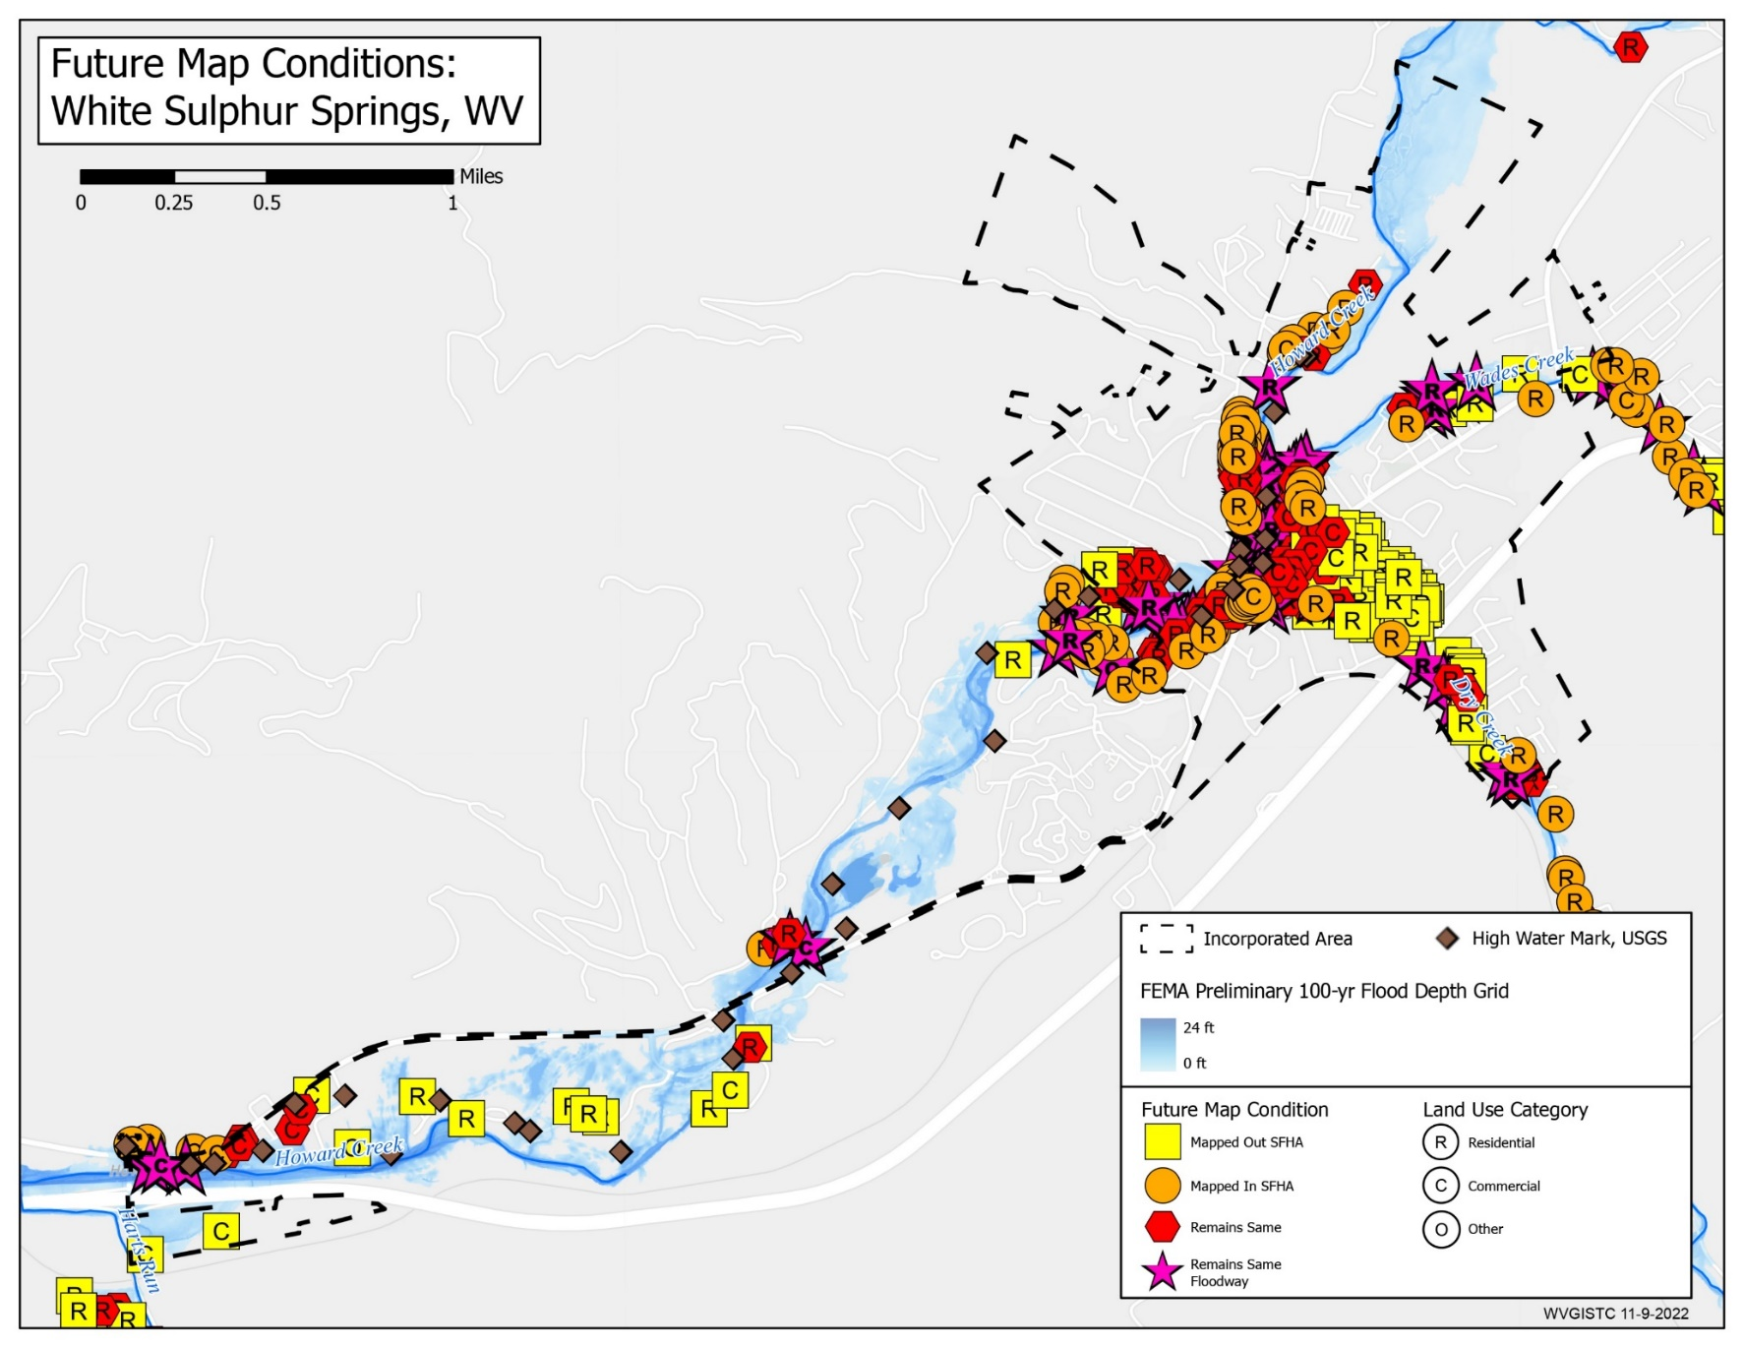
Future Map Conditions
White Sulphur Springs

Slide 9
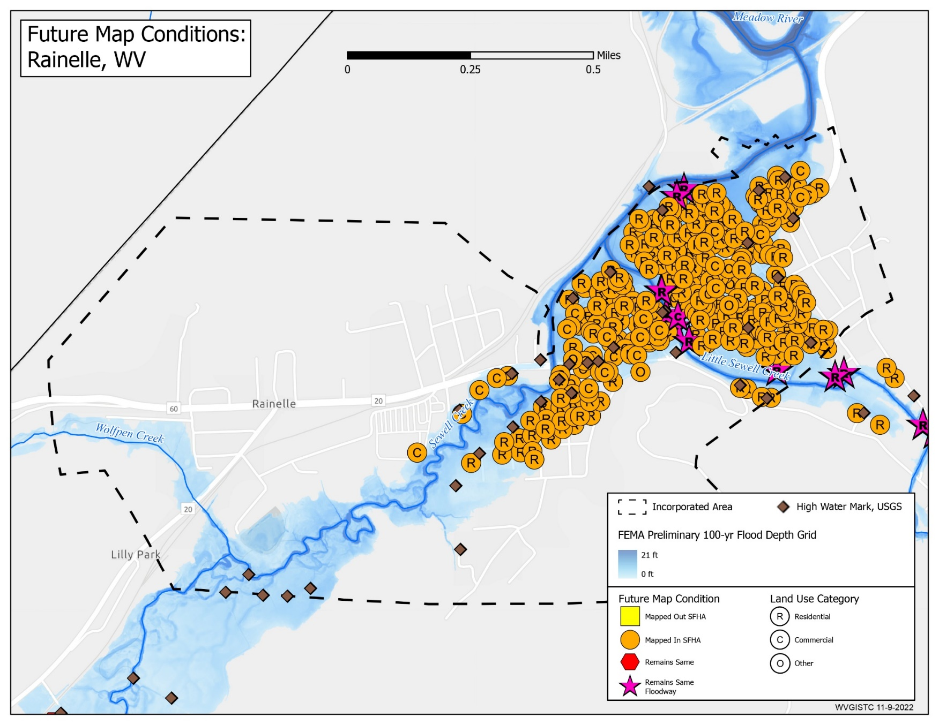
Future Map Conditions
Rainelle

Slide 10
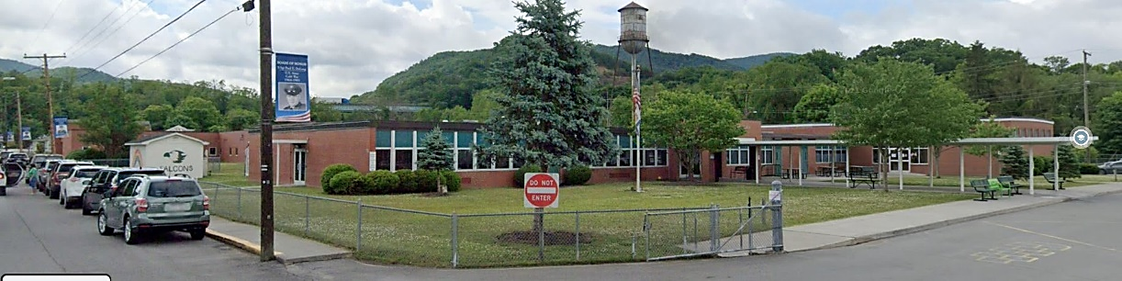
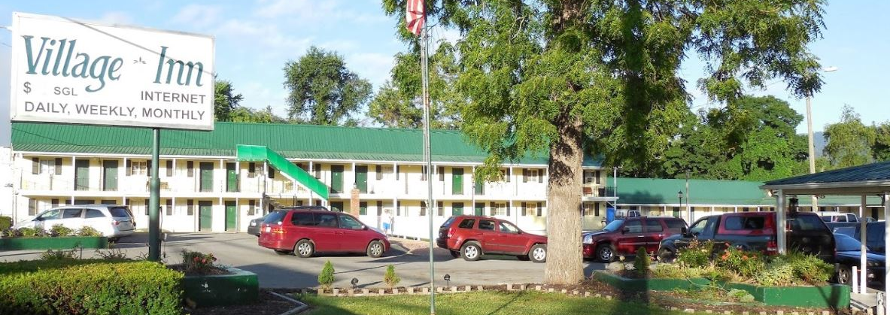

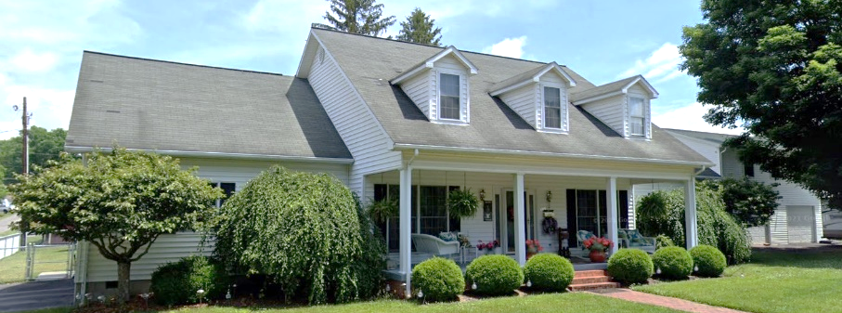
High-Value Structures
White Sulphur Springs
Highest Value:
Building ID: 13-17-0009-0342-0000_150 (WSS Elementary)
Hazard Occupancy Class: EDU1 (School)
FIRM Status: Post-FIRM (2003)
Appraised Value: $8,542,982
Flood Tool Link (New flood study mapped-out SFHA)
Highest Residential (RESx) Value:
Building ID: 13-17-0011-0246-0000_559
Hazard Occupancy Class: RES4 (Hotel/Motel - Low Rise)
FIRM Status: Pre-FIRM (1951)
Appraised Value: $254,400
Flood Tool Link (New flood study mapped-in SFHA)
Highest Apartment Building Value:
Building ID: 13-17-0009-0054-0001_767
Hazard Occupancy Class: RES3B (Multi-Family 3-4 Units)
FIRM Status: Pre-FIRM (1950)
Appraised Value: $227,600
Flood Tool Link
Highest Single-Family Value:
Building ID: 13-17-0008-0523-0000_192
Hazard Occupancy Class: RES1 (Residential 1 Family)
FIRM Status: Post-FIRM (1993)
Appraised Value: $192,700
Flood Tool Link

Slide 11
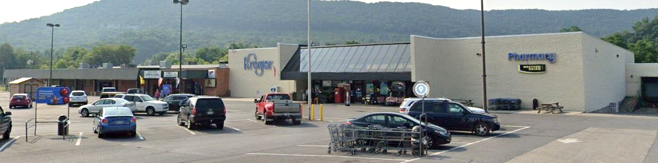
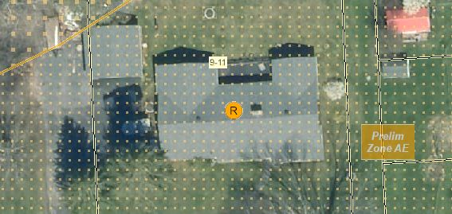
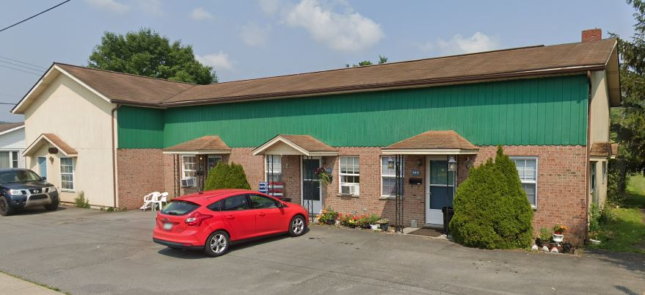
High-Value Structures
Rainelle
Highest Value:
Building ID: 13-13-0004-0194-0000_506
Hazard Occupancy Class:
FIRM Status: Post-FIRM (1994)
regulated to Pre-FIRM
Appraised Value: $1,443,900
Flood Tool Link (New flood study mapped-in SFHA)
Highest Residential (RESx) Value:
Building ID: 13-13-0009-0011-0000_242
Hazard Occupancy Class: RES1 (Residential 1 Family)
FIRM Status: Pre-FIRM (1967)
Appraised Value: $107,400
Flood Tool Link (New flood study mapped-in SFHA)
Highest Apartment Building Value:
Building ID: 13-13-0005-0341-0000_249
Hazard Occupancy Class: RES3B (Multi-Family 3-4 Units)
FIRM Status: Pre-FIRM (1960)
Appraised Value: $63,900
Flood Tool Link (New flood study mapped-in SFHA)

Slide 12
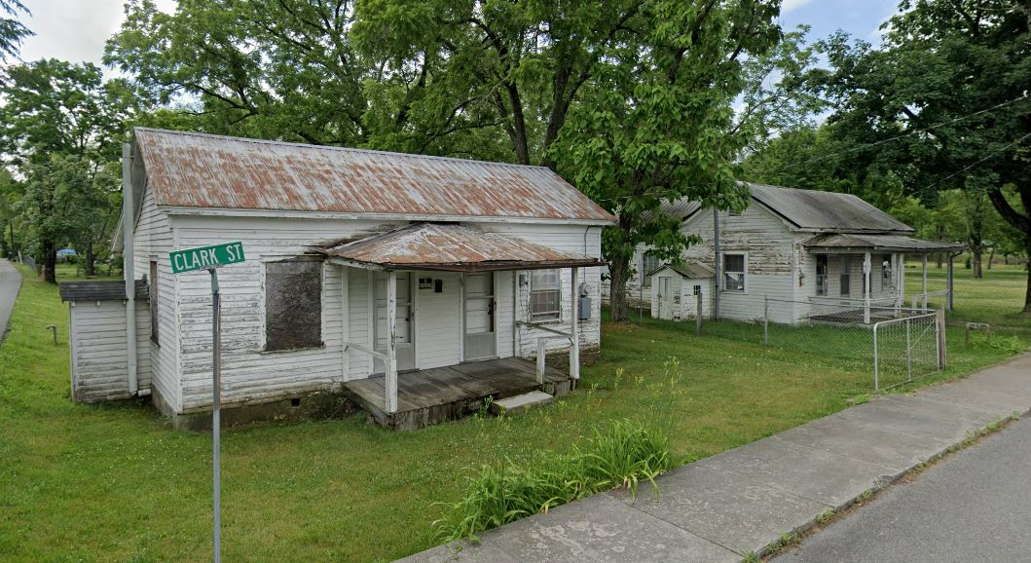
Examples of Low Valued Structures in Floodplain
White Sulphur Springs
Building IDs: 13-17-0009-0270-0000_208 & 13-17-0009-0269-0000_196
Flood Tool Link

Slide 13
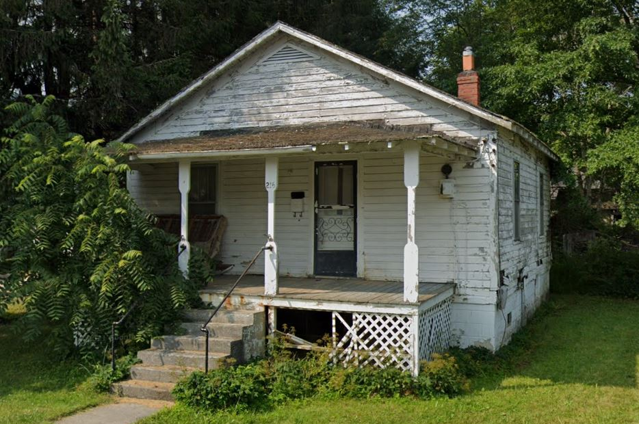
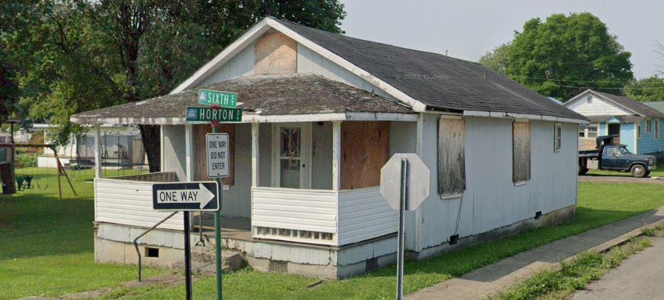
Examples of Low Valued Structures in Floodplain
Rainelle
Building ID: 13-13-0001-0176-0000_214
Flood Tool Link
Building ID: 13-13-0001-0127-0000_178
Flood Tool Link

Slide 14
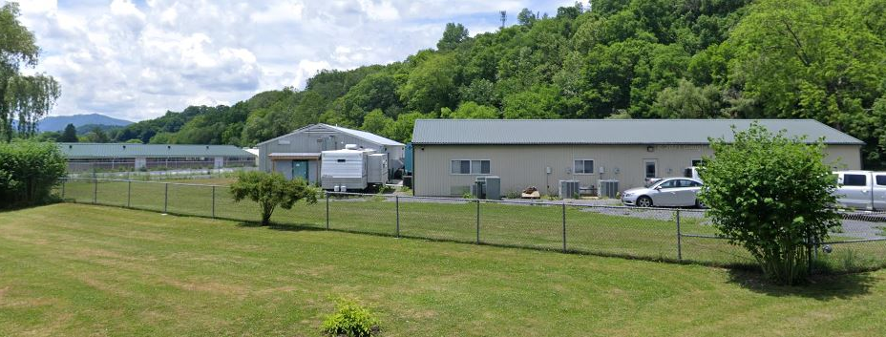
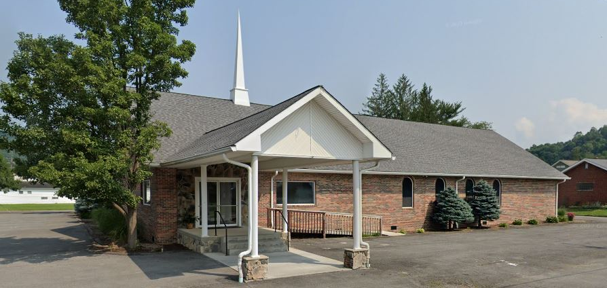
Building/Parcel Exposure
White Sulphur Springs and Rainelle
Category | Exposure Indicator | White Sulphur Springs | Rainelle | Average in WV Incorporated Areas (2021)
Significant Structures (Critical Infrastructure Count) | Number of Essential Facilities in the Moderate Risk 0.2%-Annual-Chance Floodplain | 2 | 1 | 2
 | Number of Community Assets (Non-Historical) in the High-Risk 1%-Annual-Chance Floodplain | 8 | 7 | 3
The red texts show large difference, to the risk side, from the state ratios.
White Sulphur Springs National Fish Hatchery:
Building ID: 13-17-0009-0206-0000_1087
Hazard occupancy Class: GOV1 (Government, Federal)
FIRM Status: Post-FIRM
Appraised Value: $425,073 (Highest in significant structures)
Flood Tool Link
Church of God in Rainelle:
Building ID: 13-13-0005-0366-0000_373
Hazard occupancy Class: REL1 (Religious)
FIRM Status: Post-FIRM regulated to Pre-FIRM
Appraised Value: $435,000 (Highest in significant structures)
Flood Tool Link

Slide 15
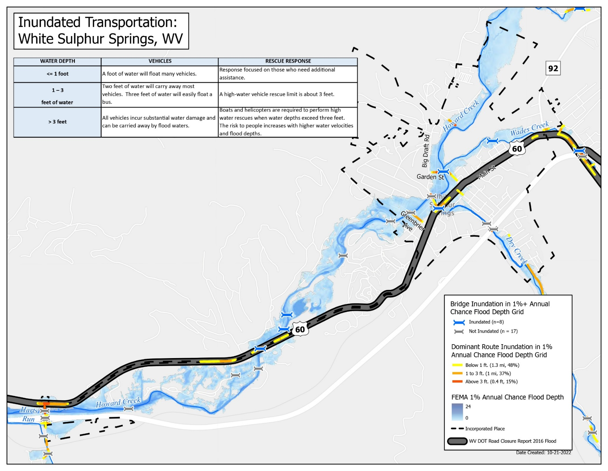
Inundated Transportation
White Sulphur Springs

Slide 16
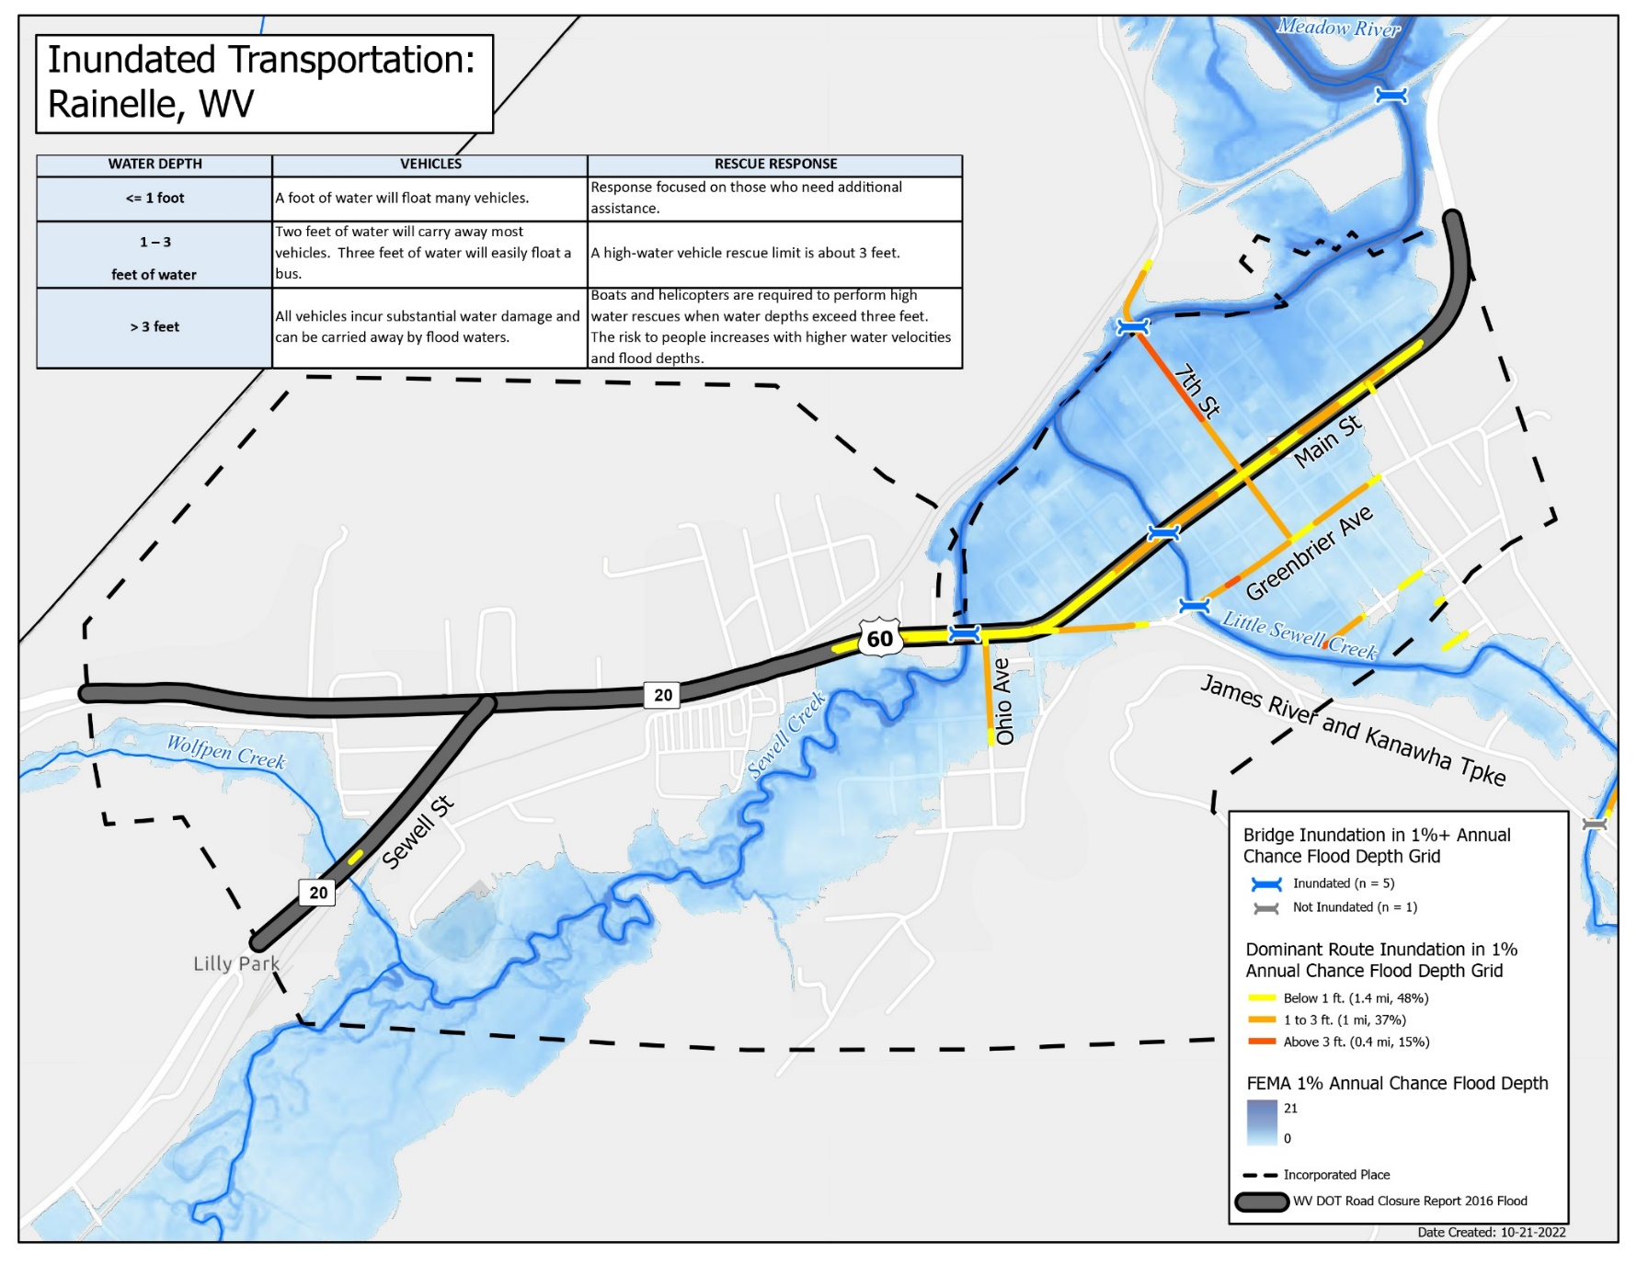
Inundated Transportation
Rainelle

Slide 17
Human Exposure
White Sulphur Springs and Rainelle
Category | Exposure Indicator | White Sulphur Springs | Rainelle | Median & Ratio in WV Incorporated Areas (2021)
Human Exposure | Estimated Population Residing in High-Risk Flood Zones | 1026 | 582 | 114
 | Percentage of Population Residing in High-Risk Flood Zones | 39% | 43% | 10%
The red texts show large difference, to the risk side, from the state ratios.

Slide 18
Criteria, Rationale, and Data Sources
Exposure Indicator | Criteria | Rationale | Data Source
Total Primary Building Count in Floodplain | All primary insurable structures in the Special Flood Hazard Area (SFHA)* or 100-year floodplain | Higher number of buildings in the floodplain indicates higher physical and human exposure and flood risk in a community. | BLRA of 10/19/2022 (based on 2022 tax assessment) & FEMA FIRM (2012 & 2022)
Building Ratio b/w Floodplain & Community Total | Ratio of the primary buildings in the floodplain to all E911 addresses in community |  | BLRA of 10/19/2022 (based on 2022 tax assessment) & E911 Addresses from Statewide Addressing and Mapping System (SAMS) 2021
Total Primary Building Value in Floodplain of Community | Sum & median appraised values of all primary structures in floodplains | Higher building values increase substantial damage thresholds and mitigation reconstruction costs. | BLRA of 10/19/2022 (based on 2022 tax assessment) & FEMA FIRM (2012 & 2022)
Median Building Value in Floodplain
Building Count in Floodway (High Velocity & Depth) | Primary buildings intersecting either floodways of 2012 or 2022 (effective or advisory) | Buildings in the main floodway channel of the river or stream, or close to the flood source, will be subject to the greatest flood depths, highest velocities, and greatest debris potential. | BLRA of 10/19/2022 (based on 2022 tax assessment) & FEMA FIRM (2012 & 2022)
Percent Count in Floodway (High Velocity & Depth)
Count Mapped in SFHA | Primary buildings that most likely will be included in the SFHA when future FEMA Restudies are done and new FIRMs become effective. | Communities should review all "mapped-in" structures. Homeowners are at higher risk to flooding and should be contacted about Flood Insurance Preferred Risk Policies and other potential mitigation measures. | BLRA of 10/19/2022 (based on 2022 tax assessment) & FEMA FIRM (2012 & 2022)
Percent Count Mapped in SFHA
Count Mapped out SFHA | Primary buildings no longer located within the high-risk flood zones of 2022 | The flood risk has only been reduced, not removed and flood insurance coverage is still recommended. | BLRA of 10/19/2022 (based on 2022 tax assessment) & FEMA FIRM (2012 & 2022)
Percent Count Mapped out SFHA
Owner Occupied Residential Buildings in Floodplain | Residential buildings occupied by owners (tax class 2) | Renters may not have flood insurance and be at higher risk. Renters may have less long-term commitment to the community. | BLRA of 10/19/2022 (based on 2022 tax assessment)
Percent Owner Occupied Residential Buildings in Floodplain
* SFHA includes both the high-risk effective and advisory 1%-annual chance floodplains.

Slide 19
Criteria, Rationale, and Data Sources…
Exposure Indicator | Criteria | Rationale | Data Source
Residential Building Count in Floodplain | Count/percent count of all residential primary buildings (RESx) in floodplains | The specified residential/non-residential occupancy class according to structure use or structure type is an important requirement for multiple flood reduction programs, activities, and products. Residential buildings in floodplains indicate higher human loss and economic risk for households. | BLRA of 10/19/2022 (based on 2022 tax assessment), occupancy classes
Percent Count Residential in Floodplain
Non-Residential Building Count in Floodplain | Count/percent count of all non-residential primary buildings (not RESx) in floodplains | Many of non-residential buildings have high replace values. Damages to such buildings can interrupt businesses in communities. Flood mitigation of such structures (e.g., elevating) is much more difficult. | BLRA of 10/19/2022 (based on 2022 tax assessment), occupancy classes
Percent Count Non-Residential in Floodplain
Residential Value in Floodplain | Value/percent value of all residential primary buildings (RESx) in floodplains | Same as above (Residential Count) | BLRA of 10/19/2022 (based on 2022 tax assessment), occupancy classes
Percent Value Residential in Floodplain
Non-Residential Value in Floodplain | Value/percent value of all non-residential primary buildings (not RESx) in floodplains | Same as above (Non-Residential Count) | BLRA of 10/19/2022 (based on 2022 tax assessment), occupancy classes
Percent Value Non-Residential in Floodplain
Mobile Homes in Floodplain | Residential manufactured buildings (RES2) in floodplains | Light-weight manufactured homes are not designed for withstanding floods and are more vulnerable to flood damage. | BLRA of 10/19/2022 (based on 2022 tax assessment), occupancy classes
Percent Mobile Homes in Residential Buildings in Floodplain

Slide 20
Criteria, Rationale, and Data Sources…
Exposure Indicator | Criteria | Rationale | Data Source
Median Construction Year in Floodplain | The median construction year of all buildings in floodplains of the community | The building year can show the structure age as an indicator of quality of the foundation and other elements. It can show if the structure was constructed before or after the FIRM date of community. | BLRA of 10/19/2022 (based on 2022 tax assessment) building year
% Pre-FIRM Structures | Percentage of primary structures constructed before the community's initial FIRM date (WSS: 8/1/1978; Rainelle: 11/19/1987) | Post-FIRM structures should be built according to the floodplain development standards set forth in the local floodplain management ordinance. | FIRM date & 2022 tax assessment building year
% Post-FIRM Structures | Percentage of primary structures constructed after the community's initial FIRM date (WSS: 8/1/1978; Rainelle: 11/19/1987)
Primary Buildings with Basements in Floodplain | All primary buildings with full or partial basements in floodplains. In addition to subgrade basements, may also include walkout basement enclosures that should be corrected using elevation certificates, buildings pictures, or field verification | Any area of a building having its floor below ground level (subgrade) is much more vulnerable to floods. | BLRA of 10/19/2022 (based on 2022 tax assessment) foundation type
Percent Count Buildings with Basements in Floodplain
One-Story Residential Buildings in Floodplain | All residential buildings (including mobile homes) in one story | Residents of one-story buildings cannot go to the higher elevations in their places while flooding. The ratio of flood damage to the total replace cost is usually higher in a one-story building as most of its parts are exposed to floods. | BLRA of 10/19/2022 (based on 2022 tax assessment) stories
Percent Count One-Story Residential Buildings in Floodplain
Red Tag: Dilapidated/Vacant Residential & Commercial Buildings | Number of dilapidated or vacant Residential & Commercial Buildings with low values | Building quality is the product of the construction conditions and maintenance state. Buildings of low quality and vacant structures cannot withstand flooding adequately and are more vulnerable to it. | BLRA of 10/19/2022 (based on 2022 tax assessment) land use & value, building pictures

Slide 21
Criteria, Rationale, and Data Sources…
Exposure Indicator | Criteria | Rationale | Data Source
Number of Essential Facilities in Floodplain | Schools, hospitals, nursing homes, police stations, fire department buildings, & E-911 emergency operations centers in the 500-year floodplains | Hospitals and nursing homes with immobile patients or residents are particularly vulnerable to floods. Schools are usually used as shelters while flooding. Communities should develop emergency plans to continue to provide emergency services during the flood. If a critical facility must be in a floodplain, then it should be provided with a higher level of protection so that it can continue to function and provide services after the flood. | BLRA of 10/19/2022 (based on 2022 tax assessment), Emergency Management Division, Department of Education, USA Reference, & Department of Transportation
Number of Community Assets (Non-Historical) in Floodplain | Utilities (water, sewage, gas, electric, or phone), post-secondary educational facilities, facilities providing emergency medical response (EMS), government buildings providing public services, & facilities hosting religious services in the 100-year floodplains (SFHA) | Many of those buildings such as churches are usually used as emergency shelters while flooding. Malfunction of utilities while flooding can damage community lifeline systems of Safety and Security, Water, Shelter, Health and Medical, and Energy . A hazard vulnerability analysis of community assets should be conducted by floodplain managers and risk planners to develop mitigation strategies for these assets. | BLRA of 10/19/2022 (based on 2022 tax assessment), Reference USA, Homeland Infrastructure Foundation-Level DATA, WV Water Development Authority, WV Infrastructure Jobs Development Council, WV Division of Natural Resources, & community feedback
Estimated Population Residing in High Risk Flood Zones | Population estimates are calculated at the building level by multiplying the Hazus defined residential occupancy class units (source tax assessment database) by average household size (source Census). | More people residing in floodplains means higher human exposure to floods causing higher human loss. | BLRA of 10/19/2022 (based on 2022 tax assessment) and average household size from Census ACS 2017
Percentage of Population Residing in High Risk Flood Zones

