Slide 1
Physical Flood Loss
White Sulphur Springs and Rainelle
Category | Loss Indicator | White Sulphur Springs | Rainelle | Rate* in WV Incorporated Areas (2021)
Physical (Building) Loss By 1%-Annual-Chance Flood Event | TEIF Building Dollar Loss Estimates | $1,225K | $997K | $1,246K (Avg.)
 | TEIF Building Loss Ratio | 3% | 6% | 10%
 | Median Individual Building Damage | $3K | $2K | $7K (Mdn.)
 | Substantial Damage (>50%) Estimates | 0 87 in 2016 Flood | 1 | 7 (Avg.)
 | Percent Substantial Damage Estimates | 0% | 0% | 6% (Avg.)
 | Moderate Damage (10-50%) Estimates | 78 98 in 2016 Flood | 109 | 47 (Avg.)
 | Percent Moderate Damage Estimates | 18% | 32% | 34% (Avg.)
 | Building Debris Removal Estimates | 450 ton | 814 ton | 165 ton (Mdn.)
 | Number of Previous Paid Losses | 89 | 152 (Rank**: 20th) | 63 (Avg.)
 | Dollar Amount of Previous Insurance Claims | $2,975K (Rank: 15th) | $3,720K (Rank: 10th) | $845K (Avg.)
 | Number of Repetitive Loss Structures | 2 | 23 | 3 (Mdn.)

Slide 2
Human Flood Loss
White Sulphur Springs and Rainelle
Category | Loss Indicator | White Sulphur Springs | Rainelle | Rate* in WV Incorporated Areas (2021)
Human Loss By 1%-Annual-Chance Flood Event | Displaced Population Estimates | 481 (Rank: 17th) | 492 (Rank: 16th) | 173 (Avg.)
 | Estimated Population in Need of Short-Term Shelter | 104 (Rank: 18th) | 123 (Rank: 14th) | 37 (Avg.)
* For numbers and dollar values, used median, or average where the median was zero or too low, in the state’s 213 incorporated areas
** Ranks mentioned based on the BLRA data of April 2022 where the community is among the top 20 incorporated areas in WV
The red texts show large difference, to the risk side, from the state ratios.
The green texts show large difference, to the resilience side, from the state ratios.

Slide 3
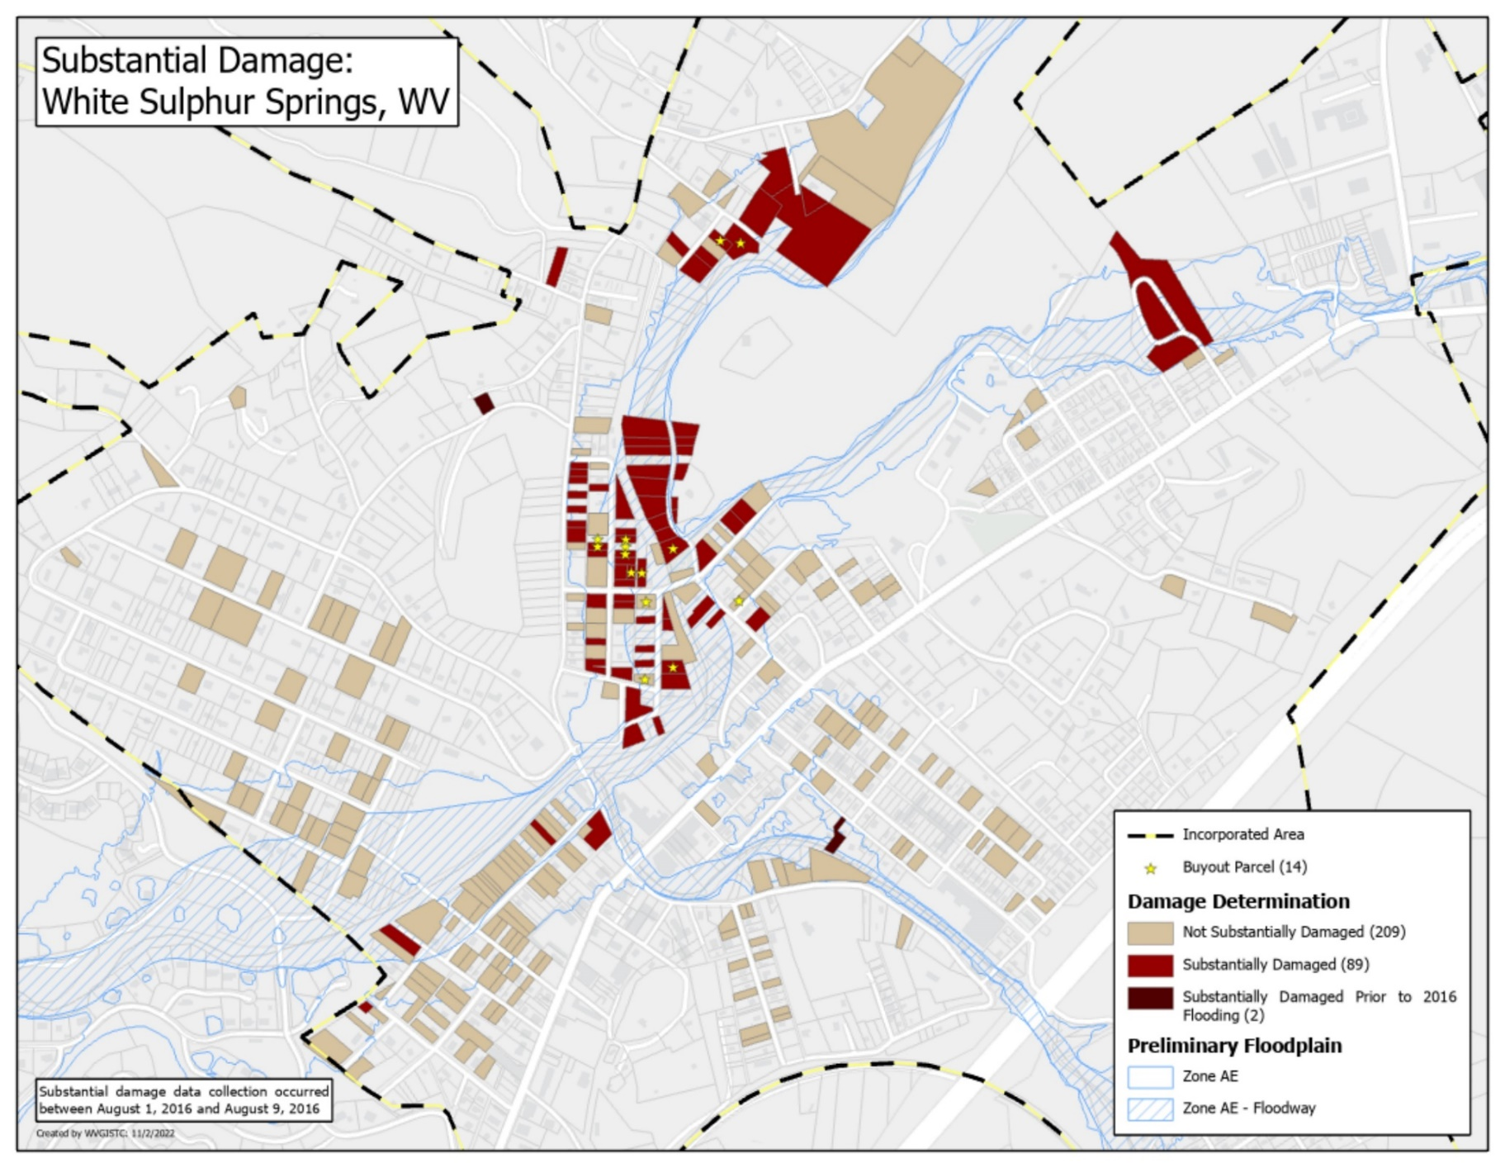
Substantial Damage (2016 Flood)
White Sulphur Springs

Slide 4
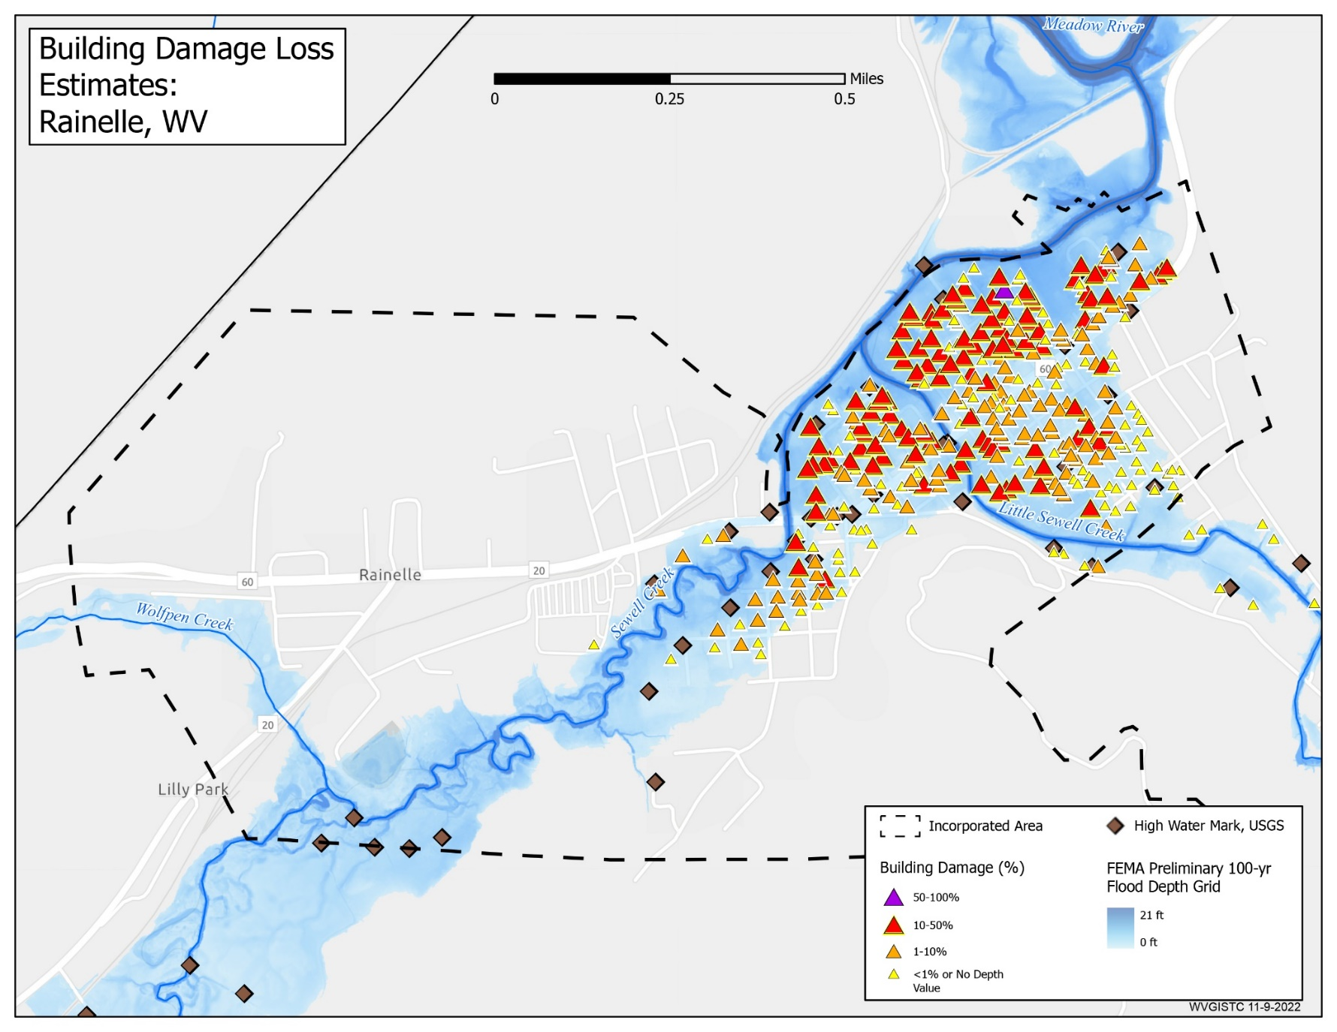
Building Damage Loss Estimates
Rainelle

Slide 5
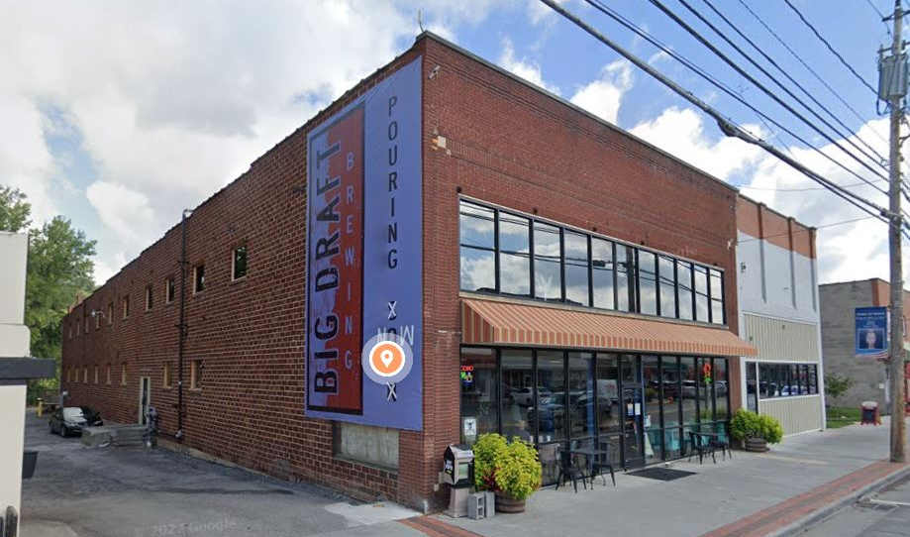
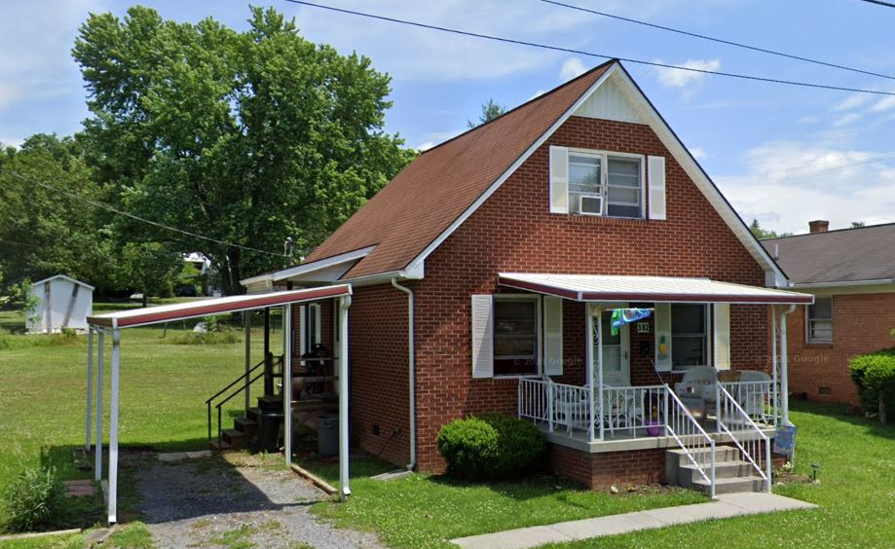
Structures with High Building Loss
White Sulphur Springs
Highest Building Loss (USD)
in White Sulphur Springs:
Building ID: 13-17-0008-0186-0000_703
Hazard Occupancy Class: COM8 (Restaurant)
FIRM Status: Pre-FIRM (1968)
Water Depth in Structure: 1.2 ft (minus rated -1 ft)
Appraised Value: $1,422,200
Estimated Building Loss: $133,687
Building Damage Percentage: 10%
Flood Tool Link
Highest Building Damage Percentage
in White Sulphur Springs:
Building ID: 13-17-0008-0435-0000_382
Hazard Occupancy Class: RES1 (Residential 1 Family)
FIRM Status: Post-FIRM (1988)
Water Depth in Structure: 3.9 ft (minus rated -4 ft)
Appraised Value: $62,200
Estimated Building Loss: $28,799
Building Damage Percentage: 46%
Flood Tool Link

Slide 6
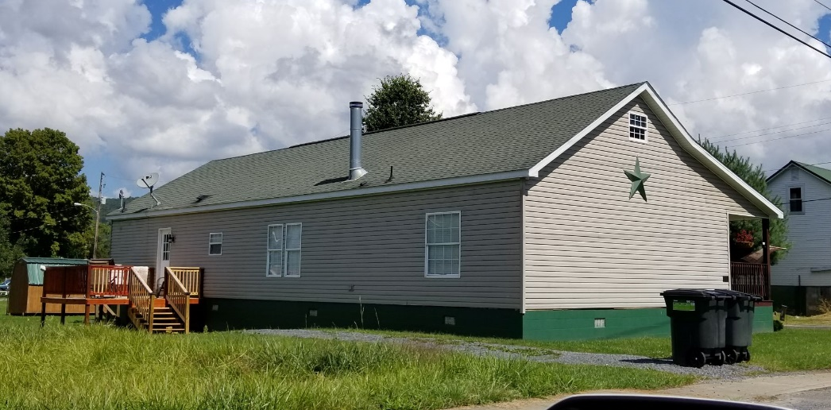
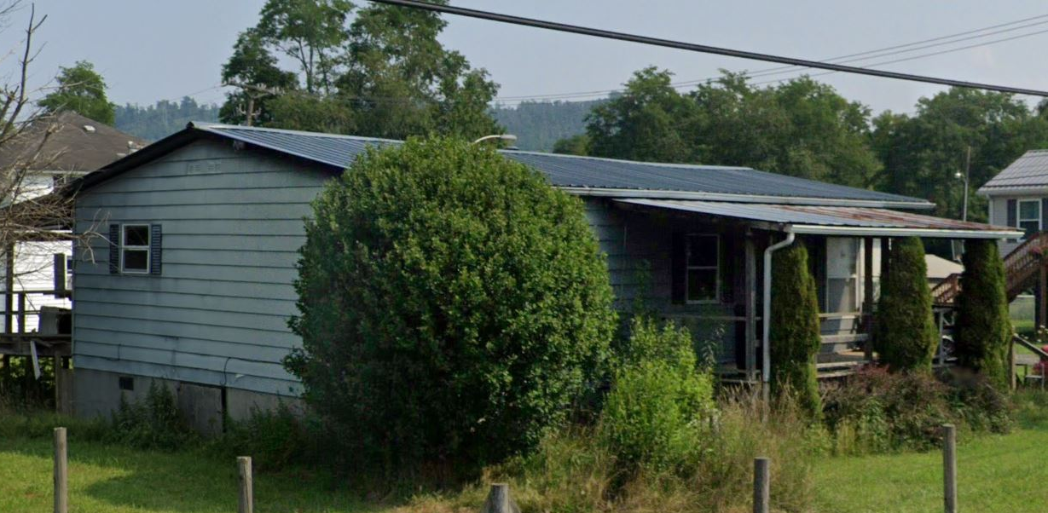
Structures with High Building Loss
Rainelle
Highest Building Loss (USD)
in Rainelle:
Building ID: 13-13-0001-0077-0000_144
Hazard Occupancy Class: RES1 (Residential 1 Family)
FIRM Status: Post-FIRM regulated to Pre-FIRM (2005)
Water Depth in Structure: 3.7 ft (minus rated -4 ft)
Appraised Value: $92,800
Estimated Building Loss: $41,667
Building Damage Percentage: 45%
Flood Tool Link
Highest Building Damage Percentage
in Rainelle:
Building ID: 13-13-0001-0091-0000_435
Hazard Occupancy Class: RES2 (Mobile Home)
FIRM Status: Pre-FIRM (1973)
Water Depth in Structure: 2.7 ft (minus rated -3 ft)
Appraised Value: $11,600
Estimated Building Loss: $8,120
Building Damage Percentage: 70%
Flood Tool Link

Slide 7
Criteria, Rationale, and Data Sources
Loss Indicator | Criteria | Rationale | Data Source
TEIF Building Dollar Loss Estimates | Using FEMA’s open-source Hazus utility, Flood Assessment Structure Tool (FAST) for a 1%-annual-chance flood event to calculate the damage percentages of the total building values (Total Exposure in Floodplain or TEIF) | Flood loss models quantify the degree of flood risk, including estimates of substantially damaged structures. Quantifying the degree of flood risk is important for risk communications and flood reduction efforts. | BLRA of 10/19/2022 (based on 2022 tax assessment), Total Exposure in Floodplain (TEIF), Building percent damage estimate values, Depth grids
TEIF Building Loss Ratio
Median Individual Building Damage | The median estimated individual building loss in each community
Substantial Damage (>50%) Estimates | Number/percent of primary structures with the estimated damages of greater that 50% of the building value |  | BLRA of 10/19/2022 (based on 2022 tax assessment), Total Exposure in Floodplain (TEIF), Building percent damage estimate values, Depth grids
Percent Substantial Damage Estimates
Moderate Damage (10-50%) Estimates | Number/percent of primary structures with the estimated damages of 10% to 50% of the building value |  | BLRA of 10/19/2022 (based on 2022 tax assessment), Total Exposure in Floodplain (TEIF), Building percent damage estimate values, Depth grids
Percent Moderate Damage Estimates
Building Debris Removal Estimates | The total tonnage of building debris that will be generated from a riverine 1%-annual-chance flood event based on FEMA’s Hazus Flood Model. The model calculates only debris from the structure and not other types of debris (e.g., woody debris, sediment, content of buildings, etc.). | Debris disposal can be a significant issue following floods. Debris removal estimates should be incorporated into debris removal plans. | BLRA of 10/19/2022 (based on 2022 tax assessment), Total Exposure in Floodplain (TEIF)
Number of Previous Paid Losses | Number of paid losses in the community’s history up to 2019 | A high number of claims in a community indicates that flooding is occurring, and community members are making claims against their policies. | FEMA’s Community Information System (CIS) 2019

Slide 8
Criteria, Rationale, and Data Sources…
Loss Indicator | Criteria | Rationale | Data Source
Dollar Amount of Previous Insurance Claims | Dollar amount of paid losses in the community’s history up to 2019 | A high total dollar amount of previous claims in a community indicates that flooding is occurring, and community members are making claims against their policies. | FEMA's Community Information System (CIS) 2019
Number of Repetitive Loss Structures | Number of structures (covered by NFIP Policies) that have experienced repetitive losses. | A preponderance of repetitive loss structures indicates that the community is at a higher risk for future losses. | FEMA's Community Information System (CIS) 2019
Displaced Population Estimates | Estimated Displaced Population (by inundation >= 1 foot) for a 1%-Annual-Chance Flood | The short-term displacement may happen by inundation causing damages to the residential units or blocking access to them. The evacuees plan to return to their communities after the inundation ends and the damaged residential units are restored. Until then, they may stay with their relatives or friends in safer areas, go to hotels, or use short-term shelters. The flood depth of evacuation is considered one foot that is the inundation at which vehicles begin to float. | BLRA of 10/19/2022 (based on 2017 tax assessment), Census 2017 ACS
Estimated Population in Need of Short-Term Shelter | Estimated Population in Need of Short-Term (up to two weeks) shelters computed using Hazus methodology with modifications of Age and Income (adjusted for inflation) factors. | A Short-Term Shelter is in an existing facility, such as a school, community center, convention center, or church temporarily converted to provide safe, accessible, and secure short-term housing for disaster survivors. It provides safe and accessible locations with a wide range of services for the survivors for up to two weeks. | BLRA of 10/19/2022 (based on 2017 tax assessment), Census 2017 ACS

