Slide 1
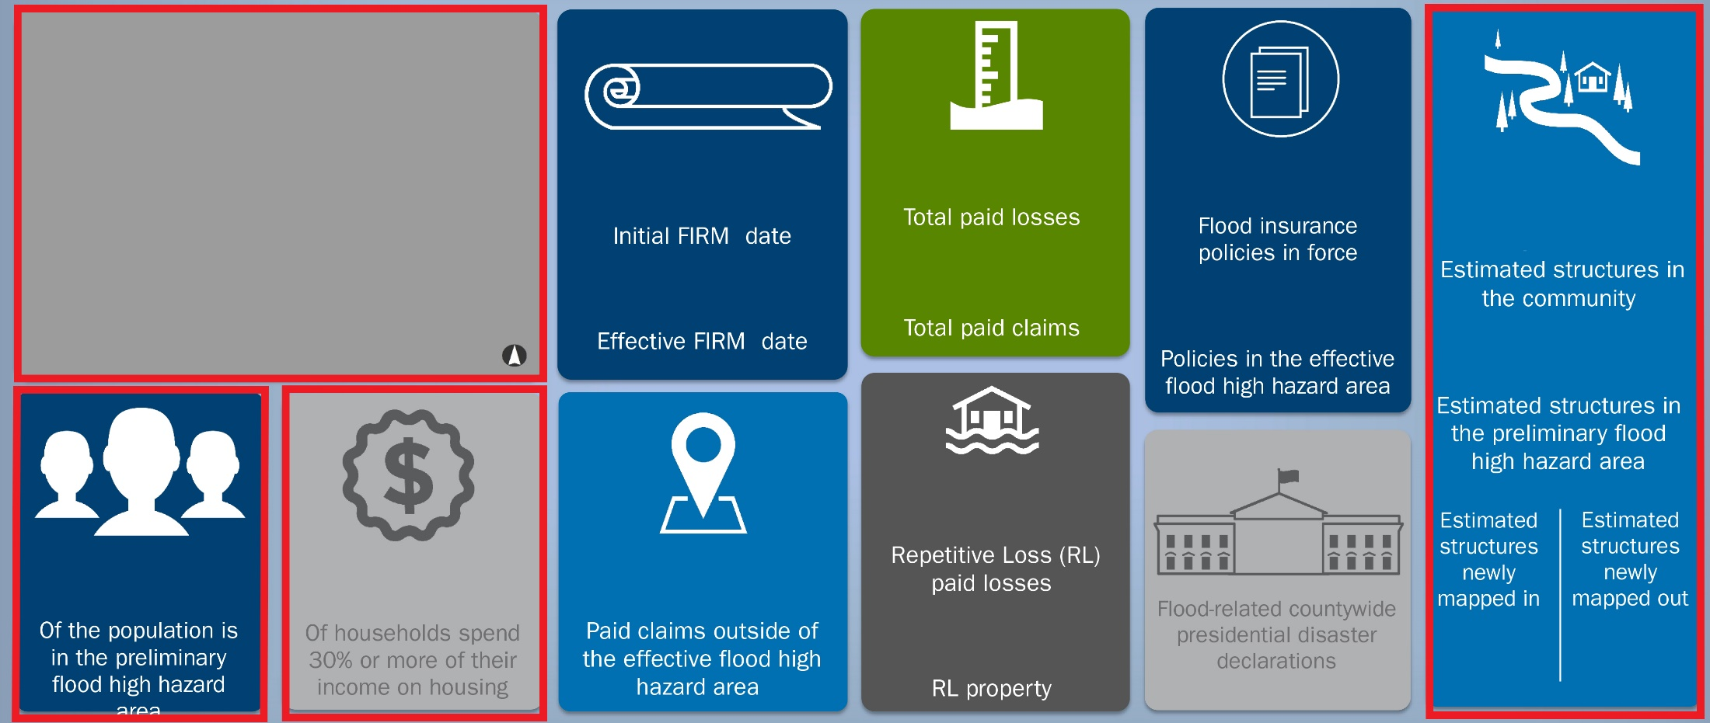
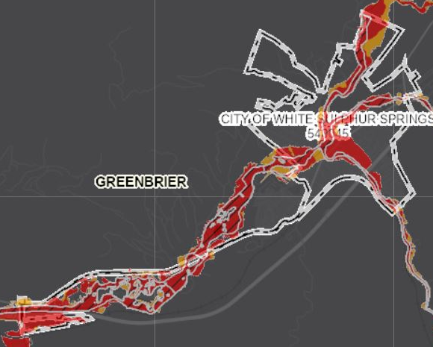
Updated Risk Dashboard, White Sulphur Springs
The fields in red boxes were updated by WVU.
Effective
Advisory
8/1/1978
$3M
133
1,620
10/16/2012
89
74
423
$71K
9
39%
38%
2
2
+72
-118
Net Structures - WVU UPDATE: Derived from the BLRA of 10/19/2022:
Estimated Structures in the Preliminary High Hazard Area and Estimated Structures Newly “Mapped In/Out”
Total Structures in Community - WVU UPDATE: Derived from the Community-wide E-911 Address Building Count based on Statewide Addressing & Mapping System (SAMS): Estimated Structures in the Community
Percentage of Households Spend 30% - WVU UPDATE: Derived from Census 5-year American Community Surveys (ACS) of 2017:
Percentage of Households Spend 30% or More of Their Income on Housing
Population Residing in Floodplain - WVU UPDATE: Derived from the Model Developed by the WVGISTC based on the BLRA of 2017 and Census 5-year ACS of 2017: Percentage of the Population in the Preliminary Flood High Hazard Area
FEMA: Derived from the CEP Data Based on the Community Information System (CIS) 2019:
Initial and Effective FIRM dates, Total Paid Losses and Claims, Paid Claims Outside of the Effective Flood High Hazard Area, Flood Insurance Policies, and Flood-related Countywide Presidential Disaster Declaration

Slide 2
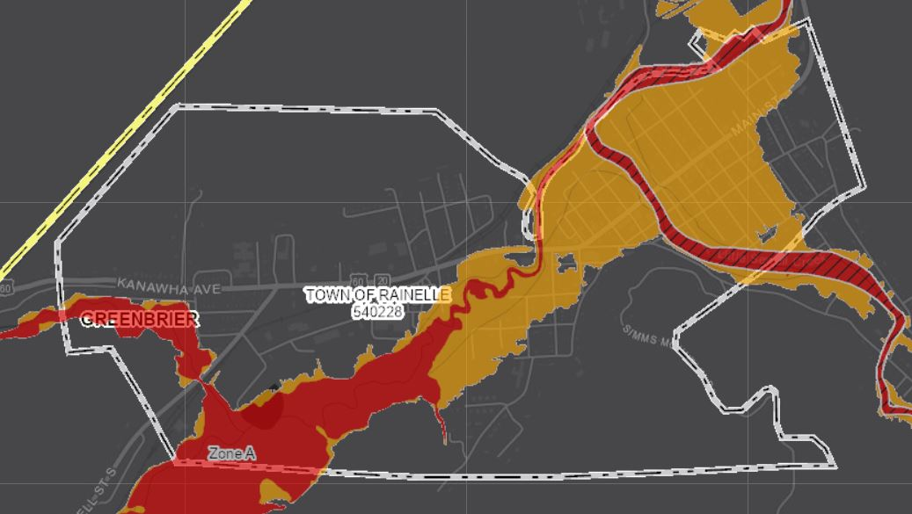
Updated Risk Dashboard, Rainelle
The fields in red boxes were updated by WVU.
Effective
Advisory
11/19/1987
$3.7M
44
997
10/16/2012
152
6
338
$1.3M
9
43%
36%
0
23
+329
0
Net Structures - WVU UPDATE: Derived from the BLRA of 10/19/2022:
Estimated Structures in the Preliminary High Hazard Area and Estimated Structures Newly “Mapped In/Out”
Total Structures in Community - WVU UPDATE: Derived from the Community-wide E-911 Address Building Count based on Statewide Addressing & Mapping System (SAMS): Estimated Structures in the Community
Percentage of Households Spend 30% - WVU UPDATE: Derived from Census 5-year American Community Surveys (ACS) of 2017:
Percentage of Households Spend 30% or More of Their Income on Housing
Population Residing in Floodplain - WVU UPDATE: Derived from the Model Developed by the WVGISTC based on the BLRA of 2017 and Census 5-year ACS of 2017: Percentage of the Population in the Preliminary Flood High Hazard Area
FEMA: Derived from the CEP Data Based on the Community Information System (CIS) 2019:
Initial and Effective FIRM dates, Total Paid Losses and Claims, Paid Claims Outside of the Effective Flood High Hazard Area, Flood Insurance Policies, and Flood-related Countywide Presidential Disaster Declaration

