Slide 1
Kurt Donaldson
Manager
West Virginia GIS Technical Center
West Virginia University
Notes:
Kurt Donaldson is the manager of the WV GIS Technical Center located at West Virginia University. Since 2003, Mr. Donaldson has been a cooperating technical partner in support of FEMA’s NFIP and Risk MAP programs.

Slide 2
WVU Faculty Supporting Hazard Mitigation Projects
Partnerships among faculty members expand the subject matter expertise for hazard mitigation planning
HAZARD MITIGATION PROJECT | FUNDING SOURCE | FACULTY MEMBER | ORGANIZATION & EXPERTISE | LINK
Statewide Risk Assessments | HMGP, CTP | Kurt Donaldson | WVU GIS Technical Center (online interactive map viewing applications, TEIF/TEAL¹ risk assessments, flood visualizations) | WV Flood Tool Statewide RA Products & Data WV Region 3 Plan w TEIF data
Landslide Susceptibility Modeling | HMGP | Aaron Maxwell | WVU Geography Professor (landslide modeling, machine learning, remote sensing) | Published Landslide Paper
Flood Buyouts | NRCS | Katherine Garvey | WVU Land Use and Sustainability Law Clinic (legal and planning services) | Region 3 Resilience Report WV Public Broadcasting
Community Recovery and Resiliency | NSF | Jamie Shinn | Adjunct WVU Geography Professor (social science, community engagement) | WV Public Broadcasting
¹ Total Exposure in Floodplain (TEIF), Total Exposure Area Landslide (TEAL)

Slide 3
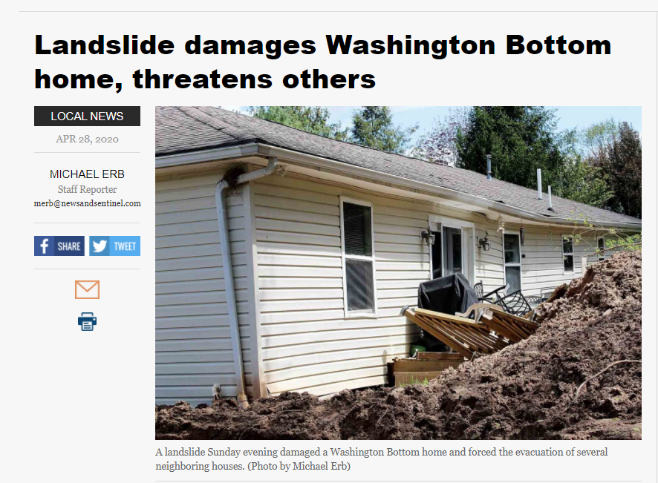
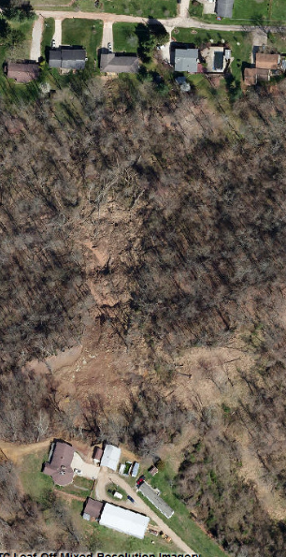
Example 1: Landslide Hazard Risk Assessment
Landslide Risk
Mitigation Planning
Impacted Home
WV Flood Tool
Higher Risk
WV Landslide Tool
April 2020 Landslide
Wood County, WV Impacted home moved from foundation
Landslide Susceptibility Zone
A statewide landslide susceptibility (high, moderate, low risk) map was created from FEMA-purchased QL2 LiDAR data
Landslide Susceptibility
Spring 2020 Imagery

Slide 4
Example 2: Voluntary Floodplain Buyout Mitigation
Flood Mitigation Measure
FEMA R3 Resiliency Report | WVPBS | Buyout Report
WV Flood Tool: Building-Level Risk Assessments
Risk assessments using FEMA’s Hazus methodology helped NRCS identify 310 properties in McDowell County for flood buyouts

Slide 5
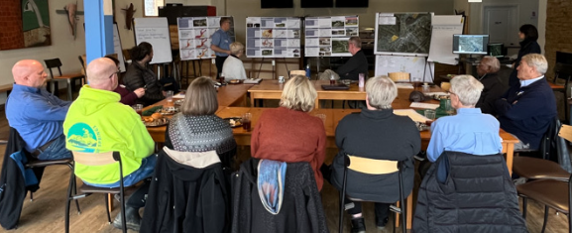
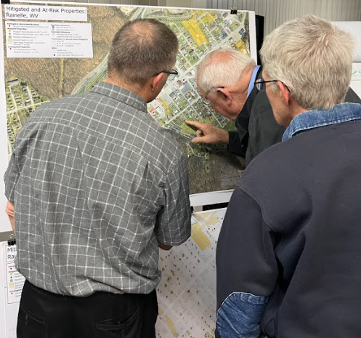
Example 3: Community Hazard Planning (Focus Group Meetings)
Mitigation Planning
White Sulphur Springs, WV (11/17/2022; 5/24/2023)
Rainelle, WV (11/18/2022; 5/23/2023)
Feedback desired from Focus Groups:
What lessons were learned from the immediate response and longer-term recovery from the 2016 flood?
What priorities are needed for a stronger flood response and recovery plan in the event of a future flood?
Feedback of Flood Study Products:
Flood Characteristics and Models
Flood Risk Assessment (vulnerability, exposure, loss)
Mitigation Maps
Flood Visualization Tools

Slide 6
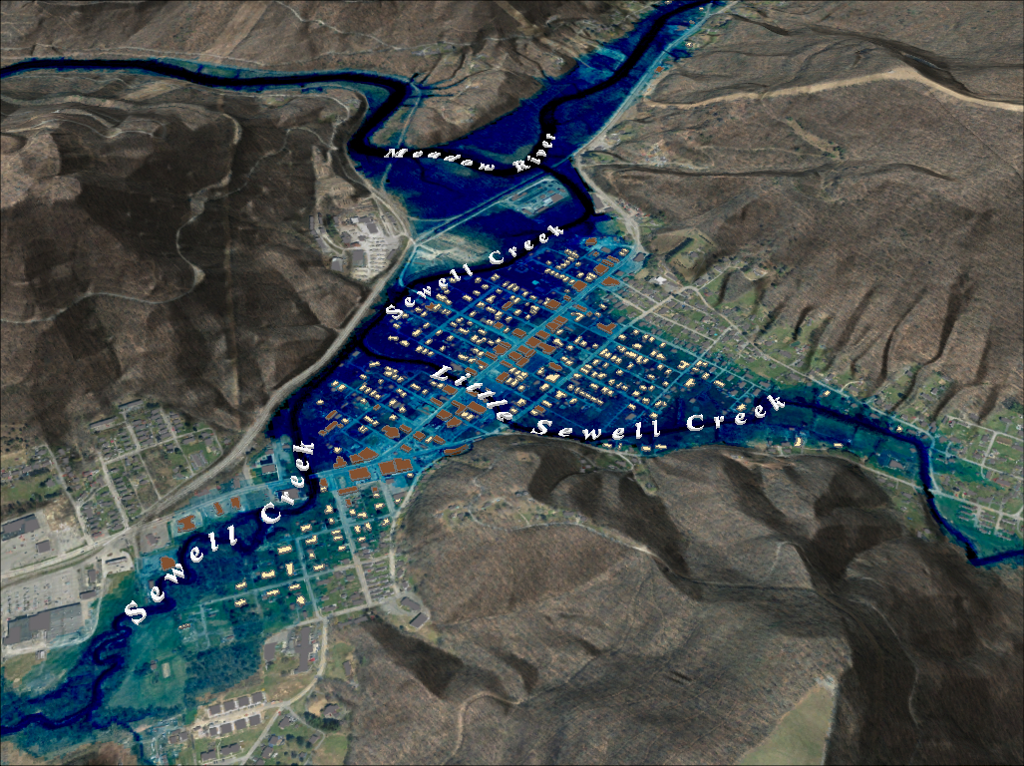
Example 3: Community Hazard Planning (Flood Risk Characteristics)
FEMA 1%+ Annual Chance (Rainelle, WV)
Category | Flood Characteristic (in context to 2016 Flood) | White Sulphur Springs | Rainelle
Frequency (new flood maps) | Probability that a flood of a specific size will be equaled or exceeded in any given year. FEMA Flood Models (new): 10-, 25-, 50-, 100-, 100+, and 500-year flood elevations. First Street Foundation Flood Models: 5-, 20-, 100-, and 500-year flood elevations. | 2016 Flood Between 100- and 500-year FEMA Climate BFE+6ft FSF Climate 2052 or 30 years in the future | 2016 Flood Between 100- and 500-year FEMA Climate BFE+1ft FSF Climate 2052 or 30 years in the future
Depth | Flood depth. Source USGS high-water marks | 6 feet | 8 feet
Velocity | Speed at which the floodwaters are flowing | High | Moderate
Duration | Measure of how long water remains above normal levels | 24 hours | 72 hours
Rise and Fall | Floodwater that rises very quickly with little or no warning | Quick Rise | Quick Rise
Climate
Change
Flood Characteristics
26% probability of flooding at least once over 30 years

Slide 7
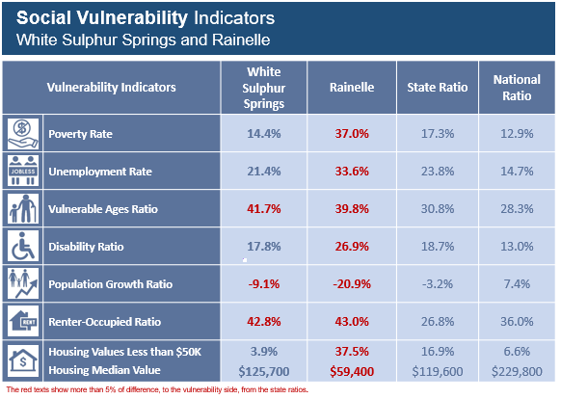
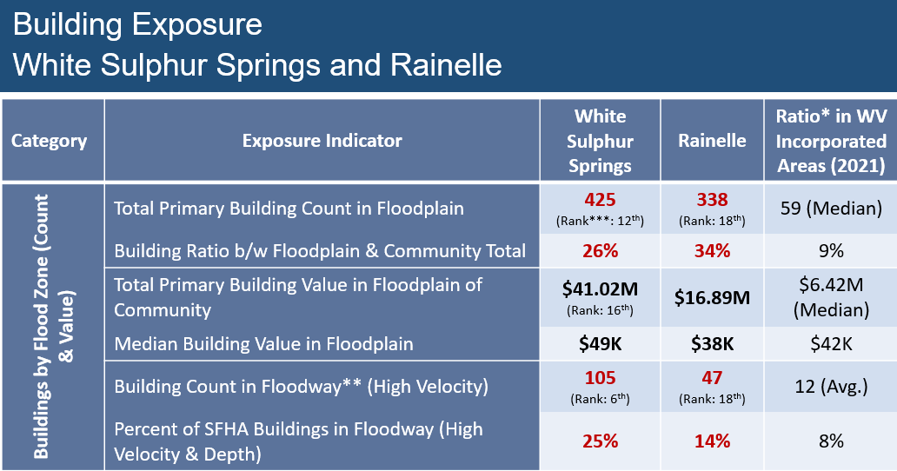
Example 3: Community Hazard Planning (Risk Indicators)
Vulnerability, Exposure, and Hazus Loss Indicators for the disadvantaged communities of Rainelle and White Sulphur Springs
Flood Risk Factors

Slide 8
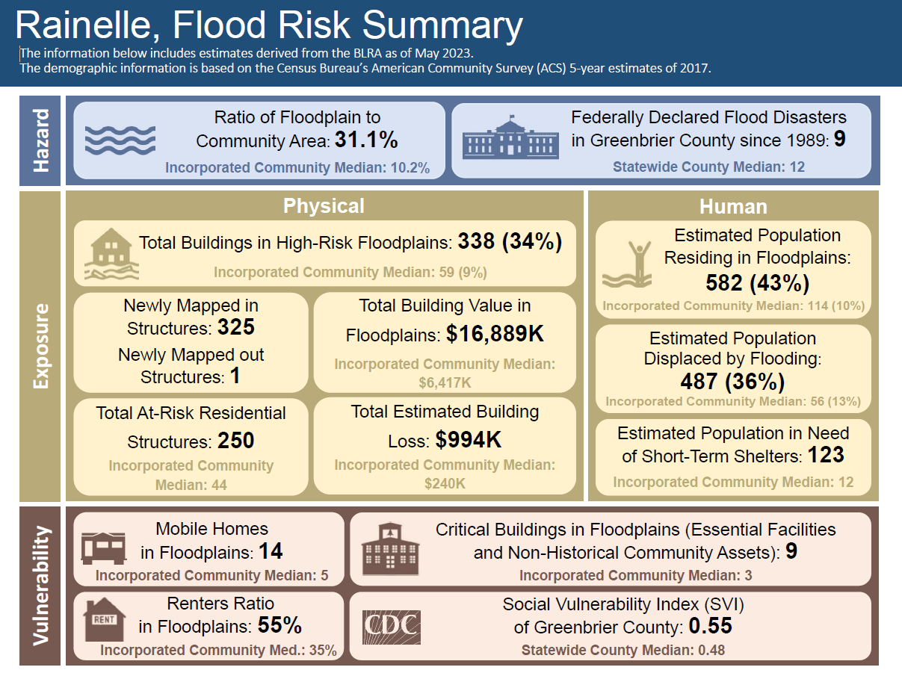
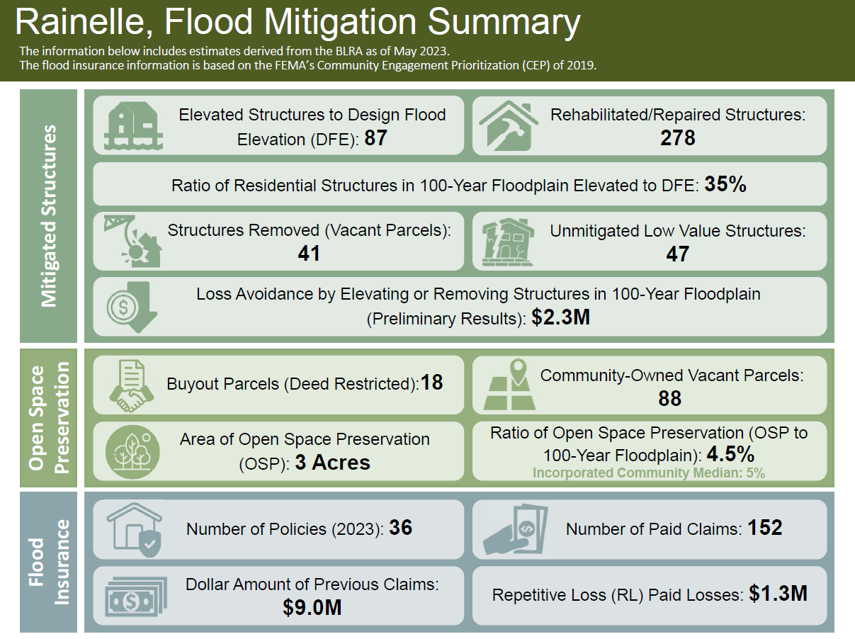
Risk and Mitigation Dashboards Community Hazard Planning
Risk Dashboard
Mitigation Dashboard
Risk & Mitigation Dashboards, Rainelle, WV

Slide 9
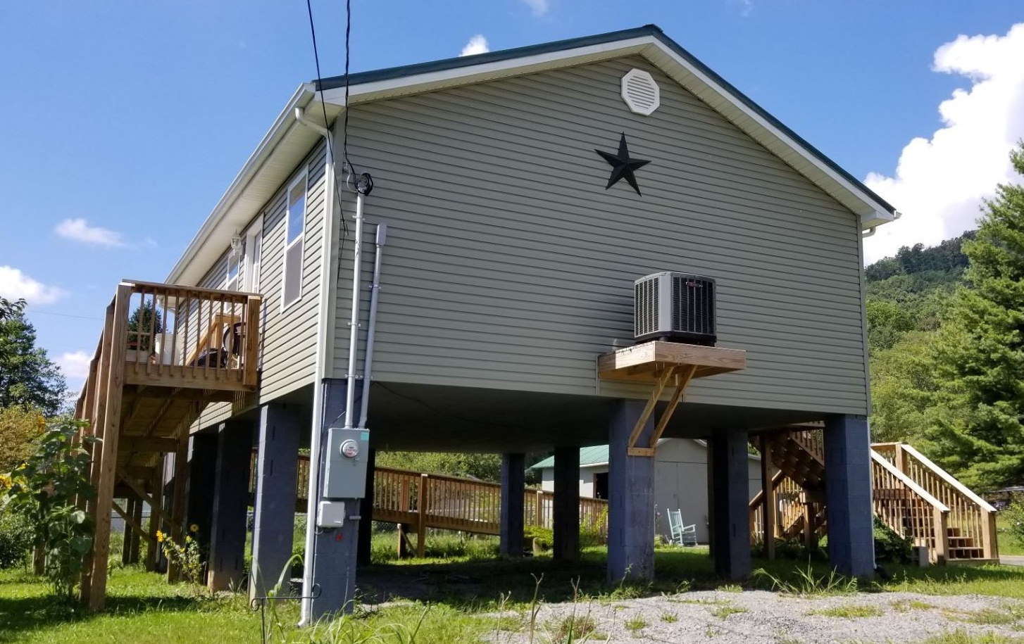
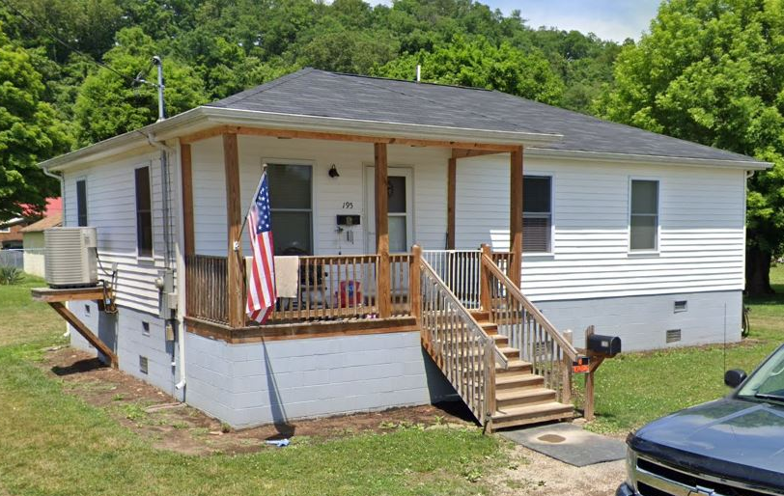
Elevated Structures to Design Flood Elevation (DFE) Mitigation Planning
Rationale:
How communities have applied flood adaptive measures in response to major flood events
DFE: 100-Year or Base Flood Elevation (BFE) + 2 feet
Findings:
Rainelle: 35% of residential structures in 100-year floodplain elevated to DFE (n=87, res./non-res.)
White Sulphur Springs: 59% of residential structures in 100-year floodplain elevated to DFE (n=217, res./non-res.)
Mitigation Reconstruction
Rainelle
White Sulphur Springs
Building ID: 13-13-0001-0069-0000_108
Flood Tool Link
Building ID: 13-17-0008-0152-0000_195
Flood Tool Link
Examples of Mitigation Reconstruction

Slide 10
Elevated Mitigation Reconstruction Still At Risk Mitigation Planning
First Floor Height BELOW: FEMA/FSF 0.2-percent chance (500-yr) floods
Mitigation Reconstruction
12.2’ (FSF 0.2% / 500-Yr )
9.9’ (FEMA; 0.2% / 500-Yr)
6.5’ (2016 High Water)
3.9’ (FEMA 1% / 100-Yr)
How well are mitigated structures protected from new flood maps or changing environmental factors due to climate change? New FEMA flood maps for Rainelle reveal that the mitigated structure above is a risk for the 1%+ (100-yr) and 0.2-percent chance (500-yr) floods.

Slide 11
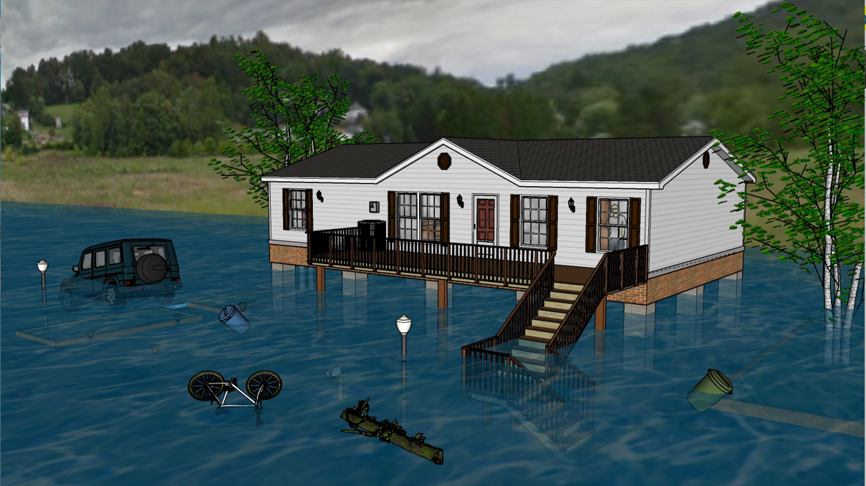
Flood Visualization 7 feet
First Floor Height ABOVE: 2016 Flood High Water Mark

Slide 12
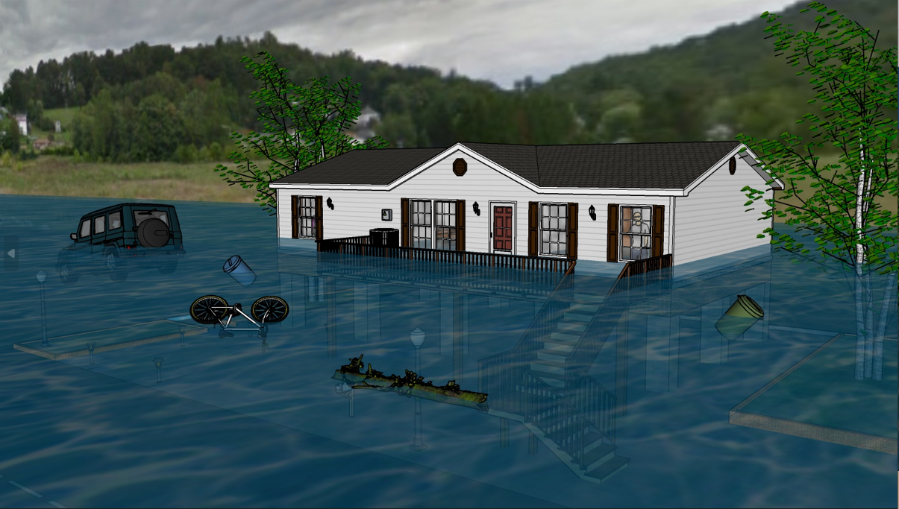
Flood Visualization 10 feet
First Floor Height BELOW: 0.2% Chance (500-yr) Flood Models

Slide 13
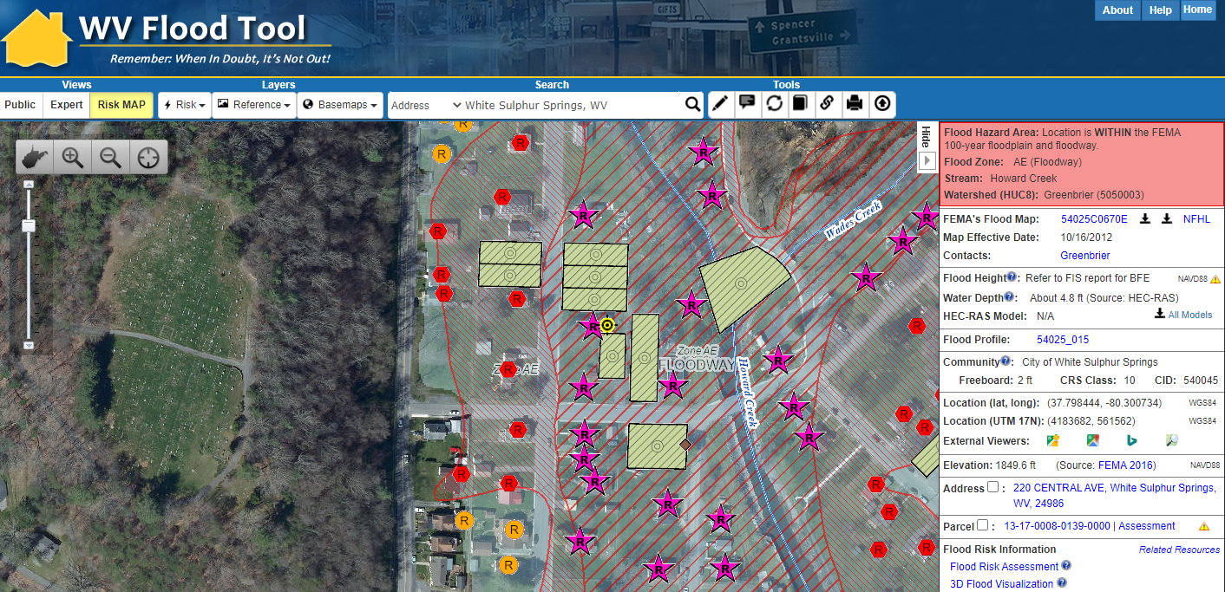
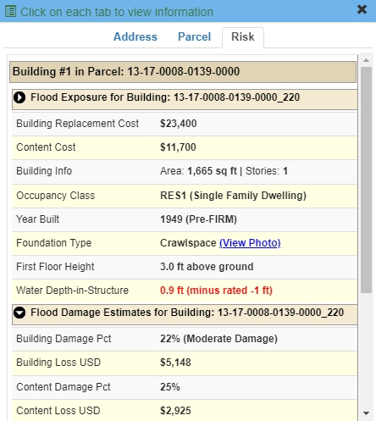
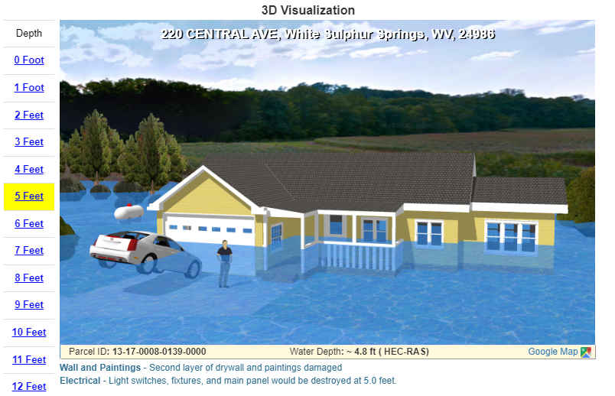
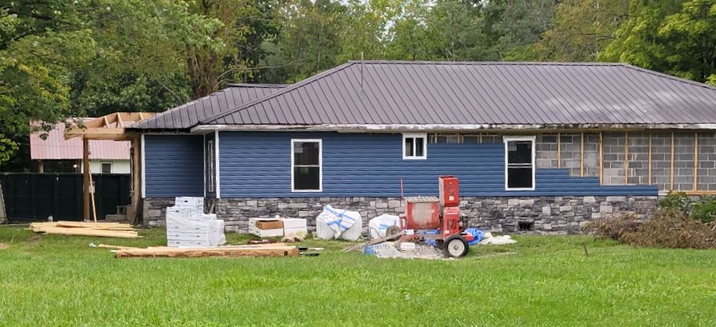
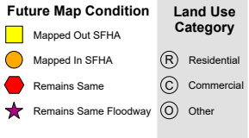
Risk Assessment/Planning using WV Flood Tool
White Sulphur Springs’ primary structures viewable on the Risk MAP View of the WV Flood Tool. Symbol letters indicate general occupancy (Residential, Commercial, Other Non-Residential).
Residential Structure in Floodway Bldg. 13-17-0008-0139-0000
Buyout Property
Building Exposure
Street View Image
Base Flood Depth – 3D Visualization
HAZUS Loss Estimate

Slide 14
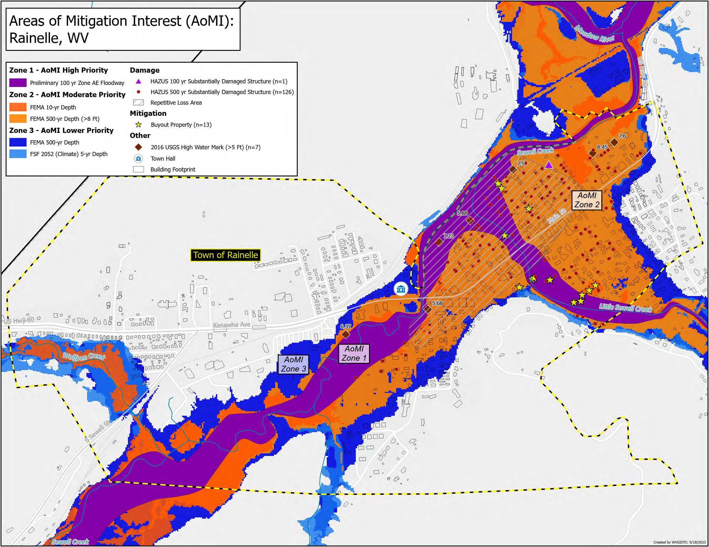
Areas of Mitigation Interest (AoMI) Mitigation Planning
Rainelle
Mitigation Planning Priorities
Recommendations:
Mitigation plans should correspond to the AoMI priorities

Slide 15
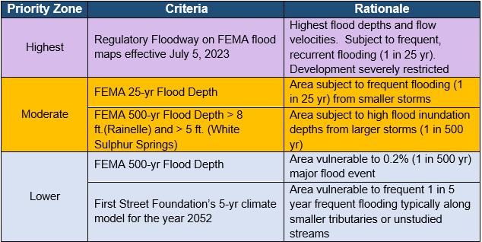
Areas of Mitigation Interest (AoMI) Mitigation Planning
Rationale:
Identifying priority zones for mitigation:
Mitigation Planning Priorities
PRIORITY ZONE FACTORS
Flood Characteristics (frequency, depth, velocity)
High Water Marks
Repetitive Loss Areas
Substantial Damaged Structures
Vulnerable Structures (floodway, mobile homes, subgrade basements, minus-rated, red tag structures, etc.)
Mitigated Structures
Buyout Parcels (Open Space Preservation
Flood Characteristics: Flood maps/models help to define mitigation zones

Slide 16
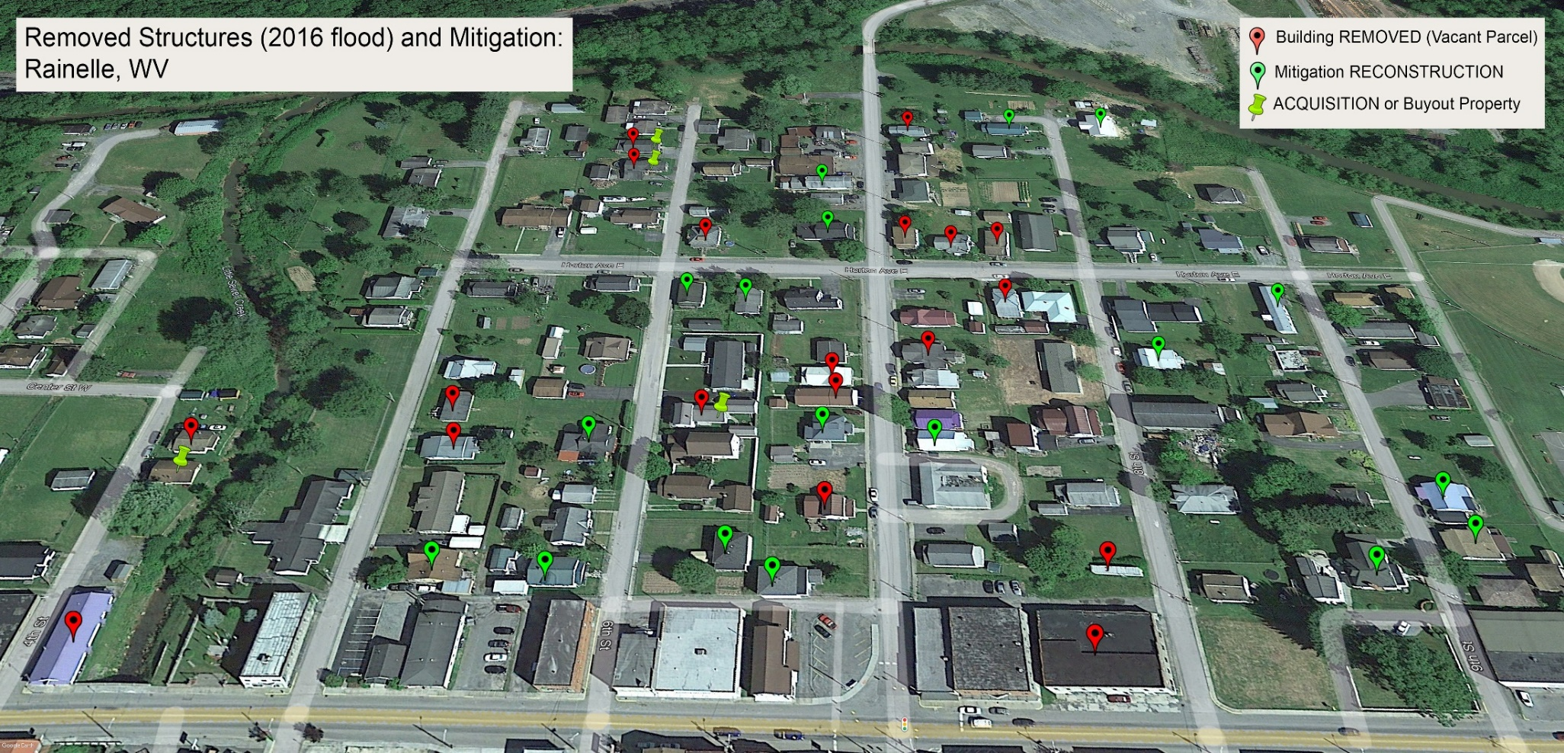
Loss Avoidance Studies Mitigation Planning
Rationale:
Difference between loss estimates for buildings with a first-floor height of 1 foot and elevated to DFE or removed entirely;
The losses avoided by federally funded riverine flood mitigation projects far exceeds the money spent (7x return on investment)*
Rainelle: $2.3M
* FEMA. “Natural Hazard Mitigation Saves Interim Report”
7th St.
Mitigation Saves $
Recommendations:
Mitigation efforts of elevating buildings above the base flood and buyouts should be considered as investment and not expense

Slide 17
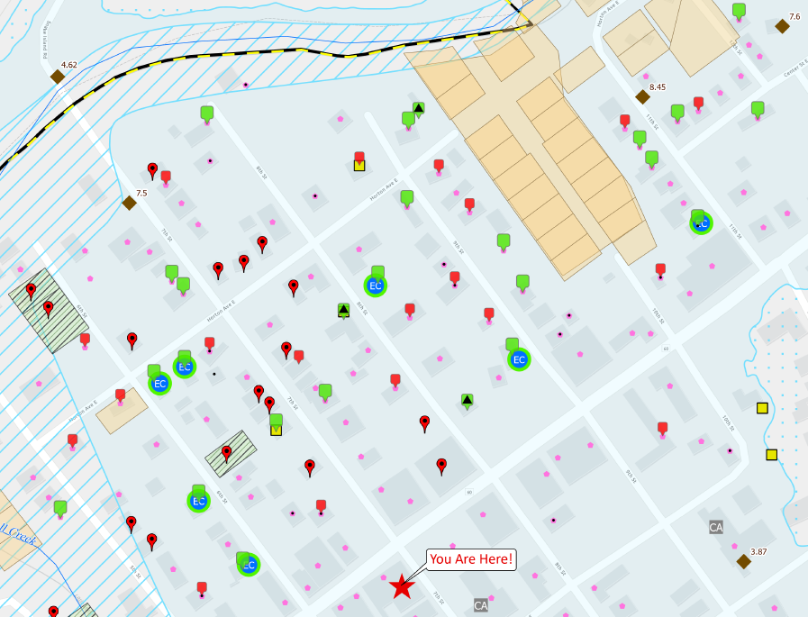
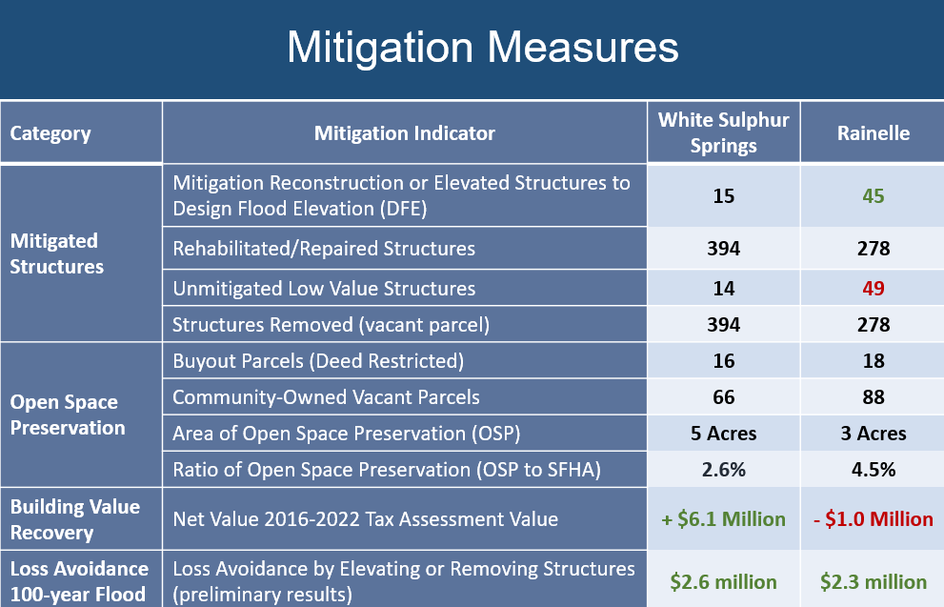
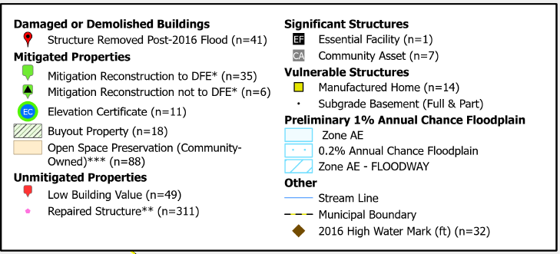
Example 3: Community Hazard Planning (Mitigation Measures)
Mitigation Measures & Planning
Mitigation Map (Rainelle, WV)
Field verification and analysis of mitigation measures implemented by property owners and the community in context of the 2016 flood and local floodplain management regulations

