Slide 1
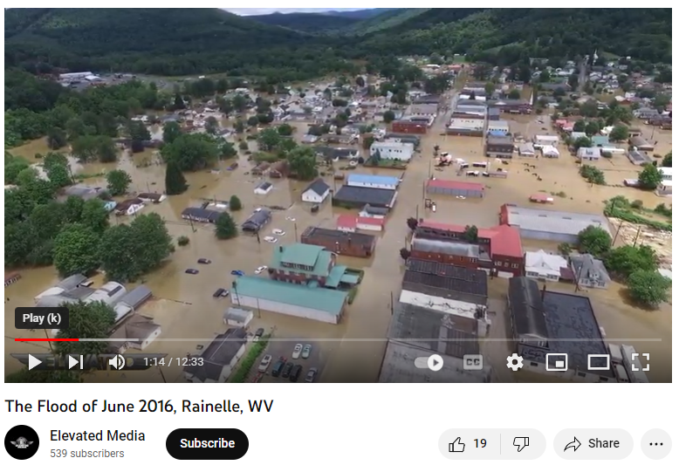
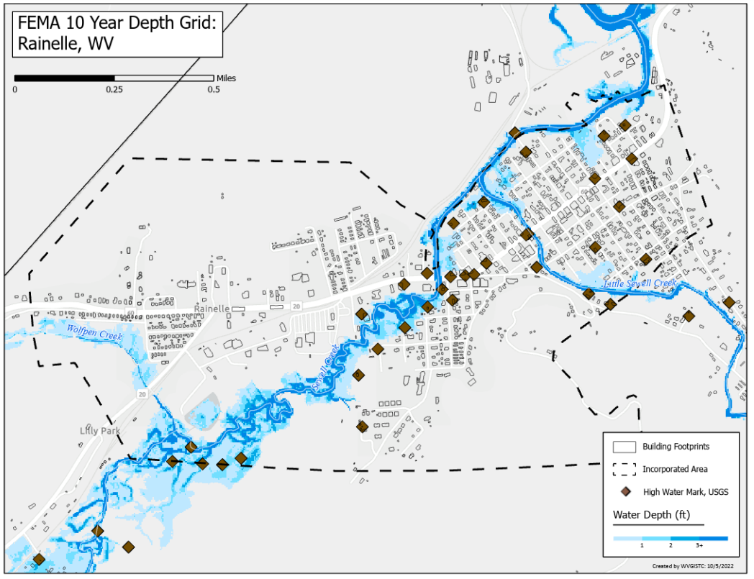
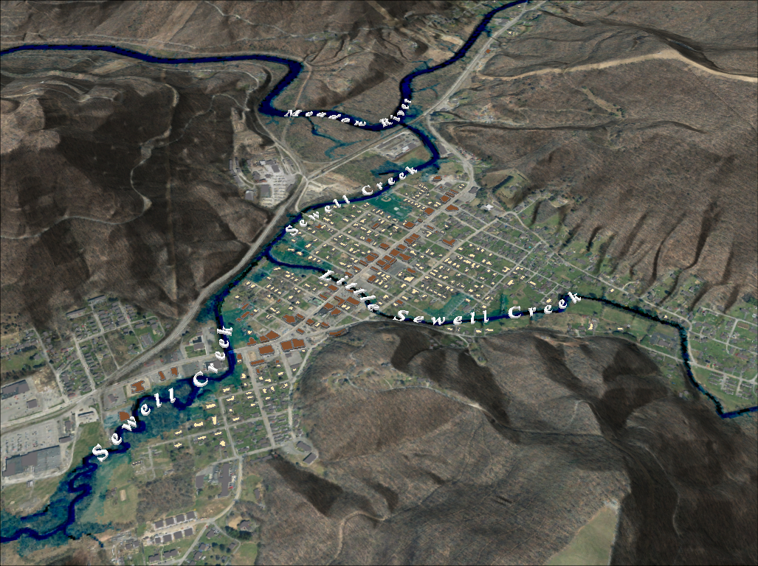
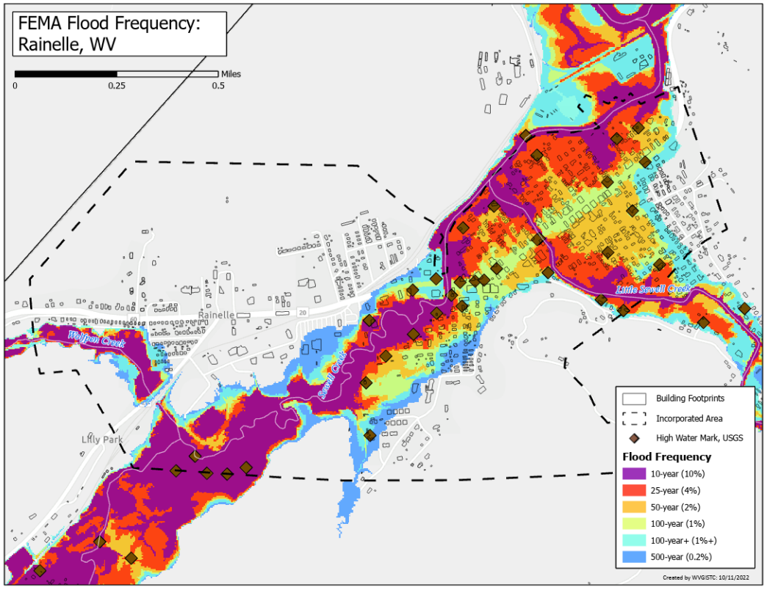
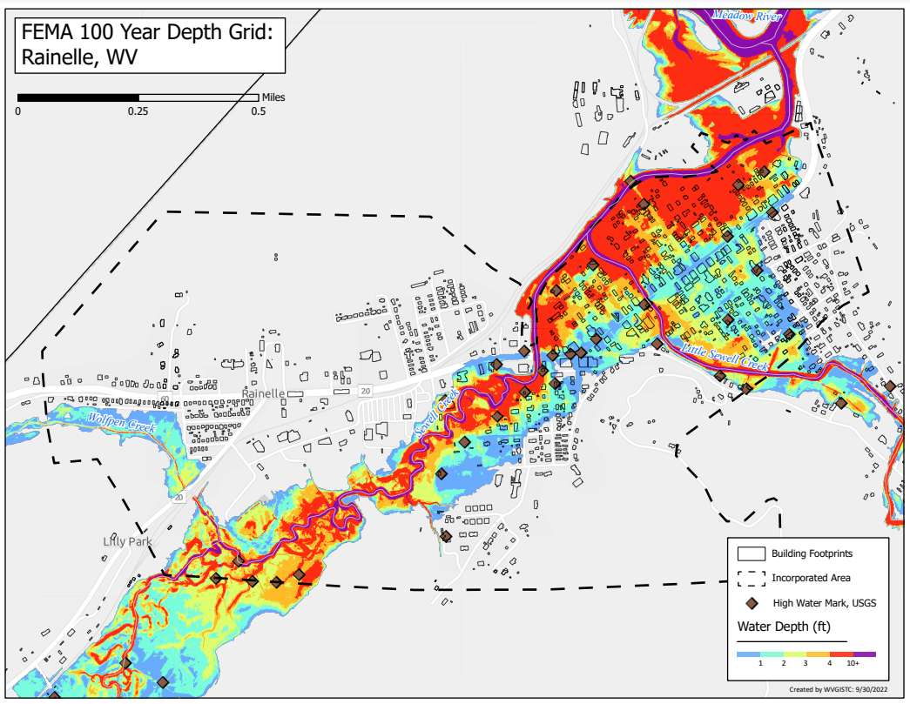
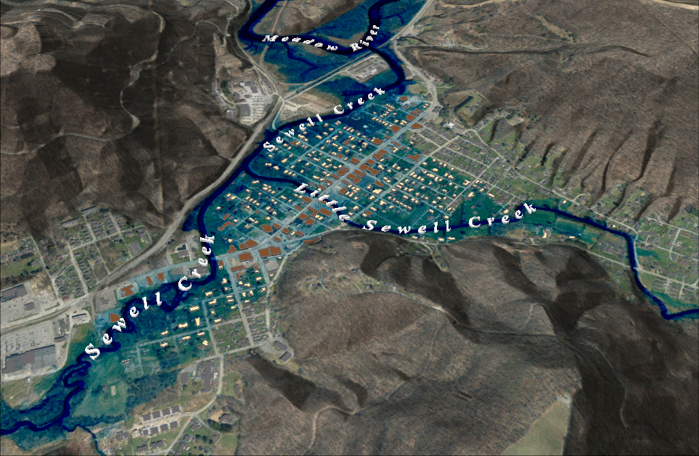
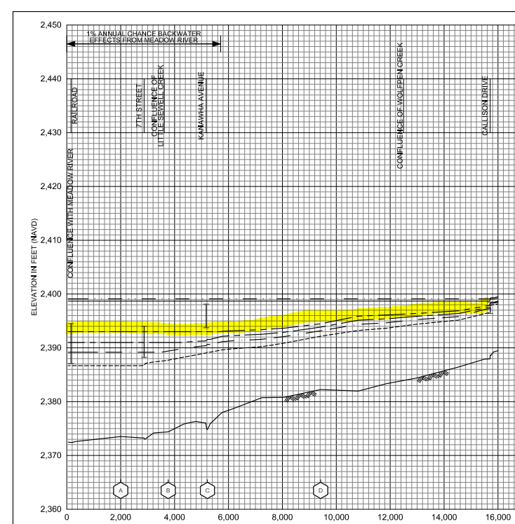
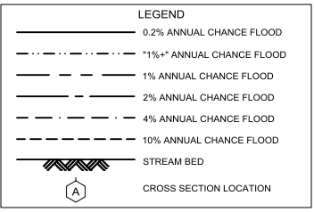
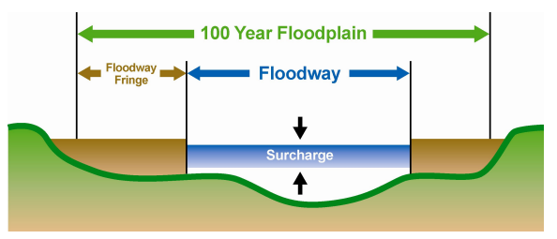
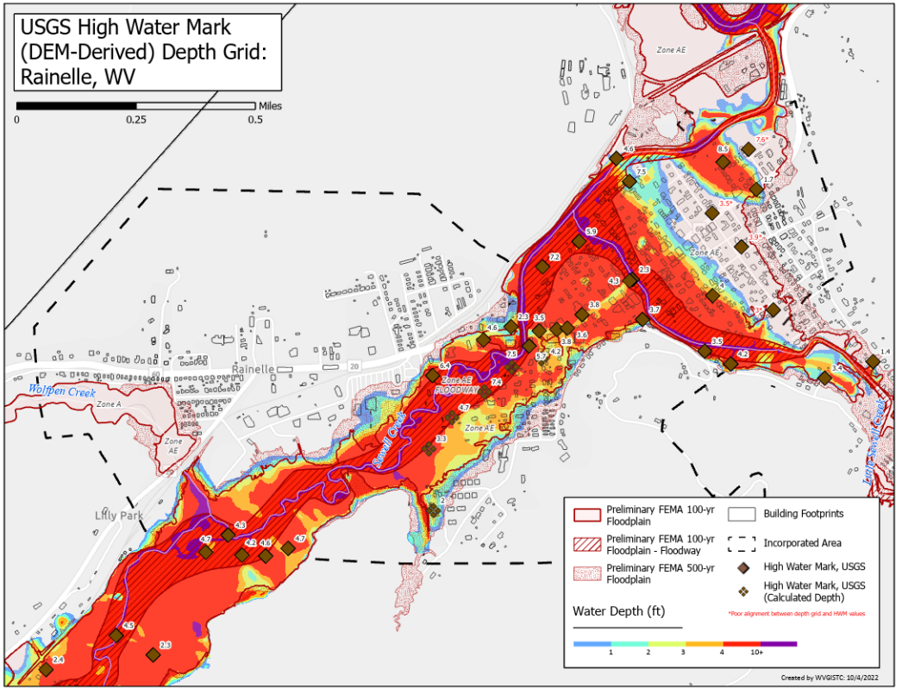
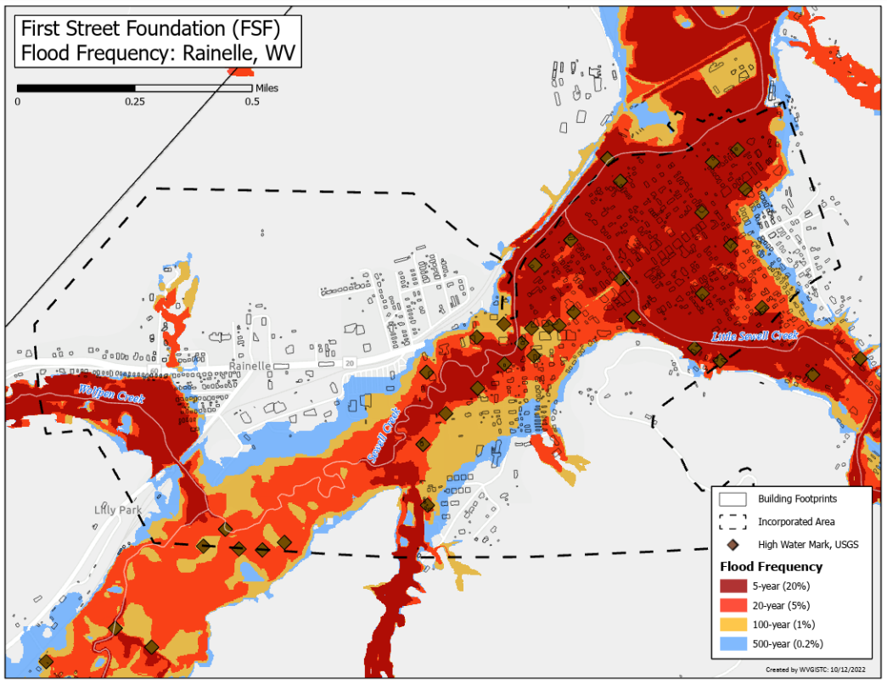
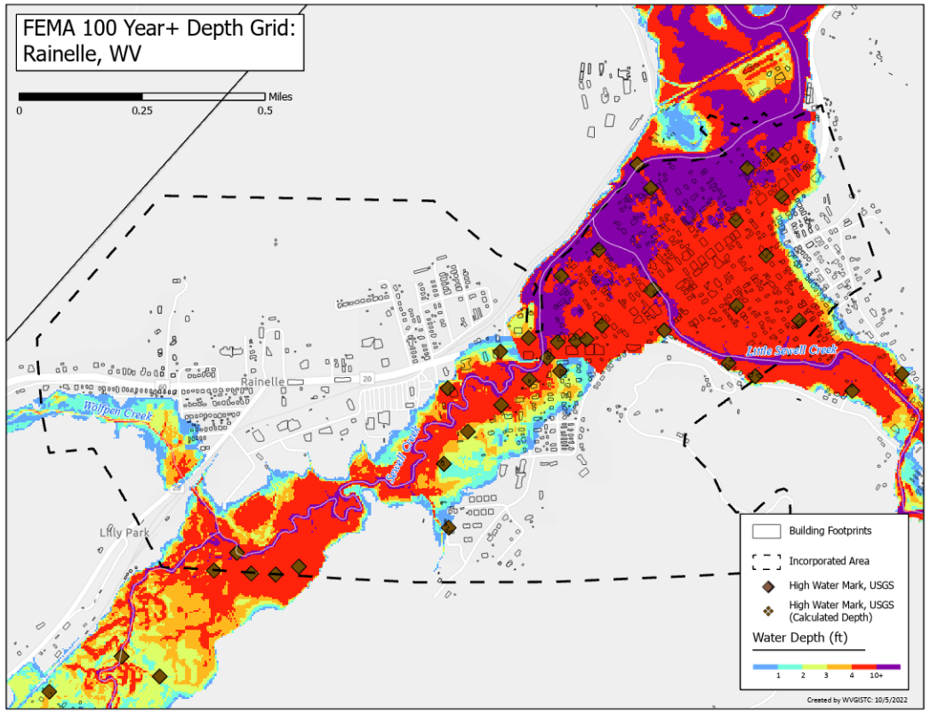
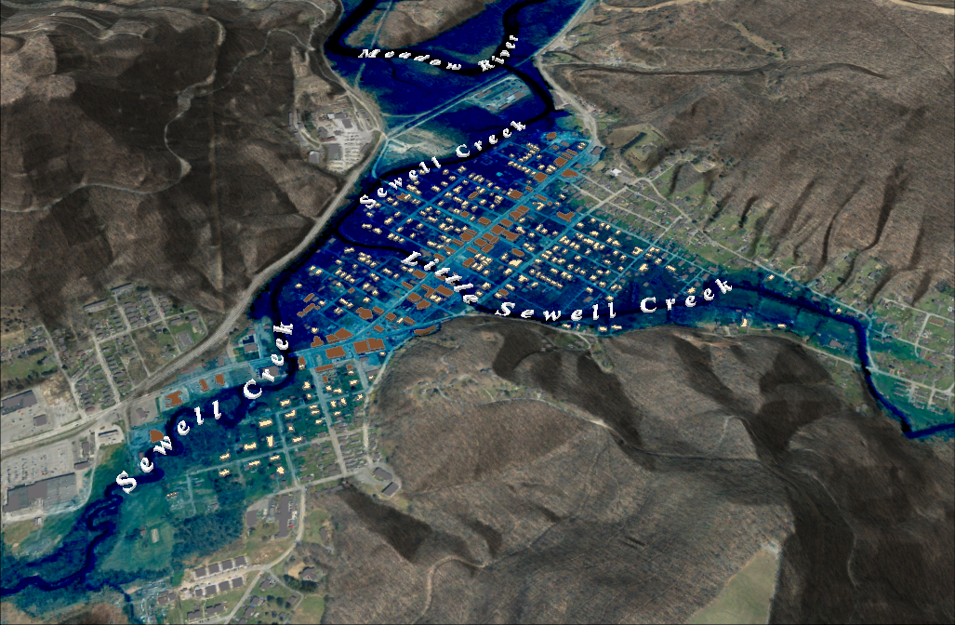
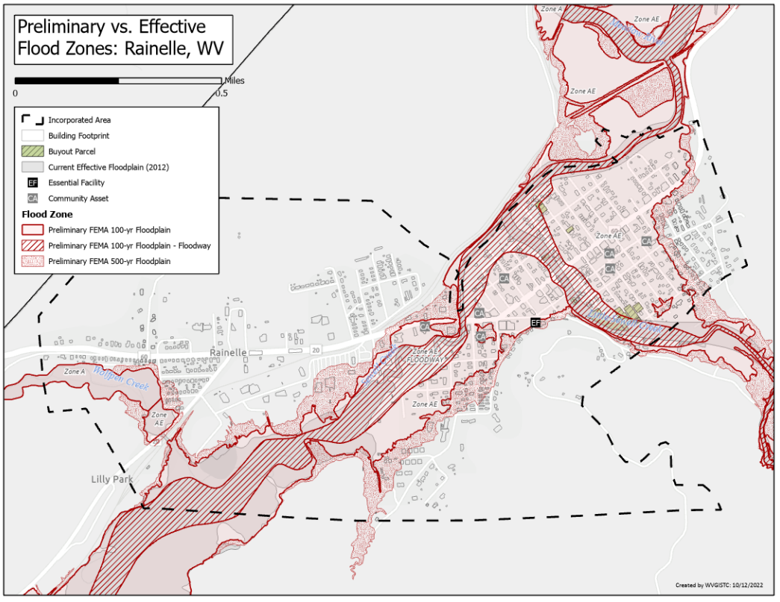
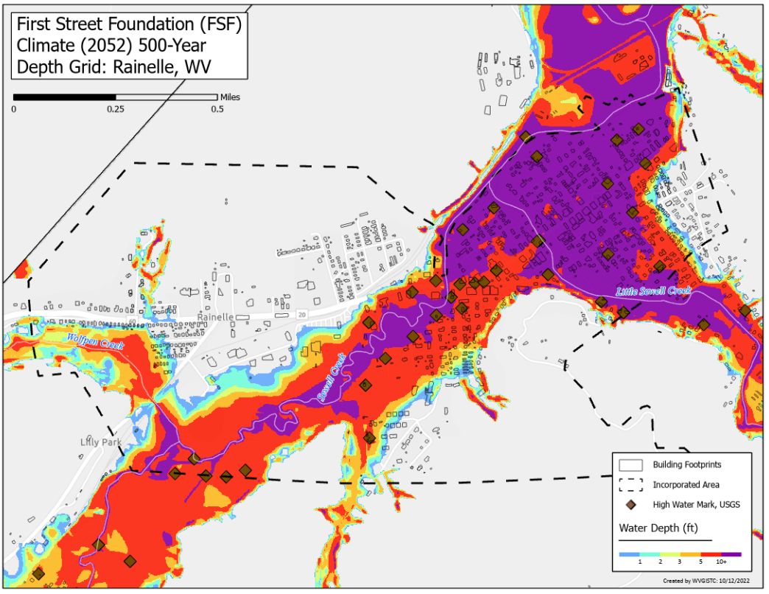
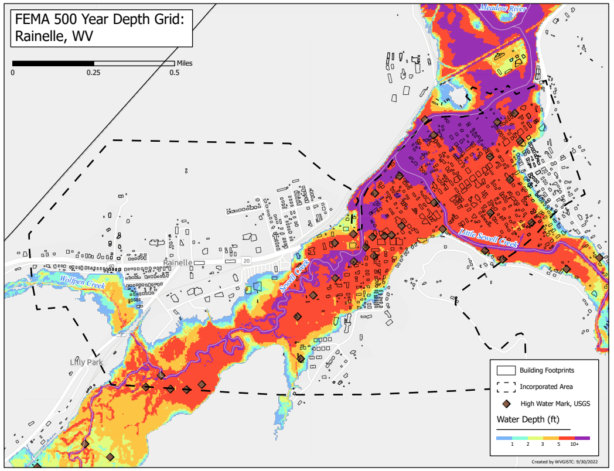
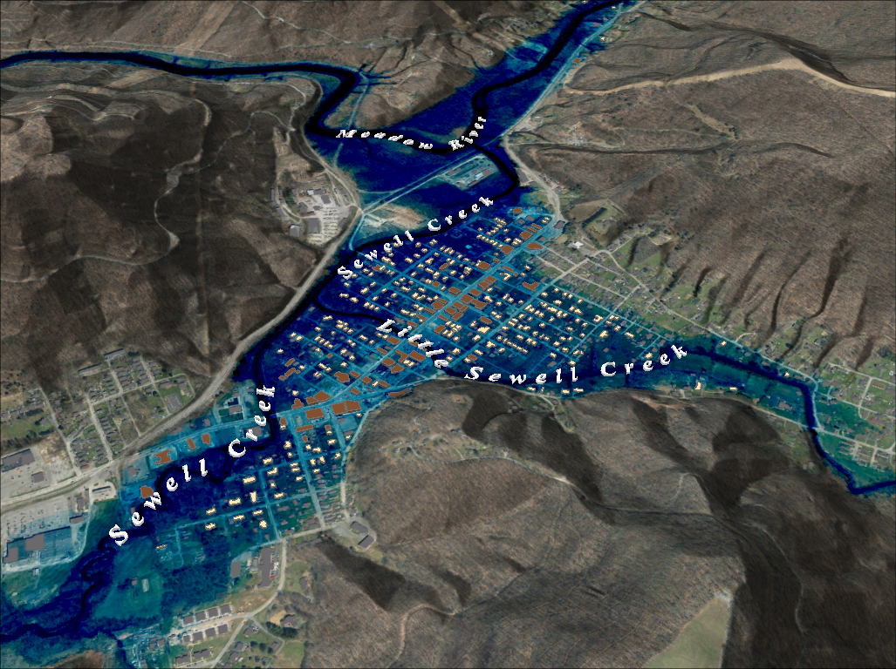
Flood Characteristics
2016 Flood Drone Video (Rainelle, WV)
FEMA Flood Model: 10-Year Flood Depth
FEMA 10% Annual Chance (10-year) Rainelle, WV
Category | Flood Characteristic | White Sulphur Springs | Rainelle
Frequency (new flood maps) | Probability that a flood of a specific size will be equaled or exceeded in any given year
 | FEMA Flood Models: 10-, 25-, 50-, 100-, 100+, and 500-year flood elevations. FEMA’s 1%+ flood elevations measure how high the 100-year flood could be given the statistical uncertainties in flood modeling (upper 84-percent confidence limit). | See models | See models
 | First Street Foundation Flood Models: 5-, 20-, 100-, and 500-year flood elevations. Climate models based on 2052 or 30 years in the future. | See models | See models
Depth | Flood depth or water surface elevation above the ground surface. Source USGS high-water marks. | 6 feet | 8 feet
Velocity | Speed at which the floodwaters are flowing | High | Moderate
Duration | Measure of how long water remains above normal levels | 24 hours | 72 hours
Rise and Fall | Floodwater that rises very quickly with little or no warning | Quick Rise | Quick Rise
0 ft.
FLOOD DEPTH
35 ft.
Video Link
Notes: Flood characteristics are based on the 2016 flood and FEMA’s new flood studies
Notes: Drone Video flood elevation: 2,392.5 ft.; Base Flood (100-yr elevation) is 2,930.0 ft., or a half foot above video footage; 2016 Flood Elevation high-water mark: 2,396.4 ft. (about 4 feet higher than video); 500-yr Flood elevation is 2,399.0 ft. or 6.5 feet above video elevation.
96% probability of flooding at least once over 30 years
Sewell Creek Flood Study Profile
FEMA Flood Models: Likelihood and Magnitude
FEMA Flood Model: 100-Year Flood Depth
FEMA 1% Annual Chance (100-year) Rainelle, WV
2022 Preliminary 1% Base Flood (100-Yr) Elevation 1850.7 ft for Building 13-17-0009-0026-0000_138
0 ft.
FLOOD DEPTH
35 ft.
New 2022 FEMA Maps
The 2012 FEMA flood maps were incomplete in that the high risk flood areas were not fully mapped. The floodplain narrowed significantly and most of the town was no longer in the Special Flood Hazard Area (SFHA).
The 2022 base flood elevation (100-yr) for a majority of Rainelle between 1st and 14th Streets is 2,393 feet. A similar base flood elevation was mapped for the 1987 flood maps for structures northwest of Main Street (U.S. 60).
The “1-percent plus” is a measure of how high the 1% flood could be given the statistical uncertainties in flood modeling. The backwater flooding from Meadow River results in more uncertainty of the flood model and thus a wider confidence level. The 1%+ flood elevation is six feet higher than 1% elevation and same as the 02%.
Confluence of Little Sewell Creek
Confluence of Wolfren Creek
182 7th Street (Bldg.13-13-0001-0054-0000_182
2016 Flood
2,396.4 ft. (BFE + 3.4 ft. to reach HWM)
Sewell Creek 2022 Flood Study Profile
The "Regulatory Floodway" is the channel of a river or other watercourse and the adjacent land areas that must be reserved in order to discharge the base flood without cumulatively increasing the water surface elevation more than a designated height. Source: FEMA
26% probability of flooding at least once over 30 years
USGS High Water Marks: 2016 Flood Depths
FSF Flood Models: Likelihood and Magnitude
FEMA Flood Model: 100-Year Plus Flood Depth
FEMA 1%+ Annual Chance (100-year) Rainelle, WV
Climate
Change
Climate
Change
0 ft.
FLOOD DEPTH
35 ft.
26% probability of flooding at least once over 30 years
Preliminary FEMA Flood Maps Effective 2023
FSF Flood Model: 500-Year Flood Depth 2052
FEMA Flood Model: 500-Year Flood Depth
FEMA 0.2% Annual Chance (500-year) Rainelle, WV
Climate
Change
0 ft.
FLOOD DEPTH
35 ft.
6% probability of flooding at least once over 30 years

