Slide 1
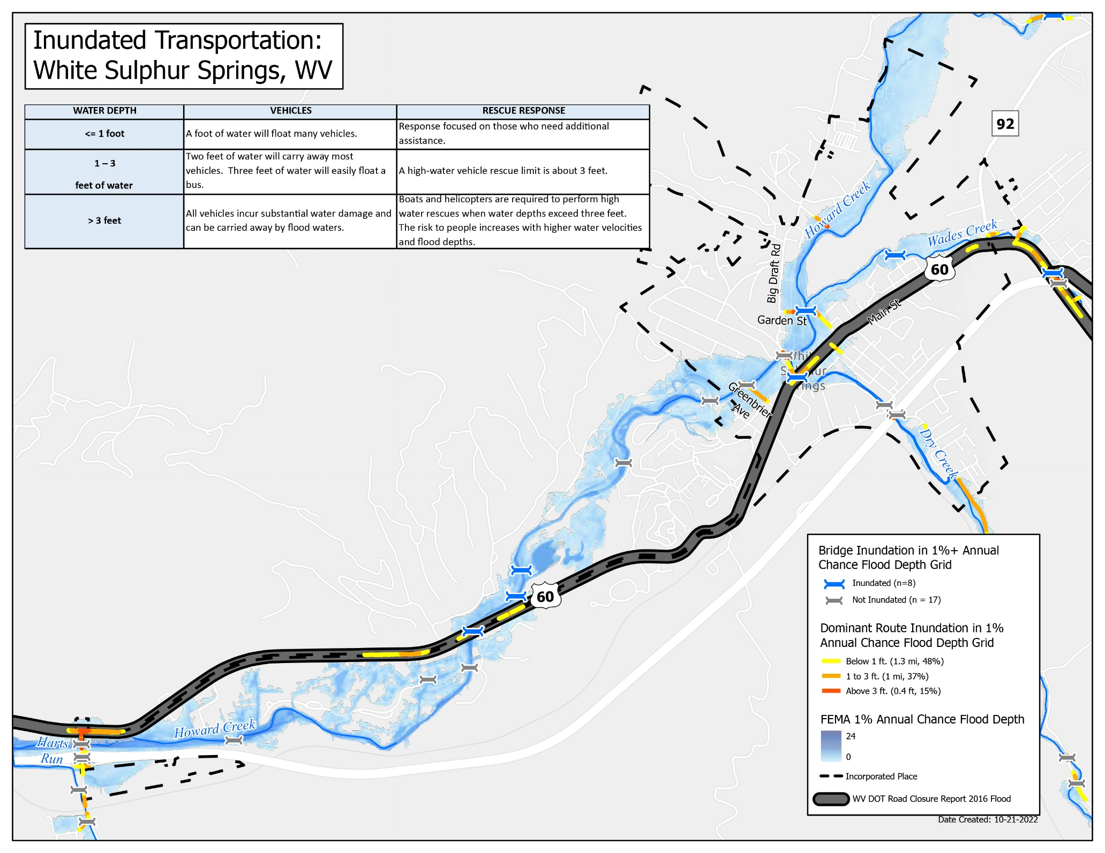



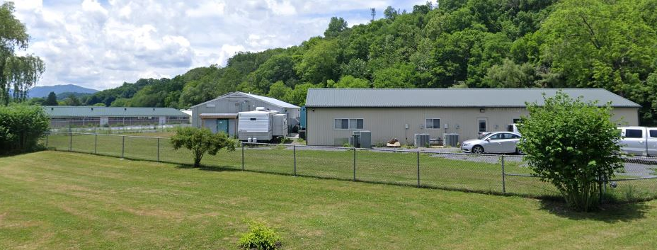
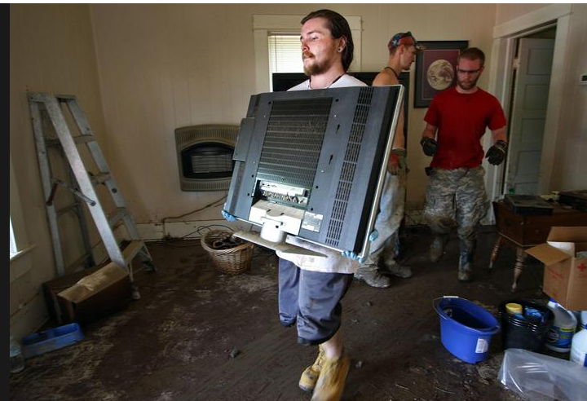
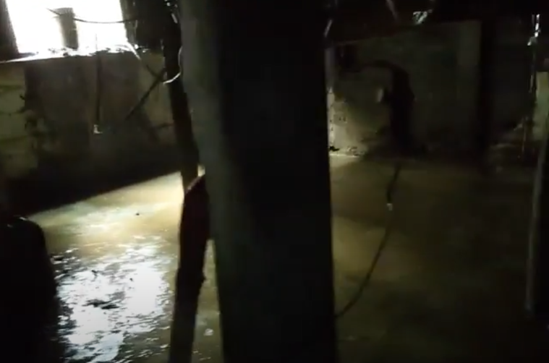




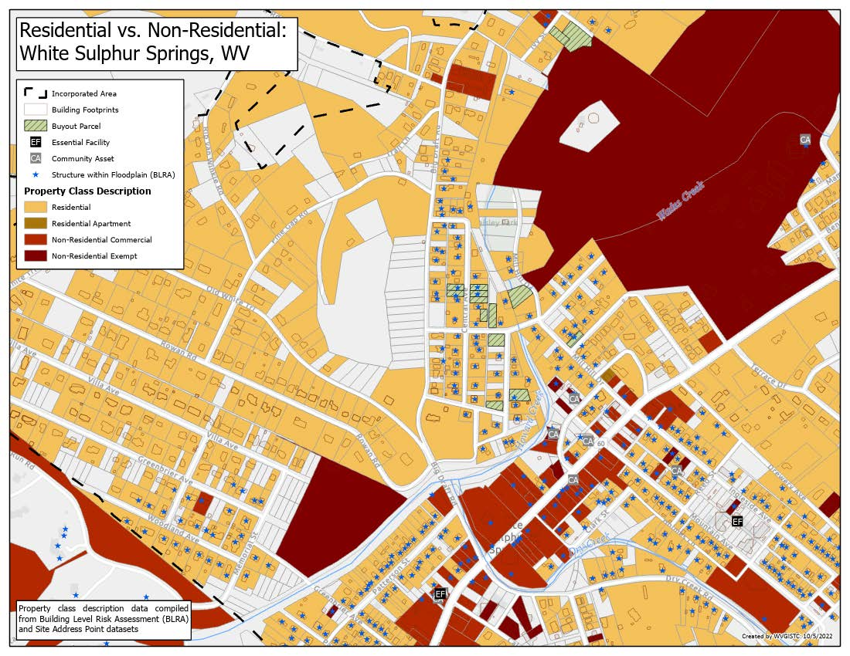
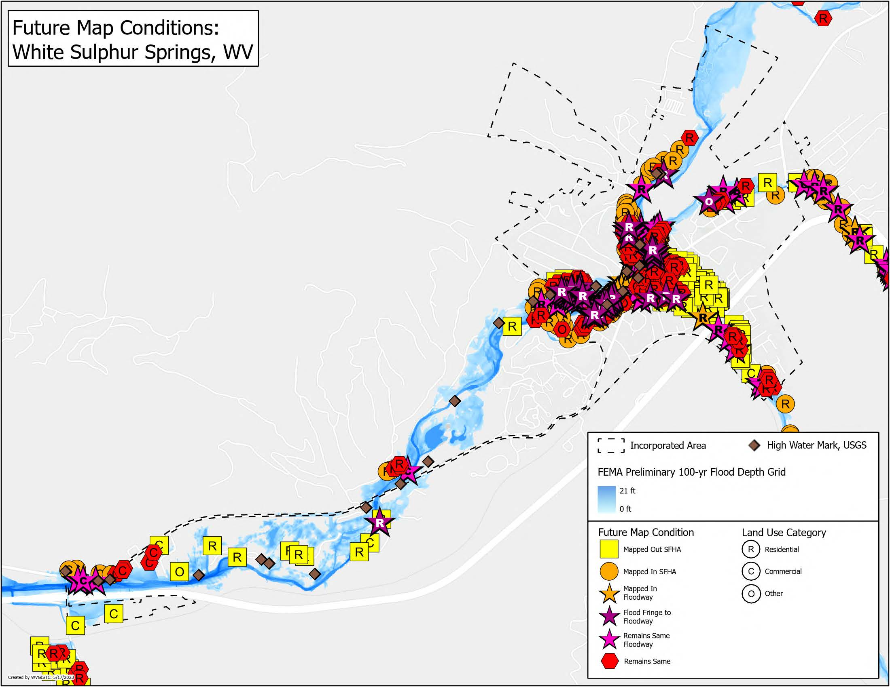
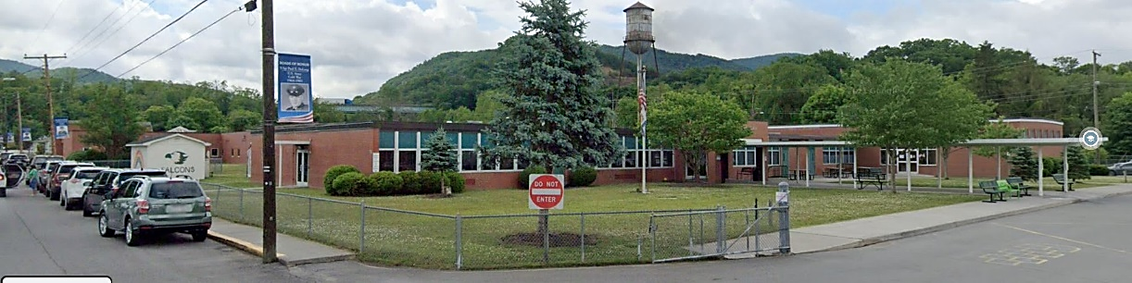
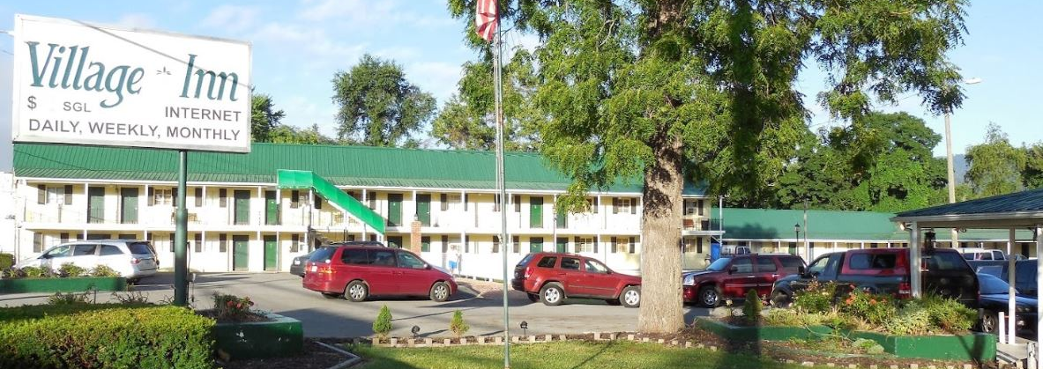
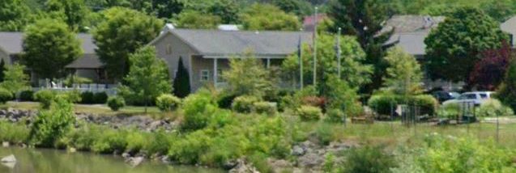
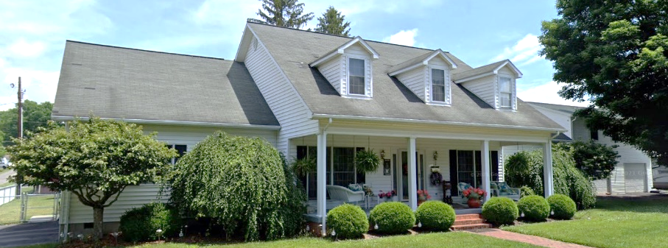
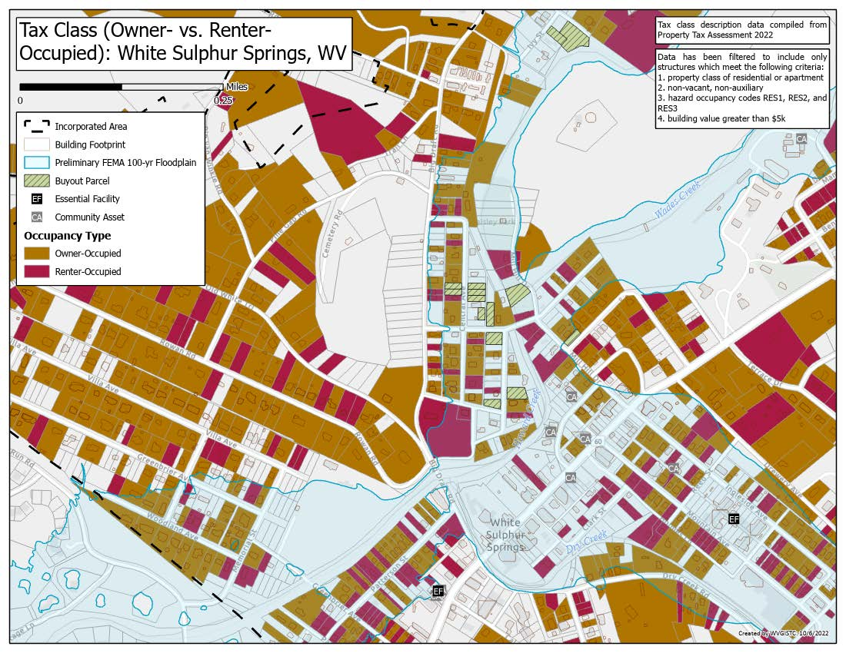
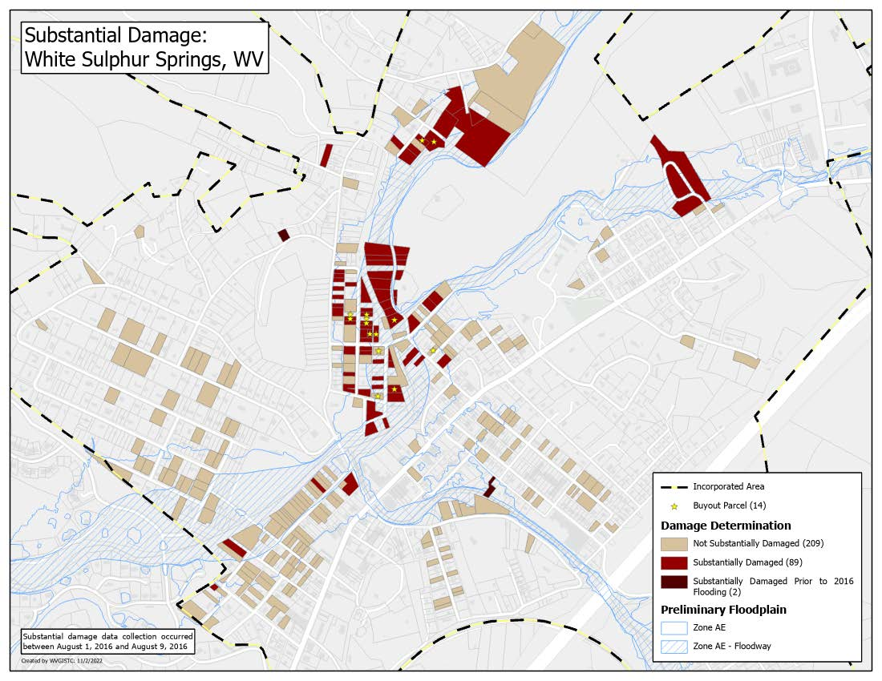
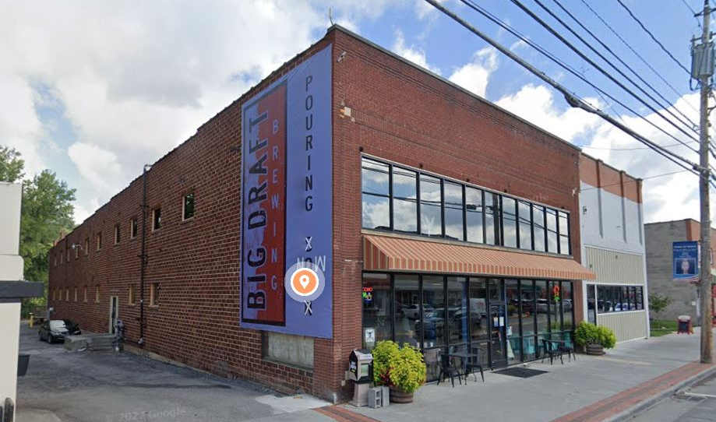
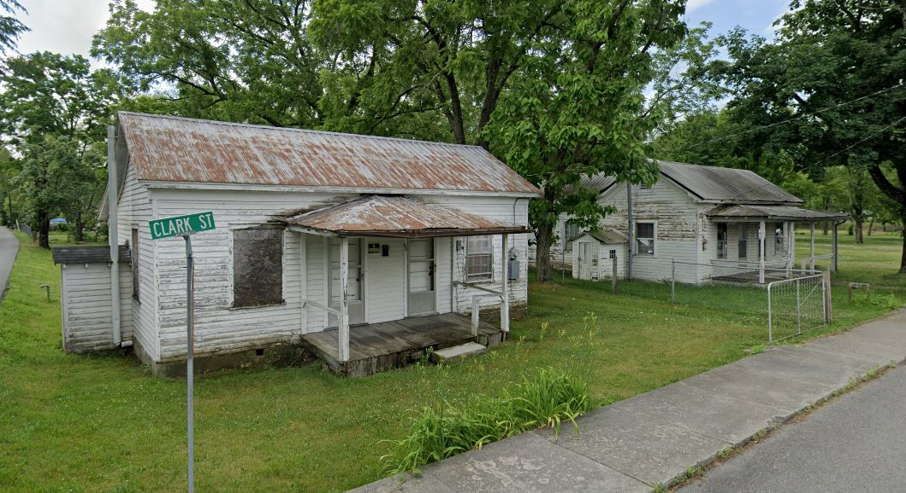
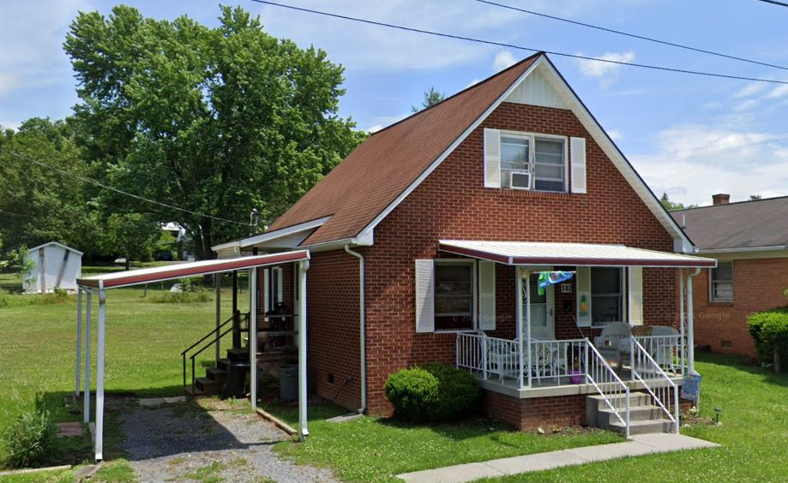
Flood Risk Assessment in
White Sulphur Springs:
Exposure,
Vulnerability, and
Loss Indicators
Social Vulnerability Indicators
White Sulphur Springs and Rainelle
Significant Structures Exposure
White Sulphur Springs and Rainelle
Infrastructure Exposure, Inundated Transportation
White Sulphur Springs
Vulnerability Indicators |  | White Sulphur Springs | Rainelle | State Ratio | National Ratio
 | Poverty Rate | 14.4% | 37.0% | 17.3% | 12.9%
 | Unemployment Rate | 21.4% | 33.6% | 23.8% | 14.7%
 | Vulnerable Ages Ratio | 41.7% | 39.8% | 30.8% | 28.3%
 | Disability Ratio | 17.8% | 26.9% | 18.7% | 13.0%
 | Population Growth Ratio | -9.1% | -20.9% | -3.2% | 7.4%
 | Renter-Occupied Ratio | 42.8% | 43.0% | 26.8% | 36.0%
 | Housing Values Less than $50K Housing Median Value | 3.9% $125,700 | 37.5% $59,400 | 16.9% $119,600 | 6.6% $229,800
Category | Exposure Indicator | White Sulphur Springs | Rainelle | Average in WV Incorporated Areas (2021)
Significant Structures Count | Number of Essential Facilities in the Moderate Risk 0.2%-Annual-Chance Floodplain | 2 | 2 | 2
 | Number of Community Assets (Non-Historical) in the High-Risk 1%-Annual-Chance Floodplain | 8 | 7 | 3
WV GIS Technical Center
May 2023
The red texts show large difference, to the risk side, from the state ratios.
The red texts show more than 5% of difference, to the vulnerability side, from the state ratios.
White Sulphur Springs National Fish Hatchery:
Building ID: 13-17-0009-0206-0000_1087
Hazard occupancy Class: GOV1 (Government, Federal)
FIRM Status: Post-FIRM
Appraised Value: $425,073 (Highest in significant structures)
Renters clearing away their belongings after the 2016 flood
An inundated basement in the 2016 flood
Building Exposure, Future Map Conditions
White Sulphur Springs
Building Exposure, High-Value Structures
White Sulphur Springs
Building Exposure
White Sulphur Springs and Rainelle
Residential vs. Non-Residential Parcels
White Sulphur Springs
Category | Exposure Indicator | White Sulphur Springs | Rainelle | Ratio* in WV Incorporated Areas (2021)
Buildings by Flood Zone (Count & Value) | Total Primary Building Count in Floodplain | 425 (Rank***: 12th) | 338 (Rank: 18th) | 59 (Median)
 | Building Ratio b/w Floodplain & Community Total | 26% | 34% | 9%
 | Total Primary Building Value in Floodplain of Community | $41.02M (Rank: 16th) | $16.89M | $6.42M (Median)
 | Median Building Value in Floodplain | $49K | $38K | $42K
 | Building Count in Floodway** (High Velocity) | 105 (Rank: 6th) | 47 (Rank: 18th) | 12 (Avg.)
 | Percent Building Count in Floodway** (High Velocity & Depth) | 25% | 14% | 8%
 | New Maps: Bldgs. “Mapped In” SFHA | 75 (Rank: 11th) | 325 (Rank: 3rd) | 19 (Avg.)
 | New Maps: Bldgs. % Count “Mapped In” SFHA | 18% | 96% | 14%
 | New Maps: Bldgs. “Mapped In” Floodway | 14 | 38 | 97
 | New Maps: Bldgs. “Mapped Out” SFHA | 117 (Rank: 8th) | 1 | 19 (Avg.)
 | New Maps: Bldgs. % Count “Mapped Out” SFHA | 28% | 0% | 14%
Highest Value:
Building ID: 13-17-0009-0342-0000_150 (WSS Elementary)
Hazard Occupancy Class: EDU1 (School)
FIRM Status: Post-FIRM (2003)
Appraised Value: $8,542,982
(New flood study mapped-out SFHA)
Highest Residential (RESx) Value:
Building ID: 13-17-0011-0246-0000_559
Hazard Occupancy Class: RES4 (Hotel/Motel - Low Rise)
FIRM Status: Pre-FIRM (1951)
Appraised Value: $254,400
(New flood study mapped-in SFHA)
Highest Apartment Building Value:
Building ID: 13-17-0009-0054-0001_767
Hazard Occupancy Class: RES3B (Multi-Family 3-4 Units)
FIRM Status: Pre-FIRM (1950)
Appraised Value: $227,600
Highest Single-Family Value:
Building ID: 13-17-0008-0523-0000_192
Hazard Occupancy Class: RES1 (Residential 1 Family)
FIRM Status: Post-FIRM (1993)
Appraised Value: $192,700
Building Exposure…
White Sulphur Springs and Rainelle
Tax Class, Owner- vs. Renter-Occupied Parcels
White Sulphur Springs
Physical Flood Loss
White Sulphur Springs and Rainelle
Substantial Damage (2016 Flood)
White Sulphur Springs
Category | Exposure Indicator | White Sulphur Springs | Rainelle | Ratio* in WV Incorporated Areas (2021)
Building Ownership | Owner Occupied Residential Buildings in Floodplain | 208 | 153 | 65%
 | Percent Owner Occupied Residential Buildings in Floodplain | 49% | 45%
Building Occupancy and Value | Residential Building Count in Floodplain | 372 (Rank: 12th) | 250 | 44
 | Percent Count Residential Building in Floodplain | 88% | 74% | 81%
 | Non-Residential Building Count in Floodplain | 53 | 88 (Rank: 11th) | 12
 | Percent Count Non-Residential Bldgs. in Floodplain | 12% | 26% | 19%
 | Residential Building Value in Floodplain | $20.45M (Rank: 16th) | $9.29M | $2.11M
 | Percent Residential Value in Floodplain | 50% | 55% | 31%
 | Non-Residential Building Value in Floodplain | $20.56M | $7.60M | $2.99M
 | Percent Non-Residential Value in Floodplain | 50% | 45% | 69%
 | Mobile Homes in Floodplain | 4 | 14 | 5
 | Percent Mobile Homes in Residential Buildings in Floodplain | 1% | 4% | 11%
Category | Loss Indicator | White Sulphur Springs | Rainelle | Rate* in WV Incorporated Areas (2021)
Physical (Building) Loss By 1%-Annual-Chance Flood Event | TEIF Building Dollar Loss Estimates | $1,225K | $994K | $1,246K (Avg.)
 | TEIF Building Loss Ratio | 3% | 6% | 10%
 | Median Individual Building Damage | $3K | $2K | $7K (Mdn.)
 | Substantial Damage (>50%) Estimates | 0 89 in 2016 Flood | 1 | 7 (Avg.)
 | Percent Substantial Damage Estimates | 0% | 0% | 6% (Avg.)
 | Moderate Damage (10-50%) Estimates | 78 98 in 2016 Flood | 106 | 47 (Avg.)
 | Percent Moderate Damage Estimates | 18% | 31% | 34% (Avg.)
 | Building Debris Removal Estimates | 450 ton | 809 ton | 165 ton (Mdn.)
 | Number of Previous Paid Losses | 89 | 152 (Rank**: 20th) | 63 (Avg.)
 | Dollar Amount of Previous Insurance Claims | $2,975K (Rank: 15th) | $3,720K (Rank: 10th) | $845K (Avg.)
 | Number of Repetitive Loss Structures | 2 | 23 | 3 (Mdn.)
Building Exposure/Physical Vulnerability
White Sulphur Springs and Rainelle
Exposure, Examples of Low Valued Structures in Floodplain
White Sulphur Springs
Human Exposure/Loss
White Sulphur Springs and Rainelle
Structures with High Building Loss (Estimated)
White Sulphur Springs
Category | Exposure Indicator | White Sulphur Springs | Rainelle | Median & Ratio in WV Incorporated Areas (2021)
Building Year Construction/ FIRM Status | Median Construction Year in Floodplain | 1940 | 1950 | 1947
 | % Pre-FIRM Structures (includes “unknown”) | 88% | 77% | 77%
 | % Post-FIRM Structures (also “mapped-in SFHA” Post-FIRM structures regulated to Pre-FIRM) | 12% | 23% | 13%
Physical Structural Vulnerability (Basements, Stories, & Value) | Primary Buildings with Basements in Floodplain | 93 | 27 | 37%
 | Percent Count Buildings with Basements in Floodplain | 22% | 8%
 | One-Story Residential Buildings in Floodplain | 336 | 292 | 69%
 | Percent Count One-Story Residential Buildings in Floodplain | 79% | 86%
 | Red Tag: Dilapidated/Vacant Residential & Commercial Buildings | 20 | 56 | 6
 | Percent Low Valued (Red Tag) Structures | 5% | 17% | 4%
Category | Exposure Indicator | White Sulphur Springs | Rainelle | Median & Ratio in WV Incorporated Areas (2021)
Human Exposure | Estimated Population Residing in High-Risk Flood Zones | 1026 | 582 | 114
 | Percentage of Population Residing in High-Risk Flood Zones | 39% | 43% | 10%
Human Loss By 1%-Annual-Chance Flood Event | Displaced Population Estimates | 462 (Rank: 17th) | 487 (Rank: 16th) | 173 (Avg.)
 | Percent of Community Population Displaced | 17% | 36% | 13%
 | Estimated Population in Need of Short-Term Shelter | 104 (Rank: 18th) | 123 (Rank: 14th) | 37 (Avg.)
Highest Building Loss (USD)
in White Sulphur Springs:
Building ID: 13-17-0008-0186-0000_703
Hazard Occupancy Class: COM8 (Restaurant)
FIRM Status: Pre-FIRM (1968)
Water Depth in Structure: 1.2 ft (minus rated -1 ft)
Appraised Value: $1,422,200
Estimated Building Loss: $133,687
Building Damage Percentage: 10%
* For numbers and dollar values, used median, or average where the median was zero or too low, in the state’s 213 incorporated areas
** Ranks mentioned based on the BLRA data of April 2022 where the community is among the top 20 incorporated areas in WV
The red texts show large difference, to the risk side, from the state ratios.
Highest Building Damage Percentage
in White Sulphur Springs:
Building ID: 13-17-0008-0435-0000_382
Hazard Occupancy Class: RES1 (Residential 1 Family)
FIRM Status: Post-FIRM (1988)
Water Depth in Structure: 3.9 ft (minus rated -4 ft)
Appraised Value: $62,200
Estimated Building Loss: $28,799
Building Damage Percentage: 46%
Building IDs: 13-17-0009-0270-0000_208 & 13-17-0009-0269-0000_196
For Greenbrier County, Red Cross sheltering data from the 2016 flood was compared to the shelter model estimates. According to the Red Cross shelter data, a total of 114 people stayed at six designated Red Cross shelters during the flood event. However, many displaced residents also stayed at unregistered shelters, including the 300 people at the Greenbrier Resort and 129 people at the Baptist Church gymnasium in Rainelle. If the registered persons of the Red Cross Shelters requiring shelter are summed together at 543 people, then this estimate is close to the shelter need model estimate of 603 people for Greenbrier County.
* For numbers and dollar values, used median, or average where the median was zero or too low, in the state’s 213 incorporated areas
** Based on the floodway maps of 2023
*** Ranks mentioned based on the BLRA data of April 2022 where the community is among the top 20 incorporated areas in WV
The red texts show large difference, to the risk side, from the state ratios.
The green texts show large difference, to the resilience side, from the state ratios.

