Slide 1
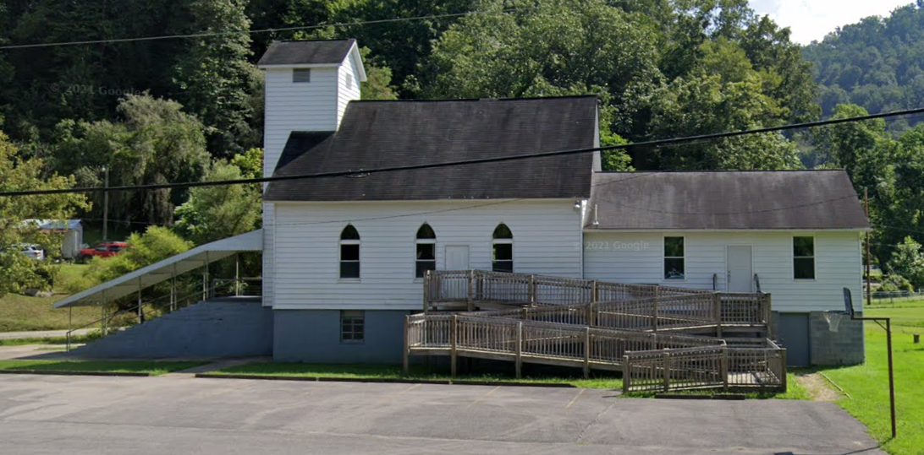
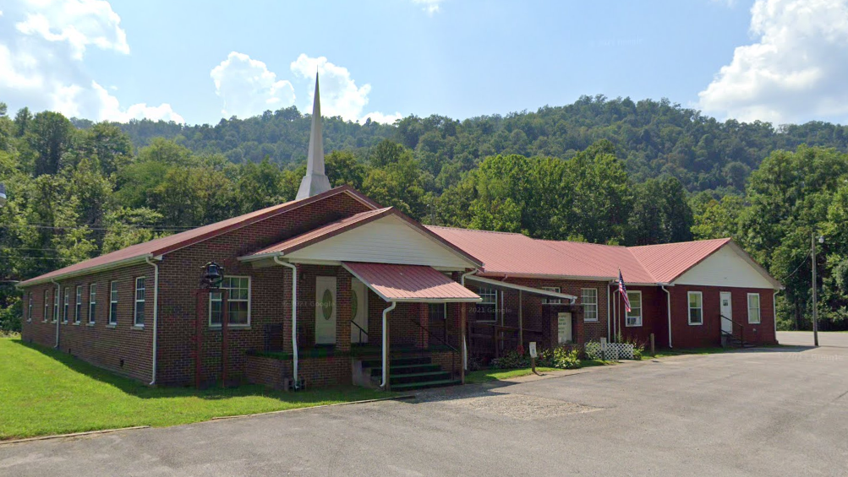
Community Assets in Coal Watershed
Ranked by Flood Depth
Rank | Building ID | Facility Name | Facility Type | Community Name | County | Building Appraisal | Flood Zone Designation | In Floodway | Stream | Flood Depth | Building Damage Percent | Building Loss USD | Flood Tool Link
1 | 03-05-0008-0027-0000_76 | Olive Baptist Church | Religious | Boone County* | BOONE | $ 110,480 | AE | No | Little Horse Creek | 15.5 | 12% | $ 13,322 | FT
2 | 03-05-0012-0058-0002_180 | Lory Baptist Church | Religious | Boone County* | BOONE | $ 295,220 | AE (Floodway) | Yes | Little Coal River | 10.8 | 15% | $ 45,472 | FT
3 | 03-03-0010-0070-0000_790 | Madison Christian Center | Religious | Madison | BOONE | $ 218,100 | AE | No | Pond Fork | 9.5 | 15% | $ 32,576 | FT
4 | 03-01-0003-0053-0002_850 | New Hope Baptist Church | Religious | Boone County* | BOONE | $ 128,100 | AE | No | Pond Fork | 9.3 | 14% | $ 18,502 | FT
5 | 03-03-0003-0003-0000_514 | Faith Bible Church | Religious | Madison | BOONE | $ 173,520 | AE | No | Little Coal River | 9.1 | 14% | $ 24,293 | FT
6 | 20-16-012B-0009-0000_9414 | New Hope Missionary Baptist Church | Religious | Kanawha County* | KANAWHA | $ 339,300 | Advisory A | No | Browns Creek | 8.8 | 14% | $ 47,502 | FT
7 | 03-06-045D-0016-0000_274 | Church of God of Prophecy | Religious | Boone County* | BOONE | $ 32,200 | AE | No | Big Coal River | 8.5 | 14% | $ 4,508 | FT
8 | 03-01-007B-0039-0000_6314 | Quinland Freewill Baptist Church | Religious | Boone County* | BOONE | $ 18,700 | AE | No | Pond Fork | 8.2 | 14% | $ 2,618 | FT
9 | 41-02-0015-0046-0000_107 | Workman Creek Church | Religious | Raleigh County* | RALEIGH | $ 147,070 | AE | No | Clear Fork | 8.2 | 14% | $ 20,590 | FT
10 | 03-01-019A-0004-0000_1765 | Gordon Missionary Baptist Church | Religious | Boone County* | BOONE | $ 77,790 | Advisory A | No | West Fork | 8.1 | 12% | $ 9,571 | FT
Olive Baptist Church
Lory Baptist Church in floodway

Slide 2
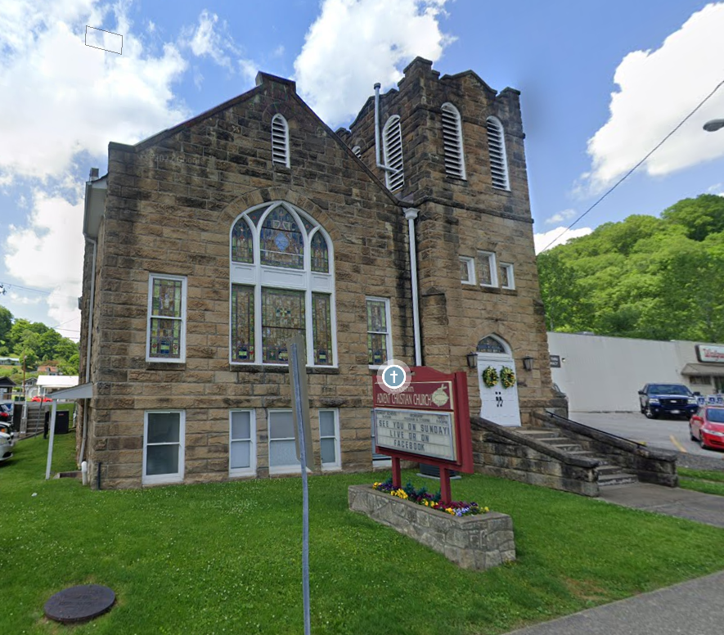
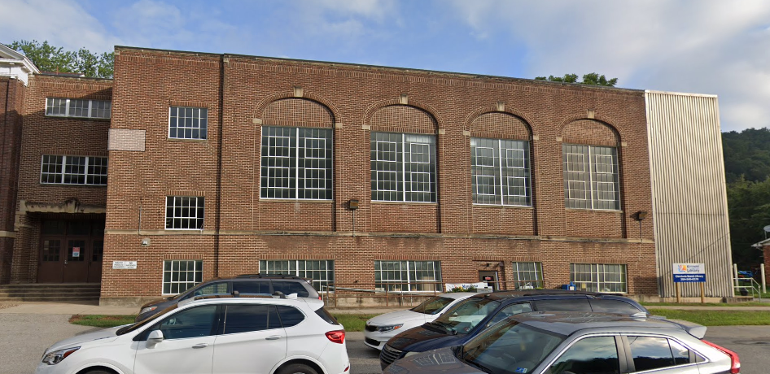
Community Assets in Elk Watershed
Ranked by Flood Depth
Rank | Building ID | Facility Name | Facility Type | Community Name | County | Building Appraisal | Flood Zone Designation | In Floodway | Stream | Flood Depth | Building Damage Percent | Building Loss USD | Flood Tool Link
1 | 20-02-0007-0030-0000_103 | Praying Pelican Missions | Religious | Clendenin | KANAWHA | $ 102,100 | AE | No | Elk River | 14.0 | 14% | $ 14,294 | FT
2 | 20-02-0002-0082-0000_8673 | Clendenin Advent Christian Church | Religious | Clendenin | KANAWHA | $ 253,400 | AE | No | Elk River | 9.6 | 14% | $ 35,692 | FT
3 | 20-01-019E-0057-0000_1166 | Stillwaters Ministries | Religious | Kanawha County* | KANAWHA | $ 39,800 | AE | No | Big Sandy Creek | 9.3 | 15% | $ 5,854 | FT
4 | 20-01-024B-0039-0001_5564 | Falling Rock Gospel Tabernacle | Religious | Kanawha County* | KANAWHA | $ 350,300 | Preliminary Flood Zone (AE) | No | Elk River | 9.2 | 14% | $ 50,122 | FT
5 | 20-02-0006-0078-0000_100 | United States Postal Service | Government | Clendenin | KANAWHA | $ 47,800 | AE | No | Elk River | 9.1 | 32% | $ 15,280 | FT
6 | 20-02-0007-0004-0003_107 | Kanawha County Public Library - Clendenin Branch | Government | Clendenin | KANAWHA | $ 291,447 | AE | No | Elk River | 9.1 | 29% | $ 84,344 | FT
7 | 20-02-0006-0008-0000_500 | Clendenin First Baptist Church | Religious | Clendenin | KANAWHA | $ 309,200 | AE | No | Elk River | 8.5 | 14% | $ 43,288 | FT
8 | 20-02-0002-0072-0000_2 | Advent Christian Fellowship Hall | Religious | Clendenin | KANAWHA | $ 186,800 | AE | No | Big Sandy Creek | 7.7 | 14% | $ 25,377 | FT
9 | 20-02-0007-0004-0002_105 | Kanawha County Emergency Ambulance Authority | EMS | Clendenin | KANAWHA | $ 85,500 | AE | No | Elk River | 7.7 | 62% | $ 52,739 | FT
10 | 20-02-0007-0034-0000_101 | Clendenin Community Center | Government | Clendenin | KANAWHA | $ 200,000 | AE | No | Elk River | 7.3 | 16% | $ 31,886 | FT
Clendenin Advent Christian Church
Kanawha County Public Library - Clendenin Branch

Slide 3
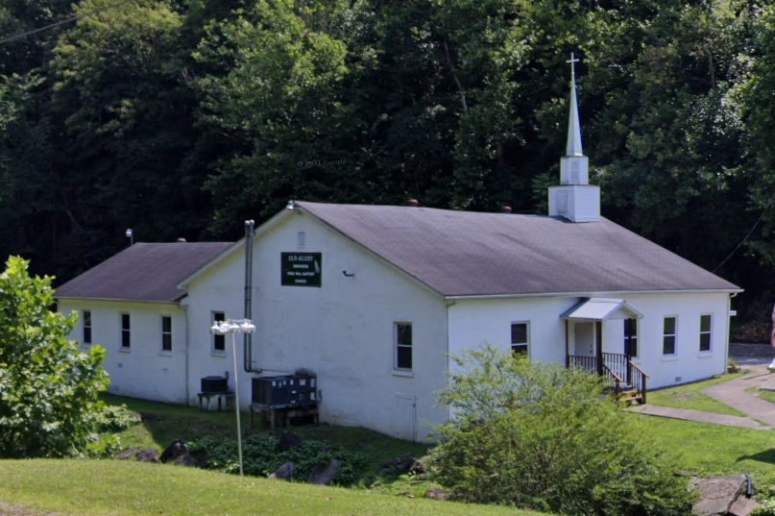
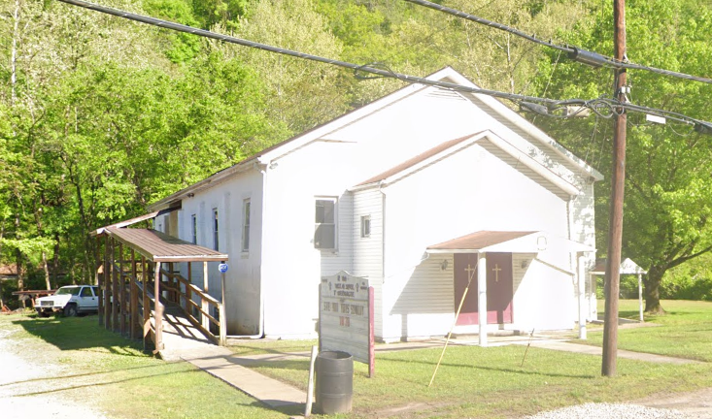
Community Assets in Upper Kanawha Watershed
Ranked by Flood Depth
Rank | Building ID | Facility Name | Facility Type | Community Name | County | Building Appraisal | Flood Zone Designation | In Floodway | Stream | Flood Depth | Building Damage Percent | Building Loss USD | Flood Tool Link
1 | 20-03-050C-0034-0000_4006 | Ronda Full Gospel Tabernacle | Religious | Kanawha County* | KANAWHA | $ 66,900 | AE (Floodway) | Yes | Cabin Creek | 8.2 | 14% | $ 9,366 | FT
2 | 10-03-043L-0001-0000_13759A | United States Postal Service Office | Government | Fayette County* | FAYETTE | $ 70,800 | A | No | Loop Creek | 7.7 | 20% | $ 55,444 | FT
3 | 20-03-013A-0005-0000_5873 | United States Postal Service | Government | Kanawha County* | KANAWHA | $ 30,200 | AE | No | Kellys Creek | 7.5 | 39% | $ 11,688 | FT
4 | 20-03-050B-0116-0001_4933 | United States Postal Service | Government | Kanawha County* | KANAWHA | $ 13,900 | AE (Floodway) | Yes | Cabin Creek | 7.3 | 21% | $ 2,881 | FT
5 | 20-05-0004-0079-0000_208 | United States Postal Service | Government | East Bank | KANAWHA | $ 122,400 | Updated AE Floodplain Boundary | No | East Bank Tributary | 6.6 | 35% | $ 42,349 | FT
6 | 20-03-060A-0058-0000_182 | First Baptist Church of Standard West Virginia | Religious | Kanawha County* | KANAWHA | $ 43,500 | AE (Floodway) | Yes | Paint Creek | 6.5 | 12% | $ 5,275 | FT
7 | 20-03-050C-0175-0000_80 | Rhonda Apostolic Church | Religious | Kanawha County* | KANAWHA | $ 179,100 | AE (Floodway) | Yes | Cabin Creek | 6.4 | 12% | $ 22,329 | FT
8 | 20-19-027A-0060-0000_77 | Lens Creek Wesleyan Church | Religious | Kanawha County* | KANAWHA | $ 58,800 | AE (Floodway) | Yes | Lens Creek | 6.2 | 12% | $ 7,073 | FT
9 | 20-03-040C-0008-0000_87 | Old Glory Freewill Baptist Church | Religious | Kanawha County* | KANAWHA | $ 193,945 | AE (Floodway) | Yes | Fields Creek | 6.0 | 13% | $ 25,213 | FT
10 | 20-03-012A-0028-0000_121 | Mt. Lewis Baptist Church | Religious | Kanawha County* | KANAWHA | $ 39,800 | AE | No | Kellys Creek | 6.0 | 12% | $ 4,843 | FT
Old Glory Freewill Baptist Church in floodway
Ronda Full Gospel Tabernacle in floodway

Slide 4
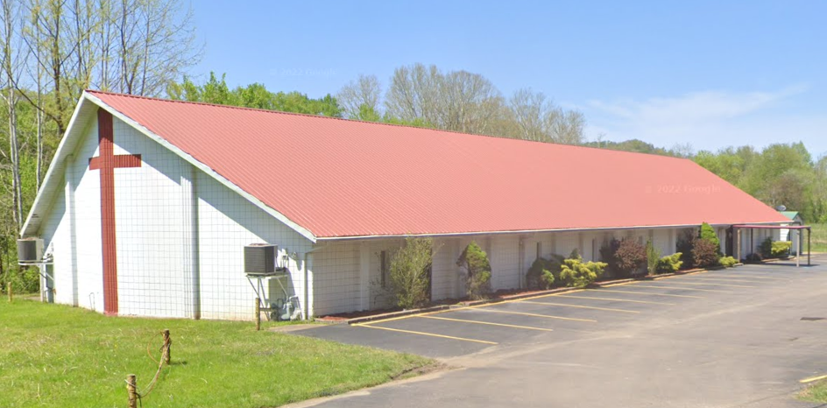
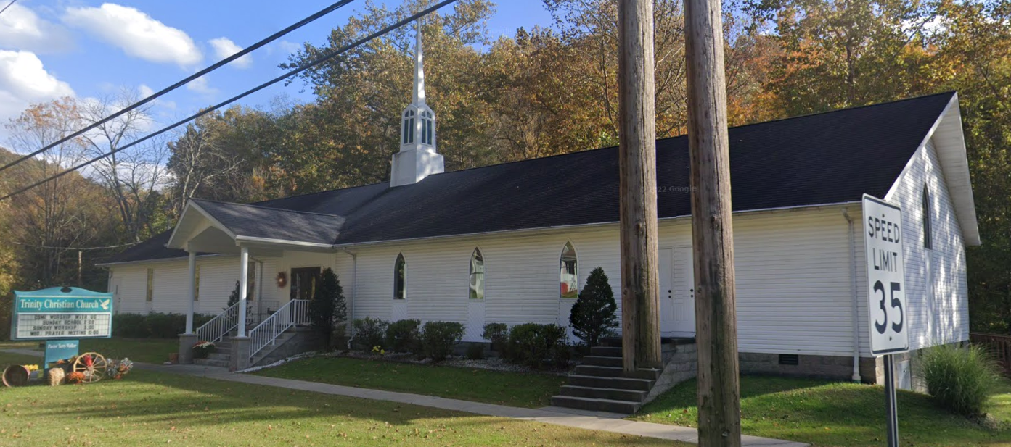
Community Assets in Lower Kanawha Watershed
Ranked by Flood Depth
Rank | Building ID | Facility Name | Facility Type | Community Name | County | Building Appraisal¹ | Flood Zone Designation | In Floodway | Stream | Flood Depth | Building Damage Percent | Building Loss USD² | Flood Tool Link
1 | 20-25-0011-0073-0001_6697 | Souls Harvest Church | Religious | Kanawha County* | KANAWHA | $ 541,900 | AE (Floodway) | Yes | Pocatalico River | 12.5 | 22% | $ 116,743 | FT
2 | 20-18-0010-0003-0001_601 | South Charleston Community Center | Government | City of South Charleston | KANAWHA | $ 1,111,400 | Updated AE Floodplain Boundary | No | Kanawha River | 12.0 | 34% | $ 374,324 | FT
3 | 26-09-0001-0012-0000_221 | Leon Baptist Church | Religious | Leon | MASON | $ 128,000 | AE | No | Thirteenmile Creek | 10.2 | 15% | $ 18,888 | FT
4 | 20-25-0011-0016-0001_6488 | Baber Agee United Methodist Church | Religious | Kanawha County* | KANAWHA | $ 116,160 | AE | No | Rocky Fork | 10.1 | 15% | $ 17,798 | FT
5 | 20-18-0009-0012-0000_9999 | South Charleston Sanitary Board | Utilities | South Charleston | KANAWHA | $ 182,160 | AE | No | Kanawha River | 8.6 | 18% | $ 32,951 | FT
6 | 20-24-0020-0010-0000_111 | Victory Church | Religious | Kanawha County* | KANAWHA | $ 17,900 | AE (Floodway) | Yes | Pocatalico River | 8.6 | 15% | $ 2,631 | FT
7 | 20-24-0013-0042-0002_9999 | Baptist Sunlight Church | Religious | Kanawha County* | KANAWHA | $ 60,500 | Updated AE Floodplain Boundary | No | Island Branch | 8.5 | 14% | $ 8,310 | FT
8 | 20-10-0021-0124-0000_2377 | Charleston Baptist Congregation | Religious | Charleston | KANAWHA | $ 27,600 | AE | No | Twomile Creek | 8.1 | 14% | $ 3,773 | FT
9 | 26-08-0001-0060-0000_301 | Victory Apostolic Church | Religious | Henderson | MASON | $ 19,000 | AE | No | Ohio River | 6.9 | 13% | $ 2,420 | FT
10 | 20-19-0004-0137-0002_1128 | Trinity Christian Church | Religious | Kanawha County* | KANAWHA | $ 285,600 | AE (Floodway) | Yes | Davis Creek | 6.6 | 12% | $ 35,469 | FT
¹ Colored cells show building values of greater than $1M. ² Colored cells show building loss of greater than $100K.
Souls Harvest Church in floodway
Trinity Christian Church in floodway

Slide 5
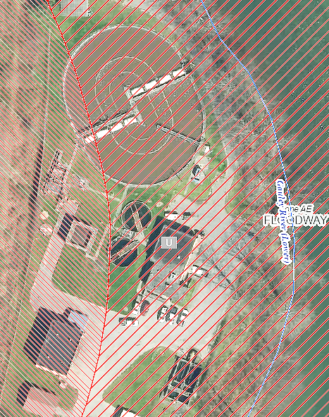
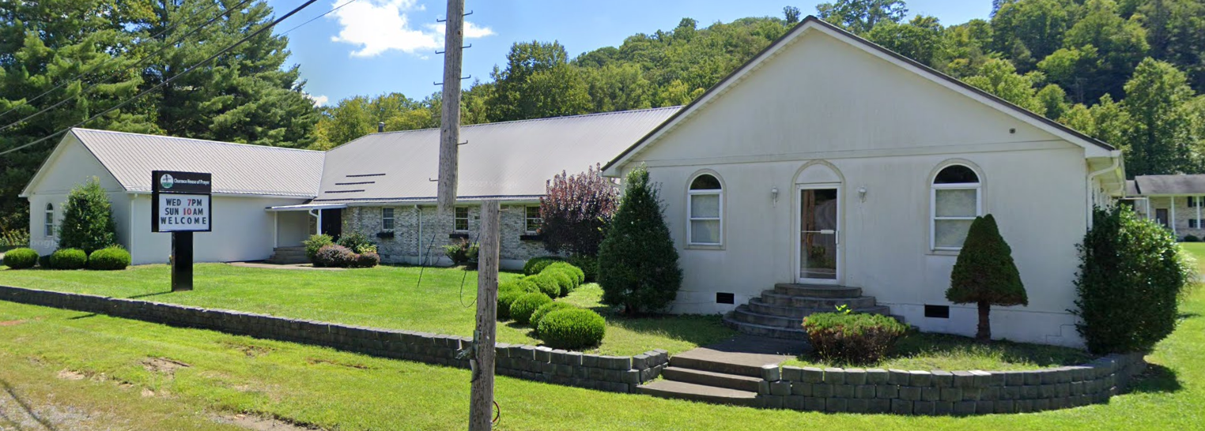
Community Assets in Gauley Watershed
Ranked by Flood Depth
Rank | Building ID | Facility Name | Facility Type | Community Name | County | Building Appraisal | Flood Zone Designation | In Floodway | Stream | Flood Depth | Building Damage Percent | Building Loss USD² | Flood Tool Link
1 | 10-03-010P-0021-0000_2 | First Church of God Alta | Religious | Fayette County* | FAYETTE | $ 27,000 | A | No | Gauley River | 9.3 | 68% | $ 18,424 | FT
2 | 51-01-0003-0001-0002_9842 | Faith Chapel of Camden On Gauley | Religious | Webster County* | WEBSTER | $ 93,600 | AE | No | Gauley River | 8.7 | 14% | $ 13,104 | FT
3 | 13-11-047G-0013-0000_4444 | House of Prayer | Religious | Greenbrier County* | GREENBRIER | $ 250,000 | AE (Floodway) | Yes | Meadow River | 6.4 | 21% | $ 53,000 | FT
4 | 34-02-0013-0088-0000_8225 | Living Word Church | Religious | Nicholas County* | NICHOLAS | $ 60,700 | A | No | Peters Creek | 6.0 | 12% | $ 7,284 | FT
5 | 13-11-048N-0005-0000_5918 | Gordon Freewill Baptist Church | Religious | Greenbrier County* | GREENBRIER | $ 75,000 | AE | No | Meadow River | 5.8 | 12% | $ 9,000 | FT
6 | 13-11-047R-0087-0000_438 | McRoss Baptist Church | Religious | Greenbrier County* | GREENBRIER | $ 75,000 | AE (Floodway) | Yes | Meadow River | 5.6 | 12% | $ 9,000 | FT
7 | 10-01-111D-0002-0000_2199 | Bellwood Baptist Church | Religious | Fayette County* | FAYETTE | $ 179,900 | A | No | Sewell Creek | 5.3 | 12% | $ 21,588 | FT
8 | 51-04-003T-9999-9999_231 | Craigsville Public Service District | Utility | Webster County* | WEBSTER | $ 523,584 | AE (Floodway) | Yes | Gauley River | 5.1 | 29% | $ 150,269 | FT
9 | 51-03-0013-0045-0000_95 | Mountain Markektplace Mission | Religious | Webster County* | WEBSTER | $ 97,800 | AE (Floodway) | Yes | Gauley River (Upper) | 4.8 | 46% | $ 44,604 | FT
10 | 34-02-011A-0016-0000_73 | Pentecostal Holiness Church | Religious | Nicholas County* | NICHOLAS | $ 35,250 | A | No | Peters Creek | 4.0 | 11% | $ 3,878 | FT
² Colored cells show building loss of greater than $100K.
House of Prayer in floodway
Craigsville Public Service District in floodway

Slide 6
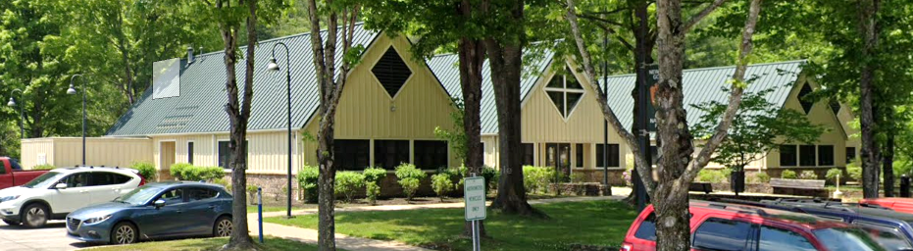
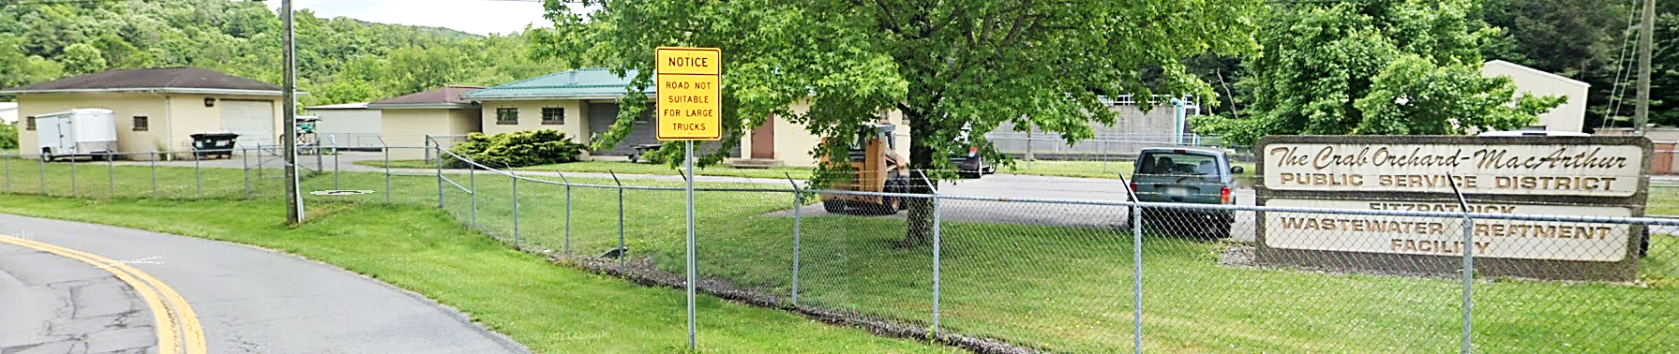
Community Assets in Lower New Watershed
Ranked by Flood Depth
Rank | Building ID | Facility Name | Facility Type | Community Name | County | Building Appraisal¹ | Flood Zone Designation | In Floodway | Stream | Depth Grid | Building Damage Percent | Building Loss USD² | Flood Tool Link
1 | 41-04-0001-0012-0002_127 | Mabscott Holiness Church | Religious | Mabscott | RALEIGH | $ 782,950 | AE | No | Whitestick Creek | 18.2 | 59% | $ 463,883 | FT
2 | 41-08-038A-0053-0000_1400 | Whitby Community Church | Religious | Raleigh County* | RALEIGH | $ 67,230 | AE | No | Spencer Branch | 5.7 | 12% | $ 8,068 | FT
3 | 10-02-037S-0024-0000_42 | United States Department of Interior Office | Government | Fayette County* | FAYETTE | $ 750,000 | A | No | Dunloup Creek | 4.5 | 14% | $ 101,620 | FT
4 | 10-02-037M-0038-0000_23 | New River Gorge Visitor Contact Center | Government | Fayette County* | FAYETTE | $ 611,294 | A | No | Dunloup Creek | 4.4 | 13% | $ 82,063 | FT
5 | 10-02-037M-0028-0000_151 | Glen Jean Union Church | Religious | Fayette County* | FAYETTE | $ 332,840 | A | No | Dunloup Creek | 4.1 | 11% | $ 36,965 | FT
6 | 10-08-0006-0141-0000_264 | First Baptist Church of Mount Hope and McDonald | Religious | Mount Hope | FAYETTE | $ 191,820 | A | No | Dunloup Creek | 3.4 | 11% | $ 21,100 | FT
7 | 41-11-0029-0017-0001_900 | Crab Orchard MacArthur PSD Wastewater Treatment Plant | Utility | Raleigh County* | RALEIGH | $ 1,400,000 | AE | No | Piney Creek | 3.3 | 18% | $ 250,271 | FT
8 | 10-02-053K-0021-0000_685 | Apostolic Pentecoastal of Mount Hope | Religious | Fayette County* | FAYETTE | $ 175,480 | A | No | Dunloup Creek | 3.1 | 11% | $ 19,303 | FT
9 | 41-08-1003-0109-0001_124 | Beaver Church Of God | Religious | Raleigh County* | RALEIGH | $ 497,530 | AE | No | Beaver Creek | 3.0 | 11% | $ 54,685 | FT
10 | 41-11-0034-0108-0001_505 | Crab Orchard-Mac Arthur PSD | Utility | Raleigh County* | RALEIGH | $ 26,000 | AE | No | Crab Orchard Creek | 2.1 | 11% | $ 2,937 | FT
¹ Colored cells show building values of greater than $1M.
² Colored cells show building loss of greater than $100K.
United States Department of Interior Office
Crab Orchard MacArthur PSD Wastewater Treatment Plant

