Slide 1
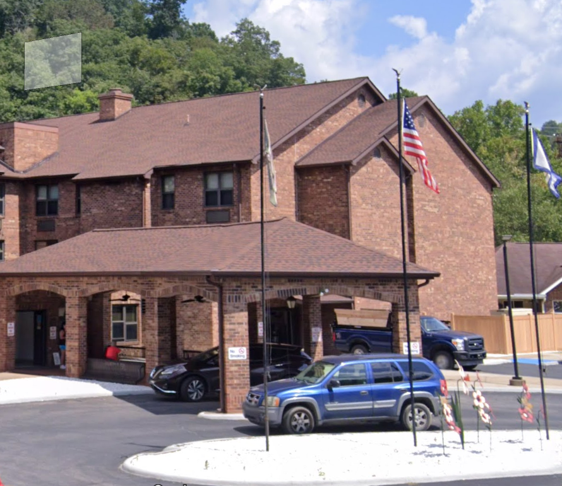
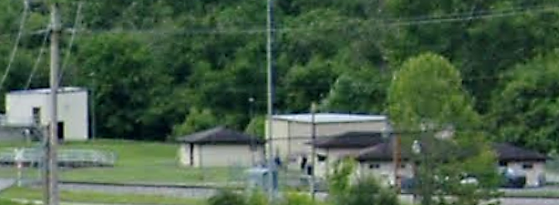
Community Assets in Coal Watershed
Ranked by Damage Loss
Rank by damage Loss | Building ID | Facility Name | Facility Type | Community Name | County | Building Appraisal¹ | Flood zone Designation | In Floodway | Stream | Building Damage Percent | Building Loss USD² | Flood Tool Link
1 | 03-05-0012-0065-0002_1 | Donald R. Kuhn Juvenile Center | Government | Boone County* | Boone | $4,527,900 | AE | No | Little Coal River | 14% | $633,906 | FT
2 | 22-09-016A-0008-0001_177 | McCorkle Free Will Baptist Church | Religious | Lincoln County* | Lincoln | $1,856,300 | A | No | Cobb Creek | 11% | $204,193 | FT
3 | 03-04-0023-0073-0000_23967 | Peytona Church of Christ | Religious | Boone County* | Boone | $1,516,743 | AE | No | Big Coal River | 11% | $172,909 | FT
4 | 03-02-0001-0001-0000_822 | Housing Authority of Boone County | Government | Town of Danville | Boone | $1,854,600 | AE (Floodway) | Yes | Little Coal River | 9% | $165,871 | FT
5 | 03-05-0017-0008-0000_822 | Danville Wastewater Treatment Plant | Utilities | Boone County* | Boone | $1,500,000 | AE (Floodway) | Yes | Little Coal River | 10% | $150,052 | FT
6 | 03-02-0001-0002-0000_768 | Madison Danville Community Center | Government | Town of Danville | Boone | $413,800 | AE (Floodway) | Yes | Little Coal River | 16% | $64,799 | FT
7 | 20-16-0005-0072-0000_2550 | Browns Creek Church of God | Religious | Kanawha County* | Kanawha | $511,240 | A | No | Browns Creek | 10% | $51,635 | FT
8 | 20-28-0030-9999-9999_41 | Emmons Church of God | Religious | Kanawha County* | Kanawha | $457,715 | AE | No | Big Coal River | 10% | $47,602 | FT
9 | 03-05-0012-0058-0002_180 | Lory Baptist Church | Religious | Boone County* | Boone | $295,220 | AE (Floodway) | Yes | Little Coal River | 15% | $45,472 | FT
10 | 03-05-0023-0080-0026_174 | Hope Gas | Utilities | Boone County* | Boone | $133,900 | AE | No | Little Coal River | 29% | $38,162 | FT
¹ Colored cells show building values of greater than $1M. ² Colored cells show building loss of greater than $100K.
03-02-0001-0001-0000_822
Housing Authority of Boone County
03-05-0017-0008-0000_822
Danville Wastewater Treatment Plant

Slide 2
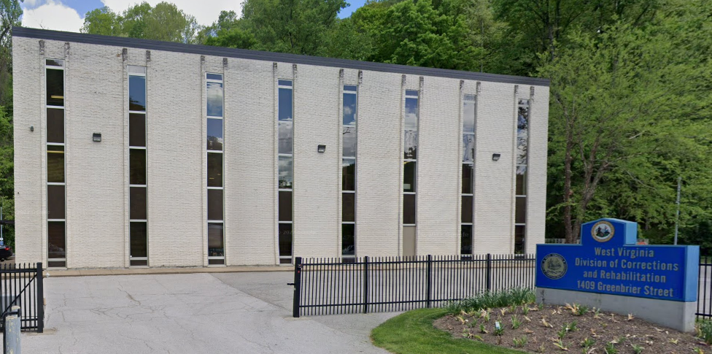
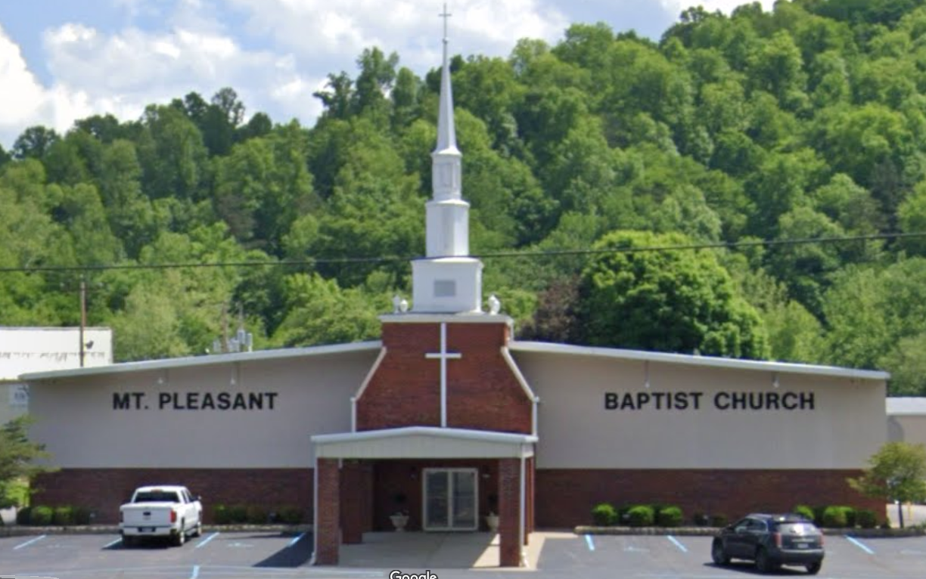
Community Assets in Elk Watershed
Ranked by Damage Loss
Rank by Damage Loss | Building ID | Facility Name | Facility Type | Community Name | County | Building Appraisal¹ | Flood zone Designation | In Floodway | Stream | Building Damage Percent | Building Loss USD² | Flood Tool Link
1 | 20-10-0059-0028-0000_1409 | WV Department of Corrections and Rehabilitation | Government | City of Charleston | Kanawha | $1,547,200 | AE (Floodway) | Yes | Elk Twomile Creek | 12% | $180,849 | FT
2 | 20-15-023B-0063-0000_58 | Mt. Pleasant Baptist Church | Religious | Kanawha County* | Kanawha | $889,870 | AE | No | Elk River | 12% | $103,225 | FT
3 | 20-02-0007-0004-0003_107 | Kanawha County Public Library - Clendenin Branch | Government | Town of Clendenin | Kanawha | $291,447 | AE | No | Elk River | 29% | $84,344 | FT
4 | 20-02-0007-0007-0000_121 | Clendenin United Methodist Church | Religious | Town of Clendenin | Kanawha | $421,900 | AE | No | Elk River | 13% | $55,101 | FT
5 | 20-02-0007-0004-0002_105 | Kanawha County Emergency Ambulance Authority | EMS | Town of Clendenin | Kanawha | $87,100 | AE | No | Elk River | 62% | $52,739 | FT
6 | 20-01-024B-0039-0001_5564 | Falling Rock Gospel Tabernacle | Religious | Kanawha County* | Kanawha | $350,300 | Preliminary Flood Zone (AE) | No | Elk River | 14% | $50,122 | FT
7 | 20-02-0006-0008-0000_500 | Clendenin First Baptist Church | Religious | Town of Clendenin | Kanawha | $309,200 | AE | No | Elk River | 14% | $43,288 | FT
8 | 20-02-0002-0082-0000_8673 | Clendenin Advent Christian Church | Religious | Town of Clendenin | Kanawha | $253,400 | AE | No | Elk River | 14% | $35,692 | FT
9 | 20-02-0007-0034-0000_101 | Clendenin Community Center | Government | Town of Clendenin | Kanawha | $200,000 | AE | No | Elk River | 16% | $31,886 | FT
10 | 20-02-0002-0072-0000_2 | Advent Christian Fellowship Hall | Religious | Town of Clendenin | Kanawha | $186,800 | AE | No | Big Sandy Creek | 14% | $25,377 | FT
¹ Colored cells show building values of greater than $1M. ² Colored cells show building loss of greater than $100K.
20-15-023B-0063-0000_58
03-02-0001-0001-0000_822
Housing Authority of Boone County
Mt. Pleasant Baptist Church

Slide 3
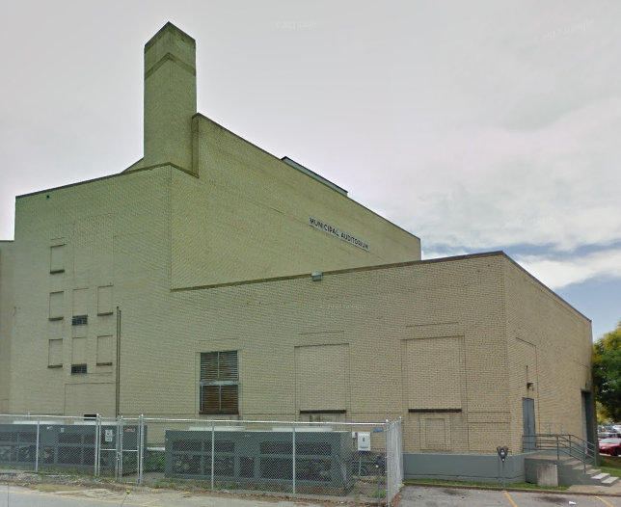
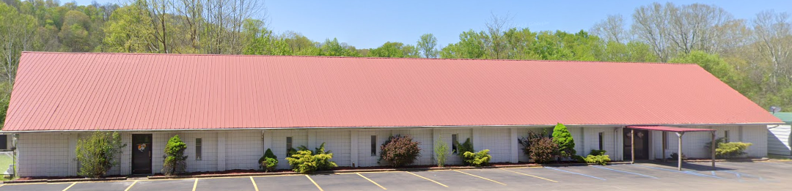
Community Assets in Lower Kanawha Watershed
Ranked by Damage Loss
Rank by Damage Loss | Building ID | Facility Name | Facility Type | Community Name | County | Building Appraisal¹ | Flood zone Designation | In Floodway | Stream | Building Damage Percent | Building Loss USD² | Flood Tool Link
1 | 20-11-0003-0011-0000_224 | Municipal Auditorium | Government | City of Charleston | Kanawha | $1,858,370 | AE | No | Kanawha River | 9% | $171,848 | FT
2 | 20-12-0009-0007-0000_2009 | North Charleston Community Center | Government | City of Charleston | Kanawha | $3,111,900 | AE | No | Kanawha River | 5% | $160,034 | FT
3 | 20-12-0028-0073-0000_900 | West Virginia Lottery | Government | City of Charleston | Kanawha | $20,186,220 | AE | No | Kanawha River | 1% | $131,068 | FT
4 | 20-11-0004-0004-0005_3009 | United States Postal Service | Government | City of Charleston | Kanawha | $44,331,800 | AE | No | Kanawha River | 0% | $130,636 | FT
5 | 20-16-008A-0057-0001_2910 | Maranatha Fellowship | Religious | Kanawha County* | Kanawha | $1,227,000 | AE | No | Two and Three Quarter Mile Creek | 10% | $126,149 | FT
6 | 20-25-0011-0073-0001_6697 | Souls Harvest Church | Religious | Kanawha County* | Kanawha | $541,900 | AE (Floodway) | Yes | Pocatalico River | 22% | $116,743 | FT
7 | 40-13-0004-0014-0007_10822 | Winfield Church of the Nazarene | Religious | Town of Winfield | Putnam | $993,100 | AE | No | Kanawha River | 11% | $109,799 | FT
8 | 44-09-0009-0005-0000_5462 | Walton PSD Water Treatment Plant | Utilities | Roane County* | Roane | $1,000,000 | A | No | Silcott Fork | 6% | $58,824 | FT
9 | 18-07-0053-0023-0000_416 | Fisher Chapel | Religious | Kanawha County* | Kanawha | $420,400 | Advisory A | No | Middle Fork | 10% | $44,612 | FT
10 | 20-27-0010-0191-0000_402 | Bridge of Faith Fellowship | Religious | City of Nitro | Kanawha | $386,100 | AE | No | Kanawha River | 11% | $42,471 | FT
¹ Colored cells show building values of greater than $1M. ² Colored cells show building loss of greater than $100K.
20-11-0003-0011-0000_224
Municipal Auditorium
20-25-0011-0073-0001_6697
Souls Harvest Church

Slide 4
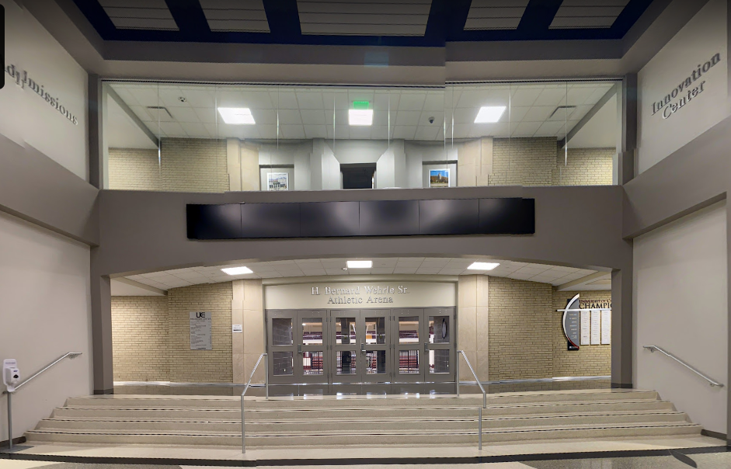
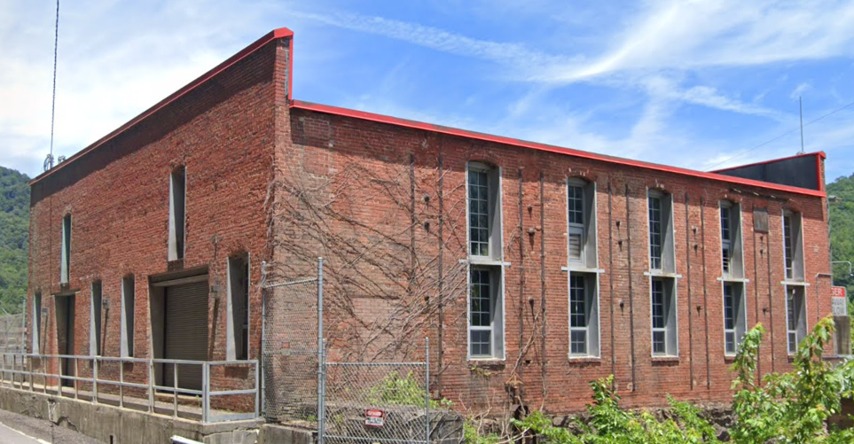
Community Assets in Upper Kanawha Watershed
Ranked by Damage Loss
Rank by Damage Loss | Building ID | Facility Name | Facility Type | Community Name | County | Building Appraisal¹ | Flood zone Designation | In Floodway | Stream | Building Damage Percent | Building Loss USD² | Flood Tool Link
1 | 20-13-0002-0006-0000_2300B | Gorman Physical Education Building | Education | City of Charleston | Kanawha | $2,824,170 | AE | No | Kanawha River | 9% | $254,175 | FT
2 | 20-23-017D-0037-0000_320 | Springfork Missionary Baptist Church | Religious | Kanawha County* | Kanawha | $552,500 | AE | No | Campbells Creek | 10% | $56,788 | FT
3 | 20-05-0004-0079-0000_208 | United States Postal Service | Government | Town of East Bank | Kanawha | $122,400 | Updated AE Floodplain Boundary | No | East Bank Tributary | 35% | $42,349 | FT
4 | 10-11-0004-0139-0000_232 | Smithers Church of God | Religious | Town of Smithers | Fayette | $373,840 | AE | No | Smithers Creek | 11% | $41,122 | FT
5 | 20-23-017L-0028-0000_543 | Campbells Creek Church of the Nazarene | Religious | Kanawha County* | Kanawha | $276,500 | AE | No | Campbells Creek | 11% | $29,937 | FT
6 | 10-11-0002-0001-0000_684 | Carbondale Baptist Church | Religious | Town of Smithers | Fayette | $264,410 | AE | No | Smithers Creek | 10% | $27,499 | FT
7 | 10-02-051B-0026-0000_86 | Weirwood Chapel | Religious | Fayette County* | Fayette | $237,920 | Advisory A | No | Paint Creek | 11% | $26,171 | FT
8 | 20-03-040C-0008-0000_87 | Old Glory Freewill Baptist Church | Religious | Kanawha County* | Kanawha | $193,945 | AE (Floodway) | Yes | Fields Creek | 13% | $25,989 | FT
9 | 10-03-0030-0019-0000_8874 | State of West Virginia Department of Natural Resources Facility | Government | Fayette County* | Fayette | $197,165 | AE (Floodway) | Yes | Kanawha River | 13% | $25,829 | FT
10 | 20-03-0059-0002-0001_6364 | Church of God of Prophecy | Religious | Kanawha County* | Kanawha | $236,817 | AE | No | Cabin Creek | 10% | $24,629 | FT
¹ Colored cells show building values of greater than $1M. ² Colored cells show building loss of greater than $100K.
10-03-0030-0019-0000_8874
State of West Virginia Department of Natural Resources Facility
20-13-0002-0006-0000_2300B
Gorman Physical Education Building

Slide 5
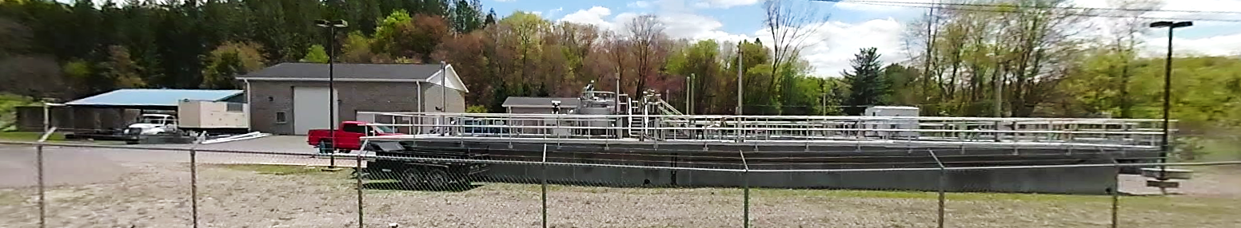
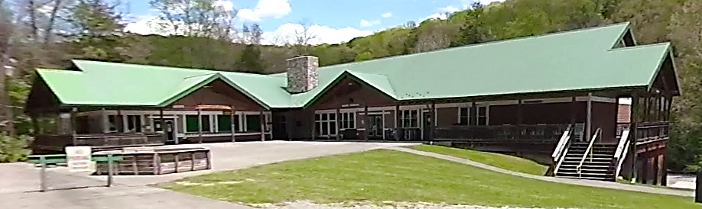
Community Assets in Gauley Watershed
Ranked by Damage Loss
Rank | Building ID | Facility Name | Facility Type | Community Name | County | Building Appraisal | Flood Zone Designation | In Floodway | Stream | Building Damage Percent | Building Loss USD | Flood Tool Link
1 | 51-04-005S-0020-0000_272 | West Virginia Baptist Camp | Religious | Webster* | WEBSTER | $ 2,157,500 | AE (Floodway) | Yes | Gauley River (Upper) | 11% | $ 237,325 | FT
2 | 51-04-004R-0064-0002_7385 | Cowen Public Service District Wastewater Treatment Plant | Utility | Webster* | WEBSTER | $ 7,000,000 | AE | No | Big Ditch Run | 2% | $ 154,919 | FT
3 | 51-04-003T-9999-9999_231 | Craigsville Public Service District | Utility | Webster* | WEBSTER | $ 523,584 | AE (Floodway) | Yes | Gauley River | 29% | $ 150,269 | FT
4 | 13-11-047G-0013-0000_4444 | House of Prayer | Religious | Greenbrier* | GREENBRIER | $ 250,000 | AE (Floodway) | Yes | Meadow River | 21% | $ 53,000 | FT
5 | 51-03-0013-0045-0000_95 | Mountain Markektplace Mission | Religious | Webster* | WEBSTER | $ 97,800 | AE (Floodway) | Yes | Gauley River (Upper) | 46% | $ 44,604 | FT
6 | 34-01-0018-0027-0000_317 | Zion's Rest Primitive Baptist Church | Religious | Nicholas* | NICHOLAS | $ 276,450 | A | No | Big Beaver Creek | 10% | $ 27,645 | FT
7 | 13-13-0005-0366-0000_373 | Greenbrier Ave Church of God | Religious | Rainelle | GREENBRIER | $ 435,000 | Preliminary AE | No | Little Sewell Creek | 5% | $ 21,750 | FT
8 | 10-01-111D-0002-0000_2199 | Bellwood Baptist Church | Religious | Fayette* | FAYETTE | $ 179,900 | A | No | Sewell Creek | 12% | $ 21,588 | FT
9 | 10-03-010P-0021-0000_2 | First Church of God Alta | Religious | Fayette* | FAYETTE | $ 27,000 | A | No | Gauley River | 68% | $ 18,424 | FT
10 | 51-01-0003-0144-0000_9999 | Bethel Methodist Church | Religious | Camden-On-Gauley | WEBSTER | $ 144,700 | Preliminary AE | No | Gauley River | 11% | $ 15,628 | FT
51-04-004R-0064-0002_7385
Cowen Public Service District Wastewater Treatment Plant
51-04-005S-0020-0000_272
West Virginia Baptist Camp

Slide 6
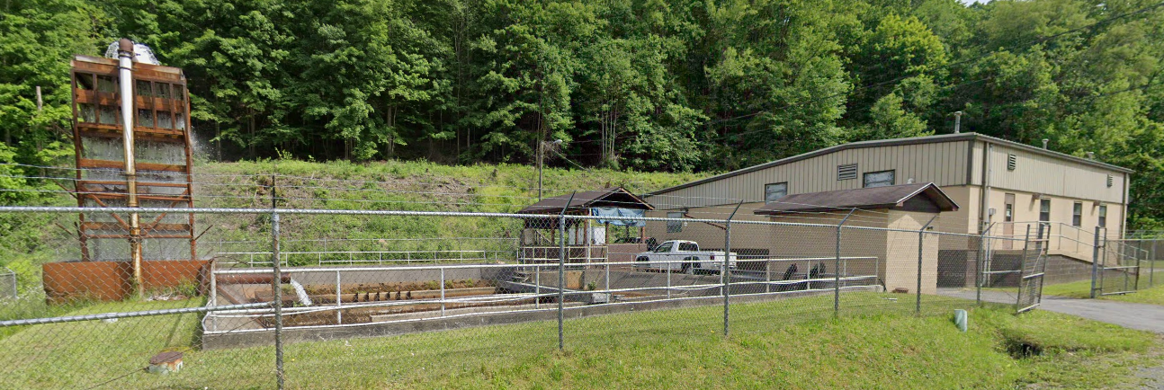
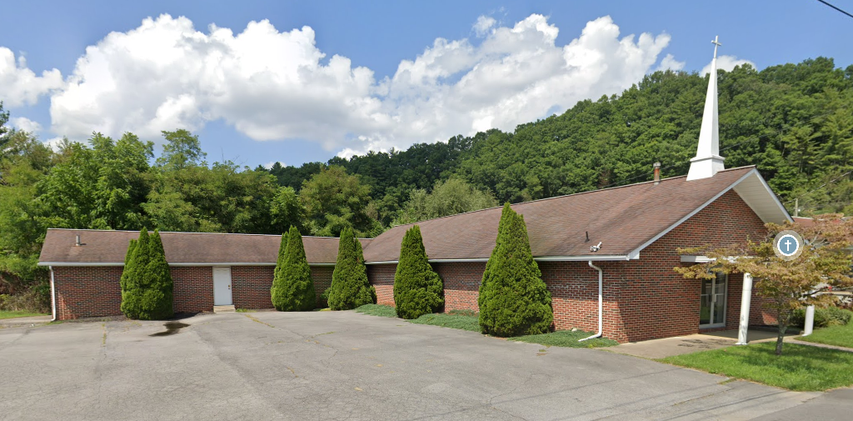
Community Assets in Lower New Watershed
Ranked by Damage Loss
Rank | Building ID | Facility Name | Facility Type | Community Name | County | Building Appraisal¹ | Flood Zone Designation | In Floodway | Stream | Building Damage Percent | Building Loss USD² | Flood Tool Link
1 | 41-04-0001-0012-0002_127 | Mabscott Holiness Church | Religious | Mabscott | RALEIGH | $ 782,950 | AE | No | Whitestick Creek | 59% | $ 463,883 | FT
2 | 41-08-1001-0002-0001_380 | Shady Spring PSD Wastewater Treatment Plant | Utility | Raleigh* | RALEIGH | $ 6,000,000 | AE | No | Piney Creek | 7% | $ 436,143 | FT
3 | 41-11-0029-0017-0001_900 | Crab Orchard MacArthur PSD Wastewater Treatment Plant | Utility | Raleigh* | RALEIGH | $ 1,400,000 | AE | No | Piney Creek | 18% | $ 250,271 | FT
4 | 10-02-037S-0024-0000_42 | United States Department of Interior Office | Government | Fayette* | FAYETTE | $ 750,000 | A | No | Dunloup Creek | 14% | $ 101,620 | FT
5 | 10-02-037M-0038-0000_23 | New River Gorge Visitor Contact Center | Government | Fayette* | FAYETTE | $ 611,294 | A | No | Dunloup Creek | 13% | $ 82,063 | FT
6 | 41-08-1003-0109-0001_124 | Beaver Church Of God | Religious | Raleigh* | RALEIGH | $ 497,530 | AE | No | Beaver Creek | 11% | $ 54,685 | FT
7 | 10-02-037M-0028-0000_151 | Glen Jean Union Church | Religious | Fayette* | FAYETTE | $ 332,840 | A | No | Dunloup Creek | 11% | $ 36,965 | FT
8 | 10-08-0006-0141-0000_264 | First Baptist Church of Mount Hope and McDonald | Religious | Mount Hope | FAYETTE | $ 191,820 | A | No | Dunloup Creek | 11% | $ 21,100 | FT
9 | 10-02-053K-0021-0000_685 | Apostolic Pentecoastal of Mount Hope | Religious | Fayette* | FAYETTE | $ 175,480 | A | No | Dunloup Creek | 11% | $ 19,303 | FT
10 | 10-02-053J-0098-0000_272 | City of Mount Hope Water Treatment Plant | Utility | Fayette* | FAYETTE | $ 3,000,000 | Advisory A | No | Dunloup Creek | 1% | $ 18,066 | FT
¹ Colored cells show building values of greater than $1M. ² Colored cells show building loss of greater than $100K.
10-02-053J-0098-0000_272
City of Mount Hope Water Treatment Plant
41-08-1003-0109-0001_124
Beaver Church Of God

