Slide 1
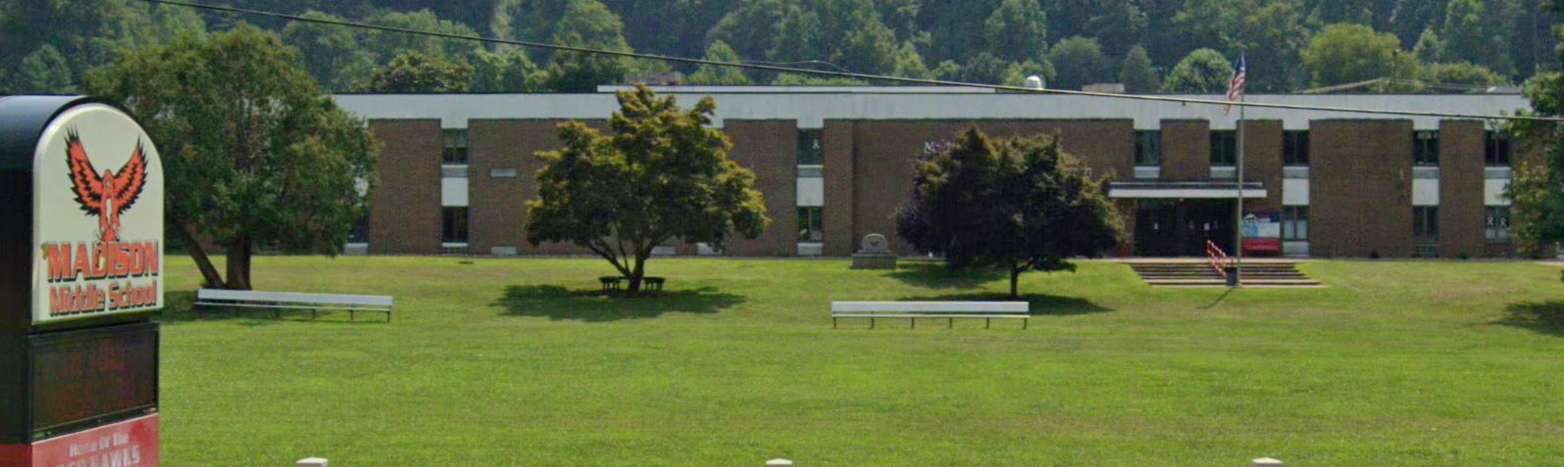
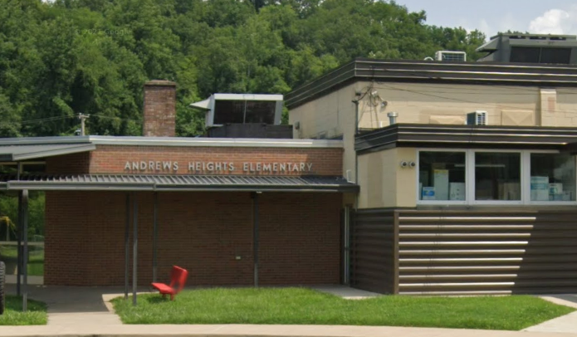
Essential Facilities in Coal Watershed
Ranked by Flood Depth
Rank | Building ID | Facility Name | Facility Type | Community Name | County | Building Appraisal¹ | Flood zone Designation | In Floodway | Stream | Flood Depth | Building Damage Percent | Building Loss USD² | Flood Tool Link
1 | 20-16-012F-0005-0001_7826 | Tornado Volunteer Fire Department | Fire Station | Kanawha County* | KANAWHA | $120,000 | AE | No | Coal River | 10 | 27% | $33,684 | FT
2 | 41-02-0009-0122-0002_4851 | Clear Fork District Elementary School | School | Raleigh County* | RALEIGH | $745,960 | AE | No | Clear Fork | 6 | 15% | $69,112 | FT
3 | 03-08-0026-0082-0000_15908 | Ramage Elementary School | School | Boone County* | BOONE | $1,224,740 | AE (Floodway) | Yes | Spruce Fork | 5 | 10% | $115,906 | FT
4 | 20-16-012F-0005-0000_7776 | Andrews Heights Elementary School | School | Kanawha County* | KANAWHA | $2,754,743 | AE | No | Coal River | 5 | 9% | $247,972 | FT
5 | 03-01-018A-0001-0000_338 | Van Elementary School | School | Boone County* | BOONE | $1,878,640 | AE (Floodway) | Yes | Pond Fork | 4 | 10% | $169,078 | FT
6 | 41-05-0002-0051-0000_11823 | WV State Police Troop 6 - Whitesville Detachment | Police Station | Raleigh County* | RALEIGH | $32,650 | A (Advisory Flood Heights available) | No | Marsh Fork | 4 | 11% | $3,601 | FT
7 | 23-04-0080-0012-0000_25 | Sharples Volunteer Fire Department | Fire Station | Logan County* | LOGAN | $304,314 | A (Advisory Flood Heights available) | No | Spruce Fork | 3 | 9% | $27,084 | FT
8 | 03-03-0003-0063-0000_404 | Madison Middle School | School | Madison | BOONE | $2,901,390 | AE | No | Little Coal River | 3 | 6% | $172,128 | FT
9 | 03-06-0011-0040-0000_9846 | Sherman Junior High School | School | Boone County* | BOONE | $1,257,370 | AE | No | Big Coal Rive | 2 | 1% | $0 | FT
10 | 03-08-026C-0061-0000_620 | Spruce River Volunteer Fire Department | Fire Station | Boone County* | BOONE | $307,500 | Updated AE | No | Hewett Creek | 2 | 2% | $11,145 | FT
¹ Colored cells show building values of greater than $1M. ² Colored cells show building loss of greater than $100K.
03-03-0003-0063-0000_404
Madison Middle School
20-16-012F-0005-0000_7776
Andrews Heights Elementary School

Slide 2
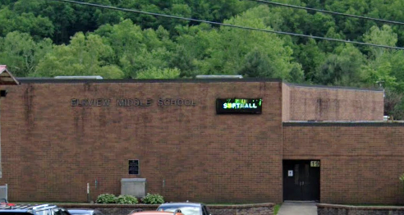
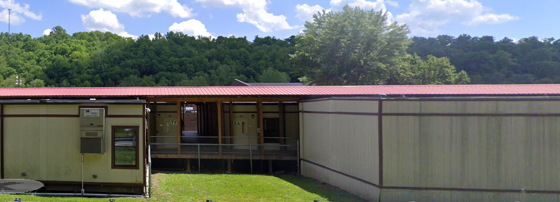
Essential Facilities in Elk Watershed
Ranked by Flood Depth
Rank | Building ID | Facility Name | Facility Type | Community Name | County | Building Appraisal¹ | Flood Zone Designation | In Floodway | Stream | Flood Depth | Building Damage Percent | Building Loss USD² | Flood Tool Link
1 | 20-15-023B-0063-0000_116 | Elk Valley Christian School | School | Elkview | KANAWHA | $615,095 | AE | No | Elk River | 9 | 14% | $86,113 | FT
2 | 20-02-0007-0034-0000_103 | Clendenin Police Department | Police Station | Clendenin | KANAWHA | $185,340 | AE | No | Elk River | 7 | 16.% | $31,886 | FT
3 | 20-02-0007-0040-0000_109 | Clendenin Volunteer Fire Department | Fire Station | Clendenin | KANAWHA | $80,000 | AE | No | Elk River | 7 | 16% | $12,910 | FT
4 | 20-15-0023-0077-0000_5120 | Bridge/Clendenin Elementary School | School | Kanawha County* | KANAWHA | $1,904,230 | AE (Floodway) | Yes | Elk River | 4 | 9% | $171,381 | FT
5 | 20-15-023A-0081-0000_902 | Kanawha County Sheriff's Office - Elkview Detachment | Police Station | Kanawha County* | KANAWHA | $804,700 | AE | Yes | Elk River | 3 | 10% | $81,546 | FT
6 | 51-07-0001-0154-0000_210 | Webster County Office of Emergency Services/ E-911 | 911 Center | Addison | WEBSTER | $124,200 | AE | No | Back Fork Elk River | 2 | 0% | $10,408 | FT
7 | 20-15-0023-0055-0001_5096 | Herbert Hoover High School | School | Kanawha County* | KANAWHA | $3,343,500 | AE | No | Elk River | 2 | 0% | $0 | FT
8 | 20-15-0023-0078-0000_5090 | Elkview Middle School | School | Kanawha County* | KANAWHA | $11,453,001 | AE | No | Elk River | 2 | 3% | $298,978 | FT
9 | 51-04-003L-0083-0000_5675 | Erbacon Volunteer Fire Department | Fire Station | Webster County* | WEBSTER | $180,706 | AE | No | Laurel Creek | 1 | 0% | $1,337 | FT
10 | 08-04-0015-0002-0003_5462 | Big Otter Volunteer Fire Department | Fire Station | Clay County* | CLAY | $264,800 | AE | No | Big Otter Creek | 1 | 8% | $0 | FT
¹ Colored cells show building values of greater than $1M. ² Colored cells show building loss of greater than $100K.
20-15-0023-0055-0001_5096
Herbert Hoover High School
20-15-0023-0078-0000_5090
Elkview Middle School

Slide 3
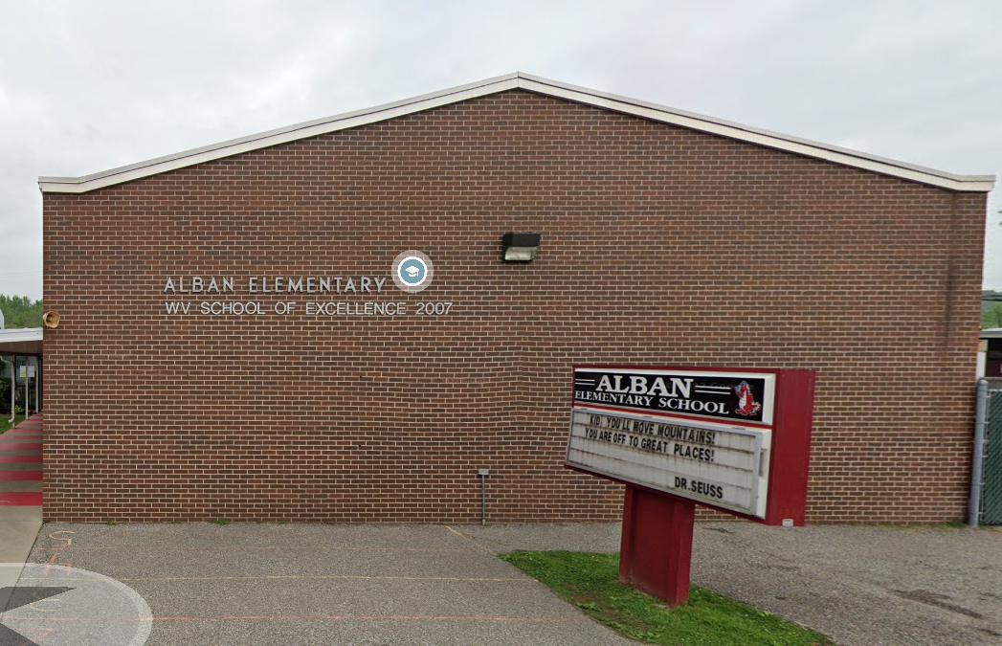
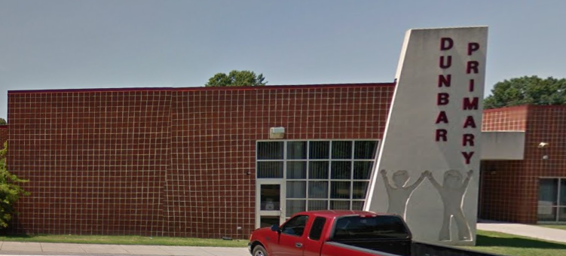
Essential Facilities in Lower Kanawha Watershed
Ranked by Flood Depth
Rank | Building ID | Facility Name | Facility Type | Community Name | County | Building Appraisal¹ | Flood Zone Designation | In Floodway | Stream | Flood Depth | Building Damage Percent | Building Loss USD² | Flood Tool Link
1 | 20-26-0013-0016-0000_907 | Dunbar Fire Department Station 1 | Fire Station | Dunbar | KANAWHA | $90,000 | AE | No | Kanawha River | 8 | 4% | $3,600 | FT
2 | 44-09-0012-0071-0000_90 | Walton Elementary / Middle School | School | Roane County* | ROANE | $6,125,650 | A (Advisory Flood Heights available) | No | Pocatalico River | 5 | 9% | $551,309 | FT
3 | 20-16-008E-0040-0001_6500 | Riverside Health and Rehabilitation Center | Nursing Home | Kanawha County* | KANAWHA | $1,585,400 | AE | No | Kanawha River | 3 | 9% | $117,812 | FT
4 | 20-17-0005-0011-0000_2030 | Alban Elementary School | School | St. Albans | KANAWHA | $3,591,331 | Updated AE | No | Kanawha River | 2 | 1% | $80,939 | FT
5 | 40-09-0009-0013-0000_2461 | Poca Police Department | Police Station | Poca | PUTNAM | $840,000 | Updated AE | No | Kanawha River | 1 | 0% | $0 | FT
6 | 40-11-0151-0049-0005_18988 | Winfield Volunteer Fire Department - Frazier Bottom - Substation | Fire Station | Putnam County* | PUTNAM | $71,700 | AE | No | Kanawha River | 1 | 1% | $1,005 | FT
7 | 40-09-0009-0013-0000_2467 | Poca Volunteer Fire Department | Fire Station | Poca | PUTNAM | $840,000 | Updated AE | No | Kanawha River | 0 | 0% | $0 | FT
8 | 20-24-025C-9999-9999_8324 | Sissonville Elementary School | School | Kanawha County* | KANAWHA | $2,715,412 | AE | No | Pocatalico River | 0 | 0% | $0 | FT
9 | 20-11-0007-0056-0000_501 | Charleston Chief of Police | Police Station | Charleston | KANAWHA | $2,949,500 | Shaded X (500-YR Flood) | No | Kanawha River |  | 0% | $0 | FT
10 | 20-26-0010-0223-0000_2401 | Dunbar Primary School | School | Dunbar | KANAWHA | $4,048,659 | Shaded X (500-YR Flood) | No | Kanawha River |  | 0% | $0 | FT
¹ Colored cells show building values of greater than $1M. ² Colored cells show building loss of greater than $100K.
20-17-0005-0011-0000_2030
Alban Elementary School
20-26-0010-0223-0000_2401
Dunbar Primary School

Slide 4
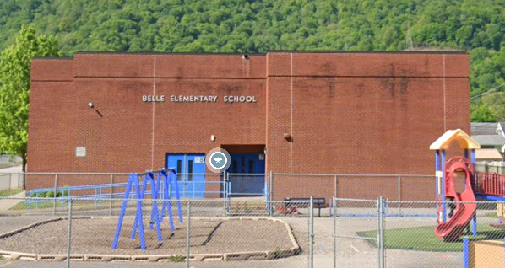
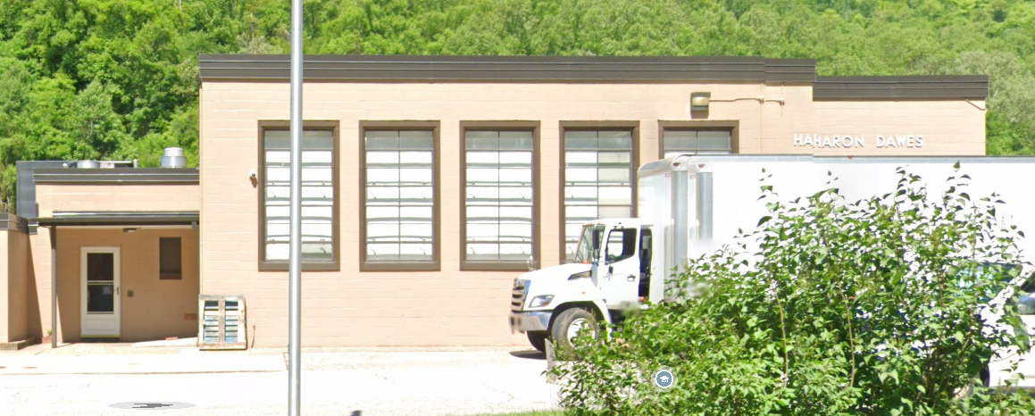
Essential Facilities in Upper Kanawha Watershed
Ranked by Flood Depth
Rank | Building ID | Facility Name | Facility Type | Community Name | County | Building Appraisal | Flood Zone Designation | In Floodway | Stream | Flood Depth | Building Damage Percent | Building Loss USD | Flood Tool Link
1 | 20-06-0001-0001-0000_119 | Glasgow Volunteer Fire Department | Fire Station | Glasgow | KANAWHA | $231,674 | AE | No | Kanawha River | 5 | 13% | $27,196 | FT
2 | 20-03-040C-0003-0001_17 | Chesapeake Volunteer Fire Department - Substation 2 | Fire Station | Kanawha County* | KANAWHA | $38,300 | AE (Floodway) | Yes | Fields Creek | 4 | 11% | $3,918 | FT
3 | 20-03-0026-0029-0001_2208 | Belle Volunteer Fire Department - Substation 2 | Fire Station | Kanawha County* | KANAWHA | $155,730 | AE | No | Kanawha River | 3 | 11% | $15,140 | FT
4 | 20-23-018B-0038-0000_136 | Olive Branch Christian Academy | School | Kanawha County* | KANAWHA | $50,400 | Updated AE | No | Kanawha River | 2 | 3% | $0 | FT
5 | 20-29-0004-0427-0000_708 | Belle Volunteer Fire Department | Fire Station | Belle | KANAWHA | $50,000 | Updated AE | No | Kanawha River | 1 | 3% | $1,272 | FT
6 | 20-29-0004-0345-0000_401 | Belle Elementary School | School | Belle | KANAWHA | $4,177,476 | AE | No | Kanawha River | 1 | 0% | $0 | FT
7 | 20-03-059A-0109-0000_5118 | Sharon Dawes Elementary School | School | Kanawha County* | KANAWHA | $3,310,702 | AE | No | Cabin Creek | 1 | 0% | $0 | FT
8 | 20-05-0004-0126-0000_2507 | East Bank Volunteer Fire Department - Station 12 | Fire Station | East Bank | KANAWHA | $40,000 | Updated AE | No | East Bank Tributary | 1 | 2% | $265 | FT
9 | 20-13-0013-0097-0000_4801 | St. Agnes School | School | Charleston | KANAWHA | $933,416 | Shaded X (500-YR Flood) | No | Kanawha River | 1 | 0% | $0 | FT
10 | 10-03-048C-0023-0000_12490 | Covenant Promise Christian Academy | School | Fayette County* | FAYETTE | $490,100 | A (Advisory Flood Heights available) | No | Loop Creek | 1 | 0% | $0 | FT
20-29-0004-0345-0000_401
Belle Elementary School
20-03-059A-0109-0000_5118
Sharon Dawes Elementary School

Slide 5
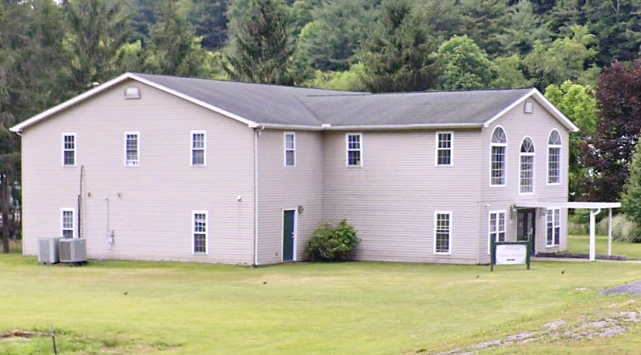
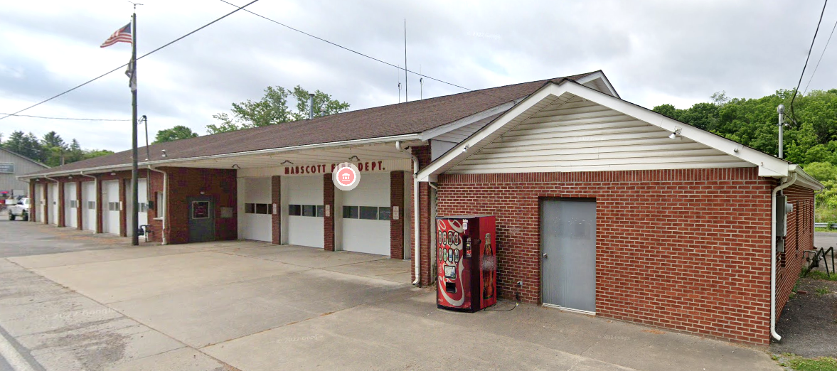
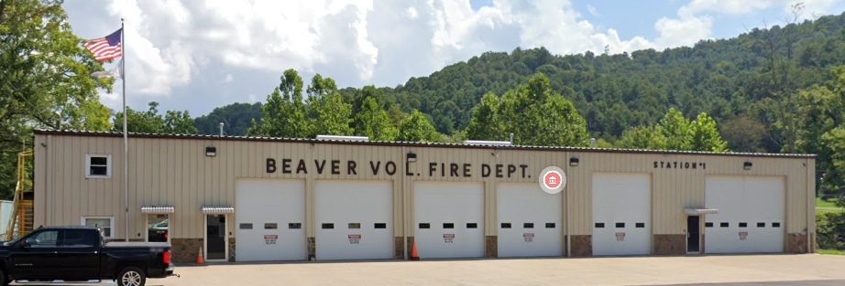
Essential Facilities in Lower New Watershed
Ranked by Flood Depth
Rank | Building ID | Facility Name | Facility Type | Community Name | County | Building Appraisal | Flood Zone Designation | In Floodway | Stream | Flood Depth | Building Damage Percent | Building Loss USD | Flood Tool Link
1 | 41-04-0001-0021-0000_103 | Mabscott Christian Academy | School | Mabscott | RALEIGH | $480,400 | AE | No | Whitestick Creek | 15 | 44% | $210,593 | FT
2 | 41-04-0002-0026-0000_407 | Mabscott Volunteer Fire Department | Fire Department | Mabscott | RALEIGH | $77,660 | AE | No | Whitestick Creek | 4 | 10% | $8,143 | FT
3 | 41-08-1003-0108-0000_147 | Beaver Volunteer Fire Department Station 1 | Fire Department | Raleigh County* | RALEIGH | $566,280 | AE | No | Beaver Creek | 3 | 11% | $62,285 | FT
41-04-0001-0021-0000_103
Mabscott Christian Academy
41-04-0002-0026-0000_407
Mabscott Volunteer Fire Department
8-1003-0108-0000_147
Beaver Volunteer Fire Department Station 1

Slide 6
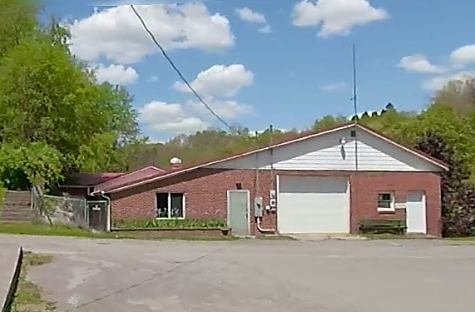
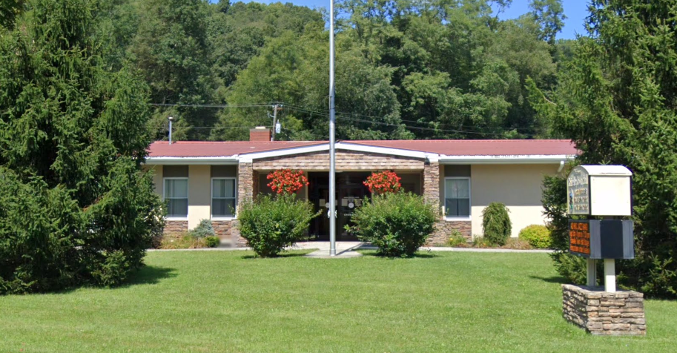
Essential Facilities in Gauley Watershed
Rank | Building ID | Facility Name | Facility Type | Community Name | County | Building Appraisal¹ | Flood Zone Designation | In Floodway | Stream | Flood Depth | Building Damage Percent | Building Loss USD | Flood Tool Link
1 | 51-01-0003-0094-0000_9676 | Camden on Gauley Police Department (Storage Facility) | Police Department | Camden-On-Gauley | Webster | $99,400 | AE | No | Coon Creek | 7 | 25% | $24,850 | FT
2 | 34-06-0005-0419-0000_6 | Richwood Police Department | Police Department | Richwood | NICHOLAS | $172,110 | AE | No | Cherry River | 0 | 0% | $0 | FT
3 | 34-06-0005-0407-0005_12 | WV State Police Troop 6 - Richwood Detachment | Police Department | Richwood | NICHOLAS | $40,660 | X | No | Cherry River |  |  |  | FT
4 | 34-06-0005-0407-0005_10 | Richwood Volunteer Fire Department | Fire Department | Richwood | NICHOLAS | $701,110 | AE | No | Cherry River | 0 | 0% | $0 | FT
5 | 10-03-011A-0009-0000_454 | Gauley River Volunteer Fire Department | Fire Department | Fayette County* | FAYETTE | $58,890 | A | No | Gauley River |  |  |  | FT
6 | 13-13-0005-0424-0000_212 | Rainelle Volunteer Fire Department | Fire Department | Rainelle | GREENBRIER | $63,400 | AE | No | Sewell Creek | 0 | 0% | $0 | FT
7 | 51-02-0004-0035-0000_25 | Glade Elementary School | School | Cowen | WEBSTER | $3,514,000 | A | No | Big Ditch Run |  |  |  | FT
8 | 13-13-0004-0147-0000_1233 | Rainelle Police Department | Police Department | Rainelle | GREENBRIER | $740,578 | X | No | Sewell Creek |  |  |  | FT
¹ Colored cells show building values of greater than $1M.
51-01-0003-0094-0000_9676
Camden on Gauley Police Department (Storage Facility)
13-13-0004-0147-0000_1233
Rainelle Police Department

