Slide 1

WV Social Vulnerability Index
(WV SVI)
West Virginia University WV GIS Technical Center
January 2024

Slide 2
WV Social Vulnerability Index
Major Category | Detailed Category | Code | Indicator | Short Description | Unit
People/ Social Risk | Social Vulnerability | WV_SVI | WV Social Vulnerability Index | Social vulnerability index developed for West Virginia based on eight socioeconomic and demographic indicators | %
Rationale | Recommendations | Data Source
A community with a higher social vulnerability is less likely to be able to recover from a flood disaster quickly and fully. The WV Socioeconomic Index is a combination of eight social and economic indicators to measure a population's vulnerability to flood hazards. The select indicators are economic factors (Poverty Rate Unemployment Rate), population characteristics (Vulnerable Ages Rate, Disability Rate, Population without a High School Diploma, Population Change), and housing (Median Housing Unit Value, Mobile Homes as Percentage of Housing). | Flood disaster planning and preparedness should evaluate socioeconomic and individual factors such as age, disability, education, employment, and housing can influence the risk of flood deaths and damage loss. Source: NIH. A wide range of federal assistance programs for individuals and public infrastructure, including funds for both emergency and permanent work, are available for disadvantaged populations and communities. | Census Bureau’s American Community Survey (ACS) 5-year estimate of 2021; Census Bureau’s Decennial Census (DEC) of 2010 & 2020 (For population change)

Slide 3
WV Social Vulnerability Index; Top 20% Rankings
RANK | All Communities | INDEX_SC | Incorporated Communities | INDEX_SC | Unincorporated Areas | INDEX_SC | Counties | INDEX_SC | Regions | INDEX_SC
1 | Anawalt | 100.0% | Anawalt | 100.0% | McDowell County* | 100.0% | McDowell County, West Virginia | 100.0% | 1 | 100%
2 | War | 99.6% | War | 99.6% | Wyoming County* | 98.1% | Wyoming County, West Virginia | 98.1% | 4 | 90%
3 | McDowell County* | 99.3% | Smithfield | 99.1% | Mingo County* | 96.3% | Mingo County, West Virginia | 96.3% | 2 | 80%
4 | Smithfield | 98.9% | Auburn | 98.7% | Webster County* | 94.4% | Clay County, West Virginia | 94.4%
5 | Lester | 98.6% | Lester | 98.2% | Clay County* | 92.6% | Webster County, West Virginia | 92.6%
6 | Auburn | 98.2% | Reedy | 97.8% | Braxton County* | 90.7% | Calhoun County, West Virginia | 90.7%
7 | Reedy | 97.9% | Matewan | 97.4% | Logan County* | 88.9% | Logan County, West Virginia | 88.9%
8 | Matewan | 97.5% | Clay | 96.9% | Calhoun County* | 87.0% | Braxton County, West Virginia | 87.0%
9 | Wyoming County* | 97.2% | Pax | 96.5% | Boone County* | 85.2% | Ritchie County, West Virginia | 85.2%
10 | Mingo County* | 96.8% | Delbarton | 96.0% | Lincoln County* | 83.3% | Lincoln County, West Virginia | 83.3%
11 | Delbarton | 96.5% | Keystone | 95.6% | Roane County* | 81.5% | Roane County, West Virginia | 81.5%
12 | Clay | 96.1% | Fort Gay | 95.2%
13 | Fort Gay | 95.7% | Northfork | 94.7%
14 | Pax | 95.4% | Quinwood | 94.3%
15 | Keystone | 95.0% | Iaeger | 93.8%
16 | Northfork | 94.7% | Harman | 93.4%
17 | Quinwood | 94.3% | Cowen | 93.0%
18 | Iaeger | 94.0% | Richwood | 92.5%
19 | Webster County* | 93.6% | Elizabeth | 92.1%
20 | Harman | 93.3% | Cameron | 91.6%
21 | Richwood | 92.9% | Grantsville | 91.2%
22 | Logan County* | 92.6% | Gary | 90.7%
23 | Cowen | 92.2% | Junior | 90.3%
24 | Cameron | 91.8% | Oceana | 89.9%
25 | Clay County* | 91.5% | West Hamlin | 89.4%
26 | Grantsville | 91.1% | Bradshaw | 89.0%
27 | Elizabeth | 90.8% | Anmoore | 88.5%
28 | Oceana | 90.4% | Kermit | 88.1%
29 | Sophia | 90.1% | Sophia | 87.7%
30 | West Hamlin | 89.7% | Gilbert | 87.2%
31 | Gary | 89.4% | Chesapeake | 86.8%
32 | Braxton County* | 89.0% | Hillsboro | 86.3%
33 | Kermit | 88.7% | Harrisville | 85.9%
34 | Junior | 88.3% | Danville | 85.5%
35 | Calhoun County* | 87.9% | Spencer | 85.0%
36 | Hillsboro | 87.6% | Rainelle | 84.6%
37 | Gilbert | 87.2% | Bramwell | 84.1%
38 | Bradshaw | 86.9% | Pennsboro | 83.7%
39 | Anmoore | 86.5% | Cairo | 83.3%
40 | Spencer | 86.2% | Womelsdorf (Coalton) | 82.8%
41 | Chesapeake | 85.8% | Pineville | 82.4%
42 | Harrisville | 85.5% | Hartford | 81.9%
43 | Boone County* | 85.1% | Hinton | 81.5%
44 | Danville | 84.8% | Rowlesburg | 81.1%
45 | Pennsboro | 84.4% | Ansted | 80.6%
46 | Womelsdorf (Coalton) | 84.0% | Alderson** | 80.2%
47 | Pineville | 83.7%
48 | Hartford | 83.3%
49 | Rowlesburg | 83.0%
50 | Hinton | 82.6%
51 | Bramwell | 82.3%
52 | Alderson** | 81.9%
53 | Lincoln County* | 81.6%
54 | Rainelle | 81.2%
55 | Sutton | 80.9%
56 | Davy | 80.5%
57 | Beverly | 80.1%
Colors:
Black --> Incorporated areas Brown --> Unincorporated areas Green --> Counties (Total) Red --> Split communities Blue --> Incorporated communities participating in the National Flood Insurance Program (NFIP) with no regulatory Special Flood Hazard Area (SFHA) Purple --> Incorporated communities with no regulatory Special Flood Hazard Area (SFHA) not participating in the National Flood Insurance Program (NFIP) (not mentioned in the FEMA's Community Status Book Report)
Black on blue: Six incorporated communities included in the detailed risk study (Camden-on-Gauley, Clendenin, Rainelle, Richwood, White Sulphur Springs, and Marlinton)

Slide 4
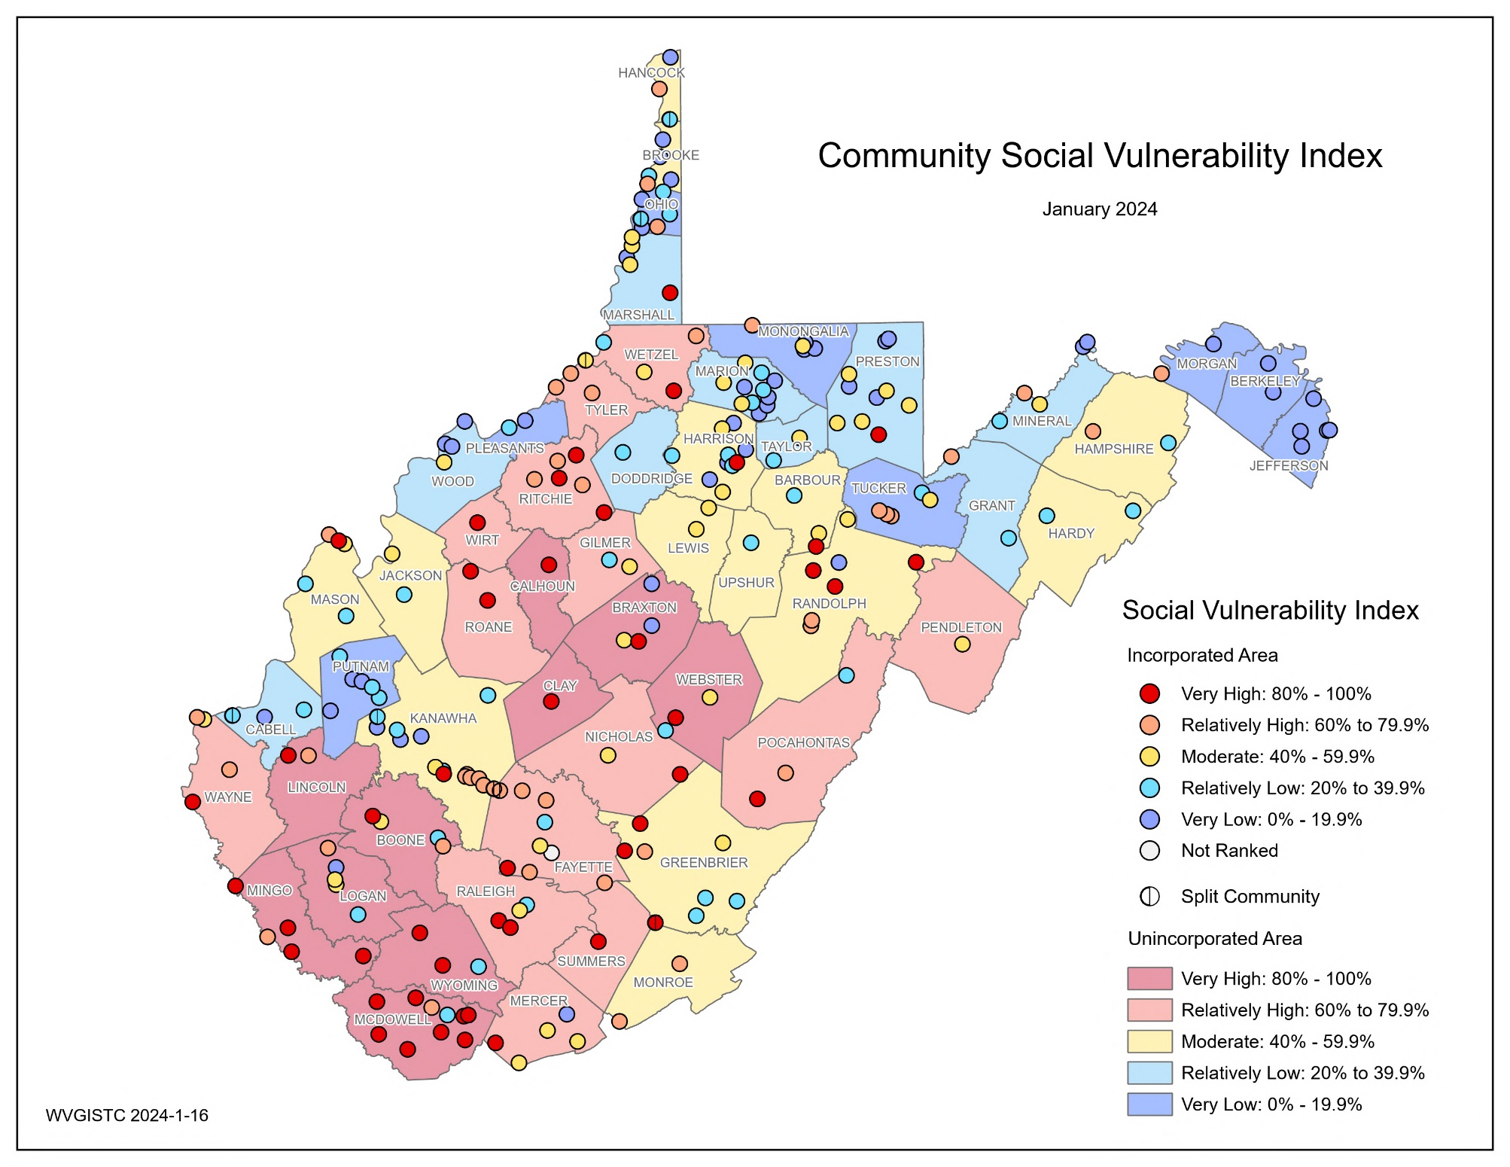
WV Social Vulnerability Index; Maps
Top 5 Communities | County | RPDC Region | WV SVI
Anawalt | McDowell | 1 | 100.0%
War | McDowell | 1 | 99.6%
McDowell County* | McDowell | 1 | 99.3%
Smithfield | Wetzel | 10 | 98.9%
Lester | Raleigh | 1 | 98.6%
* Unincorporated area

Slide 5
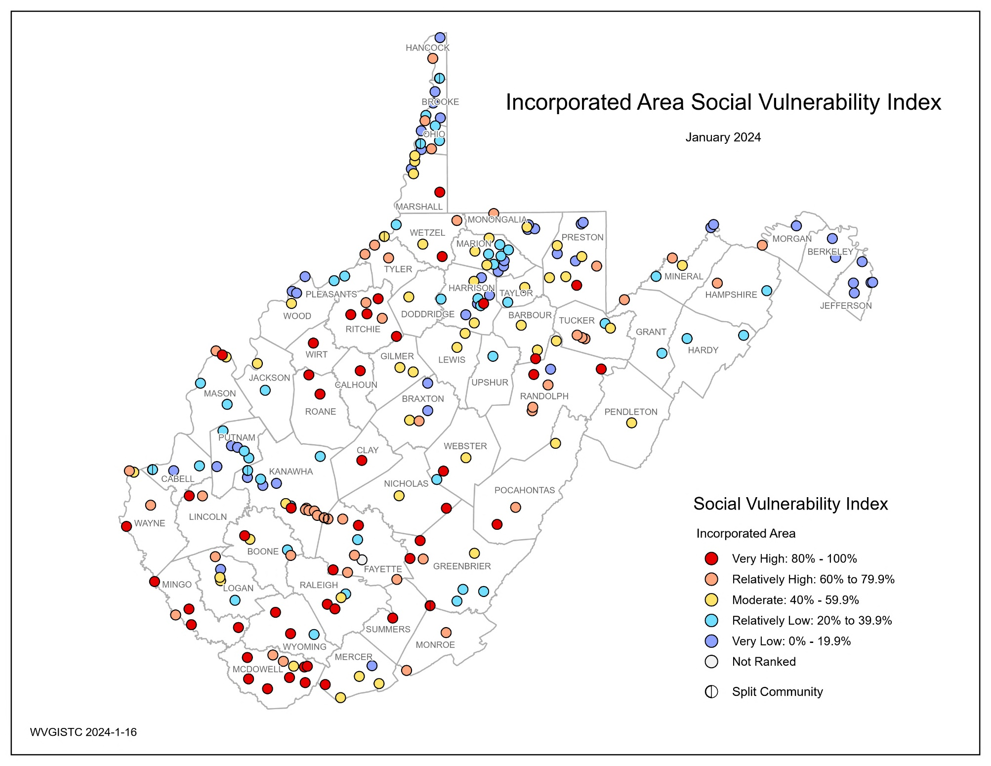
WV Social Vulnerability Index; Maps
Top 5 Incorporated Communities | County | RPDC Region | WV SVI
Anawalt | McDowell | 1 | 100.0%
War | McDowell | 1 | 99.6%
Smithfield | Wetzel | 10 | 99.1%
Auburn | Ritchie | 5 | 98.7%
Lester | Raleigh | 1 | 98.2%

Slide 6
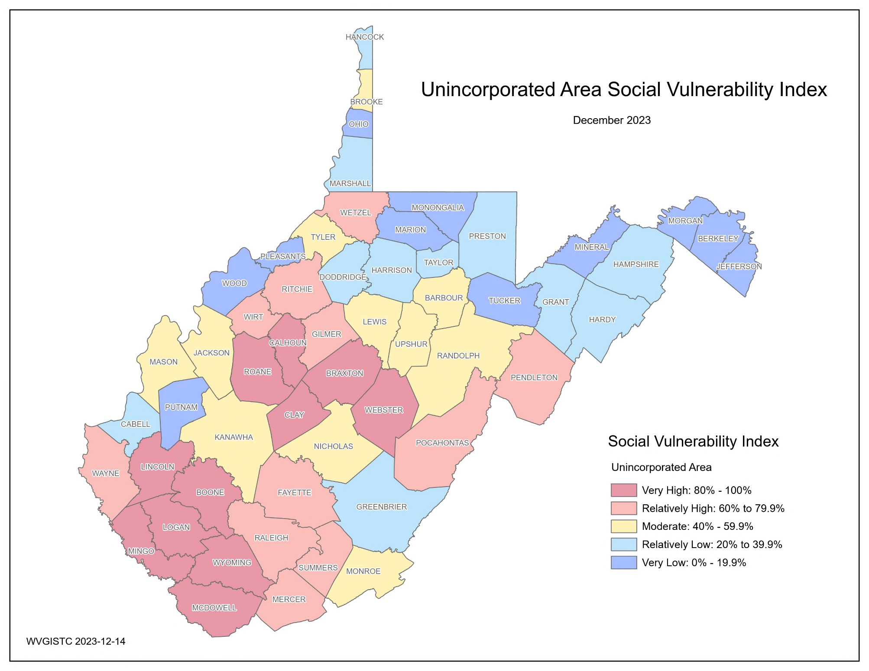
WV Social Vulnerability Index; Maps
Top 5 Unincorporated Communities | RPDC Region | WV SVI
McDowell | 1 | 100.0%
Wyoming | 1 | 98.1%
Mingo | 2 | 96.3%
Webster | 4 | 94.4%
Clay | 3 | 92.6%

Slide 7
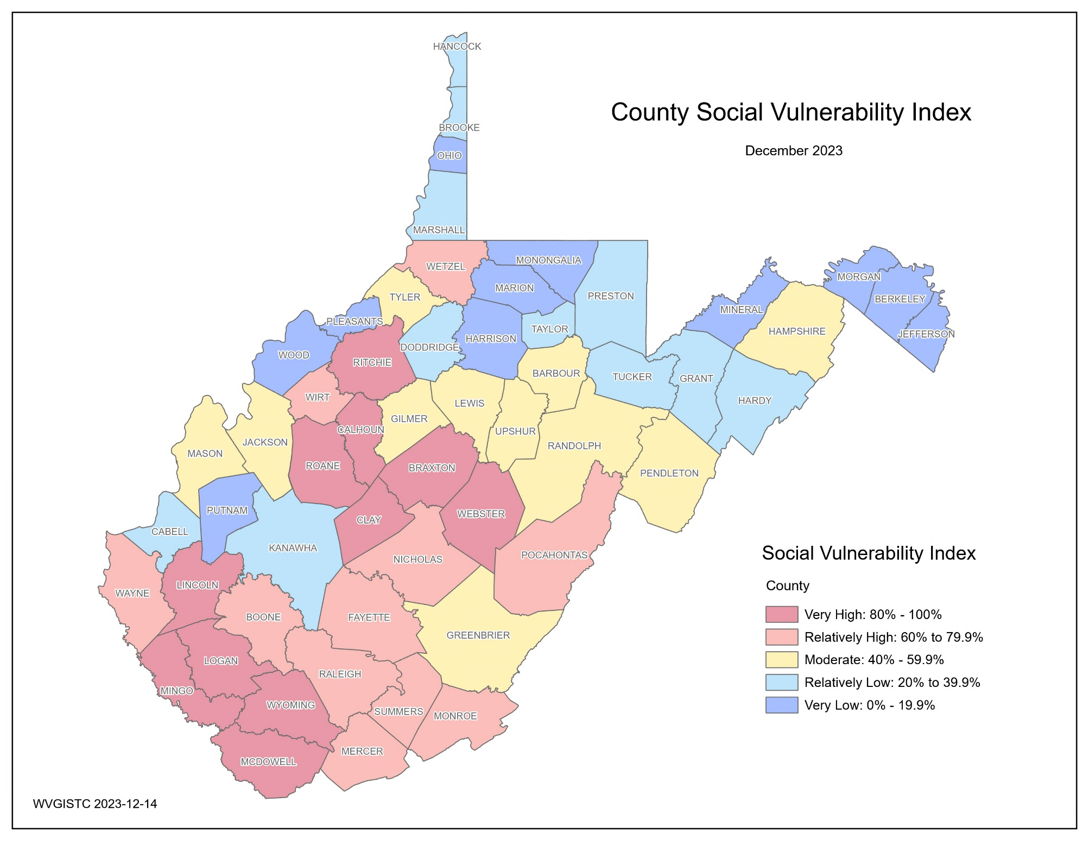
WV Social Vulnerability Index; Maps
Top 5 Counties | RPDC Region | WV SVI
McDowell | 1 | 100.0%
Wyoming | 1 | 98.1%
Mingo | 2 | 96.3%
Clay | 3 | 94.4%
Webster | 4 | 92.6%

Slide 8
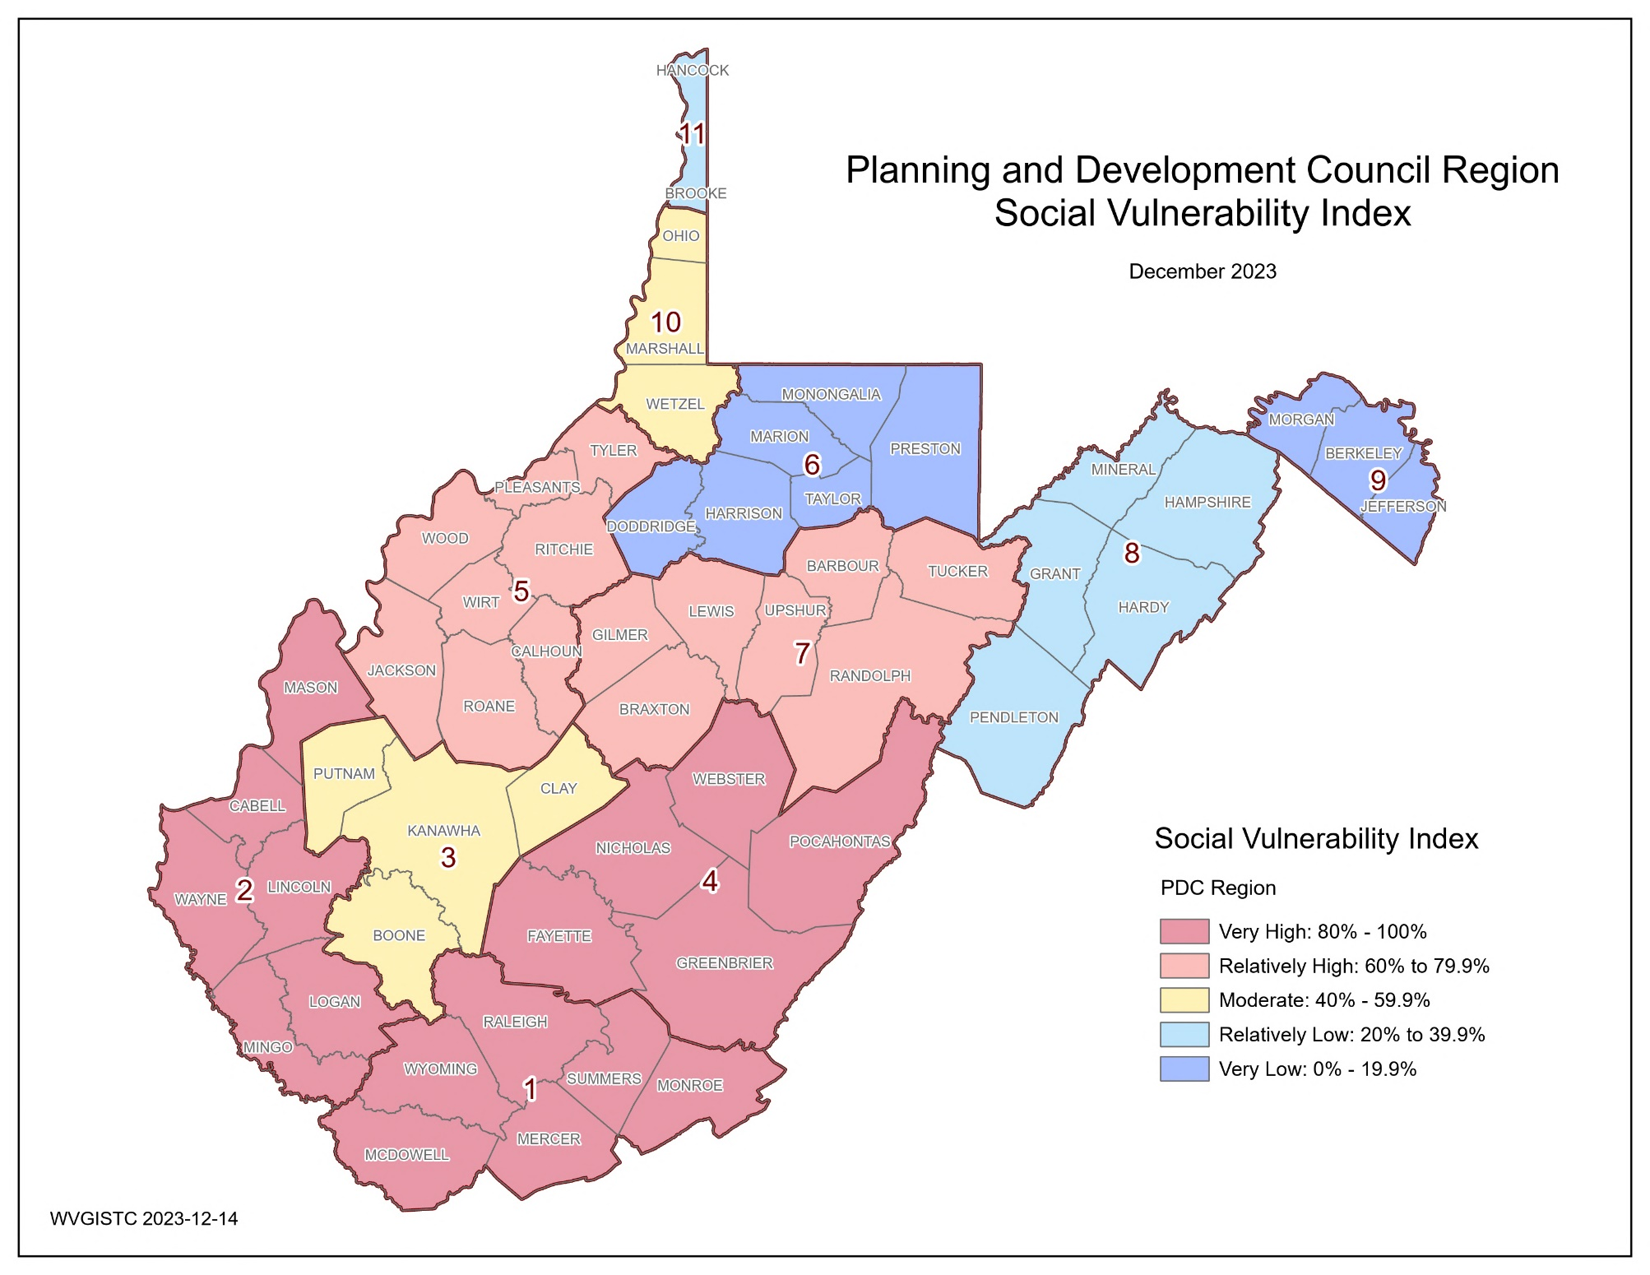
WV Social Vulnerability Index; Maps
Top 3 Regions | WV SVI
1 | 100%
4 | 90%
2 | 80%

Slide 9








WV Social Vulnerability Index; Focus Communities
Vulnerability Indicators | Vulnerability Indicators | White Sulphur Springs | Rainelle | Clendenin | Richwood | Marlinton | Camden-on-Gauley | State Ratio/Value | National Ratio/Value
 | Poverty Rate | 21.9% | 27.7% | 9.2% | 26.1% | 25.7% | 14.3% | 17.0% | 12.4%
 | Unemployment Rate | 13.0% | 22.1% | 7.3% | 39.8% | 16.3% | 8.3% | 23.7% | 14.6%
 | Vulnerable Ages Ratio | 37.5% | 36.0% | 45.4% | 43.1% | 37.6% | 33.0% | 36.7% | 34.6%
 | Disability Ratio | 20.5% | 31.9% | 11.2% | 29.9% | 27.6% | 9.7% | 19.3% | 12.6%
 | No High School Diploma Ratio | 8.3% | 15.4% | 10.1% | 13.2% | 16.1% | 4.8% | 11.9% | 11.1%
 | Population Change Ratio | -9.1% | -20.9% | -30.4% | -19.1% | -5.3% | -25.4% | -3.2% | 7.4%
 | Median Housing Value | $121,000 | $59,100 | $70,300 | $68,300 | $79,700 | $73,800 | $128,800 | $244,900
 | Mobile Homes Ratio | 0.0% | 9.3% | 3.9% | 7.5% | 4.9% | 11.1% | 14.0% | 5.9%
WV Social Vulnerability Index Score (Among incorporated communities) |  | 21.1% (Relatively Low) | 84.6% (Very High) | 36.6% (Relatively Low) | 92.5% (Very High) | 60.4% (Relatively High) | 27.3% (Relatively Low) | - | -
The indicator values in red show more than a 5% difference, toward vulnerability, compared to the state ratios.
Index Legend:
Very High: 80% to 100%
Relatively High: 60% to 79.9%
Moderate: 40% to 59.9%
Relatively Low: 20% to 39.9%
Very Low: 0% to 19.9%
Red: 90% to 100%

Slide 10
WV Social Vulnerability Indicators; Description, Rationale, and Data Sources
Vulnerability Indicator | Description | Rationale | Data Source
Poverty Rate | Percentage of households with incomes below poverty level | The poor are less likely to have the income or assets needed to prepare for a possible disaster or to recover after it occurs (Cutter et al., 2003; Flanagan et al., 2011; Morrow, 1999; Thomas, 2017). | Census 2021 ACS 5-Year Estimates
Unemployment Rate | Percentage of families (two or more people residing together and related by birth, marriage, or adoption) with no workers in the past 12 months (from 2021) | In addition to income problems, unemployed persons lack benefit plans providing health cost assistance when injuries or deaths occur due to disasters (Brodie et al., 2006; Flanagan et al., 2011). | Census 2021 ACS 5-Year Estimates
Vulnerable Ages Ratio | Percentage of population in two groups of “younger than 15” or “65 and older” | Children and the elderly are generally more vulnerable to disasters such as flooding due to the lack of experience or physical and cognitive limitations to protect themselves (Cutter et al., 2003; Flanagan et al., 2011; Morrow, 1999). | Census 2021 ACS 5-Year Estimates
Disability Ratio | Percentage of civilian noninstitutionalized population with disabilities of independent living, self-care, ambulatory, cognitive, vision, or hearing difficulties | Disabled people are more vulnerable to natural hazards such as flooding and may require special assistance to evacuate (Cutter et al., 2003; Flanagan et al., 2011; Morrow, 1999). | Census 2021 ACS 5-Year Estimates
No High School Diploma Ratio | Percentage of population 25 years and older with no high school diploma | Highly educated individuals and societies are reported to have better preparedness and response to disasters, suffered lower negative impacts, and can recover faster (Muttarak & Lutz, 2014). | Census 2021 ACS 5-Year Estimates
Population Growth Ratio | Percentage of population change from 2010 to 2020 | Although rapid population growth in dense urban areas can contribute to the risk (Cutter et al., 2003) we believe population decrease can be a factor of social vulnerability in WV communities. | Decennial Census (DEC) of 2010 & 2020
Housing Median Value | Median dollar values of owner-occupied residential units | The value can be an indicator of building quality. Buildings of low quality cannot withstand flooding adequately and are more vulnerable. Residents in communities with higher median housing values may be more likely to carry flood insurance policies, as their properties represent substantial investments. This can enhance financial preparedness and resilience (Flanagan et al., 2011; Morrow, 1999; Thieken et al., 2008). | Census 2021 ACS 5-Year Estimates
Mobile Homes Ratio | Percentage of manufactured homes in the whole community | Light-weight manufactured homes are not designed for withstanding floods and are more vulnerable to flood damage. Communities with a higher prevalence of manufactured homes often encounter more obstacles in achieving resilience, as these structures typically do not offer the same level of security as traditionally constructed homes. Moreover, these homes are often situated in regions beyond the urban core, where access to major roadways and public transit systems may be less available. | Census 2021 ACS 5-Year Estimates

Slide 11
WV Social Vulnerability Index; Findings
Top 10 communities with the highest social vulnerability:
WV SVI, Top 10 Communities
Rank | Community | County | RPDC Region | POV_RT | UNEMP_RT | V_AGE_RT | DISABL_RT | NOHSDP_RT | POP_CH_RT | MED_HU_VAL | MOBILE_H_RT | INDEX_SC
INCORPORATED
1 | Anawalt | McDowell | 1 | 25.8% | 51.4% | 46.8% | 45.6% | 64.9% | -27.0% | $20,700 | 33.0% | 100.0%
2 | War | McDowell | 1 | 44.6% | 68.2% | 43.9% | 36.1% | 28.3% | -27.7% | $35,100 | 15.0% | 99.6%
3 | Smithfield | Wetzel | 10 | 60.4% | 70.6% | 53.0% | 41.0% | 31.3% | -29.0% | $90,000 | 8.7% | 99.1%
4 | Auburn | Ritchie | 5 | 36.0% | 57.1% | 35.5% | 41.9% | 32.5% | -18.6% | $36,300 | 13.3% | 98.7%
5 | Lester | Raleigh | 1 | 56.0% | 42.9% | 53.2% | 30.2% | 22.8% | -2.9% | $75,200 | 31.3% | 98.2%
6 | Reedy | Roane | 5 | 29.8% | 46.2% | 53.3% | 29.2% | 17.9% | -17.6% | $55,800 | 8.8% | 97.8%
7 | Matewan | Mingo | 2 | 38.3% | 41.4% | 40.7% | 43.4% | 19.4% | -17.4% | $90,100 | 18.9% | 97.4%
8 | Clay | Clay | 3 | 63.0% | 26.3% | 50.3% | 23.3% | 23.1% | -19.3% | $71,400 | 9.6% | 96.9%
9 | Pax | Fayette | 4 | 32.7% | 69.7% | 22.3% | 43.7% | 20.3% | -18.6% | $47,100 | 16.7% | 96.5%
10 | Delbarton | Mingo | 2 | 30.4% | 32.4% | 31.3% | 46.0% | 28.5% | -27.1% | $82,700 | 34.4% | 96.0%
Rank | Community | RPDC Region | POV_RT | UNEMP_RT | V_AGE_RT | DISABL_RT | NOHSDP_RT | POP_CH_RT | MED_HU_VAL | MOBILE_H_RT | INDEX_SC
UNINCORPORATED
1 | McDowell | 1 | 27.4% | 54.6% | 40.8% | 28.7% | 29.3% | -18.8% | $43,700 | 30.6% | 100.0%
2 | Wyoming | 1 | 24.2% | 40.4% | 39.0% | 36.6% | 24.9% | -11.7% | $75,500 | 31.6% | 98.1%
3 | Mingo | 2 | 27.4% | 38.4% | 38.3% | 31.5% | 25.3% | -12.5% | $83,000 | 36.7% | 96.3%
4 | Webster | 4 | 20.8% | 38.7% | 41.1% | 25.0% | 20.7% | -8.3% | $75,900 | 27.3% | 94.4%
5 | Clay | 3 | 23.2% | 34.3% | 38.2% | 27.4% | 19.7% | -13.9% | $87,700 | 29.4% | 92.6%
6 | Braxton | 7 | 21.8% | 30.8% | 39.6% | 20.9% | 19.3% | -14.1% | $88,700 | 32.1% | 90.7%
7 | Logan | 2 | 24.9% | 40.1% | 38.3% | 31.9% | 20.2% | -11.1% | $92,100 | 23.1% | 88.9%
8 | Calhoun | 5 | 26.0% | 35.8% | 39.4% | 22.2% | 15.1% | -18.8% | $103,700 | 28.9% | 87.0%
9 | Boone | 3 | 18.9% | 37.2% | 36.5% | 25.2% | 17.1% | -12.4% | $80,100 | 31.6% | 85.2%
10 | Lincoln | 2 | 19.3% | 31.7% | 37.4% | 27.4% | 19.7% | -4.6% | $82,900 | 34.0% | 83.3%
INDEX_SC: Cumulative index score for WV SVI (0% to 100%)
Socioeconomic Status:
POV_RT: Poverty rate
UNEMP_RT: Unemployment rate
Population Characteristics:
V_AGE_RT: Vulnerable ages ratio
DISABL_RT: Disability ratio
NOHSDP_RT: No high school diploma ratio
POP_CH_RT: Population change rate
Housing Characteristics:
MED_HU_VAL: Median housing value
MOBILE_H_RT: Percentage of mobile homes

Slide 12
WV Social Vulnerability Index; Findings
Top 5 counties with the highest social vulnerability:
WV SVI, Top 5 Counties
Rank | County | RPDC Region | POV_RT | UNEMP_RT | V_AGE_RT | DISABL_RT | NOHSDP_RT | POP_CH_RT | MED_HU_VAL | MOBILE_H_RT | INDEX_SC
1 | MCDOWELL | 1 | 27.5% | 51.2% | 38.5% | 30.4% | 25.4% | -13.6% | $43,700 | 23.5% | 100.0%
2 | WYOMING | 1 | 23.9% | 38.5% | 38.6% | 35.2% | 22.6% | -10.1% | $75,500 | 29.2% | 98.1%
3 | MINGO | 2 | 29.9% | 37.2% | 38.2% | 32.8% | 24.2% | -12.2% | $83,000 | 30.7% | 96.3%
4 | CLAY | 3 | 25.9% | 33.8% | 39.1% | 27.0% | 19.9% | -14.2% | $87,700 | 28.0% | 94.4%
5 | WEBSTER | 4 | 25.7% | 36.6% | 39.8% | 23.2% | 21.3% | -8.5% | $75,900 | 23.4% | 92.6%
Socioeconomic Status:
POV_RT: Poverty rate
UNEMP_RT: Unemployment rate
Population Characteristics:
V_AGE_RT: Vulnerable ages ratio
DISABL_RT: Disability ratio
NOHSDP_RT: No high school diploma ratio
POP_CH_RT: Population change rate
Housing Characteristics:
MED_HU_VAL: Median housing value
MOBILE_H_RT: Percentage of mobile homes
INDEX_SC: Cumulative index score for WV SVI (0% to 100%)
Social Vulnerability Spatial Distribution:
Counties classified as “Very High” or “Relatively High” are mostly clustered in the Southwestern and central parts of the state.
Counties classified as “Very Low” or “Relatively Low” are mostly clustered in the Northeastern part of the state and its panhandles.
Focus Communities Highlights:
Richwood has the most critical situation in terms of overall social vulnerability (among the top 10%) followed by Rainelle (among the top 20%).
Rainelle has the highest Poverty Rate (27.7%) and highest Disability Ratio (31.9%) among the focus communities.
Richwood has the highest Unemployment Rate (39.8%).
Clendenin has the highest Vulnerable Ages Ratio (45.4%).
Marlinton has the highest No High School Diploma Ratio (16.1%).
Clendenin has the highest rate of Population Decrease among these communities (-30.4%).
Rainelle has the lowest Median Housing Value ($59,100).
Camden-on-Gauley has the highest Mobile Home Percentage (11.1%).

