Slide 1
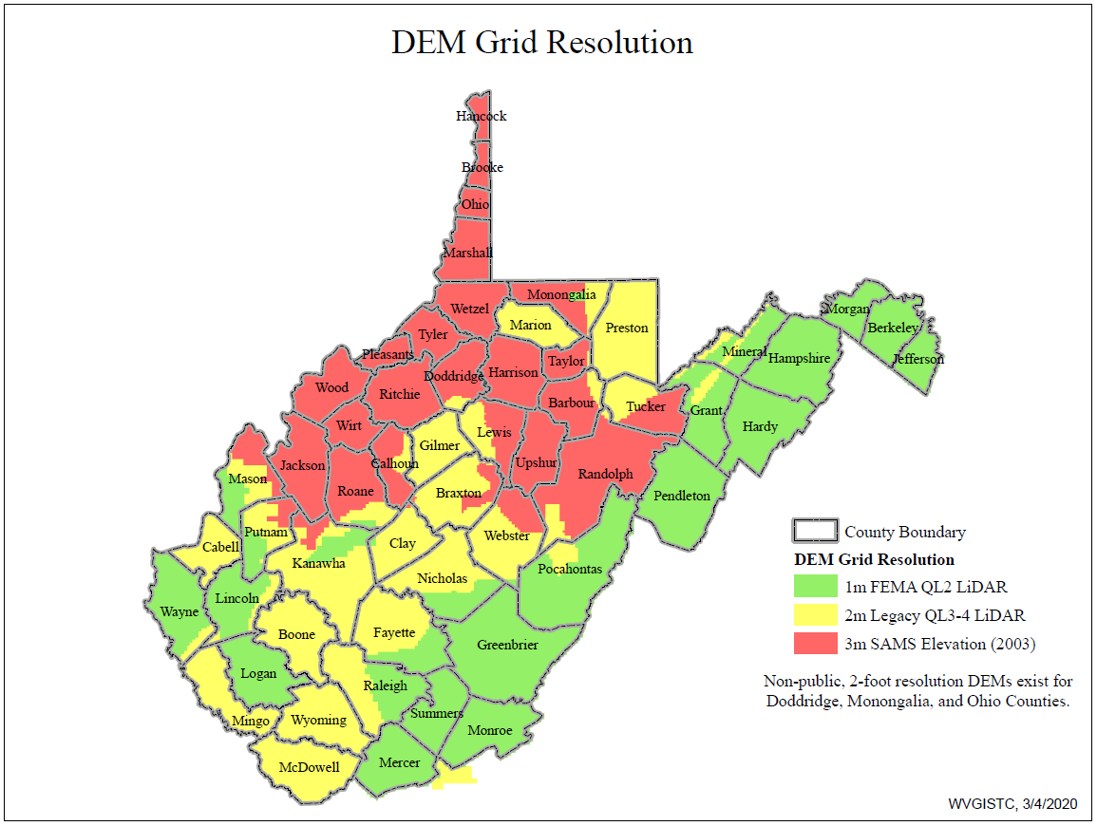
DEM Grid Resolution, March 2020

Slide 2
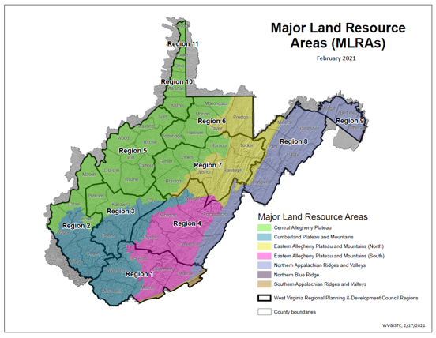
DEM Resolution Determined Mapping Schedule
5th
4th
1st
2nd
3rd

Slide 3
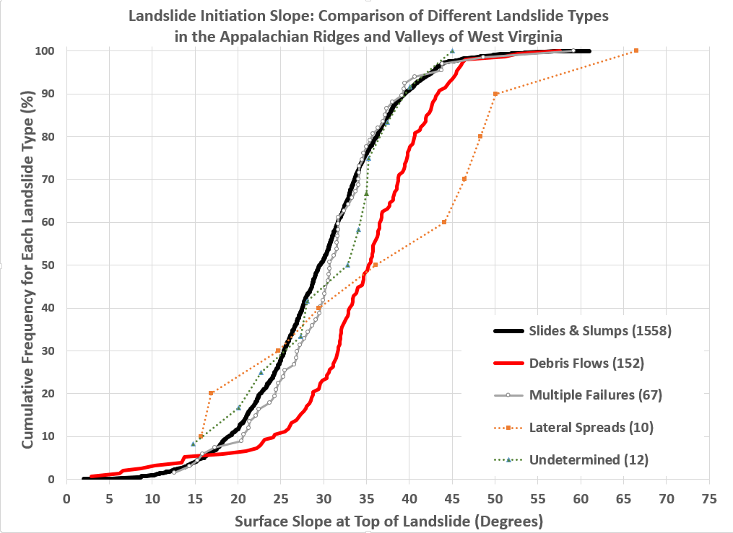

Slide 4
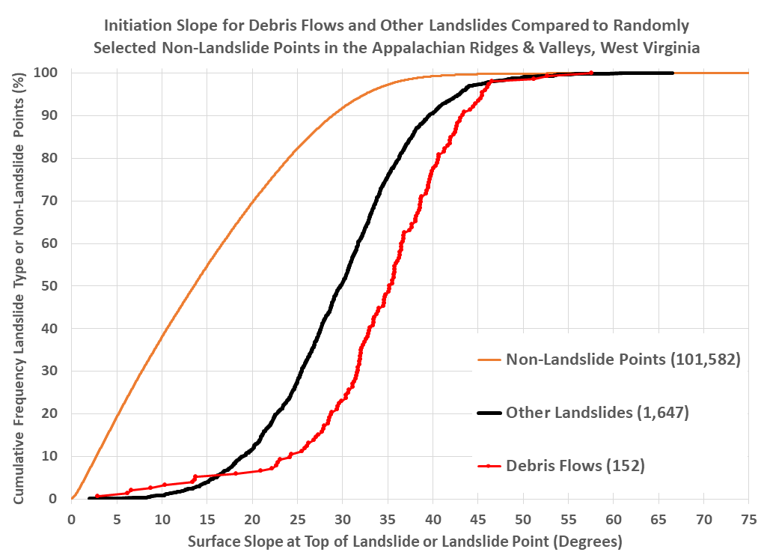

Slide 5
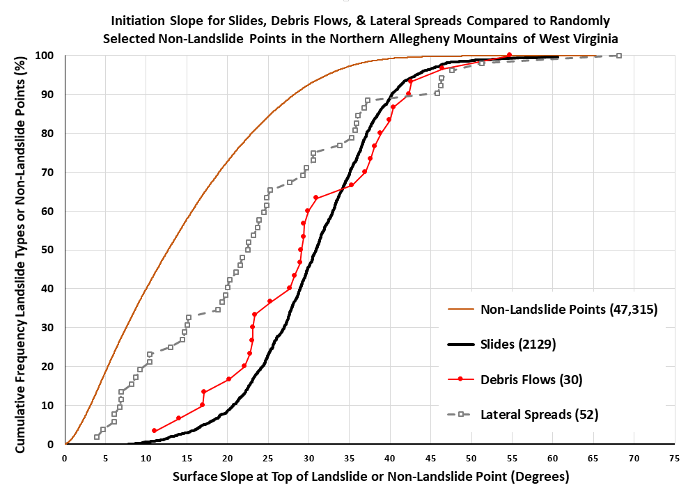

Slide 6
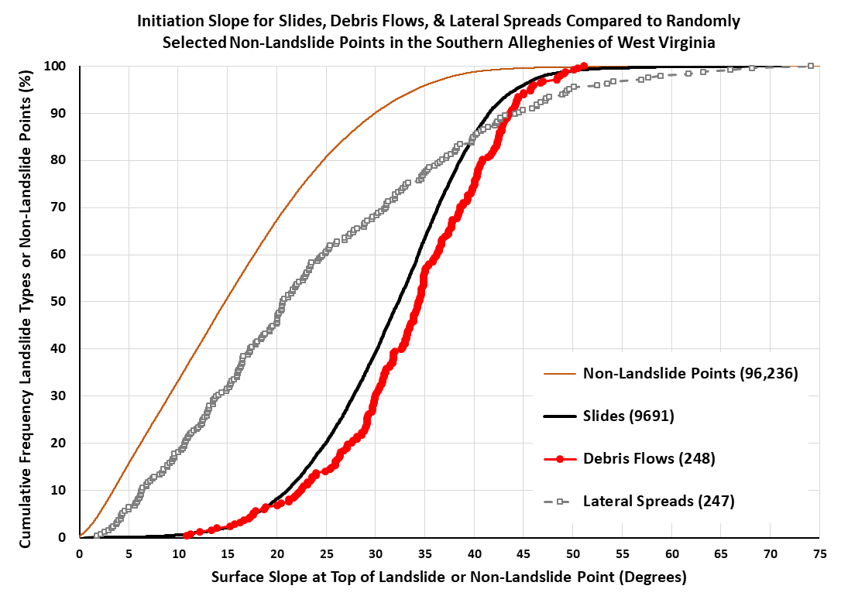

Slide 7
