Slide 1
Statewide Hazard Assessment
Landslide Risk Assessment

Slide 2
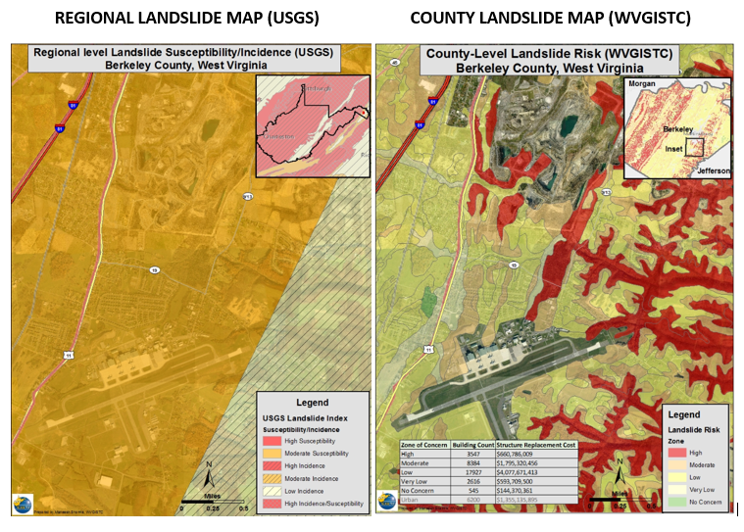
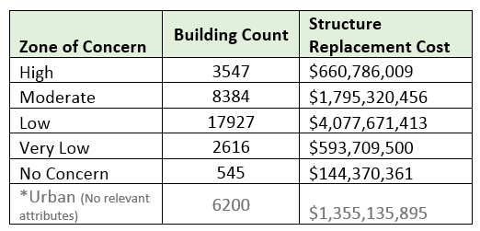
Landslide Maps – Old versus New
Old Way - Very Generalized
New Way – More Detailed
Landslide
Risks
Buildings Exposed to Landslide Risks
Risk Assessment table showing building counts along with estimated replacement costs in landslide zones of concern
Landslide susceptibility map showing generalized USGS map and more detailed prototype map

Slide 3
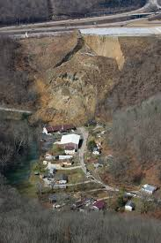
Landslide Risk Assessment
Goals
Develop a landslide inventory
Create valid landslide models for specific WV regions
Generate county-level resolution landslide maps
Create an interactive web map application for displaying landslide models and variables
Use the new landslide models and information to update the State Hazard Mitigation Plan
Did you know?
Landslides are the #2 Hazard in West Virginia
2015 Yeager Airport Slide

Slide 4
Landslide Incident Inventory
Collected data from various sources
  WVGES
    Landers and Smosna, 1973
    Lessing et al, 1976
    Kite, 1985
  USGS
    Ohlmacher et al, 1975-85
    Jacobson, 1993
  NPS/WVGES
    Yates and Kite, 2014-15
  WVDHSEM
    State Hazard Mitigation office
  WVDOT
    Geospatial Transportation Information (GTI) Section, 1973-2016
  WVU
    Kite, 1983-97
    Konsoer, 2008
    WVGISTC, 2018-19

Slide 5
Landslide Incident Inventory
# | Agency | Year | Author or Source Agency | Title/Description | General Location | Purpose | Total Incidence Data
1 | WVGES | 1973 | Landers and Smosna | Final Report on Landslides of July 9, 1973 in Kanawha City Area of Charleston, West Virginia | Charleston, West Virginia | Landslide risk assessment | 10
2 | WVGES | 1976 | Lessing et al. | WV Landslides and Slide-Prone Areas; funded by Appalachian Regional Commission | Statewide (39 topo quads) | Landslide risk assessment | 46,630
3 | USGS | 1975-85 | Ohlmacher et al. | Landslide Quad Maps: Open File Maps | Statewide (382 topo quads) | Landslide risk assessment | 22,120
4 | WVGES | 1987 | Kite | SEFOP Field Guide, Open File Report 8801 | Canaan Valley State Park | Research study (1985)
5 | USGS | 1993 | Jacobson | U.S. Geological Survey Bulletin 1981: Geomorphic studies of the storm and flood of November 3-5, 1985, in the upper Potomac and Cheat River basins in West Virginia and Virginia | Cheat and Potomac River basins; Wills Mountain Anticline; Eastern WV | Research study (1985) | 3,571
6 | WVU | 1983-97 | WVU | Landslide incidences with Images | Statewide | Landslide risk assessment | 46
7 | WVU | 2008 | Konsoer | LiDAR, GIS, and multivariate statistical analysis to assess landslide risk, Horseshoe Run watershed, West Virginia | Horseshoe Run Watershed, Tucker County | Landslide risk assessment | 149
8 | NPS/WVGES | 2014 | Yates and Kite | Unpublished Digital Surficial Geologic Map of Bluestone National Scenic River and Vicinity, West Virginia (NPS, GRD, GRI, BLUE, BLUS digital map) adapted from a West Virginia University and West Virginia Geological and Economic Survey Open File Map by Yates and Kite (2014) | Bluestone National Scenic River and Vicinity | Landslide inventory | 12
9 | NPS/WVGES | 2015 | Yates and Kite | Digital Surficial Geologic Map of New River Gorge National River, West Virginia (NPS, GRD, GRI, NERI, NERS digital map) adapted from a West Virginia University and West Virginia Geological and Economic Survey Open File Report map by Yates and Kite (and Gooding) (2015) | New River Gorge National River | Landslide inventory | 212
10 | WVDOT | 2016 | Geospatial Transportation Information (GTI) Section | Road landslide inventory | Statewide | Landslide inventory | 1,406
11 | WVDHSEM | 2017 | State Hazard Mitigation Office | FEMA Buyout Properties for Landslides | Southern West Virginia | Landslide mitigation | 7
12 | WVU | 2019 | WVGISTC | Statewide Landslide Risk Assessment; Funded by FEMA and WV Division of Homeland Security and Emergency Management | Statewide | Landslide risk assessment | 1100
75,263 landslide features

Slide 6
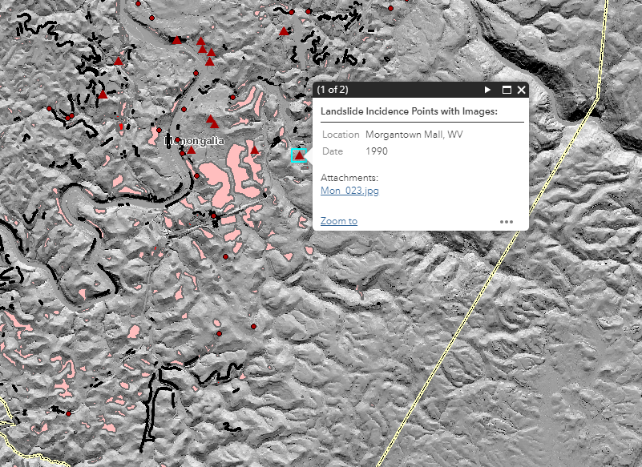
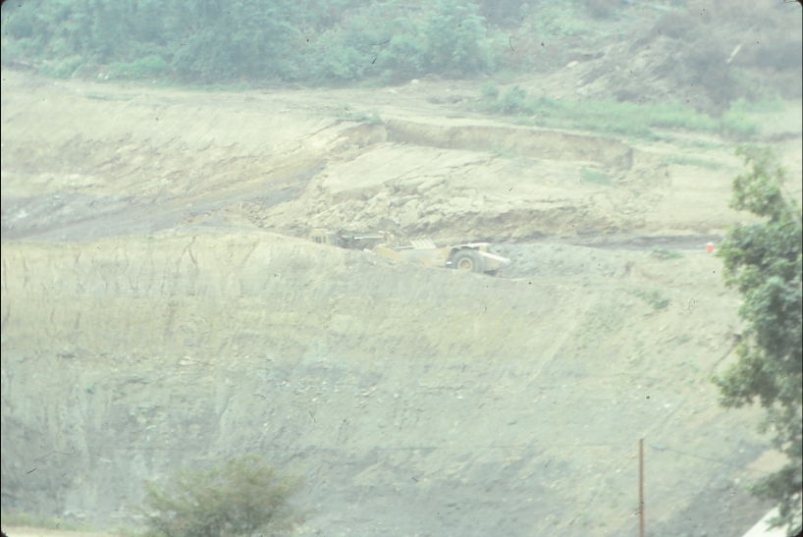
Landslide Incident Inventory
Landslide Incidence Points with Images
  From Dr. Kite
    Slides were scanned and tagged with geographical information, dates taken, and descriptions
    Added to the landslide incidence database

Slide 7
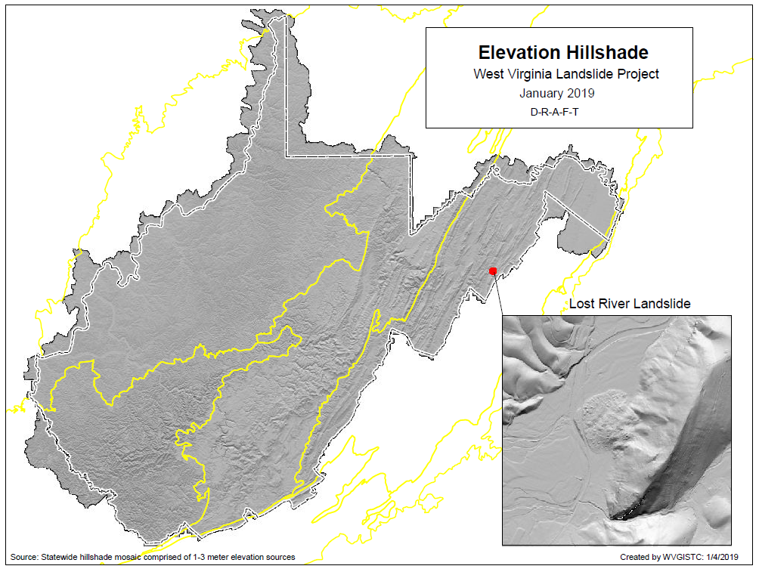
Mapping Landslides from new DEM
FEMA is purchasing statewide Quality Level 2 lidar for the entire State that will improve the mapping of existing landslides. Lidar-derived products include 1-meter DEM and 1-foot Contours
Central
Allegheny
Plateau
Northern Appalachian Ridges and Valleys
Eastern
Allegheny
Plateau and Mountains
Cumberland
Plateau and Mountains
Best-Available Elevation Sources for West Virginia: https://www.mapwv.gov/floodtest/docs/WV_FloodTool_ElevationSource_Metadata.pdf

Slide 8
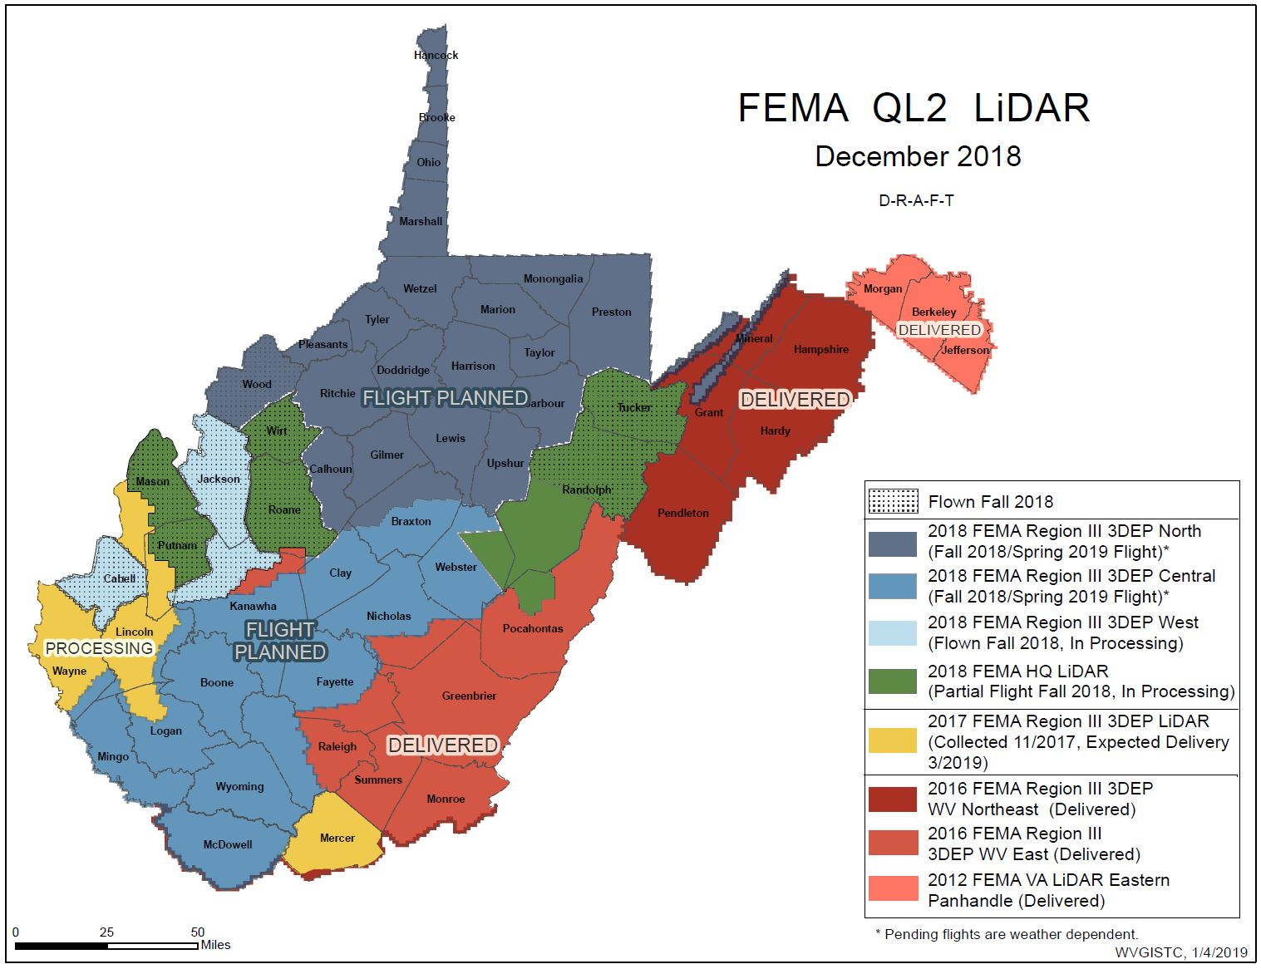
Mapping Landslides from new DEM
Best-Available Elevation Sources for West Virginia: https://www.mapwv.gov/floodtest/docs/WV_FloodTool_ElevationSource_Metadata.pdf

Slide 9
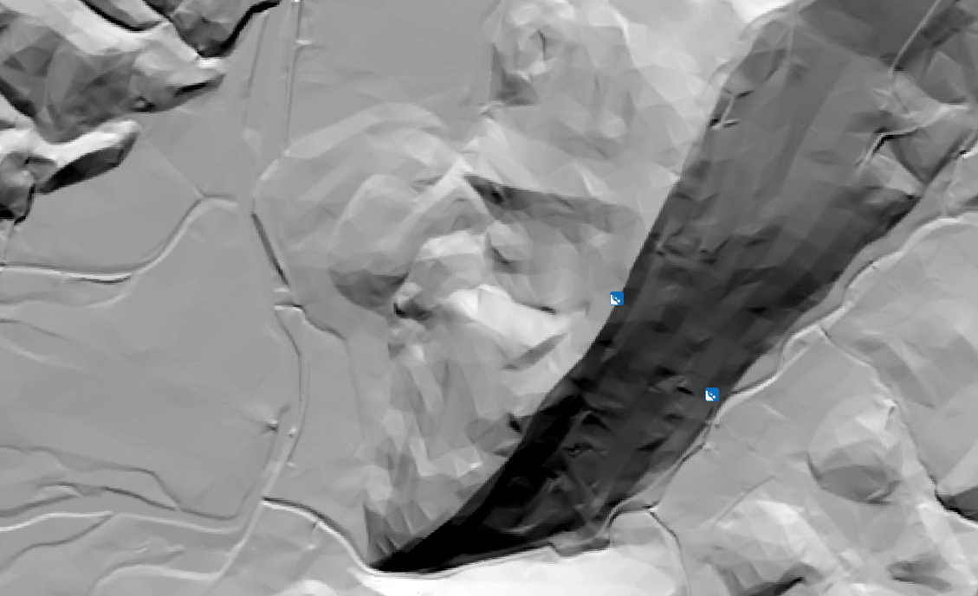
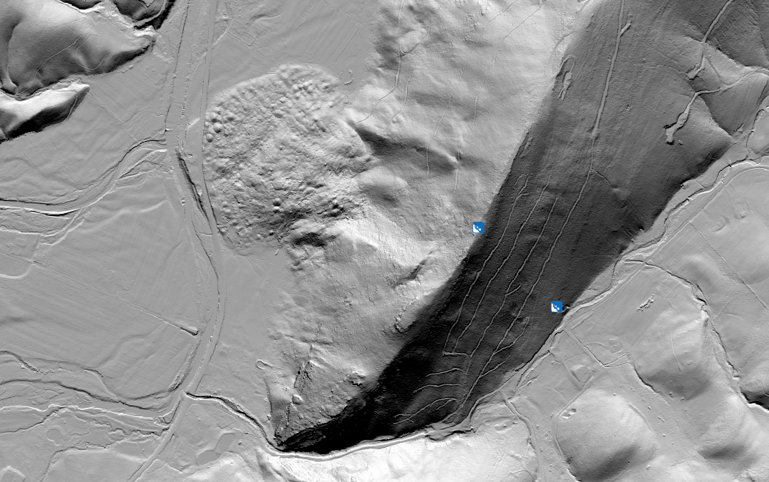
Old DEM
Mapping Landslides from new DEM
New DEM
Comparison of Old and New 1 meter DEM

Slide 10
Landslide Incident Inventory
Landslide mapping from new LiDAR-derived DEM
  Identifying following types of landslides
    Slide
    Fall
    Flow
    Lateral Spread
    Multiple Failures
    Unknown

Slide 11
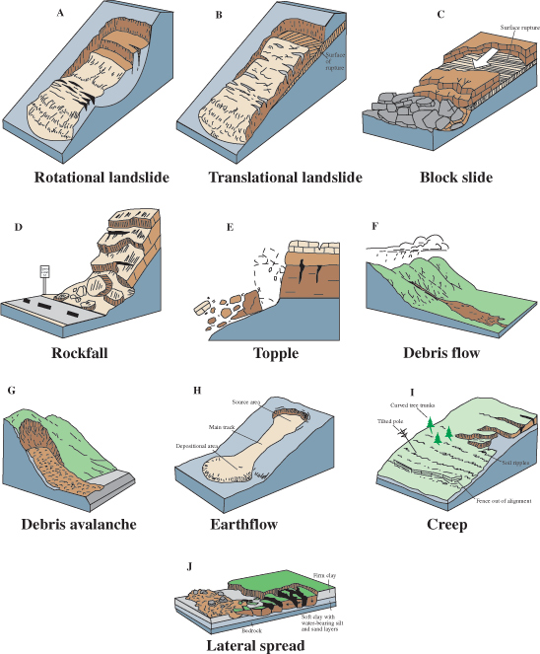
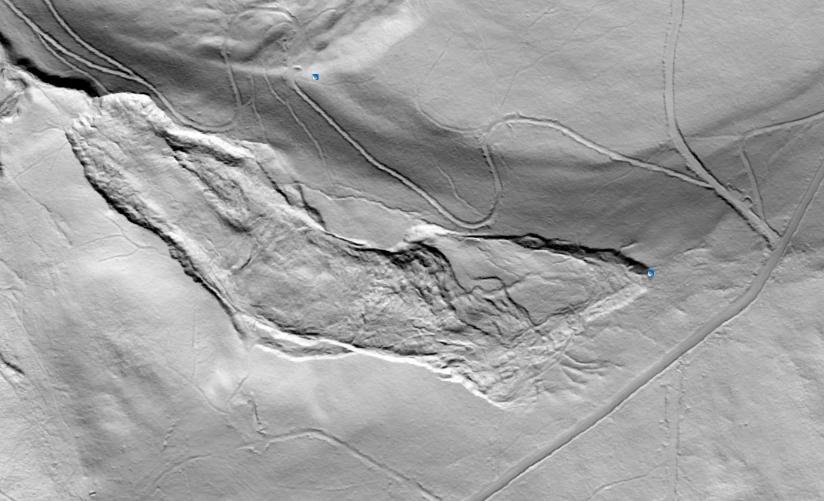
Landslide Incident Inventory
Slide (includes rotational and translational movement)*: mass movements, where there is a distinct zone of weakness that separates the slide material from more stable underlying material
Mineral County, WV
*Description from https://pubs.usgs.gov/fs/2004/3072/fs-2004-3072.html
Images from https://pubs.usgs.gov/fs/2004/3072/fs-2004-3072.html

Slide 12
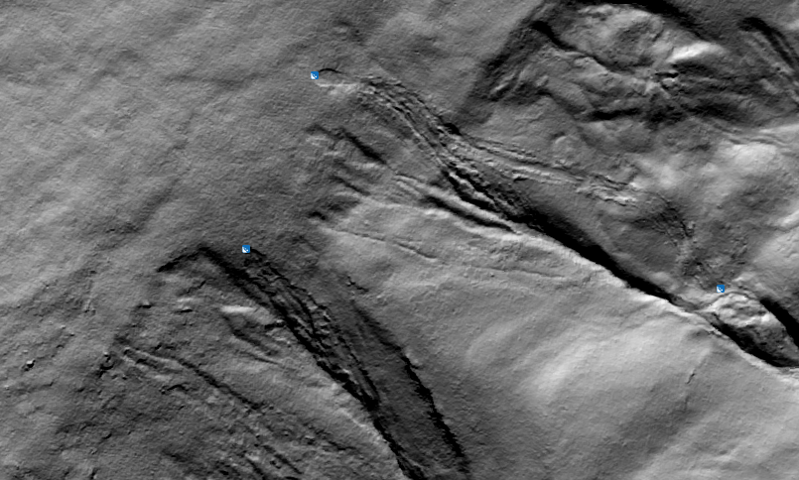
Landslide Incident Inventory
Debris Flow*: A form of rapid mass movement in which a combination of loose soil, rock, organic matter, air, and water mobilize as a slurry that flows downslope; they are often associated with steep gullies, and debris-flow deposits are usually indicated by the presence of debris fans at the mouths of gullies
Pendleton County, WV
*Description from https://pubs.usgs.gov/fs/2004/3072/fs-2004-3072.html
Images from https://pubs.usgs.gov/fs/2004/3072/fs-2004-3072.html

Slide 13
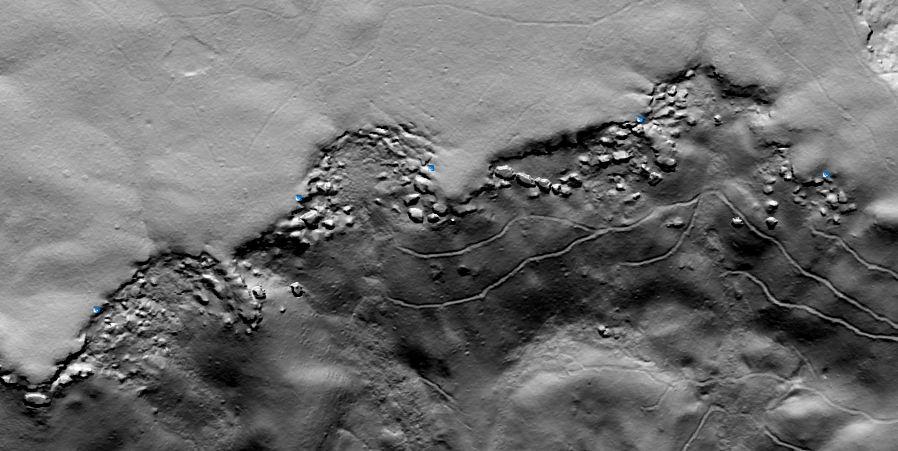
Landslide Incident Inventory
Lateral Spread*: When coherent material, either bedrock or soil, rests on materials that liquefy, the upper units may undergo fracturing and extension and may then subside, translate, rotate, disintegrate, or liquefy and flow; usually occur on very gentle slopes or flat terrain
Greenbrier County, WV
*Description from https://pubs.usgs.gov/fs/2004/3072/fs-2004-3072.html
Images from https://pubs.usgs.gov/fs/2004/3072/fs-2004-3072.html

Slide 14
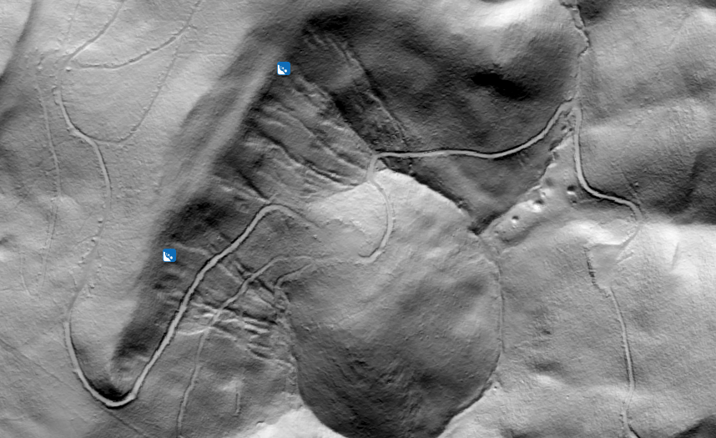
Landslide Incident Inventory
Multiple Failures: This classification is used when multiple (>4) failures, usually small debris flows, occur in a restricted area
Pendleton County, WV
*Description from https://pubs.usgs.gov/fs/2004/3072/fs-2004-3072.html
Images from https://pubs.usgs.gov/fs/2004/3072/fs-2004-3072.html

Slide 15
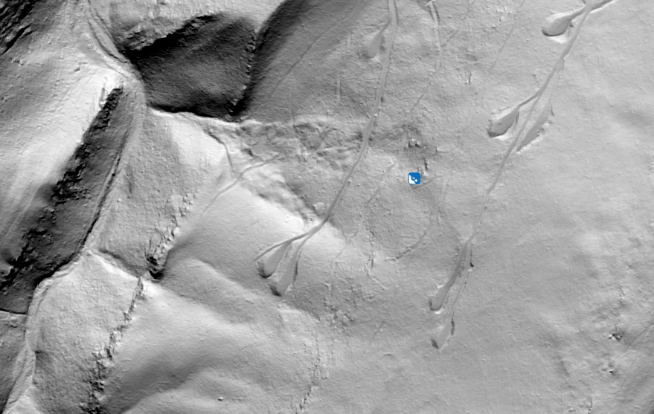
Landslide Incident Inventory
Fall*: Abrupt movements of masses of geologic materials, such as rocks and boulders, that become detached from steep slopes or cliffs
Undetermined: Some failure is present, but it is not possible to determine the type of movement
Pendleton County, WV
*Description from https://pubs.usgs.gov/fs/2004/3072/fs-2004-3072.html
Images from https://pubs.usgs.gov/fs/2004/3072/fs-2004-3072.html

Slide 16
Landslide Incident Inventory
Type of Movement | Number of user identified points | Percentage of user identified points | Description
Slide | 856 | 78.6 | A zone of weakness separates the slide from the underlying material; can be translational or rotational
Fall | 0 | 0 | Rocks or other geologic materials dislocate from steep slopes
Debris Flow | 86 | 7.9 | Fluid mobilizes material into a slurry that flows downslope; often associated with gullies or steep channels
Lateral Spread | 69 | 6.3 | Extension along very shallow or horizontal slopes which causes material to break into block-like shapes
Multiple Failures | 59 | 5.4 | Usually a combination of multiple small debris flows in a restricted location
Undetermined | 18 | 1.7 | Some failure is clearly present, but it is difficult to determine the type of movement

Slide 17
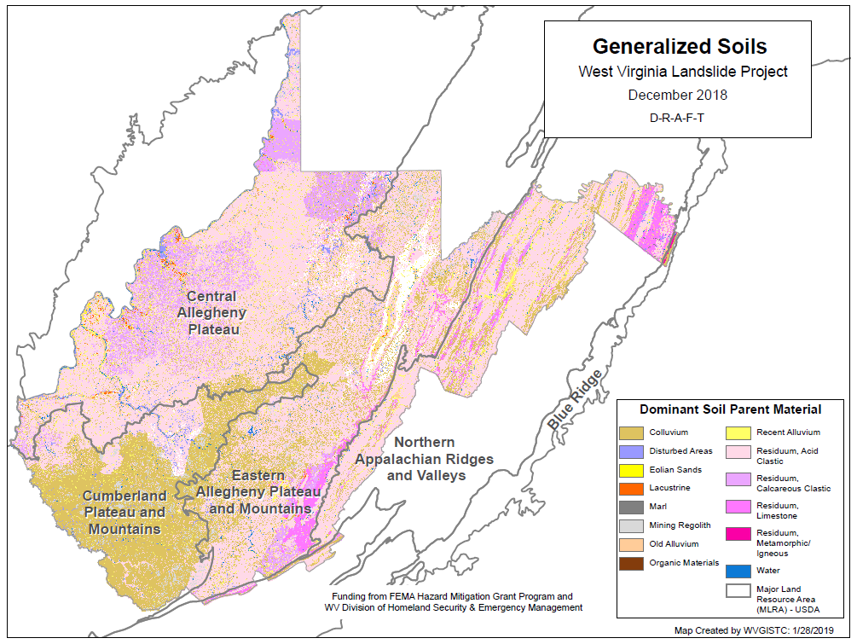
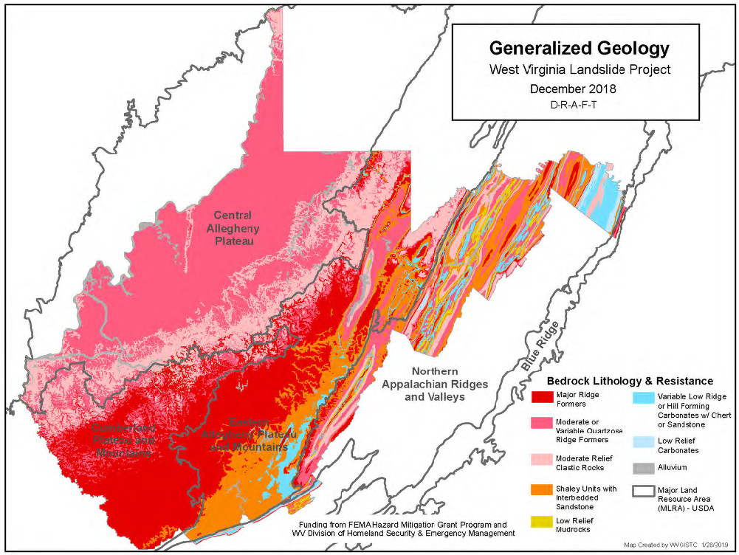
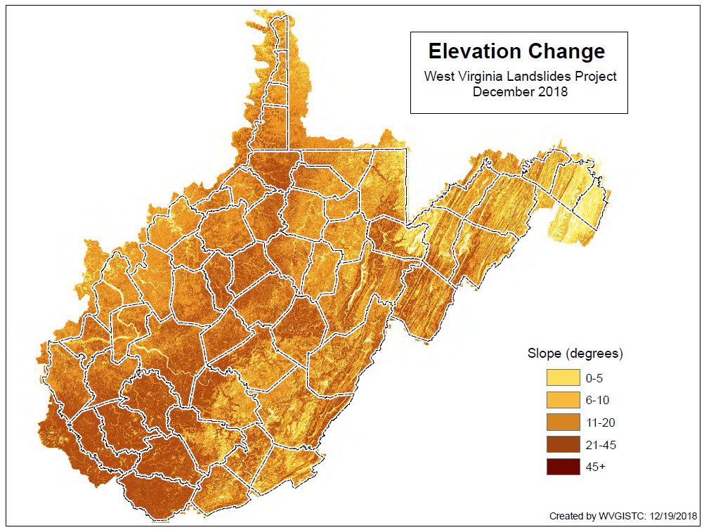
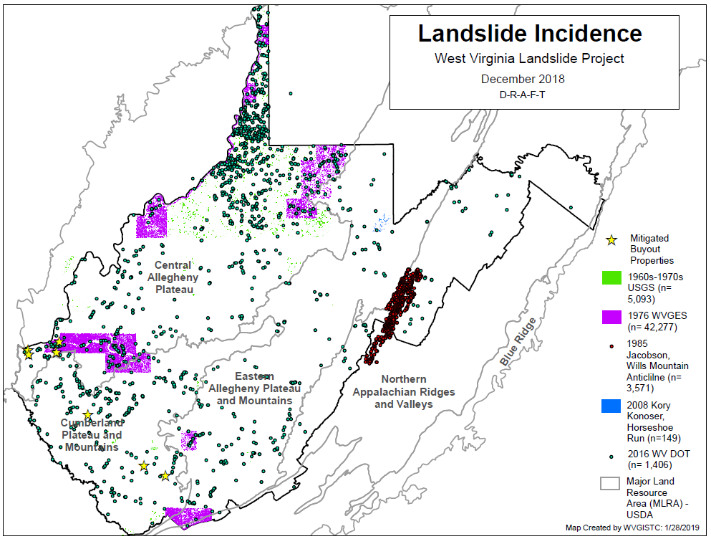
Landslide Method Development
The West Virginia University Study Team includes Dr. Steve Kite (Geomorphologist), Dr. James Thompson (Soil Scientist), Dr. Aaron Maxwell (Geologist/Modeler), and Dr. Maneesh Sharma (Geologist/GIS)

Slide 18
Landslide Method Development
Statistical model is being developed to evaluate various spatial inputs that have a high correlation to mapped landslide incidents
  Geology
  Soils
    Dominant soil parent material
    Drainage class
    Depth class
    Particle size class
  Topography
    Slope
    Roughness
    Aspect, etc..
  Proximity to roads
  Proximity to streams

Slide 19
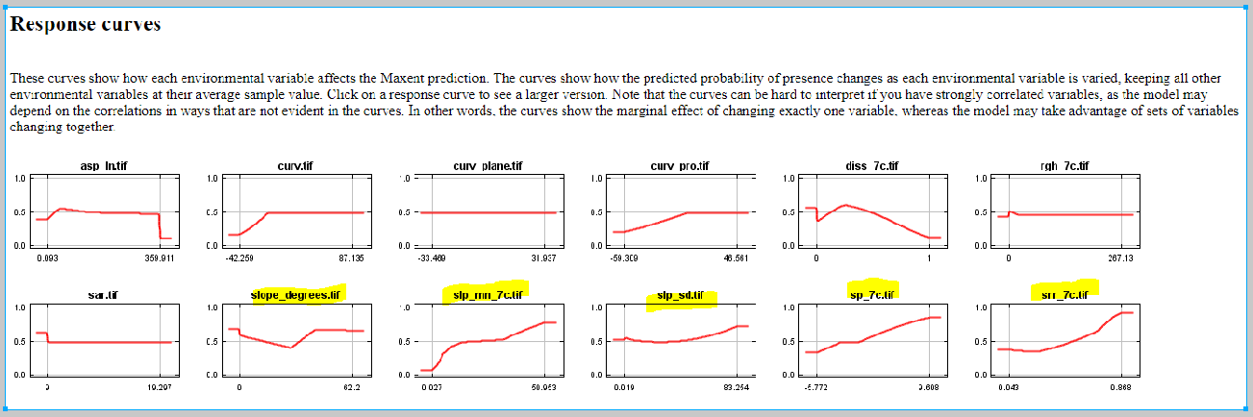
Landslide Method Development
Maximum Entropy Model has been run on Topographic variables in Monongalia County, WV. Following variables show higher correlation
Slope Averaged of a 7 cell radius window
Topographic Roughness over a 7 cell radius window
Aspect as linear variable
Slope in Degrees

Slide 20
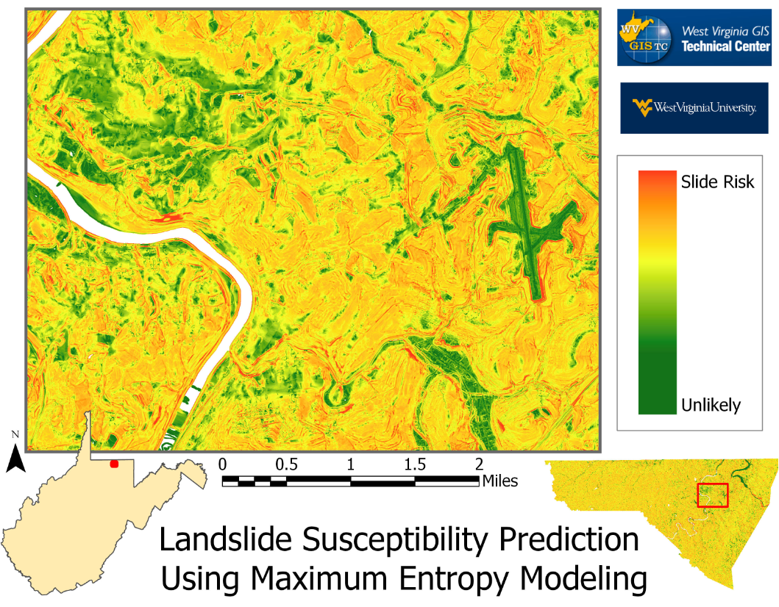
Landslide Susceptibility Prediction
The WVU Study Team has initiated a landslide susceptibility pilot for Monongalia County using a machine learning technique called Maximum Entropy Modeling. Professor Aaron Maxwell is conducting the modeling.

Slide 21
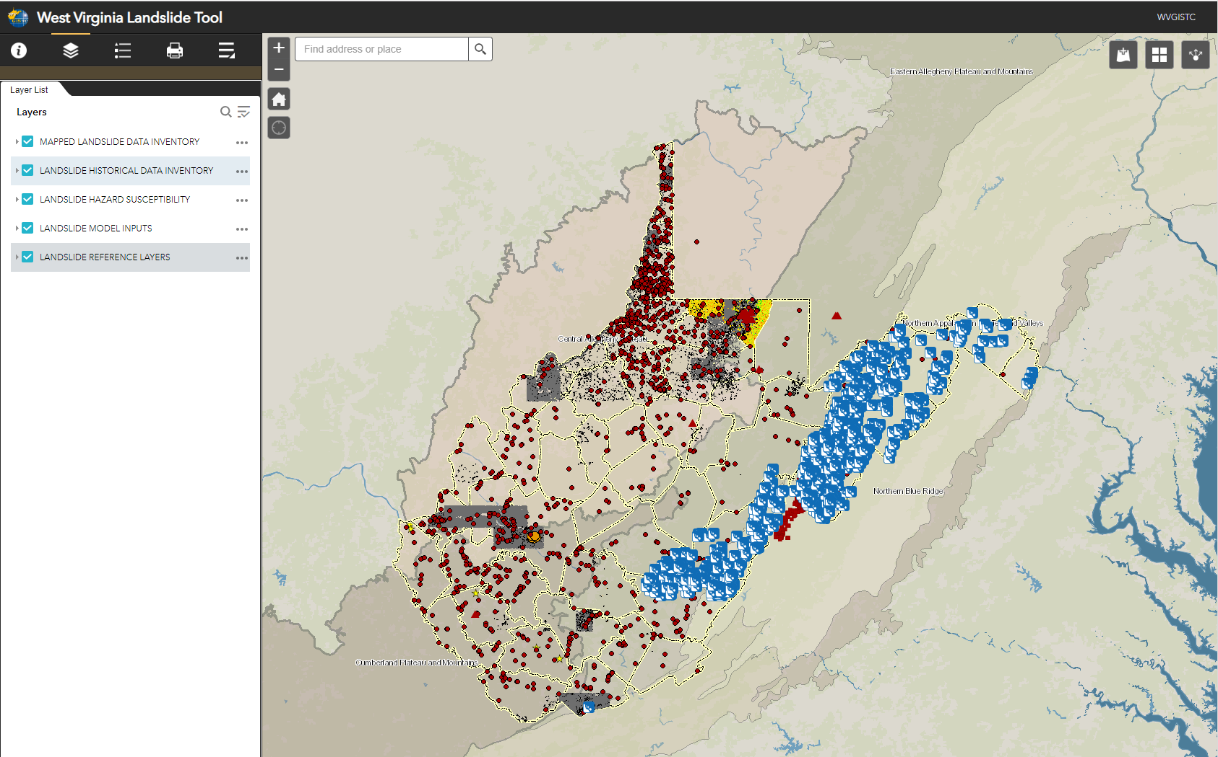
Landslide Incident Inventory
www.mapWV.gov/Landslide (in development)
Over 75,000 landslide incident point and polygon features have been inventories into a digital geodatabase

Slide 22
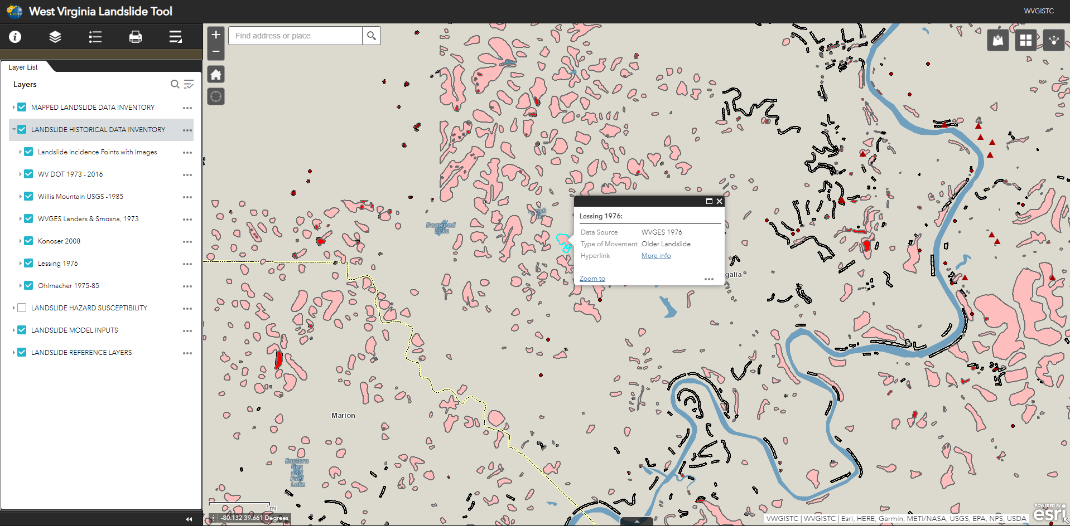

Landslide Incident Inventory
www.mapWV.gov/Landslide (in development)
Over 75,000 landslide incident point and polygon features have been inventories into a digital geodatabase

Slide 23
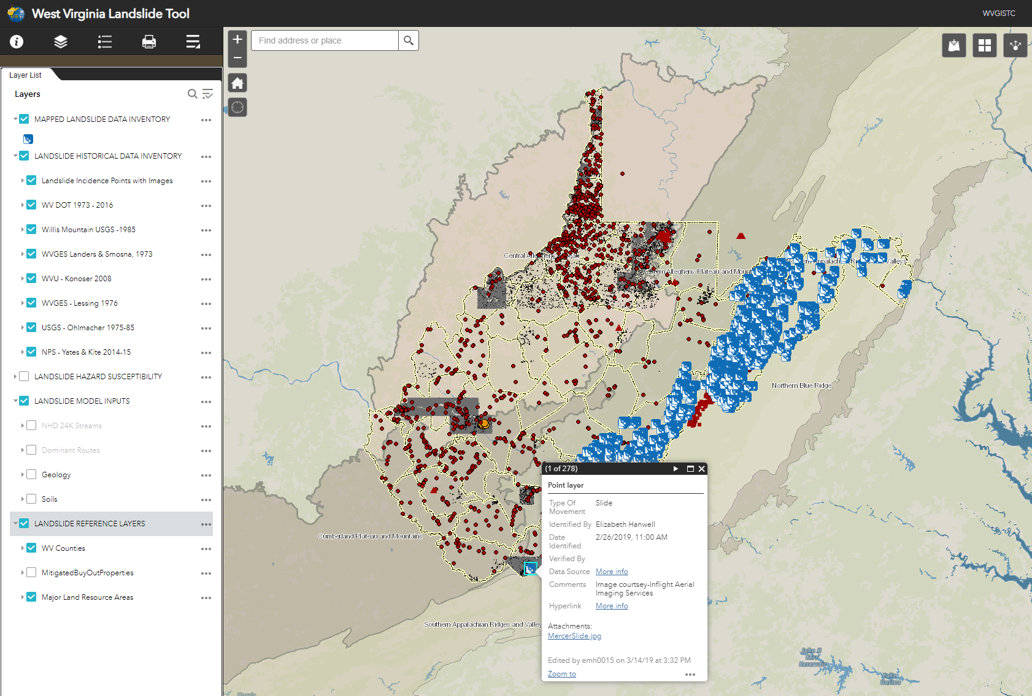
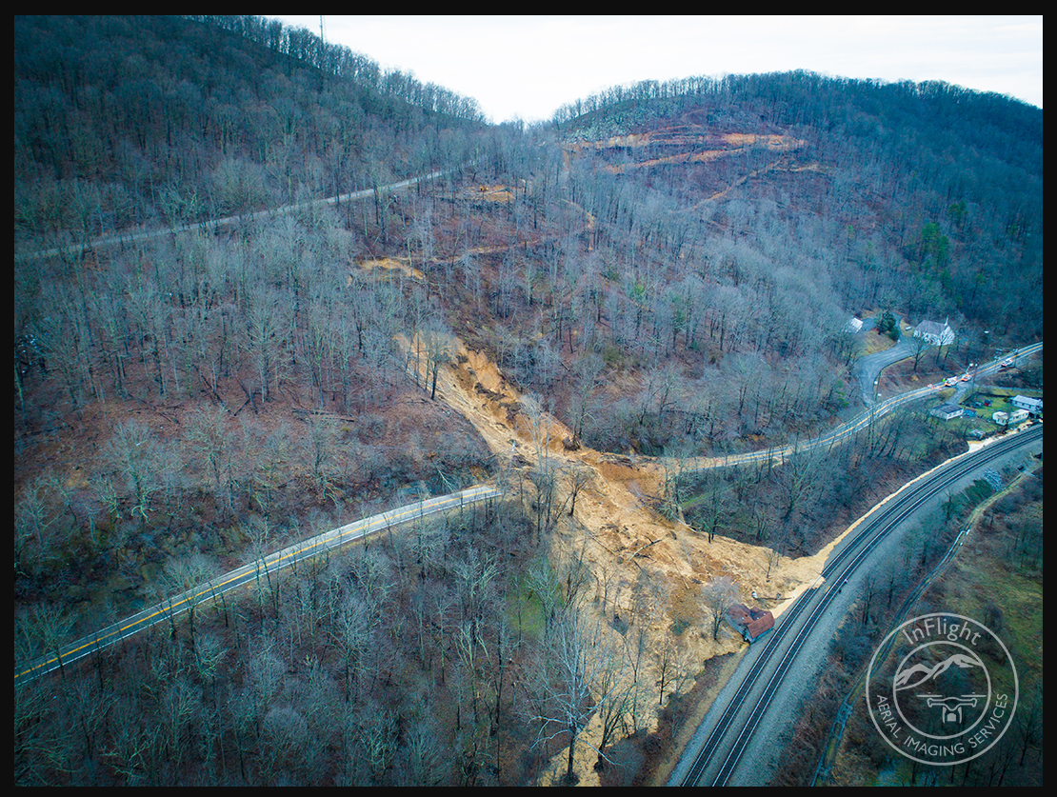
Landslide Incident Inventory
www.mapWV.gov/Landslide (in development)
According to Dr. Kite “Looks to be in the 5000-8000 square meter range in total. One of the biggest observed slides I know about in the state”. Feb 25, 2019

Slide 24
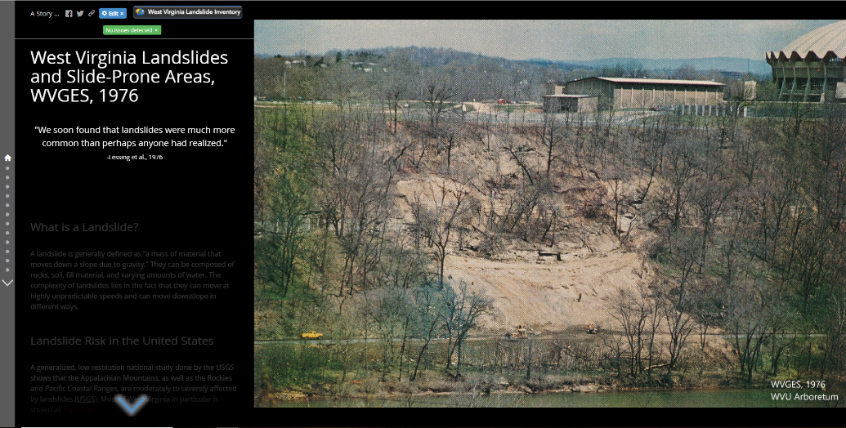
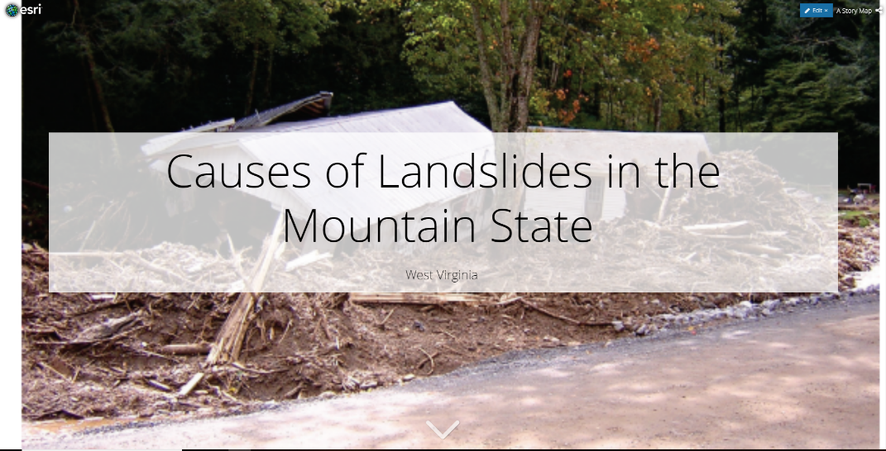
Landslide Outreach Material
Two StoryMaps In Development
  West Virginia Landslides and Slide-Prone Areas, WVGES 1976
https://arcg.is/1KDnvq
Causes of Landslides in Mountain State, West Virginia
https://arcg.is/1SW0Sn

Slide 25
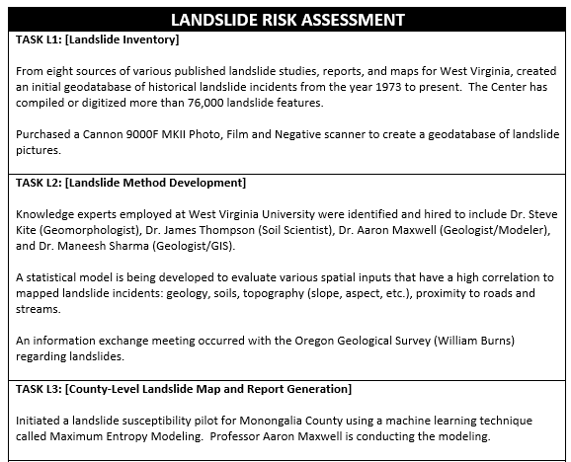
HMGP Landslide FY19 1st Quarterly Report
Five Major Landslide Goals and Deliverables
Q2: Published 41 landslide incidence data with photos
Q2: Mapped 1100 incidence points using 1m Lidar-derived DEM
Q2: Dominant Soil Parent Material variable was added to gSSURGO
Q2: Road and Stream layer was prepared for modelling
Q2: Continued modelling with new input variables

Slide 26
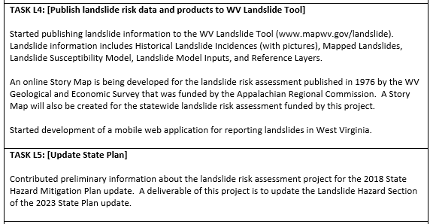
HMGP Landslide Quarterly Report (Cont.)
Five Major Landslide Goals and Deliverables
Q2: Published new operational, reference and background layers to Landslide Inventory Tool
Q2: Started developing two online Story Maps

Slide 27
Landslide Risk Assessment
Goals
Develop a landslide inventory
Create valid landslide models for specific WV regions
Generate county-level resolution landslide maps
Create an interactive web map application for displaying landslide models and variables
Use the new landslide models and information to update the State Hazard Mitigation Plan
QUESTIONS?
2015 Yeager Airport Slide

