Slide 1
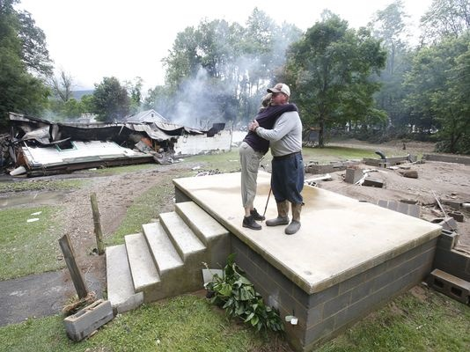
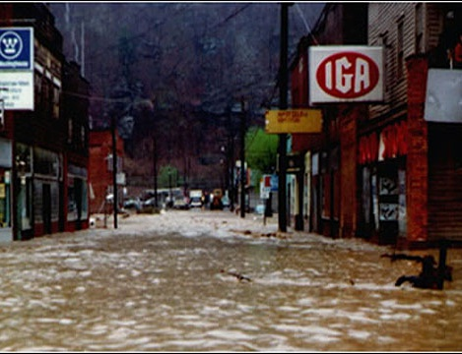
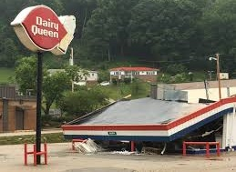
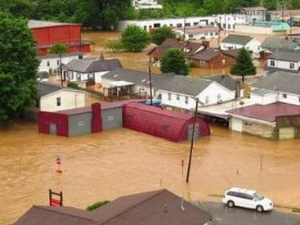

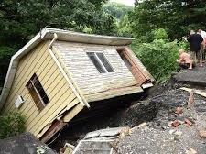
WV Flood Risk Assessment &
Visualization Tools
WVU GIS Technical Center
Kurt Donaldson
Aaron Maxwell
Behrang Bidadian
Annie Mahmoudi
2024 Symposium: Building Flood Resiliency in West Virginia Communities
← Devastating June 2016 Flood

Slide 2
Slides related to the June 2016 Flood Extracted

Slide 3
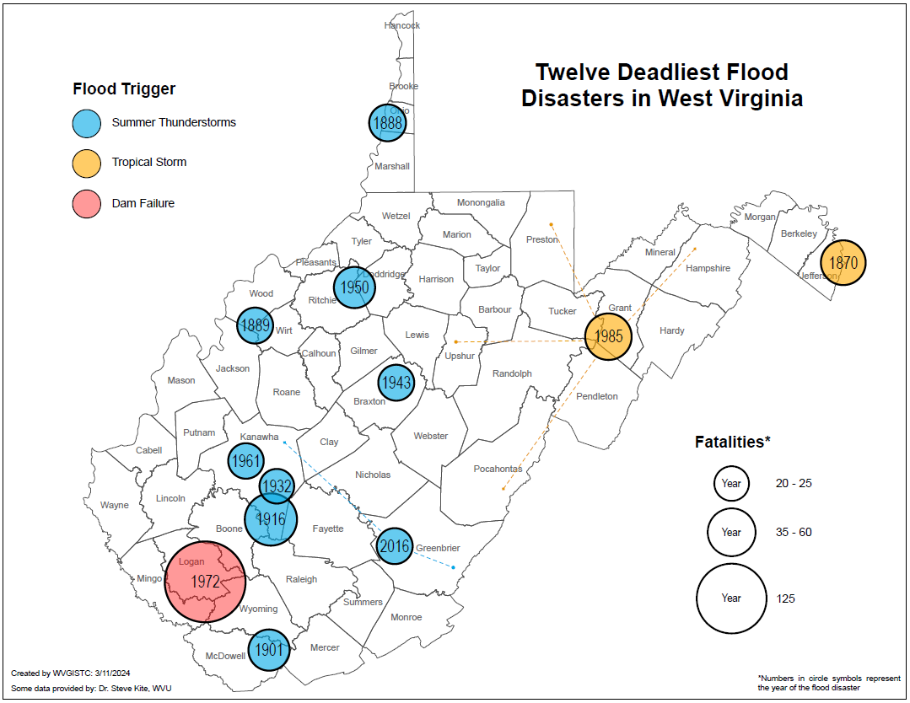
12 Deadliest Disasters
According to the analysis of flood fatalities in the 48 contiguous United States between 1959 and 2019, West Virginia has the third highest ranking in the nation when flood fatalities are standardized as the average annual number of fatalities per million inhabitants (Han and Hatim, 2021).

Slide 4
12 Deadliest Disasters
Summer Thunderstorms
Tropical Storms
Four of the Deadliest Floods have occurred in Kanawha County from cloudbursts during the summer months

Slide 5
Major Disasters (Property Damage)
Tug Basin Flood
1 BILLION

Slide 6
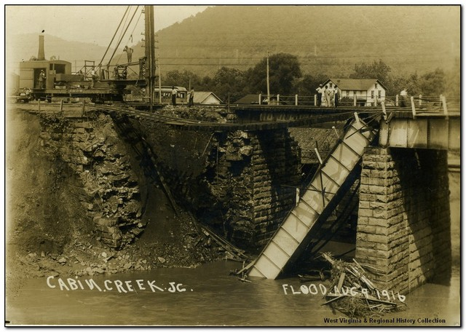
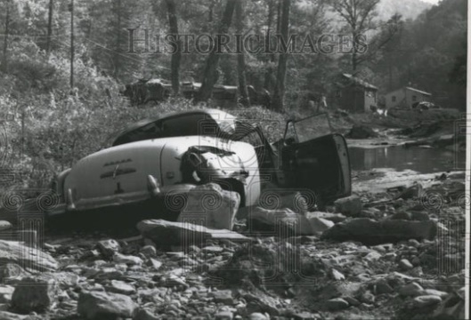
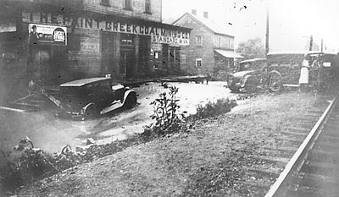
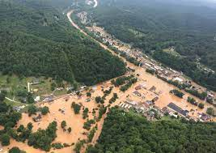
Kanawha County Deadly Flood Disasters
1916 CABIN CREEK (60 DEAD)
1961 CHARLESTON (20 DEAD)
1932 PAINT CREEK (20 DEAD)
2016 FLOOD (23 DEAD; 5 KANAWHA)

Slide 7
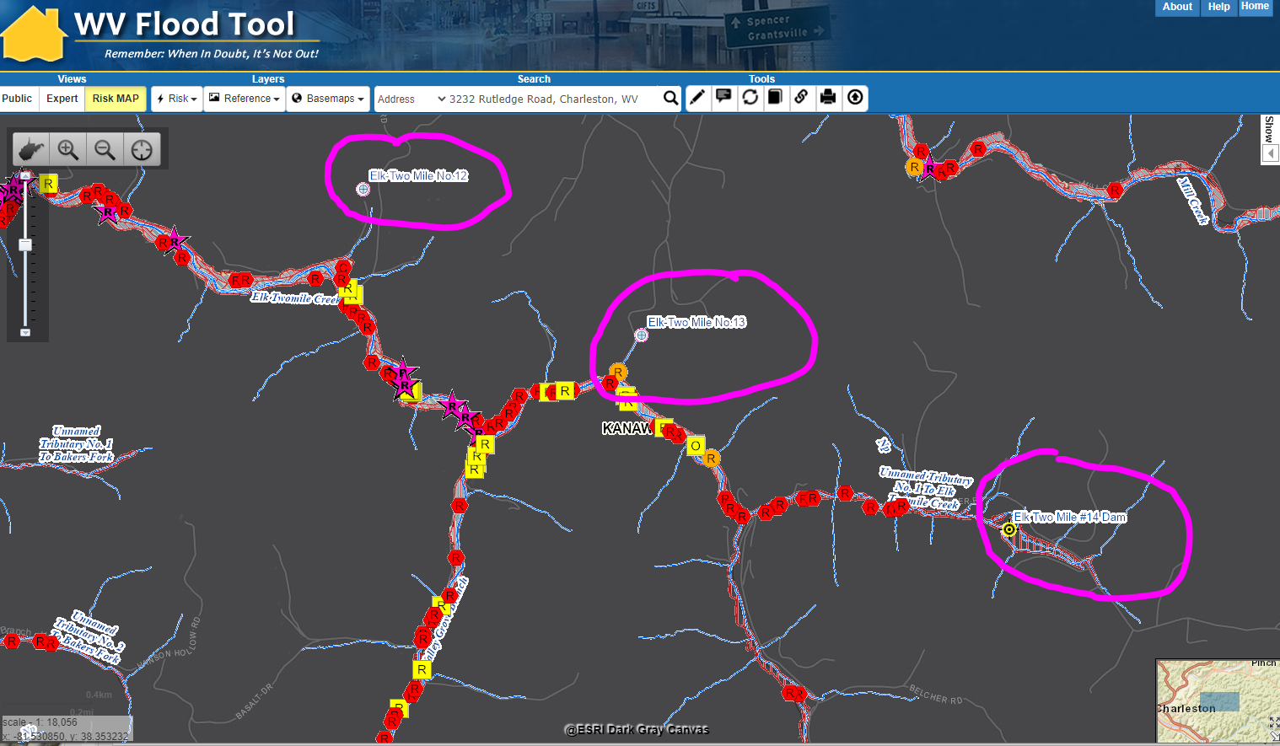
WV Flood Tool RiskMap View: Rutledge Avenue
Dams
Rutledge Road

Slide 8

Elk Twomile Dams (flood mitigation)

Slide 9
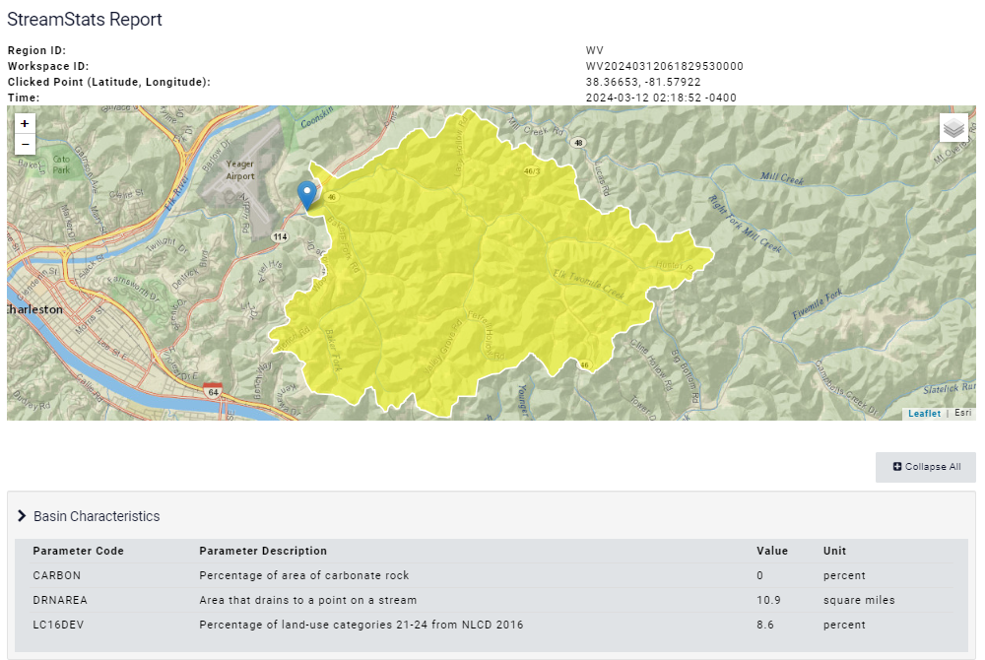
StreamStats Report for Rutledge Road (Airport)
No Flood Mitigated Structures in headwaters above Rutledge Road
Yaeger Airport

Slide 10
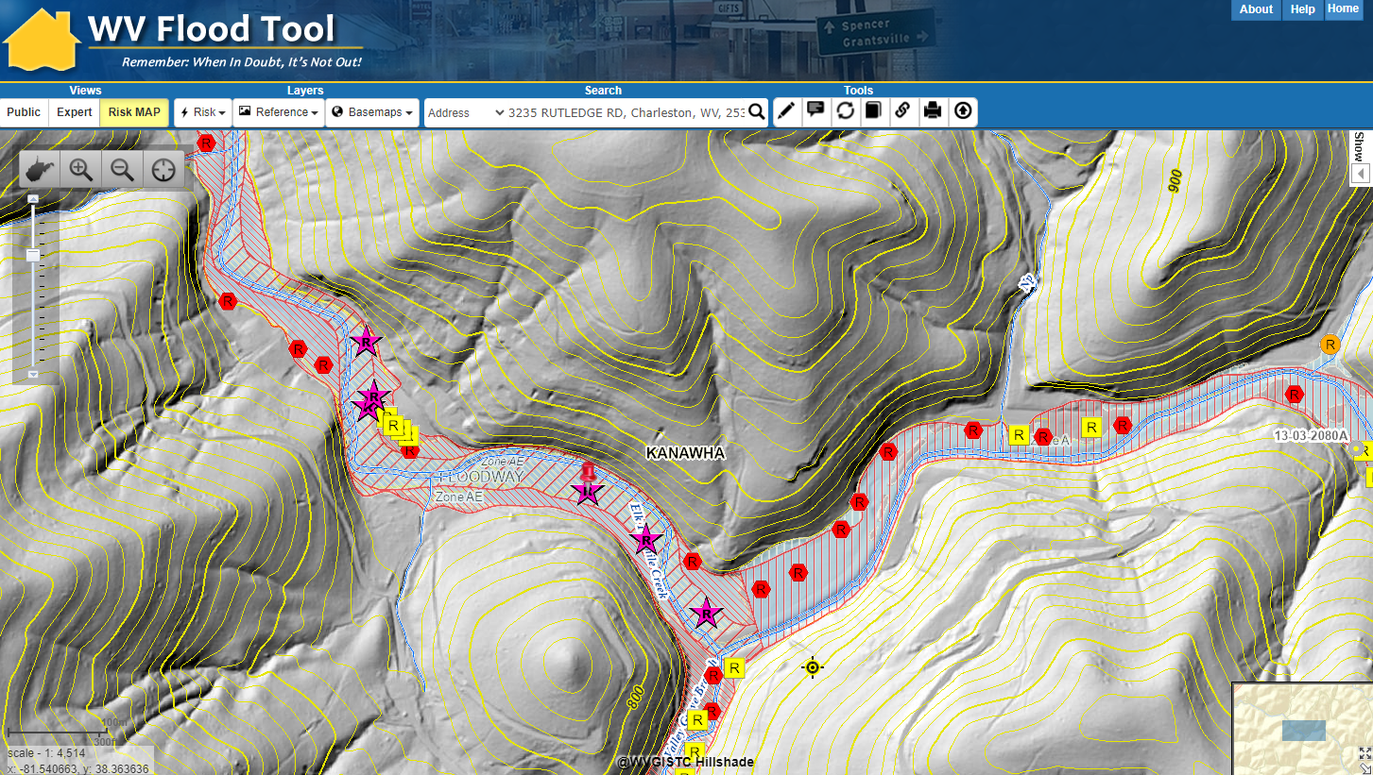
Risk Assessment: 3235 RUTLEDGE RD, Charleston
BUILDING LEVEL ANALYSIS
Elk Twomile Creek

Slide 11
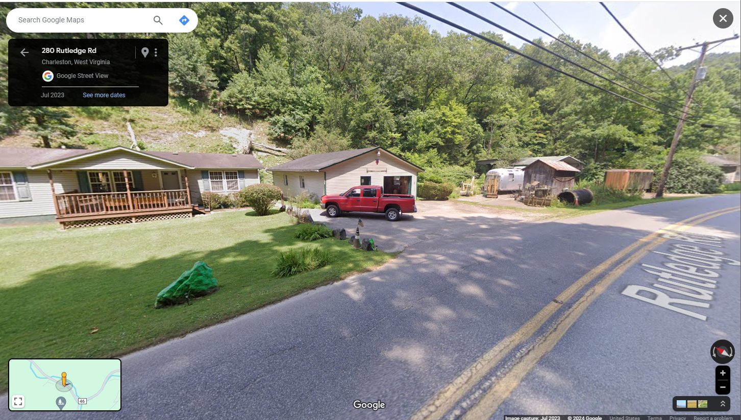
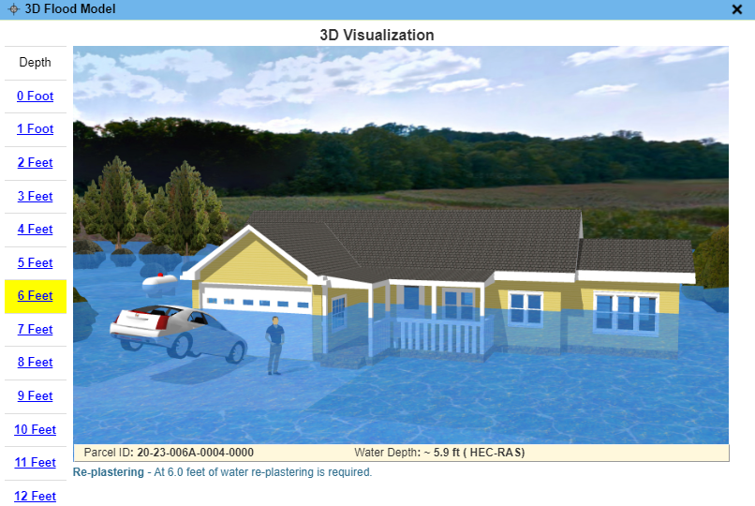
Risk Assessment: 3235 RUTLEDGE RD, Charleston
WV Flood Tool link to Street View and 3D Visualization
FLOOD VISUALIZATIONS
Google Street View

Slide 12
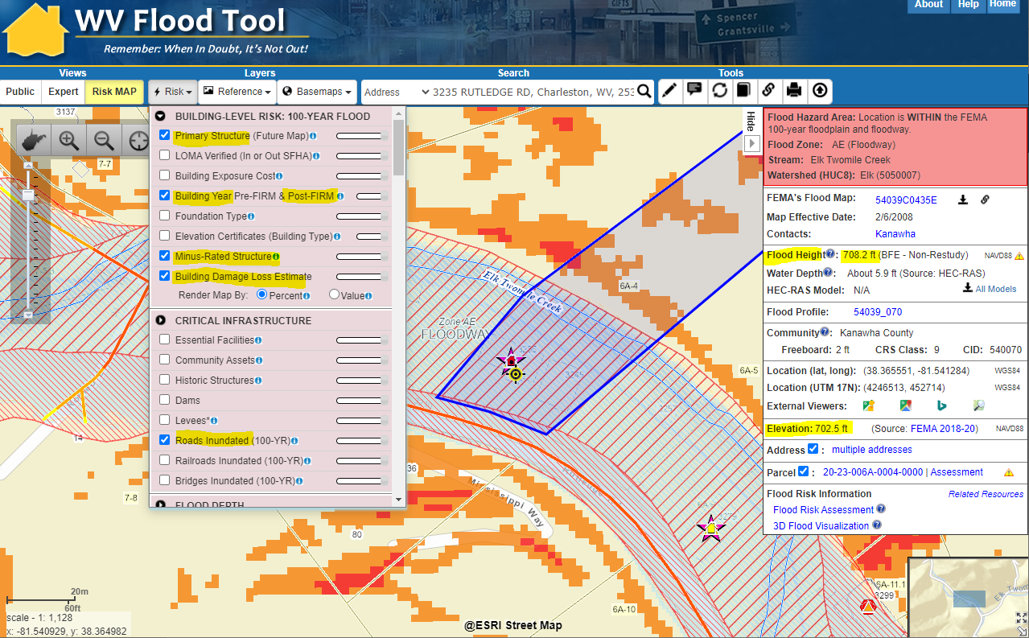
3232 Rutledge Road Structure (1997)
100-YR Risk Assessment
STRUCTURE
Floodway
Minus-Rated
Moderate Structure Damage Estimated
Debris Damage Risk
OTHER RISKS
Road Inundated
Landslide Susceptibility
Risk Assessment for 3232 Rutledge Road one-story residential home built in 1997
BUILDING LEVEL ANALYSIS
What is at risk? Degree of risk?
Source: WV Flood Tool
RiskMAP View
Panel 5400700153C 1985 FIRM with BFE

Slide 13
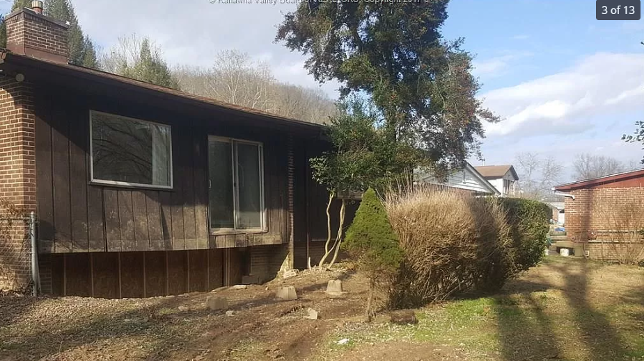
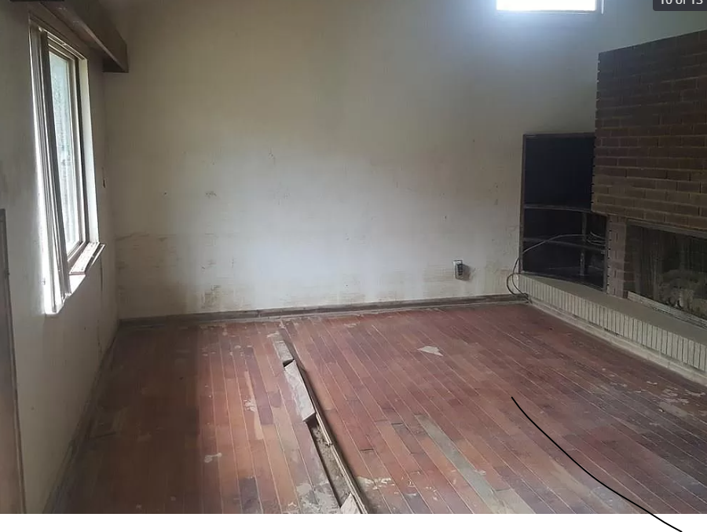
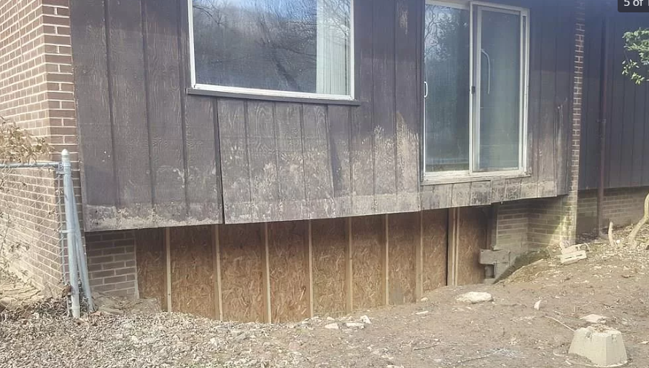
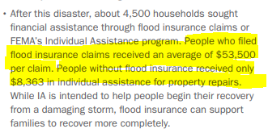
Risk Assessment: 200 Riverview Drive (2 fatalities)
Flood Insurance Claim Avg: $53,500
IA for People w/o Insurance: $8,863
Source: FEMA Flood Report

Slide 14
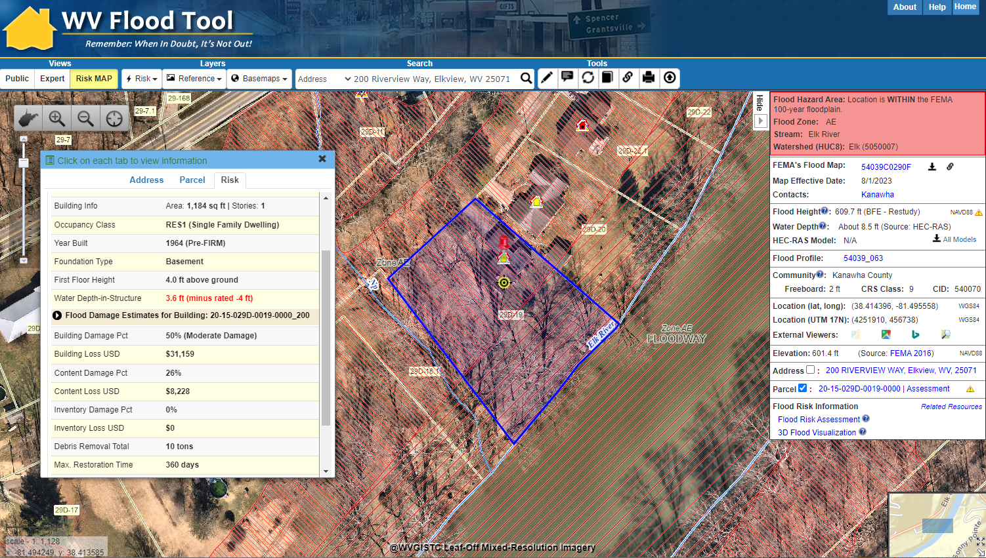
Riverview Drive: Pre-FIRM Minus-Rated Structure
100-YR Risk Assessment
STRUCTURE
Subgrade Basement
Minus-Rated
High Flood Depth
Nearly Substantial Damage Estimated
Hydrodynamic Flood Forces (Foundation Collapse)
Risk Assessment for 200 Riverview Drive for one-story residential home with basement built in 1964
BUILDING LEVEL ANALYSIS
50% Substantial Damage
Hazus
Building-Level
Damage Loss Estimate
RiskMAP View
Source: WV Flood Tool

Slide 15
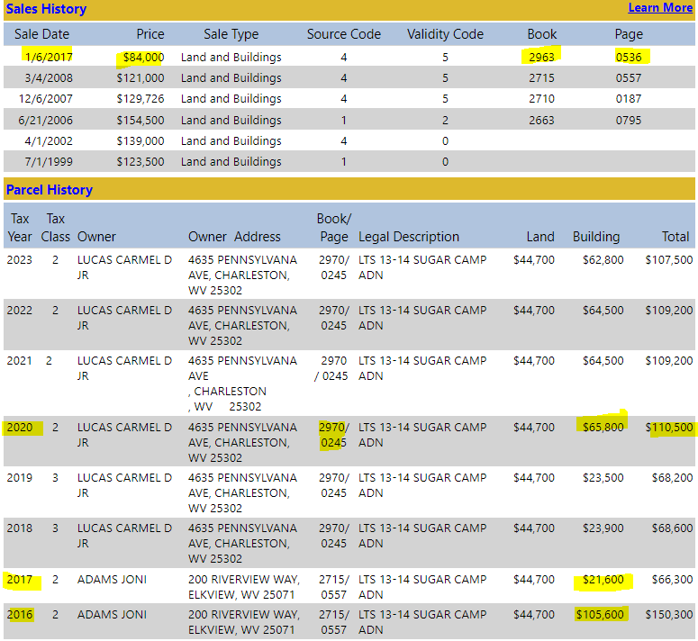
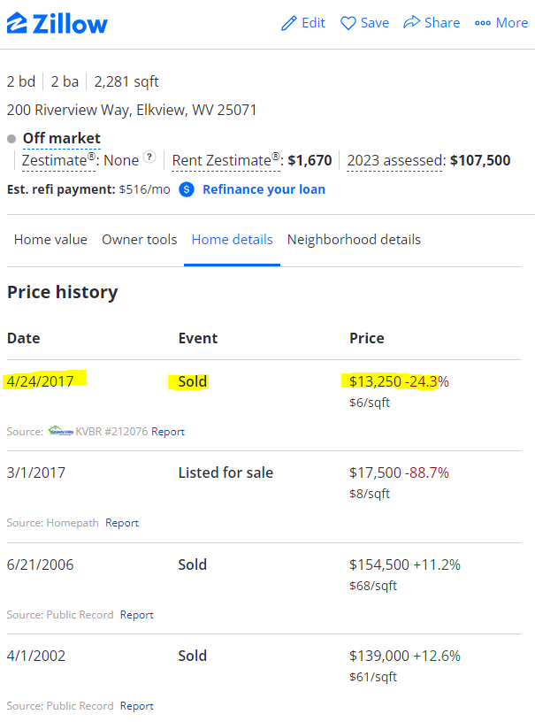
200 Riverview Drive: FEMA 50% Rule
WV Flood Tool Parcel Report
FEMA 50% Rule
80% Decrease

Slide 16
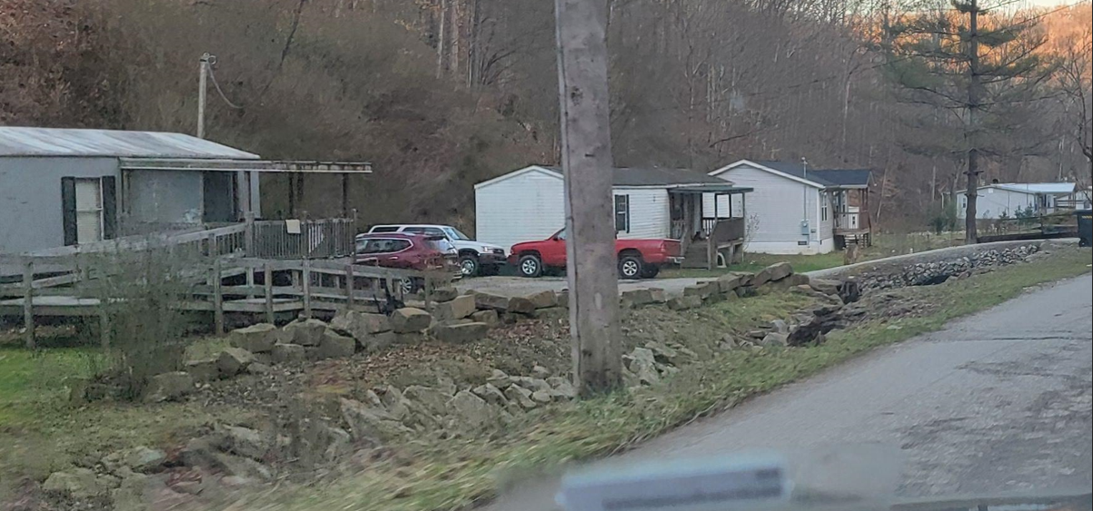
Risk Assessment: 2466 JORDAN CREEK RD
All these homes along Jordan Creek Road near Clendenin were swept away during the flood
BUILDING LEVEL ANALYSIS

