Slide 1
Slides related to the April 2024 Flood Extracted

Slide 2

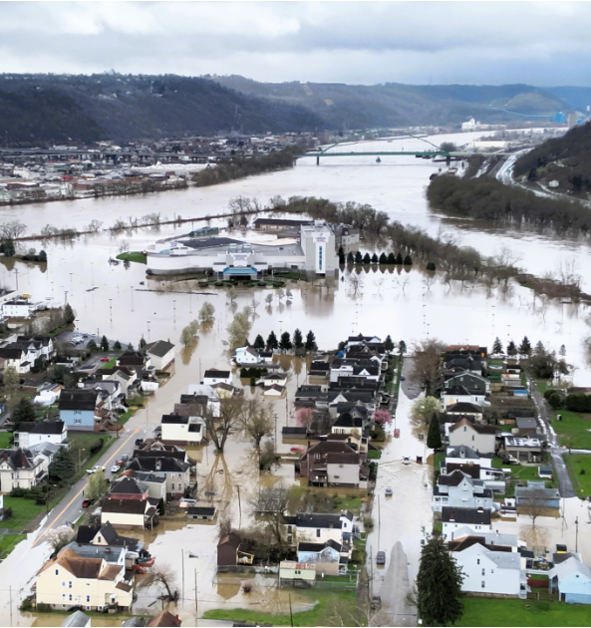
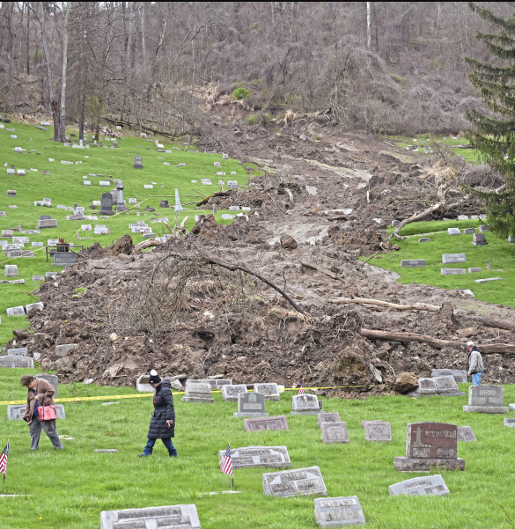
WV Flood Resiliency Framework Toolkit
Wheeling Island
Mt. Zion Cemetery (Ohio County)
Hazard identification using WV Flood Tool

Slide 3
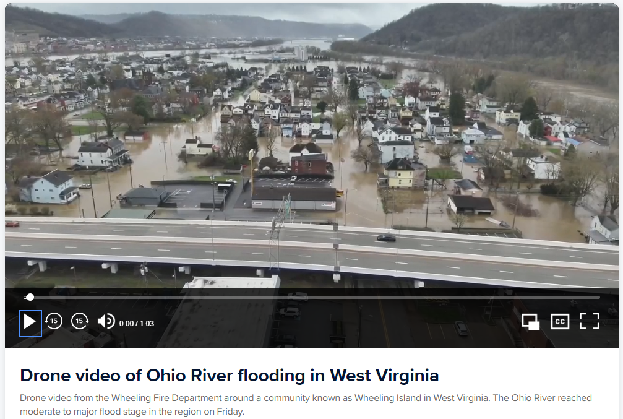
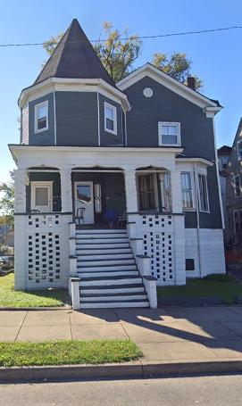
Recent Flood Event (Wheeling Island)
40 VIRGINIA ST, Wheeling, WV
Stream Gauge
Wheeling Island Hotel Casino Racetrack, WV
I-70
40 Virginia St, Wheeling
Drone Link

Slide 4
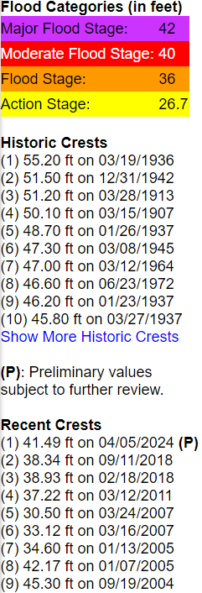
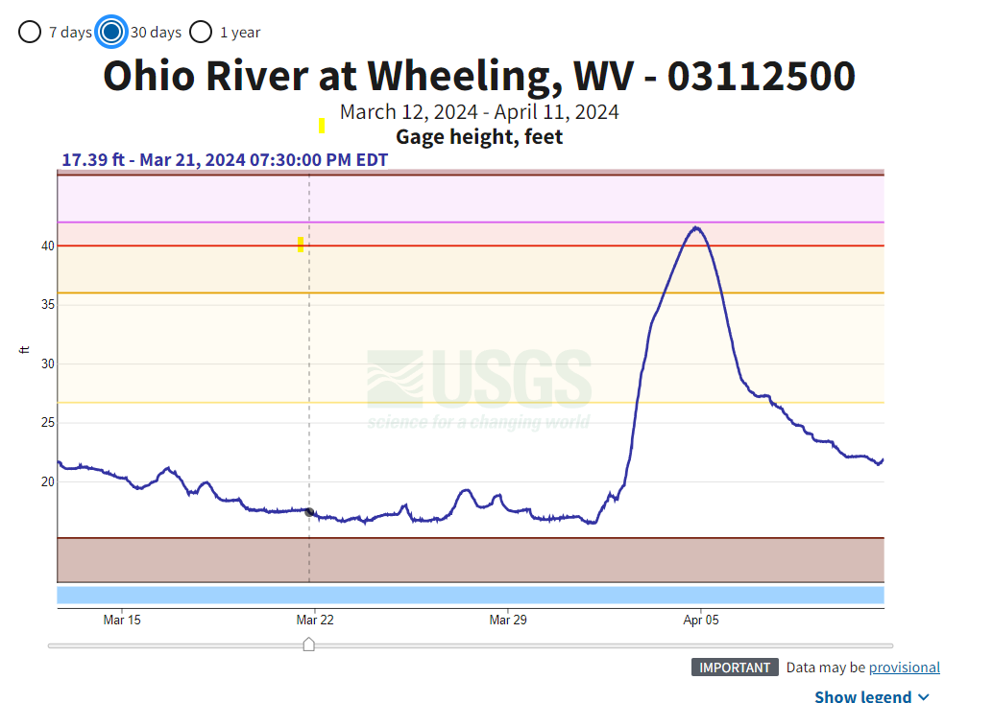
2024 Flood Crest 41.5 feet (April 5)
High Water Mark from 1936 Flood
Source: USGS Ohio River Gauge Height

Slide 5
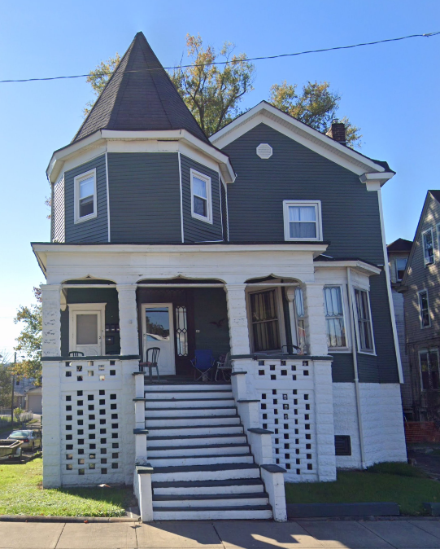
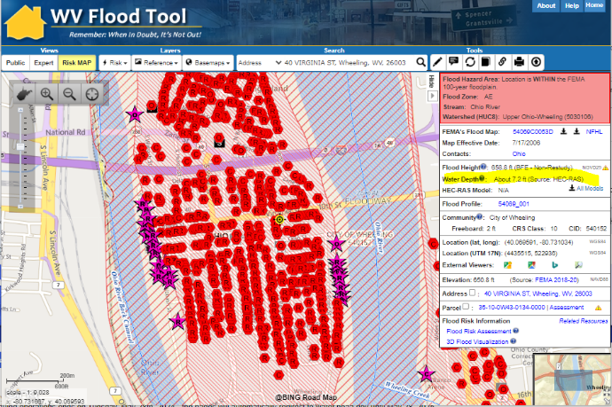
Wheeling Flood Probabilities
Flood Depth Probabilities (ft.)
FIRM Effective Date | 50 year (2%) | 100 year (1%) | 500 year (0.2%)
2006 | 4.1 | 7.2 | 10.1
1% Annual Chance (100-YR) Flood Event for 40 Virginia St., Wheeling, WV
7.2 ft. base flood depth above ground (Source: FEMA)
49 ft. flood stage gauge height (Source: USGS/NWS)
13.0 ft. (1936 HWM)
10.1’ (FEMA 0.2% / 500 YR)
7.2’ (FEMA 1% / 100 YR)
40 VIRGINIA ST, Wheeling, WV
4.1’ (FEMA 2% / 50 YR)
Building: 35-10-0W43-0134-0000_40
0.0 ft. (2024 HWM) (41.5’ flood stage)

Slide 6
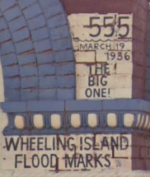
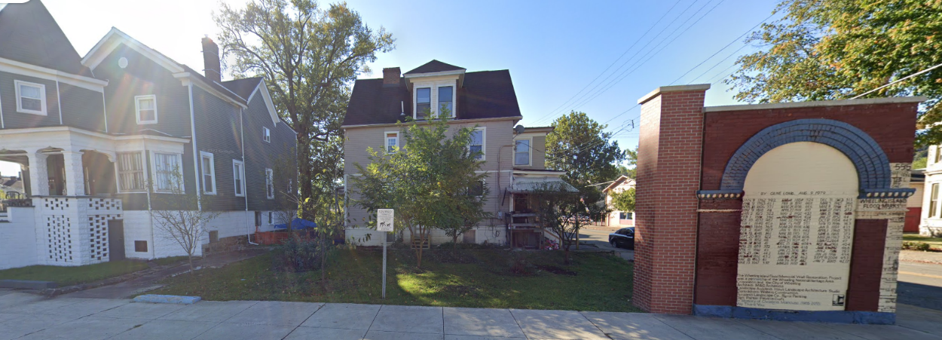
Wheeling (40 VIRGINIA ST, Wheeling, WV, 26003
High Water Mark from 1936 Flood (13 ft.)
WV Flood Tool link
1936 HWM = 607.3 ft. (gauge height = 0) + 55.2 ft. = 662.5 ft. The 1936 Flood Depth (662.5 ft. HWM minus LAG 649.5) estimate is 13 feet flooding above ground level. In structure, estimate four feet of water above lowest floor for 1936 flood.
2024 HWM = 41.5 feet crest on 5 April 2024. 607.3 ft. (gauge height = 0) + 41.5 ft. = 648.8 feet. Flooding should not have impacted this property. House just outside of drone footage.

Slide 7
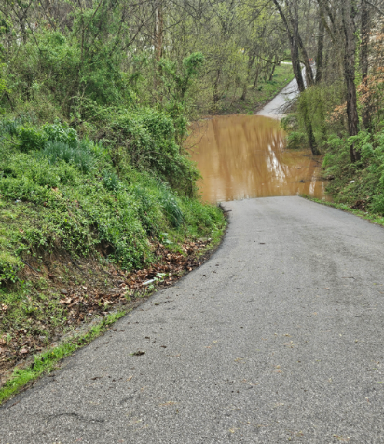
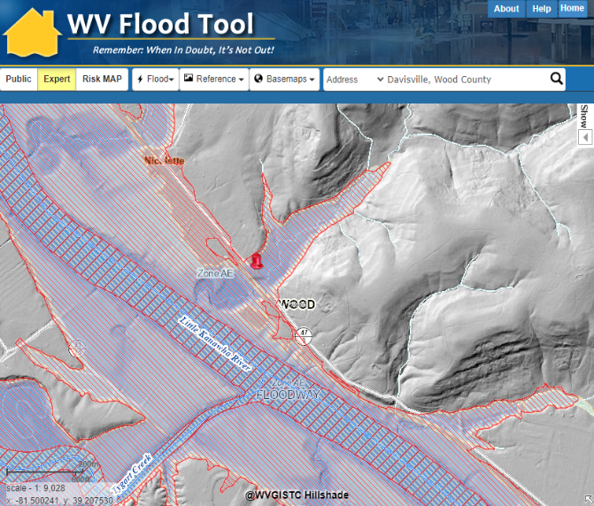
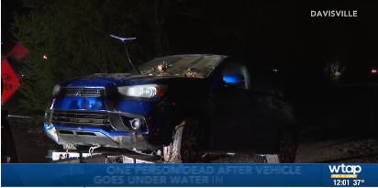

Vehicular Fatality (Wood County)
Vehicular Drowning
The driver entered the flooded area of Nicolette Road at a deep dip in the roadway. The water flipped the blue SUV vehicle over in approximately 15-20 feet of water off the roadway edge.
Valerie Swisher, 49, drowned on Nicolette Road (County Highway 47/3) on a small tributary of the Little Kanawha River.

Slide 8
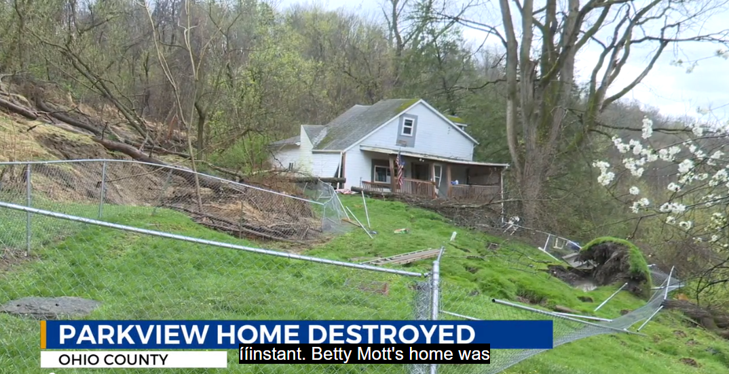
Landslides (Ohio County)
Drone Link
1311 PARK VIEW RD, Wheeling, WV,
WTRF.com

Slide 9
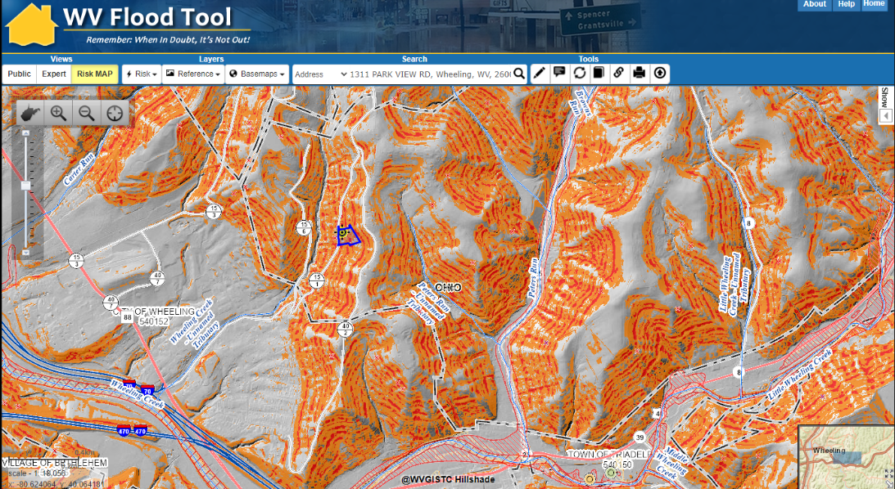
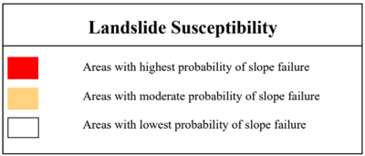
Landslides (Ohio County)
Drone Link
County-Level Scale, Generalized Susceptibility Maps
1311 PARK VIEW RD, Wheeling, WV,

