Slide 1
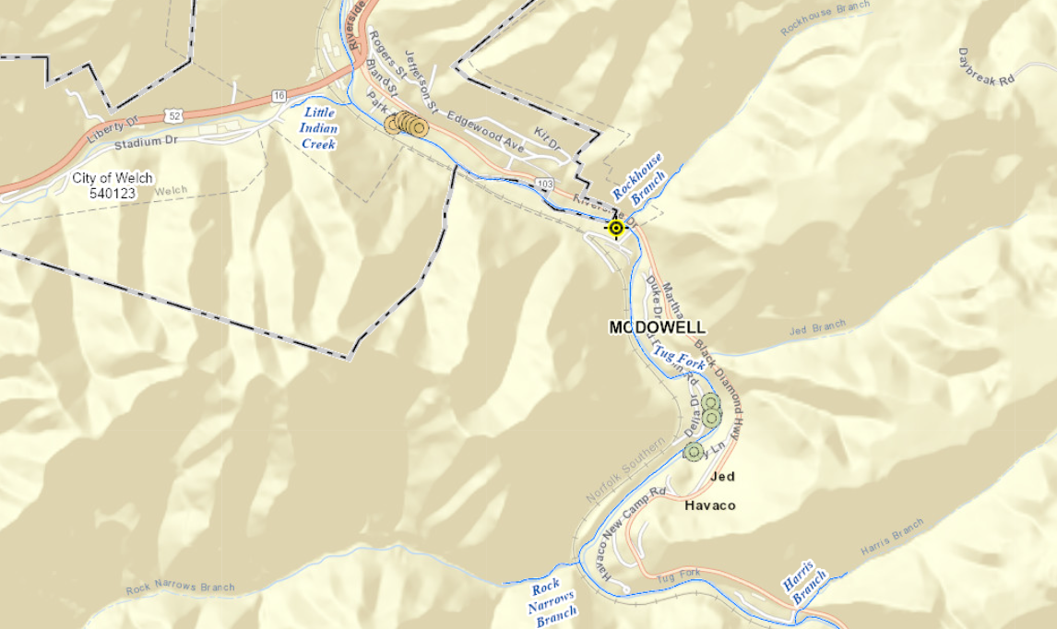
2 girls rescued from water at Coney Island Bridge
Mudslide at 903 RIVERSIDE DR, Welch, WV, 24801. According to WV DOT, truck ends up here dowstream.
Truck with 5 occupants swept away by floodwaters on Riverside Drive (Route 103) at confluence of Rockhouse Branch and Tug Fork. Two victims rescued, three fatalities.
Welch, WV
Old Pizza Hut on Riverside Drive
Deceased resided in home at 326 HAVACO NEW CAMP RD, Havaco, WV, 24801, located in floodway of Tug Fork River

