Slide 1



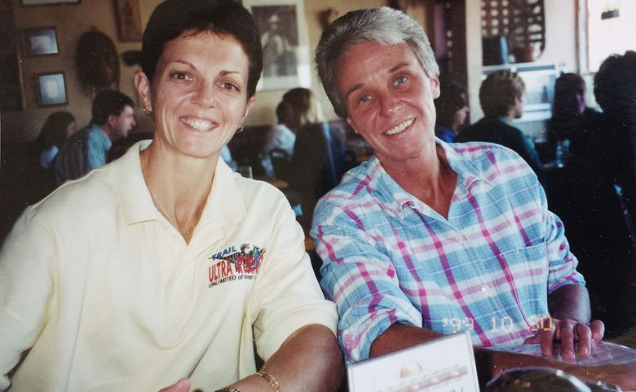
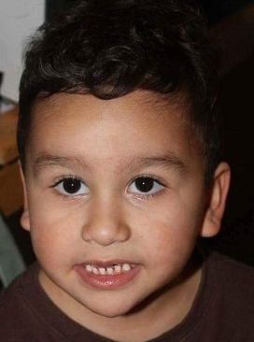












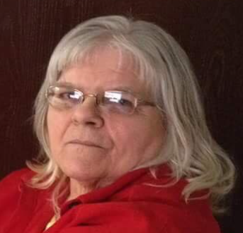
FLOOD RISK RESEARCH – including 2016 WV Flood Deaths
Remembering
the
West Virginia
2016
Flood Victims
Delmas & Rita Parsons
Counties:
Kanawha
Greenbrier
Jackson
Ohio

Slide 2
2016 WV Flood Fatality Research

Slide 3
2016 WV Flood Fatality Research

Slide 4
WV 12 Deadliest Floods (1870-2016) for Fatalities
Summer Thunderstorms
Tropical Storms
Dam
Failure
Summer Thunderstorms
Tropical Storms

