Slide 1
Using GIS to Analyze Historical Flood Fatality Patterns
WV GeoCon 2026
West Virginia GIS Technical Center

Slide 2
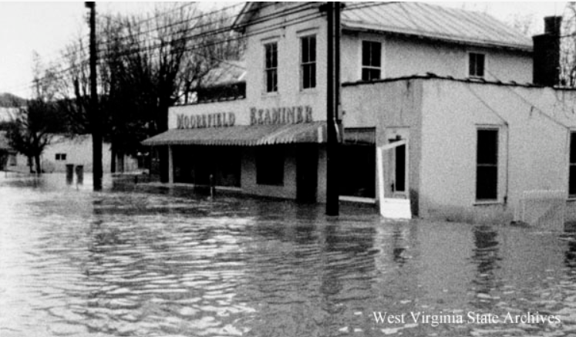
Why use GIS?
Historical flood fatality records are spatially incomplete
Fatality locations are dispersed across archival sources
GIS enables spatial reconstruction and pattern analysis
Supports flood mitigation and hazard planning
Notes:
There locations are scattered across newspapers, reports, books
GIS allows us to look at patterns - in this particular case, most interested in mass casualty events, mitigation structures post flood event, FEMA flood zone, streams. Generally trying to understand what areas in our state are most vulnerable to floods and why
Photo is Moorefield, WV 1985 election day flood

Slide 3



Data Sources
Historical newspapers
WV Culture Center
FEMA
NOAA rainfall / flood records
USGS
NID (National Inventory of Dams)
Notes:
wvculture center for death certificates
USGS for historical topo maps and stream stats
other sources include various books written on specific flood events in WV, police reports, and even videos

Slide 4
Historical Records
Data Extraction & Validation
Geocoding Historical Fatalities
GIS Database Development
Spatial Analysis
Geospatial Products

Slide 5
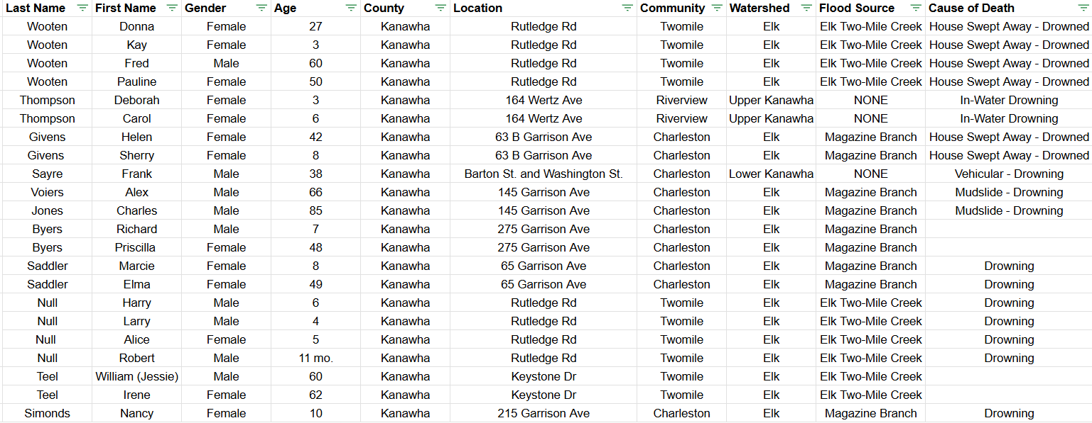
Notes:
First, all fatality information from sources were gathered organized in an excel sheet. At this point we have no spatial data, just descriptions and general locations.
This example is of the 1961 flood event with all fatalities occurring in Kanawha county.

Slide 6
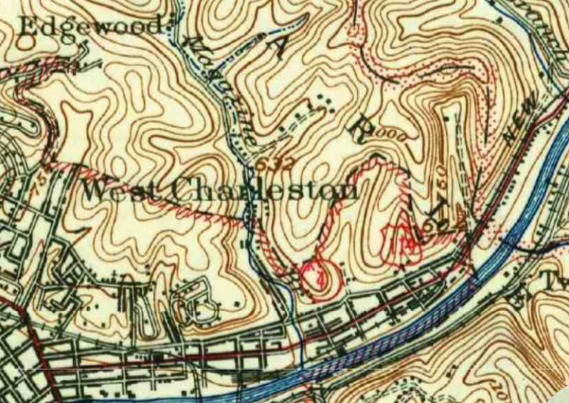
Geocoding Historical Fatalities
Locations reconstructed from historical newspaper descriptions
Historical place names and roadway changes complicated geolocation
GIS aligned archival references with modern spatial datasets
Notes:
one of the biggest GIS challenges in this project was reconstructing fatality locations from historical records that contained vague descriptions. Historical newspapers often referenced landmarks, stream crossings, or communities that have changed over time. Historical topo maps were used alongside modern GIS datasets to approximate these locations as accurately as possible

Slide 7
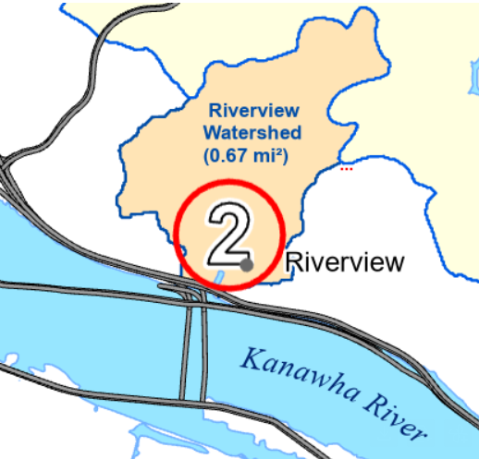
Spatial Analysis
Overlay with FEMA flood zones
Stream / roadway analysis
Watershed integration
Comparison with post-flood mitigation structure locations

Slide 8
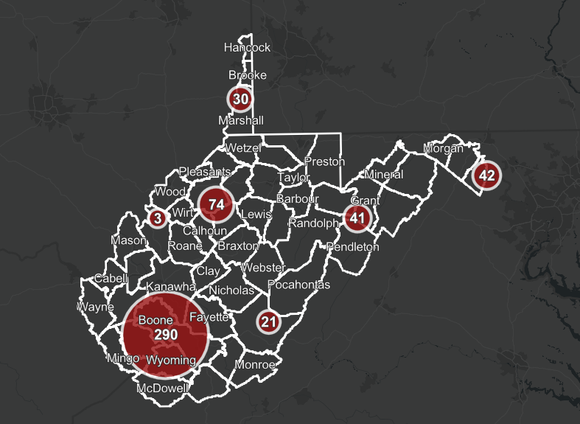
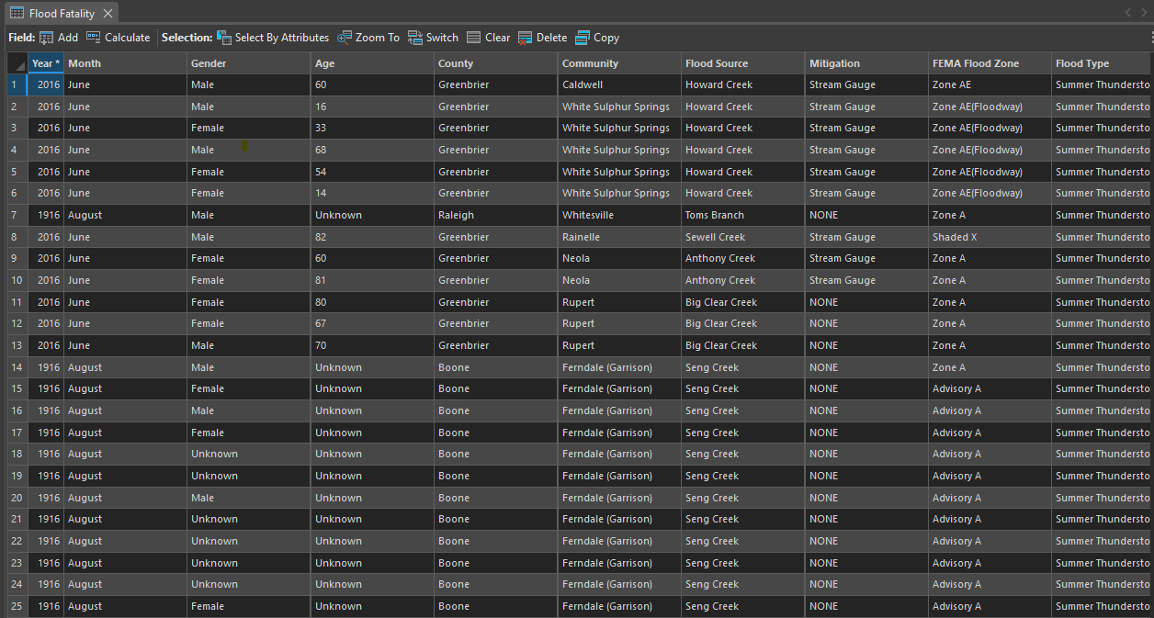
Notes:
After research and location mapping for all 12 disasters was completed, all data was combined into an arconline project and geodatabase and attributes were standardized for all 488 fatalities.

Slide 9
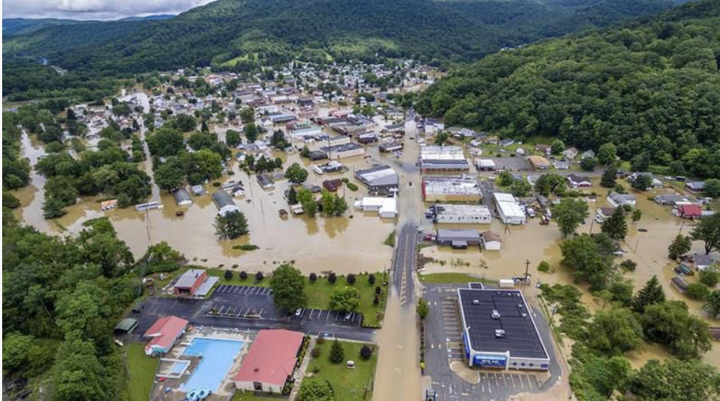
Spatial Findings
Fatalities clustered in narrow valleys
Several fatalities occurred outside modern FEMA flood zones
Many deaths occurred near stream crossings and transportation corridors
Majority of fatalities were part of mass casualty events
Notes:
Just from this spatial analysis, observations made were
Image from Rainelle 2016 flood

Slide 10
Geospatial Deliverables

Slide 11
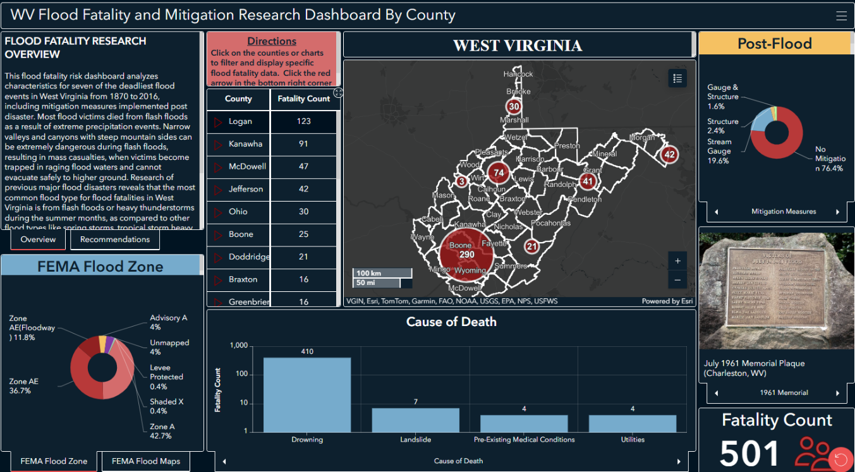
Dashboards
Notes:
2 dashboards were created to further analyze patterns - one disaster based and other county based which contains most recent 2025 flood fatality information

Slide 12
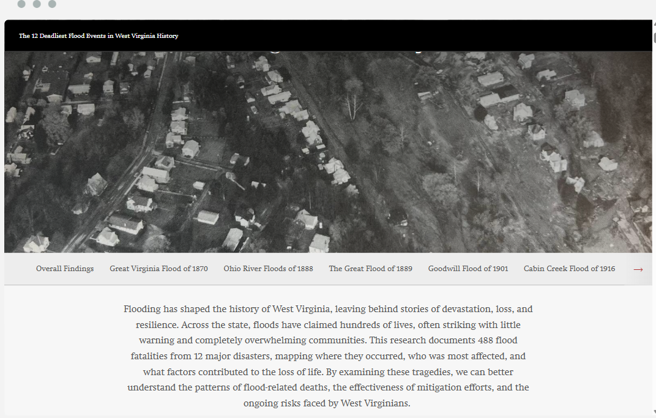
Story Map
Notes:
A story map was created to have interactive visualization, public accessibility, and user friendly

Slide 13
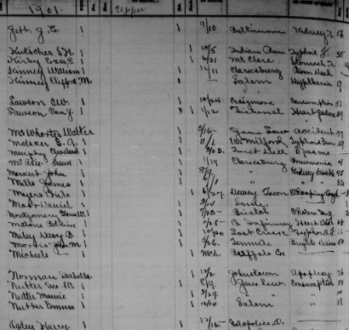
Limitations
Historical newspaper accounts often contained vague or inconsistent location descriptions
Geocoding accuracy was limited by changing place names, road networks, and landscape features
Notes:
Historical reporting accuracy- varied across time periods, some records lacking accurate information such as names, locations, overall fatality counts, or detailed causes of death
Overall, with assumptions had to be made

Slide 14
Future GIS Applications
Predictive modeling of future flood fatality risk
Expansion into real-time hazard and evacuation planning
Machine learning approaches for vulnerability predictions
Integration of LiDAR and high-resolution terrain analysis
Notes:
Just some other potential GIS applications for flood fatalities -

Slide 15


Thank you!
Whitney Belcher – whitney.belcher@mail.wvu.edu
wvgis.wvu.edu
Notes:
Dashboards and story maps are available on the WVFRF website

