Slide 1


WV Hazard Library
Hazard Library of online hazard resources including data, documents, and media searchable by title, subject, event, geography, and more.
WV HAZARD LIBRARY
TOPICS | MEDIA TYPES |  | SEARCH TYPES
Risk Assessment & Planning State Risk Assessments Local Risk Assessments Planning Resources Web Tools Mitigation Flood Insurance Floodplain Management Floodplain Mapping Other Mitigation Measures Flood Disaster Events Flood Event Flood Research | 3D Movie Bldg. Profile Dashboard Data-GIS Data-Metadata Data-Table Flyer Graphic Guide Journal Article Letter News Article Picture | Plan Poster Report Slides Social Media Static Map Story Map Video Viewshed Web Info Web Tool | Agency Downloadable Data Event Disaster Event Meeting Geographic Scale Entity Media Type Publication Date Subject Major Group Category Subcategory cross-indexing Stakeholder Type Title (free text search) Predefined Searches Visualizations Floodplain Management Key Materials
Notes:
The WV Hazard Library contains more than 24 media resource types relevant to West Virginia. Resources are organized into three major topics: risk assessment/planning, mitigation, and flood disaster. Users can search online hazard resources by title, subject, media, event, geography, data, stakeholder type, etc.

Slide 2
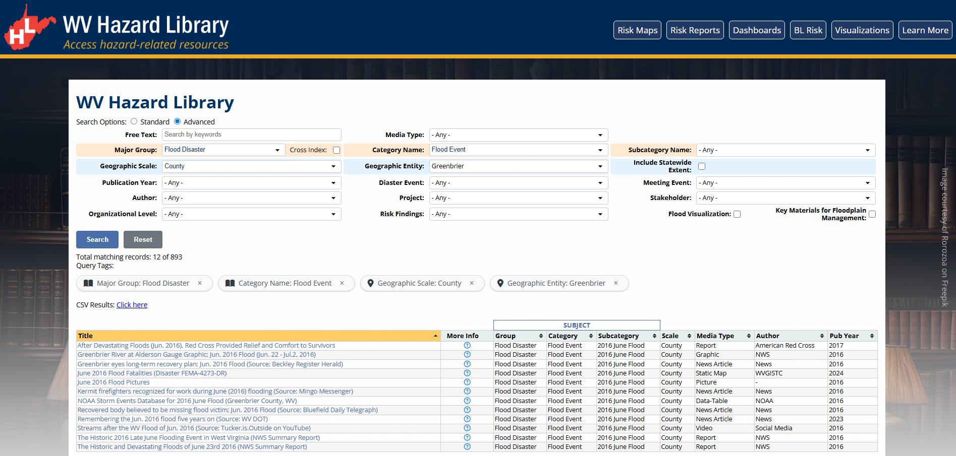
WV Hazard Library
An example query on Hazard Library: Documents related to flood events in Greenbrier County
Major group: Flood Disaster; Category Name: Flood Event; Geographic Scale: County; Geographic Entity: Greenbrier
Query Link: https://wvfrf.org/library/?groupID=9&categoryID=37&ScaleID=3&entityID=13&view=advanced&sortfield=Title&sorttype=asc

