Slide 1
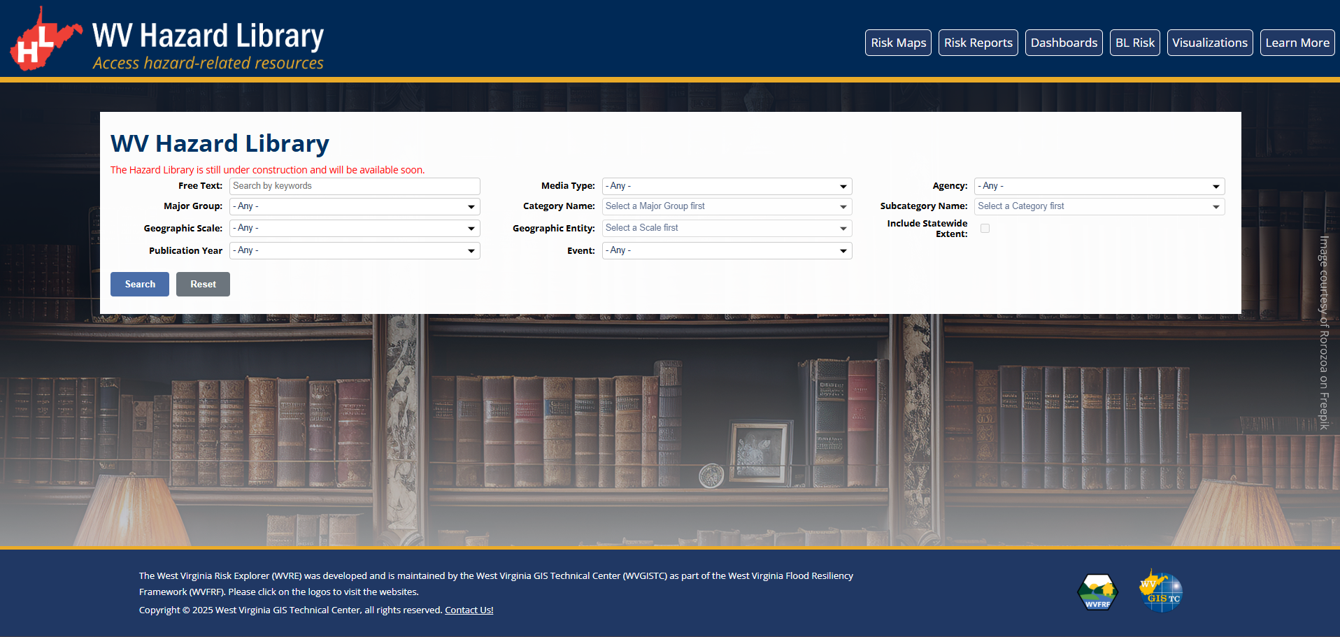

WV Hazard Library
Search Options:
Standard
Advanced
Free Text:
Search by keywords
Media Type:
- Any -
Major Group:
- Any -
Cross Index:
Category Name:
Select a Major Group first
Subcategory Name:
Select a Category first
Geographic Scale:
- Any -
Geographic Entity:
Select a Scale first
Include Statewide Extent:
Publication Year:
- Any -
Disaster Event:
- Any -
Author:
- Any -
Notes:
“Include Statewide Extent” should be selectable independently.

Slide 2
WV Hazard Library
Search Options:
Standard
Advanced
Free Text:
Search by keywords
Media Type:
- Any -
Major Group:
- Any -
Cross Index:
Category Name:
Select a Major Group first
Subcategory Name:
Select a Category first
Geographic Scale:
- Any -
Geographic Entity:
Select a Scale first
Include Statewide Extent:
Publication Year:
- Any -
Disaster Event:
- Any -
1870 September Flood
1888 July Flood
1916 August Flood
1932 July Flood
1937 January Flood
1943 August Flood
1950 June Flood
1961 July Flood
1972 February Flood
1977 April Flood
1985 November Flood
2001 July Flood
2016 June Flood
2021 July Flood
2021 March Flood
2023 August Flood
2024 April Flood
2025 February Flood
2025 June Flood
Author:
- Any -
starting year…
ending year…
Notes:
Selection option by checkboxes for Media Type, Category Name, Subcategory Name, Geographic Entity, Publication Year, Disaster Event, Meeting Event, Author, Organizational Level, Project, Stakeholder, and Risk Findings.
(All except for Major Group and Geographic Scale)
Example: Disaster Event selection from the drop-down menu.
If multiple selected, sort should be on the selected field.

Slide 3
WV Hazard Library
Search Options:
Standard
Advanced
Free Text:
Search by keywords
Media Type:
- Any -
Major Group:
- Any -
Cross Index:
Category Name:
Select a Major Group first
Subcategory Name:
Select a Category first
Geographic Scale:
- Any -
Geographic Entity:
Select a Scale first
Include Statewide Extent:
Publication Year:
- Any -
Disaster Event:
- Any -
Meeting Event:
- Any -
Author:
- Any -
Project:
- Any -
Stakeholder:
- Any -
Organizational Level:
- Any -
Risk Findings:
- Any -
Flood Visualization:
Key Materials for Floodplain Management:
Notes:
Add:
Project, Meeting Event, Author Organizational Level, Project, Stakeholder, Flood Visualization, Key Materials for Floodplain Management, and Risk Findings.

Slide 4
WV Hazard Library
Search Options:
Standard
Advanced
Free Text:
Search by keywords
Media Type:
- Any -
Major Group:
- Any -
Cross Index:
Category Name:
Select a Major Group first
Subcategory Name:
Select a Category first
Geographic Scale:
- Any -
Geographic Entity:
Select a Scale first
Include Statewide Extent:
Publication Year:
- Any -
Disaster Event:
- Any -
Meeting Event:
- Any -
Author:
- Any -
Project:
- Any -
Stakeholder:
- Any -
Organizational Level:
- Any -
Risk Findings:
- Any -
Flood Visualization:
Key Materials for Floodplain Management:
Local
State
Notes:
Add:
Project, Meeting Event, Author Organizational Level, Project, Stakeholder, Flood Visualization, Key Materials for Floodplain Management, and Risk Findings.

