Slide 1
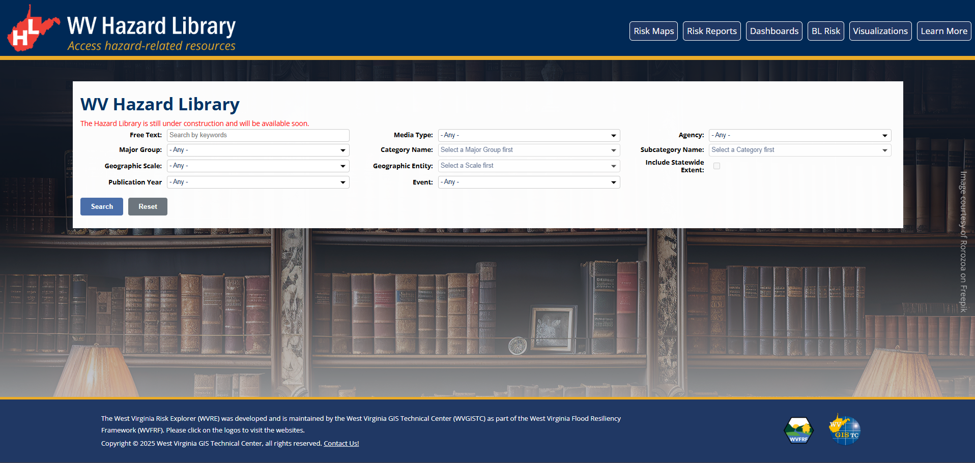

WV Hazard Library
Search Options:
Simple
Standard
Advanced
Free Text:
Search by keywords
Media Type:
- Any -
Major Group:
- Any -
Category Name:
Select a Major Group first
Subcategory Name:
Select a Category first
Geographic Scale:
- Any -
Geographic Entity:
Select a Scale first
Include Statewide Extent:
Publication Year:
- Any -
Disaster Event:
- Any -
Author:
- Any -
starting year…
ending year…
Notes:
“Include Statewide Extent” should be selectable independently.

Slide 2
WV Hazard Library
Search Options:
Simple
Standard
Advanced
Free Text:
Search by keywords
Media Type:
- Any -
Major Group:
- Any -
Category Name:
Select a Major Group first
Subcategory Name:
Select a Category first
Geographic Scale:
- Any -
Geographic Entity:
Select a Scale first
Include Statewide Extent:
Publication Year:
- Any -
Disaster Event:
- Any -
1870 September Flood
1888 July Flood
1916 August Flood
1932 July Flood
1937 January Flood
1943 August Flood
1950 June Flood
1961 July Flood
1972 February Flood
1977 April Flood
1985 November Flood
2001 July Flood
2016 June Flood
2021 July Flood
2021 March Flood
2023 August Flood
2024 April Flood
2025 February Flood
2025 June Flood
Author:
- Any -
starting year…
ending year…
Notes:
Selection option by checkboxes for Media Type, Category Name, Subcategory Name, Geographic Entity, Publication Year, Disaster Event, Meeting Event, Author, Organizational Level, Project, Stakeholder, and Risk Findings.
(All except for Major Group and Geographic Scale)
Example: Disaster Event selection from the drop-down menu.
If multiple selected, sort should be on the selected field.

Slide 3
WV Hazard Library
Search Options:
Simple
Standard
Advanced
Free Text:
Search by keywords
Media Type:
- Any -
Major Group:
- Any -
Category Name:
Select a Major Group first
Subcategory Name:
Select a Category first
Geographic Scale:
- Any -
Geographic Entity:
Select a Scale first
Include Statewide Extent:
Publication Year:
- Any -
Disaster Event:
- Any -
Author:
- Any -
2016
2025
Notes:
Disaster Event search by the starting and ending years.

Slide 4
WV Hazard Library
Search Options:
Simple
Standard
Advanced
Free Text:
Search by keywords
Media Type:
- Any -
Major Group:
- Any -
Category Name:
Select a Major Group first
Subcategory Name:
Select a Category first
Geographic Scale:
- Any -
Geographic Entity:
Select a Scale first
Include Statewide Extent:
Publication Year:
- Any -
Disaster Event:
- Any -
Meeting Event:
- Any -
Author:
- Any -
starting year…
ending year…
starting year…
ending year…
Organizational Level:
- Any -
Project:
- Any -
Stakeholder:
- Any -
Risk Findings:
- Any -
Flood Visualization:
Key Materials for Floodplain Management:
Notes:
Add:
Project, Meeting Event, Author Organizational Level, Project, Stakeholder, Flood Visualization, Key Materials for Floodplain Management, and Risk Findings.
Meeting Events selection from a drop-down menu or by entering the starting and ending years (similar to the Disaster Event).

Slide 5
WV Hazard Library
Search Options:
Simple
Standard
Advanced
Free Text:
Search by keywords
Media Type:
- Any -
Major Group:
- Any -
Category Name:
Select a Major Group first
Subcategory Name:
Select a Category first
Geographic Scale:
- Any -
Geographic Entity:
Select a Scale first
Include Statewide Extent:
Publication Year:
- Any -
Disaster Event:
- Any -
Meeting Event:
- Any -
Author:
- Any -
starting year…
ending year…
starting year…
ending year…
Organizational Level:
- Any -
Project:
- Any -
Stakeholder:
- Any -
Risk Findings:
- Any -
Flood Visualization:
Key Materials for Floodplain Management:
Local
State
Notes:
Selection option by checkboxes for Media Type, Category Name, Subcategory Name, Geographic Entity, Publication Year, Disaster Event, Meeting Event, Author, Organizational Level, Project, Stakeholder, and Risk Findings.
(All except for Major Group and Geographic Scale)

Slide 6
WV Hazard Library
Search Options:
Simple
Standard
Advanced
Media Name or Keyword:
Media Type:
Major Group & Category:
Geographic Scale:
Geographic Entity:
Statewide Extent
Search by keywords
- Any -
- Any -
- Any -
Select a Scale first

Slide 7
WV Hazard Library
Search Options:
Simple
Standard
Advanced
Media Name or Keyword:
Media Type:
Major Group & Category:
Geographic Scale:
Geographic Entity:
Statewide Extent
Search by keywords
- Any -
- Any -
- Any -
Select a Scale first
- Any -
Flood Disaster
Flood Disaster Research
Flood Event
Flood Insurance
NFIP Information
NFIP Penetration Analysis
Floodplain Management
Base Flood Elevation
Community Assets Mitigation
Community Rating System
Critical Infrastructure
Dilapidated Properties
Flood Elevation
Freeboard Status
Legal and Planning Guidance
NFIP Community Status
Permits
Requirements & Guidance
Risk Communications
Floodplain Mapping
Letters of Map Change (LOMCs)
Risk Communications
Risk MAP Flood Studies
Other Mitigation Measures
Community Support & Funding
Flood Safety & Preparedness
Flood Warning
Mitigation Planning
Mitigation Priorities
Mitigation Saves
Physical Non-Structural
Structural Mitigation
Risk Assessment – Local
Building Characteristics
- Any -

